Slide 1
TEST PLATFORM
An Application for conducting tests for the students

Slide 2
ABSTRACT
The ONLINE TEST is a web application for to take online test in an efficient manner and no time wasting for checking the paper. The main objective of ONLINE TEST is to efficiently evaluate the candidate thoroughly through a fully automated system that not only saves lot of time but also gives fast results. For students they give papers according to their convenience and time and there is no need of using extra thing like paper, pen etc. This can be used in educational institutions as well as in corporate world. Can be used anywhere any time as it is a web based application(user location doesn’t matter). No restriction that examiner has to be present when the candidate takes the test.

Slide 3
INTRODUCTION
PURPOSE
The purpose of this application is to conduct the test and display the result. The means of education are expanding far and wide .Education is not limited to the four walls of the classroom. It has expanded to your fingertips as a result of advancing technology.
Conducting online examinations is very efficient for large number of students.Also,the evaluation becomes easier.Results can be released faster.

Slide 4
GENERAL DESCRIPTION
This application is a user interface web application developed using the technologies PHP and MySQL.
The PHP Hypertext Preprocessor is a programming language that allows web developers to create dynamic content that interacts with databases.
MySQL is the database used for this application. MySQL is an open source relational database management system.

Slide 5
FUNCTIONAL REQUIREMENTS
LOGIN
Input : User name and password
processing : Checking the login details in the database
Output : If details are valid enter into the exam page.

Slide 6
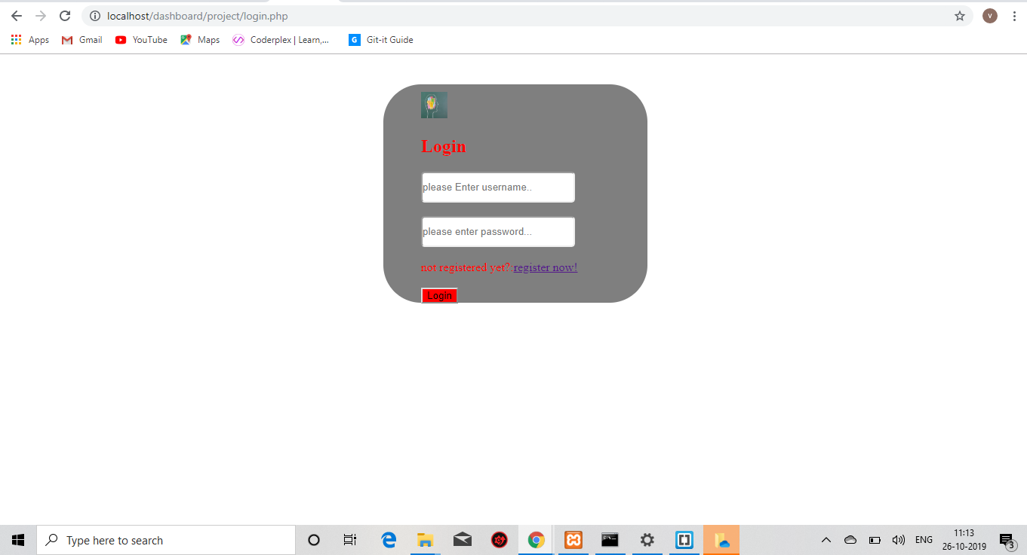

Slide 7
SIGNUP
Input : New user name ,Password ,Phone number, email id
Processing: new details are stored in the database
Output :Enters into the page while login

Slide 8
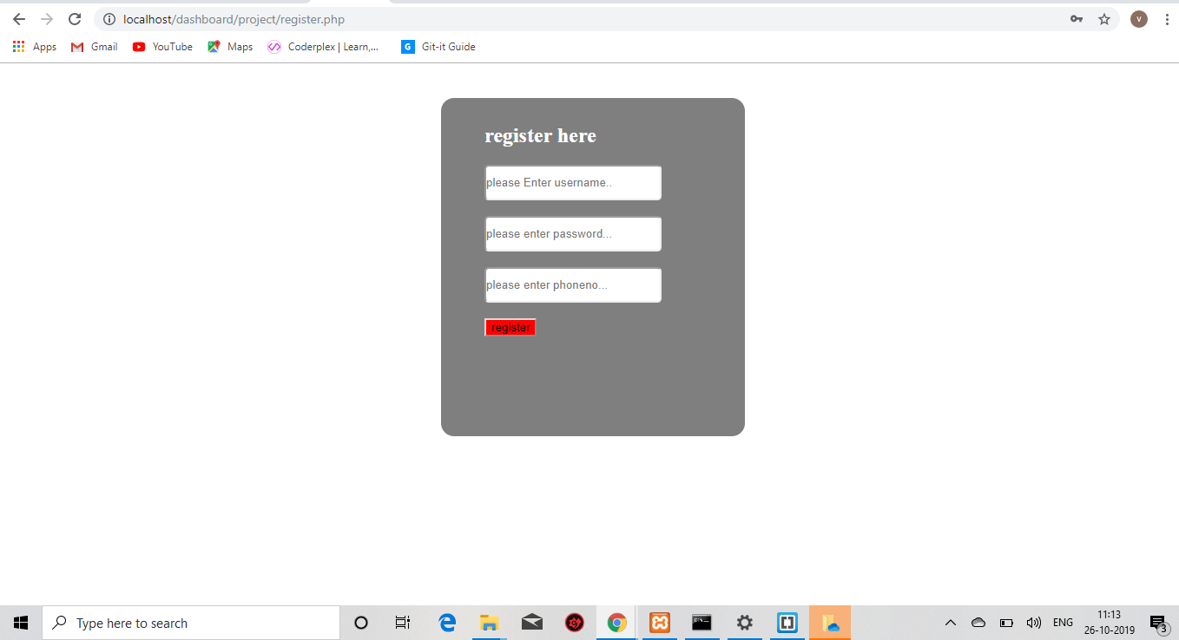

Slide 9
Take the test
Input: answers given by the user.
Processing: checks whether the answers are valid.
Final output:
Displays the result.

Slide 10
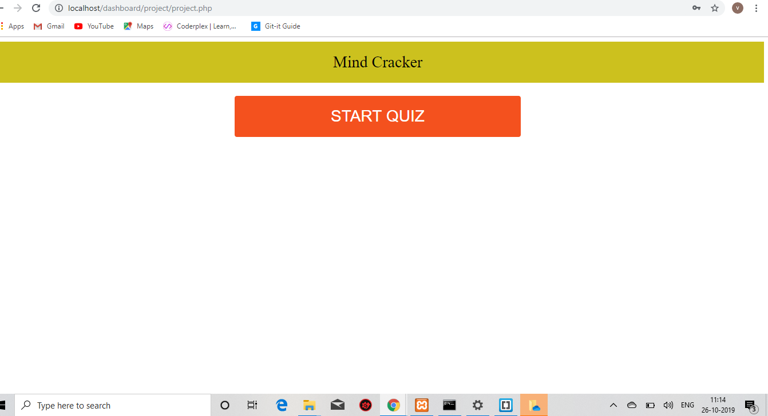

Slide 11
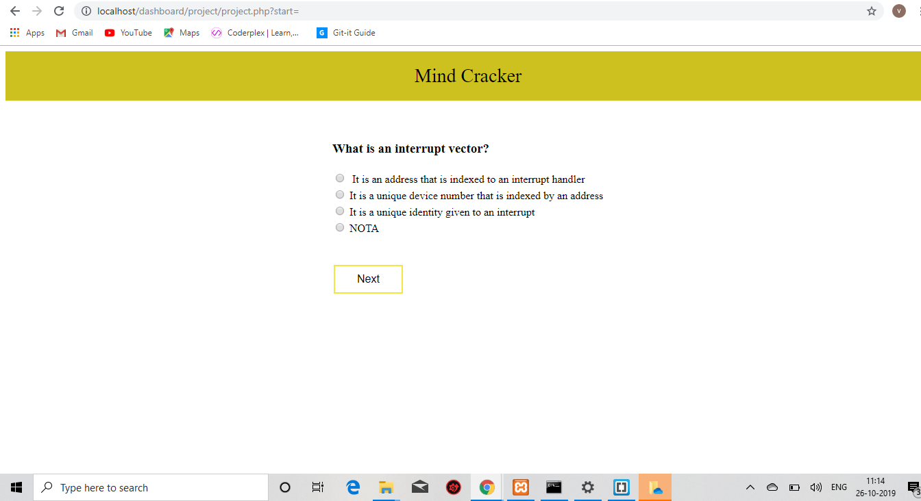

Slide 12
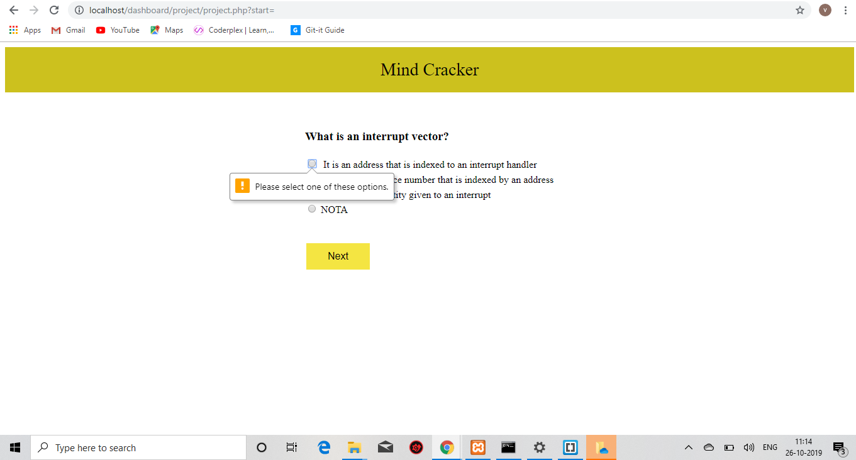

Slide 13
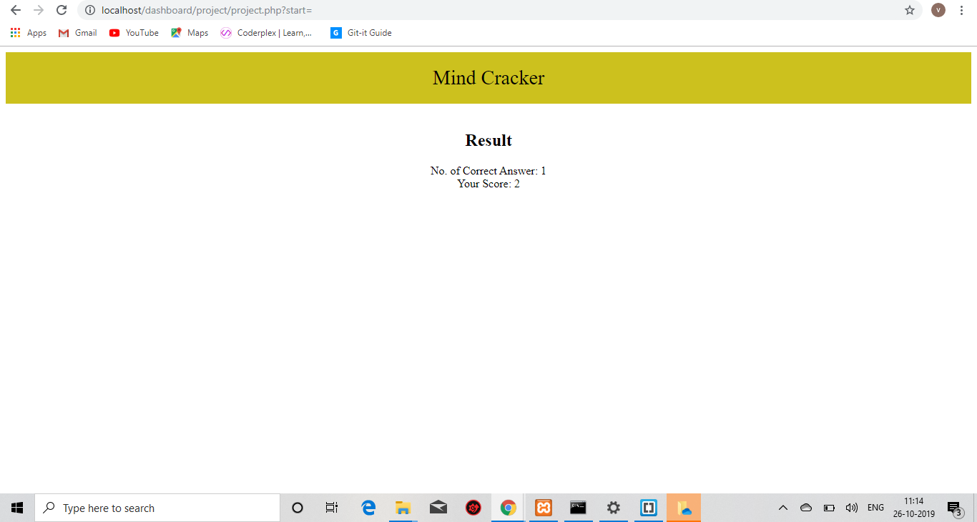

Slide 14
CONCLUSION
This online test system provides facility to conduct online examination world wide. It saves time as it allows number of students to give the exam at a time and displays the results as the test gets over, so no need to wait for the result. It is automatically generated by the server. Administrator has a privilege to create, modify and delete the test papers and its particular questions. User can register, login and give the test with his specific id, and can see the results as well.

