Slide 1


Portal for scholarship details
A web based application for handling the scholarship of the students

Slide 2
Table of content
Abstract
Requirements of project
Hardware requirements
Software requirements
Functional requirements
Working of project
Introduction to coding part

Slide 3
Table of content
Limitations
Drawbacks
Future Enhancements

Slide 4

abstract
The main theme of our project is to develop a web based application for handling the scholarships of the students.
Now-a-days everything is being digitalized and at this stage it is very inefficient to use manual way of approval of the scholarships of the students in educational institutions.
And more over it is causing a lot of errors in approving and consuming more amount of time.
The main significance of using this project is to reduce the waste of papers and reduces manual entry of the data by the admin

Slide 5
Requirements of project
The overall requirements for the project are mainly categeorised into 3 components
They are as follows :
1) Hardware requirements
2)Software requirements
3)Functional requirements

Slide 6

Hardware Requirements
The basic hardware requirements for proper working of this project are listed as below :
1) System of 1 TB of memory
2)RAM of 8 GB size
3) 64 bit micro processor
4) Server for hosting of the website
5) Database server for maintain the whole student scholarship data

Slide 7

Software requirements
The basic software requirements required for the efficient performance of the project are as follows :
1) Windows 10/Linux OS
2)Web browser
3)Network connecting tools
4)Proper GUI components

Slide 8
Functional requirements
The functional requirements of the project mainly deals with the features of the project or the various events that are performed in the project
Certain functional requirements of the project are as follows :
1)Login/Signup for student
2)Login for admin
3)Personal data filling for students
4)Review of notices
5) Queries etc

Slide 9
Working of the project
1)Admin user
2) Student user
Login
Approval of scholarships
View of list of students with scholarships
Posting of notices to students
Response to student queries
Login /Sign up
Filling profile
View of status of scholarship
View of Notices posted by admin
Asking queries to the admin

Slide 10
Intro to coding part
The development of our web project has done mainly on the basis of following technologies :
1) Front end ---- HTML,CSS
2) Back end ------ PHP
3) Database connectivity ------MySql

Slide 11
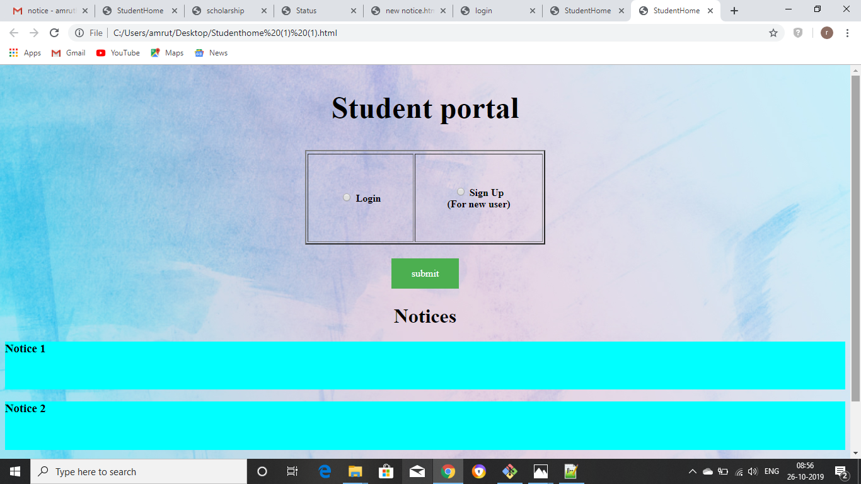
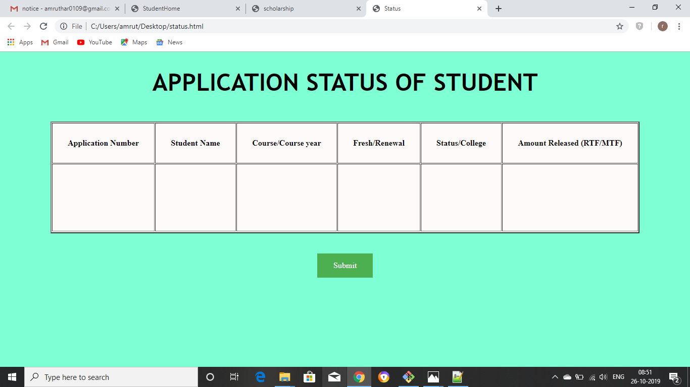
Front end coding

Slide 12
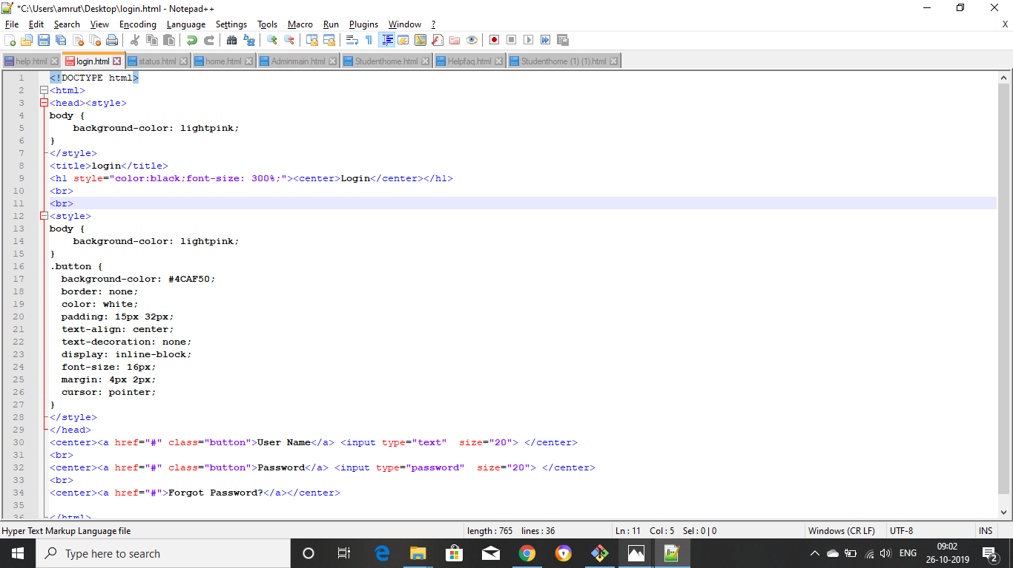
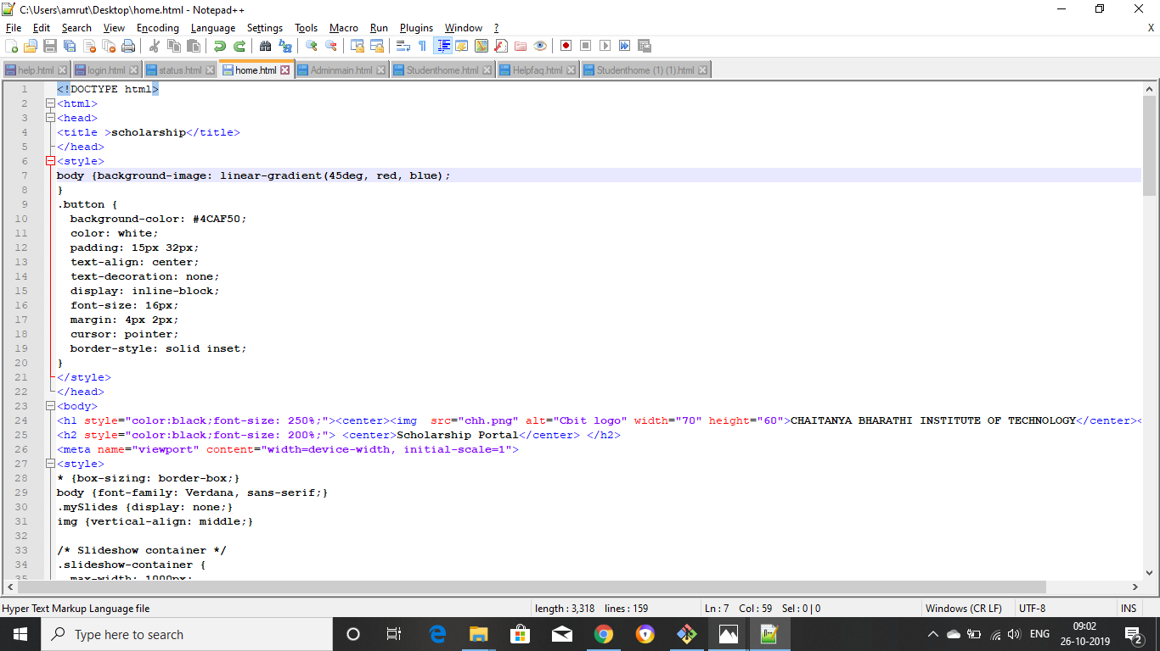
Back End and Data base

Slide 13
Limitations
Difficult in handling large and large amounts of the data
No proper media storage database
It cant access with any of the other existing system
i.e. a stand alone application
The students applied will be directly approved and added for the scholarships no approval by the admin is present

Slide 14
Future enhancements
At present the project can interact only in between college management and students i.e the data that has been sent from student can be present with the management.
The management has to handle all this data and has to sent for the government for allocation of scholarship.
So the main future enhancement for this project is to provide a plarform where students can interact with the college management and also those info of students can be directly forwarded to govt by the college management through thisn same website.

Slide 15

Team : Techy pirates

