Slide 1
STAFF LEAVE APPLICATION SYSTEM
TEAM - 52

Slide 2
PROBLEM STATEMENT
An application where staff can log in and apply for leaves by providing necessary details. They can also check the status of previous leaves they applied for. If eligible leaves are over, they will not be allowed to apply for more leaves. The admin role is given to the HOD. They can log in and view all leave applications. Admins can open leave applications to read the reason description and grant/decline leaves, set and modify the number of leaves a faculty can apply for. Additional features can include attendance tracking of every staff member.​

Slide 3
Meet our team
Nayan Kaslikar
SaiTeja
Modern Education Society’s College of Engineering
JAWAHARLAL NEHRU TECHNOLOGICAL UNIVERSITY HYDERABAD
MOHAMMAD SHAIBAZ QAISAR
Chandu
JAWAHARLAL NEHRU TECHNOLOGICAL UNIVERSITY HYDERABAD
JAWAHARLAL NEHRU TECHNOLOGICAL UNIVERSITY HYDERABAD

Slide 4
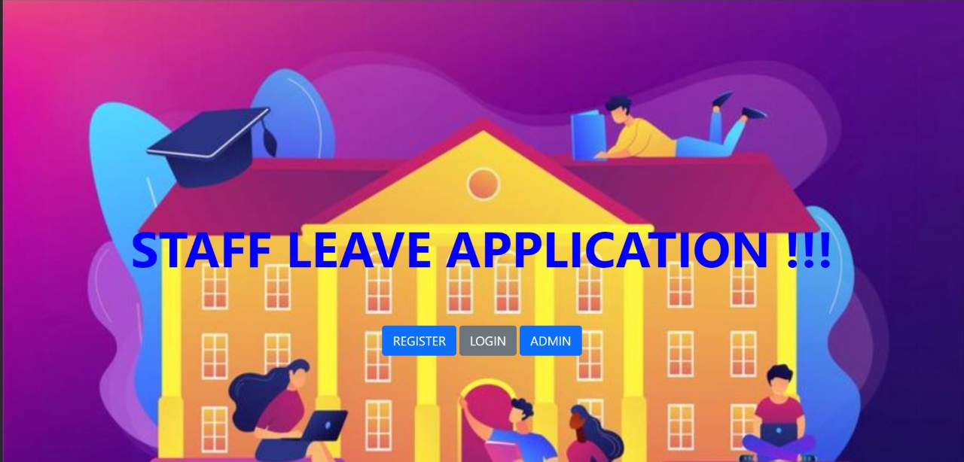
WELCOME !!!
Our Application is a web based type. It allows staff members to apply for leaves. They can also check for their previous leaves.
Not only the site is used by staff members but also by admin .The admin is given proper rights to grant or decline the leave applications. He can also change the number of eligible leave numbers.

Slide 5
WORK FLOW
--END--
1. Register
Users & Admin can
Sign in or login
2. User’s Dashboard
All information related to leaves
3. Apply For Leave
Mention Reason of leave & other necessary details
4. Admin Dashboard
Every access to admin & authorities
5. Logout

Slide 6
Goals Achieved
To maintain proper records
User – friendly
Using technology to ease our lives

Slide 7
Technologies used
HTML
CSS
BOOTSTRAP
TAILWIND CSS
MYSQL
NODEJS

Slide 8
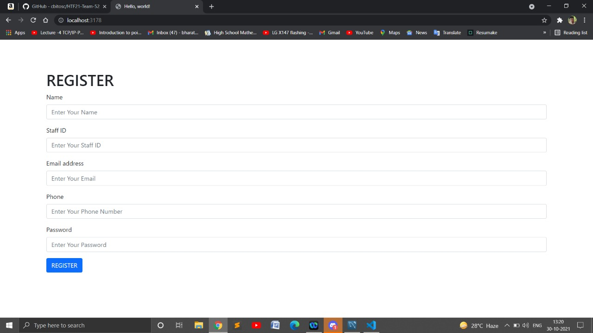
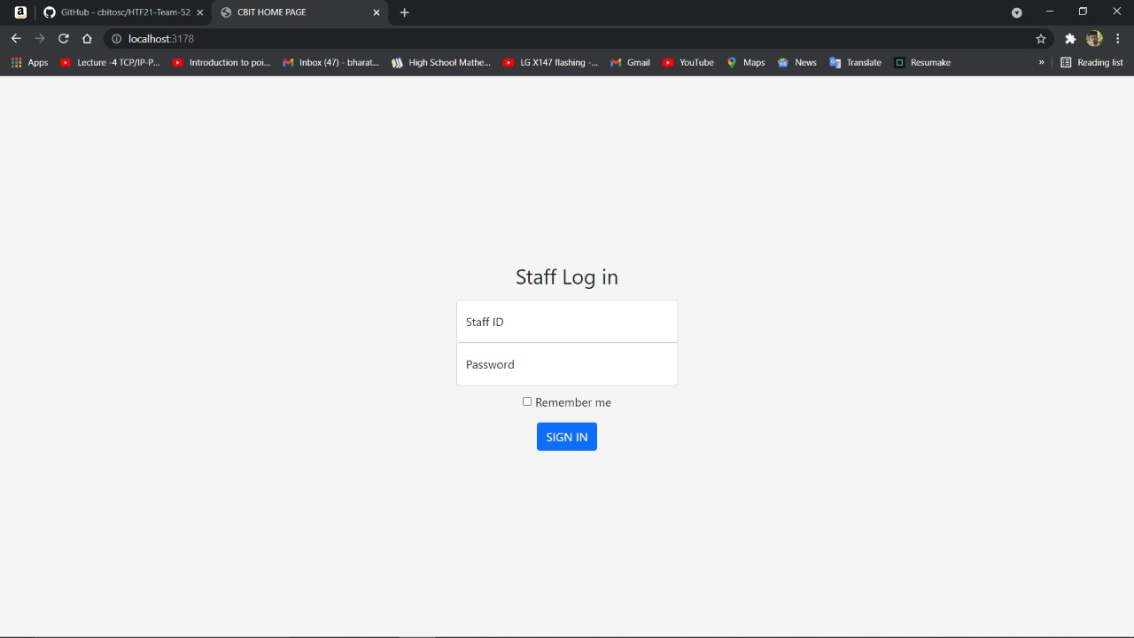
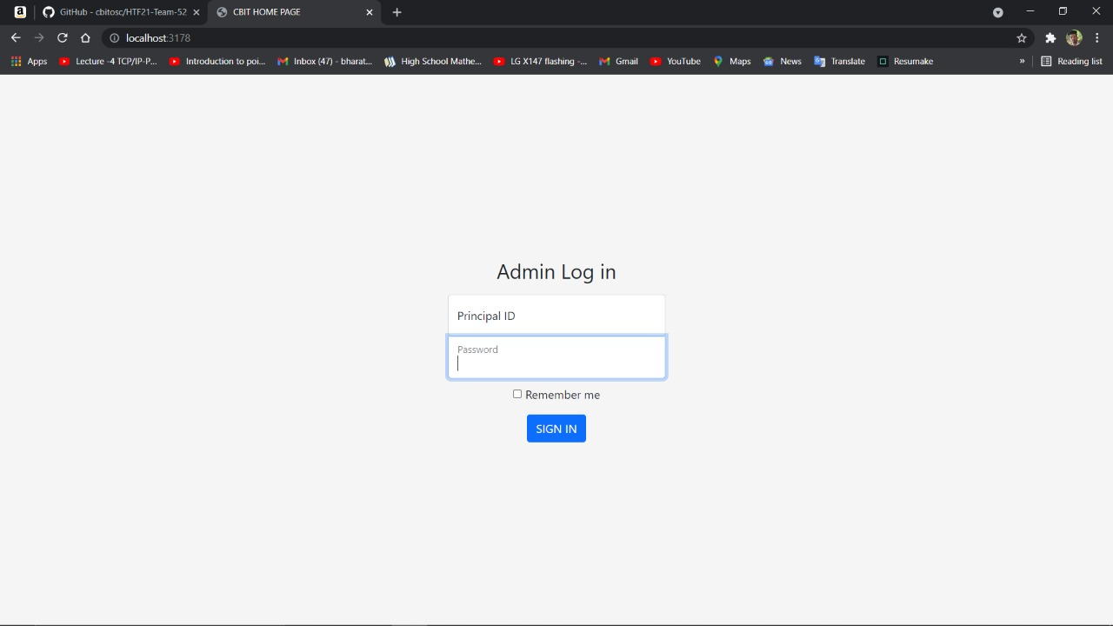
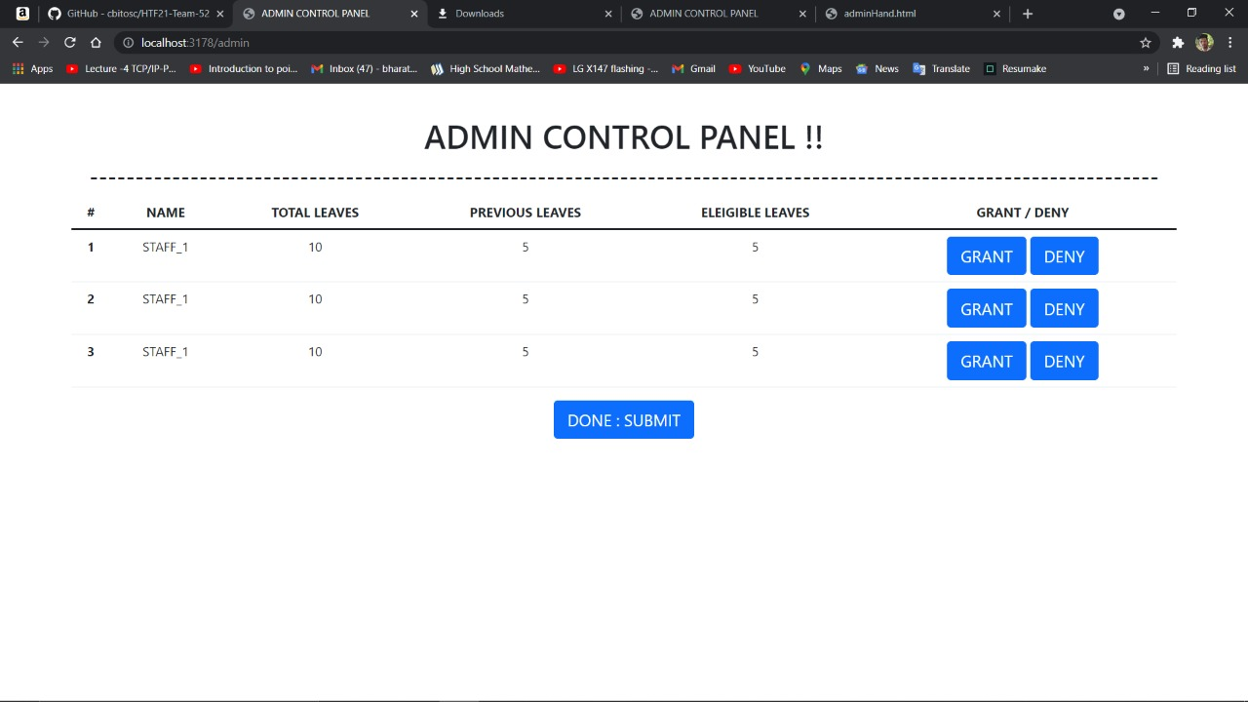
“
”
Richard Branson

Slide 9
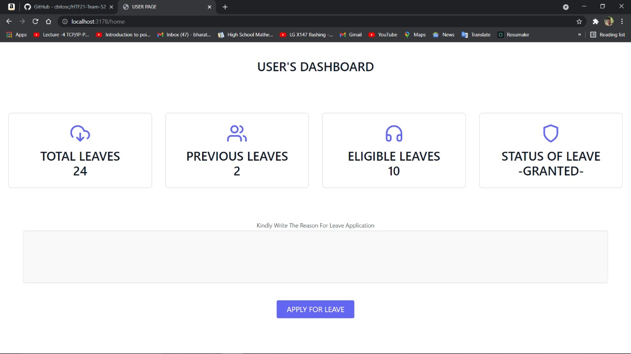
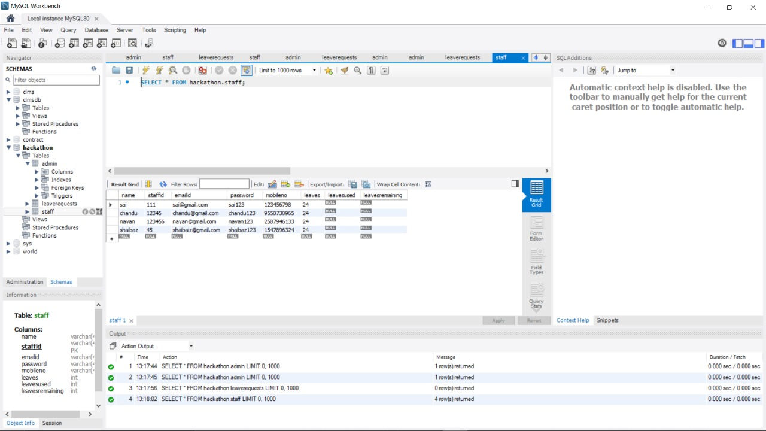
“
”

Slide 10
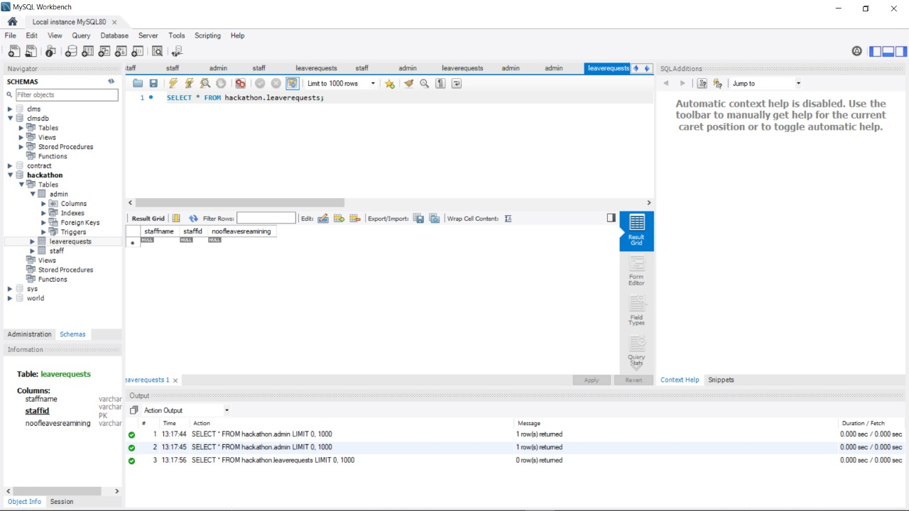
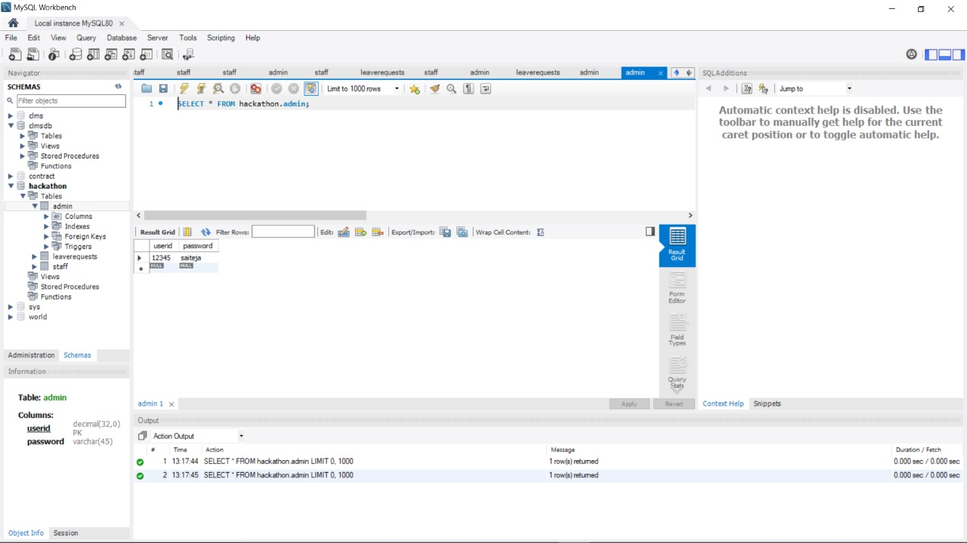
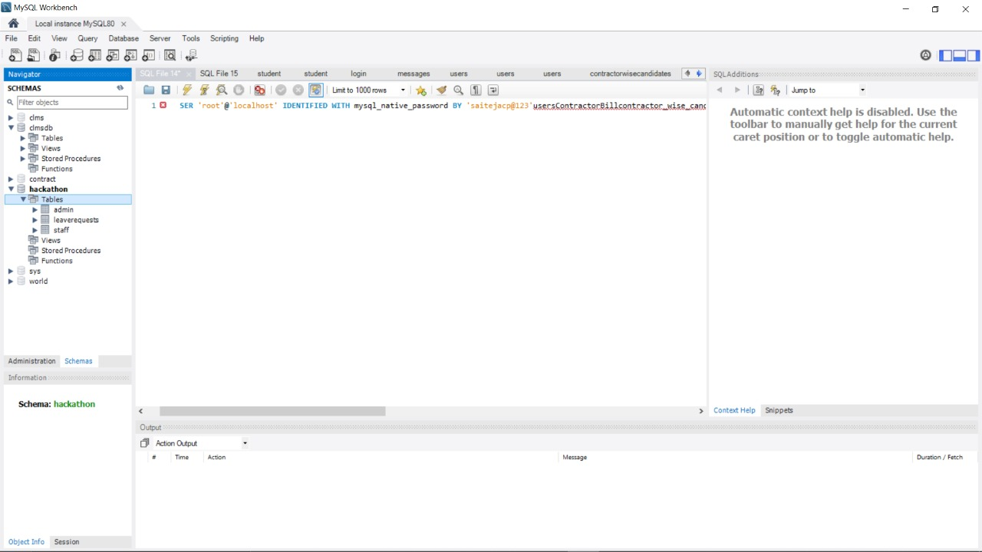
“
”

Slide 11
Plan for product launch
Deploy strategic networks with compelling e-business needs
Planning
Synergize scalable e-commerce
Marketing
Disseminate standardized metrics
Design
Coordinate
Foster holistically superior methodologies
Launch
Strategy
e-business applications
1
2
3
4
5

Slide 12
Summary
An application where staff can log in and apply for leaves by providing necessary details. They can also check the status of previous leaves they applied for. If eligible leaves are over, they will not be allowed to apply for more leaves. The admin role is given to the HOD. They can log in and view all leave applications. Admins can open leave applications to read the reason description and grant/decline leaves, set and modify the number of leaves a faculty can apply for.

Slide 13
Thank you

