Slide 1
Application for Shruthi Sports
-by group-10

Slide 2
Team members:
Database and api team :
V Dharani CSE 2/4
Sanan Moinuddin CSE 1/4
Android team:
KVN Sai Ram Reddy CSE 3/4
Soma Pavani CSE 1/4
Web app team :
Pittala Rahul CSE 2/4
Shaik Abdullah Adnan IT 2/4
J.S.S. Chaitanyanand CSE 1/4
Thoutam Dileep CSE 1/4

Slide 3
Abstract
Online application is one of the easiest methods for applying for anything. You are just few clicks away registering for a sport. This project has user and admin interface where the users (students) can register for their team using a mobile application and the admin accepts them through the web page.
This project is done using python, Java programming language and we have used Django,Flask , HTML ,CSS , Bootstrap and Android studio . The mobile app provides a platform for the students to register for a sport and the web app enables the sport’s faculty to schedule the matches online and to accept the registrations.

Slide 4
Acknowledgements
Our project report is a brainchild of the combined efforts of all members of the group and accomplishing this would not have been easy without the consistent guidance, inspiring words and relentless support received from the following, throughout the execution of this project work.
We would fall short of words to express our heartfelt gratitude and thanks to Mohammed Ameer Uddin, Mentor , Who has been a friend ,a guide and power house of inspiration to complete our project
We would like to express our sincere gratitude to Smt. M Trupthi, Asst. professor, Department of Information Technology , Chaitanya Bharathi Institute of Technology, Gandipet, for providing us with stringent terms of reference and matchless guidance for pursuit of this project.
We would also like to thank the entire COSC team for providing us an internship opportunity during this pandemic
We are indeed grateful to the above mentioned distinguished men/women.

Slide 5
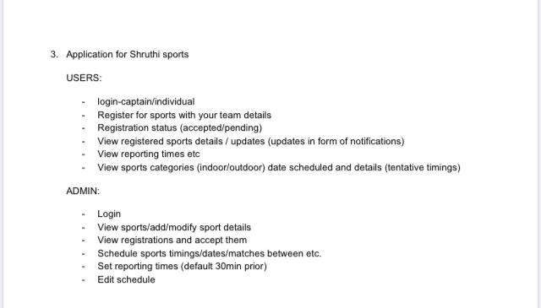
Problem statement

Slide 6

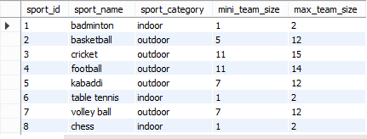


Database tables
Schedule
User registration
Sports
Team details
Admin
Heroku link
https://group-10-api.herokuapp.com/
https://group-10-user-api.herokuapp.com/

Slide 7
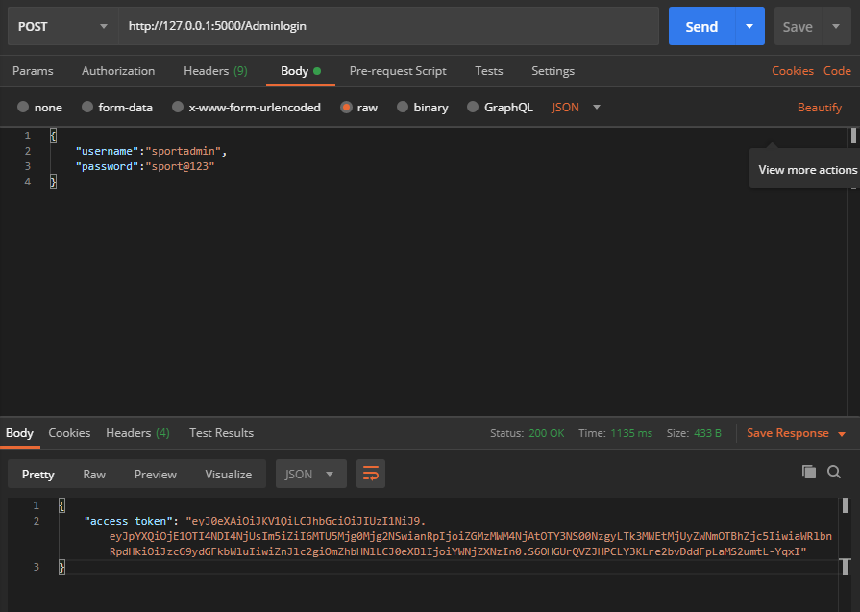
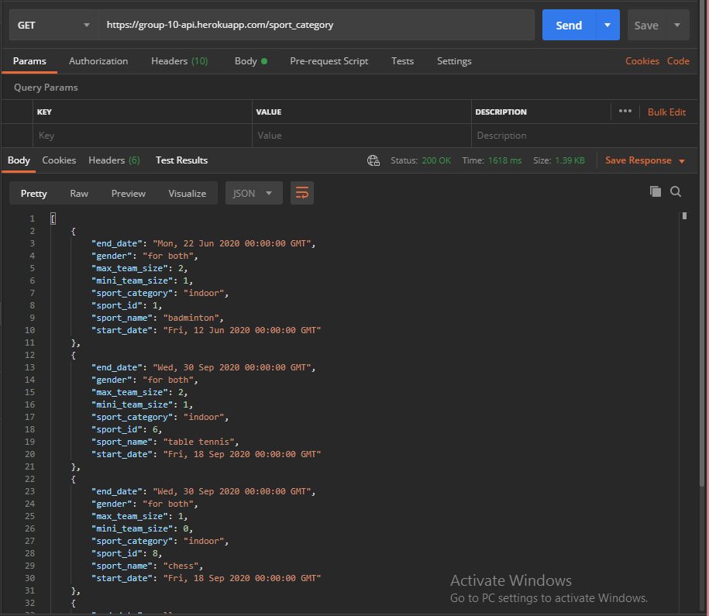
End points
For admins:
/Adminlogin
/sport_category

Slide 8
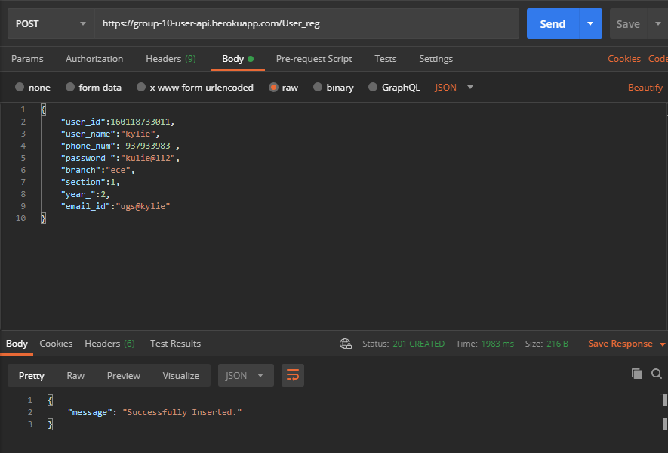
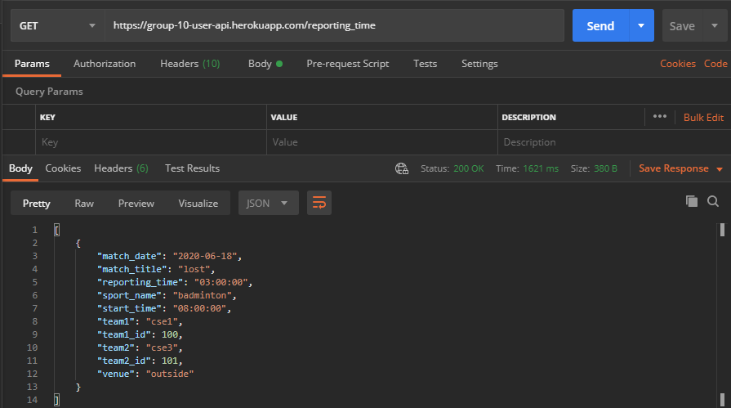
For Users:
/User_reg
/reporting_time

Slide 9
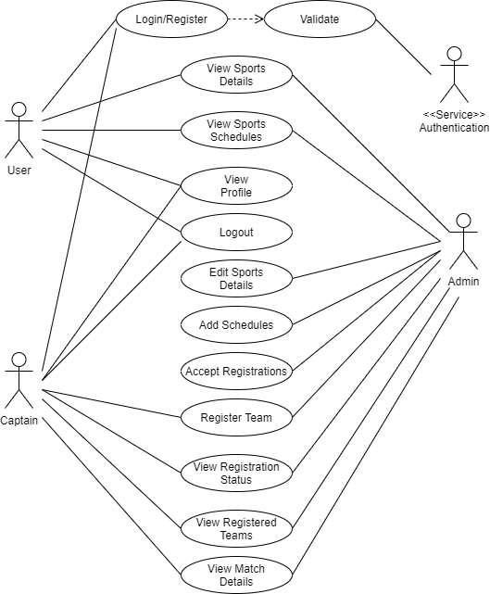
Use Case Diagram

Slide 10
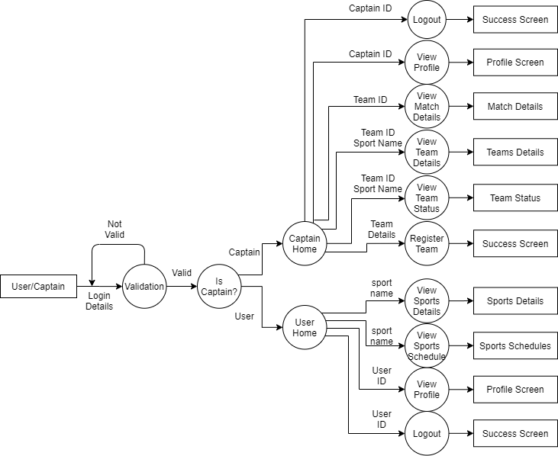
User Data Flow Diagram

Slide 11

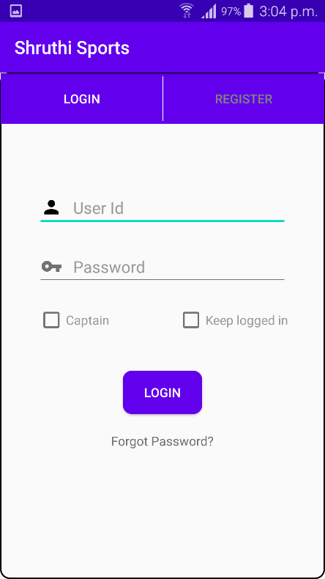
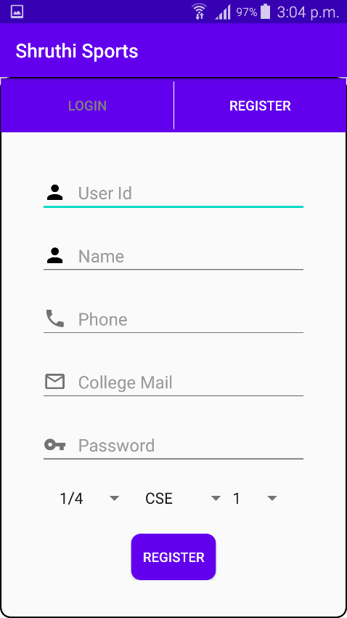
User registration app
Splash screen where all initializations takes place. Login and Register screen for the user to login and register into the application

Slide 12
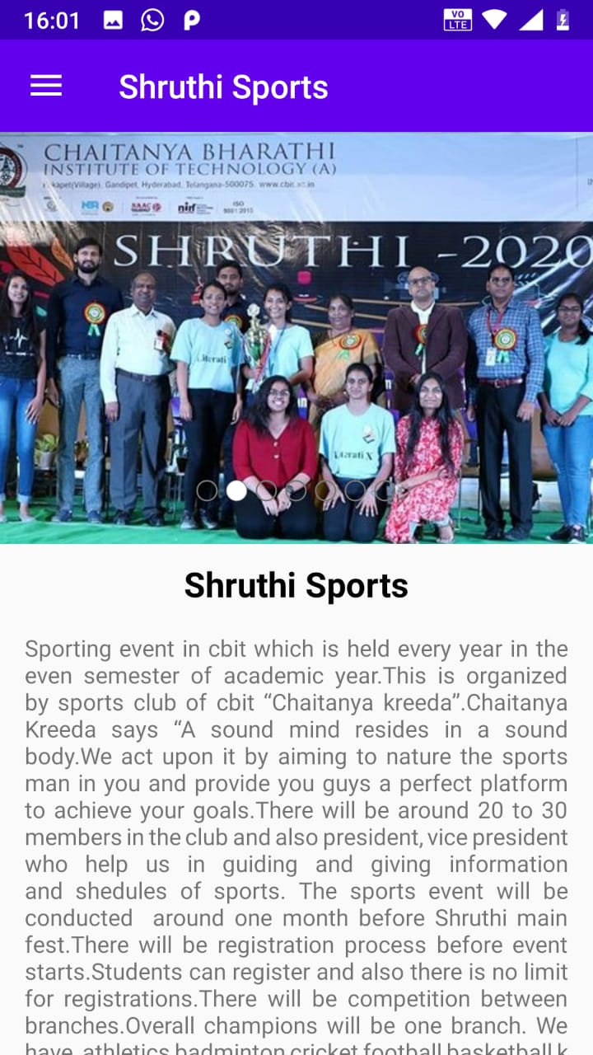
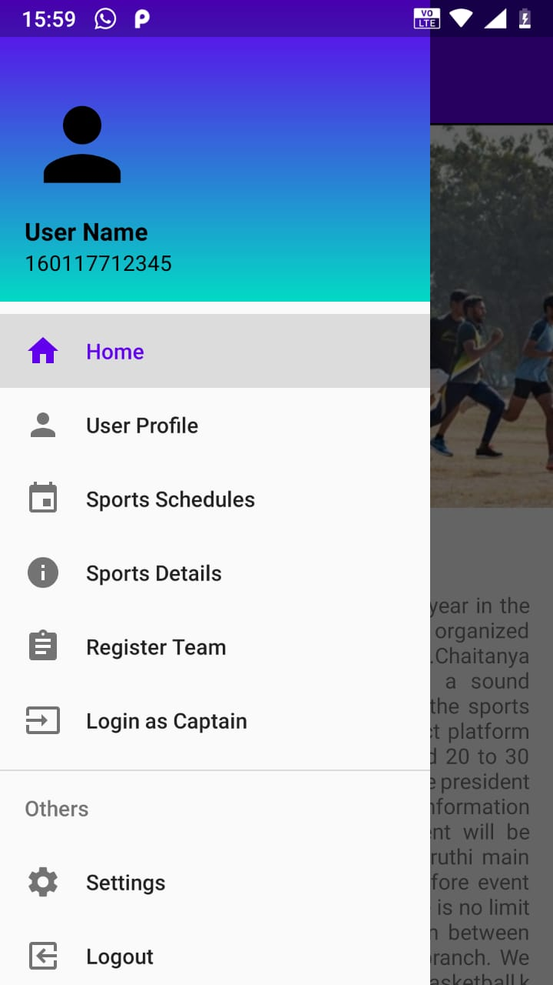
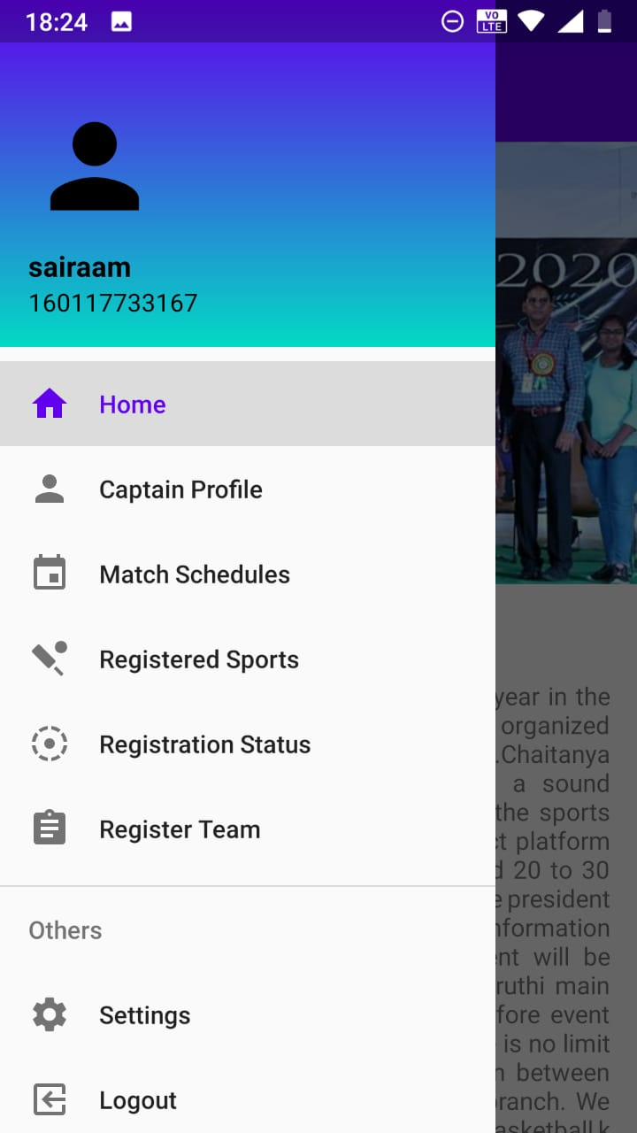
Hom
Home screen that shows details of Shruthi Sports events. Navigation Drawer for User and Captains to access various features in the application

Slide 13
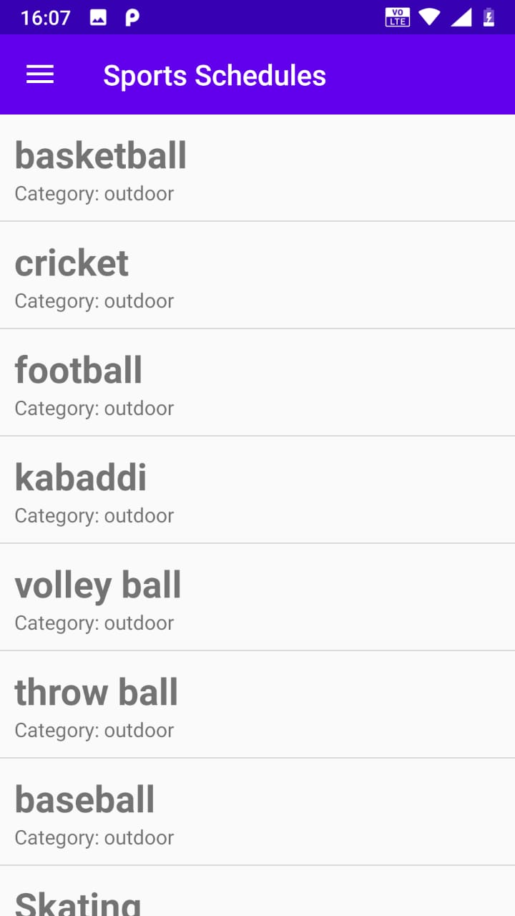
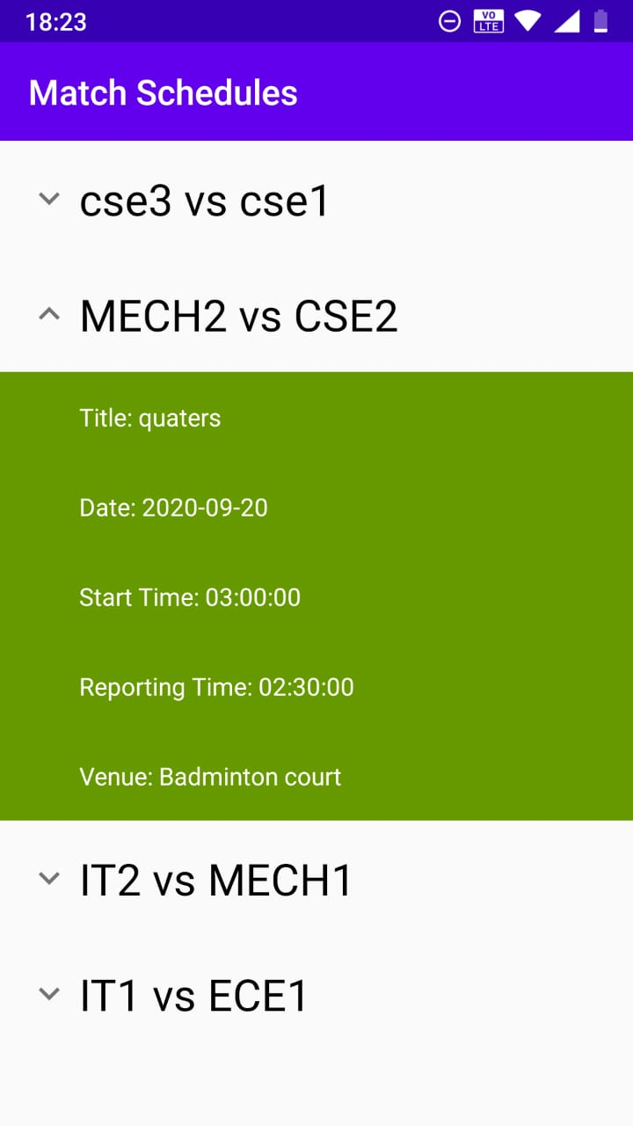
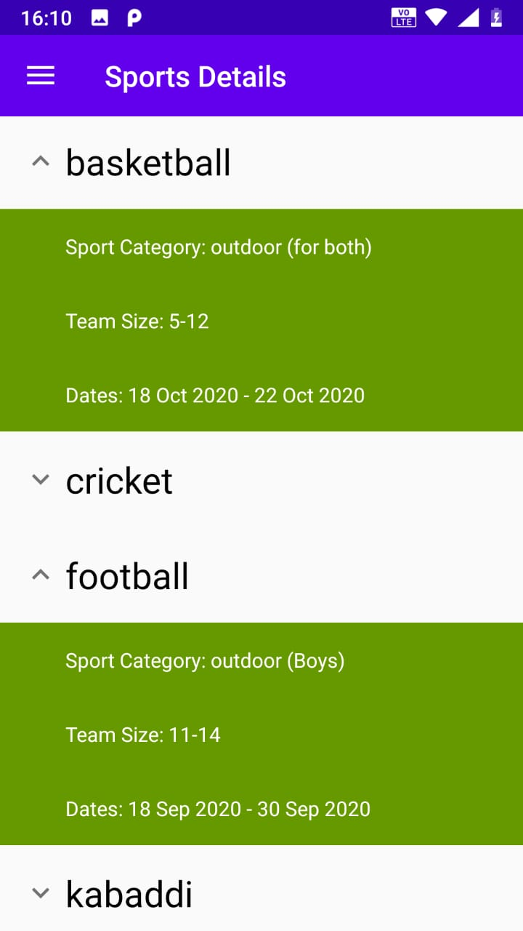
Schedule screen where user can choose the sport whose schedule he wants to see and Sports details screen where a user can check all the details of a particular sport.

Slide 14
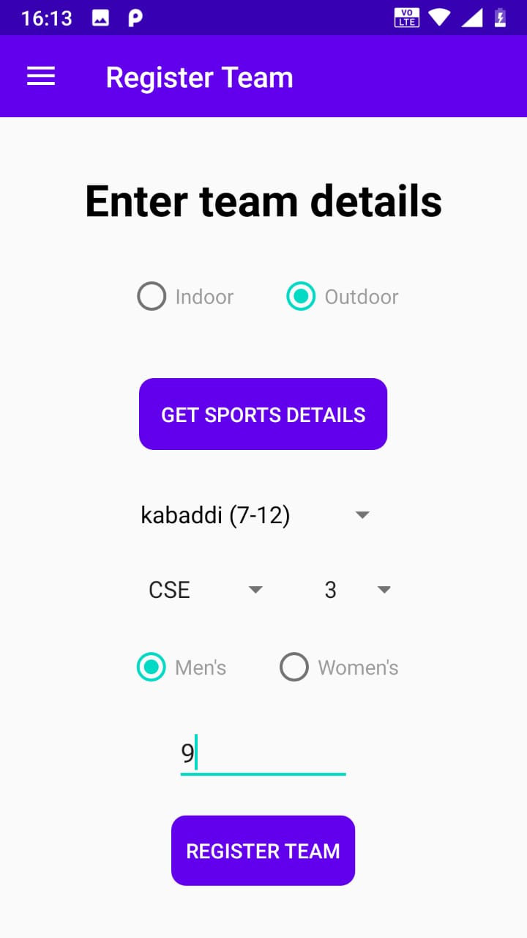
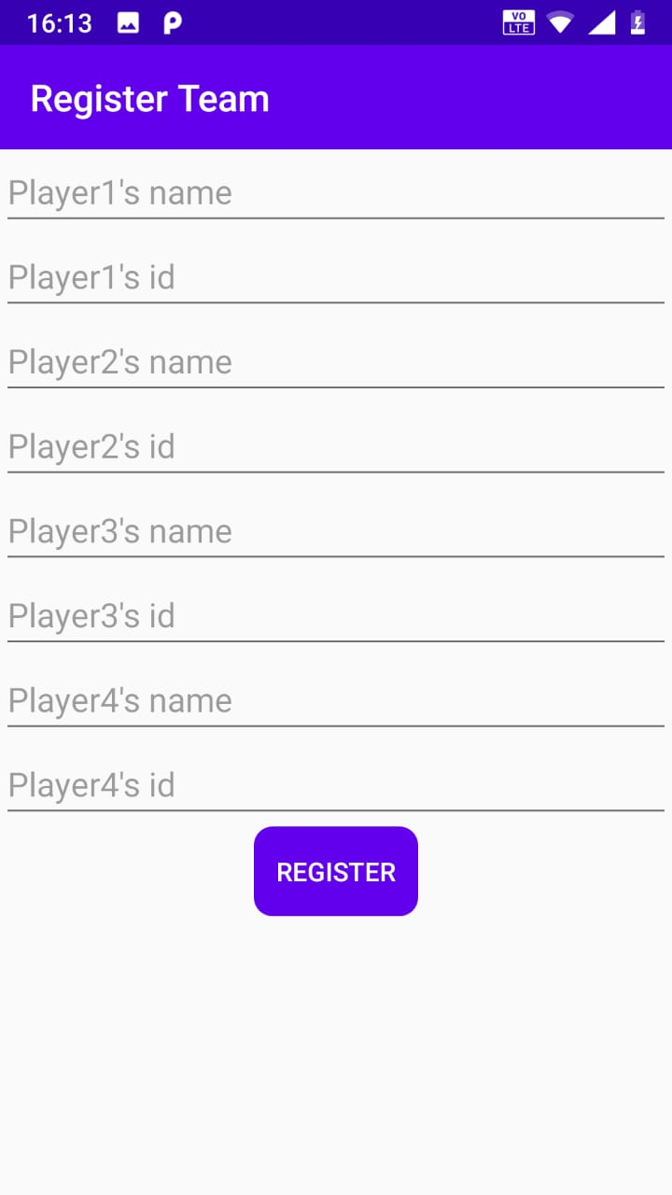
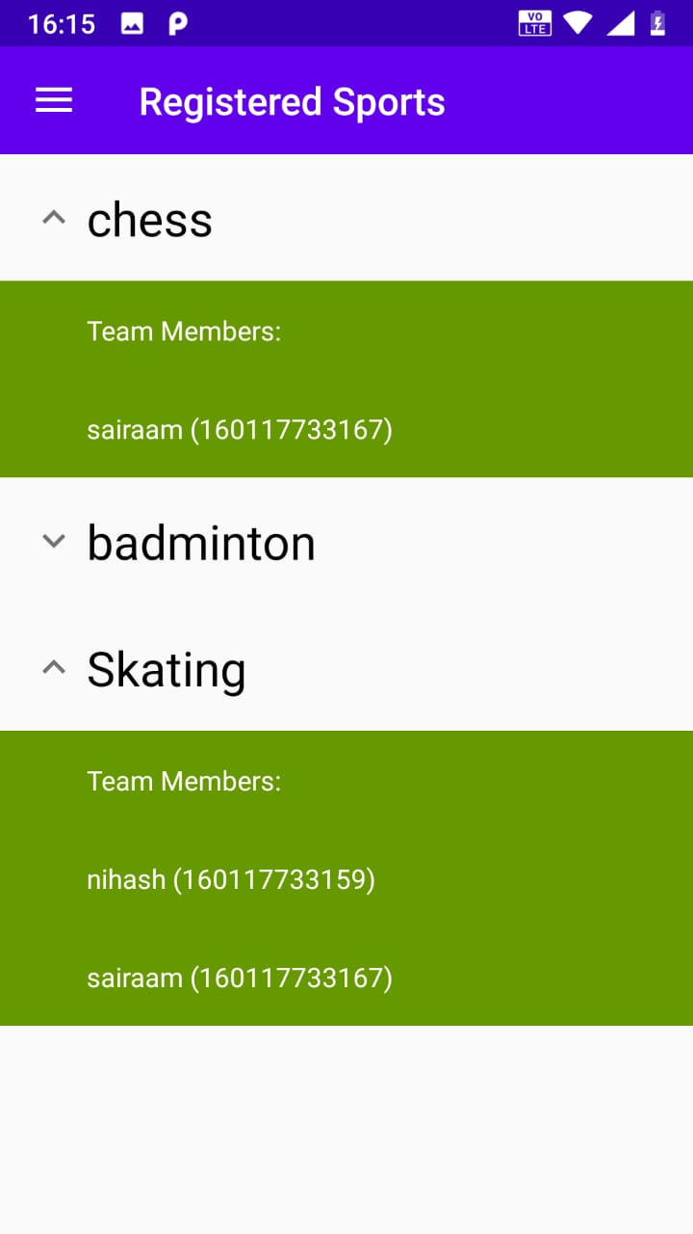
Register team screen for a captain to register his team by giving all the team details. Registered sports team where user can see the details of the team details of the sports he registered for.

Slide 15
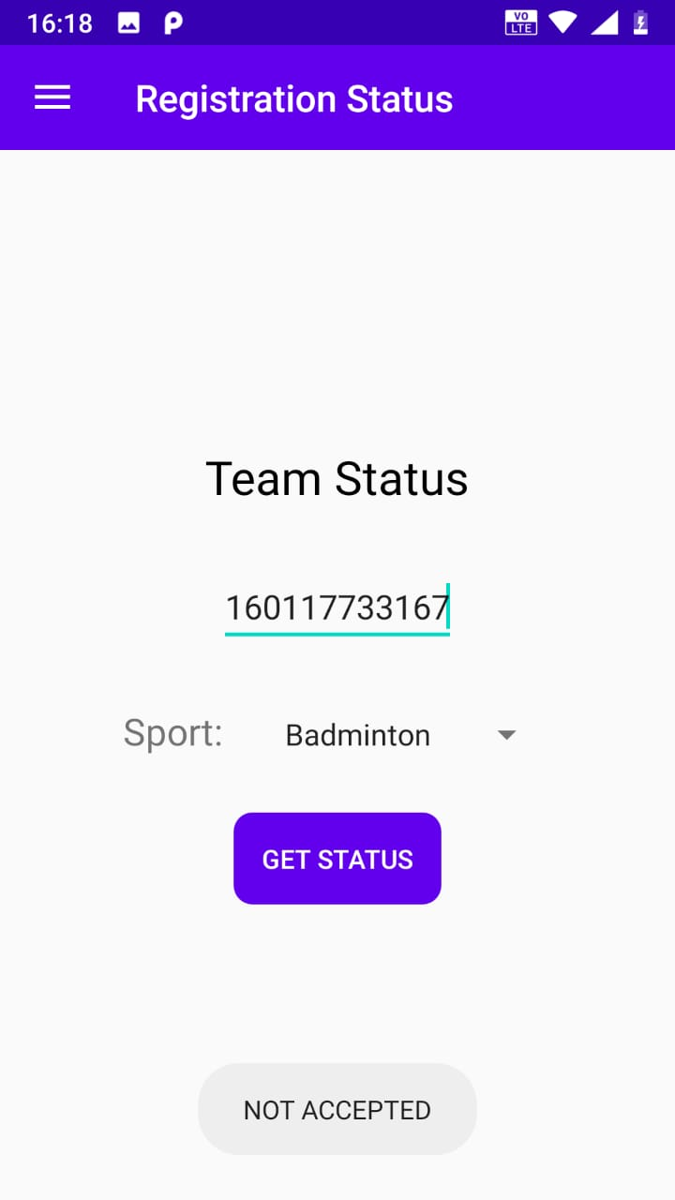
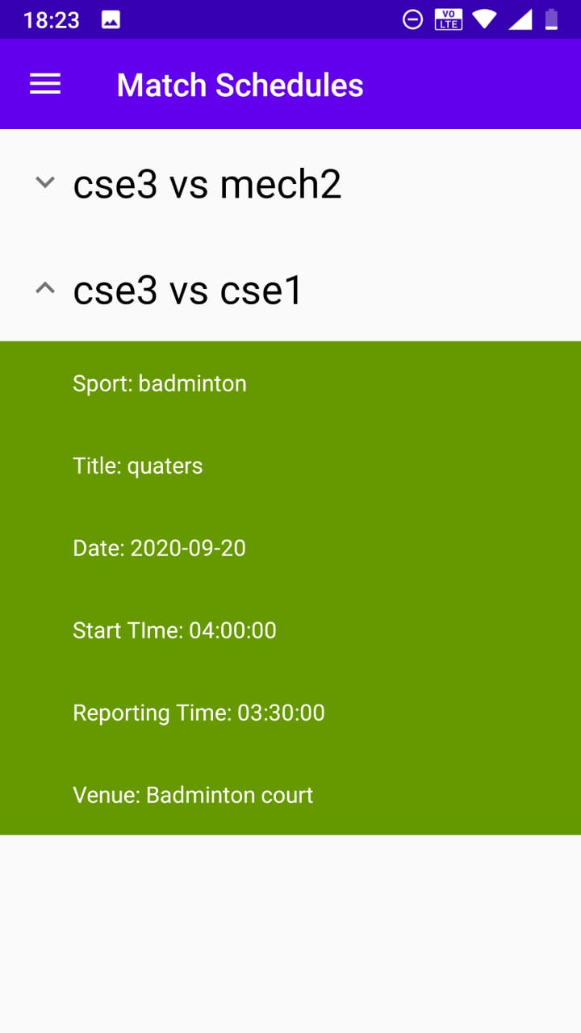
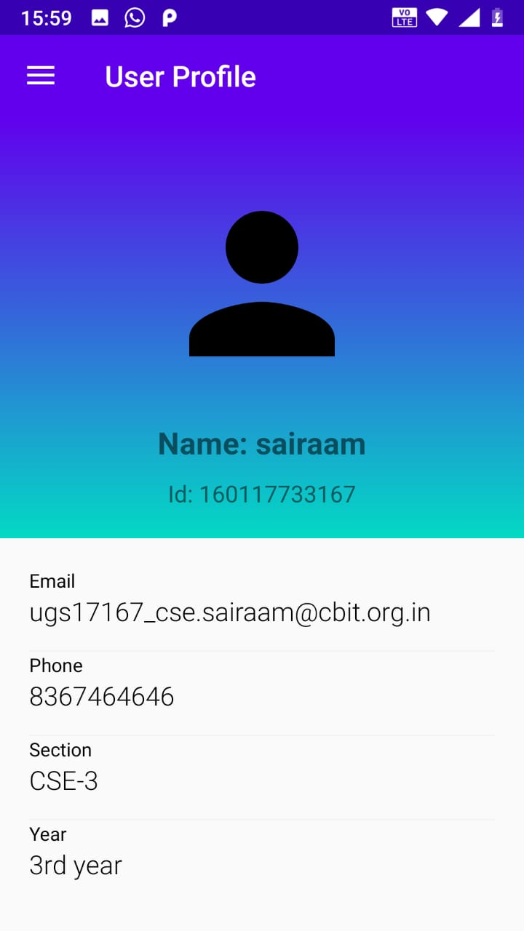
Team status screen where captain can check his teams’ status. Match schedules screen which displays all the matches of captains’ registered teams. Profile screen which shows the complete account details of the user.

Slide 16
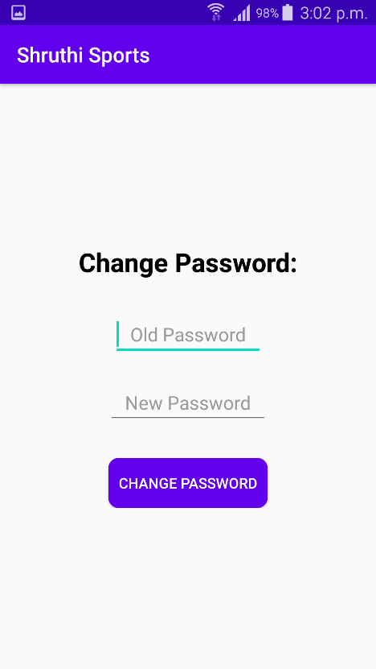
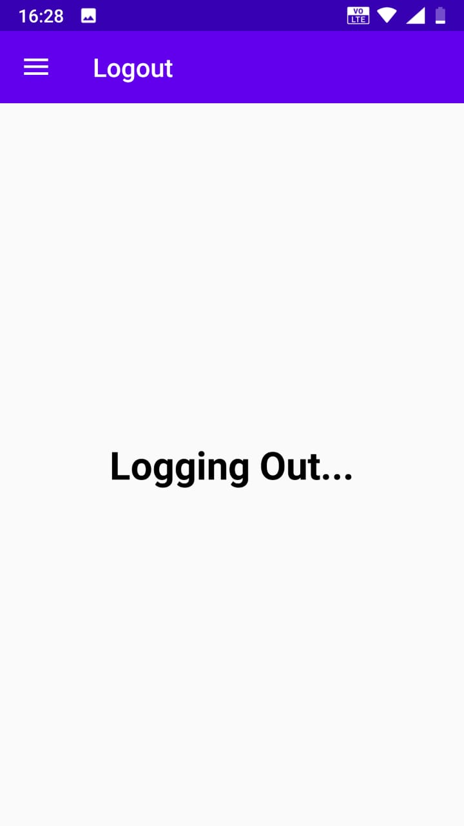
Change password screen for users to change their passwords. Logout screen where all on device user details will be erased.

Slide 17
Web page for Admins
Admin Login is the first page which is displayed once an admin opens the website.
On successful login with the correct Admin ID and password, the Admin is redirected to the main Admin Dashboard.
This is done with the help of JWT.

Slide 18
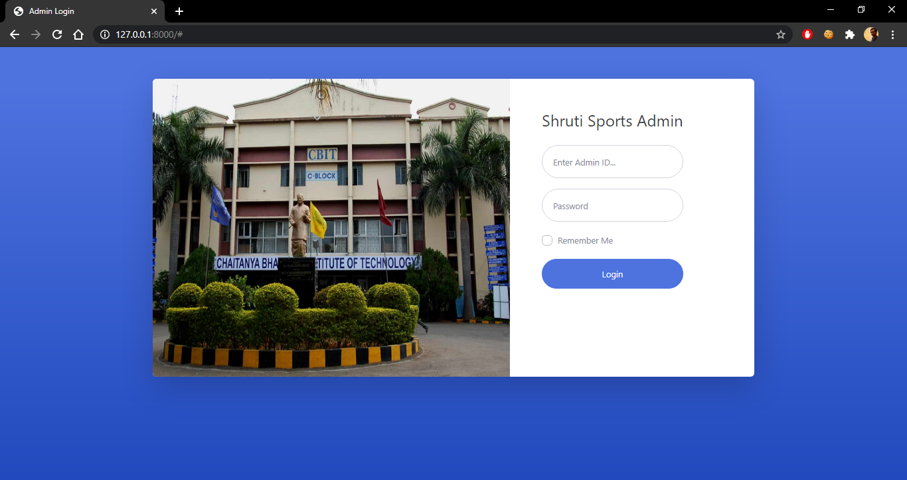

Slide 19
Admin Dashboard
On Successful login by the Admin, the Admin Dashboard page is opened.
The Admin can do all the related additions, changes and other required activities.
To name a few :
Sports ( Add, Remove, etc )
Registrations
Schedule

Slide 20
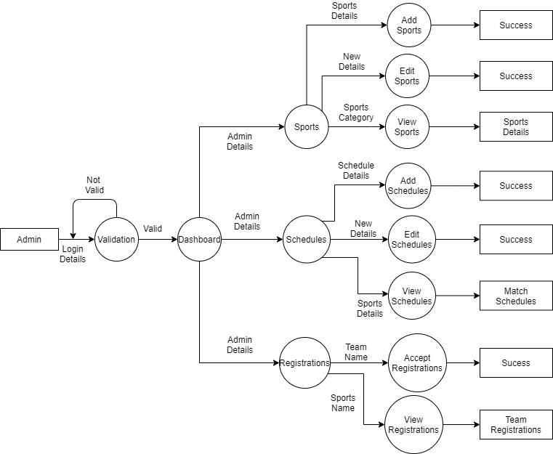
Admin Data Flow Diagram

Slide 21
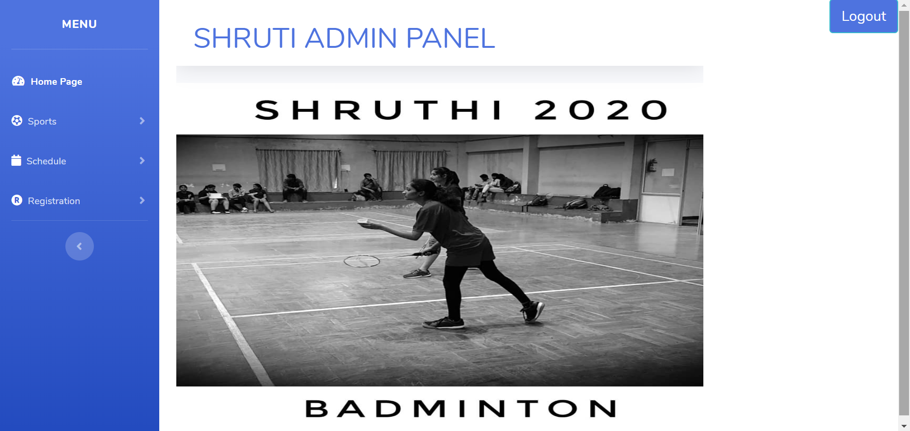

Slide 22
Connecting to the Database
All the inputs made by the admin and changes made are reflected in the database accordingly.
The API has been deployed on Heroku and is then imported into the Django Framework.

Slide 23
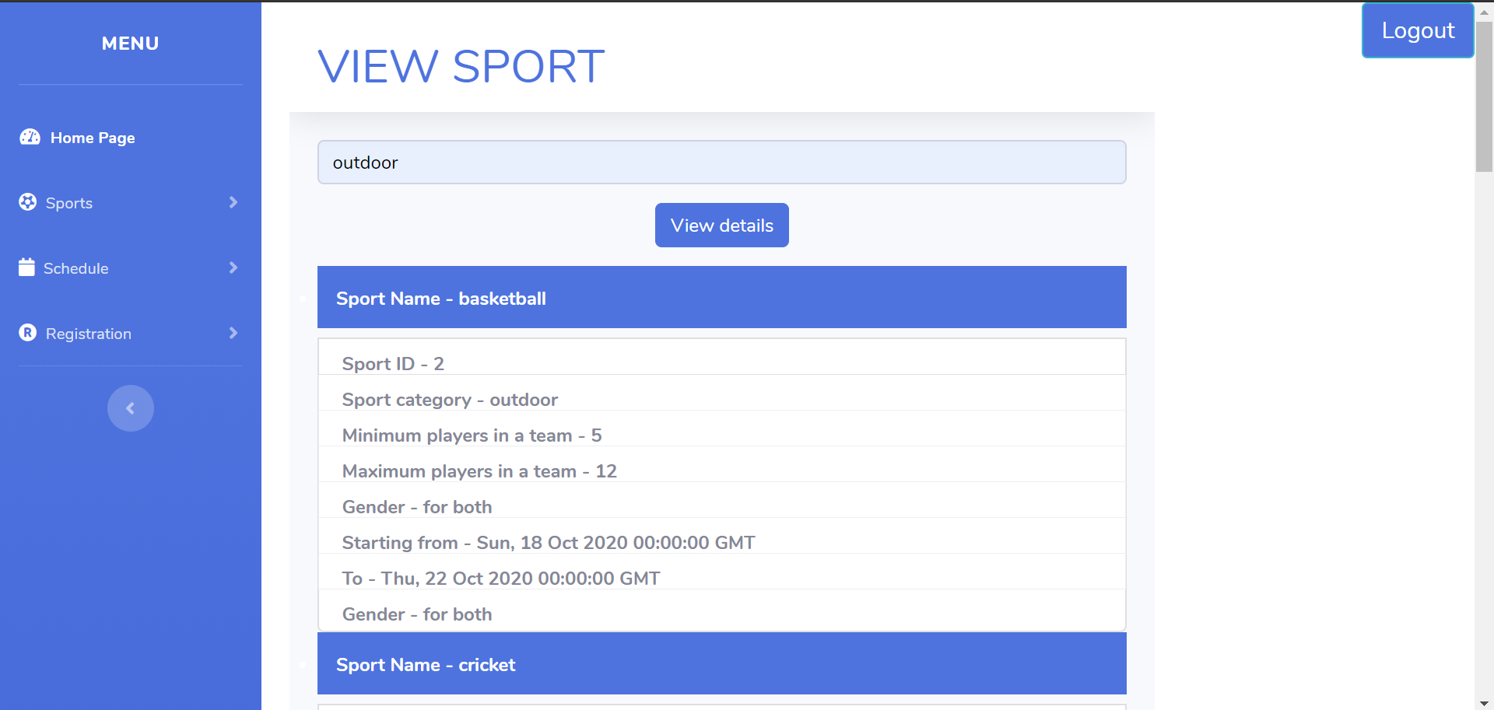
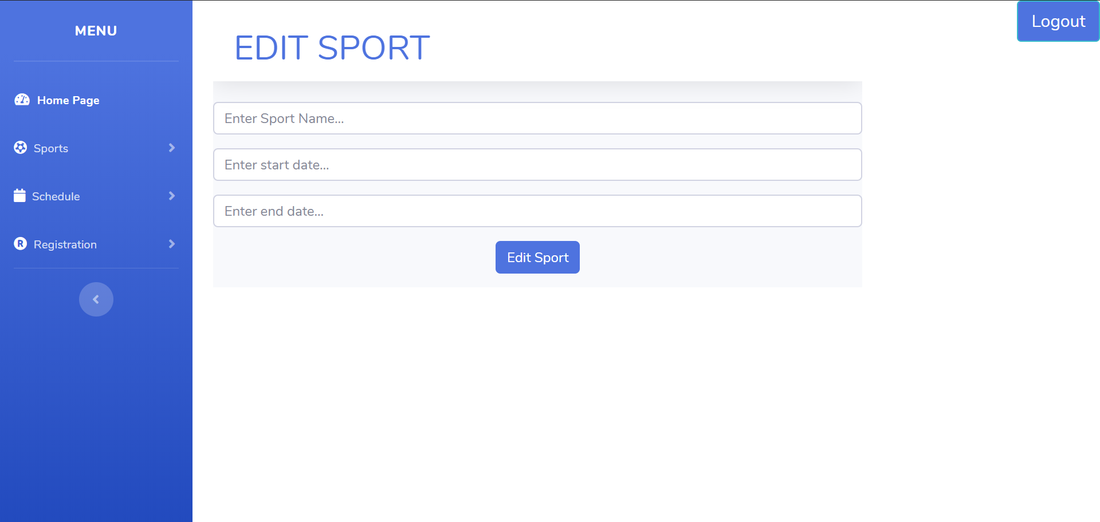
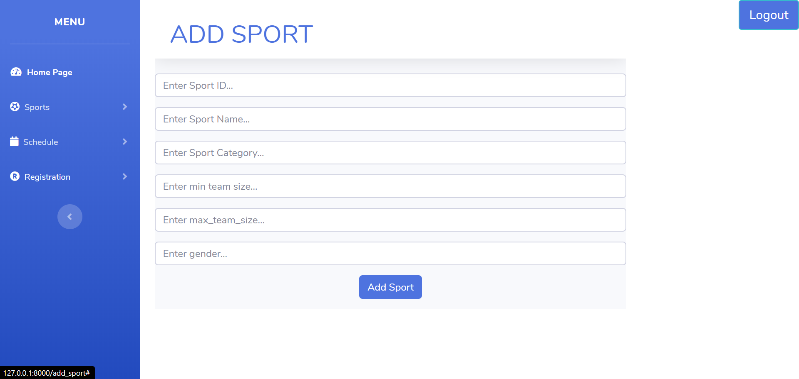

Slide 24
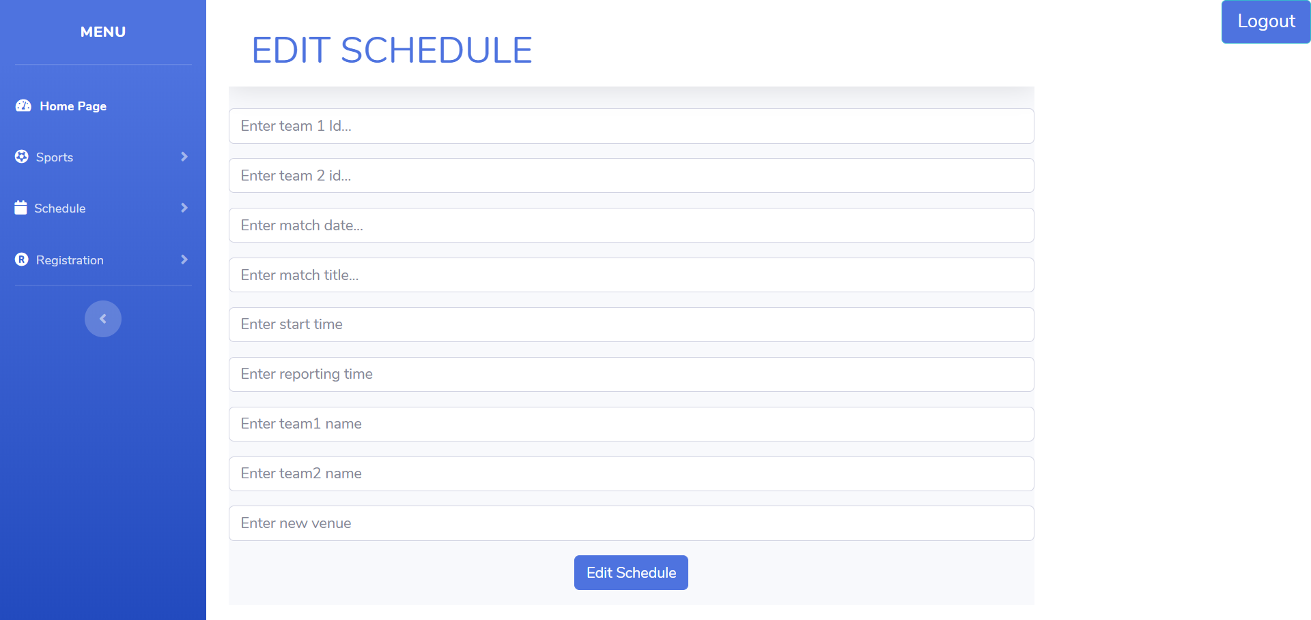

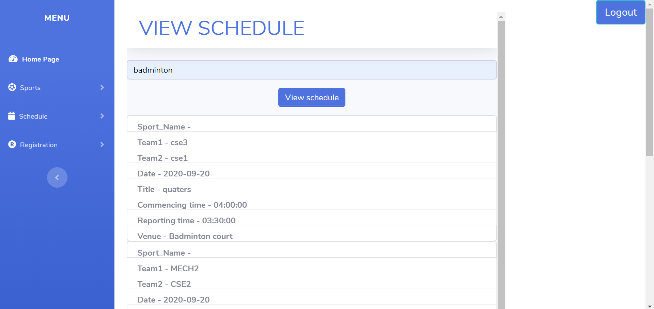

Slide 25
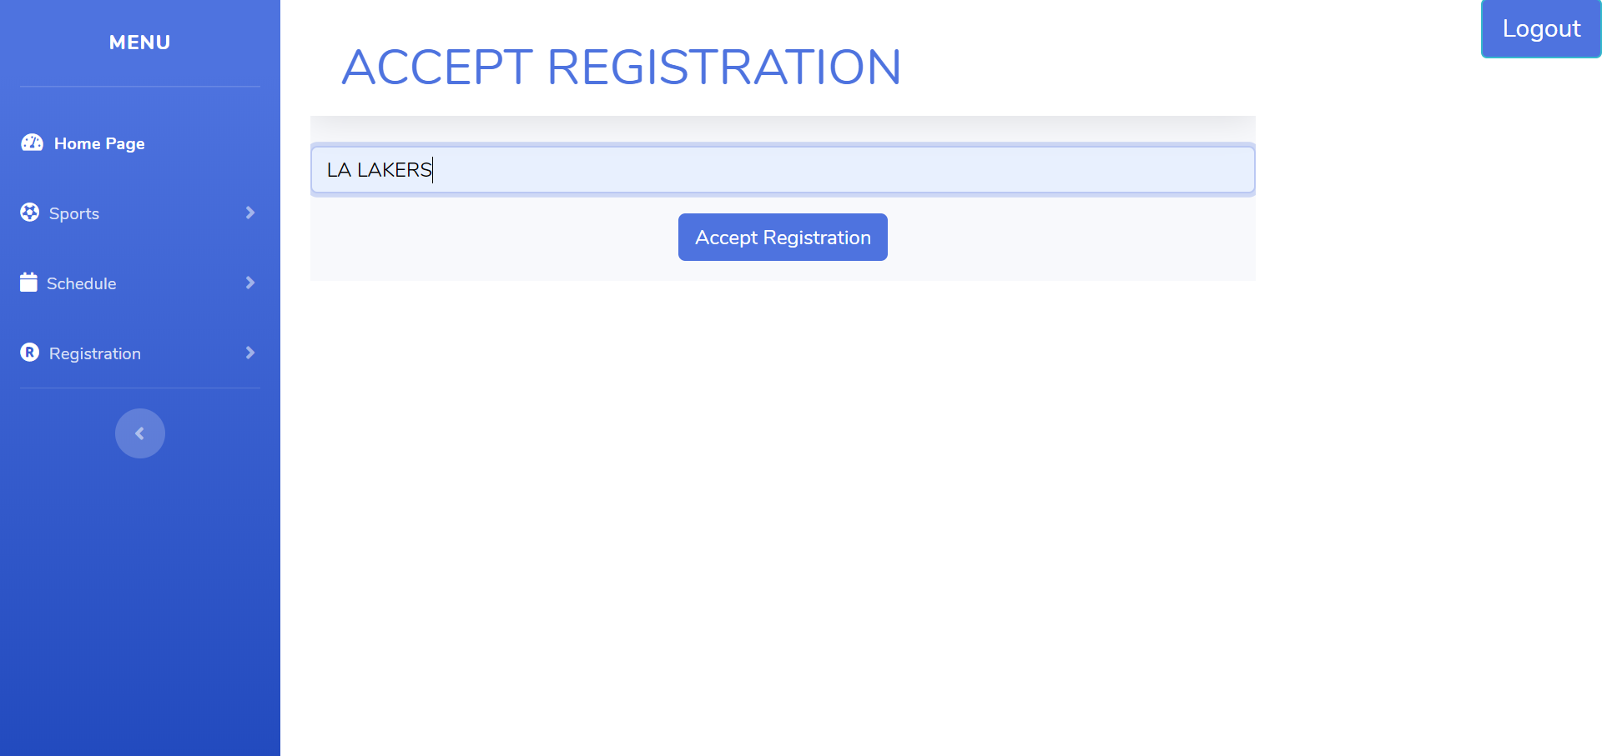
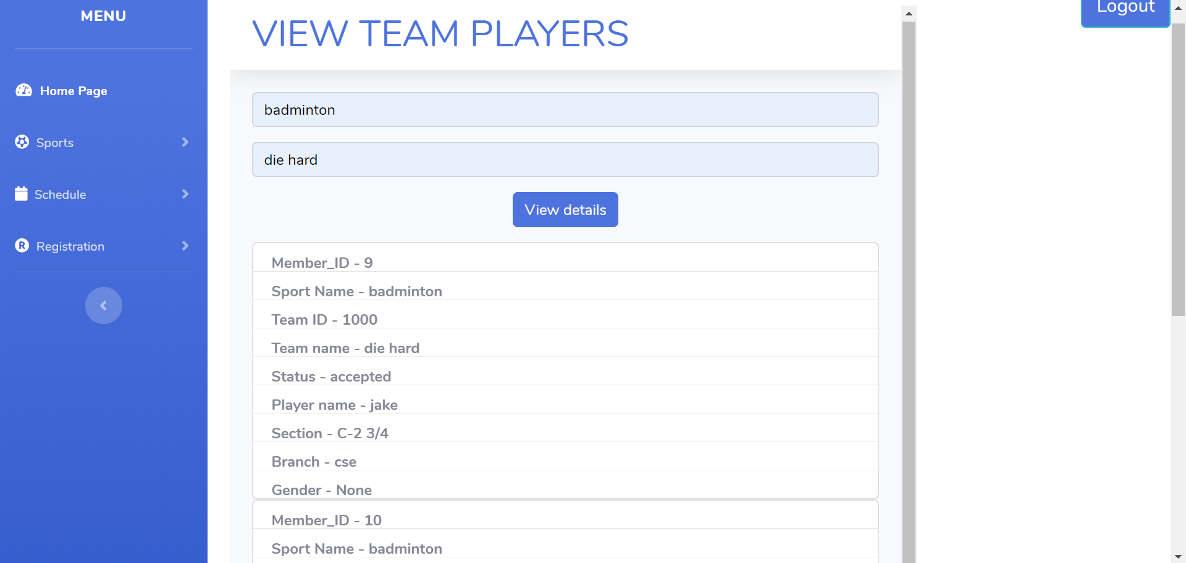
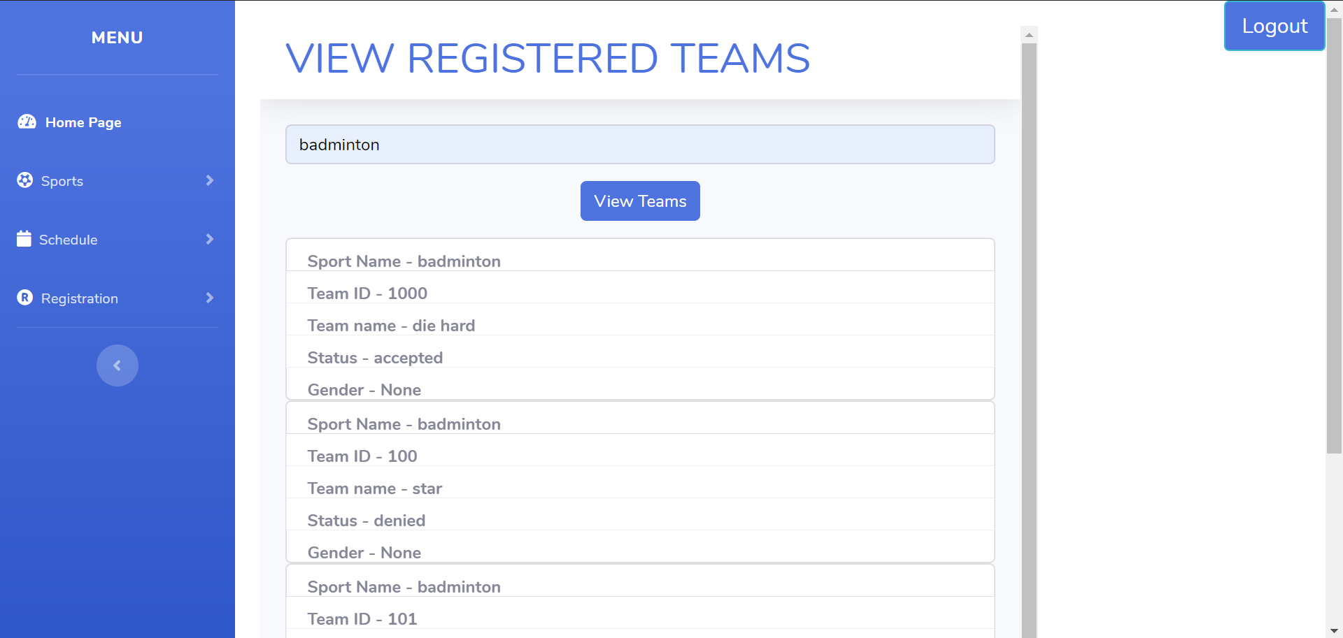

Slide 26
Conclusion & Future scope
To conclude we have successfully created an android application where user can receive data regarding sports events, captains can register and manage team and a web application where the admin manage sports details, match schedules and registration to digitalize the whole process of registration and enquiry of Shruthi Sports. Using this application user, captains and also admins can effectively manage the events without wasting hours of time waiting and going from one end of college to another, they can manage everything through devices in their hands.
As applying for sports manually, every year, is a tedious task, this project helps the students as well as the faculty to handle the registrations smoothly. The application which is made for the students is very useful and handy as all we need is a smart phone and good internet connection .

Slide 27
THANK YOU !

