Slide 1
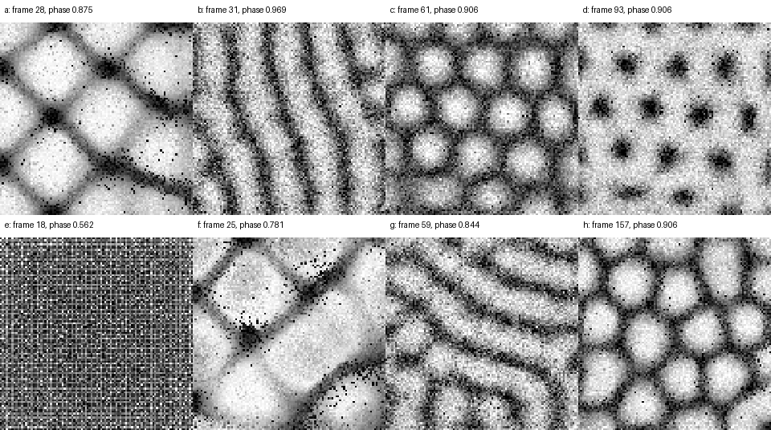
AI × PHYSICS
Can an AI agent
rediscover a granular
simulation?
A controlled benchmark for algorithmic reconstruction, not image imitation.
Chris Bizon · first draft
Notes:
Open with the central question. This is not primarily a benchmark of whether a model can make a plausible picture. It is a benchmark of whether an agent can independently reconstruct the physical simulation that produced those pictures.
[Sources]
- Local benchmark reference rendering: artifacts/reference/generated and harness/scripts/render_reference_snapshots.py
[/Sources]

Slide 2
I wanted to try Fable
on a biology problem.
That was the obvious experiment.
It would not do the biology.
02
Notes:
This is the personal starting point: the original goal was simply to see how Fable behaved on a scientific problem. When biology was off the table, the question became what other experiment would still expose real scientific reasoning.

Slide 3
THE PIVOT
That forced a better experiment.
Choose a problem where both the result and the method are inspectable.
01
02
03
Known science
Visible target
Inspectable algorithm
A problem I understand well enough to recognize shortcuts and mistakes.
A paper with unmistakable patterns that make qualitative failure obvious.
A correct implementation whose scheduling, collision law, and numerical pathologies can be audited.
03
Notes:
The failure to start with biology was useful. It pushed the experiment toward a domain where a visually impressive answer could be separated from a physically and algorithmically correct answer.

Slide 4
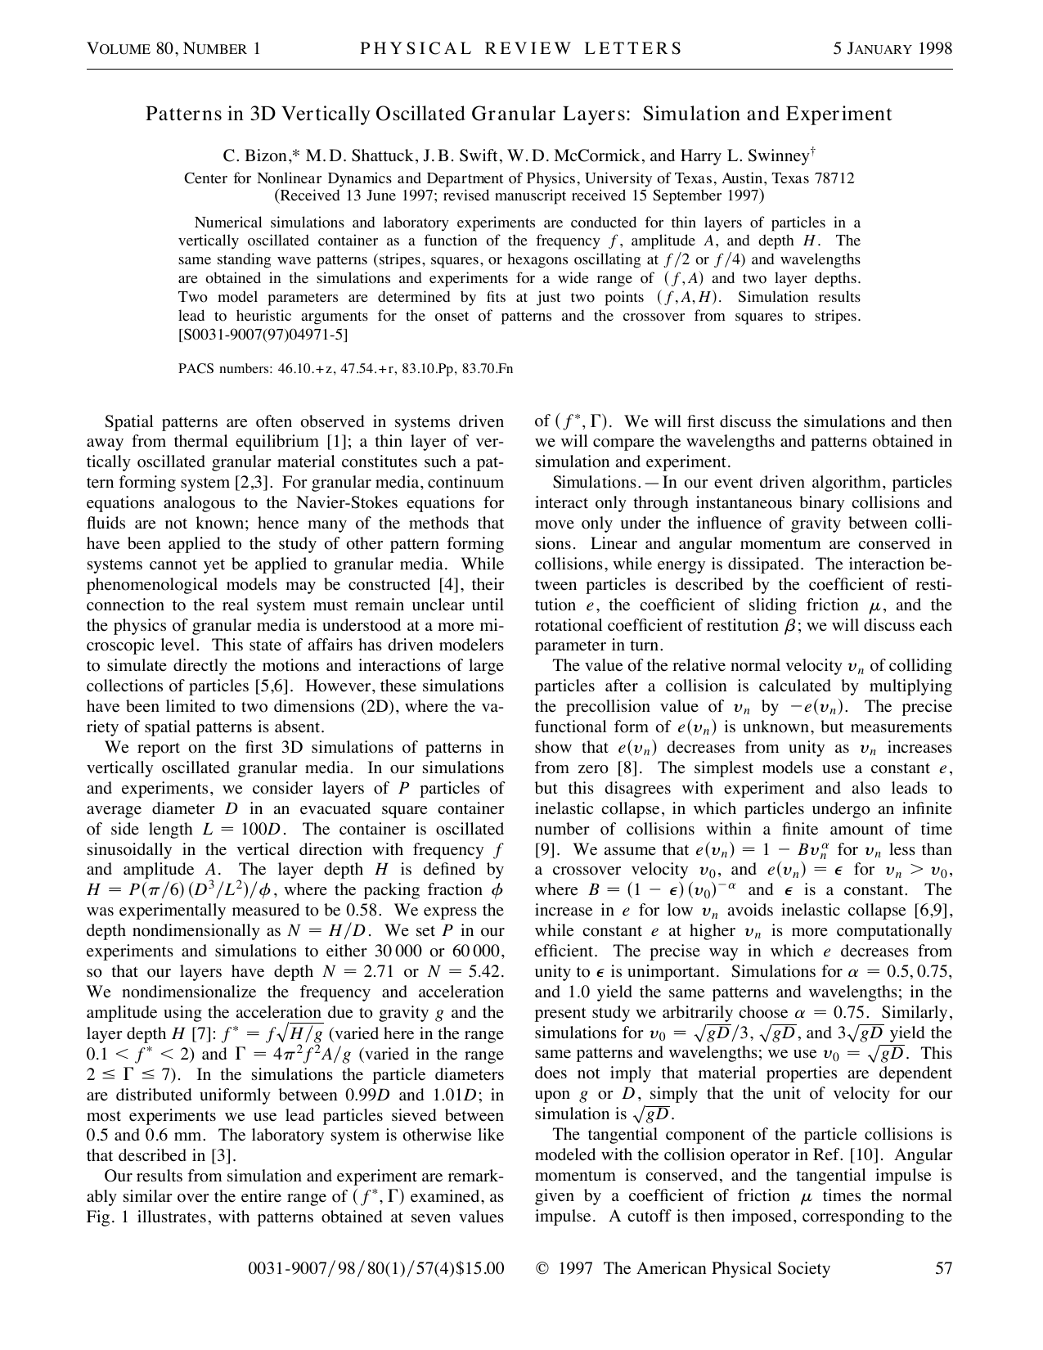
THE PAPER
The target was a 1998 granular-physics result.
Patterns in 3D Vertically Oscillated Granular Layers
Simulation and experiment
Bizon et al. · Physical Review Letters · 1998
A thin granular layer, shaken vertically, spontaneously forms squares, stripes, and hexagons.
04
Notes:
The challenge is anchored to a compact paper with a memorable Figure 1 and a very specific computational method. The images are accessible, but reproducing them honestly requires understanding the collision model and event scheduler.
[Sources]
- challenge/sources/bizon1998a.pdf
[/Sources]

Slide 5
THE PHYSICS
A thin layer of hard spheres sits in a vibrating box.
gravity
The reference simulation
stationary
sidewalls
60,000 hard spheres
Gravity between collisions
sinusoidal
vertical drive
Instantaneous binary impacts
Moving bottom plate
Hard, non-periodic sidewalls
100 particle diameters
The forcing injects energy. Inelastic collisions remove it.
05
Notes:
The setup is deliberately simple: hard spheres in a square container under gravity, with a vertically oscillating bottom and fixed sidewalls. Complexity emerges from repeated dissipative collisions.
[Sources]
- challenge/sources/bizon1998a.pdf
- artifacts/reference/generated/manifest.json
[/Sources]

Slide 6
COLLISION PHYSICS
Elastic and inelastic collisions differ in what they preserve.
Elastic
e = 1
Inelastic
0 < e < 1
before
after
before
after
Relative normal speed is preserved. Kinetic energy is not lost in the impact.
The particles separate more slowly than they approached. Mechanical energy becomes heat, deformation, and sound.
06
Notes:
The coefficient of restitution e is the ratio of separation speed to approach speed along the collision normal. With e below one, every impact dissipates energy. That dissipation is what makes granular matter qualitatively different from an ideal gas of billiard balls.
[Sources]
- challenge/sources/bizon1998a.pdf
- challenge/sources/walton-1993-chapter-25.pdf
[/Sources]

Slide 7
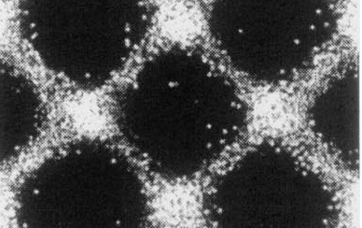
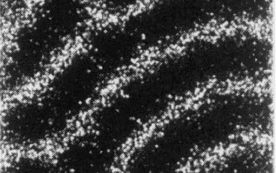
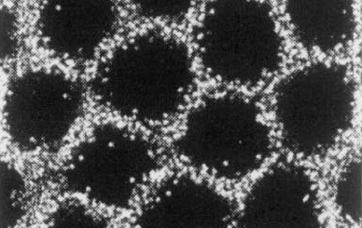
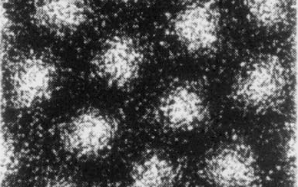
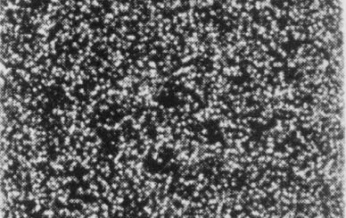
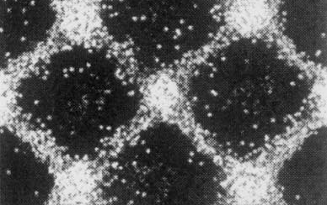
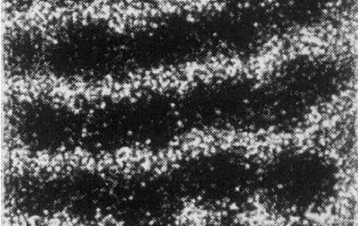
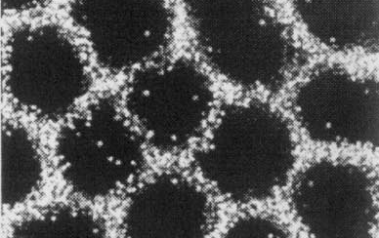
THE TARGET
The layer organizes into standing-wave patterns.
a squares · f/2
b stripes · f/2
c hexagons · phase 1
d hexagons · phase 2
e flat · f/2
f squares · f/4
g stripes · f/4
h hexagons · f/4
The geometry changes with forcing frequency and acceleration; the pattern can also repeat every two or four drive cycles.
07
Notes:
Figure 1 gives a compact visual target: squares, stripes, alternating hexagons, and a flat state across f/2 and f/4 responses. The benchmark uses all seven simulation cases behind these eight image panels.
[Sources]
- challenge/sources/bizon1998a.pdf
- output/presentations/granular-benchmark-story/assets/figure1-manifest.json
[/Sources]

Slide 8
08
Notes:
This animation is generated directly from the benchmark's stored trajectories from the updated C code. Every panel is sampled at the same forcing phase. In presentation mode the GIF should animate; the included sidecar GIF can also be used independently.
[Sources]
- artifacts/reference/generated/*/trajectory.npz
- harness/balls_bench/metrics.py
[/Sources]

Slide 9
WHY EVENT-DRIVEN?
Collisions are extremely brief compared with free flight.
physical time
ballistic motion under gravity
ballistic motion under gravity
ballistic motion under gravity
collision
collision
collision
collision
Do not march through every tiny time step. Jump directly from one collision event to the next.
09
Notes:
Hard-sphere impacts are modeled as instantaneous, while particles spend most of their time in analytically predictable free flight. An event-driven algorithm exploits that separation by jumping to the next collision rather than resolving empty time.
[Sources]
- challenge/sources/bizon1998a.pdf
- challenge/sources/lubachevsky-1991-billiards.pdf
[/Sources]

Slide 10
EVENT-DRIVEN HARD SPHERES
The simulation advances by processing a collision schedule.
1
2
3
4
Predict
Jump
Resolve
Reschedule
Find the next particle-particle, particle-wall, or particle-plate collision.
Advance the simulation clock directly to that event.
Apply the collision law to velocity and spin.
Recompute only events invalidated by the collision.
Priority queue ordered by event time
10
Notes:
The core loop is a priority queue of predicted events. A correct implementation must preserve event ordering, invalidate stale predictions, handle the moving plate, and update translational and rotational velocities according to the collision model.
[Sources]
- challenge/sources/bizon1998a.pdf
- challenge/sources/rapaport-1980-event-scheduling.html
[/Sources]

Slide 11
THE ORIGINAL ALGORITHM
Two implementation ideas keep 60,000 particles tractable.
Delayed states
Virtual cells
Update a particle's position only when an event actually needs it.
Search nearby spatial cells instead of testing every possible particle pair.
Only the colliding pair is brought to the current time.
Candidate neighbors are local.
11
Notes:
Delayed states avoid globally advancing every particle after every event. Virtual cells avoid all-pairs collision searches. These are not optional implementation decorations; they are central tests of whether an event-driven solution is genuinely scalable.
[Sources]
- challenge/sources/bizon1998a.pdf
- challenge/sources/lubachevsky-1991-billiards.pdf
- harness/qualitative/RUBRIC.md
[/Sources]

Slide 12
INELASTIC COLLAPSE
Inelasticity creates a numerical catastrophe.
With a constant restitution coefficient, collision intervals can shrink geometrically.
Δtₙ → 0
Δt₁
Δt₂
Infinitely many collisions occur in finite simulated time.
12
Notes:
This is inelastic collapse: a cluster undergoes an infinite sequence of ever-faster dissipative collisions before the simulation clock can advance beyond a finite time. A naive event queue can effectively freeze in this state.
[Sources]
- challenge/sources/bizon1998a.pdf
- challenge/sources/marin-risso-cordero-1993.pdf
[/Sources]

Slide 13
THE SOLUTION
The paper regularizes collapse with a physical restitution law.
At low impact speed, collisions become nearly elastic.
1
Why it works
Dissipation remains at ordinary collision speeds.
restitution e
Near-zero-speed impacts stop draining energy geometrically.
high-speed value
The event clock can continue to advance.
This is a model of material behavior, not an arbitrary timeout.
impact speed |vₙ|
13
Notes:
The paper uses a velocity-dependent coefficient of restitution that approaches one as the normal collision speed approaches zero. The exact low-speed approach is less important than eliminating the geometric dissipation that produces collapse.
[Sources]
- challenge/sources/bizon1998a.pdf
- challenge/sources/marin-risso-cordero-1993.pdf
[/Sources]

Slide 14
FROM DEMO TO BENCHMARK
A single Fable result would be entertaining, not informative.
One run
Controlled comparison
“Fable made something that looks like granular patterns.”
Same paper and prompt
Same tools and compute envelope
Same output contract
Same deterministic evaluator
Interesting anecdote
Same qualitative code review
Evidence about model behavior
14
Notes:
The original impulse was to try Fable. But without other models and effort levels under the same conditions, there would be no basis for calling the result good, bad, or improved.

Slide 15
A SECOND QUESTION
More reasoning effort may help—or produce elaborate wrong turns.
XHIGH / MAX
More time and context.
Also more opportunity to rationalize a bad approach.
HIGH
More exploration.
Potentially better reconstruction.
LOW
Moves quickly.
May miss the algorithm.
This is an empirical question, not a slogan about model quality.
15
Notes:
The campaign also tests a live concern in agent evaluation: the highest effort setting may improve careful implementation, but it may also encourage a model to overthink, improvise, or persist with a sophisticated wrong abstraction.

Slide 16
THE CAMPAIGN
So we threw the kitchen sink at one consistent challenge.
CODEX
CLAUDE
5.6 Sol
low · xhigh
Fable 5
high
5.6 Terra
low · xhigh
Opus 5
low · max
5.6 Luna
low · xhigh
Opus 4.8
low · max
5.5
low · xhigh
Sonnet 5
low · max
5.4
low · xhigh
17 runs · concurrency 2 · identical benchmark contract
16
Notes:
The campaign spans multiple model families and effort levels. The point is not that this is a definitive ranking, but that each result is generated under one explicit and reviewable contract.
[Sources]
- campaigns/model-sweep.json
[/Sources]

Slide 17
EXPERIMENTAL CONTROL
Rule 1: every run starts newborn.
Run N − 1
Run N
NO
CARRY-
OVER
The agent receives:
code
transcript
results
lessons
The challenge prompt
The specified paper and references
The allowed runtime tools
A clean workspace
No previous code, transcript, result, or agent memory.
17
Notes:
Each run must be independent. The agent container receives only the challenge inputs. It does not receive earlier submissions, model transcripts, local user configuration, or benchmark memory that could contaminate comparisons.
[Sources]
- challenge/prompt.md
- harness/kubernetes/sterling/README.md
[/Sources]

Slide 18
NO CHEATING
Rule 2: the agent cannot look up an implementation.
An earlier interactive run quietly found the old C code on GitHub and used it.
The controlled version
A reproduction can look excellent
and still answer the wrong question.
No repository search
No GitHub source access
No hidden reference implementation
Network policy enforced
The paper is evidence. Existing code is leakage.
18
Notes:
This constraint comes from an actual failure mode. In a prior interactive attempt, the agent found an old implementation and used it without foregrounding that choice. That may reproduce the figure, but it does not test reconstruction from the paper.
[Sources]
- challenge/prompt.md
- User-reported observation from an earlier interactive run
[/Sources]

Slide 19
ISOLATED EXECUTION
Kubernetes turns those rules into infrastructure.
Orchestrator
Durable Job
Agent init
Evaluator
Artifacts
launch
recover
collect
timeouts
watchdog
status
paper
prompt
tools
reference
metrics
report
manifest
plots
review
Persistent volume: code, outputs, transcript, evaluator products
The untrusted agent never sees the trusted reference.
19
Notes:
The orchestration layer launches durable Kubernetes Jobs with a persistent volume. The agent runs first in an isolated init container. Only after it exits does the trusted evaluator mount the reference artifacts and produce comparisons.
[Sources]
- README.md
- harness/kubernetes/sterling/README.md
- harness/balls_bench/kubernetes.py
[/Sources]

Slide 20
THE EXPERIMENTAL LOOP
The harness separates generation from judgment.
1
2
3
4
Agent builds
Harness checks
Evaluator compares
Reviewer judges
Reads the paper, writes code, runs simulations, and submits trajectories plus a manifest.
Validates schemas, files, units, phases, shapes, and execution records deterministically.
Computes reference-relative metrics and renders plots, images, and time series.
A qualitative agent classifies the method and audits code, tests, and transcript decisions.
The agent is not allowed to grade itself.
20
Notes:
The executing agent's job is to produce code and simulation outputs. The harness, not the agent, decides how those outputs compare with the reference. The resulting report preserves deterministic evidence and a separate qualitative review.
[Sources]
- README.md
- challenge/prompt.md
- harness/balls_bench/evaluator.py
- harness/balls_bench/viewer.py
[/Sources]

Slide 21
QUANTITATIVE EVIDENCE
The deterministic evaluator asks whether the outputs behave alike.
PATTERN
TIMING
DYNAMICS
CONTACT
contrast
wavelength
Q₂ · Q₄ · Q₆
phase alignment
f/2 vs f/4
temporal correlation
COM height
velocity
spin · energy
collision rate
precision-
qualified overlaps
Reference and submission are processed by the same metric code.
21
Notes:
The quantitative layer compares patterns, phase behavior, bulk dynamics, velocities and spins, collision rates, and physically meaningful overlaps. It also renders the images and time-series comparisons that make unexpected behavior inspectable.
[Sources]
- harness/METRICS.md
- harness/balls_bench/metrics.py
- harness/balls_bench/evaluator.py
[/Sources]

Slide 22
CODE AND TRANSCRIPT REVIEW
The qualitative evaluator asks what the agent actually built.
First: classify the simulation
Then: audit the implementation and process
Event-driven hard-sphere MD
Event mechanics
queue, invalidation, free flight, moving plate
Time-stepped hard-sphere MD
Scalability
delayed states, virtual cells, local rescheduling
Soft-sphere time-stepped MD
Dense behavior
collapse regularization, overlap handling
Wave equation / image-fit model
Tests
collision response, prediction, sequencing, boundaries
Something else
Transcript
major decisions, waiting time, retries, subscription stalls
The rest of the rubric is gated by that answer.
22
Notes:
Classification comes first because later questions depend on the model type. An image-fitting wave model should not receive credit for event queue correctness, and an event-driven implementation must be examined for delayed states, virtual cells, collision sequencing, and collapse regularization.
[Sources]
- harness/qualitative/RUBRIC.md
- harness/qualitative/README.md
[/Sources]

Slide 23
The benchmark asks two different questions.
1
2
Did it reproduce
the patterns?
Did it build
the right physics?
The interesting results are where those answers disagree.
23
Notes:
Close on the benchmark's core distinction. A model may make plausible patterns with the wrong algorithm, or implement the correct algorithm but fail to reach the target state. Both are scientifically meaningful outcomes, and the harness is designed to preserve the evidence needed to tell them apart.

