Slide 1

Monocromatic into RGB image using Deep Learning
ALVA’S INSTITUTE OF ENGINEERING
AND
TECHNOLOGY
DEPARTMENT OF COMPUTER SCIENCE ADN ENGINEERING
Anooj Raj | 4AL19CS011
Ashik H R | 4AL19CS013
Chetan M Wali | 4AL19CS024
Chinmaya Bhat K K | 4AL19CS025
Under guidence of Mr.Vasudev S Shahapur

Slide 2
ABSTRACT
Image colorization is the process of assigning colors to a grayscale image to make it more aesthetically appealing and perceptually meaningful.
There are two main approaches for image colorization:
One that requires user to assign colors to some regions and extends such information to the whole image.
Another one that tries to learn the color of each pixel from a color image with similar content.
We extract the information about color from an image and transfer it to another image.
A CNN consists of multiple layers of small computational units that only process portions of the input image in a feed-forward fashion.

Slide 3
PROBLEM STATEMENT
Traditional way of image colorization was done manually, by using variety of image editing software and was very time consuming and expensive.Saving human time to process large amount of image data is inevitable.

Slide 4
Objective of the Project
To colorize the image using machine without intervention of manual colorization.
To implement deep learning techniques to achive accurate result.
Use web UI for input and output operation.
Make web UI free of cost for all.

Slide 5
Scope of the Project
All the web pages today charge money for image colorization.
The need of image colorization is very important for upcoming generation.
Manual colorization is highly time consuming where as machine colorization can save a lot of time.

Slide 6
Literature Survey
The approach used is that both the content-image and the style-image are passed into a CNN network that will be pre-trained and then the formats of content representation and styled representation will be extracted. [1]
This model also solved issues of image-inconsistency. The system can be made to learn to produce pictures that could be compared with real images [2].
A very simple survey was done at the end to determine the frequency of colorings which were accurate but this approach proved to be too slow and blunt [3].
The deep features obtained from ImageNet were not enough competitive to perform the tasks. The Places dataset was 60 times larger than the SUN database [4].

Slide 7
Proposed System
As part of our project, we aim to provide fairly accurate image colorization using deep leaning and convolution neural network.
This includes taking input from user through web UI and the process the image in server/machine and show the output image in web UI in downloadable format.

Slide 8
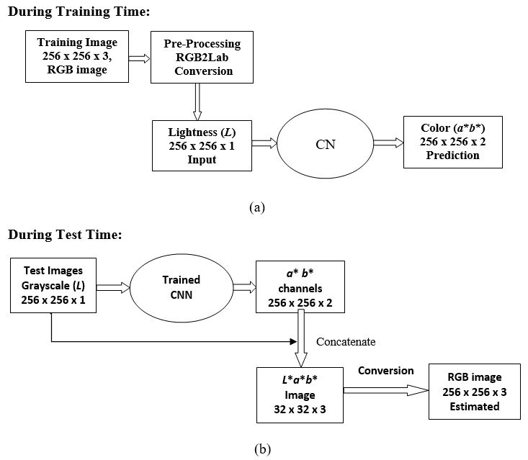
System Design

Slide 9
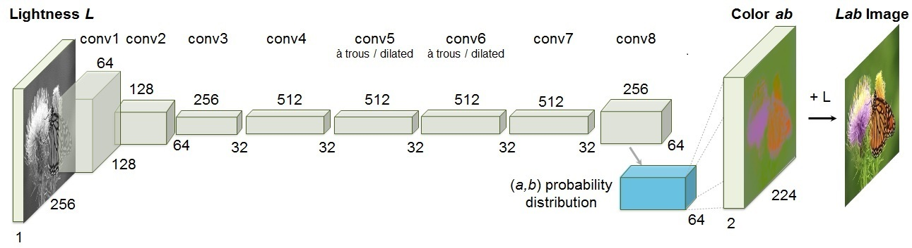
System Design(contd..)

Slide 10
System Requirements Specification
Hardware requirements (minimum):
• Processor: 2.5 gigahertz (GHz) frequency or above.
• RAM: A minimum of 8GB of RAM.
• Hard disk: A minimum of 16 GB of available space.
Software requirements (minimum):
• Chrome/Firefox/Opera or any other web browser to run the website
• Windows/Linux/Mac operating system for using browser application

Slide 11
Methodology and Implementation
Domain: Deep Convoluted Neural Networks (CNN)
A CNN is a kind of network architecture for deep learning algorithms and is specifically for image recognition and tasks that involve the processing of pixel data.
Libraries: Tensorflow
Frontend: Web page UI

Slide 12
Conclusion
This metod can save lot of time and saves human efforts.
Can be implemented for large set of data like automation can be done for huge set of imagesin future.
Furthur application includes colorization of video frame by frame.
If the system specifications are maintained then image colorization can be done in live or dynamically .

Slide 13
References
Federico Baldassare, Diego Gonzalez Morn and Lucas Rodes-Guirao. “Deep Koalarization: Image Colorization using CNNs and Inception-Resnet-v2”. arXiv:1712.03400, 2017.
Tung Nguyen, Kazuki Mori and Ruck Thawonmas, “Image Colorization Using a Deep Convolutional Neural Network”. arXiv:1604.07904, April 2016.
David Futschik, “Colorization of black-and-white images using ImageEditors”,IJCRT January 2018.
Kreahenbuhl, P, Doersch, C, Donahue, J, Darrell, “Data-dependent initializations of convolutional neural networks.” ICOLR (2016).

Slide 14
THANK YOU

