Slide 1

Portal
USGS-CRRP

Slide 2
?
Why?

Slide 3
Today’s scientific computation is too complicated
the gap between data and analysis is broad
data assets become management liabilities
unnecessary computation and data redundancy is common
the research workspace is more fractured than it is unified

Slide 4
An interactive solution is needed
requires no new training
maximizes use of existing standards and libraries
takes advantage of the existing use cases
answers the current administrative questions
doesn’t create new ones
Portal

Slide 5
?
What is Portal?

Slide 6
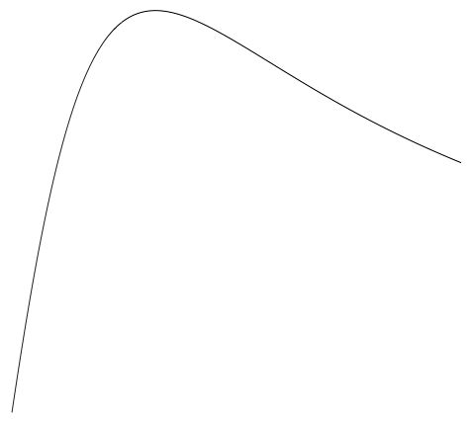
Portal is a simplified:
data visualization and filtration system
entry for local data to a research cloud
minimization of redundancy in data sharing
linkage between data acquisition and analysis

Slide 7




A graphical way to manage:
data sets
computational resources
cloud network topologies
processes
What is Portal?

Slide 8

Networking Protocol
Web GUI
Analysis (future)
Metadata Server
Data IO
Visualization
Database
Import/Export
Graphing UI

Slide 9
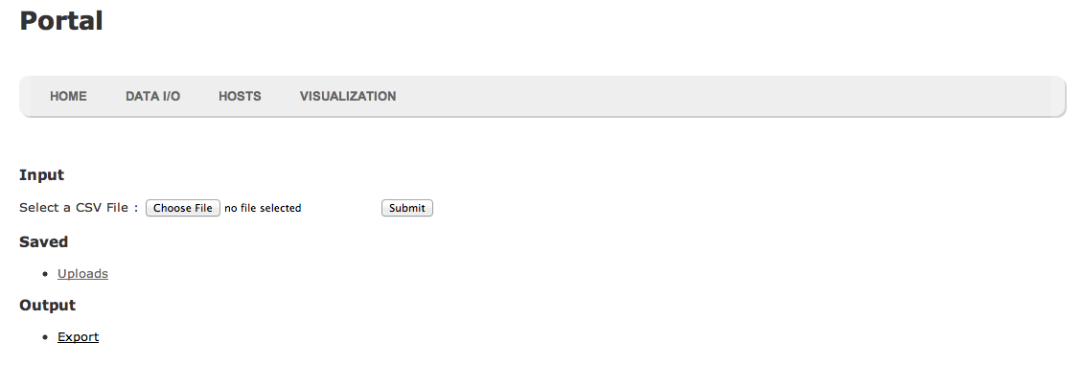
decentralized cloud
seamless data management
communication encouragement
preservation of group autonomy

Slide 10
Completed so far
Import Data
Currently, EcoData supports data that is formatted in well-structured Comma-Separated Values (CSV) format.
A CSV data file is uploaded via the web interface (pictured above) and stored in the database.
Manipulate Data
Currently all data must be manipulated before being imported into EcoData. This limitation will be overcome as the database backend is finalized.
Visualize Data
A visualization framework has been put in place and is nearly ready to accept user data. Once the database structure is finalized, data will be graphed as seen in “Visualizations in the Web Browser.”

Slide 11
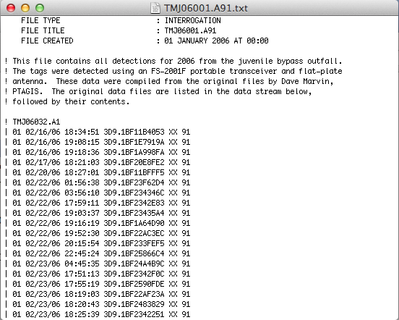
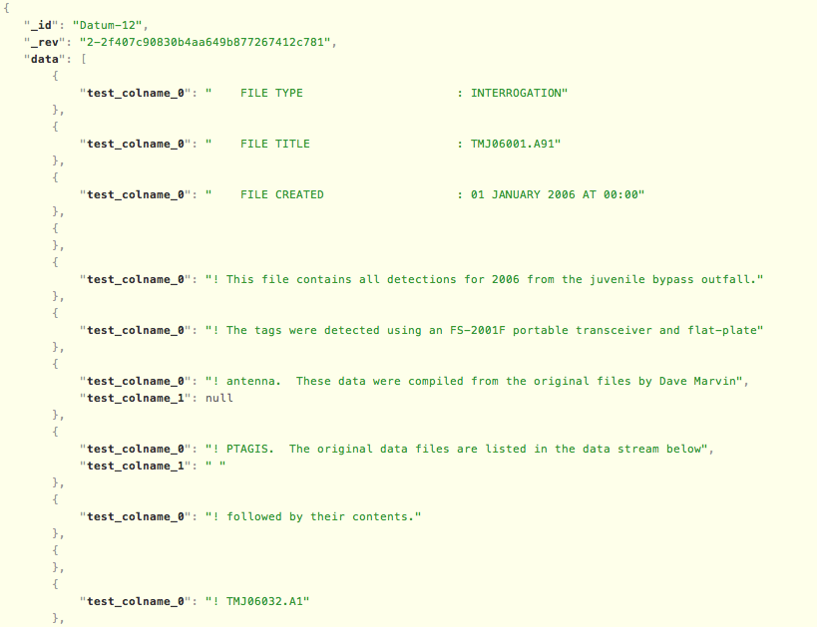
Data IO, Search, Filter
data to the cloud and back

Slide 12
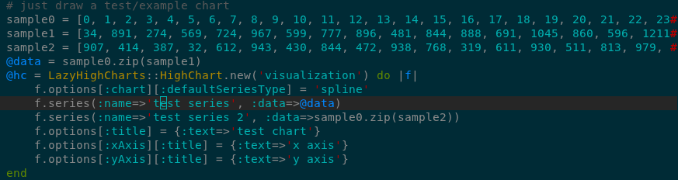
Sample data

Slide 13
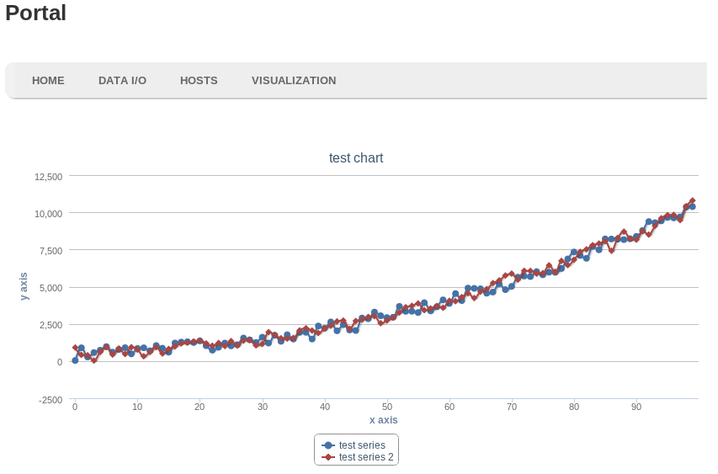
Sample graph

Slide 14
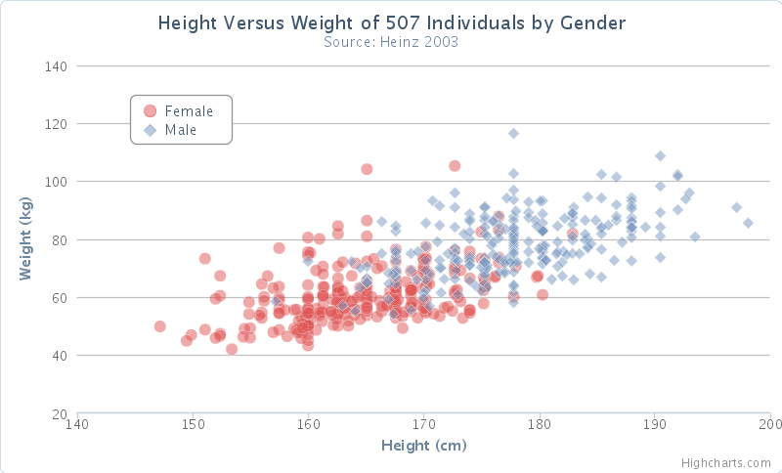
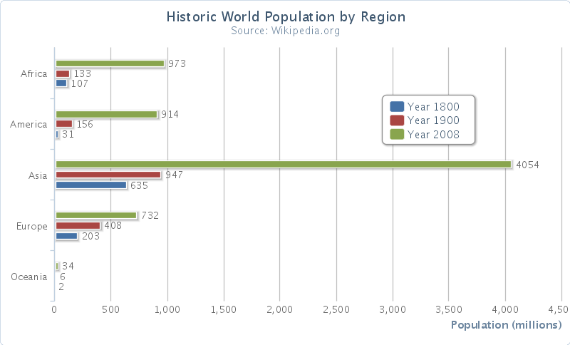
Sample graphs

Slide 15
Alex Fremier, Associate Professor at the University of
Idaho College of Natural Resources
PTAG Data
Hydrological Data
US Fish and Game, Methow River
Customers

Slide 16
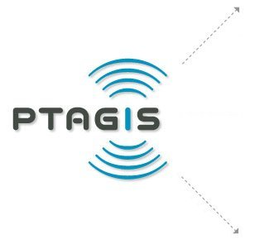



Who else?

Slide 17
Trial and error
coupling design too closely to the data
tool dependencies
coupling data too closely to the tools
tool module coupling

Slide 18
Long term goals
While the simplest use of EcoData is a simple process involving importing and storage of data followed by manipulations and visualizations, each stage of the process can and will be elaborated upon.
• Import data
o Support other data types
• Manipulate Data
o Filtering
o Joins between tables of data
• Visualize data
o Add more types of visualizations
Other objectives include:
• Authentication and security for data
• Availability of data between servers
• Cross-server data availability
o Fast transfers of data between remote servers

Slide 19
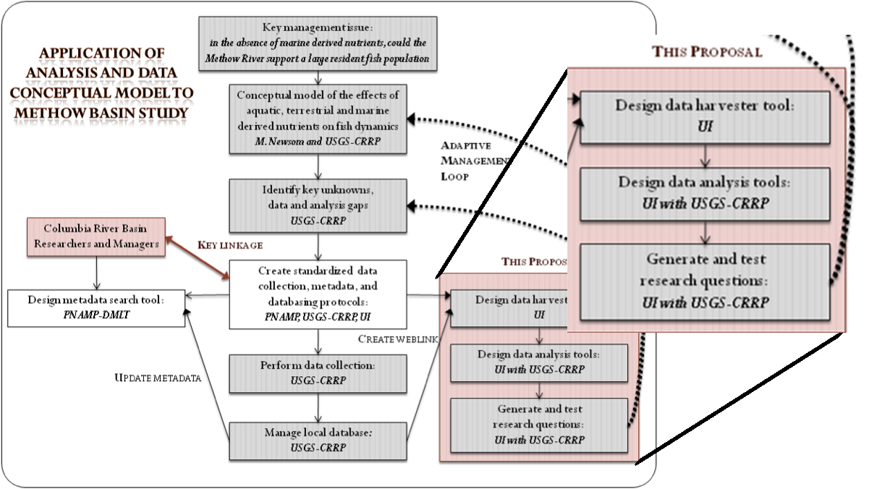
Future of Portal
Portal is the first piece in a larger data management and analysis system.
It provides the tools necessary to convert and store data in a structured format and to produce basic visualizations of that data.
Eventually, it will be used as one piece in a more complex data analysis pipeline, allowing for more sophisticated data manipulations and visualizations.

