Slide 1

HATCH
Overview

Slide 2
OVERVIEW
Hatch is a cloud based solution for storing, sharing, and searching data.
Locating data close to computational and storage resources leads to better utilization, and less requirements on researchers.
Tools enable and encourage reduction of data redundancy.
Sharing and searching eliminates cumbersome data collections, and improves research.

Slide 3

DATA STORAGE
Local data is uploaded to Hatch’s cloud storage.
Hatch filters different kinds of data into one storage type.
Different kinds of data are now equally searchable, mergable, and sharable.
Data still must meet their original structure and scheme requirements.

Slide 4


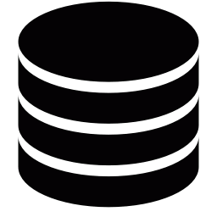

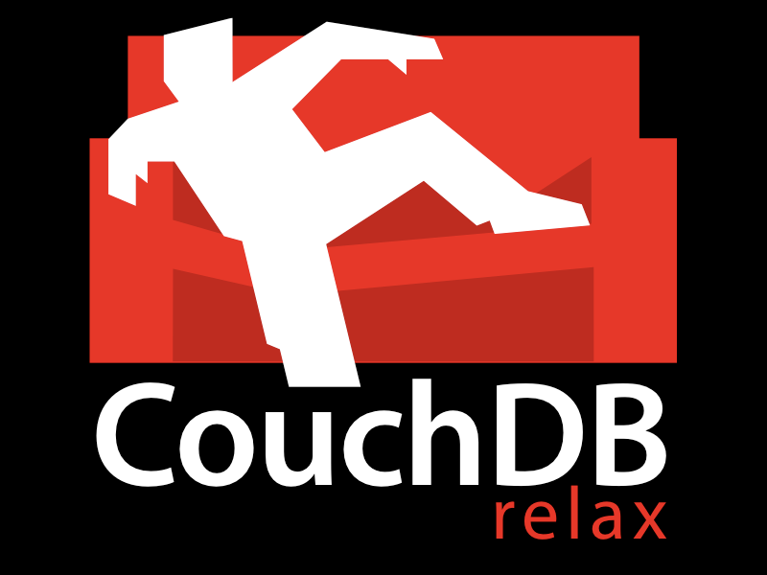

Schemeless database for storing documents
Schemed database for forcing Hatch relationshiships
Search engine for fast document indexing

Slide 7
HATCH HYBRID DATABASE
Schemed
Hatch data is schemed when its needed.
Enforcing relationships is central to Hatch’s design.
Data relationships that are know up front are kept in the schemed layer.

Slide 8
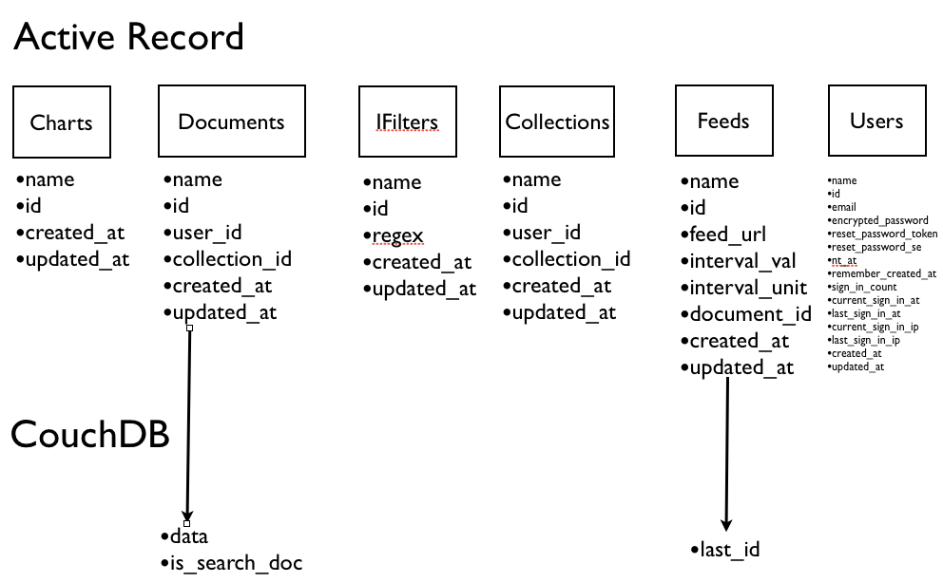
HATCH SCHEME
Postgresql

Slide 9
HATCH HYBRID DATABASE
Unschemed
Data relationships that are not know up front are kept in the unschemed layer.
Hatch Project owners define data schemes on the Hatch API.
Users then eventually converge their data to different project schemes.
Project data is highly available to other members, instead of being only available once perfected.
Projects can enforce not only data schemes, but data quality.

Slide 10
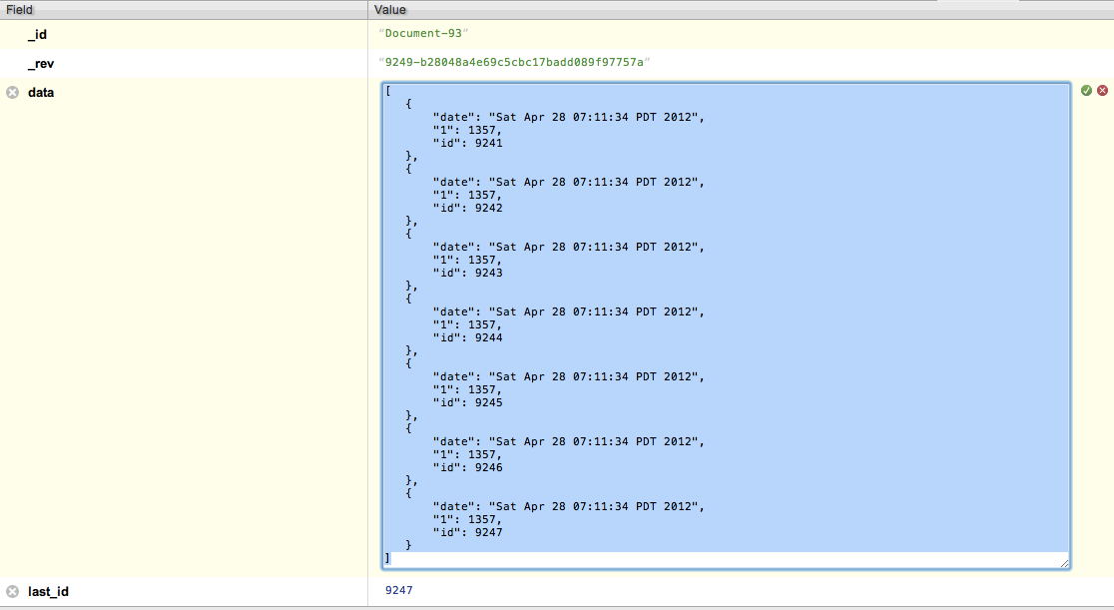
HATCH SCHEMELESS
CouchDB

Slide 11
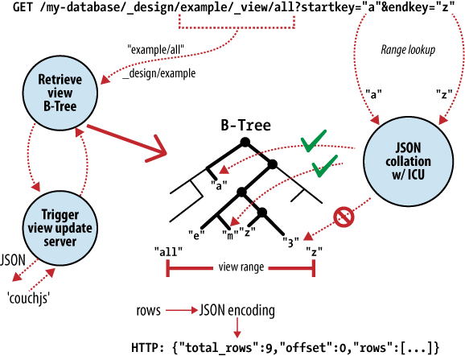
HATCH SCHEMELESS
CouchDB

Slide 12
HATCH SEARCH
Elasticsearch
The Hatch search engine automatically indexes incremental changes in the database.
The Lucene query syntax is familiar to existing tools (i.e. Google).
Search also finds relationships between data, some of which the user may not know about.
Search can merge different document types together if the core data is related.

Slide 13
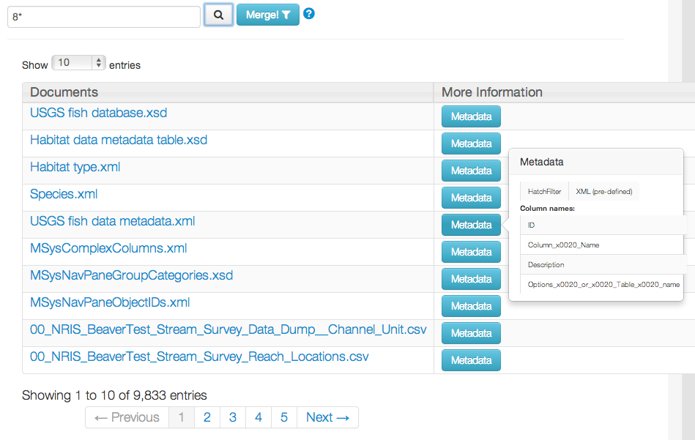
HATCH SEARCH
Elasticsearch

Slide 14
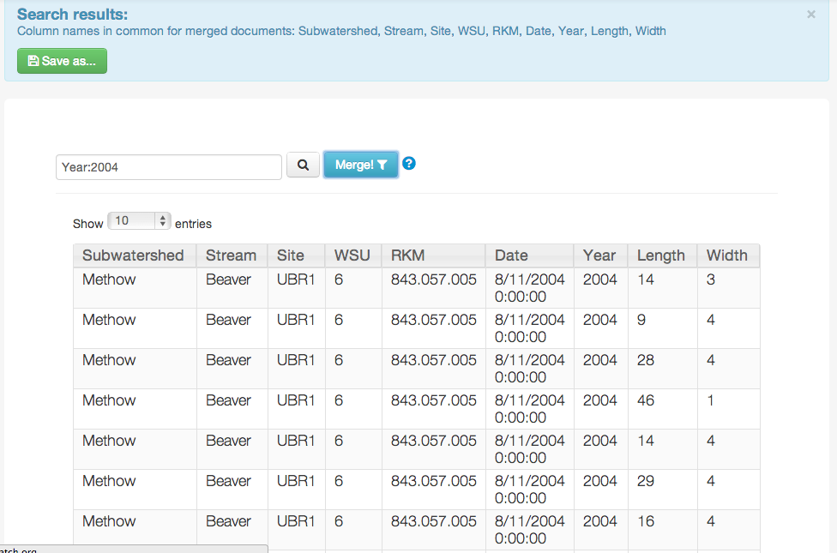
HATCH SEARCH
Elasticsearch - Merging

