Slide 1

Portal
USGS-CRRP

Slide 2
?
Why?

Slide 3
Today’s scientific computation is too complicated
the gap between data and analysis is broad
data assets become management liabilities
unnecessary computation and data redundancy is common
the research workspace is more fractured than it is unified
Portal

Slide 4
An interactive solution is needed
requires no new training
maximizes use of existing standards and libraries
takes advantage of the existing use cases
answers the current administrative questions
doesn’t create new ones
Portal

Slide 5
?
What is Portal?

Slide 6
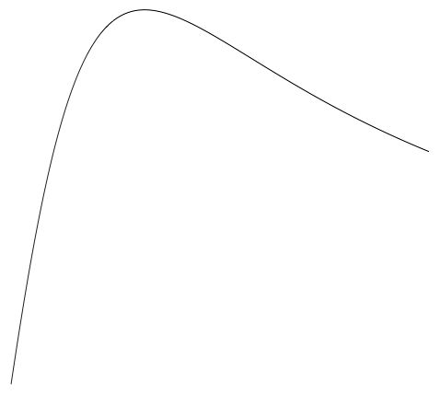
Portal is a simplified:
data visualization and filtration system
entry for local data to a research cloud
minimization of redundancy in data sharing
linkage between data acquisition and analysis
What is Portal?

Slide 7

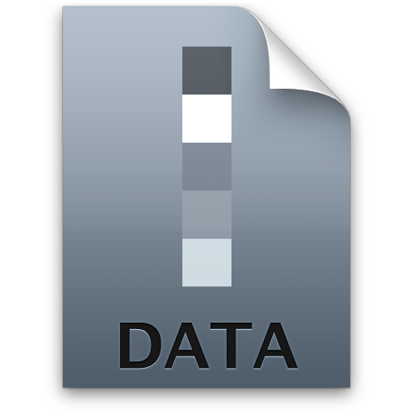


A graphical way to manage:
data sets
computational resources
cloud network topologies
processes
What is Portal?

Slide 8

Networking Protocol
Web GUI
Analysis (future)
Metadata Server
Data IO
Visualization
Database
Import/Export
Graphing UI

Slide 9
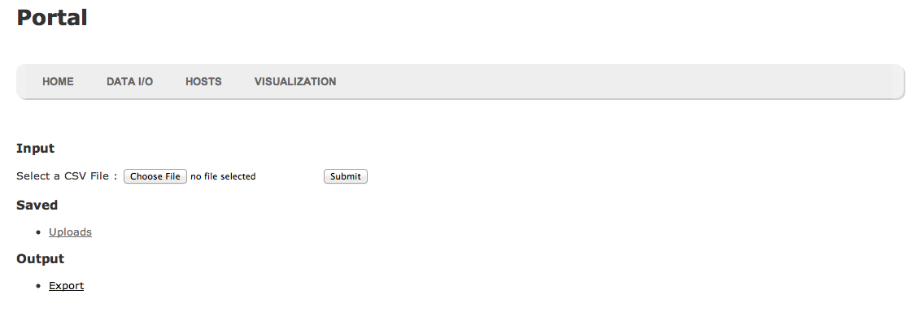
decentralized cloud
seamless data management
communication encouragement
preservation of group autonomy

Slide 10
Alex Fremier, Associate Professor at the University of
Idaho College of Natural Resources
PTAG Data
Hydrological Data
US Fish and Game, Methow River
Who will use it?

Slide 11
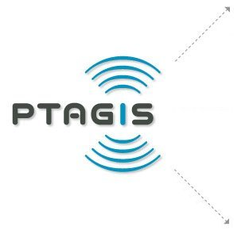



Who else?

Slide 12
Trial and error
coupling design too closely to the data
tool dependencies
coupling data too closely to the tools
tool module coupling

