Slide 1
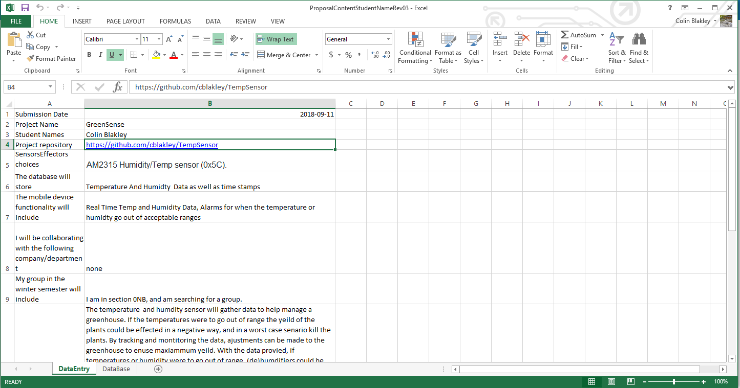
https://github.com/cblakley/TempSensor/blob/master/Documentation/ProposalContentStudentNameRev03.xlsx

Slide 2
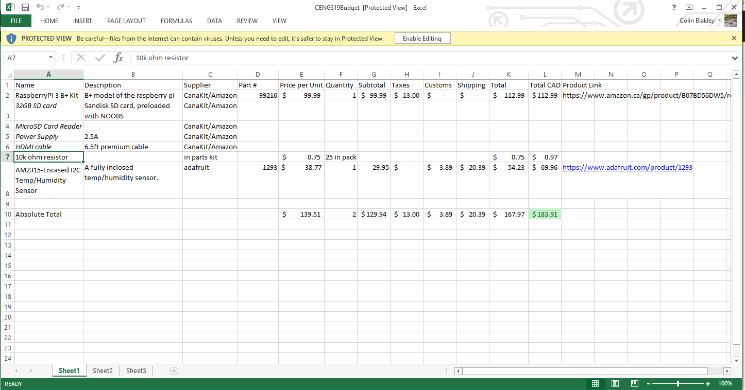
https://github.com/cblakley/TempSensor/blob/master/Documentation/CENG319Budget.xlsx

Slide 3
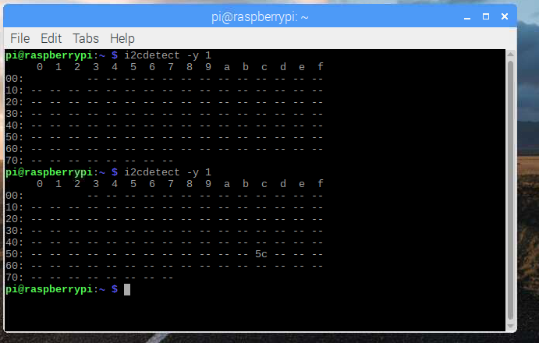
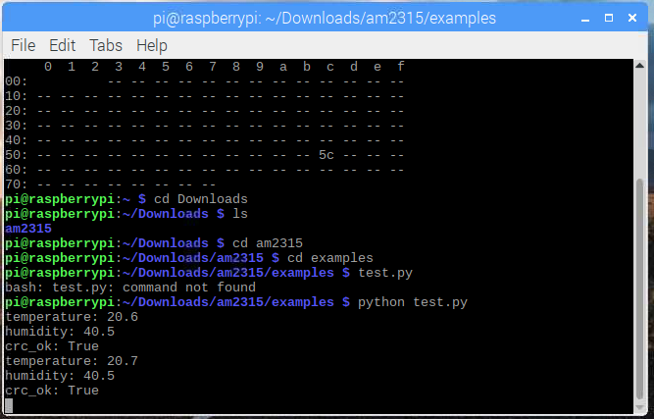
Images of I2C address and sensor data output.

Slide 4
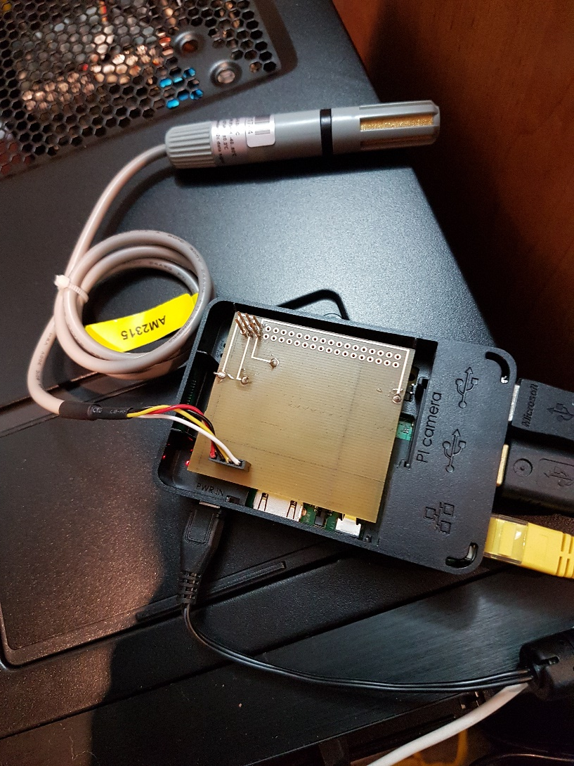
Images of Device

