Slide 2
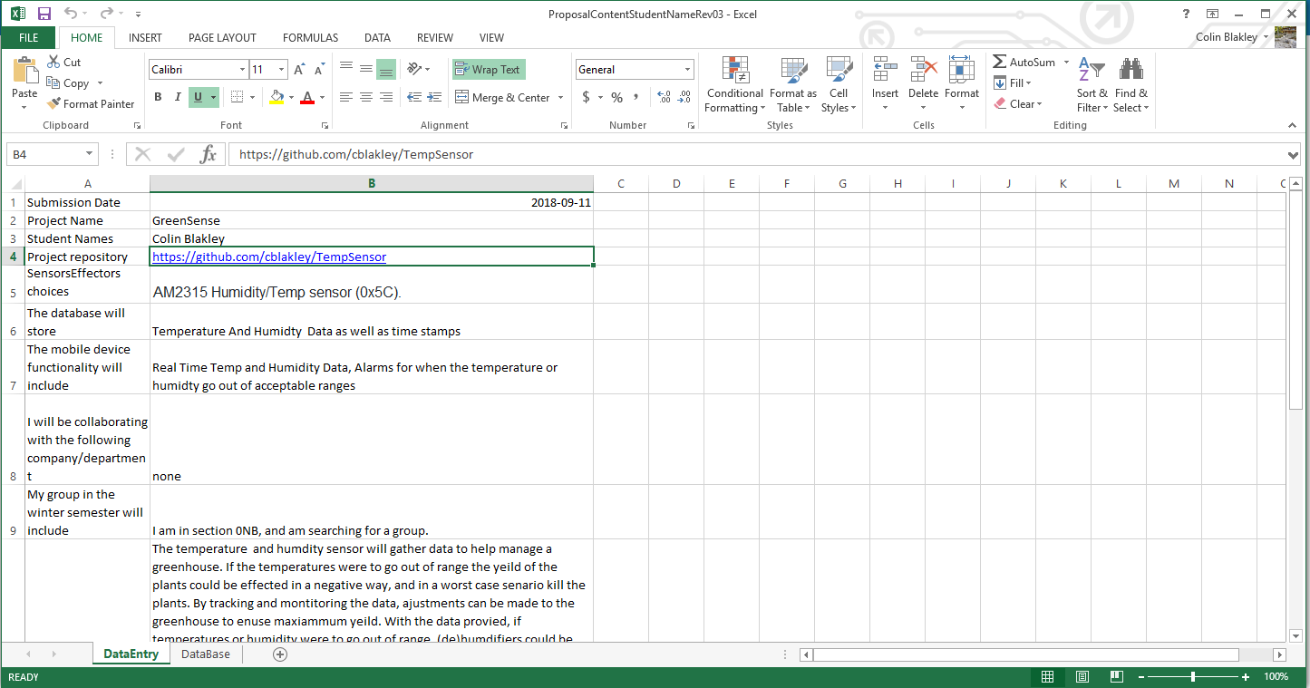
https://github.com/cblakley/TempSensor/blob/master/Documentation/ProposalContentStudentNameRev03.xlsx

Slide 3
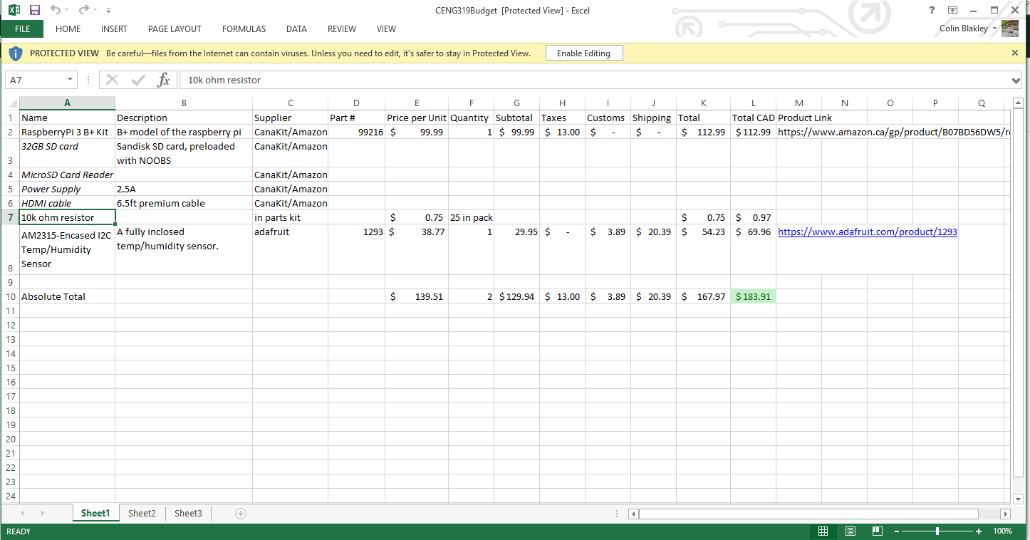
https://github.com/cblakley/TempSensor/blob/master/Documentation/CENG319Budget.xlsx

Slide 4
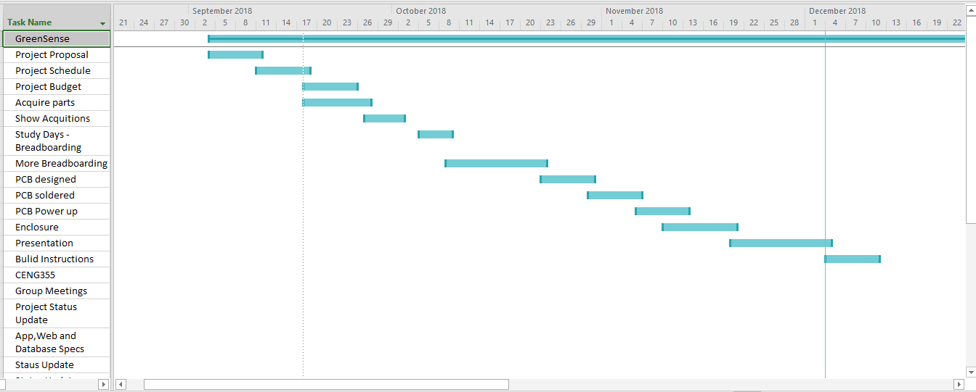
https://github.com/cblakley/TempSensor/blob/master/Documentation/ProjectSchedule.mpp

Slide 5
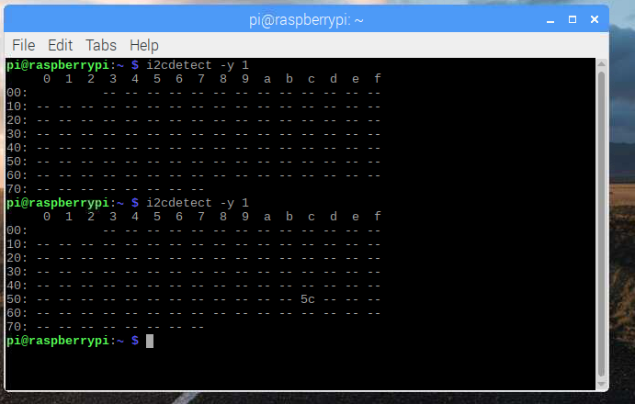
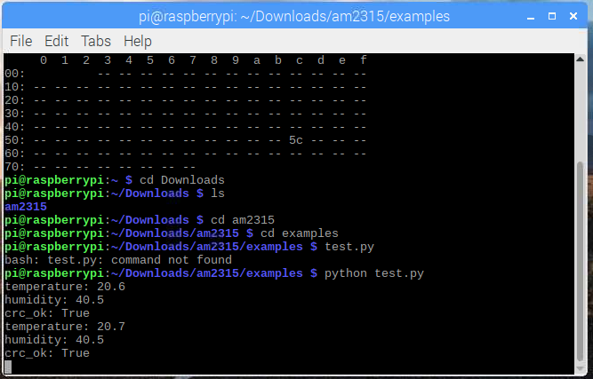
Images of I2C address and sensor data output.

Slide 6
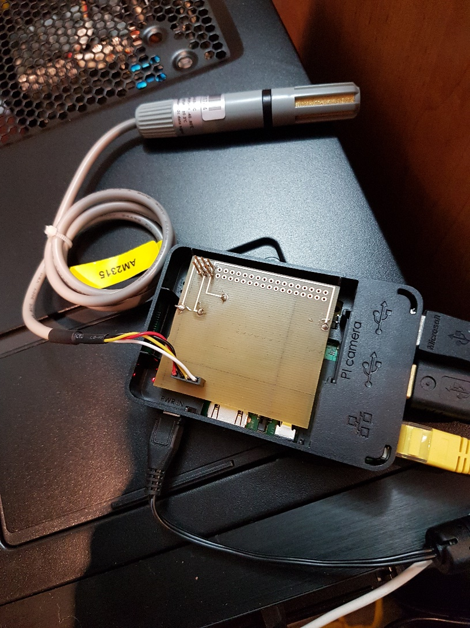
Images of Device

Slide 7
Previous Courses
TECH101
TECH153

