Slide 1
Video Games Sales data analysis Presentation
By Baoshan Li, Christian Blankenback,
Abdoul Kadir Ali, Stefan Vlajich, Dhary Salih

Slide 2

Overview
We assume that we're going to help our (video game) company set a year direction plan at the end of 2015. And we get the data from
https://www.kaggle.com/datasets/gregorut/videogamesales

Slide 3
Data description
Rank - Ranking of overall sales
Name - The games name
Platform - Platform of the games release (i.e. PC,PS4, etc.)
Year - Year of the game's release
Genre - Genre of the game
Publisher - Publisher of the game
NA_Sales - Sales in North America (in millions)
EU_Sales - Sales in Europe (in millions)
JP_Sales - Sales in Japan (in millions)
Other_Sales - Sales in the rest of the world (in millions)
Global_Sales - Total worldwide sales

Slide 4
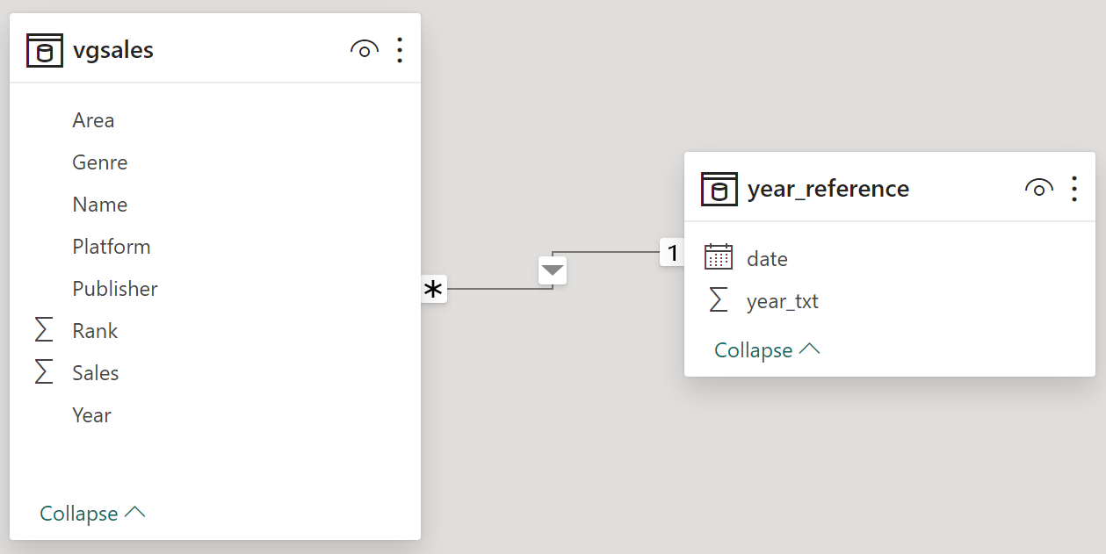
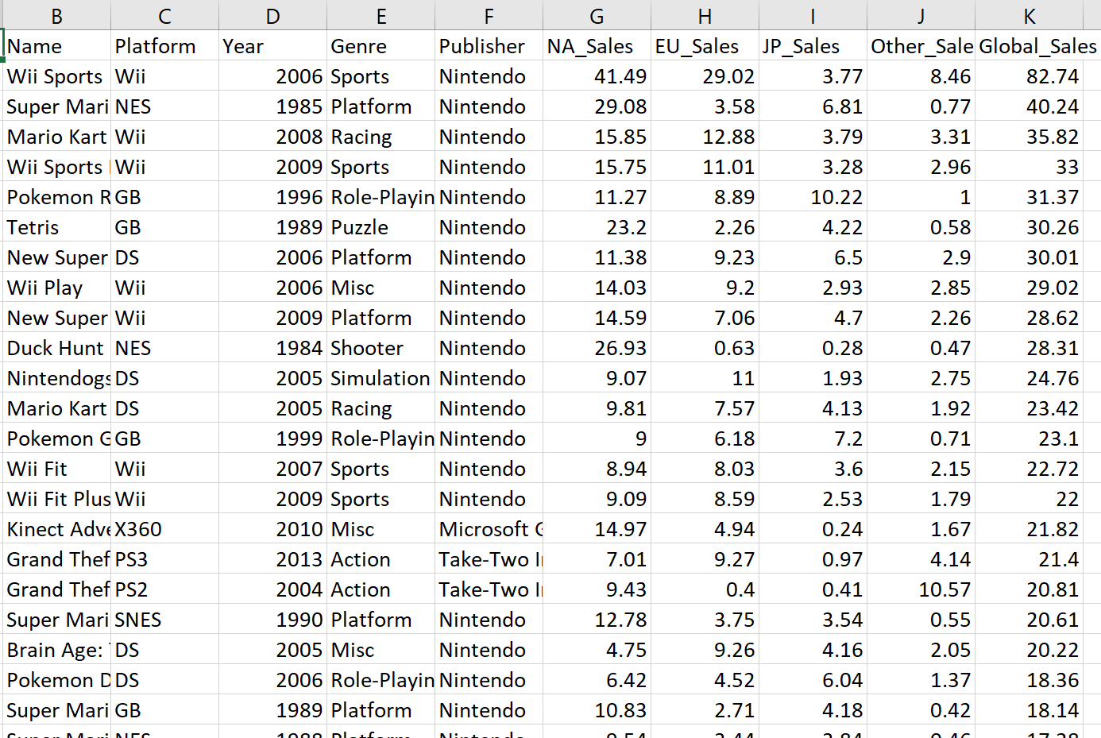
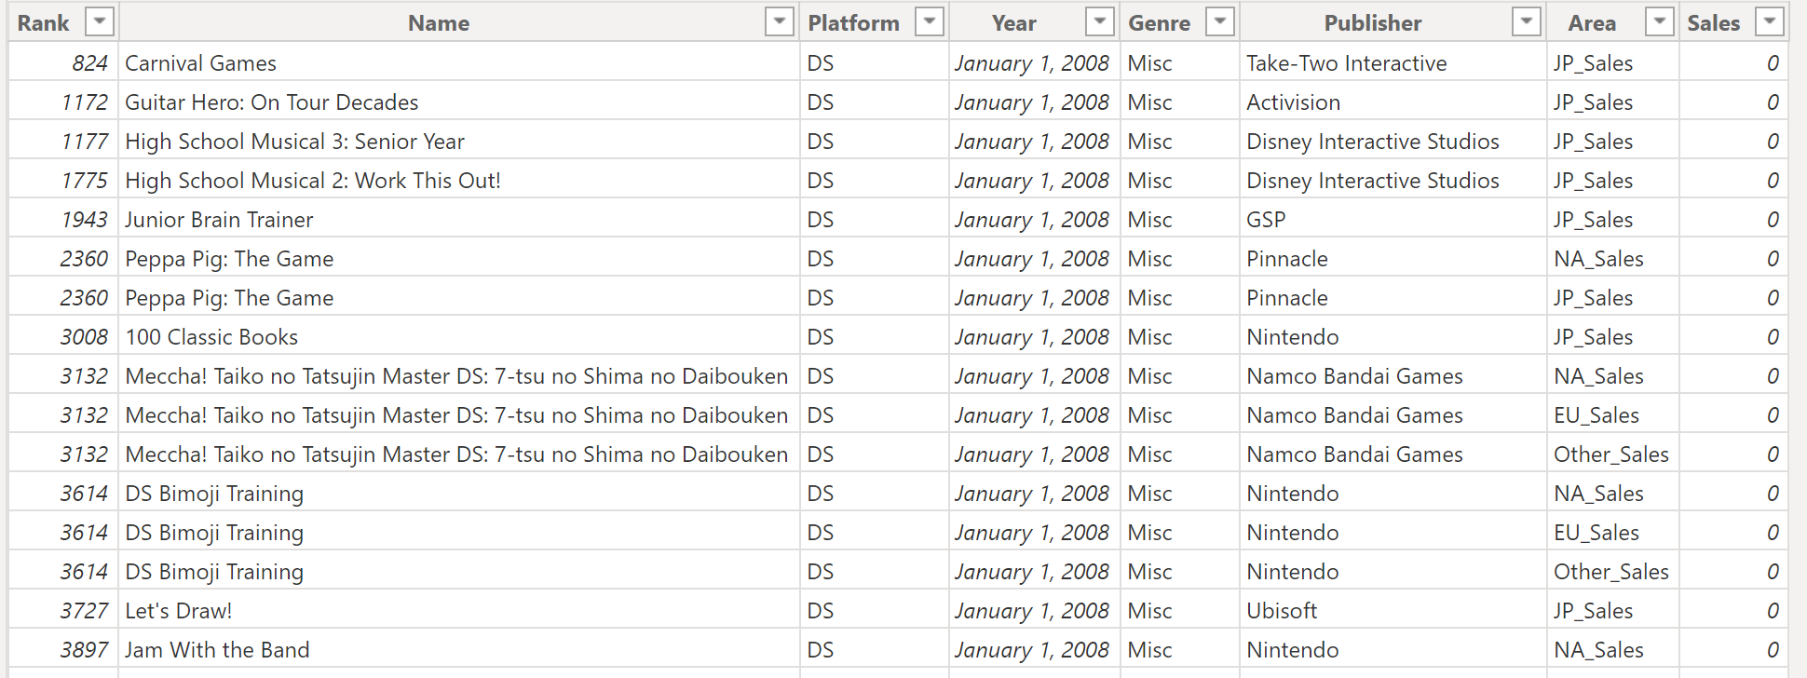
Data Preparing
Data cleaning
Build Reference Table

Slide 5
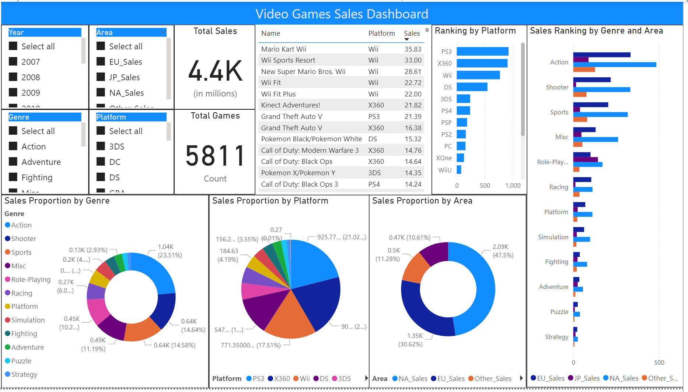
Power BI Dashboard

Slide 6
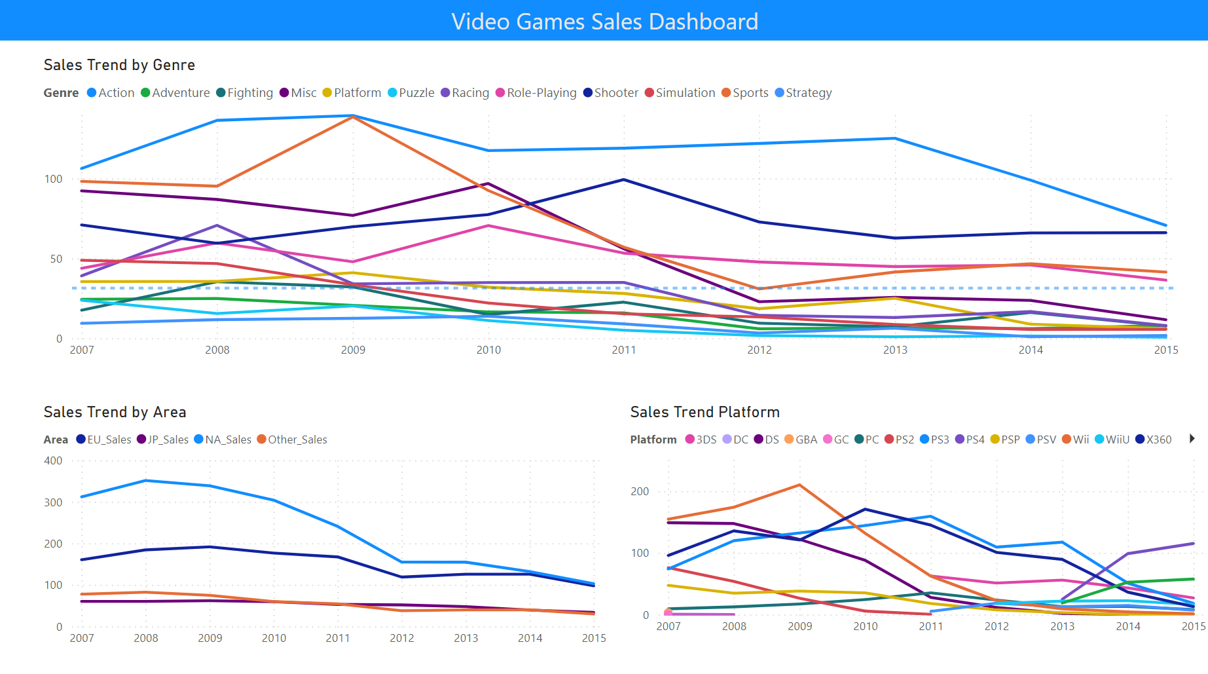
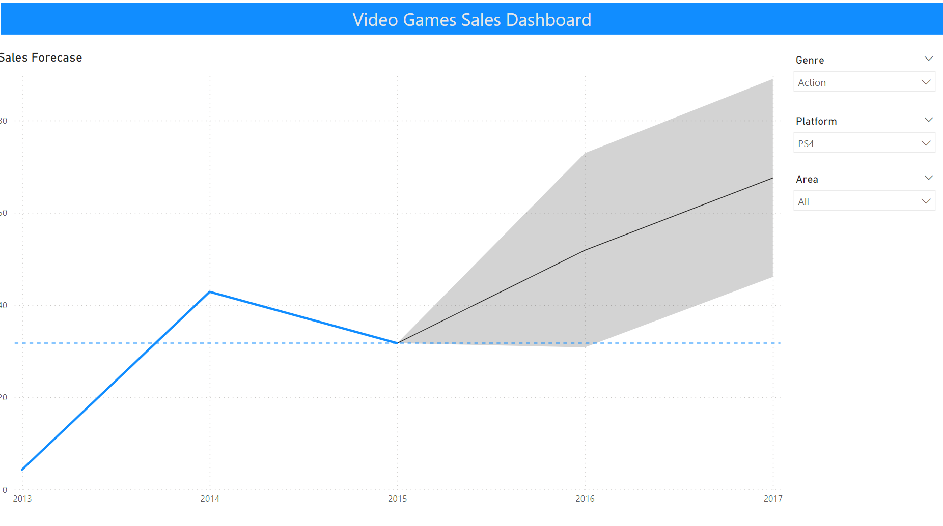
Power BI Dashboard

Slide 7
Technical Report…

Slide 8
conclusion

Slide 9


