Slide 1
EZ Recipes
By Brooke Kennedy and Carson Blevins
5/1/2017
E-commerce

Slide 2
Motivation
Provide a convenient way for users to discover recipes and easily purchase the necessary ingredients.
Cut out the hassle of searching for ingredients in multiple locations

Slide 3
Company Info
Brooke Kennedy
Create and integrate database functionality
Create look and feel of the site
Documentation
Carson Blevins
Work with food2fork API
Create pages and layout of site
Documentation

Slide 4
Growth of E-commerce
The turn of the century saw broadband as a part of more than 20% of American homes
More and more transactions carried out over the internet on sites like Amazon.
With the ease of use and low cost of shopping on the internet, e-commerce thrived
Many department stores close
Over 25% of all departmental stores are projected to close by 2018
E-commerce sales totaled $341.7 billion in 2015 and have steadily grown since

Slide 5
EZ Recipes
Discover recipes through categories and search features
View desired recipe information
Ingredients
Directions
Purchase all of a recipe’s ingredients at the push of a button
Shop for groceries

Slide 6
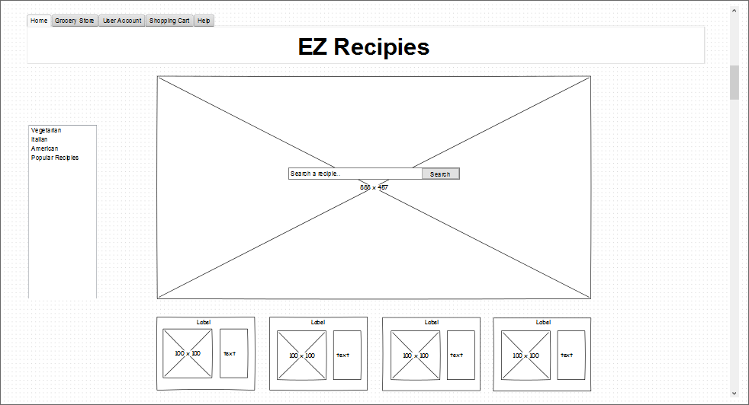
Wireframe

Slide 7
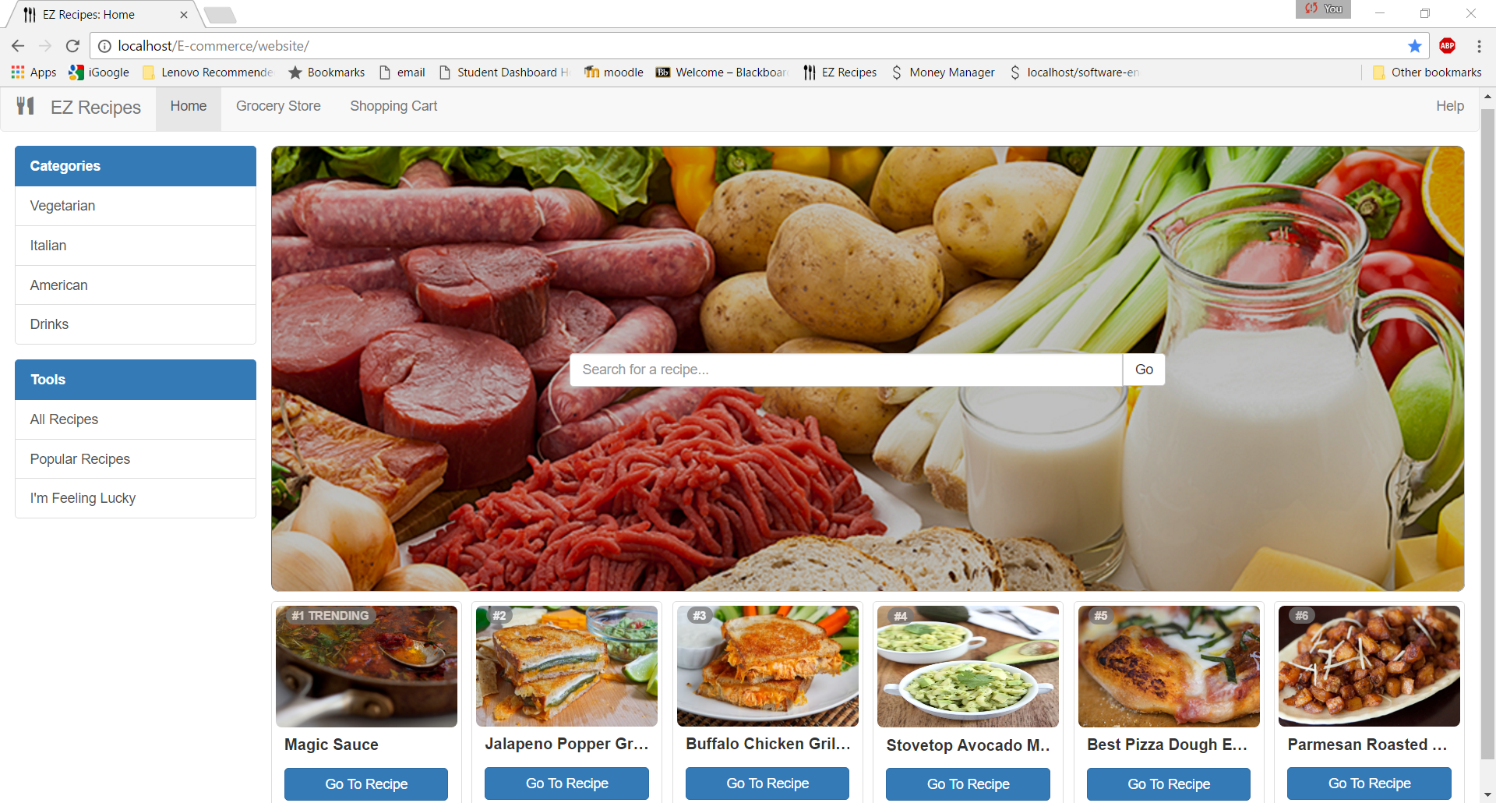
Home

Slide 8
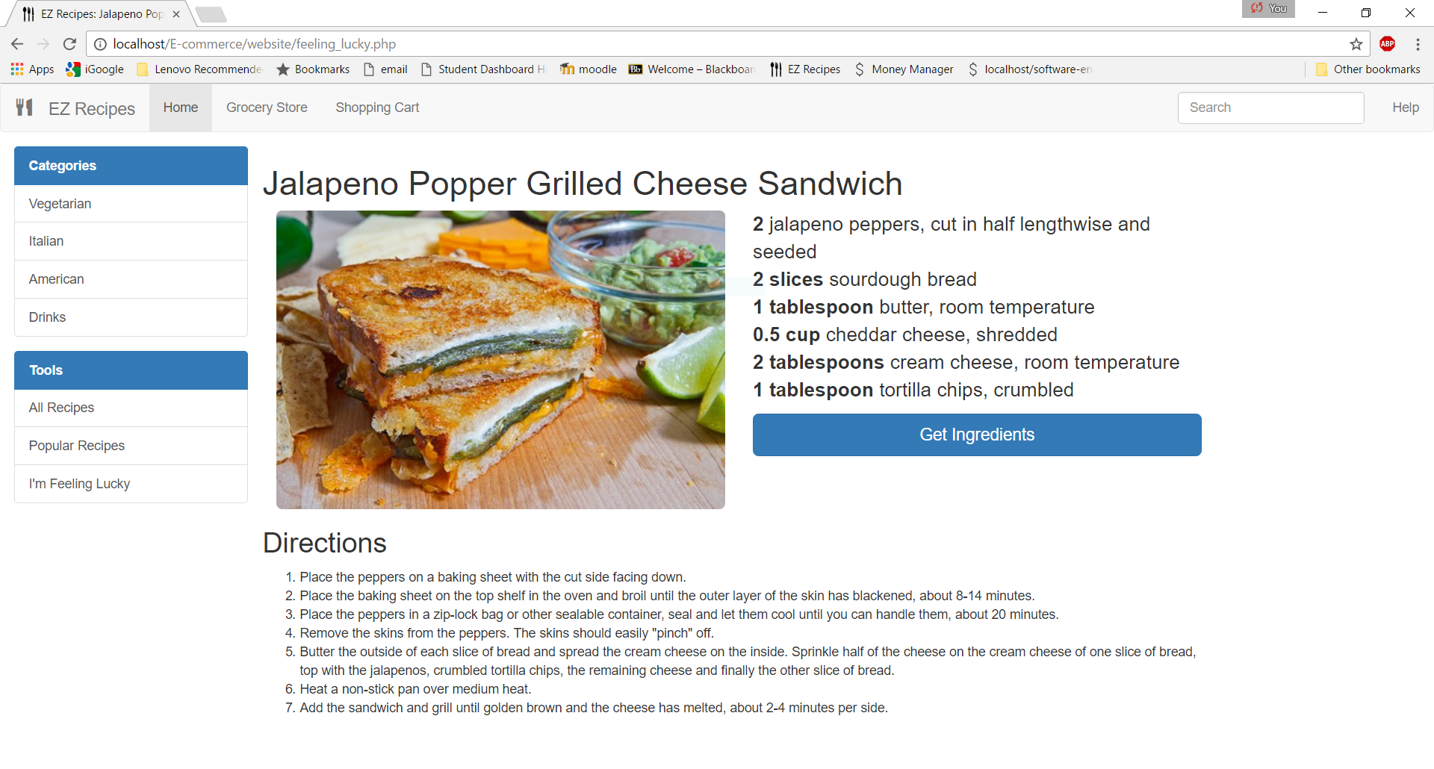
Recipes

Slide 9
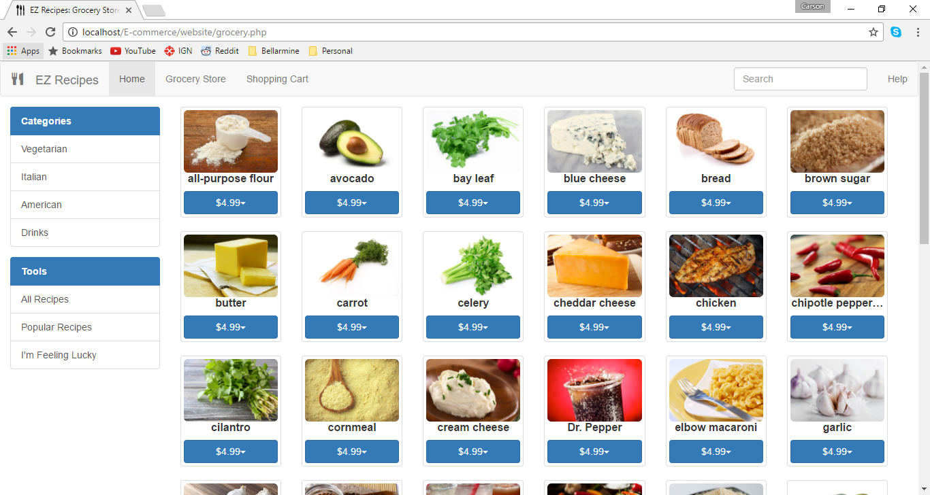
Grocery

Slide 10
Barriers to success
Cannot have every recipe a user may want, resulting in a loss of traffic
In the grocery, there is no way to specify an exact amount of an ingredient a dish may call for.
Issues with inventory and distribution

Slide 11
Cost analysis and Revenue Projection
Total: $10,900
Labor – 60hrs x $90 x 2 = $10,800
Web Server - $100
Use licensed products in order to gain revenue in the future
Cost of packaging and distribution of groceries
Maintenance of site

Slide 12
Future Plans
Add more recipes and groceries
Use licensed products as grocery items
Add more information for the recipes such as preparation time
Add more filtering options (such as Calories)
Allow users to save recipes

Slide 13
Site Demo
www.ezrecipes.us

