Slide 1


Opeyemi Soremekun
Mendelian Randomization Workshop
Lagos 2023

Slide 2
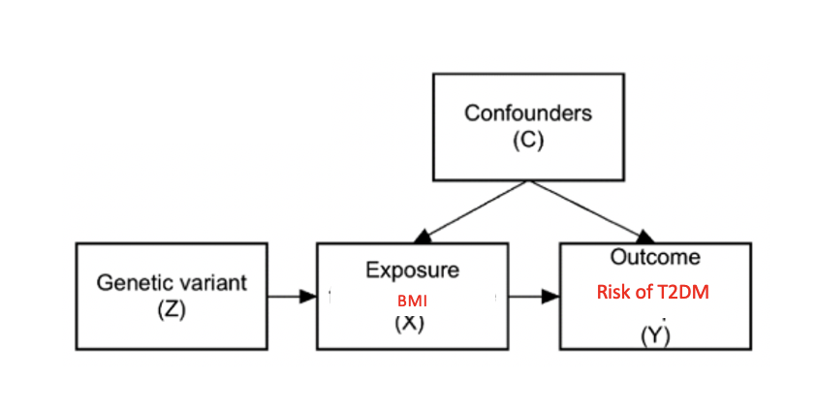
Mendelian randomization is a statistical method used to assess causal relationships between an exposure (such as a risk factor) and an outcome (such as a disease).
The method uses genetic variants that are associated with the exposure of interest as instrumental variables to infer causality between the exposure and the outcome.
Mendelian Randomization is a natural equivalent of Randomized control trials

Slide 3
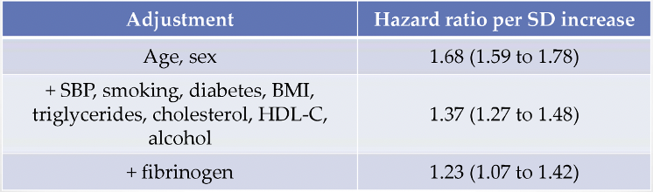
Conventional observational epidemiology
C-reactive protein (CRP) is an acute-phase marker of inflammation.
CRP is strongly associated with CHD in observational prospective epidemiological studies.
Results from meta-analysis of 54 prospective studies:
Question of causality uncertain

Slide 4
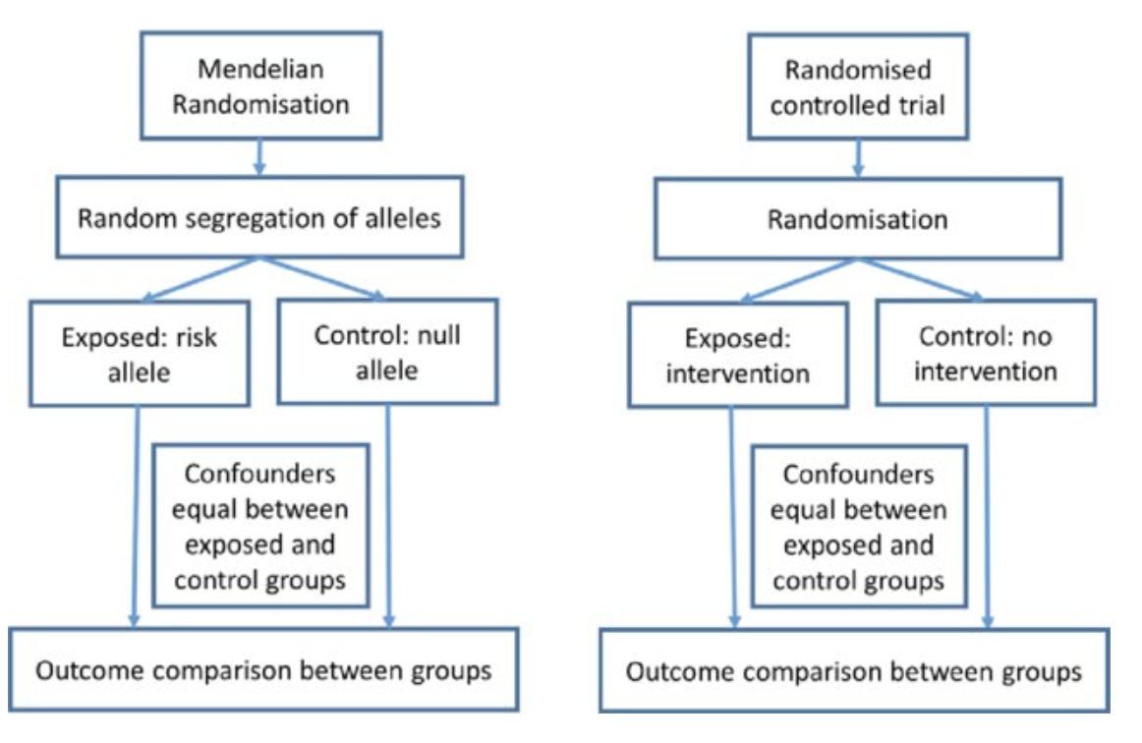
Mendelian Randomization and RCT

Slide 5
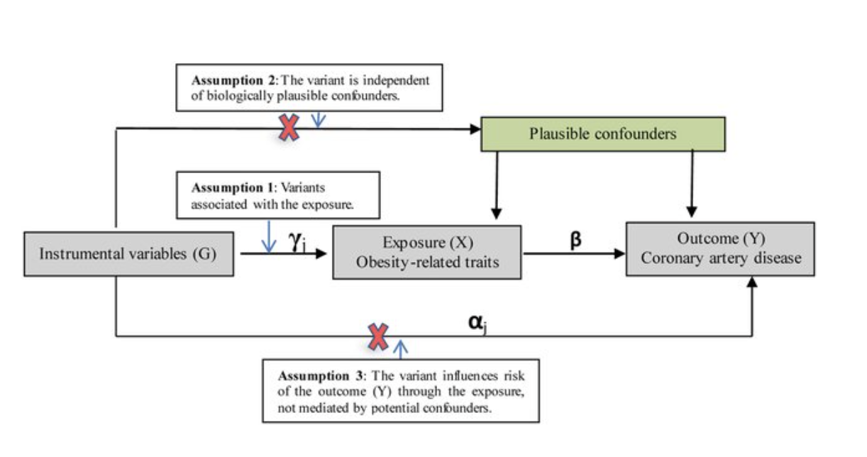
MR Assumptions
The genetic variant used as an instrumental variable is associated with the exposure of interest.
The genetic variant used as an instrumental variable is not associated with confounding factors.
The genetic variant used as an instrumental variable affects the outcome of interest only through the exposure

Slide 6
Types of MR
One-sample MR involves using genetic data from a single dataset to estimate the causal effect of an exposure on an outcome.
Two-sample MR involves using genetic data from two separate datasets to estimate the causal effect of an exposure on an outcome.
Two-sample MR can be more powerful than one-sample MR, as it allows for larger sample sizes and can help to reduce bias due to population stratification.
However, it requires careful consideration of issues such as the use of harmonized genetic data.

Slide 7
Univariate MR
MR analyses in which genetic instruments for only one exposure are used

Slide 8
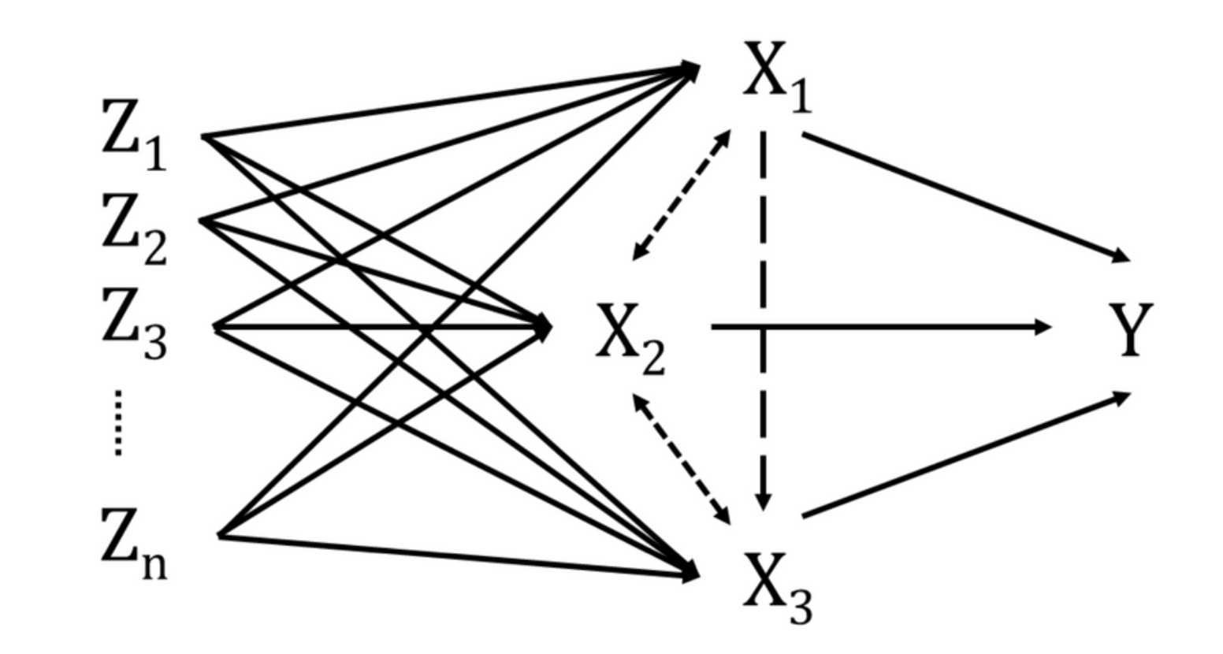
Multivariate MR MR analyses in which genetic instruments for more than one exposure are used.

Slide 9
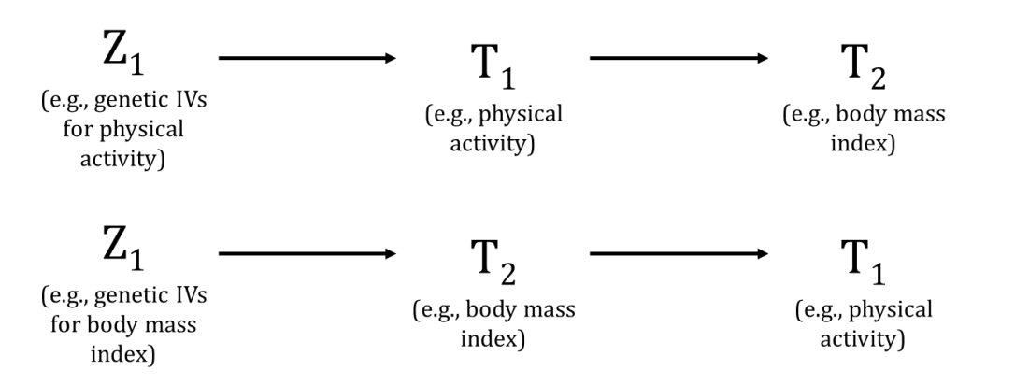
Bidirectional MR An MR analysis that tries to differentiate whether factor A is a cause or a consequence of factor B or whether there is a true bidirectional causal effect between A and B.

Slide 10
Harmonization in MR
Harmonization is an important step in MR analysis as it ensures that the genetic variants used as instrumental variables are consistent across different datasets.
Evaluate harmonization potential of the selected datasets
The effect allele must be available in all datasets to be harmonized. Additional variables, such as the other allele and effect allele frequency, improve the harmonization potential.
Missing exposure-associated variants in the variant-outcome dataset may be replaced by proxies available in the latter.
Consider whether the populations used to generate the datasets are sufficiently similar to harmonize them.
Harmonize the data
Identify variants that do not share the same allele pair between datasets, and either correct this if possible or eliminate such variants.
Identify variants with unmatched effect and other alleles and ‘flip’ their effect estimates and effect allele frequencies in only one of the datasets

Slide 11
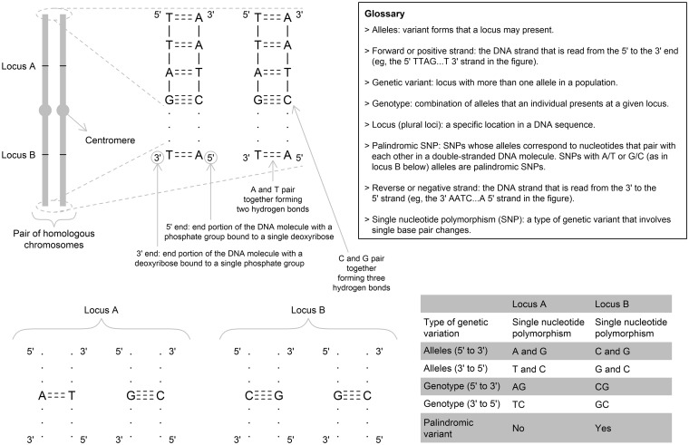
Hartwig et al., 2016

Slide 12
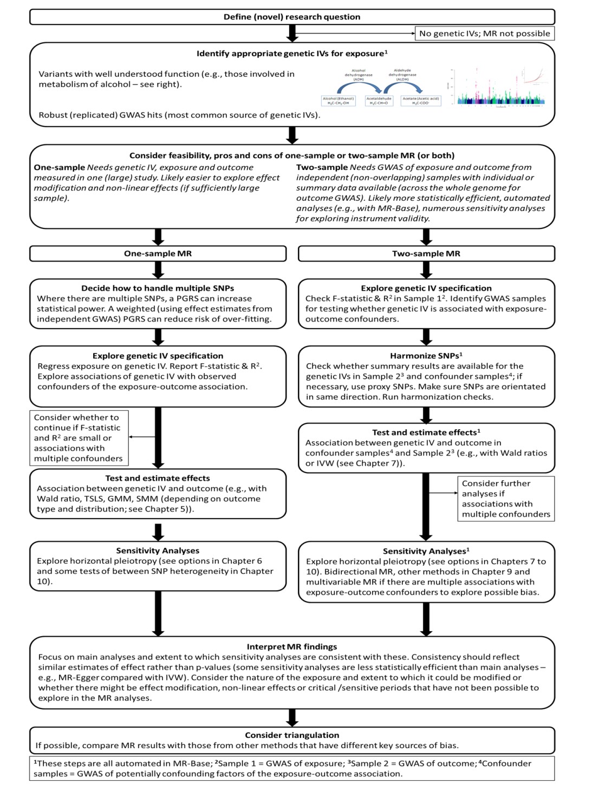
DA Lawlor 2018

Slide 13
How MR work in Practice

Slide 14
Advantages
Accessible
Fast
Cost-effective
Increasing popular
Limitation
Assumptions
Pleiotropy
Accessible, fast, cost-effective, popular … and therefore can be done very badly!
Lack of data
Limited by its assumptions

Slide 15
Wrong effect alleles
Strand issues
Palindromic SNPs
Incompatible alleles

Slide 16
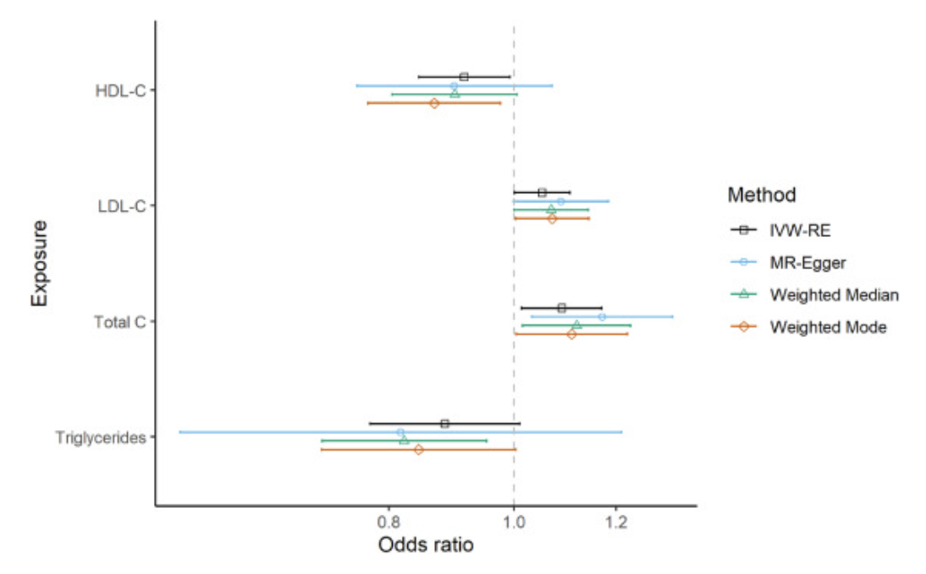
Case Study: Lipids traits and type 2 diabetes in African ancestry individuals: A Mendelian Randomization study.

