Slide 1

Python Beginner Tutorials
By Caylin Blue

Slide 2
Topics Covered
Variables
A variable is a name for storing data in the computer’s memory.
To create a variable and make it a reference, you must use an assignment statement.
User input
Python uses built-in input function to read input from the keyboard.
Input function inside an assignment statement: variable = input(prompt)
Prompt is a string that is displayed on the screen and instructs the user to enter a value.
Input function defaults to returning a string, even if numeric data is entered. To store numeric values from the input function, Python uses built-in functions int(argument) and float(argument)

Slide 3
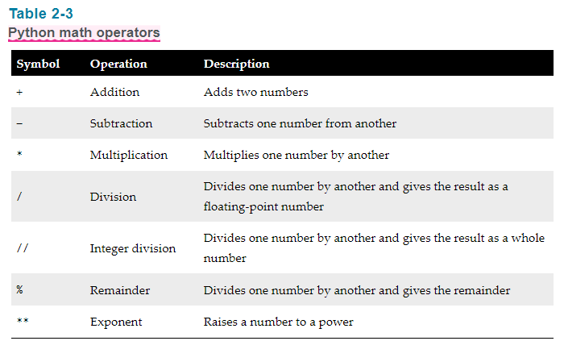
Topics Covered Con’t
Calculations
The programmer’s tool for performing calculations is math operators.

Slide 4
Topics Covered Con’t
F-Strings
F-strings are a special type of string literal that allows you to format values in a variety of ways
{ } is a placeholder for a variable.
Format is: print(f’argument {variable}.’)
Format specifier causes the placeholder’s value to be formatted when it’s displayed.
‘.2’ is a precision designator.
‘f’ is a type designator (f is float, d is an integer)
Specifying a minimum field width
{placeholder:(# of spaces)}
This is how to create columns, tables, and such.

Slide 5
TUTORIAL #1: Compound Interest

Slide 6

Background
When a bank account pays compound interest, it pays interest not only on the principal amount that was deposited into the account, but also on the interest that has accumulated over time. Suppose you want to deposit some money into a savings account, and let the account earn compound interest for a certain number of years. The formula for calculating the balance of the account after a specified number of years is:
Notes:
A is the amount of money in the account after the specified number of years, P is the principal amount that was originally deposited into the account, r is the annual interest rate, n is the number of times per year that the interest rate is compounded, t is the specified number of years.

Slide 7
Task Description
Write a program that makes the calculation for you. The program should ask the user to input the following:
The amount of principal originally deposited into the account
The annual interest rate paid by the account
The number of times per year that the interest is compounded
The number of years the account will be left to earn interest
Once the data has been entered, the program should calculate and display the amount of money that will be in the account after the specified number of years.

Slide 8
TUTORIAL #2: Planting Grapevines

Slide 9

Background
A vineyard owner is planting several new rows of grapevines, and needs to know how many grapevines to plant in each row. She has determined that after measuring the length of a future row, she can use the following formula to calculate the number of vines that will fit into the row, along with the trellis end-post assemblies that will need to be constructed at each end of the row.
Notes:
V is the number of grapevines that will fit into the row, r is the length of the row, in feet, E is the amount of space in feet used by an end post assembly, s is the space between vines, in feet

Slide 10
Task Description
Write a program that makes the calculation for the vineyard owner. The program should ask the user to input the following:
The length of the row, in feet
The amount of space used by an end-post assembly, in feet
The amount of space between the vines, in feet
Once the input data has been entered, the program should calculate and display the number of grapevines that will fit in the row.

Slide 11
New Topics
Constants
A named constant is a name that represents a special value, such as a magic number
A magic number is an unexplained value in a program’s code.
Standard practice to use because using named constants makes widespread changes to the program easy.
Constants are written in all uppercase

Slide 12
TUTORIAL #3: Stock Transaction

Slide 13
Background
Last month, Joe purchased some stock in Acme Software, Inc. Here are the details of the purchase:
The number of shares that Joe purchased was 2,000
When Joe purchased the stock, he paid $40.00 per share
Joe paid his stockbroker a commission that amounted to 3% of the amount he paid for the stock
Two weeks later, Joe sold the stock. Here are the details of the sale
The number of shares that Joe sold was 2,000
He sold the stock for $42.75 per share
He paid his stockbroker another commission that amounted to 3% of the amount he received for the stock

Slide 14
Task Description
Write a program that displays the following information:
The amount of money Joe paid for the stock
The amount of commission Joe paid his broker when he bought the stock
The amount for which Joe sold the stock
The amount of commission Joe paid his broker when he sold the stock
Display the amount of money that Joe had left when he sold the stock and paid his broker (both times). IF this amount is positive, then Joe made a profit. If the amount is negative, then Joe lost money.

Slide 15
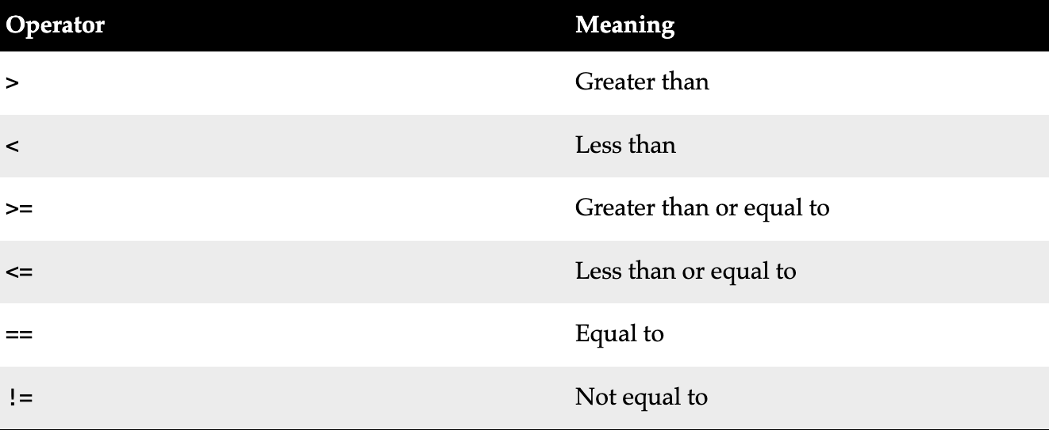
New Topics
The if Statement
A control structure is a logical design that controls the order in which a set of statements execute.
A sequence structure is a set of statements that execute in the order they appear as.
A decision structures execute a set of statements only under certain circumstances.
Format is: if (argument) (logical operator) (argument):

Slide 16
Topics Cont.
The if-else statement
The dual alternative decision structure has two possible paths of execution, one path is taken if a condition is true, the other path is taken if the condition is false.
The if clause and the else clause need to be aligned.
Blocks of code follow indented after each clause.
Comparing Strings
Using equal operator to compare strings. (==)
Note: Python is case-sensitive
When a program compares characters, it compares the codes for the character.
If the length of the string is the same, it compares code.
If the length of the strings is not the same, it will consider the shorter string less than the longer one.

Slide 17
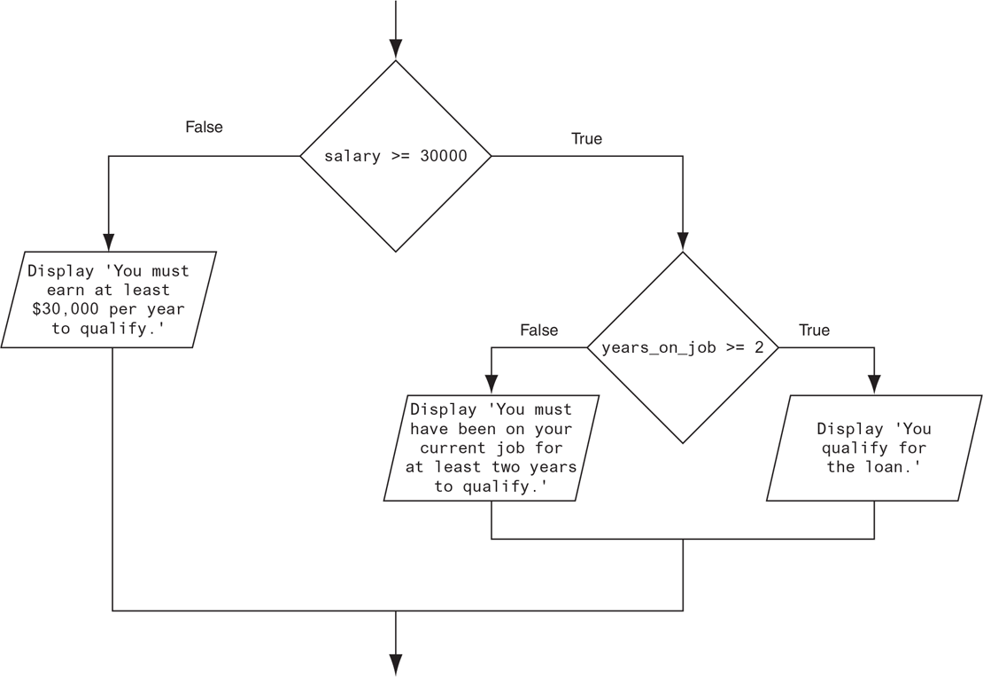
New Topics Cont.
Nested Decision Structures
if-elif-else Statements
Clauses are all aligned
An advantage when there are complex conditions
elif is a condition tested if the first proves false, else is executed if none other conditions are met

Slide 18
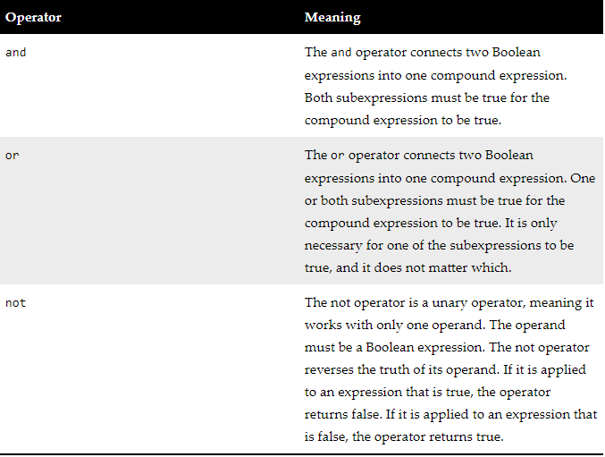
New Topics Cont.
Logical Operators
Boolean Variables
Boolean variables reference True or False
A flag is a variable that signals when some condition exists in the program

Slide 19
TUTORIAL #4: ROULETTE WHEEL COLORS

Slide 20
Background
On a roulette wheel, the pockets are numbered from 0 to 36. The colors of the pockets are as follows:
Pocket 0 is green
For pockets 1 through 10, the odd-numbered pockets are red, and the even-numbered pockets are black
For pockets 11 through 18, the odd-numbered pockets are black, and the even-numbered pockets are red
For pockets 19 through 28, the odd-numbered pockets are red, and the even-numbered pockets are black
For pockets 29 through 36, the odd-numbered pockets are black, and the even-numbered pockets are red

Slide 21
Task Description
Write a program that asks the user to enter a pocket number and displays whether the pocket is green, red, or black. The program should display an error message if the user enters a number that is outside the range of 0 through 36.

Slide 22
TUTORIAL #5: TIME CALCULATOR

Slide 23
Task Description
Write a program that asks the user to enter a number of seconds and works as the follows:
There are 60 seconds in a minute. If the number of seconds entered by the user is greater than or equal to 60, the program should convert the number of seconds to minutes and seconds
There are 3600 seconds in an hour. If the number of seconds entered by the user is greater than or equal to 3600, the program should convert the number of seconds to hours, minutes, and seconds.
There are 86,400 seconds in a day. If the number of seconds entered by the user is greater than or equal to 86,400, the program should convert the number of seconds to days, hours, minutes, and seconds.

Slide 24
New Topics
Repetition Structures
Known as a LOOP
Condition-controlled loop uses a true/false condition to control the number of times that it repeats
A count-controlled loop repeats a specific number of times
While loop
Known as the pretest loop, it tests the condition before performing an iteration
Infinite loops do not have a way of stopping
Can be used as a controlled loop with a counter-variable
while condition: statement

Slide 25
New Topics Cont.
The for loop
for variable in [value1, value2, etc]:
statement…
Python provides a built-in function called range
An iterable object is like a list, it contains a sequence of values that can be iterated over with something like a loop
Sentinels
A sentinel is a special value that marks the end of a sequence of values
A sentinel value must be distinctive enough that it will not be mistaken as a regular value in the sequence
Input Validation
Inspecting input to make sure it is valid before using it in computation. Done with a loop that iterates if an input variable references bad data.

Slide 26
New Topics Cont.
Nested loops
A nested loop is a loop inside another loop
Inner loops go through all of their iterations for every single iteration of an outer loop
Using break, continue, and else with loops
The break statement causes a loop to terminate early
The continue statement causes the current iteration of a loop to end immediately and ignores all the statements. Then begins its next iteration.

Slide 27
TUTORIAL #6: CALCULATING FACTORIALS

Slide 28
Background
In mathematics, the notation n! represents the factorial of the nonnegative integer n. The factorial of n is the product of all the nonnegative integers from 1 to n. for example:
7! = 1 x 2 x 3 x 4 x 5 x 6 x 7 = 5,040

Slide 29
Task Description
Write a program that lets the user enter a nonnegative integer then uses a loop to calculate the factorial of that number. Display the factorial.

Slide 30
TUTORIAL #7: POPULATION

Slide 31
Background
Write a program that predicts the approximate size of a population of organisms. The application should prompt the user to enter the starting number of organisms, the average daily population increase (as a percentage), and the number of days the organisms will be left to multiply. Put data into a table.

