Slide 1

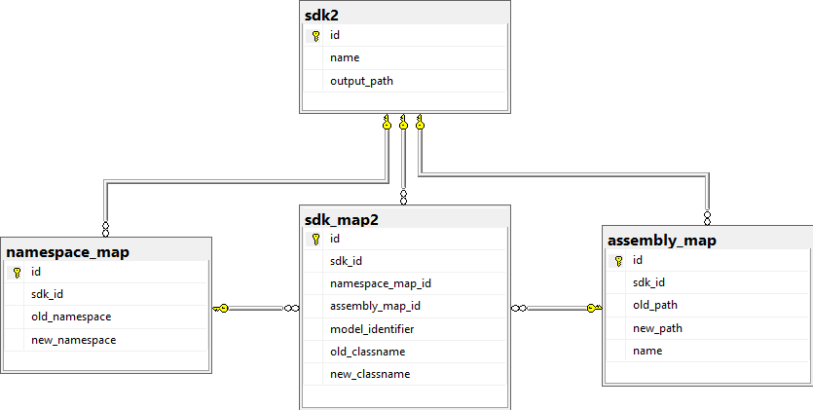
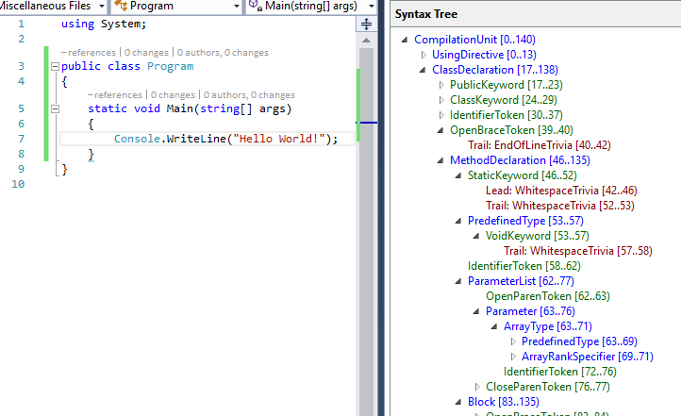
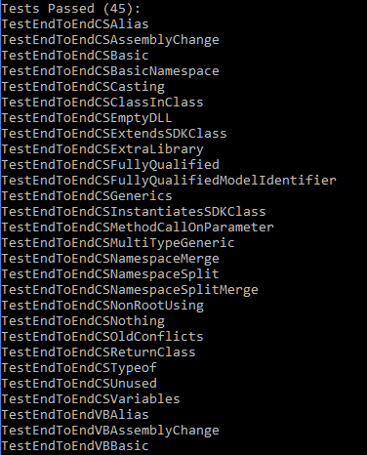
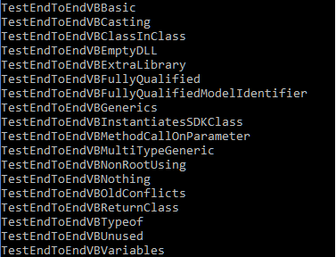
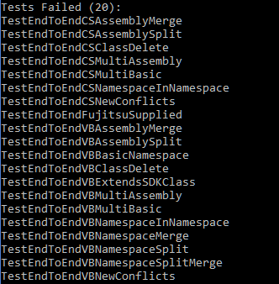

Marketplace Migration and Refactoring
Patrick Clouse Nathan Faulkner Christopher Lupo Joshua Zelin
Problem Overview
Source Code Changes
Aliases
Before: using testAlias = FujitsuSDKOld;
Casting
Before: OldClass cast = (OldClass)new Casting();
Class extensions
Before: class Program : oldNamespace.OldClass
Method parameters and return types
Before: public OldClass testMethod(OldClass a)
After: using testAlias = FujitsuSDKNew;
After: NewClass cast = (NewClass)new Casting();
After: class Program : newNamespace.NewClass
After: public NewClass testMethod(NewClass a)
Fujitsu develops C# and Visual Basic SDKs that clients use, but some of the SDKs are being refactored
The SDKs contain sets of critical artifacts which include namespaces, class names, and assembly (dll) file path references
In the refactored SDKs, some of these artifacts may have changed. If a client tries to use the new SDK with their existing project, then their project will not compile
Our project automates changing client source code and project files to use artifacts from the new SDKs
Using Statements
Before: using oldNamespace;
After: using newNamspace;
Member Declarations
Before: private OldClass b = new OldClass();
After: private NewClass b = new NewClass();
Fully Qualified Names
Before: oldNamespace.OldClass t = new oldNamespace.OldClass();
After: newNamespace.NewClass t = new newNamespace.NewClass();
We generalized the changes for all cases of source code artifacts. Examples above
Old Client Project
.csproj file
Schema
Old Fujitsu SDK
Set of dlls
CreateMappings
Stage 1
Database
New Fujitsu SDK
Set of dlls
Mappings
Mapping
Project Flow
Mappings
TransformClient
Stage 2
Persistence of mappings between executions
Solves large memory problem
Divides mapping into foreign key relationships
Allows batch processing for Stage 2 when Stage 1 is complete
New Client Project
Roslyn
A .NET compiler with an API for application developers
Roslyn exposes compiler syntax tree
Allows developers to easily make changes to source code
Testing
Automated Black Box tests using Visual Studio’s built in testing suite and Roslyn.
The tests use a common file structure, allowing more tests to be added with minimal effort.
Basic data structure used to handle transformation
Artifacts are found using Reflection on the assembly files
ModelIdentifier is a guaranteed unique identifier for a class
Maps old SDK artifacts to corresponding new SDK artifacts
Mapping is stored in the database

