Slide 1

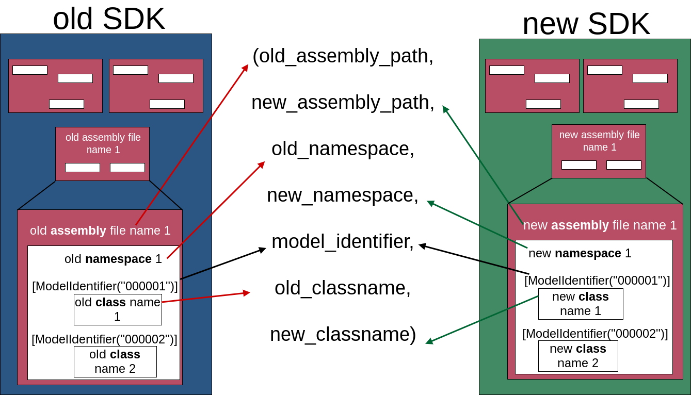
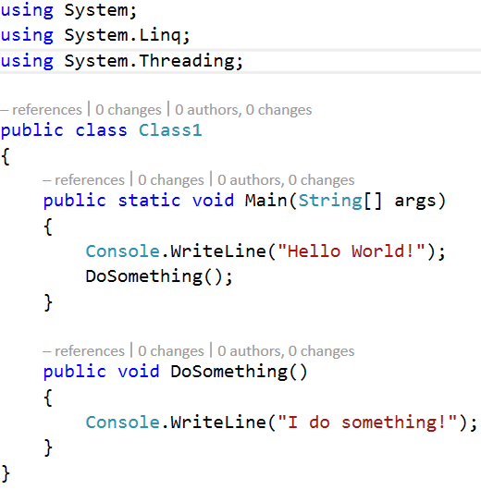
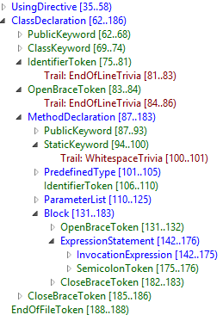
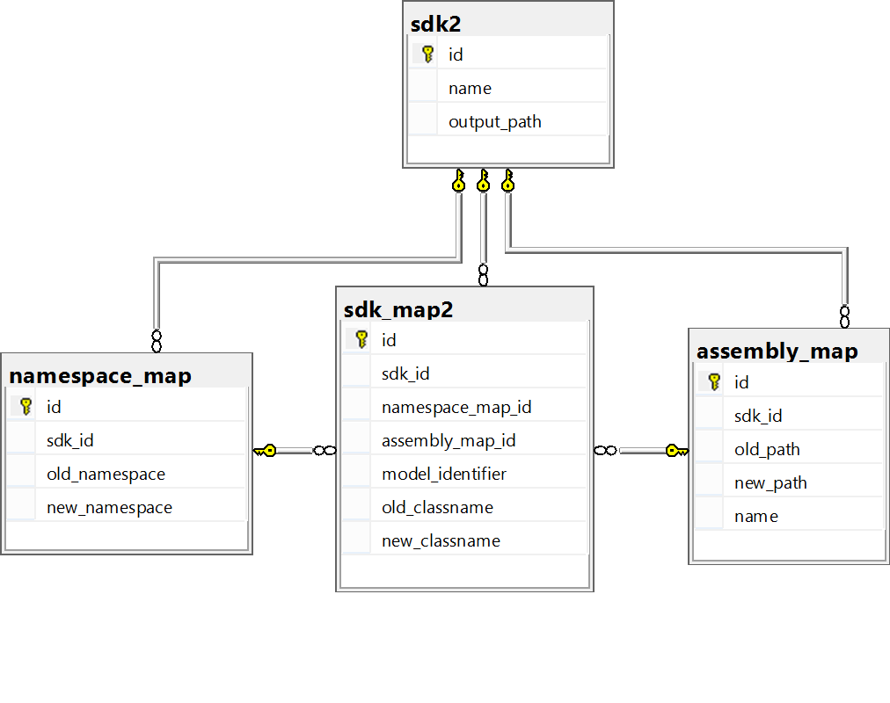

Marketplace Migration & Refactoring
Patrick Clouse Nathan Faulkner Christopher Lupo Joshua Zelin
Problem Overview
Project Flow
Old Client Project
.csproj file
Fujitsu is refactoring C# and Visual Basic SDKs that clients use
The SDKs contain sets of critical artifacts which include namespaces, class names, and assembly (dll) file path references
Client projects won’t compile with the new SDKs because artifacts changed
Our project automates changing client source code and project files to the new SDK artifacts
Old Fujitsu SDK
Set of dlls
CreateMappings
Stage 1
Mappings
Database
TransformClient
Stage 2
New Client Project
Mappings
New Fujitsu SDK
Set of dlls
Mapping
Roslyn
Basic data structure used to handle transformation
Artifacts are found using reflection on the assembly files
ModelIdentifier is a guaranteed unique identifier for a class
Maps old SDK artifacts to corresponding new SDK artifacts
Mapping is stored in the database
A .NET compiler with an API for application developers
Roslyn exposes compiler syntax tree
Allows developers to programmatically make changes to source code
Source Code Changes
We generalized the changes for all cases of source code artifacts. Examples include:
Using Statements
Before: using oldNamespace;
After: using newNamspace;
Member Declarations
Before: private OldClass b = new OldClass();
After: private NewClass b = new NewClass();
Fully Qualified Names
Before: old.OldClass t = new old.OldClass();
After: new.NewClass t = new new.NewClass();
Aliases
Before: using testAlias = FujitsuSDKOld;
Casting
Before: OldClass cast = (OldClass)new Casting();
Class extensions
Before: class Program : oldNamespace.OldClass
Method parameters and return types
Before: public OldClass testMethod(OldClass a)
After: using testAlias = FujitsuSDKNew;
After: NewClass cast = (NewClass)new Casting();
After: class Program : newNamespace.NewClass
After: public NewClass testMethod(NewClass a)
Schema
Testing
Persistence of mappings between executions
Solves large memory problem
Divides mapping into foreign key relationships
Allows batch processing for Stage 2 when Stage 1 is complete
45 passing, automated Black Box tests using Visual Studio’s built in testing suite and Roslyn
No unit testing for main code because Black Box tests cover the majority of use cases
Because of parse tree complexity, Black Box tests cover use cases we wouldn’t come up with
Unit test for all database functions
The Black Box tests use a common file structure, allowing more tests to be added with minimal effort

