Slide 1


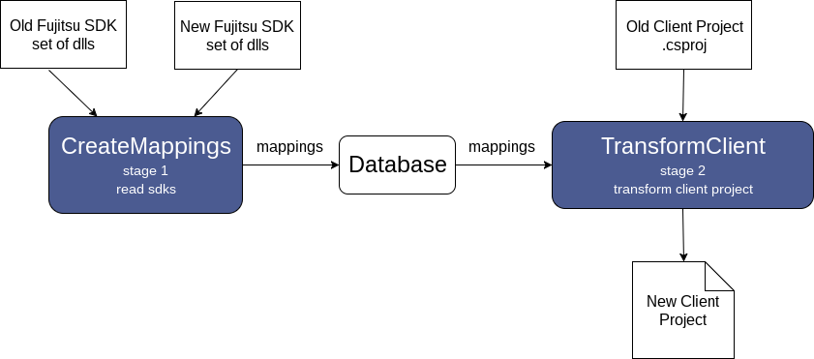
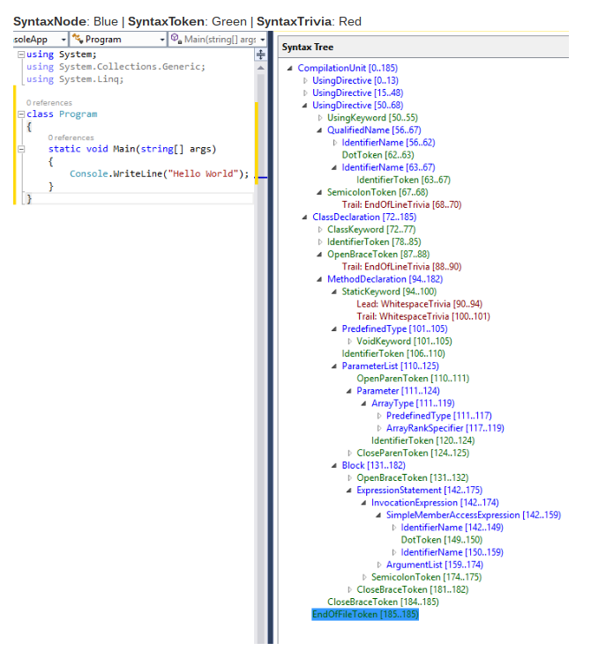
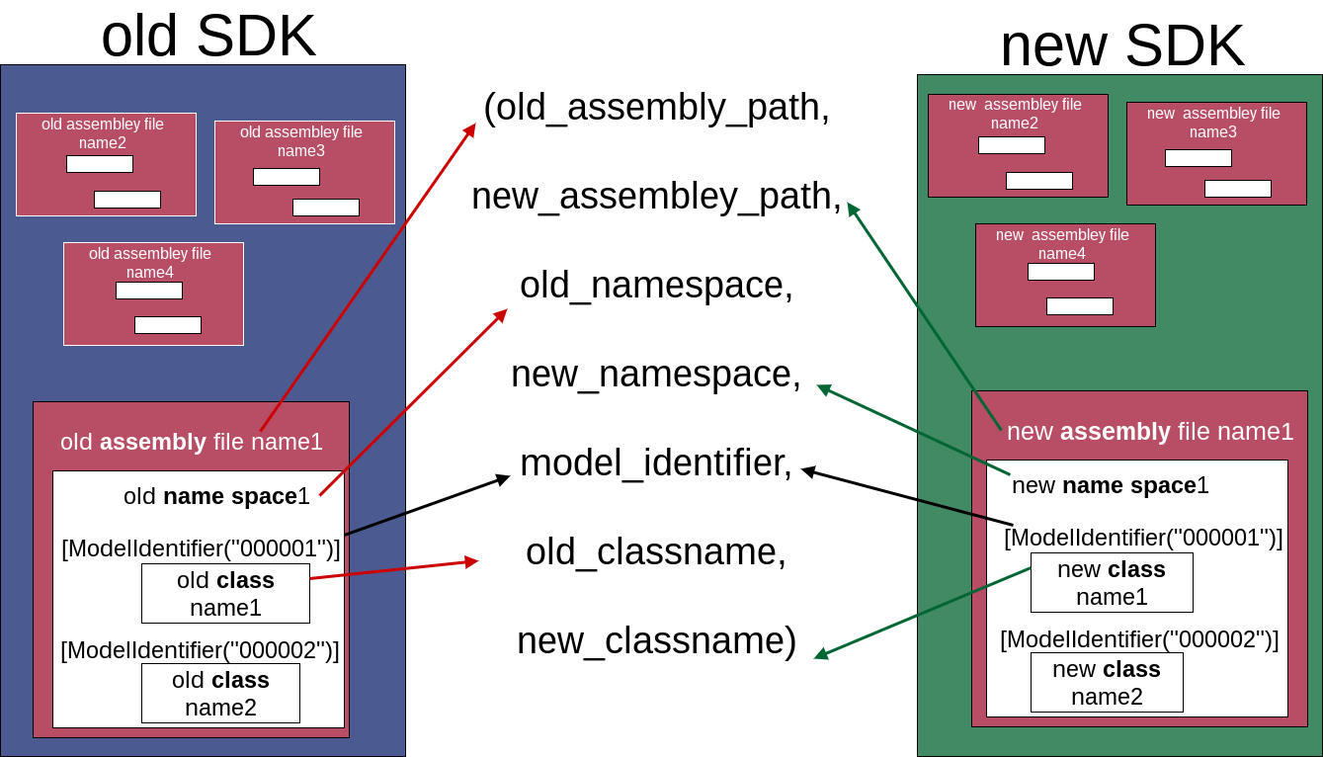
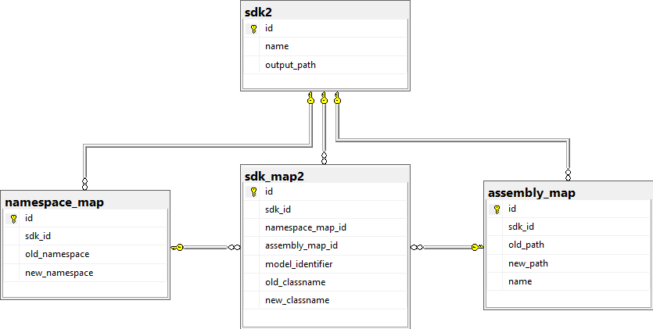
Marketplace Migration and Refactoring
Patrick Clouse Nathan Faulkner Christopher Lupo Joshua Zelin
Problem Overview
Required Changes
Edge Cases
Fujitsu develops certain SDKs that clients use and these SDKs are undergoing refactoring. SDKs contain sets of critical artifacts which include namespaces, class names, and assembly (dll) file path references. In the refactored SDKs, some of these artifacts may have changed. If a client tries to use the new SDK with their existing project, then their project will not compile.
Due to the complexity of the SDKs and the client source code, the process of building a working client project that uses the new SDK has been automated.
Using Statements
Before: using oldNamespace;
After: using newNamspace;
Member Declarations
Before: private OldClass b = new OldClass();
After: private NewClass b = new NewClass();
Fully Qualified Names
Before: oldNamespace.OldClass t = new oldNamespace.OldClass();
After: newNamespace.NewClass t = new newNamespace.NewClass();
Aliases
Before: using testAlias = FujitsuSDKOld;
Casting
Before: OldClass cast = (OldClass)new Casting();
Class extensions
Before: class Program : oldNamespace.OldClass
Method parameters and return types
Before: public OldClass testMethod(OldClass a)
After: using testAlias = FujitsuSDKNew;
After: NewClass cast = (NewClass)new Casting();
After: class Program : newNamespace.NewClass
After: public NewClass testMethod(NewClass a)
Roslyn
Project Flow
Mapping
Database Schema
Testing
Automated Black Box tests using Visual Studio’s built in testing suite and Roslyn.
The black box tests do the following
Run the CreateMappings program
Run the TransformClient program
Use Roslyn to make sure the project compiles
Run the compiled project and verify output
The tests use a common file structure, allowing more tests to be added with minimal effort.

