Slide 1
DATASET
Association Internationale pour le Développement de l'Apnée (AIDA) Ranking
Year
Rank (for current year)
Athlete
Total points
Discipline scores: CWT, CWTB, CNF, FIM

Slide 2
Analyzing Peak Performances and Career Declines

Slide 3
Metrics
Peak performance - year(s) where an athlete achieves their:
    highest total points;
    best ranking (lowest number, e.g., rank 1)
Decline - downward trend in either:
    points decreasing significantly over time
    worsening of rank (increasing in number, e.g., rank 20 to 42)

Slide 4
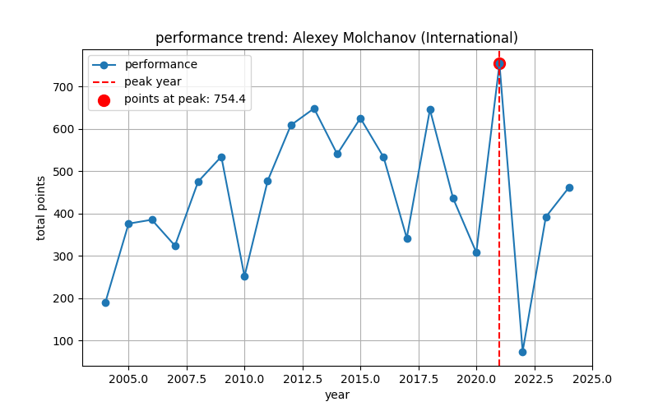

Slide 5
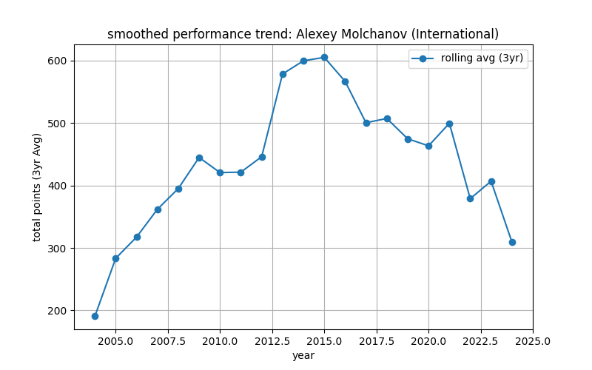

Slide 6
Historical trends
How long it took an athlete to reach their peak;
How long before their decline;
Additional metrics:
  Years until peak - difference between the first recorded year and the peak year for each athlete
  Years before decline - difference between the peak year and the first recorded declining year
  Average years until peak - average time taken by all athletes to reach their peak
  Average years before decline - mean duration from peak to decline
    Average years until peak: 2.20 years
    Average years before decline: 1.34 years
Notes:
To analyze how long it takes for an athlete to reach their peak and how long before their decline, we can compute the following:
Compute years until peak:
We first determine the first recorded year for each athlete and subtract it from their peak year.
Compute years before decline:
we determine the first year their performance declined after peaking
Compute Overall Averages
we calculate the average time to peak and average time before decline across all athletes

Slide 7
Median:
Years (median) until peak: 1.00 years
Years (median) before decline: 1.00 years
Categorize athlete by career length:
Career Years_Until Years_Before
_Length _Peak _Decline
0-5 1.296245 1.218253
6-10 5.835474 1.643119
11-15 10.490000 1.730000
16+ 15.303571 2.116071
Notes:
It may be fair to compute mean years until peak and mean years before decline, even though athletes have different career lengths. However, we should be aware of biases and limitations in our analysis:
1. Potential Biases & Considerations
Survivorship Bias
Athletes with short careers may never reach a peak or decline, skewing the averages.
Older athletes may have more recorded data, making it easier to detect peak and decline.
Incomplete Career Data
If an athlete has not yet declined, their "Years Before Decline" will be missing.
If an athlete has not yet peaked, their "Years Until Peak" may be overestimated.
Different Career Trajectories
Some athletes improve quickly and peak early, while others have a long and steady climb.
Some decline gradually, while others drop sharply (e.g., due to injury or retirement).
The median is less sensitive to extreme cases and career-length differences.
This avoids overweighting athletes with very long or short careers.
This allows comparisons across short-career vs. long-career athletes.

Slide 8
Predicting peak performance using ANN
Long Short-Term Model (LSTM) – learns long term dependencies; model sequential data; tracks performances over multiple years
Input features:
    Years_Competing : time since the first recorded competition
    Performance_Growth_Prev_Year : year-over-year change in total points
    Ranking_Variability_Prev_Year : fluctuation in ranking
    Years_Since_Last_Best : time since their peak performance
    Discipline scores: CWT, CWTB, CNF, FIM scores in different disciplines
Scaling & Reshaping
LSTM cell: memory and gates
Output layer : predict “Year until peak”
Notes:
Predict when an athlete will peak in their performance based on historical data
The model predicts how many years are left until the athlete reaches their best performance.

Slide 9
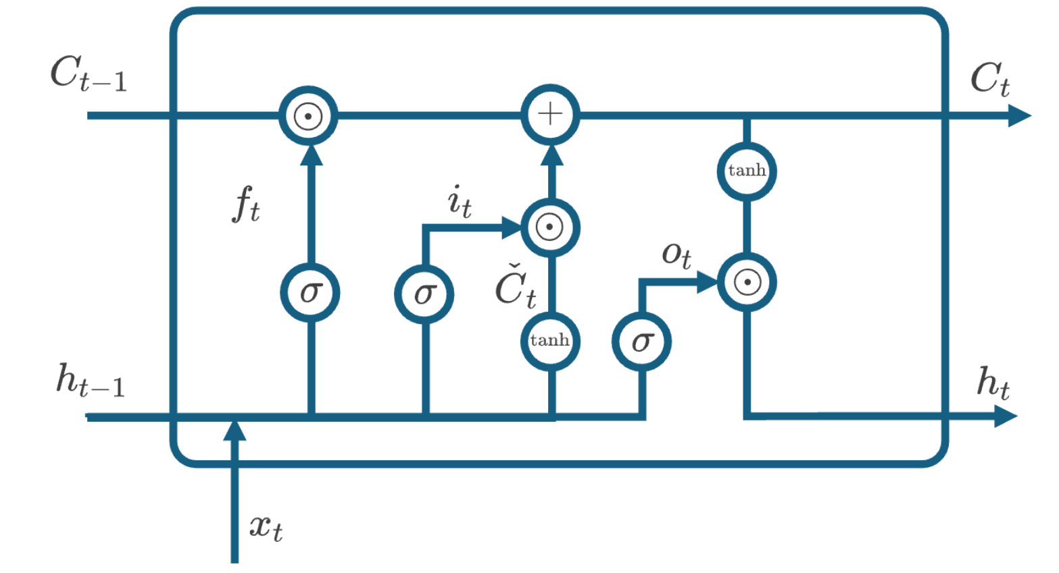
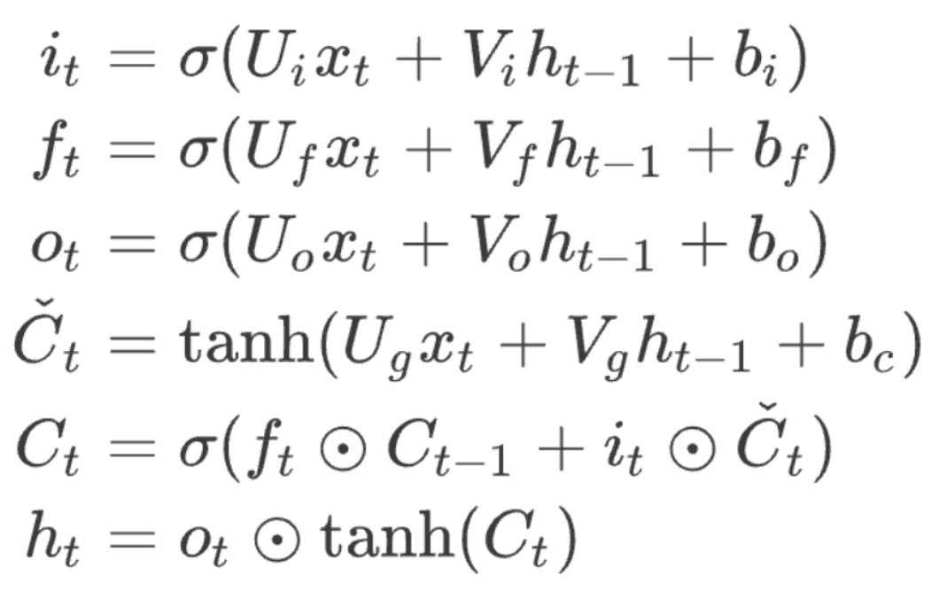
Cell state
Forget gate
Input gate
Output gate
Hidden state

