Slide 1




Java File Server

Slide 2
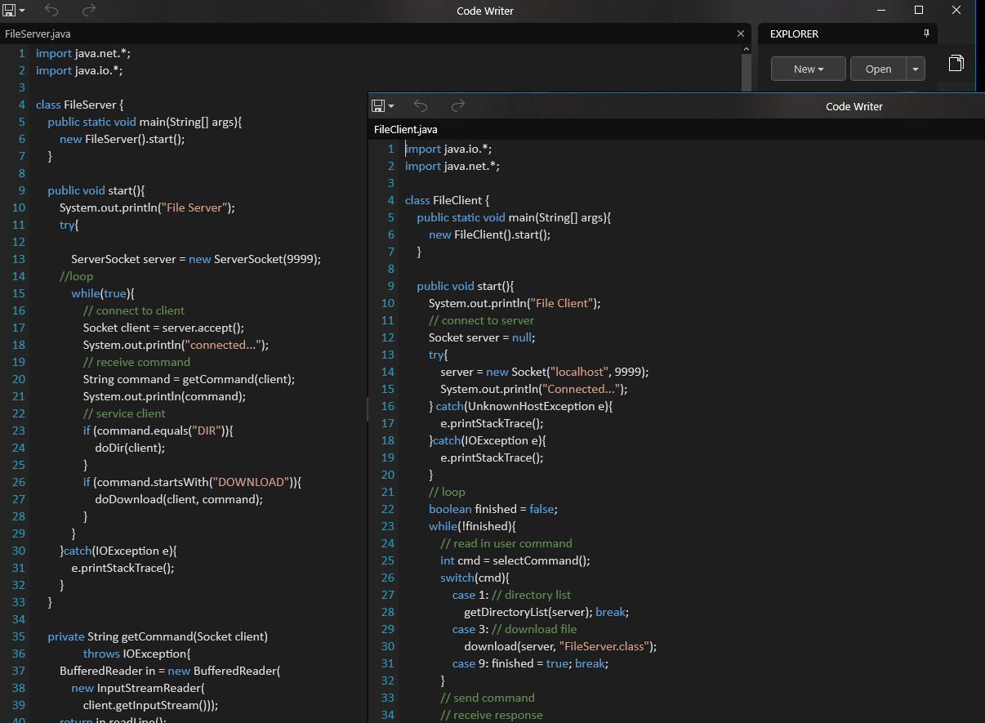

Slide 3
