Slide 1
WeatherCheck
Dothraki SoftwareDevelopment LLC.

Slide 2

Using WeatherCheck in my daily life ????

Slide 3
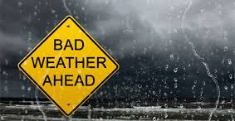
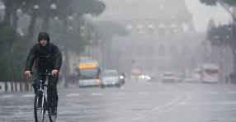

Always be wise and prepared
Get Ready
Commute
Wise Advice
Weather is changing constantly where three to four seasons can be experienced in one day
In most urban areas, majority of people use public transportation to commute.
WeatherCheck app under your fingertips will solve the problem and gives you a peace of mind

Slide 4



Team Collaboration Tools

Slide 5
Technologies Used
NodeJS
ExpressJS
Twilio (API used for sending SMS texting)
dark-sky (API used for supplying current and historical weather data)
node-schedule (API used to schedule background tasks at specified times - like crontab)
node-geocoder (Google API being used to convert user input of zip code to longitude/latitude required by dark-sky weather API)
Handlebars
Passport Authentication

Slide 6
Dothraki Team
FRONTEND
BACKEND
RION
DATABASE
CBO- PM
OTHO
ULAS

Slide 7

CBO Backend Developer, PM
Production team lead- provide support to UI, Database and Backend production team,
Defining the technologies to be used,
server configuration,
iteration of the node packages including Twilio, API, schedule and geocoder,
Testing WeatherCheck,
Deployment of the app Heroku

Slide 8

Otho Backend Developer
API Routes,
server configuration
researching for suitable weather API to be used by WeatherCheck App
DarkSky API key to be obtained

Slide 9

Rion Frontend/UI Developer
Handlebars
CSS (Bootstrap)
UI JavaScript
HTML Routes

Slide 10

Ulas Database
Modeling schema for database and working on sequelize
Management of the Trello workflow.

Slide 11
DEMO TIME…

Slide 12
WeatherCheck Version 2.2
In the first quarter of 2019, our development team will be adding new features to WeatherCheck 2.2 version which will include:
Email notification
Notification for outdoor activities and options to choose from in the set preferred temperature.
Travel plans how long destination, profile photo
Deleting users from the system

