Slide 1
Capstone

Slide 2
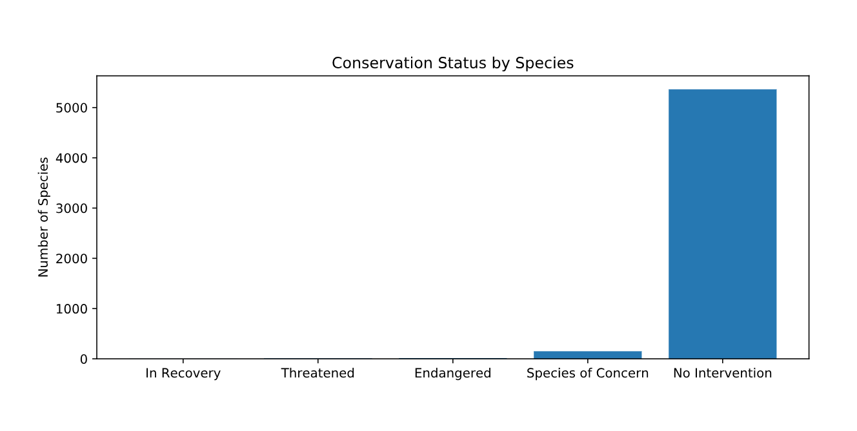
Data & Information on Species
Species are categorized by Endangered, In Recovery, Species of Concern, and Threatened.
Our data tells us the following number of species per category
Endangered: 15
In Recovery: 4
Species of Concern: 151
Threatened: 10
Several species do not fall under one of these categories
No Intervention: 5363

Slide 3
Significance of Species for Endangerment
The difference between the percentage of protected versus not-protected birds and mammals proved to be insignificant. Birds were at a percentage of 15% and mammals at 15%. However, this was a result of chance.
The same analysis between reptiles and mammals proved a significant difference though in which reptiles were at 6%.
Therefore we can conclude that certain types of species are more likely to be endangered than others.
Species such as Birds and Mammals are more likely to be endangered and should be monitored in a higher priority over lesser in percentage endangered species.

Slide 4
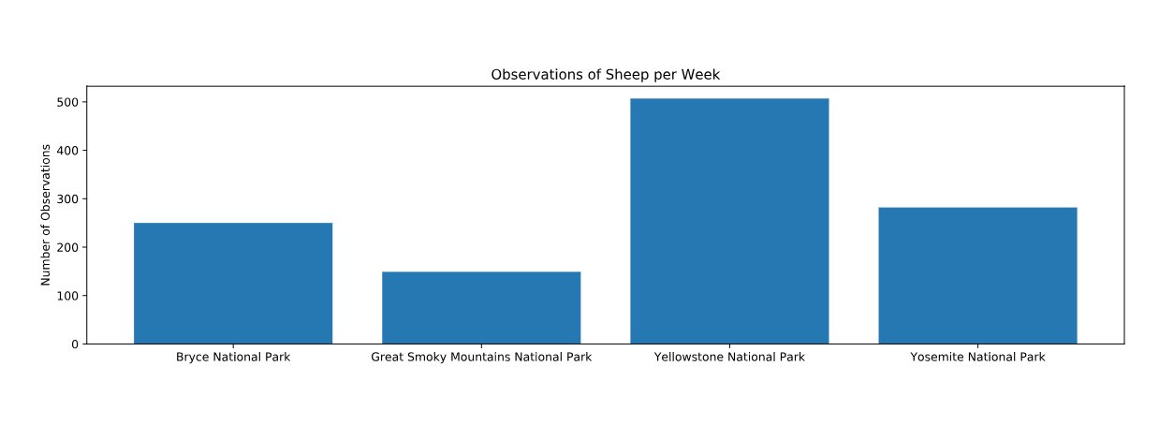
Sample Size Determination
Baseline is determined by the current percentage of sheep with the disease.
Minimum detectable effect is determined by taking the percentage of the baseline by the desired minimum amount.
Sample Size per variant is 870.
Dividing the sample size by the number of observed sheep per location will determine the number of weeks to observe enough sheep per location.

