Slide 1
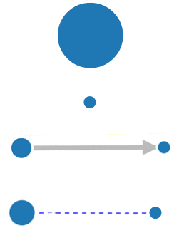



Used in many jobs
Used in few jobs
Imports/Depends On
Used in same job with
This application
Used mostly when this app is used
Used mostly without this app.

