Slide 1
Caustic Design
Camille Boillet,
Patrick Engelhard

Slide 2

Caustics

Slide 3
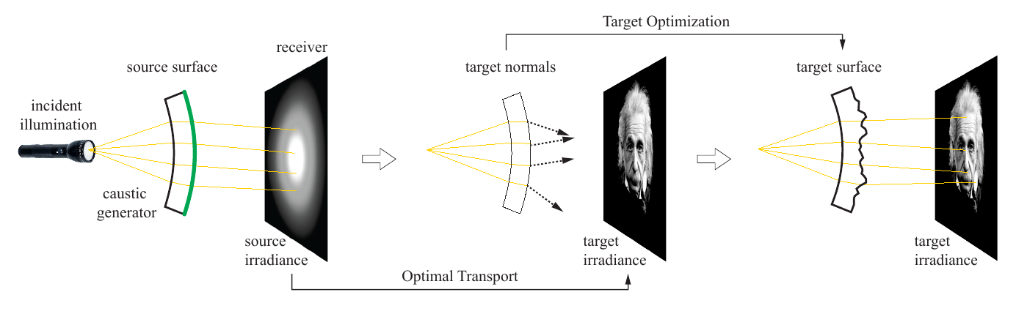
Algorithm

Slide 4
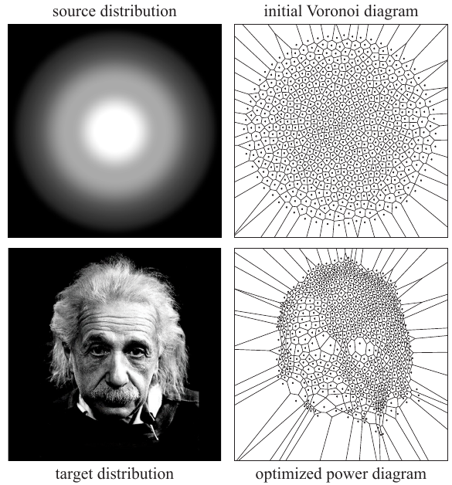
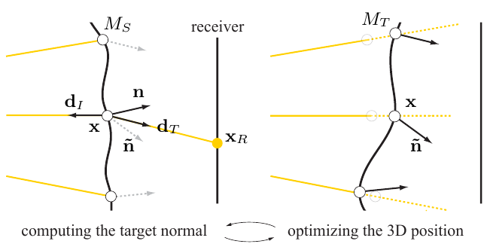
Steps of the Algorithm

Slide 5
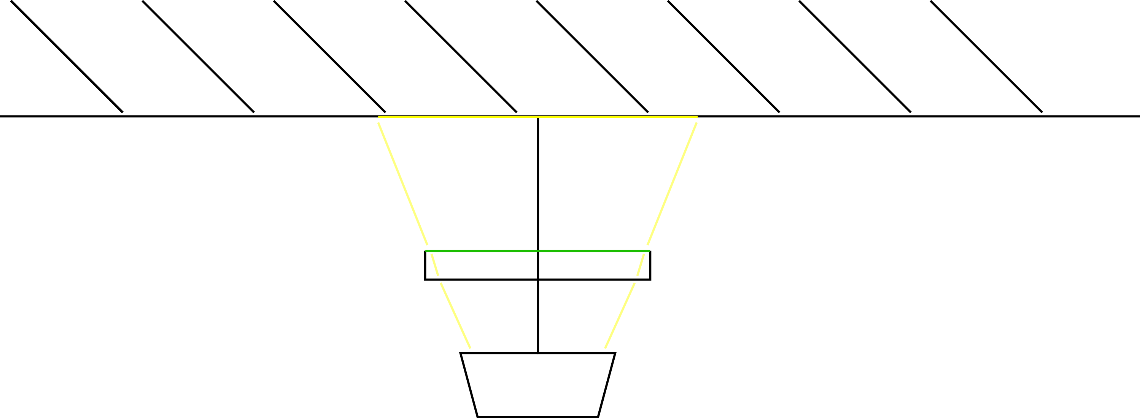
Fabrication

