Slide 1
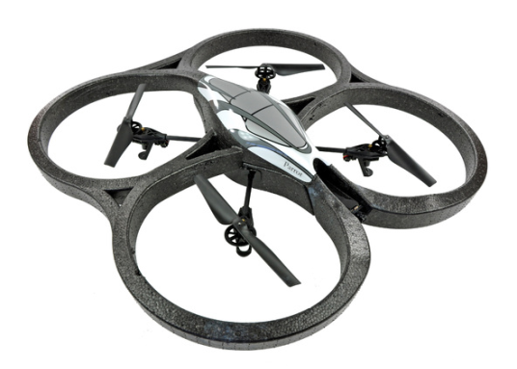
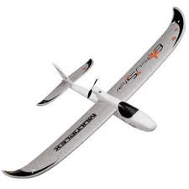
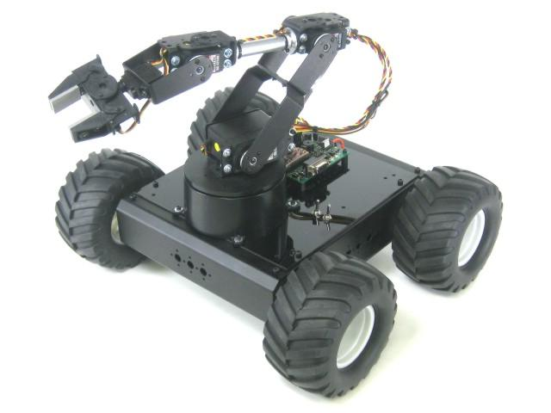
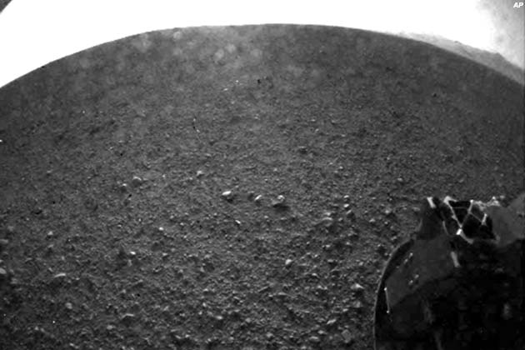
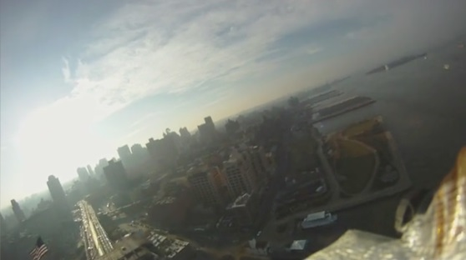

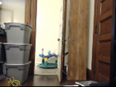

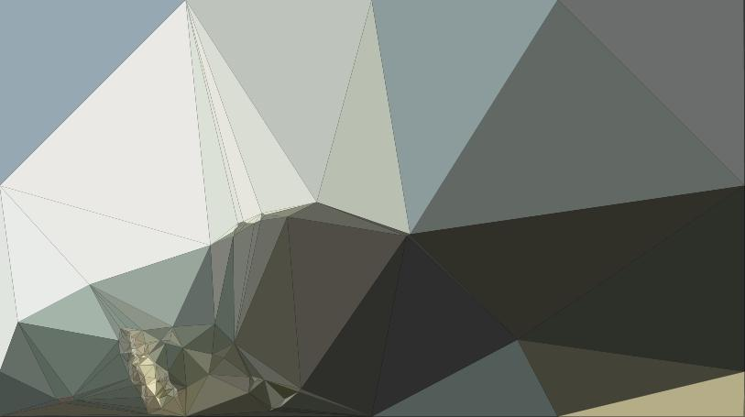



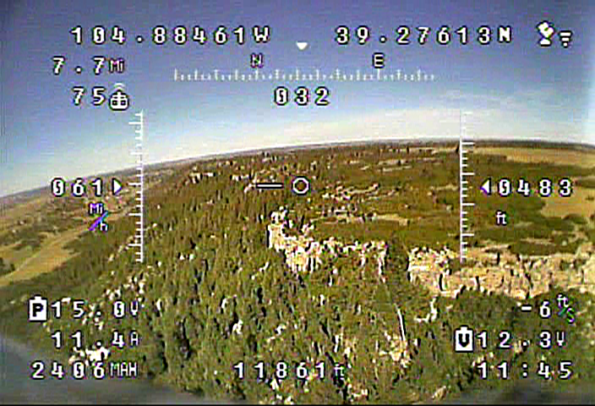
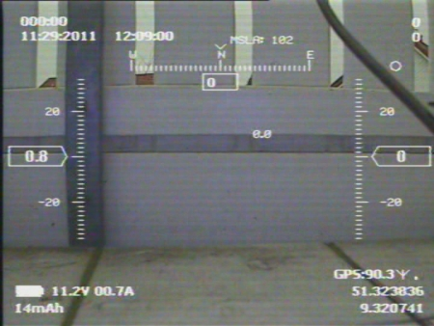
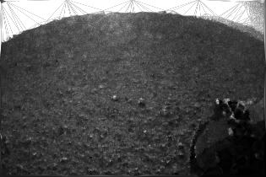
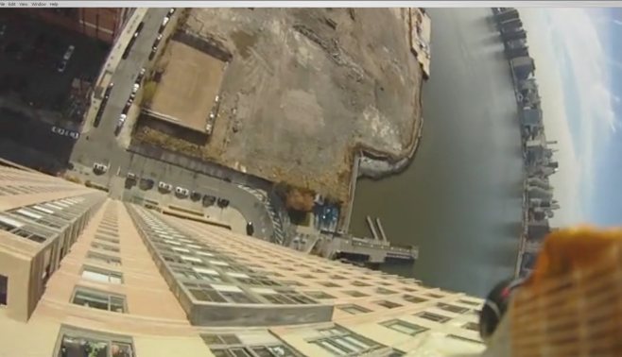
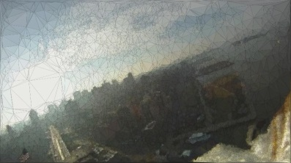
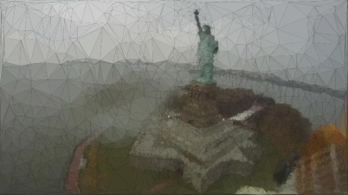
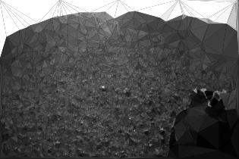
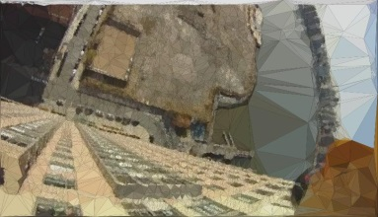
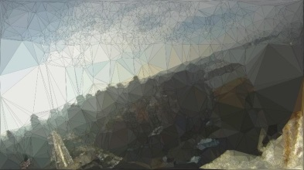
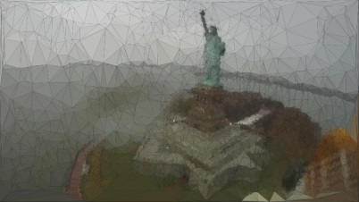
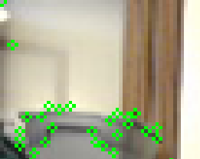
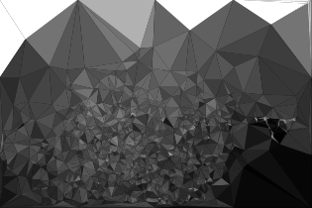

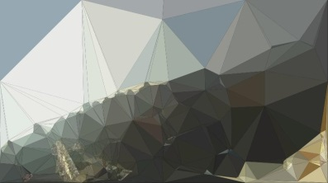
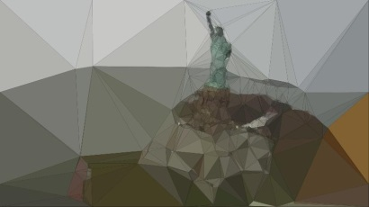
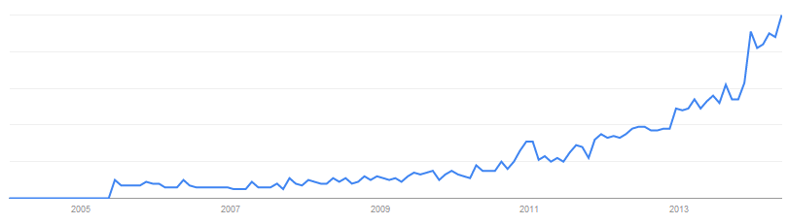
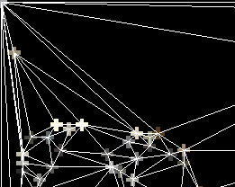
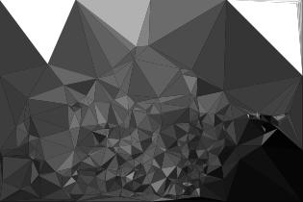
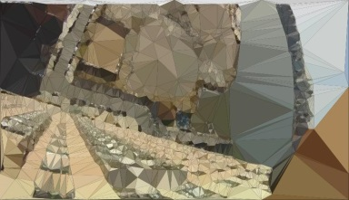
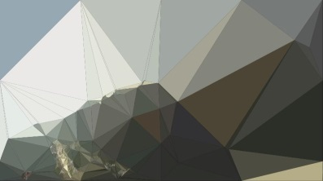
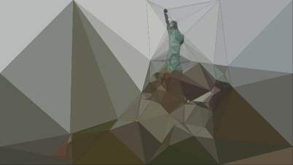
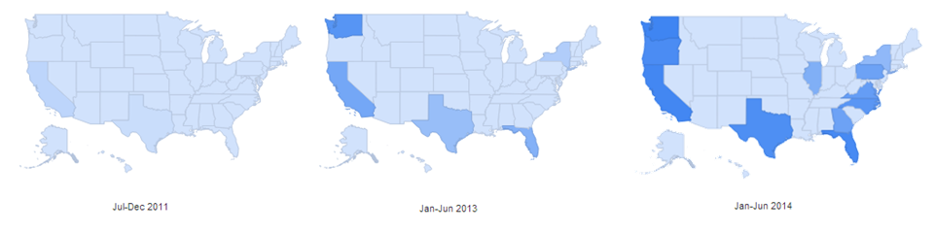
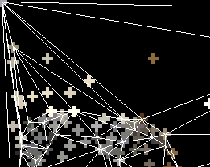
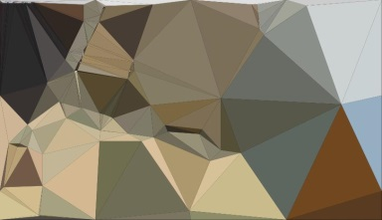

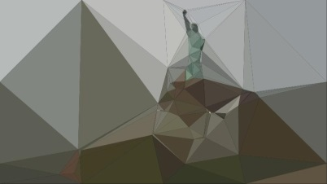
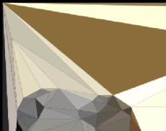
Real-Time Vector Geometry Based Video Compression for Low-Latency Teleoperation over Low-Bandwidth Connections
What is FPV?
What is the problem?
Results and Conclusions
Everything is in place except: Real-Time wireless video transmission
Many low-bandwidth devices are perfect form factor and price
But they cannot transfer data fast enough to support a useful video (max rate <<1Mb/s)
Feature Detection Comparison
Compression Time
Remote driving or flying an RC vehicle (drone) through wireless onboard video feed
Thrill/enjoyment/videography very similar to full sized vehicle for orders of magnitude cheaper
Enabling immediate disaster investigation, search & rescue, real-time information that was previously impossible/impractical
Compression Limited to 316 Triangles
630 x 420 pixels
Computer Vision Solution
235 | 22526
102 | 9104
18 | 1832
7 | 620
4 | 316
Reduce Dimensionality
1627 x 910 pixels
Assume only subset of image data is needed
Corners
Edges
Areas of high contrast
Areas of high detail
Watching objects move = operator can build intuitive environmental model
Sounds like Structure From Motion!
Compression Ranges
Original Size KB
280
1329
1470
716
Compressed Size KB
# of Triangles
Explosion in Interest and Usage
Hobbyist
Venders
Open source projects
Fierce market competition driving down prices
Professional (Non-military)
Real estate
Agriculture
Environmental /conservation
Search and rescue
Research
Algorithm Description
Find Features
Pseudo Segmentation
Triangle Color
Encode/Render
“fpv” US Google Trends
References
Federal Standard 1037C Glossary of Telecommunication Terms http://www.its.bldrdoc.gov/fs-1037/fs-1037c.htm
How I Accidentally Kickstarted the Domestic Drone Boom CHRIS ANDERSONhttp://www.wired.com/2012/06/ff_drones/all/
"Data Source: Google Trends (www.google.com/trends)."
End of 2011
End of 2013
Beginning of 2014
"Data Source: Google Trends (www.google.com/trends)."

