Slide 1

Statistics and the Logic of Discovery
Dan Maxwell, PhD and Sarah Meyer, MS

Slide 2
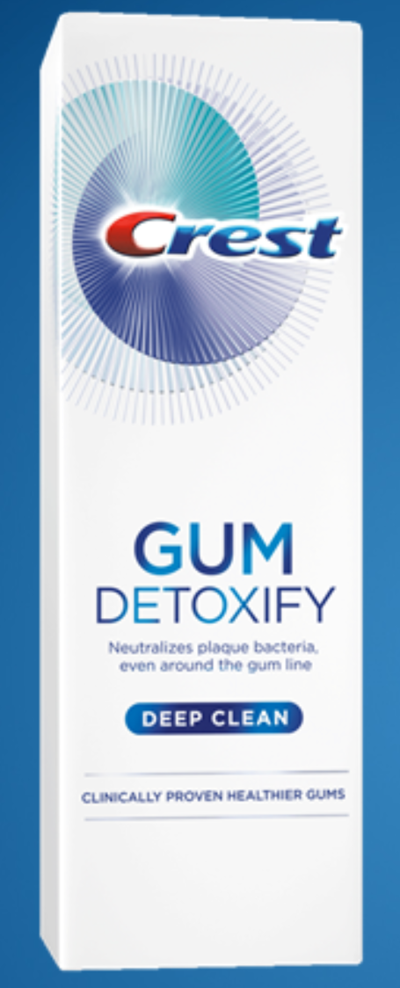
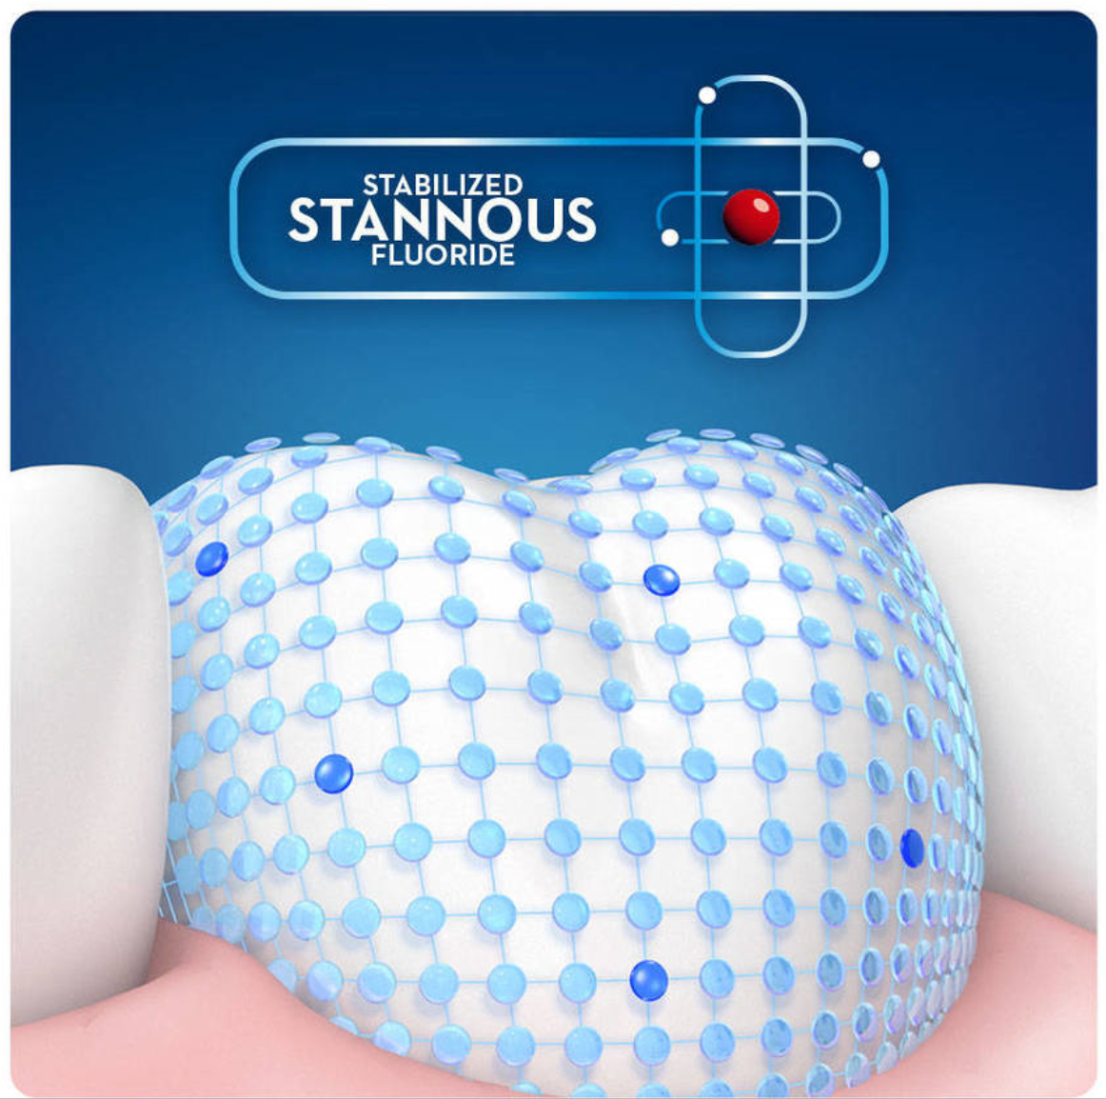
Gum Detoxify (Website)
Gum Detoxify (TV Advertisement)

Slide 3
One of your future dental clients asks, “Should I use Crest Detoxify? Is there scientific ‘proof’ that this product works?”
How would you respond?

Slide 4
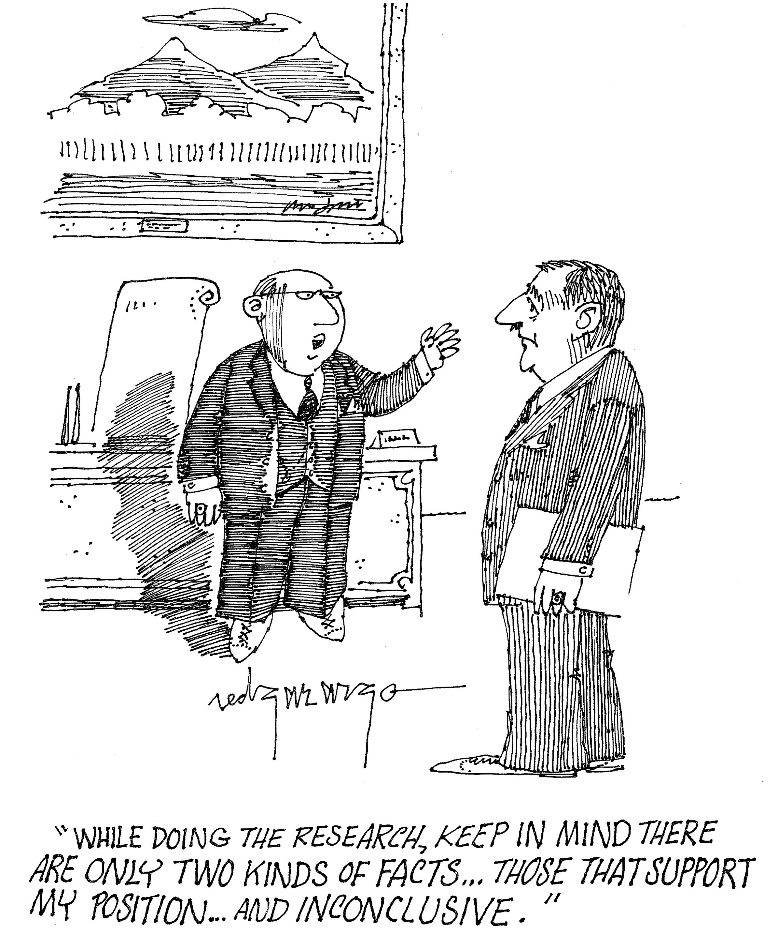
Notes:
To maintain your professional independence and credibility, you don’t want to sound like a walking Crest commercial. On the other hand, the Crest product might be superior to alternatives. The problem is that a lot of medical research is funded by big corporations with vested interests in achieving certain outcomes. Is that the case here? Is the research biased?
In this clinic, we will walk you through the basics of the scientific method and the process a scientist would undertake to either confirm or refute a claim like the one being made by Crest, using nothing more than basic statistics.

Slide 5
How would you design an experiment to justify or invalidate the claims Crest makes?
Notes:
With your existing knowledge of microbiology, you know that a subset of bacterial species have been linked to gingivitis, cavities, and oral bleeding. Thus you know that a reduction in "bad bugs"" is a good thing, resulting in a healthier mouth.
Keep in mind that research is never done in a vacuum. As researchers, we already know certain things – assume certain things are true – and that knowledge, in turn, shapes our research question(s) and the ensuing inquiry…
So if Gum Detoxify works, as Crest claims, we should observe less gingivitis and bleeding in populations that use it on a regular basis. In other words, the product will prove effective at eliminating bad bacteria and that, in turn, should promote healthier gums and teeth.

Slide 6
Control
Treatment
Notes:
The most basic research design is when an investigator compares two groups. In statistics, these are called the control and treatment groups. As its name suggests, our treatment group consists of individuals who use Gum Detoxify while our control group consists of individuals who use a competing product that does not have stannous fluoride in it. Or do not brush at all.

Slide 7
Null Hypothesis (H₀)
Research Hypothesis (H_{a})
Notes:
The outline of a possible research design is now coming into view. The first step is to state our null and research hypotheses. The research hypothesis - also known as the alternative hypothesis - states what happens when the treatment works. The null hypothesis, on the other hand, states what happens when there is no observable treatment effect, when the treatment does not work. It is considered good form to write both out, at the start of a research project.
In the research literature, the symbol for the null hypothesis is $H_{0}$, spoken as H naught or H zero. The alternative hypothesis is usually written as $H_{a}$.

Slide 8
What’s the null and alternative hypotheses for the stannous fluoride research project?
Notes:
Our alternate hypothesis states that the population of people who use a stannous fluoride toothpaste will obtain lower gingival health and bleeding scores than the population of people using products that lack this ingredient. Our null hypothesis, on the other hand, states that there will be little-to-no difference between the gingival/bleeding scores for the two groups.

Slide 9
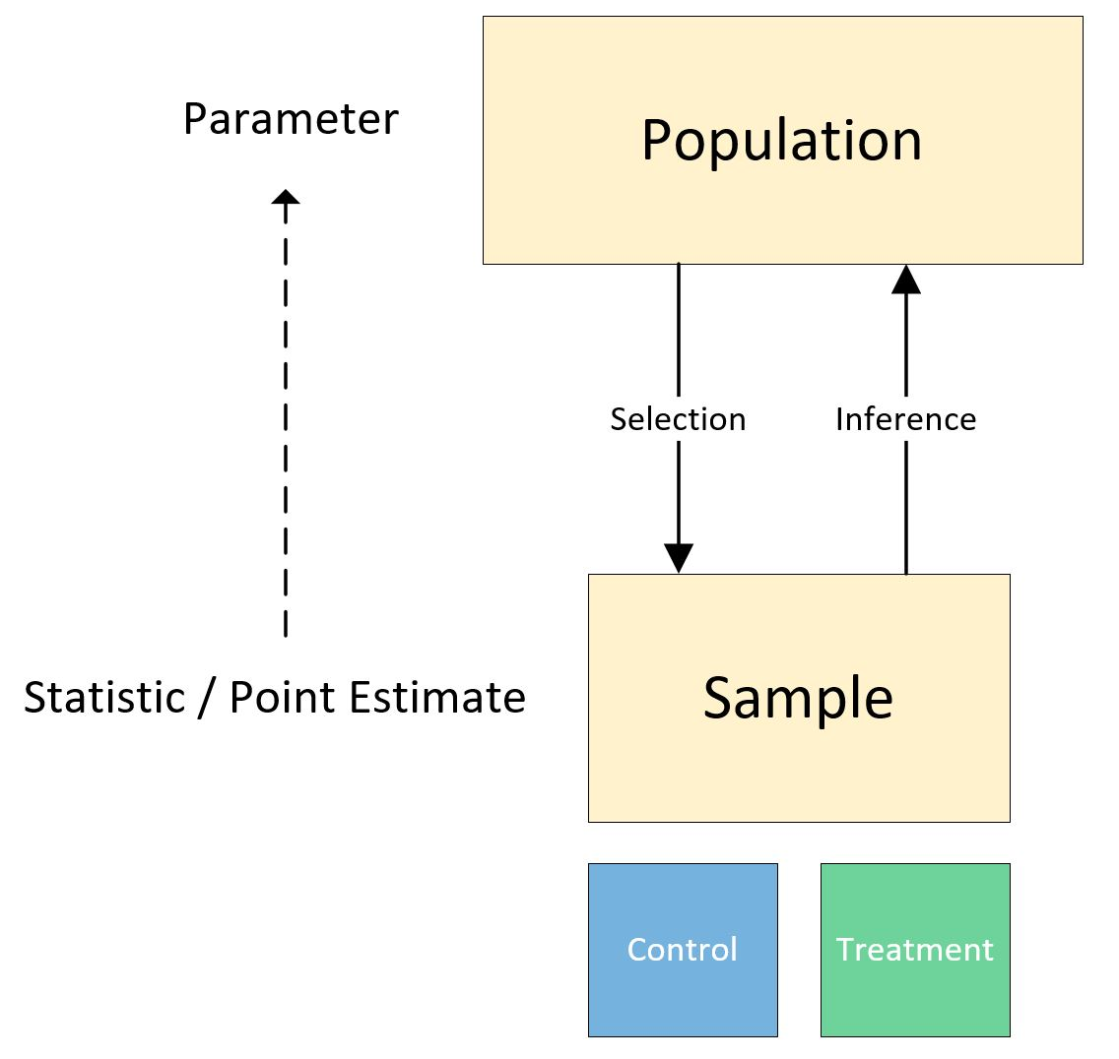
Notes:
With our two hypotheses defined, we now recruit study participants, drawing a sample from the population of potential candidates. If done well, our study participants will represent the population from which they were drawn -- by age, race, income, gender, and so forth. Here we want to avoid drawing a biased sample. Our sample, in turn, provides us with a statistic, a point estimate of a population parameter.
Our next step is to randomly assign each study participant in our sample to either the control or treatment group, a process that can be done easily in R or a statistical package such as SPSS, Stata, or SAS. We also need to select an appropriate study duration. Do we want to compare the two groups for 6 months, a year, or some other length of time?
And finally, we need to select an appropriate instrument to measure the oral health of our participants. In this case, two indices are probably needed, one to measure gum health and a second to score bleeding.

Slide 10
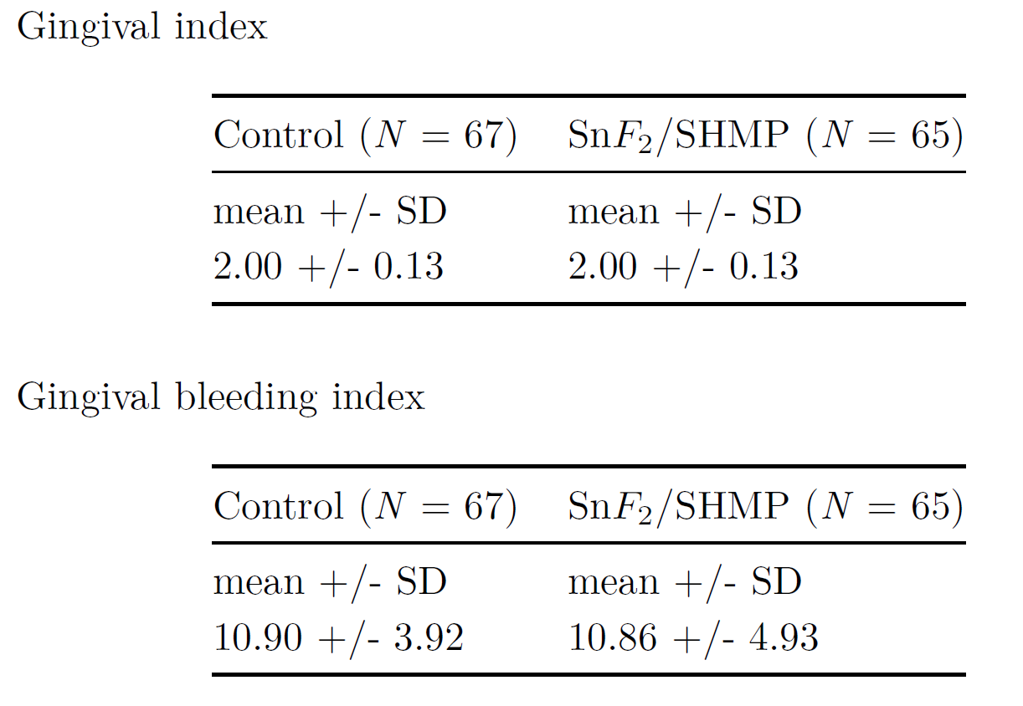
Baseline
Notes:
With a basic understanding of research logic in-hand, let’s take a look at some data from an actual study. These tables are from an article by Mallett, et al., published in 2007 in the Journal of Clinical Periodontology. A complete reference is provided at the end of this presentation. As noted in a previous slide, we see that these authors selected two indices. The first measures the participant’s overall gingival health, the second measures gingival bleeding. Note: smaller numbers are better.
Let's briefly review some basic statistics vocabulary. N is the number of observations. From the two tables, we see that the sample size for the two groups differs by 2. SD stands for Standard Deviation, a measure of the spread of the data about the mean. In a normal distribution, 68% of the scores are within 1 SD of the mean, 95% within 2 SDs, and 99% within 3 SDs. Unfortunately, we don't have time in this session to delve into the details. And finally, the mean is the average of the scores and is calculated by summing the scores and then dividing by N. The mathematical notation looks like this: $M = \frac{\sum X}{N}$
With baseline scores obtained, we can now begin the study, being diligent to monitor participant adherence to the protocol. That is, we want to ensure that participants in the treatment group only use Sn$F_{2}$ infused toothpaste while those in the control group brush with a product that does not contain this chemical.

Slide 11
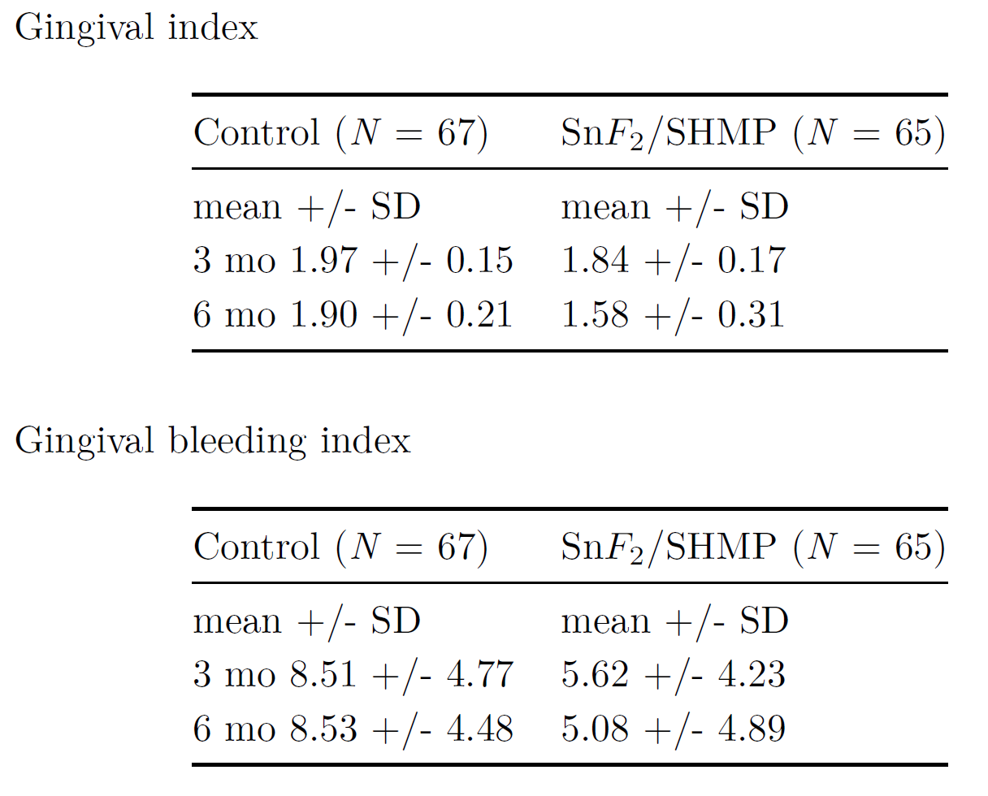
3 & 6 Month Observations
Notes:
A cursory glance at these numbers indicates that participants in our treatment group have lower mean values. Our research hypothesis appears to be true -- regular usage of Gum Detoxify reduces gum inflammation and bleeding. But can we be sure? How do we definitively rule out the null hypothesis, the idea that our treatment numbers are the product of pure chance (sampling error)? If we ran the experiment again and observed little, if any, difference between our control and treatment groups, that would tend to support the null hypothesis. To bolster our argument that SnF infused toothpaste is effective, we could run additional studies or find others which compare it to regular toothpaste. Then, we could conduct a meta-analysis to arrive at an overall conclusion.
So – case closed? Are you ready to recommend that your patient immediately begin using Crest Detoxify?

Slide 12
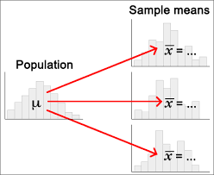

Say “Hello” to the Variance Monster
Notes:
Well, not so fast… there’s a big gotcha here. Say “Hello” to the Variance Monster. Here’s the problem. Earlier, we divided our sample into control and treatment groups. Each group then became a sub-sample, representing either the population of those who use Crest Detoxify or the population of those who don’t. But because of chance, samples vary – sometimes greatly – and provide imprecise estimates of the true population mean. In other words, chance creates noise, making us less certain of the conclusions we tentatively reached in the last slide.
Let’s visualize the problem. To do so, I’m going to conduct a simulation using a special Excel spreadsheet developed by Geoff Cummings, the author of Introduction to the New Statistics.
Run simulation with the ESCI Cijumping tab. Click on Mean Heap at Red 5. Turn off Confidence Intervals at Red 6.
This is very interesting. The sample means fall mainly within the two lines which delimit our margin of error. However, there’s a lot of variability here. A few sample means fall outside our two lines and are thus poor estimates of the population mean (parameter). On the other hand, other samples fall close to the true mean. So how do we communicate this sample variation? How do we add a certain level of fuzziness to our point estimate? Drum roll. Enter the Confidence Interval.

Slide 13
Definition: Confidence Interval (CI)
An interval which has an χ% chance of containing the population parameter of interest. (90%, 95%, and 99% are popular options for χ)
Source: https://rpsychologist.com/d3/CI/
Notes:
As we just saw in the ESCI simulation, our sample means jump from side to side. Those outside the margins of error could actually be considered misleading. Imagine if we conducted a single study and obtained an extreme value like one of those pictured in this simulation. Would you feel comfortable making a clinical recommendation based on that alone? Thus replication and meta-analysis are becoming more and more important in medical research.
Now that we’ve defined what a confidence interval is, let’s visualize it in ESCI.
Near red 6, make sure C = 95 and that Assume s is: Known is selected. Click CIs. Near red 7, click m line and Capture of m.

Slide 14
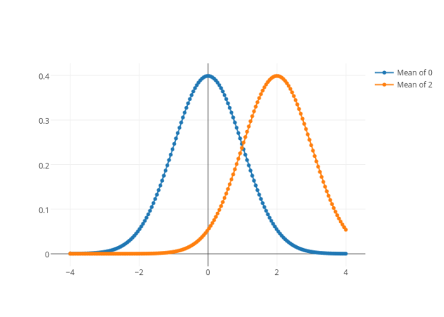
A p-value is the probability of observing a result equal to, or as extreme as the actual value observed, assuming the null hypothesis is true.
Notes:
Can the Variance Monster be defeated?
Clearly, what we need is a way to determine if the observed distance between the control and treatment means is large enough to silence the Chance Monster once and for all. Or, as statisticians would say, “Are the results significant? That is, is it highly unlikely (improbable) that the observed difference between our SnF treatment and control groups is due to chance? In the case of traditional NHST, this is done by calculating a p-value. However, this leads to binary (yes/no) thinking. P is significant, typically less than .05, or it isn’t – in which case a research journal will probably not publish the findings. And, as we saw in our first ESCI simulation, a point estimate can vary greatly, thanks to chance. The problem is that NHST gives us an illusion of certainty whereas the reality is much more nuanced.
Let’s take a look at the difference between our control and treatment groups from a confidence interval point-of-view. The numbers in ESCI are for the gingival index at 3 months. (ESCI – Click on Summary Two) The farther apart the two groups are from each other, the lower the p value. A large difference is strong evidence against the possibility of this outcome being due to chance.

Slide 15
Given these results, what can we conclude about the claims Crest has made for Gum Detoxify? Does the evidence support or disconfirm the claim that stannous-fluoride infused products like Gum Detoxify reduce gum inflammation and bleeding?
Notes:
With all of the evidence in-hand, it's time to make a decision. Do we reject or fail to reject the null hypothesis? The null hypothesis, in this case, is the claim that stannous-fluoride toothpaste is no better than regular toothpaste at reducing gum inflammation and bleeding. In other words, the results obtained from our study are due to chance and sampling error.
At this point, an important point needs to be kept in mind. One never accepts the null hypothesis. Rather, one rejects or fails to reject it. Furthermore, rejecting a null hypothesis does not conclusively prove that the alternate hypothesis is true. There is always the possibility of mistakenly rejecting a null hypothesis and claiming a treatment effect when none actually occurred.
The alpha level quantifies the level of risk we're willing to accept, of rejecting the null hypothesis when it is true. This is known as a Type I error. It does so by setting the cutoff values of the rejection region(s). Thus an alpha level of 0.05 indicates that we're willing to accept the risk of committing a Type I error in 5% of cases. To reduce that risk, we would simply reduce the alpha level to possibly 1% or lower. But doing so comes at a cost - we must increase the number of study participants which, in turn, increases the cost of the project.
See page 164 An Introduction to Statistics for discussion of why we do not accept the null hypothesis…

Slide 16
Reference
Mallatt, M., Mankodi, S., Bauroth, K., Bsoul, S. A., Bartizek, R. D., & He, T. (2007). A controlled 6-month clinical trial to study the effects of a stannous fluoride dentifrice on gingivitis. Journal of Clinical Periodontology, 34(9), 762-767. doi:10.1111/j.1600-051x.2007.01109.x

