Slide 1
The DataStory Initiative
Rethinking Data Education in the Precision Health Sciences

Slide 2
Agenda
The need for a new approach to data education.
So what is a data story?
Initial research objectives.

Slide 3
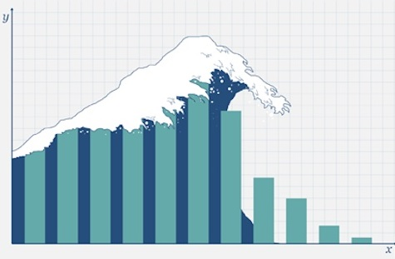
Our students face a data deluge…

Slide 4
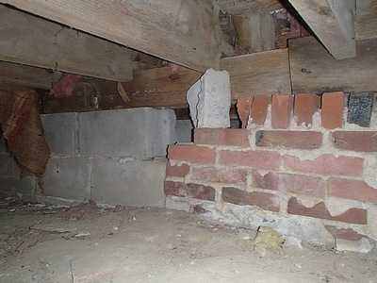
…but their technical foundation often looks like this.

Slide 5

…while our technical training sounds like this.

Slide 6
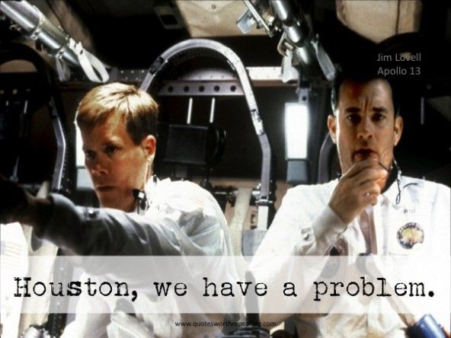
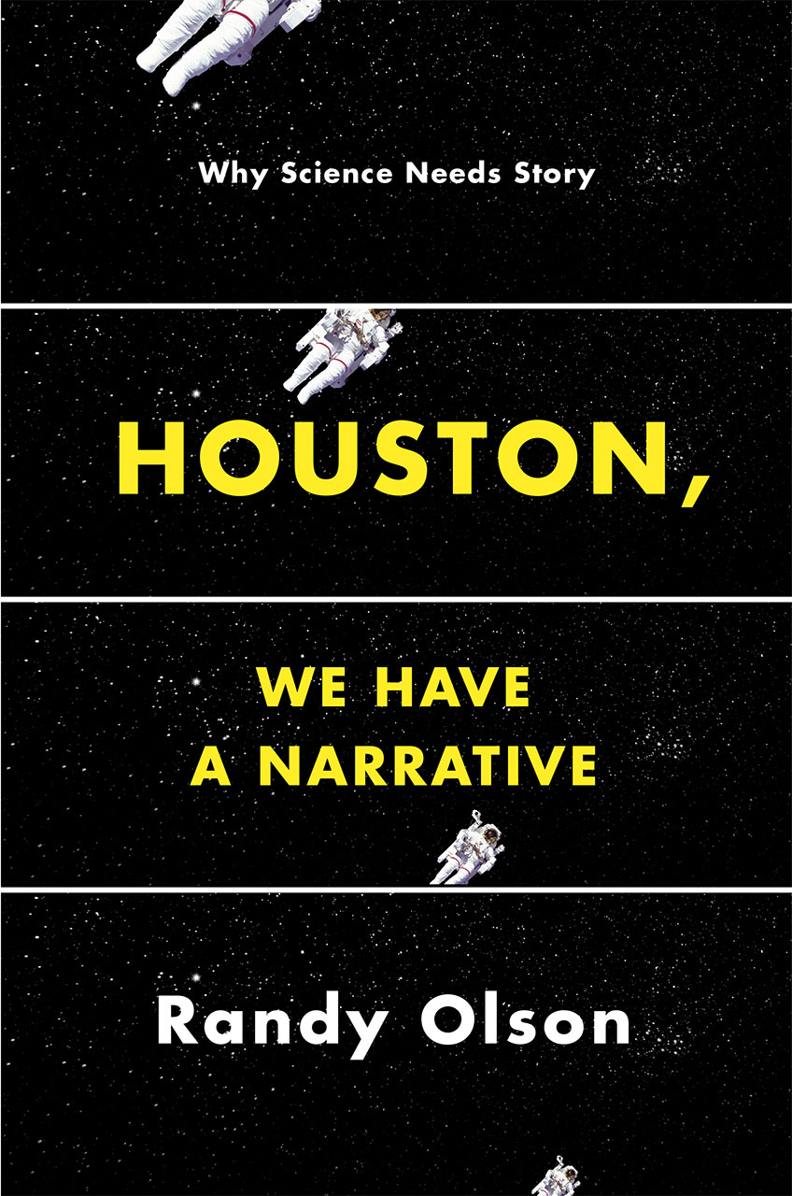

Slide 7
So what is a DataStory?
What do you get when you cross a group of comic book characters with a dataset, basic statistics, and open-science tools? You get a data story.
A data story – as its name suggests – is narrative about a data set with the primary objective of educating even as it engages the student in a journey through its narrative arc.

Slide 8





Data Stories Slated for Release

Slide 9
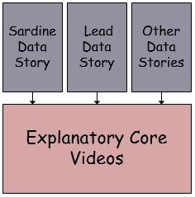
The Data Story Ecosystem

Slide 10
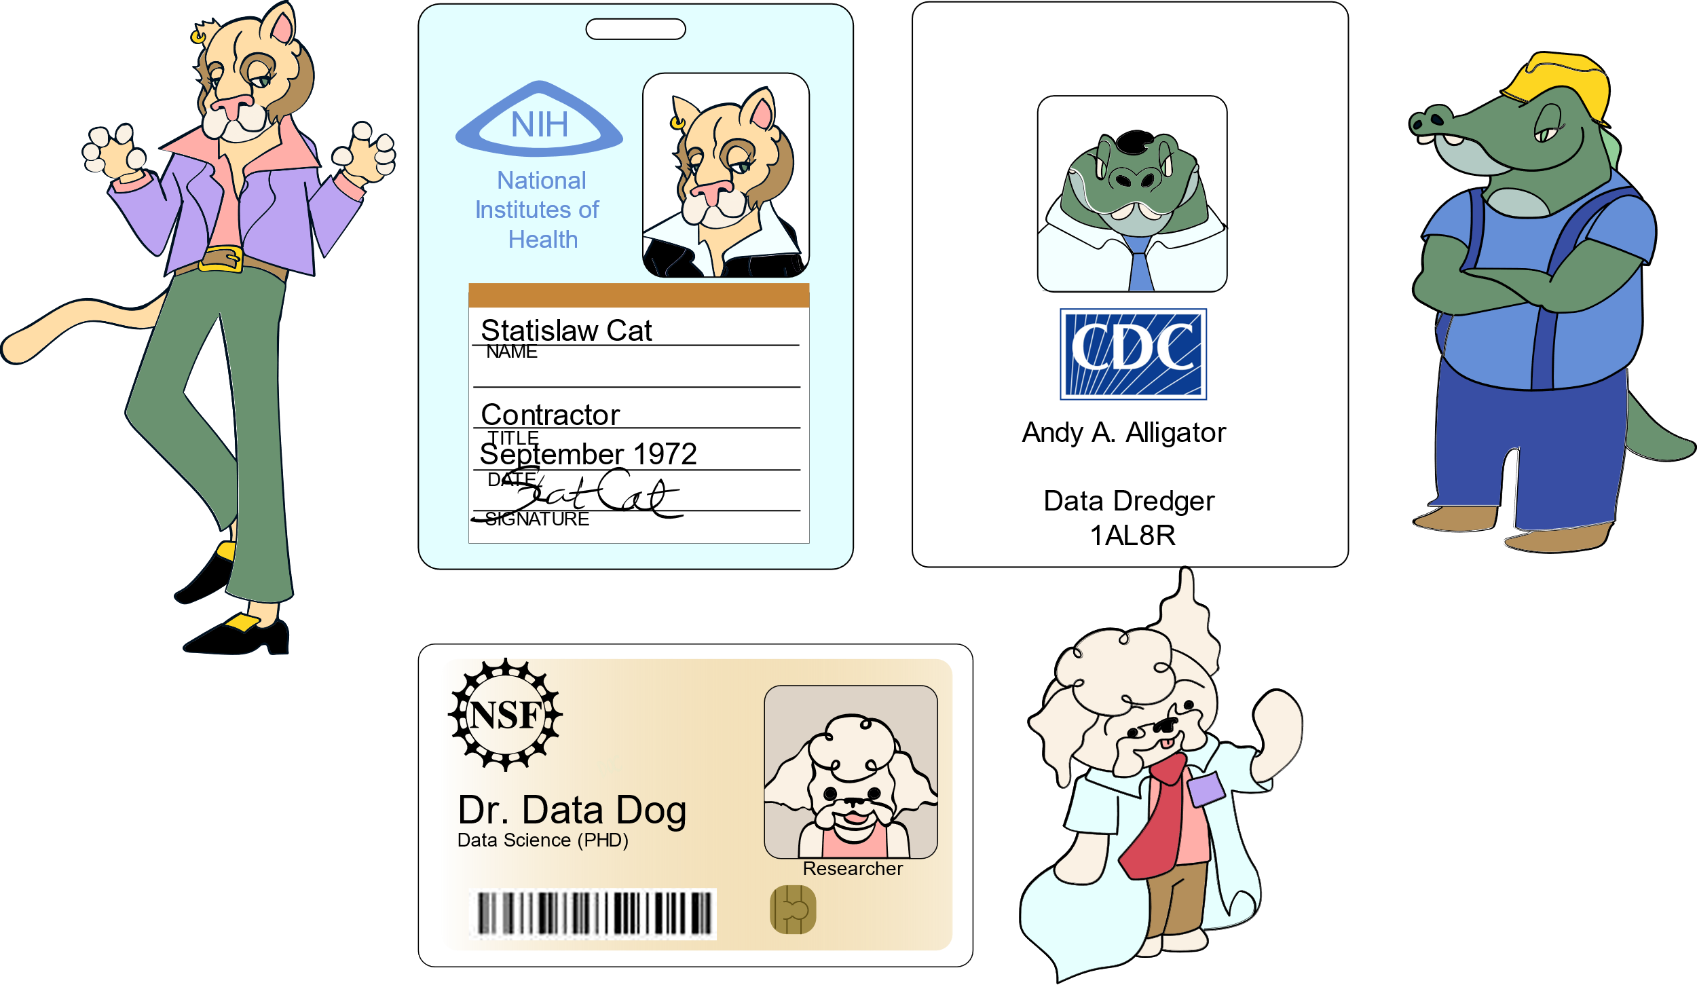
Our Explanatory Core Characters

Slide 11
Initial Research Objectives
Our initial research will assess the pedagogical effectiveness of Data Stories, specifically their ability to:
Arouse Emotion
Motivate
Engage

Slide 12


