Slide 1
Working with Data
Steven King

Slide 2
Big Data?
Big data is a buzzword, or catch-phrase, used to describe a massive volume of both structured and unstructured data that is so large that it's difficult to process using traditional database and software techniques.
We are working with structured data.

Slide 3
Rule #1
“Data does not lie but people do and they use data to do it.”
Anyone can draw conclusion from data and make broad statements without actually understanding it.

Slide 4
Rule #2
Duplicate your data and back it up in multiple places and ways.

Slide 5
How to find stories in data
Explore
Question
Test
Visualize

Slide 6
Explore The Date
Open in Excel,
Sort Columns
See how clean it is?
Make a graph or two
What stands out.

Slide 7
Oh, wait, Clean it up!
Most of the time data is dirty, ulgy and needs work.
You have to massage data.
https://github.com/OpenRefine/OpenRefine

Slide 8
Use the Scientific Method
Start with a question and a hypothesis
“Test” the hypothesis by querying the data and getting a very specific result.
Then write a new question and test.
Ask the questions everyone is asking
Then Ask the tough questions everyone is afraid to ask

Slide 9
Visualize
Now you can make some charts and graphs that demonstrate your conclusions.

Slide 10
Accuracy, Honesty and Integrity in Data!
Carful! Remember, people lie and they use numbers. Here are some things to keep in mind.

Slide 11
Correlation != Causation
Less Americans die in years when astronauts visited the moon than in the years since we canceled manned flight to the moon. Due to the higher number of deaths, NASA should reinstate moon missions.

Slide 12
Correlation != Causation
The introduction of sex education courses at the high school level has resulted in increased promiscuity among teens. A recent study revealed that the number of reported cases of STDs (sexually transmitted diseases) was significantly higher for high schools that offered courses in sex education than for high schools that did not.

Slide 13
Sample Size
BA OB SP OBSP
Brian LaHair .333 .400 .667 1.067
Ted Williams .344 .482 .634 1.116
baseball-refrence.com (BL: 9 AB on LHS vs. TW 162 ave)

Slide 14
Careful of Selection Bias
Online Polls,
Random Selection at a Mall
Phone call polls, etc.

Slide 15
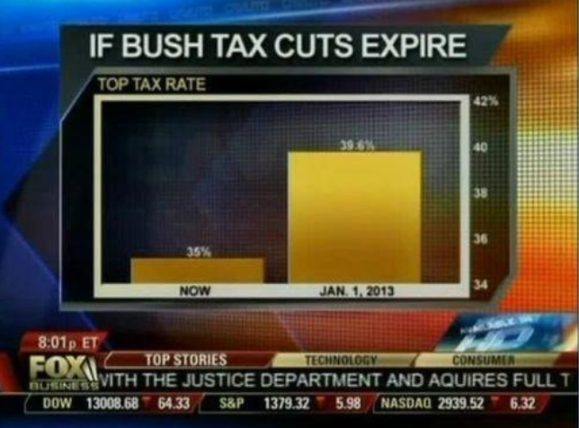
Misleading Visuals

Slide 16
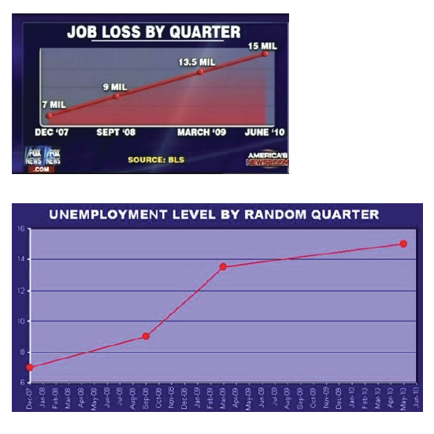

Slide 17
Careful with numbers
Do percentages add up?
Account for population changes over time
Look at scale in numbers and on charts.

Slide 18
Getting Data
Data.gov
Search for US Natural Gas Prices
Explore, Ask Questions

Slide 19
How to clean it up
http://science.kennesaw.edu/~jdemaio/1107%20sports%20and%20games/pie%20charts.pdf

