Slide 1
Twitter API
Using PHP to access Twitter REST Search API

Slide 2
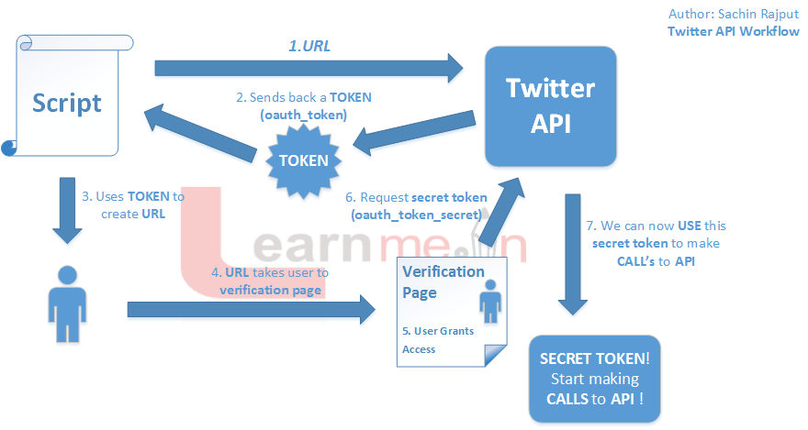
Understanding The Process

Slide 3
Step1: Create a New Application
http://dev.twitter.com
Click Sign in on top right
Go to My Applications under icon on top right
Click New Application top right

Slide 4
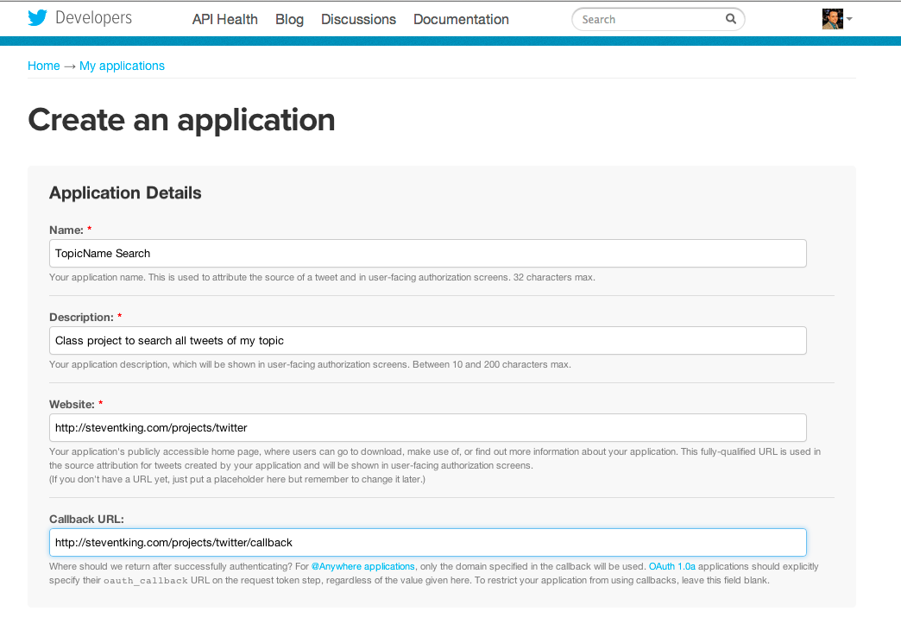

Slide 5
Step 2: Create Access Token
Click Create Access Token
Might have to wait a minute and refresh a few times
Token allows you access to the API

Slide 6
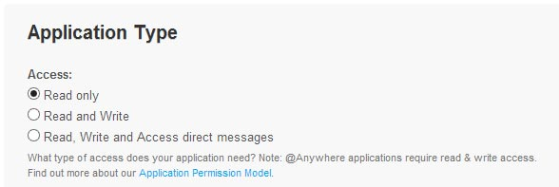
Step 2: Token set access

Slide 7
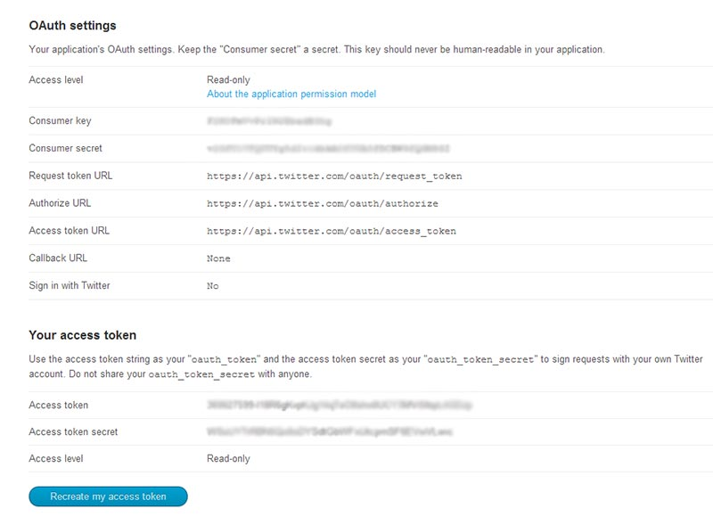

Slide 8
Why PHP?
Security and authorization. Twitter needs to make a request and receive a response.

Slide 9
Aside: Basics of PHP
Server
Syntax
HTML + PHP
Variables
Arrays
Loops

Slide 10
Server
Your server must run PHP. Most do.
This will not work locally

Slide 11

PHP Hello World

Slide 12
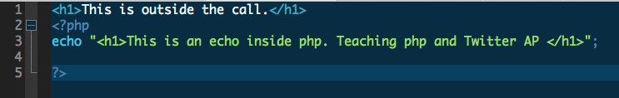
PHP echo and print

Slide 13
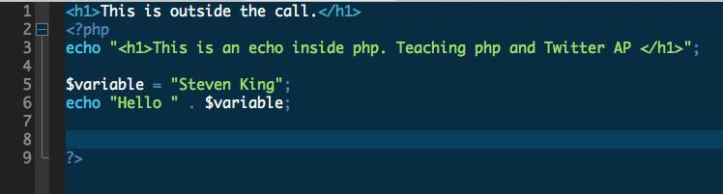
Php Variables

Slide 14
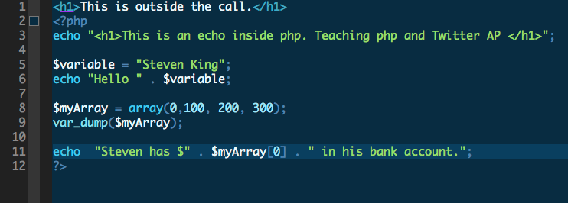
PHP Arrays

Slide 15
Back to Twitter, Step 3: PHP Wrapper
Simple PHP Wrapper for Twitter API
https://github.com/J7mbo/twitter-api-php
Handles the tough part. We pass it variables and params

Slide 16
Step4: Setup your app
myapp.php

Slide 17
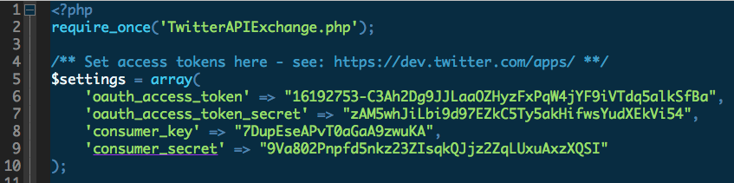
Apply Your Token and Access

Slide 18
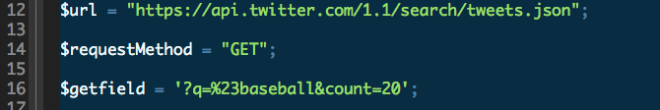
Setup Query

Slide 19
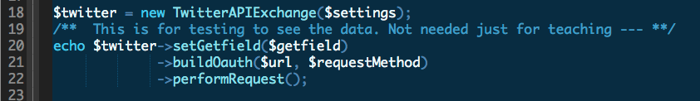
Look at the data

Slide 20
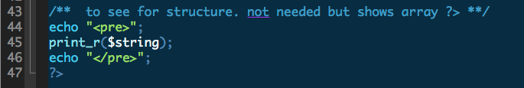
Need to debug?

Slide 21
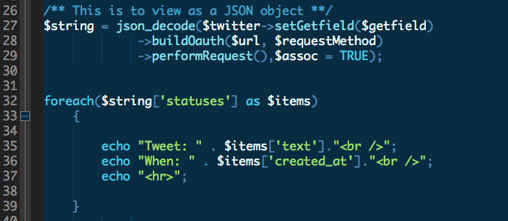
Loop and Display for each tweet

Slide 22
