Slide 1
Twitter API Introduction
For J586

Slide 2
Basics
Twitter is RESTful
meaining you use URLs with GET and POST for data

Slide 3
Actually 3 APIs
REST API
For editing, viewing, changing, personal stream
Search API
Look beyone your followers, for trends, searches, etc.
This is what we will use
Stream API
Fire Hose. Everything! Only for approved developers.

Slide 4
Search Twitter
Lets get all the tweets for a particular subject

Slide 5
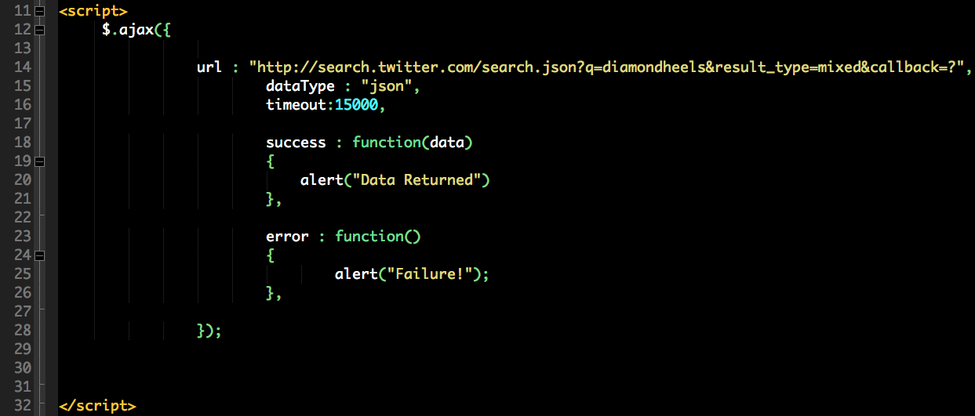
Start

Slide 6
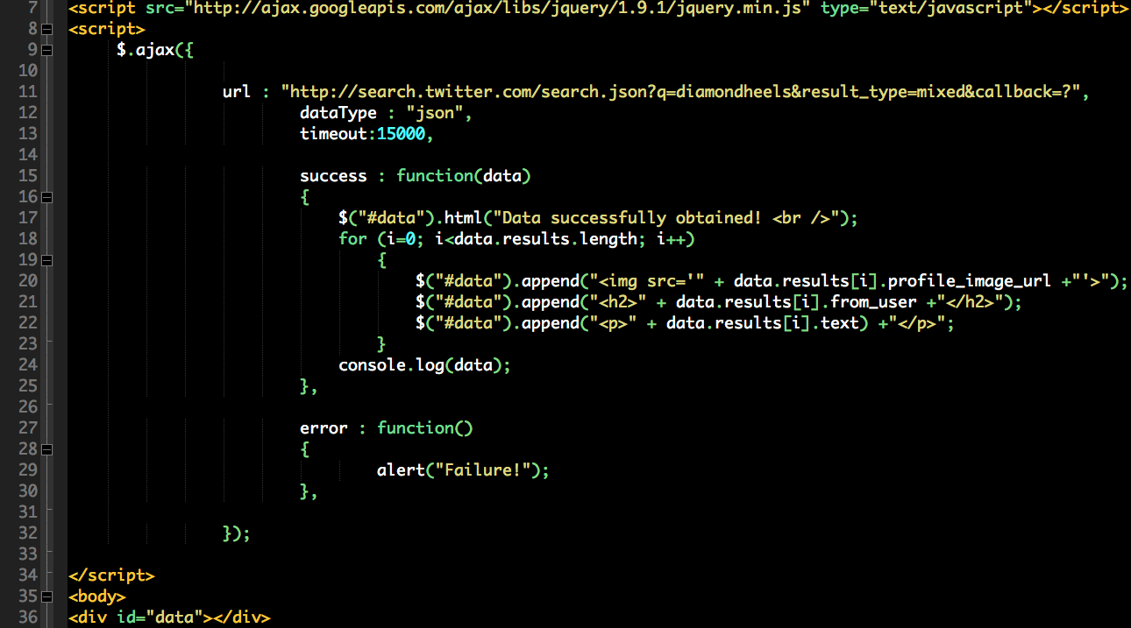
Final

