Slide 1
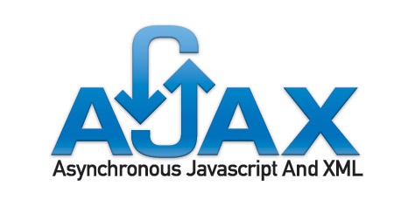
Intro to AJAX
Introduction to AJAX
AJAX, XML and JSON

Slide 2
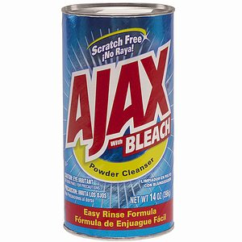
What is this AJAX
Asynchronous JavaScript and XML
A group of technologies working together to communicate with a server without interfering with the page or user experience.
Using JavaScript to get data from a server
Bathroom cleaner
Makes web pages web applications

Slide 3
A buzzword for something you use every day!
Form Validation
Search Engines
Shopping carts
Data Applications

Slide 4
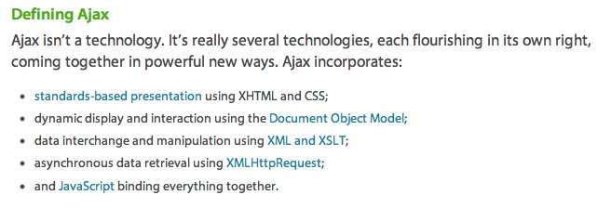
Computer Nerd History
Term coined February 18th 2005 by Jesse James Garnett on an article that defined what we know of today as a web application
It was Ajax (not AJAX) and not an acronym.
Source: Garnet, J. 2005: http://www.adaptivepath.com/ideas/ajax-new-approach-web-applications

Slide 5
XML
Extensible Markup Language
Structured Data Format
Easy to transport and store (load and save)
Human Readable
Well-formed (required to open and close tags)
Tags are intuitive and custom
Easily programed
You can do a lot more with XML than we will ever touch.

Slide 6
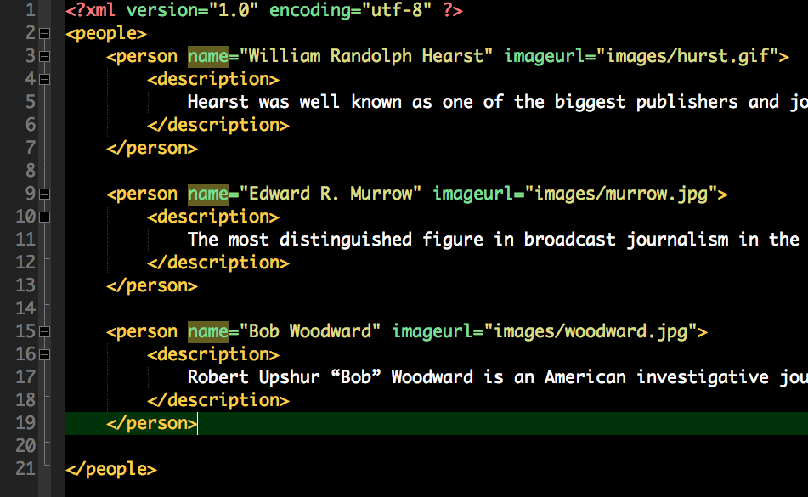
Example XML

Slide 7
JSON
JavaScript Object Notation
Structured Data Format
Easy to transport and store (load and save)
Human readable but maybe not as easy as XML (JSONP)
No closing tags
Written like JavaScript
Tags are intuitive and custom
Easily programed
Not as extensible as XML but great for data transfers

Slide 8
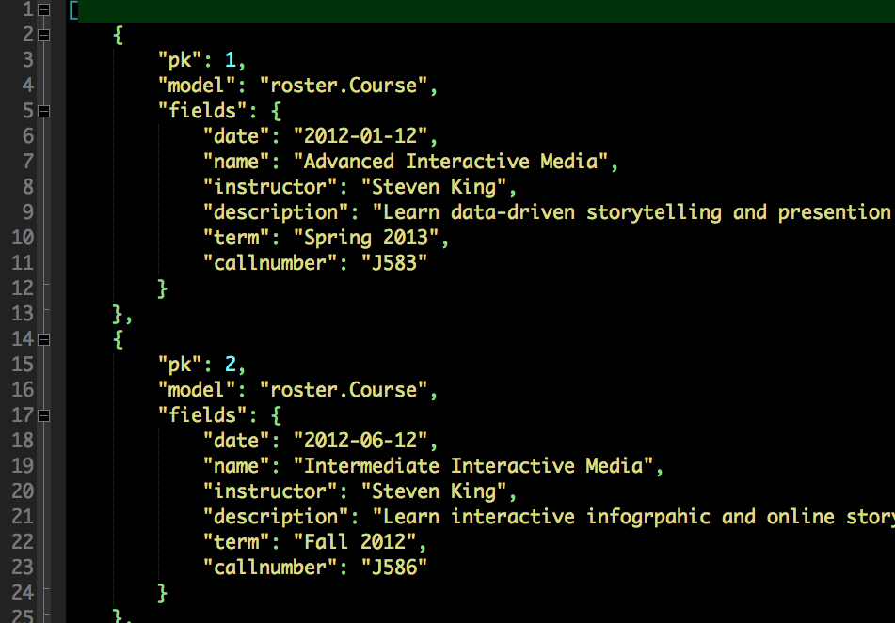
Example JSON

Slide 9
JSON or XML: The choice is yours
This is like the Mac or PC debate
Some argue XML is better because it is extensible while others argue JSON is better because it is simpler.
For large data sets, XML tends to be larger in file size because of the closing tags.
Use the right tool for the job. Both have purposes.

Slide 10
JavaScript Component
“Calls” the XML or JSON without reloading the page.
Data is displayed instantly when JS writes it.
Gives the impression of an application rather than a webpage

Slide 11
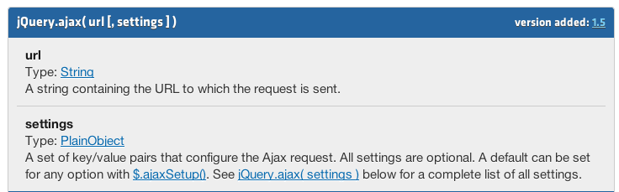
jQuery to the rescue
jQuery has a AJAX function/object
http://api.jquery.com/jQuery.ajax/

Slide 12

Starting Point
Open the index_start.html and save as index.html
CSS and jQuery files included
NOTE: Chrome does not like AJAX local but it does work on the server.
SO.... Lets run our own server....
Comand line:

Slide 13
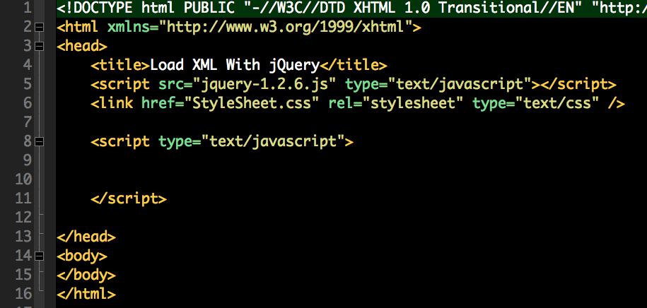
Starting Point
Open the index_start.html and Save as index.html
CSS and jQuery files included
NOTE: Chrome does not like AJAX local but it does work on the server. We will be testing in Firefox

Slide 14
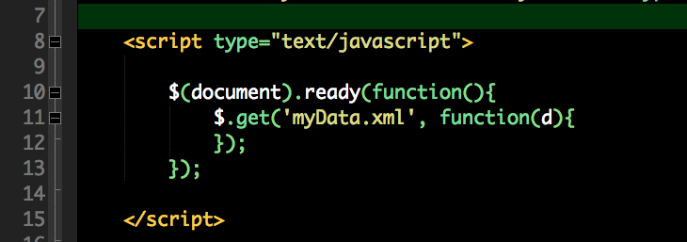
Document Ready Load XML
Inside a document ready function
Load myData.xml (relative url)

Slide 15
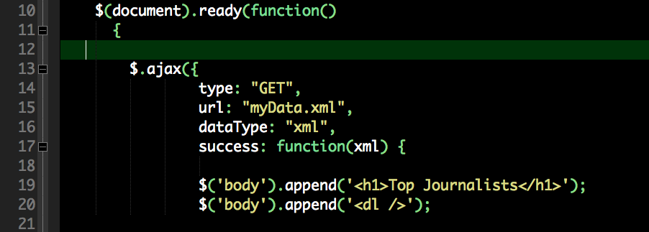
AJAX function

Slide 16
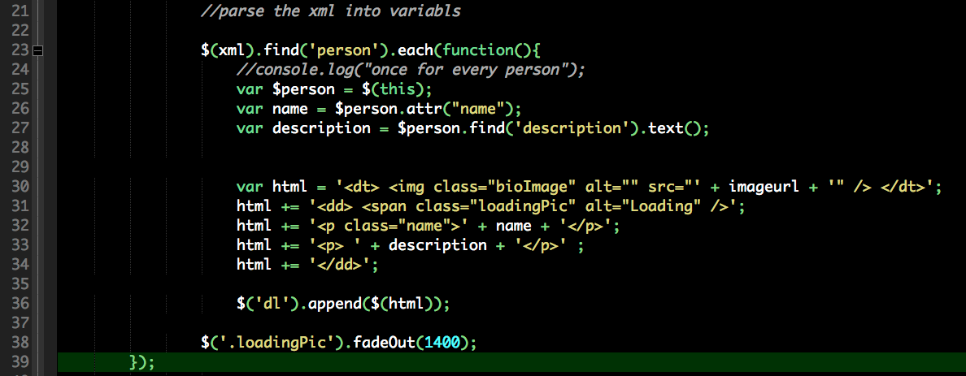
XML Loops

Slide 17
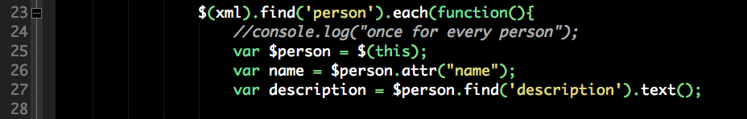
Find and hold data in the node
this refers to the current node selected or found

Slide 18
Nodes and Attributes
Nodes open and close
Attributes are values associated with a tag.
Retrieve the data differently.

Slide 19
Add a var for image url
On your own, create a variable called imageurl and place the url for the image in that variable.

Slide 20
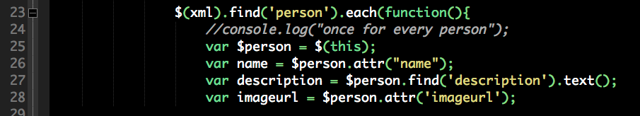
imageurl answer

Slide 21
HTML building variable

Slide 22
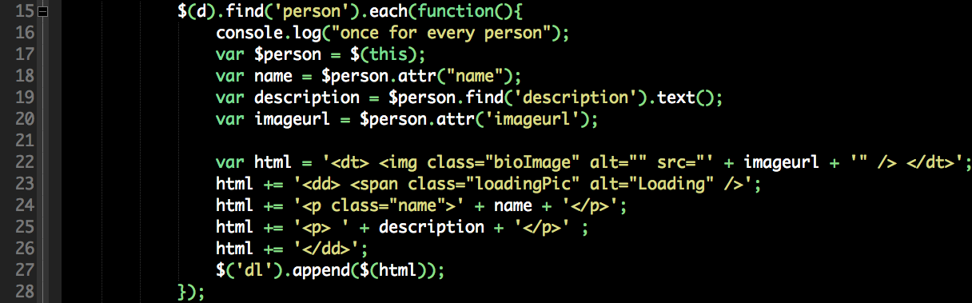
More dynamic HTML
Build the html of the page using += and calling the dynamic variables

Slide 23
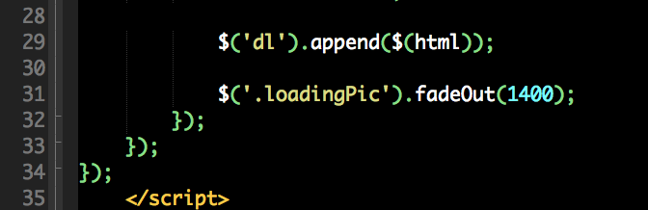
Showing Off!

Slide 24
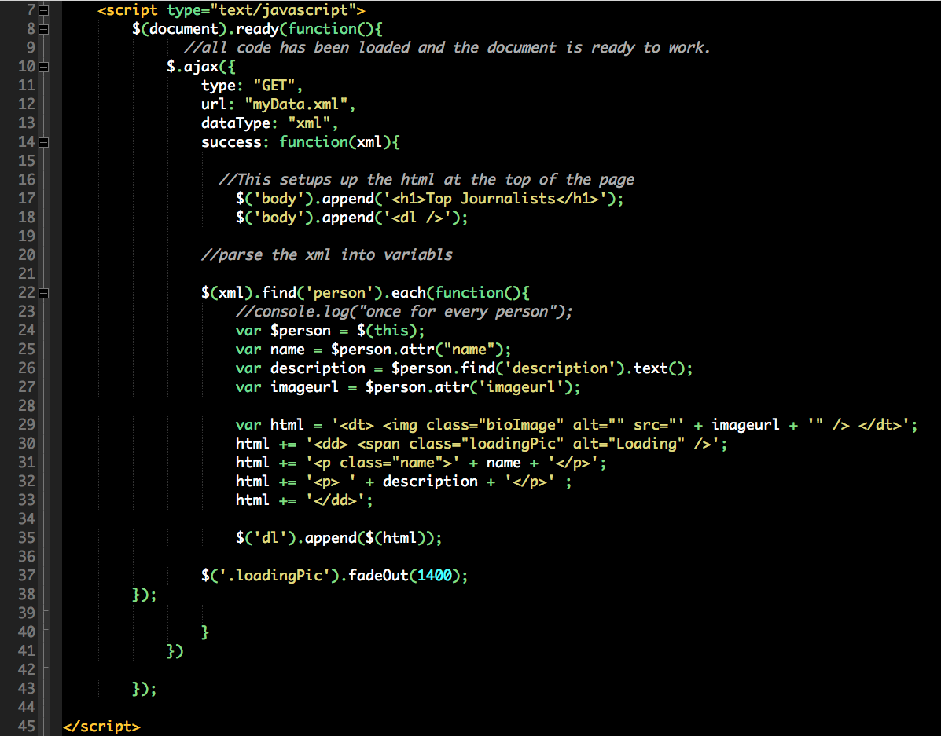
Entire Script

Slide 25
In Class Assignment
Repetition!
Open ncaa_start.html and save as ncaa.html
Create a dynamic page off of the ncaa.xml

Slide 26
