Slide 1
Working with Data
Steven King

Slide 2
Big Data?
Big data is a buzzword, or catch-phrase, used to describe a massive volume of both structured and unstructured data that is so large that it's difficult to process using traditional database and software techniques.
We are working with structured data.

Slide 3
Rule #1
“Data does not lie but people do and they use data to do it.”
Anyone can draw conclusion from data and make broad statements without actually understanding it.

Slide 4
Example
President Obama said, “A woman makes .77 for every dollar man makes.” ~SOTU 2014
Women make 14% less than men.
Women earn 38% of what men earn.
Using the same data, each is true but which is accurate?
Source: http://www.bls.gov/cps/cpswom2012.pdf

Slide 5
Example
Compare numbers across all job types, (hourly, salary, tip/service)
14% Difference
Normalize for less hours worked by women based on preference/choice
9% Difference
Account for preference to “better parental benefits”
5% Difference
Source: http://www.bls.gov/cps/cpswom2012.pdf

Slide 6
Example
10 Highest Paid Professions
10 Lowest Paid Professions
1. Petroleum Engineering: 87% male
2. Pharmacy Pharmaceutical Sciences : 48% male
3. Mathematics and Computer Science: 67% male
4. Aerospace Engineering: 88% male
5. Chemical Engineering: 72% male
6. Electrical Engineering: 89% male
7. Naval Archit. & Marine Engineering: 97% male
8. Mechanical Engineering: 90% male
9. Metallurgical Engineering: 83% male
10. Mining and Mineral Engineering: 90% male
1. Counseling Psychology: 74% female
2. Early Childhood Education: 97% female
3. Theology and Religious Vocations: 34% female
4. Human Services and Community Org: 81% female
5. Social Work: 88% female
6. Drama and Theater Arts: 60% female
7. Studio Arts: 66% female
8. Communication Disorders Sciences: 94% female
9. Visual and Performing Arts: 77% female
10. Health and Medical 55% female

Slide 7
Example
When comparing men to women across the same profession
7% difference
When comparing men and women that have chosen not to marry
4% difference
Source: http://www.bls.gov/cps/cpswom2012.pdf

Slide 8
Rule #2
Duplicate your data and back it up in multiple places and ways.

Slide 9
How to find stories in data
Explore
Question (Interview)
Test
Visualize

Slide 10
Explore The Date
Open in Excel or favorite table editor,
Sort Columns
See how clean it is?
Make a graph or two
What stands out.
What is missing?
What is obvious?
What seems wrong?
What seems crazy?
Why/How was the data collected

Slide 11
Oh, wait, Clean it up!
Most of the time data is dirty, ugly and needs work.
You have to massage data.
https://github.com/OpenRefine/OpenRefine

Slide 12
Use the Scientific Method
Start with a question and a hypothesis
“Test” the hypothesis by querying the data and getting a very specific result.
Then write a new question and test.
Ask the questions everyone is asking
Then Ask the tough questions everyone is afraid to ask

Slide 13
Visualize
Now you can make some charts and graphs that demonstrate your conclusions.

Slide 14
Accuracy, Honesty and Integrity in Data!
Carful! Remember, people lie and they use numbers. Here are some things to keep in mind.

Slide 15
Correlation != Causation
Less Americans die in years when astronauts visited the moon than in the years since we canceled manned flight to the moon. Due to the higher number of deaths, NASA should reinstate moon missions.

Slide 16
Correlation != Causation
The introduction of sex education courses at the high school level has resulted in increased promiscuity among teens. A recent study revealed that the number of reported cases of STDs (sexually transmitted diseases) was significantly higher for high schools that offered courses in sex education than for high schools that did not.

Slide 17
Sample Size
BA OB SP OBSP
Brian LaHair .333 .400 .667 1.067
Ted Williams .344 .482 .634 1.116
baseball-refrence.com (BL: 9 AB on LHS vs. TW 162 ave)

Slide 18
Careful of Selection Bias
Online Polls,
Random Selection at a Mall
Phone call polls, etc.

Slide 19
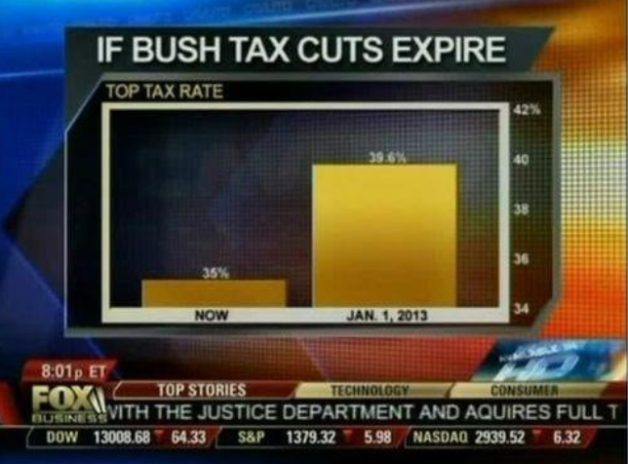
Misleading Visuals

Slide 20
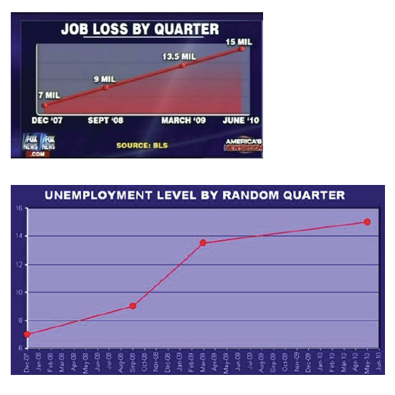

Slide 21
Careful with numbers
Do percentages add up?
Account for population changes over time
Look at scale in numbers and on charts.

Slide 22
Getting Data
Data.gov
Search for US Natural Gas Prices
Explore, Ask Questions

Slide 23
Excel
Pretty basic stuff
Sorting multiple columns
Creating Formulas
Inverse Tables
Pivot Tables
Simple Graphs
Speed Stuff

