Slide 1

Intro to jQuery
Implementing jQuery

Slide 2
A Framework not a Language
The purpose is to make your life much easier!
jQuery is a JavaScript Framework
Other JS Frameworks
MooTools
YUI
Prototype
And about 50 more

Slide 3
So Why jQuery?
The most popular
Use on ½ of all websites (W3Tech Aug 2012)
Well documented
Easy plugin concept

Slide 4
jQuery Plugins
So, you want a slider, overlay, text bubble, form validator, messenger, navbar, accordion, kitchen sink, someone has written a jQuery plugin to do that.
http://www.jquery4u.com/plugins/top-100-jquery-plugins-2012-part-1/

Slide 5
Let’s get started!
Steps to using jquery
Load jQuery
onDocument Ready function
Load plugin script

Slide 6
Loading jQuery
include the file in a script include.
Download and run locally
<script src=“jquery.js”></script>
Link to hosted version
<script src=“//ajax.googleapis.com/ajax/lib/jquery/1.8.3/jquery.min.js”></script>
Saves download time because user probably already downloaded it.

Slide 7
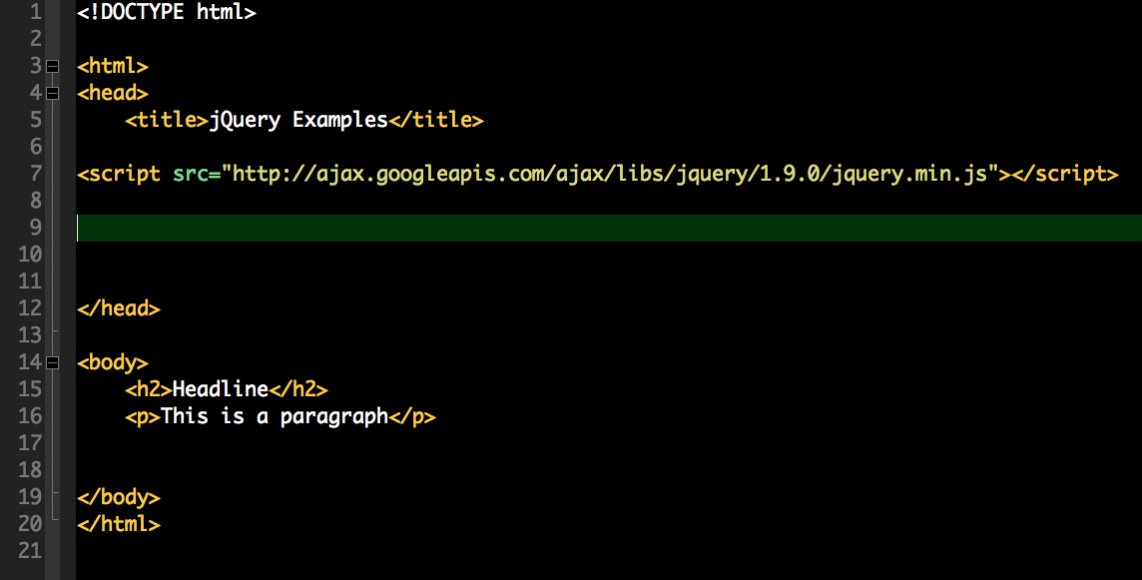
Link to jQuery

Slide 8
DOM Ready
DOM stands for Document Object Model
What you need to know is that the page is ready!
document.ready()

Slide 9
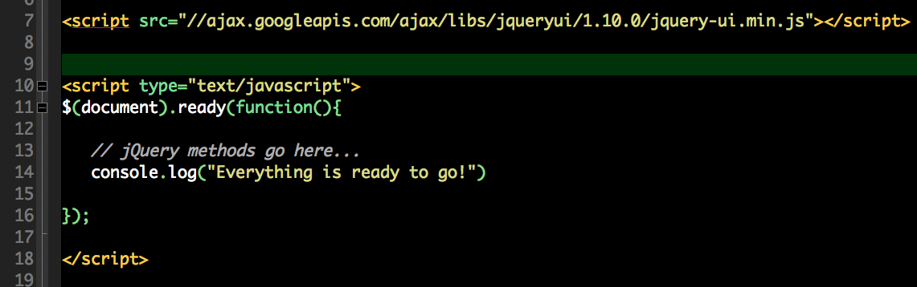
Kickoff! Document Ready Function

Slide 10
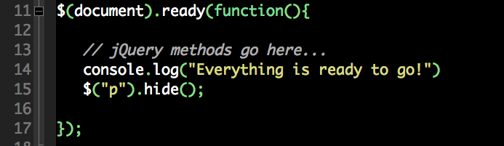
Selectors
jQuery allows you to select items in the HTML document.
Select all p tags and hide them
$(“p”).hide();

Slide 11
jQuery Syntax
The jQuery syntax is tailor made for selecting HTML elements and perform some action on the element(s).
Basic syntax is: $(selector).action()
A $ sign to define/access jQuery
A (selector) to "query (or find)" HTML elements
A jQuery action() to be performed on the element(s)

Slide 12
Lets make a button to hide an ID
In a Function
jQuery + Selector + action

Slide 13
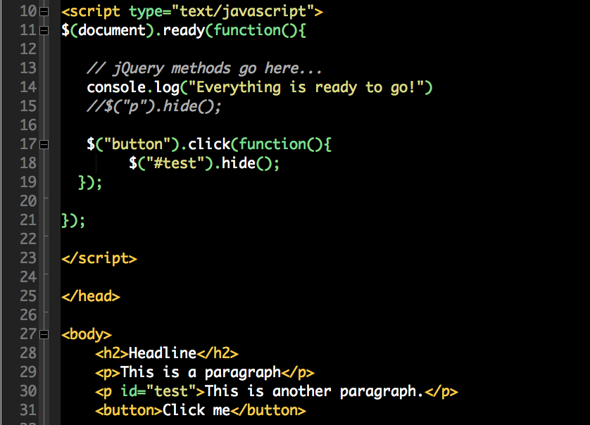

Slide 14
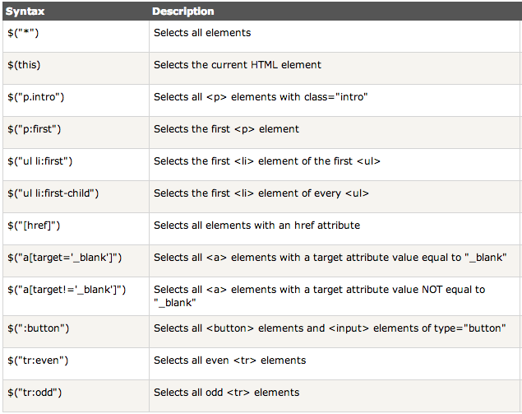
Other Selectors

Slide 15
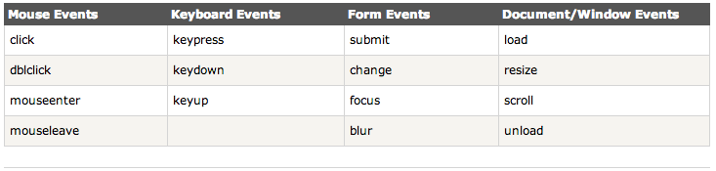
Events
Events are actions that happen and then code is performed.
Function and Events work together
Typically, the event calls a function

Slide 16
Lets Make some Rain

Slide 17
Lets jump to a plugin
http://craigsworks.com/projects/simpletip/#

Slide 18
In Class Assignment:
Create a menu using ddSlick plugin
http://designwithpc.com/Plugins/ddSlick

