Slide 1
Intro to JavaScript
Learn the basics of JS to create in-page interaction.
Steven King
UNC Chapel Hill
School of Journalism

Slide 2
What is JavaScript?
JavaScript is a scripting language
JavaScript was designed to add interactivity to HTML pages

Slide 3
What is a Scripting Language?
A scripting language is a lightweight programming language that supports the writing of scripts.
Scripts are code lines that can be interpreted and executed "on-the-fly", without explicit compile and link steps.

Slide 4
What can JS do?
JavaScript gives HTML designers a programming tool HTML editors are normally not programmers, but JavaScript is a language with a very simple syntax. Almost anyone can put small "snippets" of JavaScript code into HTML pages.
JavaScript can manipulate HTML JavaScript can both read and change the content of HTML elements.
JavaScript can manipulate CSS JavaScript can both read and change the style of HTML elements.
JavaScript can validate data JavaScript can be used to validate data, like validating forms input.
JavaScript can store data JavaScript can be used to store and retrieve information on the visitor's computer.
JavaScript can react to events JavaScript can be set to execute when something happens, like when a user clicks on an HTML element.

Slide 5
JavaScript vs. Java
IMPORTANT: These are NOT the same thing. Don’t screw this up in a job interview.
JavaScript and Java are two completely different languages, in both concept and design.
Java (developed by Sun Microsystems) is a complex programming language in the same category as C and C++.

Slide 6
JavaScript = ECMA Script
ECMA-262 is the official JavaScript standard.
JavaScript was invented by Brendan Eich at Netscape, and first appeared in Netscape Navigator (a no longer existing web browser) in1995. First it was called Mocha, then LiveScript, and finally JavaScript.
The JavaScript standard was adopted by the industry standard association ECMA in 1997.
The standard (called ECMAScript-262) was approved as an international ISO standard in 1998.
The development of ECMAScript is still in process.

Slide 7
Enough of that, Lets Code!
A JavaScript is surrounded by a <script> and </script> tag.
JavaScript is typically used to manipulate HTML elements.
So let’s do that!

Slide 8
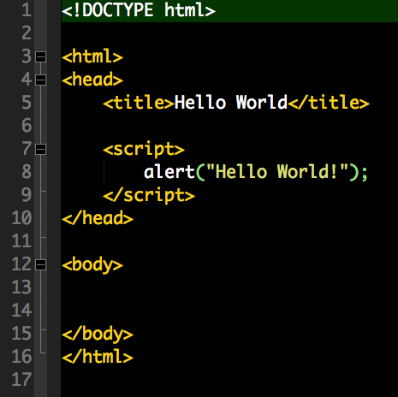
The <script> tag
To insert a JavaScript into an HTML page, use the <script> tag.
The <script> and </script> tells where the JavaScript starts and ends.
The lines between the <script> and </script> contain the JavaScript

Slide 9
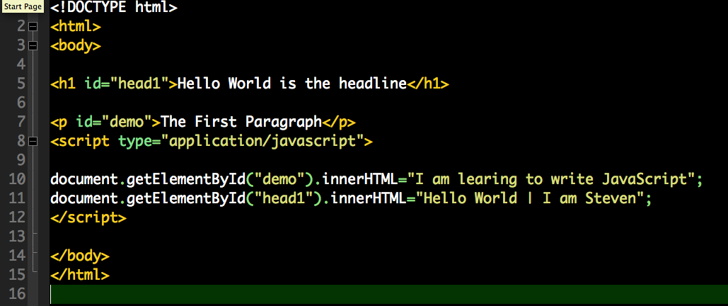
Change HTML elements

Slide 10
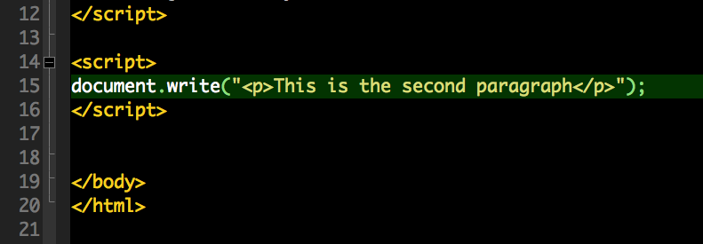
Writing directly to HTML
The example below writes a <p> element directly into the HTML document output:

Slide 11
Location of JavaScripts
Body (inline scripts)
Embedded (in the head)
Linked (ideal)
Just like CSS

Slide 12
Don’t forget
JavaScript is case sensitive so watch capitalization closely
End a line in a ;
getElementById is not the same as getElementbyID.

Slide 13
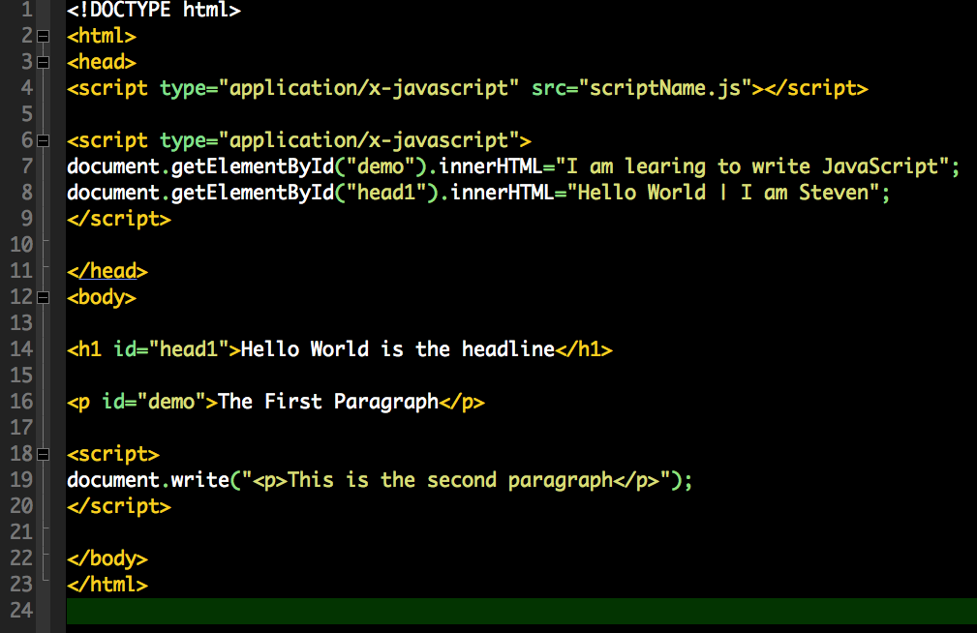
Location of JavaScripts

Slide 14
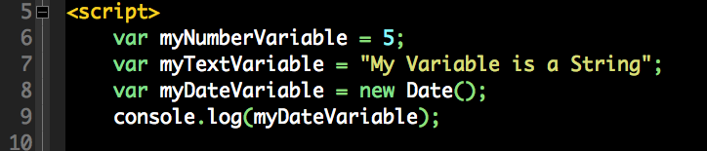
Variables
Most basic and most important programing concept.
x = y.

Slide 15
Variable Data Types
String
Number
Booleans
Arrays
Objects
Text “Hello World”
Number 5
True or False
Lists of variables (5,3,6,234)
Data Object (complex list)

Slide 16
JavaScript Events and Function
Sometimes we want to execute a JavaScript when an event occurs, such as when a user clicks a button. Then we can write the script inside a function, and call the function when the event occurs.
Here is a short example but we will learn more about events and functions later.

Slide 17
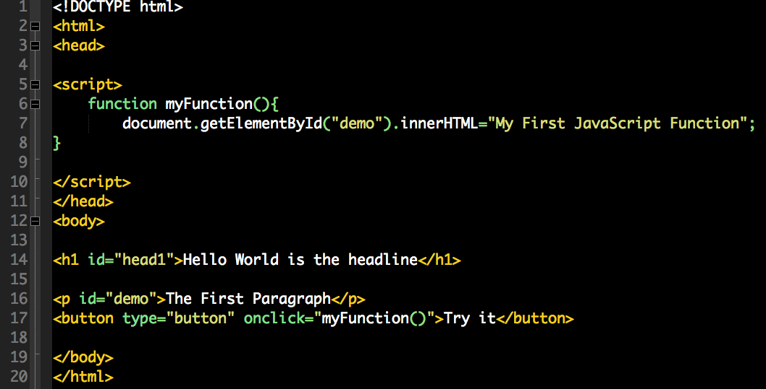
Event calls a function
Click event calls myFunction()

Slide 18
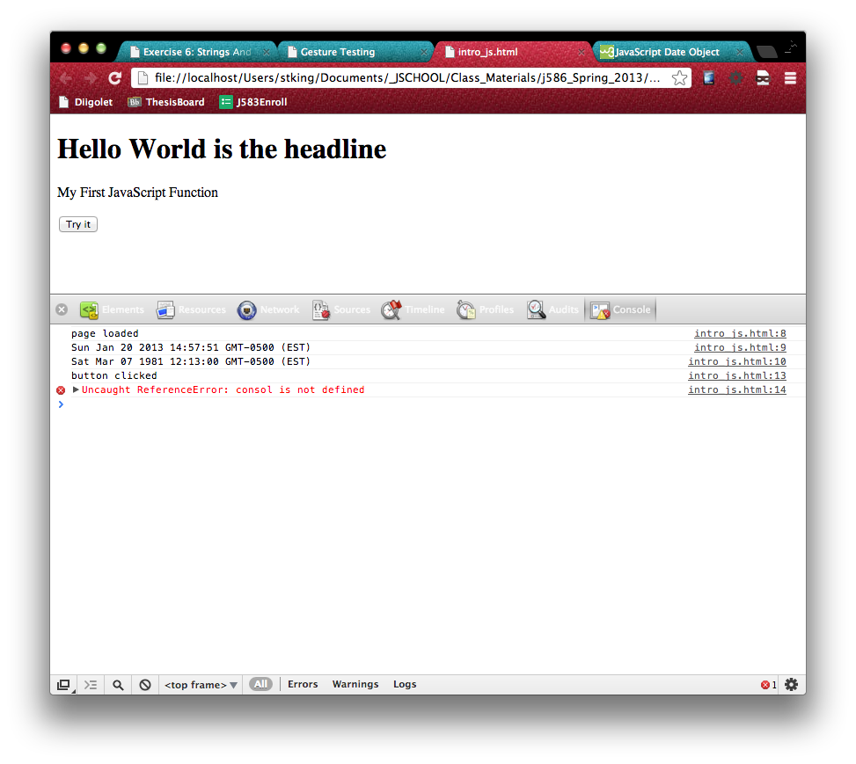
JavaScript Console Log
I LOVE THE CONSOLE!

Slide 19
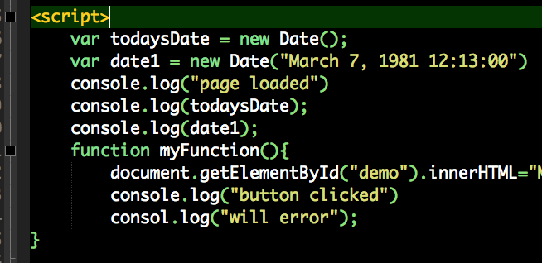
JS Function and Console

Slide 20
In-Class Exercise
Write a JS application using embedded code that:
Changes the <h1> tag to say, “Hello, Your Name” based on a variable.
Display Today’s Date
Changes the second paragraph to something else when a button is clicked.
Bonus: Make the alert box show when the same button is clicked above.
Use CSS to make the headline Tarheel Blue #53A0D3 and paragraphs gray (#666) with double line spacing.
Call me over when complete.

Slide 21
Weekend Assignment #3
Read Introduction (if feeling lost)
Read Ch1 and Ch2 and complete Tutorial (Asking for Information) on page 57.
Submit into dropbox last_firsname_assign3.html before class on Monday.
Quiz on Ch 1 and CH2 Monday.

