Slide 1
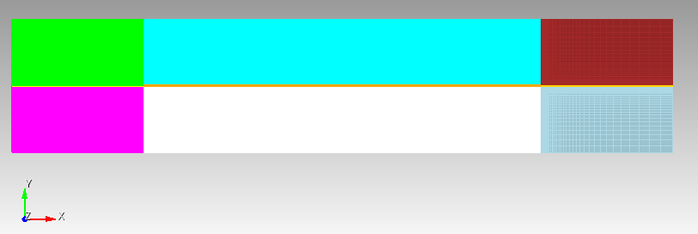

(-.3, 0.1003)
(0.5, 0.1003)
(-.5, 0.1003)
(0.3, 0.1003)
(-0.5, -0.1003)
(-0.3, 0.0003)
Fracture (Blue region with orange mesh): 0.0006 wide, Diffusivity = 2
(-0.3, -0.0003)
Everything else is matrix(including the thing yellow region): Diffusivity = 1e-3

Slide 2
case 0: Only contains matrix material properties
case 1: monolithic, matrix and fracture together
case 2: Subapp approach: Main - matrix, Sub - fracture
Only transferring temperature and applying with PourousFlowHeatMassTransfer on timestep begin or end of multiapp execution. What should the transer_coefficient be? Should it have the same sign on the sub and main app? Should it be related to the diffusivity?
Use picard iterations to force 2 sub-main app iterations per timestep. Transferring temperature and the residual produced by PourousFlowHeatMassTransfer and applying as coupledForce. Trying to account for energy exchange between the two domains. Doesn’t make a difference.
Using coarse nonconforming main app mesh and 2d fracture mesh on sub-app
Using Coarse nonconforming main app mesh and 1d fracture mesh on sub-app

Slide 3
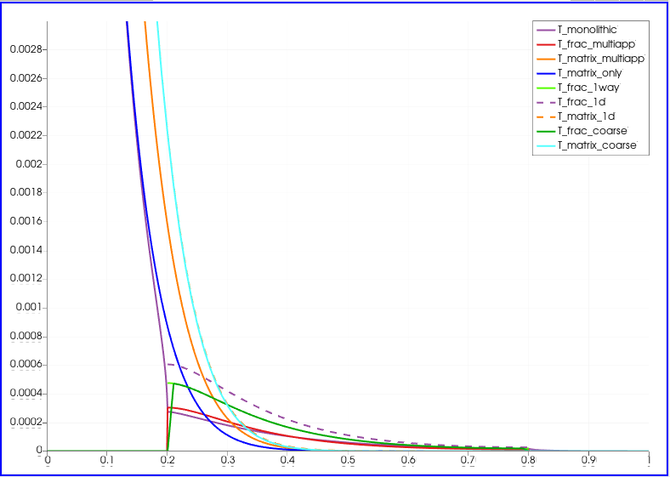
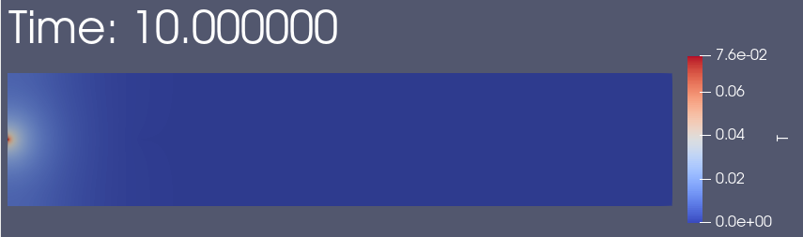
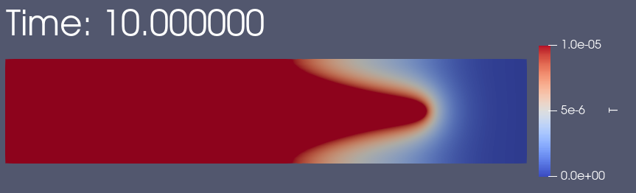
Temperature profiles across centerline Time = 10

Slide 4
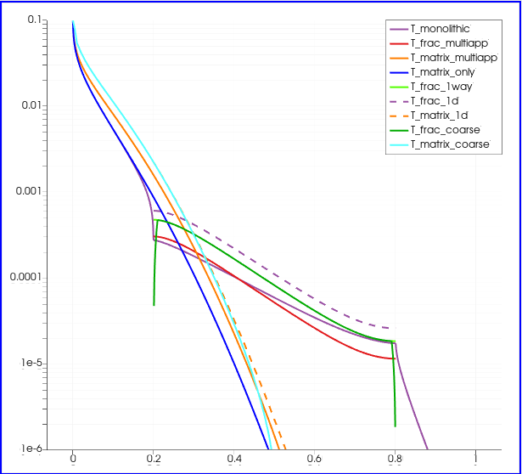
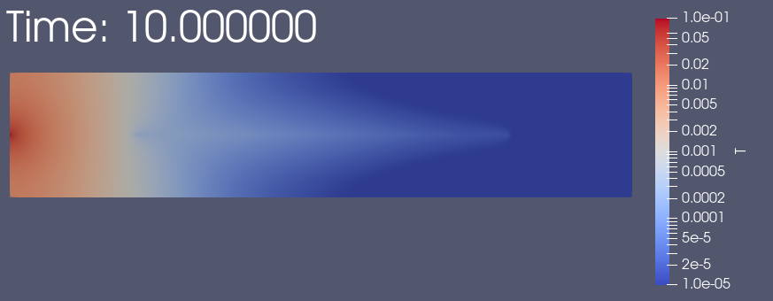
Temperature profiles (log scale) across centerline Time = 10

