Slide 1
Lab 01: Introduction to Vivado & Logic Gates
Presented By: (Name)

Slide 2
Chips, what? An IEEE CEDA Education Initiative
Presenter name

Slide 3
Lab 01 Part 0: Vivado

Slide 4


Vivado

Slide 5
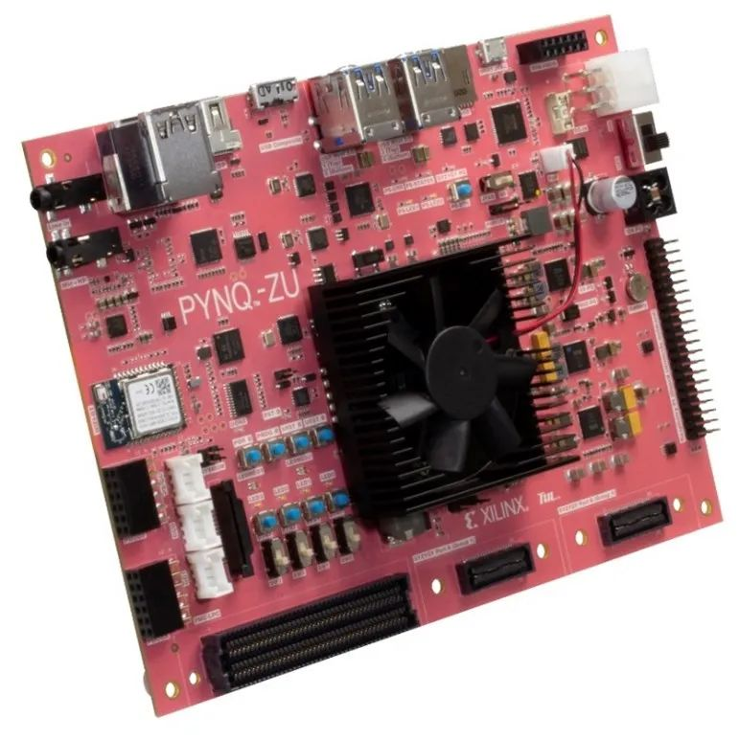
Vivado
AMD XILINX Vivado 2024.2:
Synthesis & analysis of HDLs
Block design integration
Included logic simulator
GUI-based commands
Each laboratory session is prepared as a stand-alone project

Slide 6
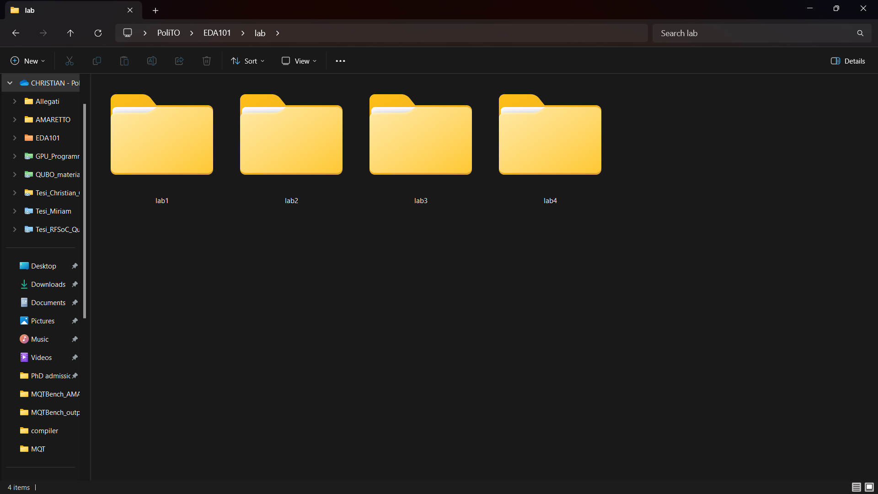
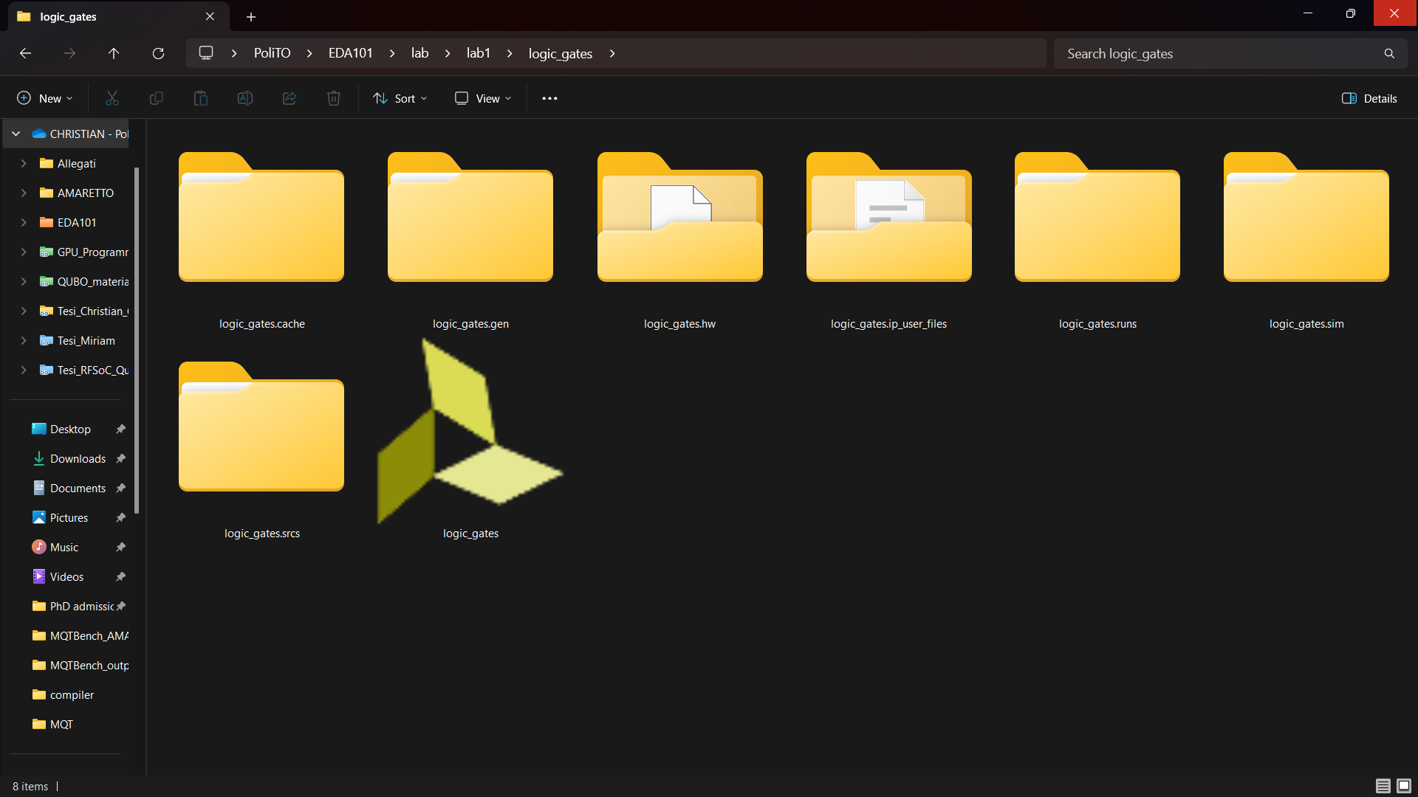
Start a Laboratory Session
Start a new laboratory session with Vivado:
To each laboratory session corresponds a Vivado project directory:
Lab01
Lab02{a,b,c}
Lab03{a,b,b_synth,c,c_synh,_soc}
Lab04
Inside each Lab directory, there is the project for the current laboratory

Slide 7

Inside a Project Folder
A project is made of different files carrying different information regarding the project:
srcs (sources): the descriptions of the components of the blocks of the projects.
sim (simulation): the file useful to the EDA tool to simulate the project.
Other files: generated by the tool to run the project and generate the implementation.
The Project File
To open a project, double-click on the Project File

Slide 8
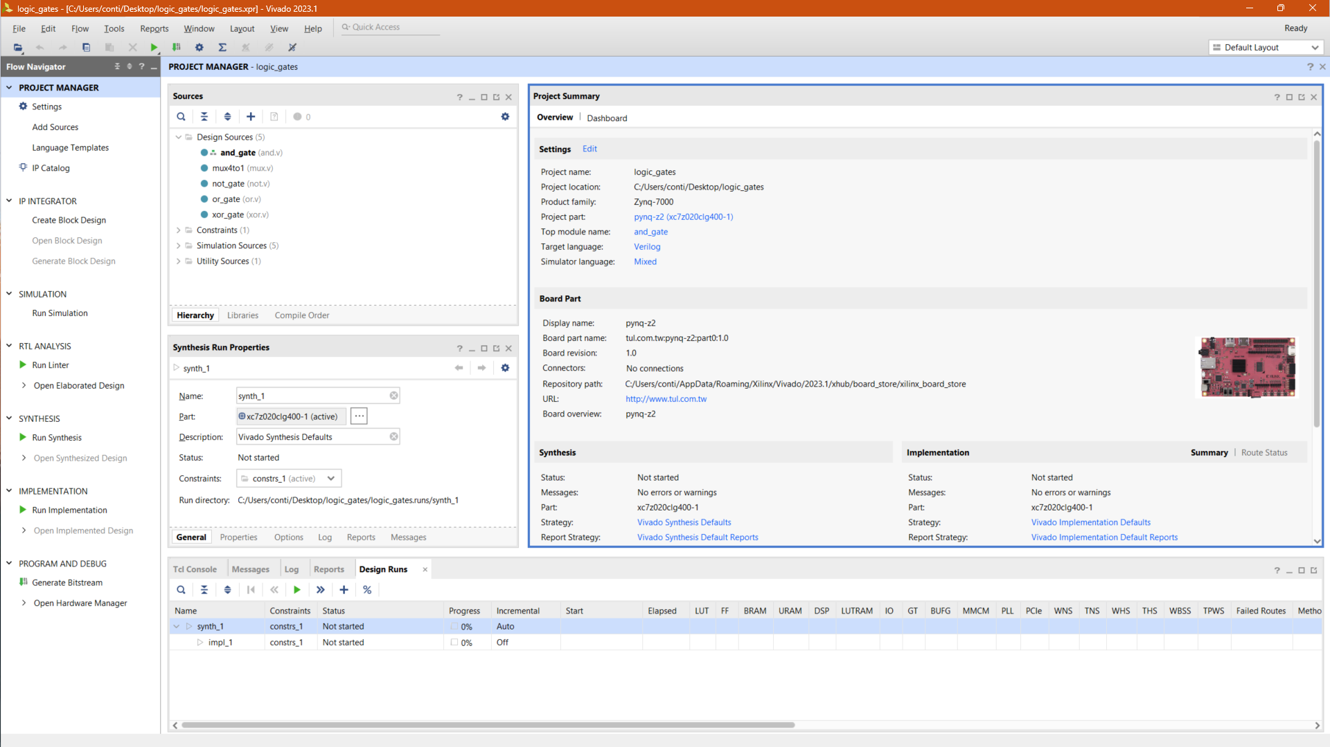
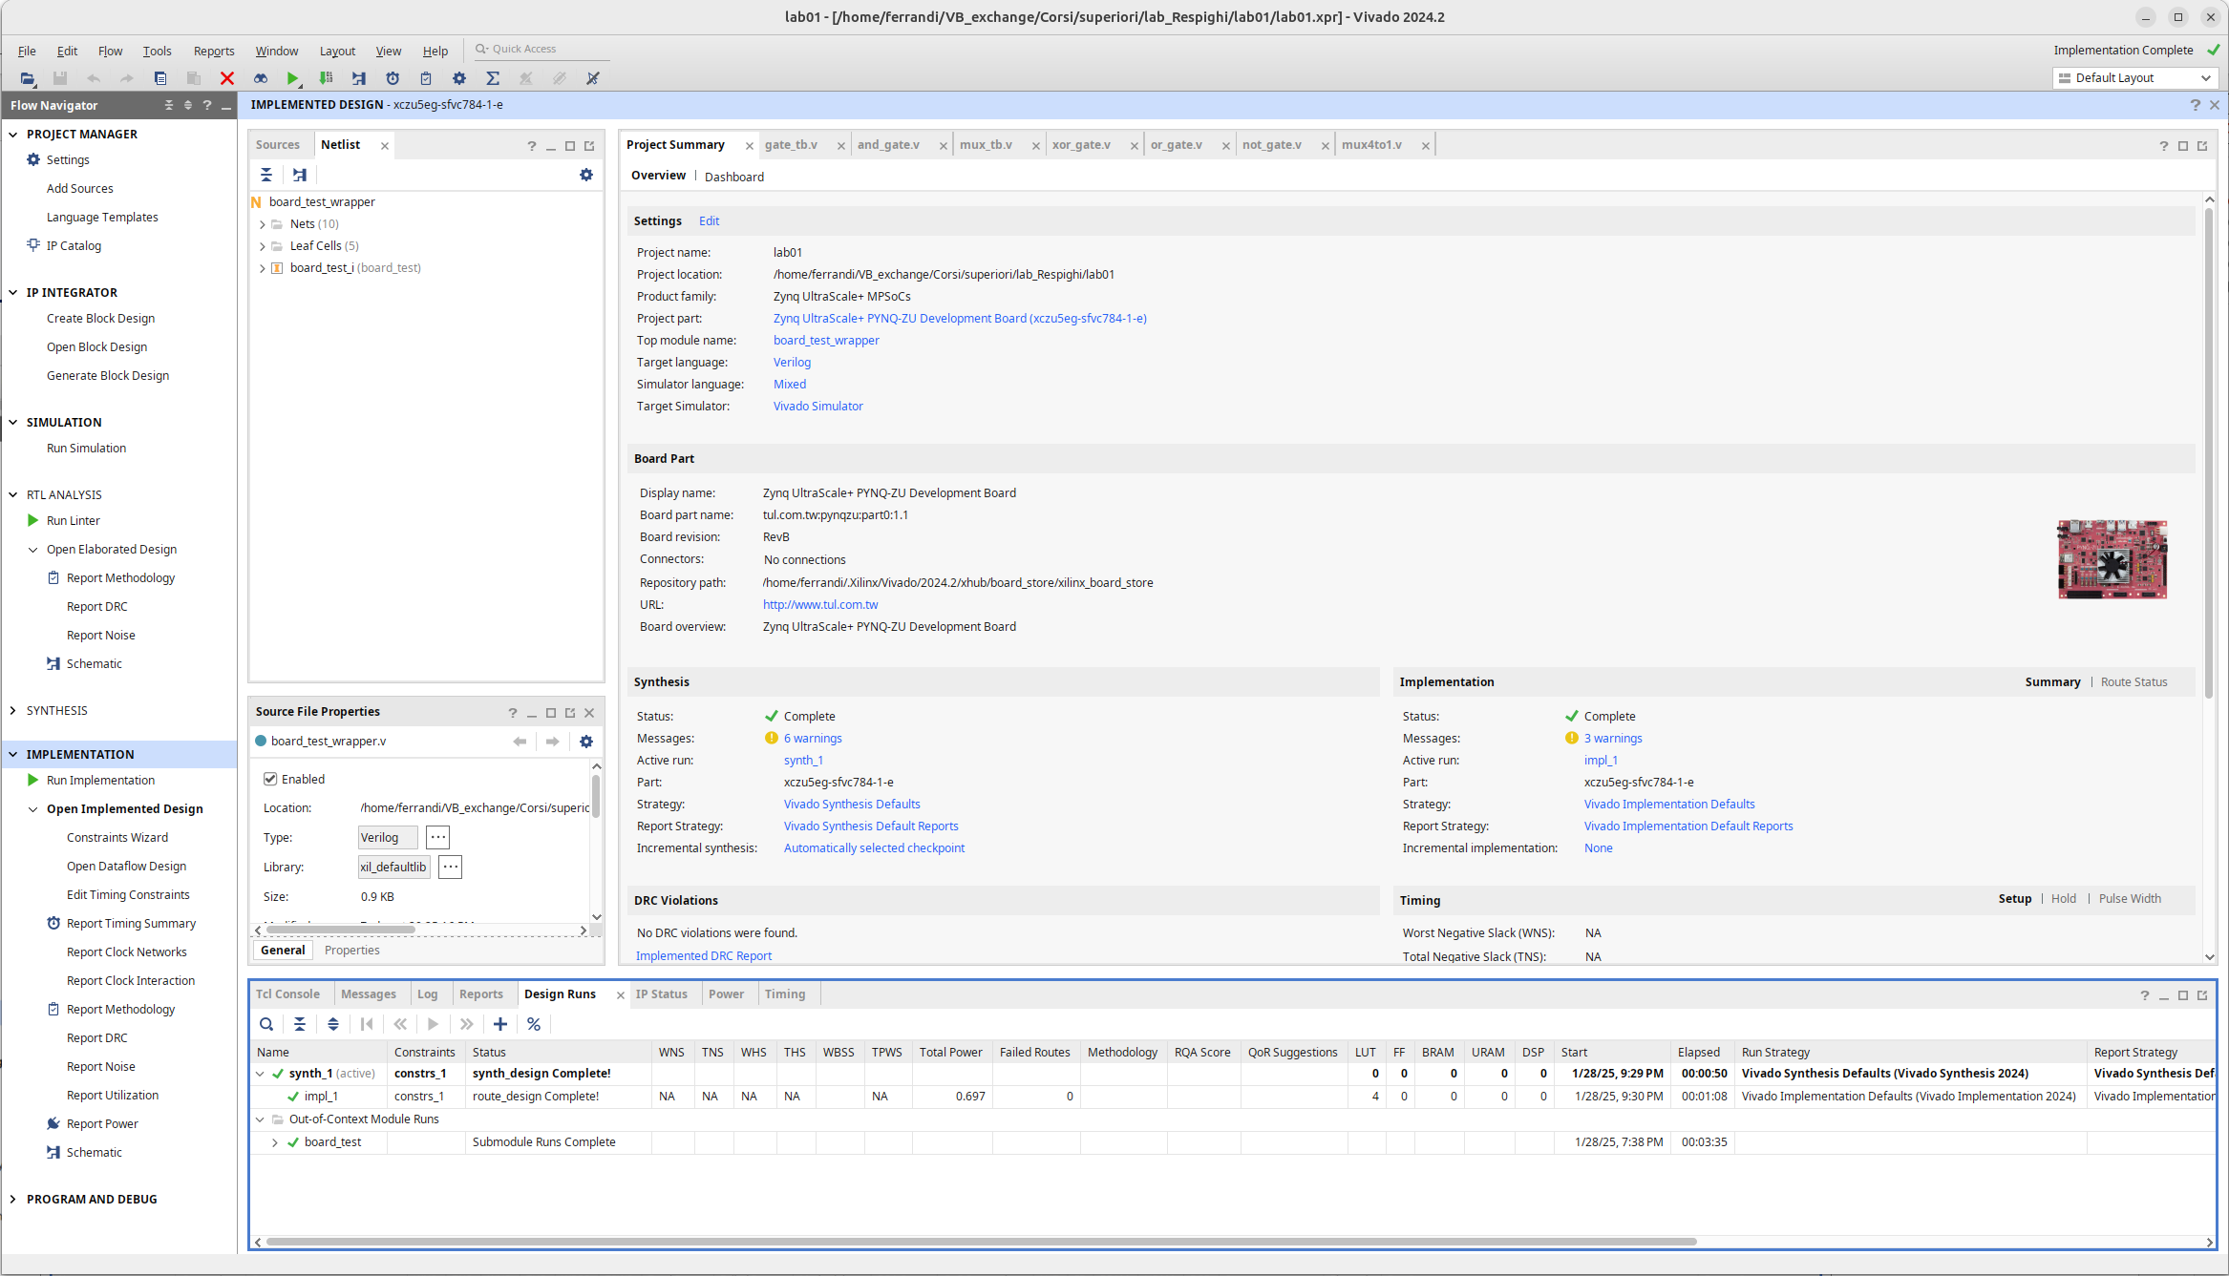
Vivado a First Glance

Slide 9
Vivado a First Glance
Flow Navigator, to navigate inside the project, it is possible to change the view, from simulation, through synthesis to implementation

Slide 10
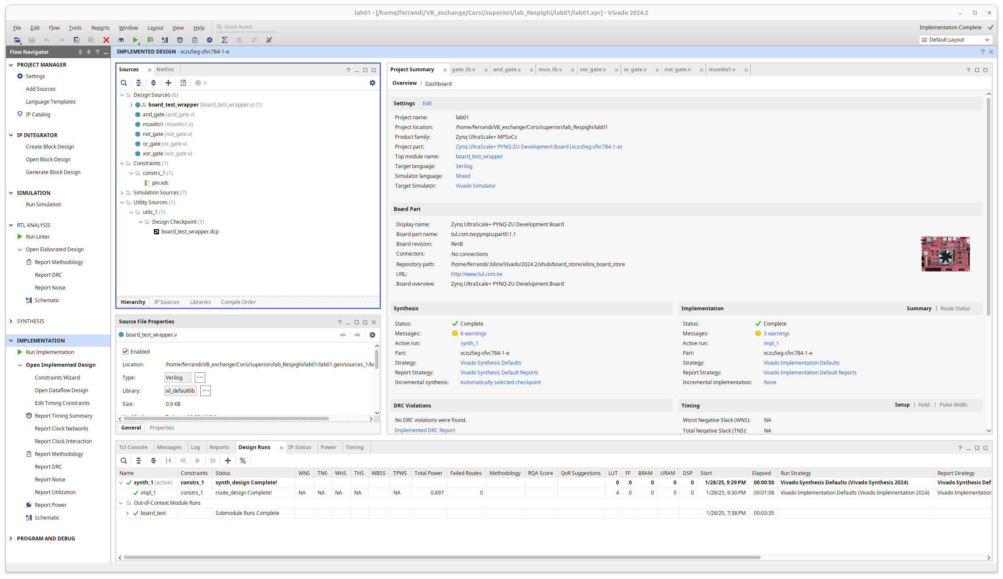
Vivado a First Glance
Sources, contain the handwritten description of the modules used during the current laboratory

Slide 11
Vivado a First Glance
The information panel, contains information regarding synthesis, implementation, errors, warnings and info

Slide 12
Vivado a First Glance
The main window of the project, contains the project summary, the block diagram of the design and other useful windows

Slide 13
Lab 01 Part 1: Create the First Gate

Slide 14
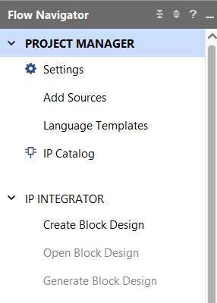
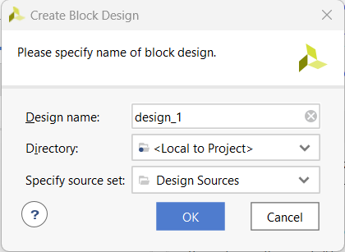
Create a Block Design
A Block Design is a canvas to place structural components for our design:
Create a new block design:
PROJECT MANAGER →
IP INTEGRATOR → Create Block Design
“Create Block Design” window will appear:
“Design name”: xor_bd
“OK”
2.
1.
3.

Slide 15
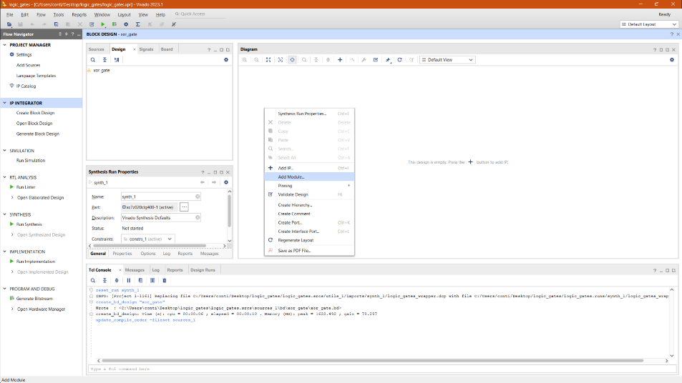

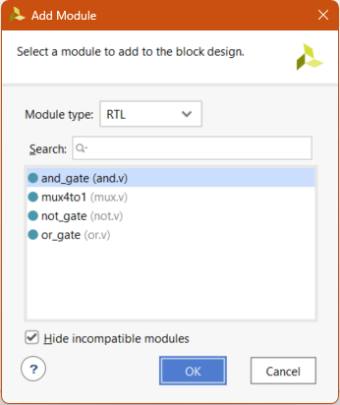
Modules in a Block Design
Modules are “ready to place” components in the design. They can be simple logic gates or complex digital circuits:
Right-click on the main window
Select Add Modules…
A new window with the available modules will pop up
2.

Slide 16
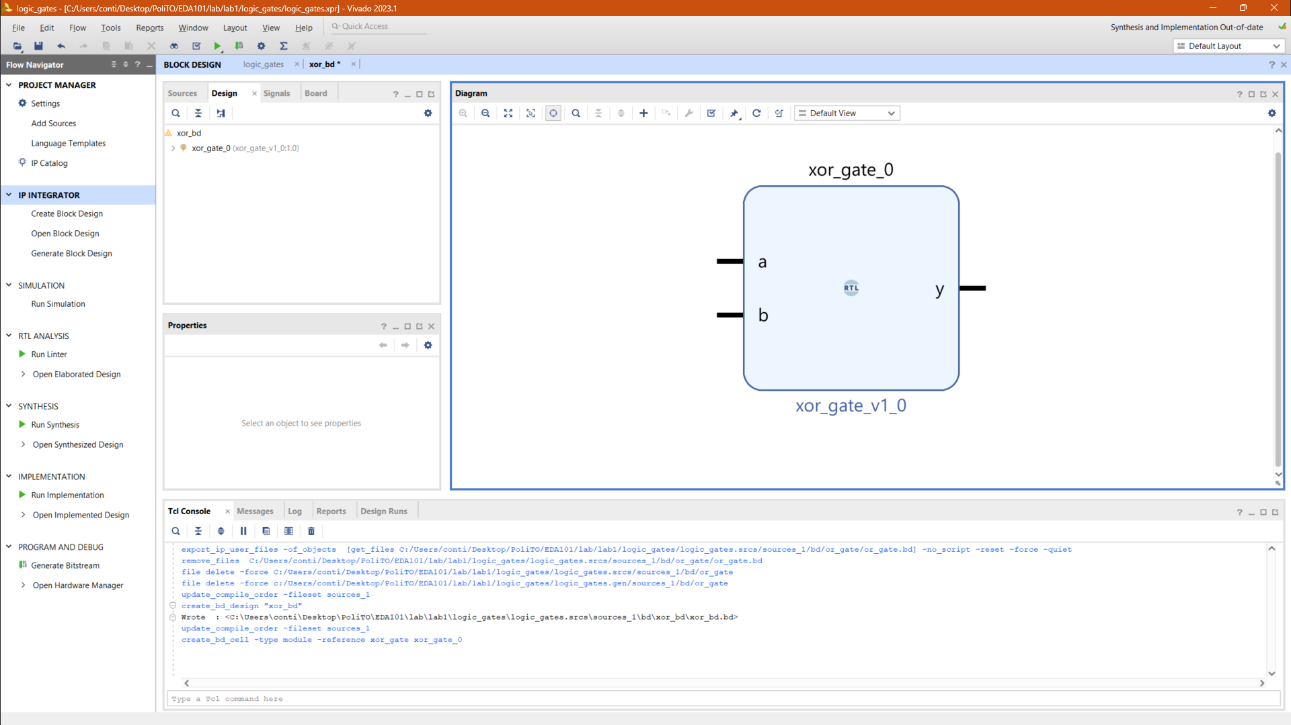
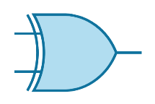
Modules in a Block Design
Module name
Module version

Slide 17
Instantiate a Module
Modules are “ready to place” components in the design. They can be simple logic gates or complex digital circuits:
Right-click on the main window
Select Add Modules…
A new window with the available modules will pop up
2.

Slide 18
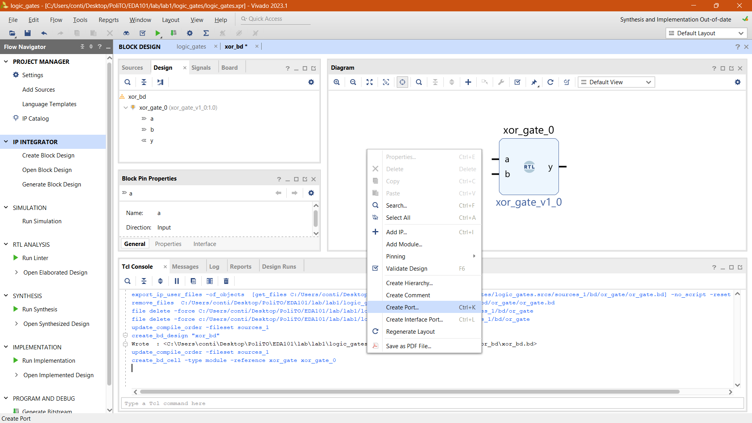
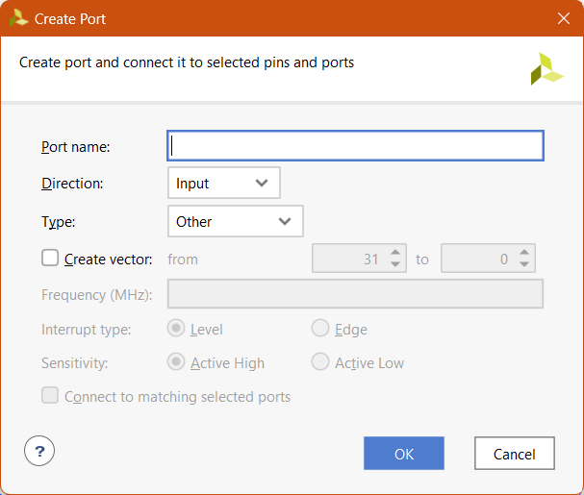
Input & Output Ports
Ports are the connections of our circuit with the external world, they provide the input and show the output:
Right-click on the main window
Select Create Port…
A new window with the ports settings will pop up
2.

Slide 19

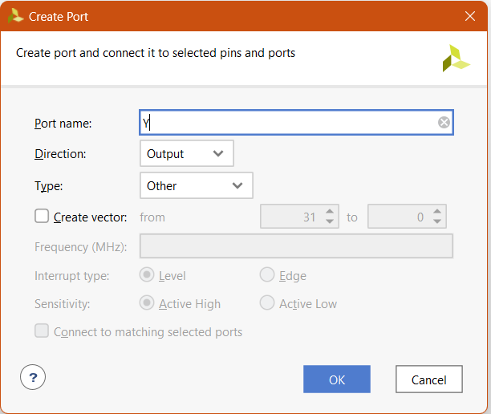
Input & Output Ports
It is important to name appropriately the ports (_i for inputs and _o for outputs), so the EDA tool can understand how to map them to the die:
Input (Direction: Input, Type: Other):
A_i, B_i
Output (Direction: Output, Type: Other):
Y_o
Input
Output

Slide 20
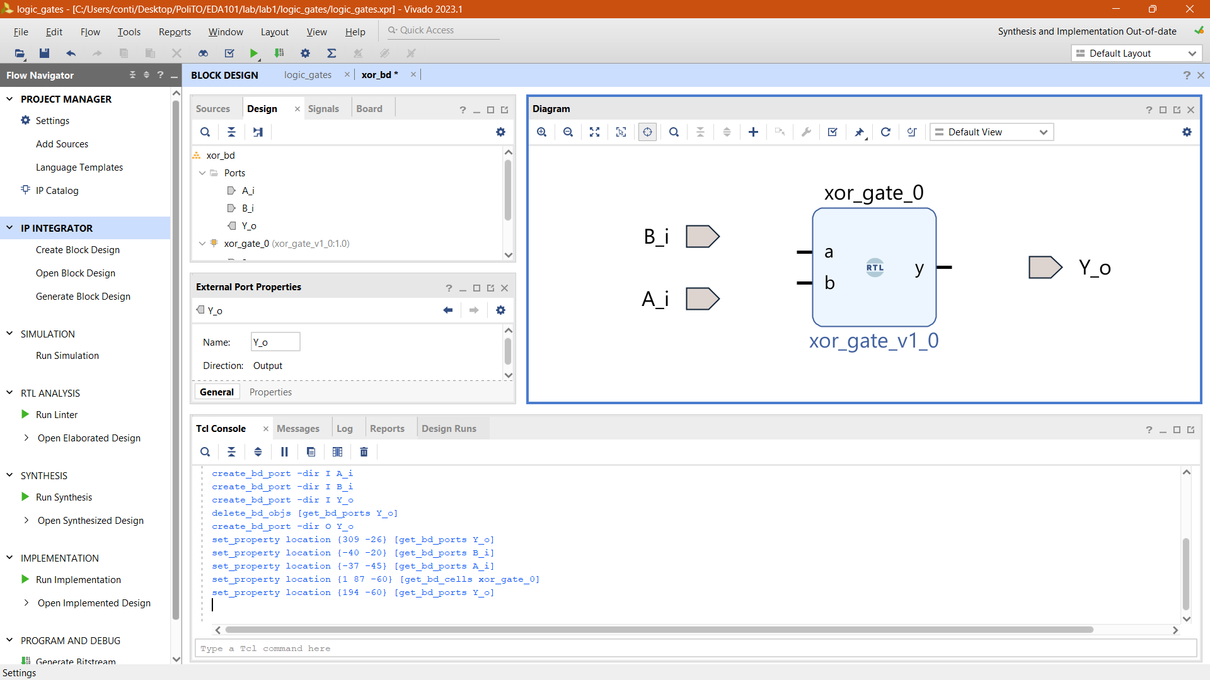
Input & Output Ports
It is important to name appropriately the ports (_i for inputs and _o for outputs), so the EDA tool can understand how to map them to the die:
Input (Direction: Input, Type: Other):
A_i, B_i
Output (Direction: Output, Type: Other):
Y_o
Input
Output

Slide 21
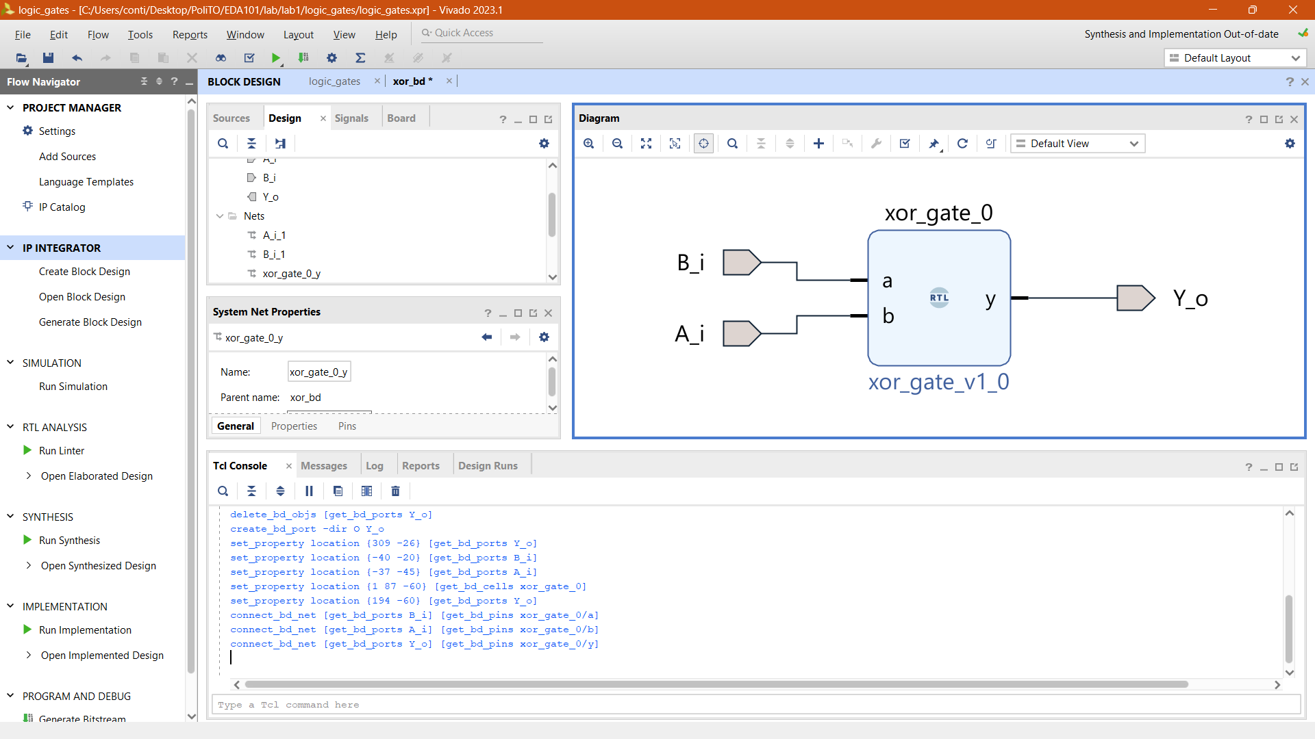
Interconnections
Connect the different logic gates to create the circuit:
With the mouse over on an input, click and drag to another connection point
Connect all the logic gates and the ports
Validate the design
2 →
1
↓

Slide 22
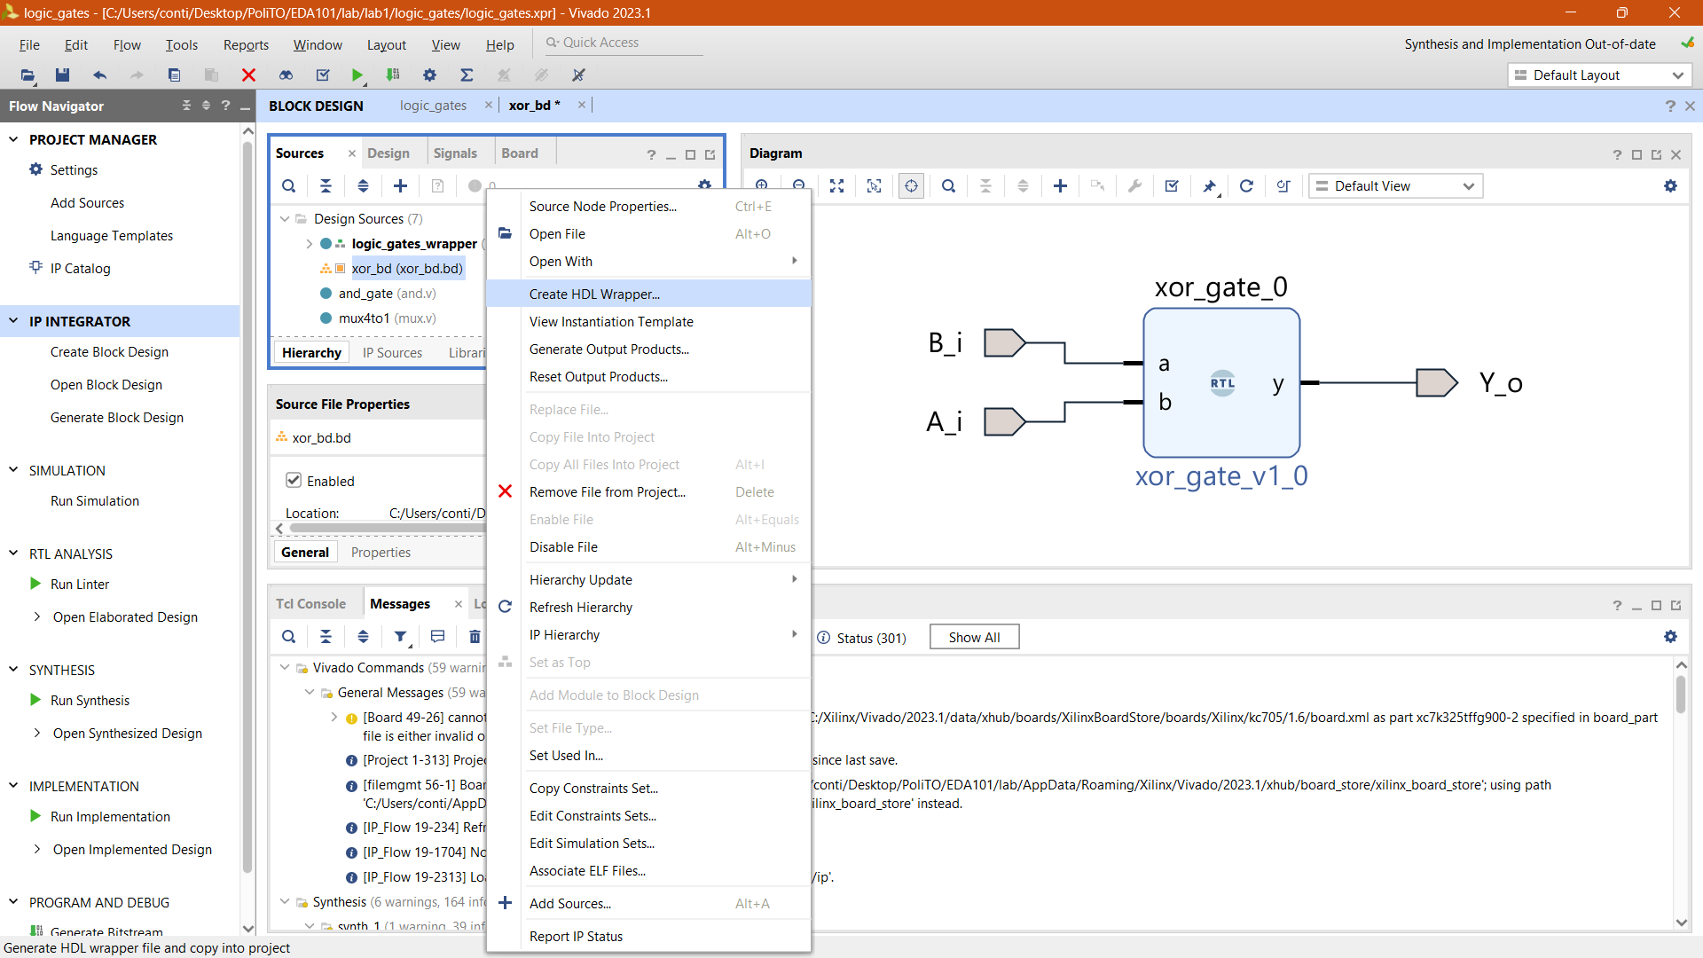
Generate the Design
The EDA tool generates the code of our design taking into consideration the input and output ports of the chip:
Right-click on block design “xor_bd” in Design Sources
Select Create HDL Wrapper…
A new window with the available modules will pop up
Ok
1.
2.

Slide 23
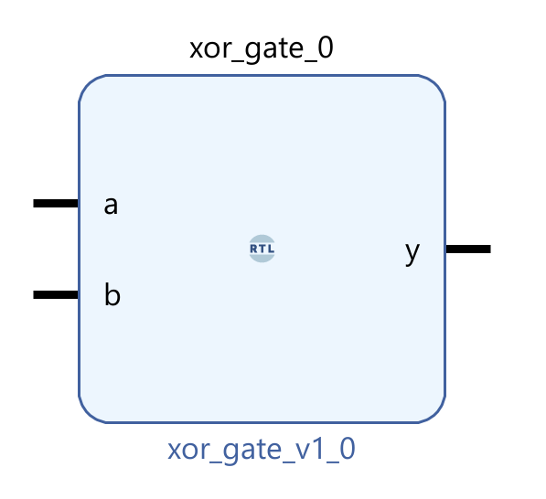
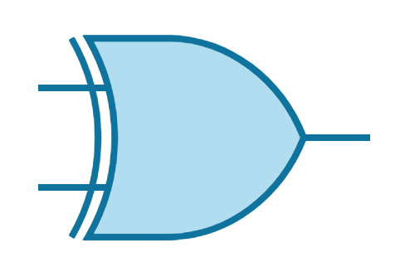
An In Deep Look to the Generated Design
`timescale 1 ps / 1 ps
module xor_gate (
A_i,
B_i,
Y_o );
input A_i;
input B_i;
output Y_o;
assign y = a ^ b;
endmodule

Slide 24
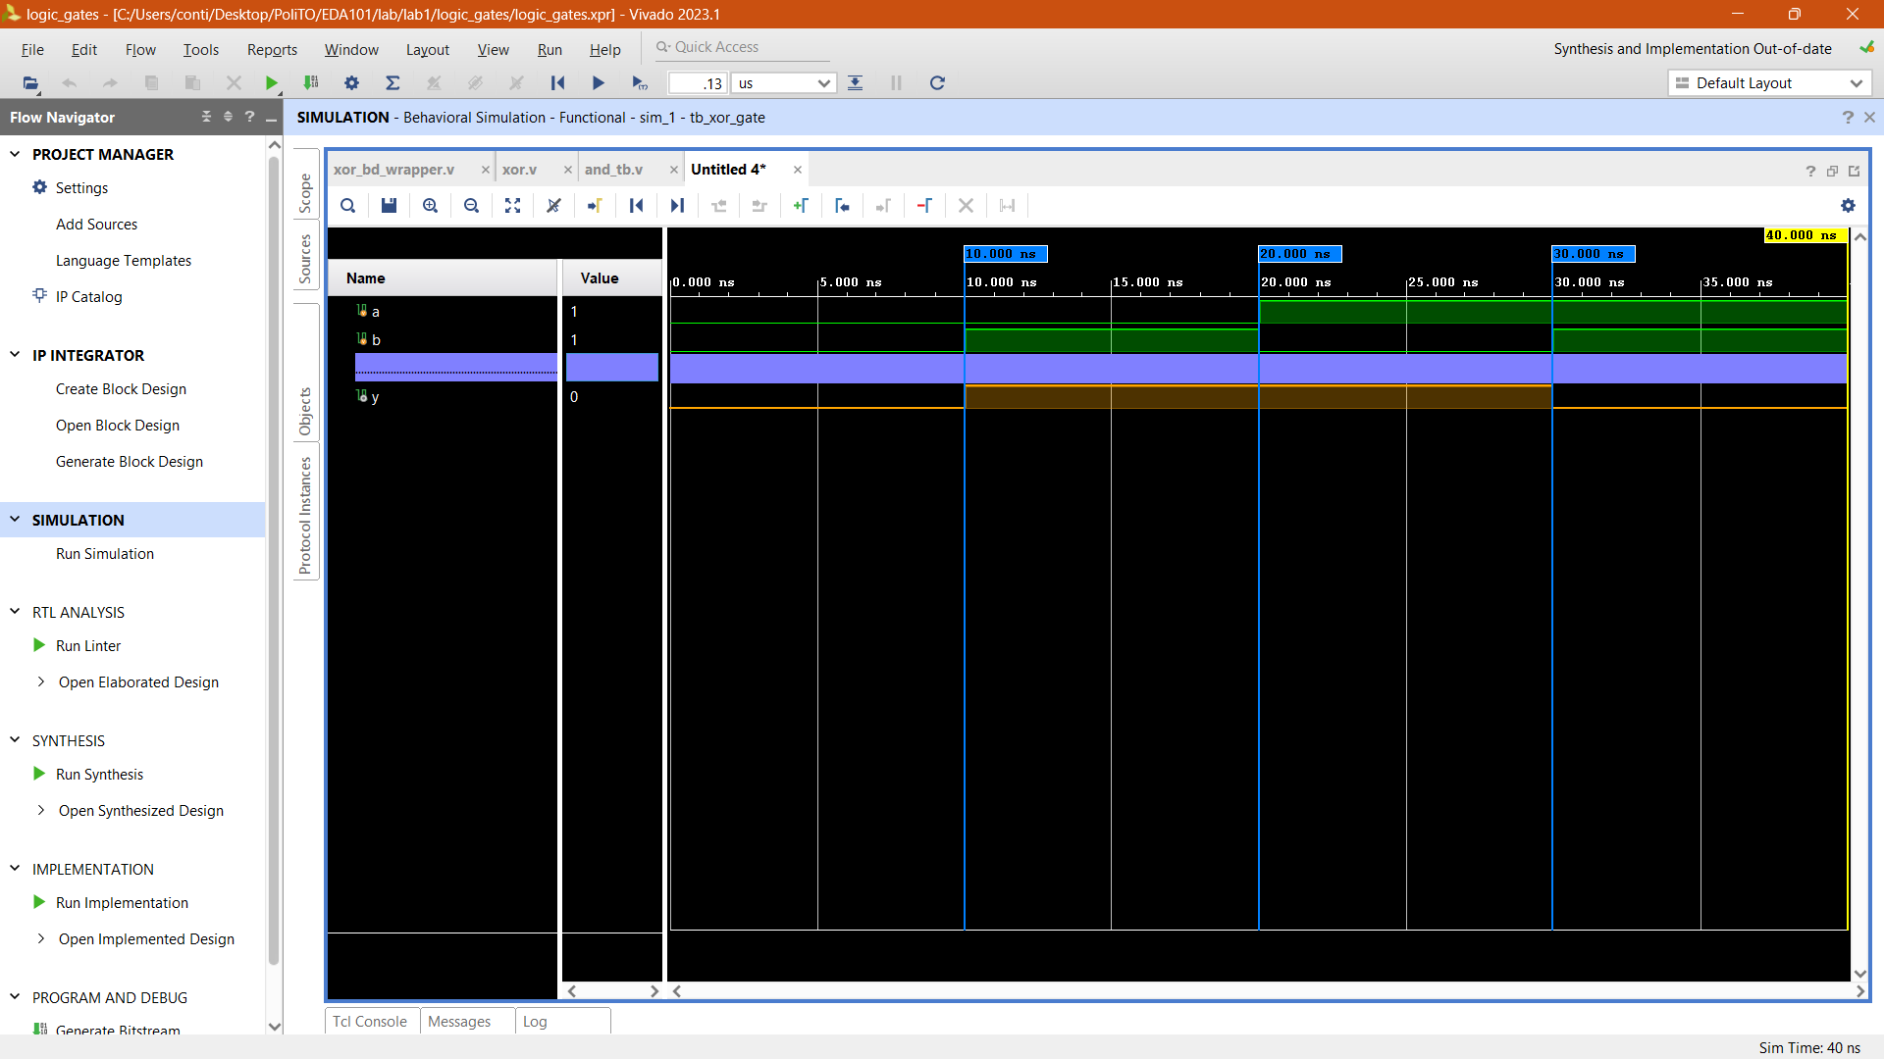
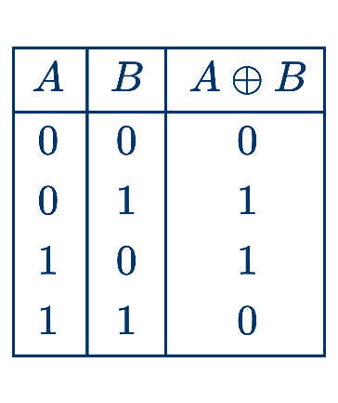
Verify the Design
After the Block Design is complete, it is important to check the functionalities of our design with a simulation:
Left-click on Run Simulation in the Flow Navigator window
Run Behavioral Simulation
A new panel with the behavior of our design will appear, from there we can check its functionalities

Slide 25
Lab 01 Part 2: Logic Gates

Slide 26

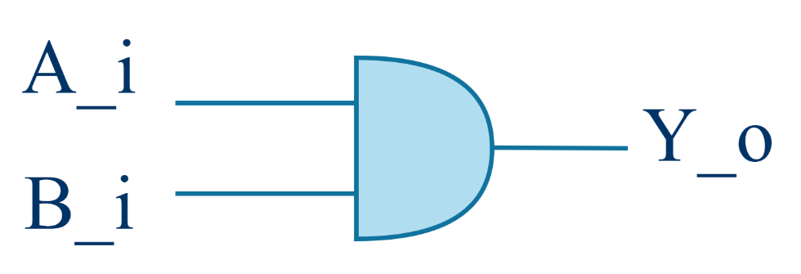
Evaluate the Logic Gates
Evaluate the AND Gate
We have seen how to create a project and how to implement a XOR logic gate.
Now try to implement others Boolean Functions and evaluates their outputs.
and_bd

Slide 27

Evaluate the Logic Gates
Evaluate the NOT Gate
We have seen how to create a project and how to implement a XOR and AND logic gates.
Now try to implement others Boolean Functions and evaluates their outputs.
not_bd

Slide 28
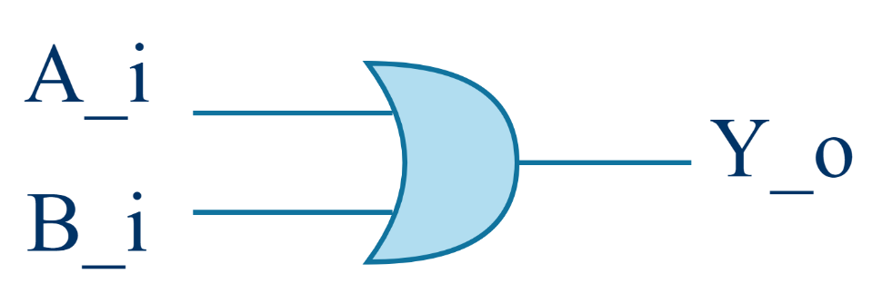
Evaluate the Logic Gates
Evaluate the
OR Gate
We have seen how to create a project and how to implement a XOR, AND, and NOT logic gate.
Now try to implement others Boolean Functions and evaluates their outputs.
or_bd

Slide 29
Lab 01 Part 3: The Multiplexer

Slide 30
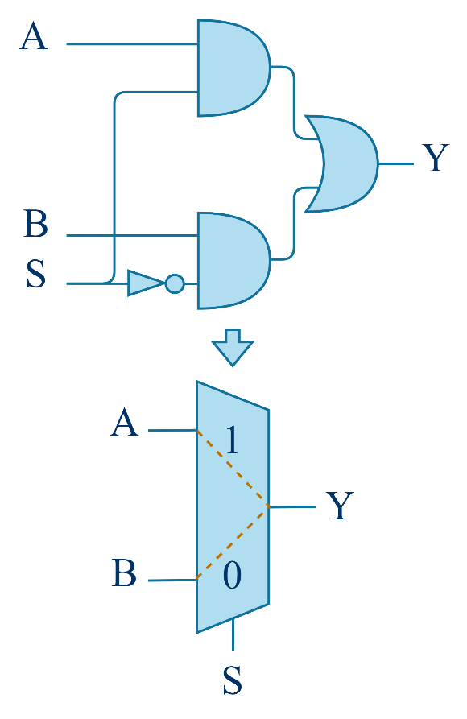
Combining Logic Gates
To create complex logic functions designers combine basic logic gates together.
The multiplexer is a digital circuit that choose an input among different with a control signal.

Slide 31
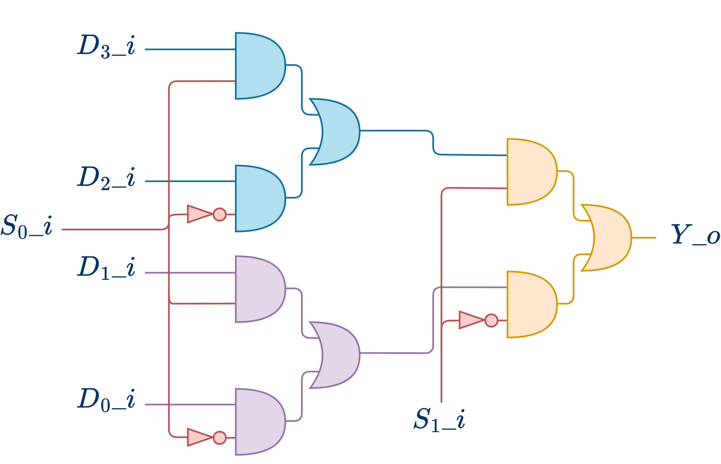
Combining Digital Blocks
As logic gates digital blocks can also be combined to form more complex structures

Slide 32

Practice Time
…again

Slide 33
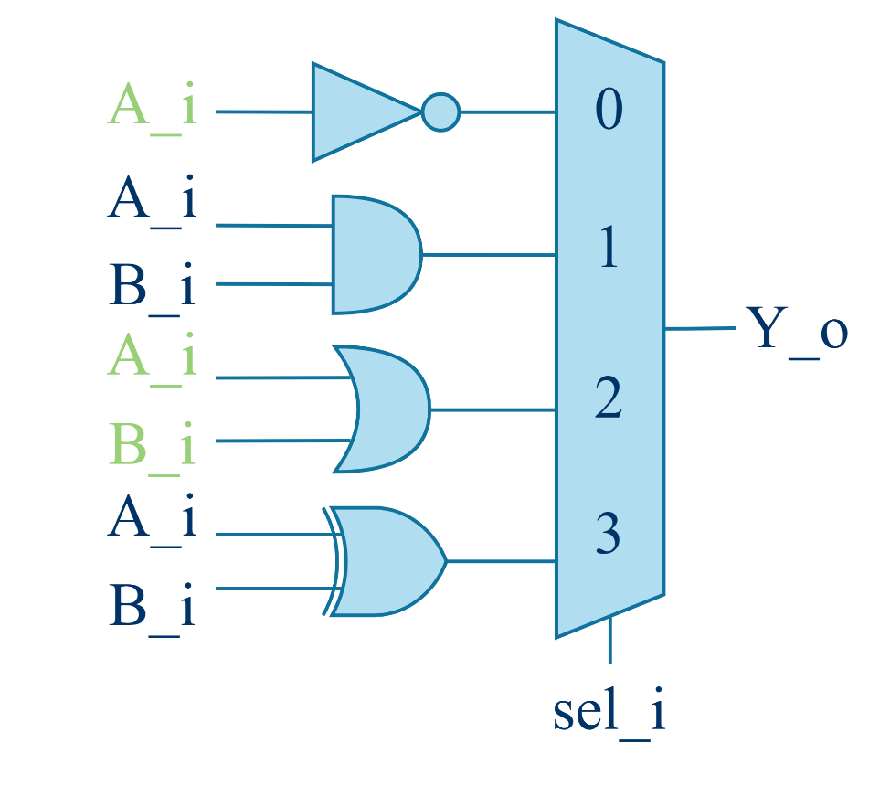
Test All the Logic Gates
The modules available for the laboratory also include other common logic gates.
Connect all the logic gates to a multiplexer and test them directly on the board.

Slide 34
Lab 01 Part 4: Implementation

Slide 35
Implement the Circuit on the Board
Click on “Generate Bitstream” and the EDA Tool will provide the files to upload the design on the board
Open the “Hardware manager”

Slide 36
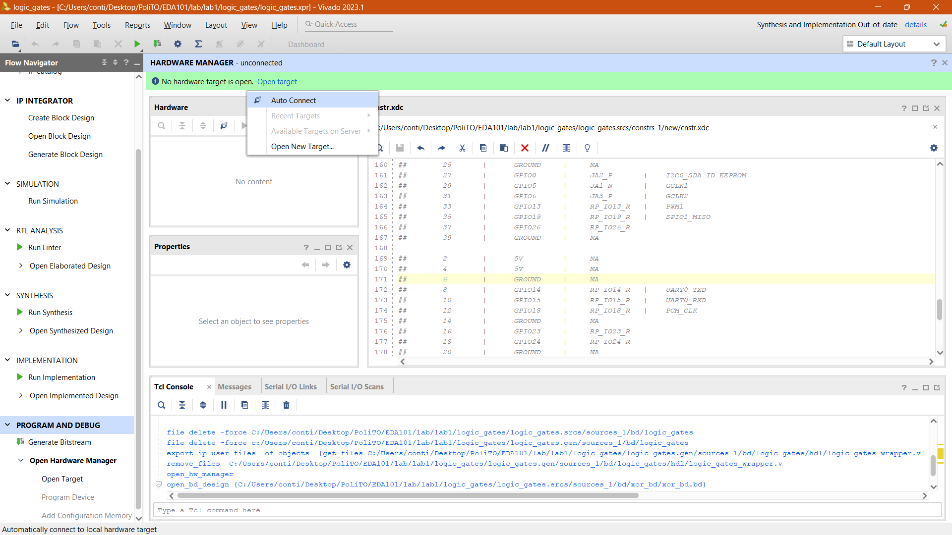
The Hardware manager
The Hardware Manager handles the connections with the board.
To connect:
Open target
Auto Connect

Slide 37
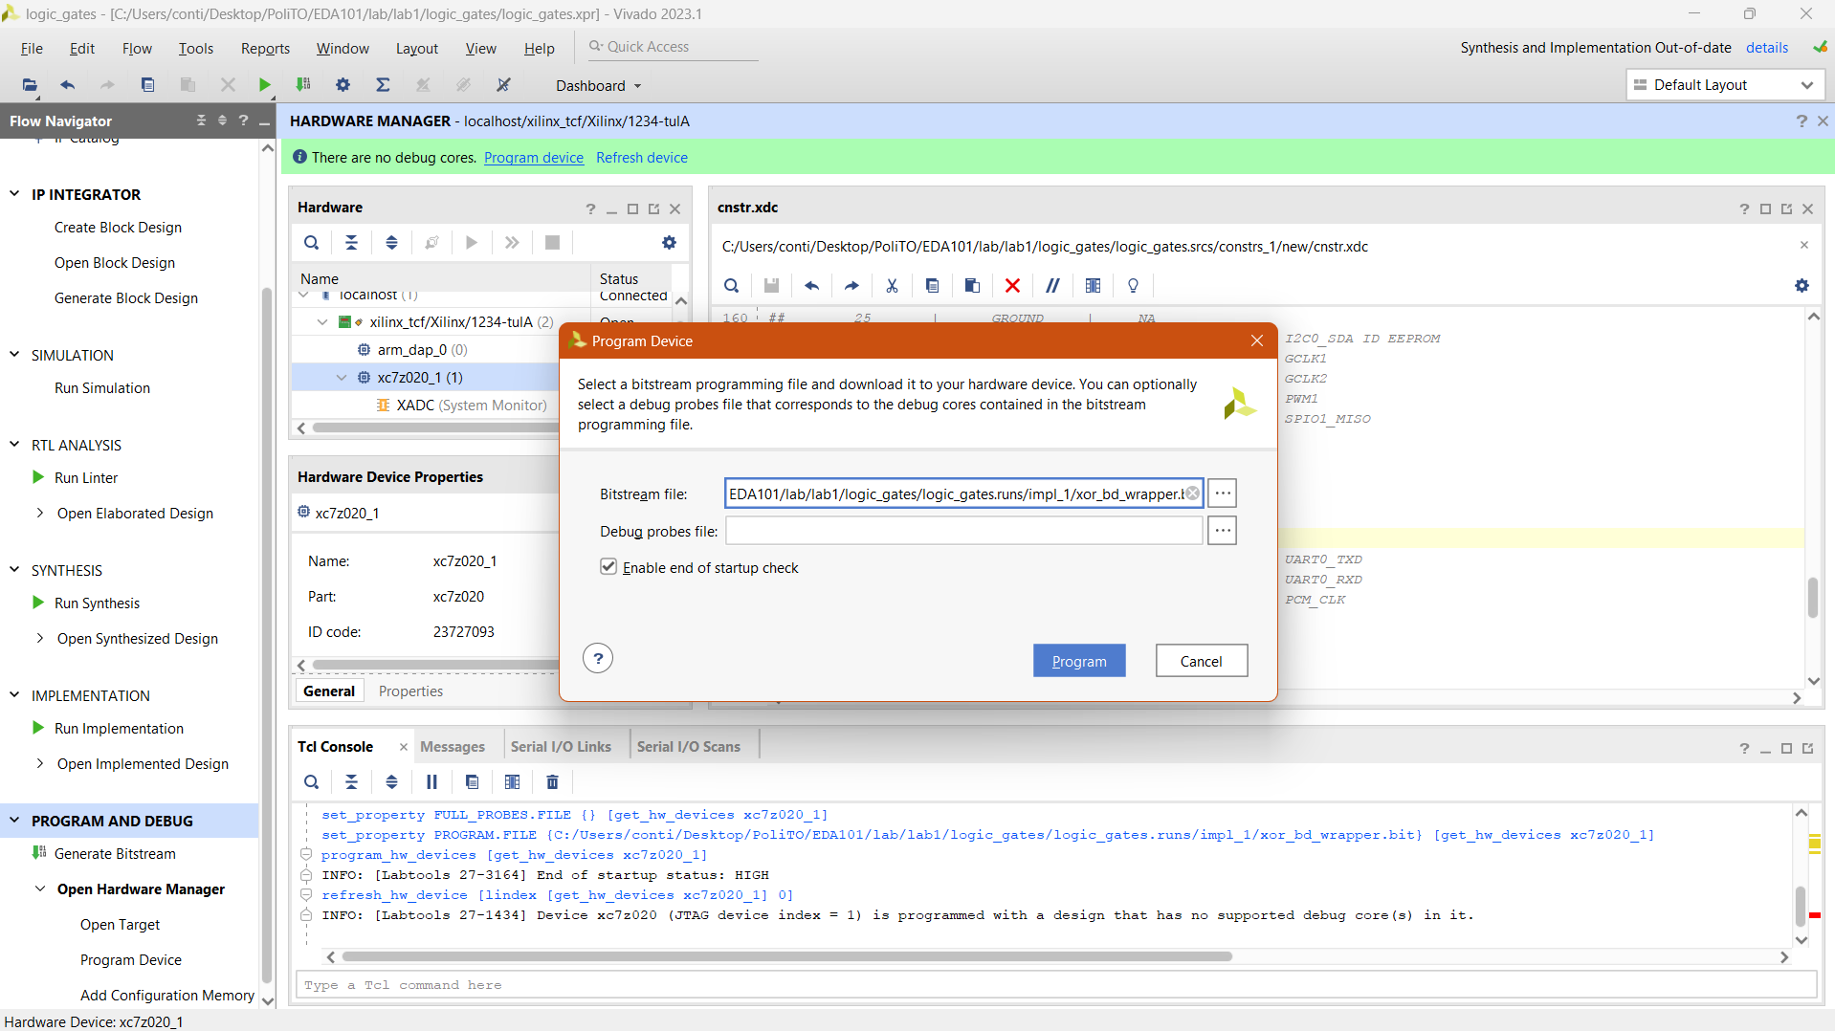
The Hardware manager
To program the device, click on Program device, then Program
Now your design is working on the board!

Slide 38







Authorship & License
Authors
License
Christian Conti christian.conti@polito.it
Gianvito Urgese gianvito.urgese@polito.it
Daniele Jahier Pagliari daniele.jahier@polito.it
Enrico Macii enrico.macii@polito.it
Cristiana Bolchini cristiana.bolchini@polimi.it
Fabrizio Ferrandi fabrizio.ferrandi@polimi.it
These slides are distributed under the Creative Commons license "Attribution – Non-commercial - Share alike 2.5 Italy (CC BY-NC-SA 2.5)"
You are free to:
to reproduce, distribute, communicate to the public, exhibit in public, represent, perform and recite this work
to modify this work
Under the following conditions:
Attribution - You must attribute authorship of the work to the original authors and in a way that does not suggest that they endorse you or the way you use the work.
Non-commercial - You may not use this work for commercial purposes.
Share Alike - If you alter or transform this work, or if you use it to create another, you may distribute the resulting work only under an identical or equivalent license to this one.
http://creativecommons.org/licenses/by-nc-sa/2.5/

