Slide 1
Lab 03: From Architectures to SoCs
Presented By: (Name)

Slide 2
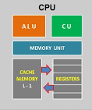
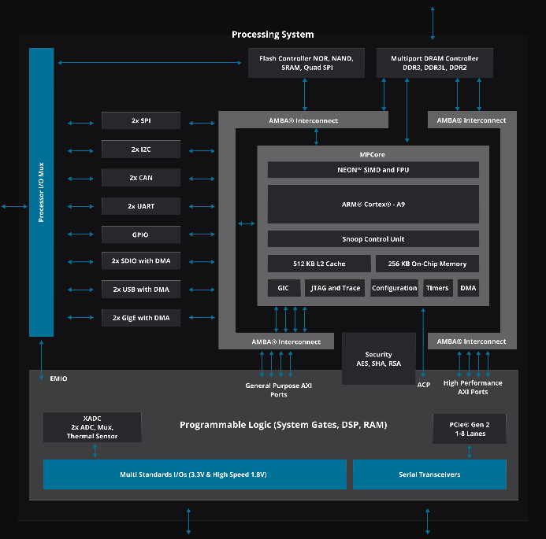
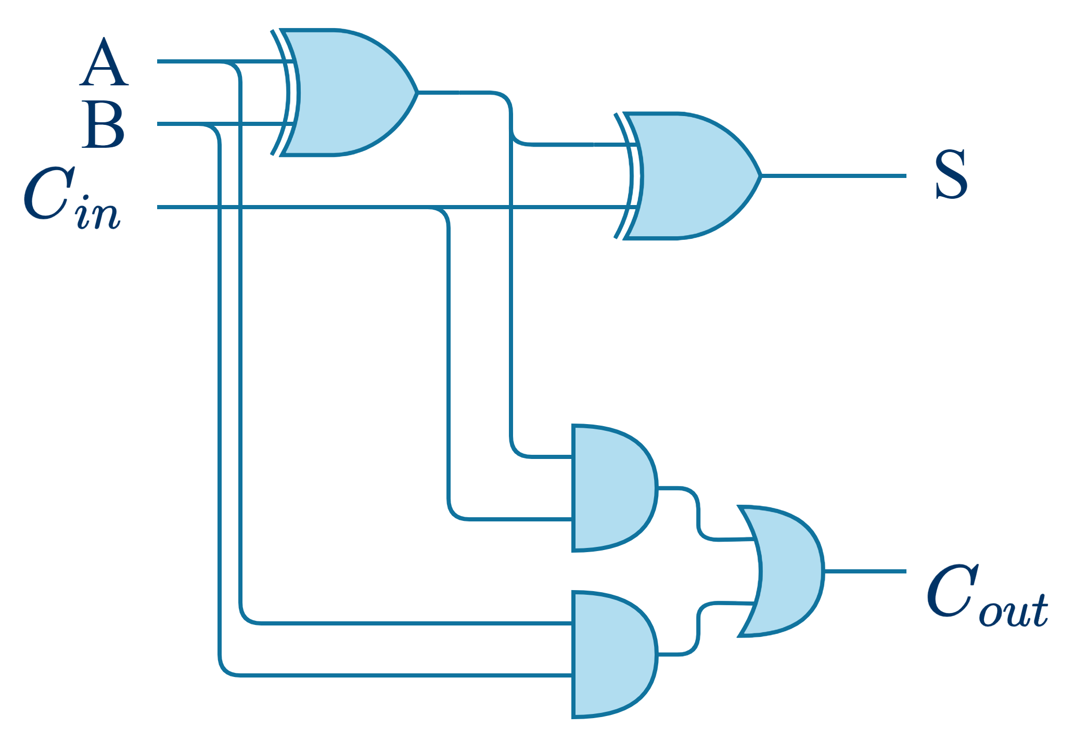
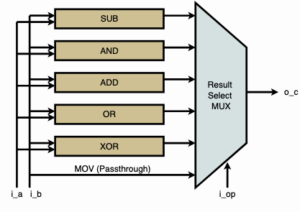
Hierarchical Design: From Gates to Architectures to SoCs
Gates
Multi-bit adder
ALU
CPU
SoC
Sum[15:0]
Cout
+
A[15:0]
B[15:0]
Seen in lab02
Today (at high-level)

Slide 3
Lab 03 Part 1: Implementation of an ALU

Slide 4
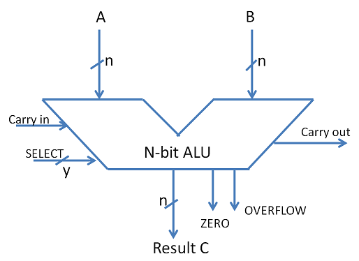
ALU
An ALU Arithmetic Logic Unit is a component used inside a processor to perform basic logical and arithmetical operations.

Slide 5
RTL Design: Input & Output Ports
Bit Vectors: ordered sets of bits with a single name
The whole vector can be interpreted (for example) as an unsigned number.
The example above corresponds to A = 83.
Index | 7 | 6 | 5 | 4 | 3 | 2 | 1 | 0
Bit | 0 | 1 | 0 | 1 | 0 | 0 | 1 | 1
A[5] = 0
A
A[1] = 1
A[0] = 1

Slide 6
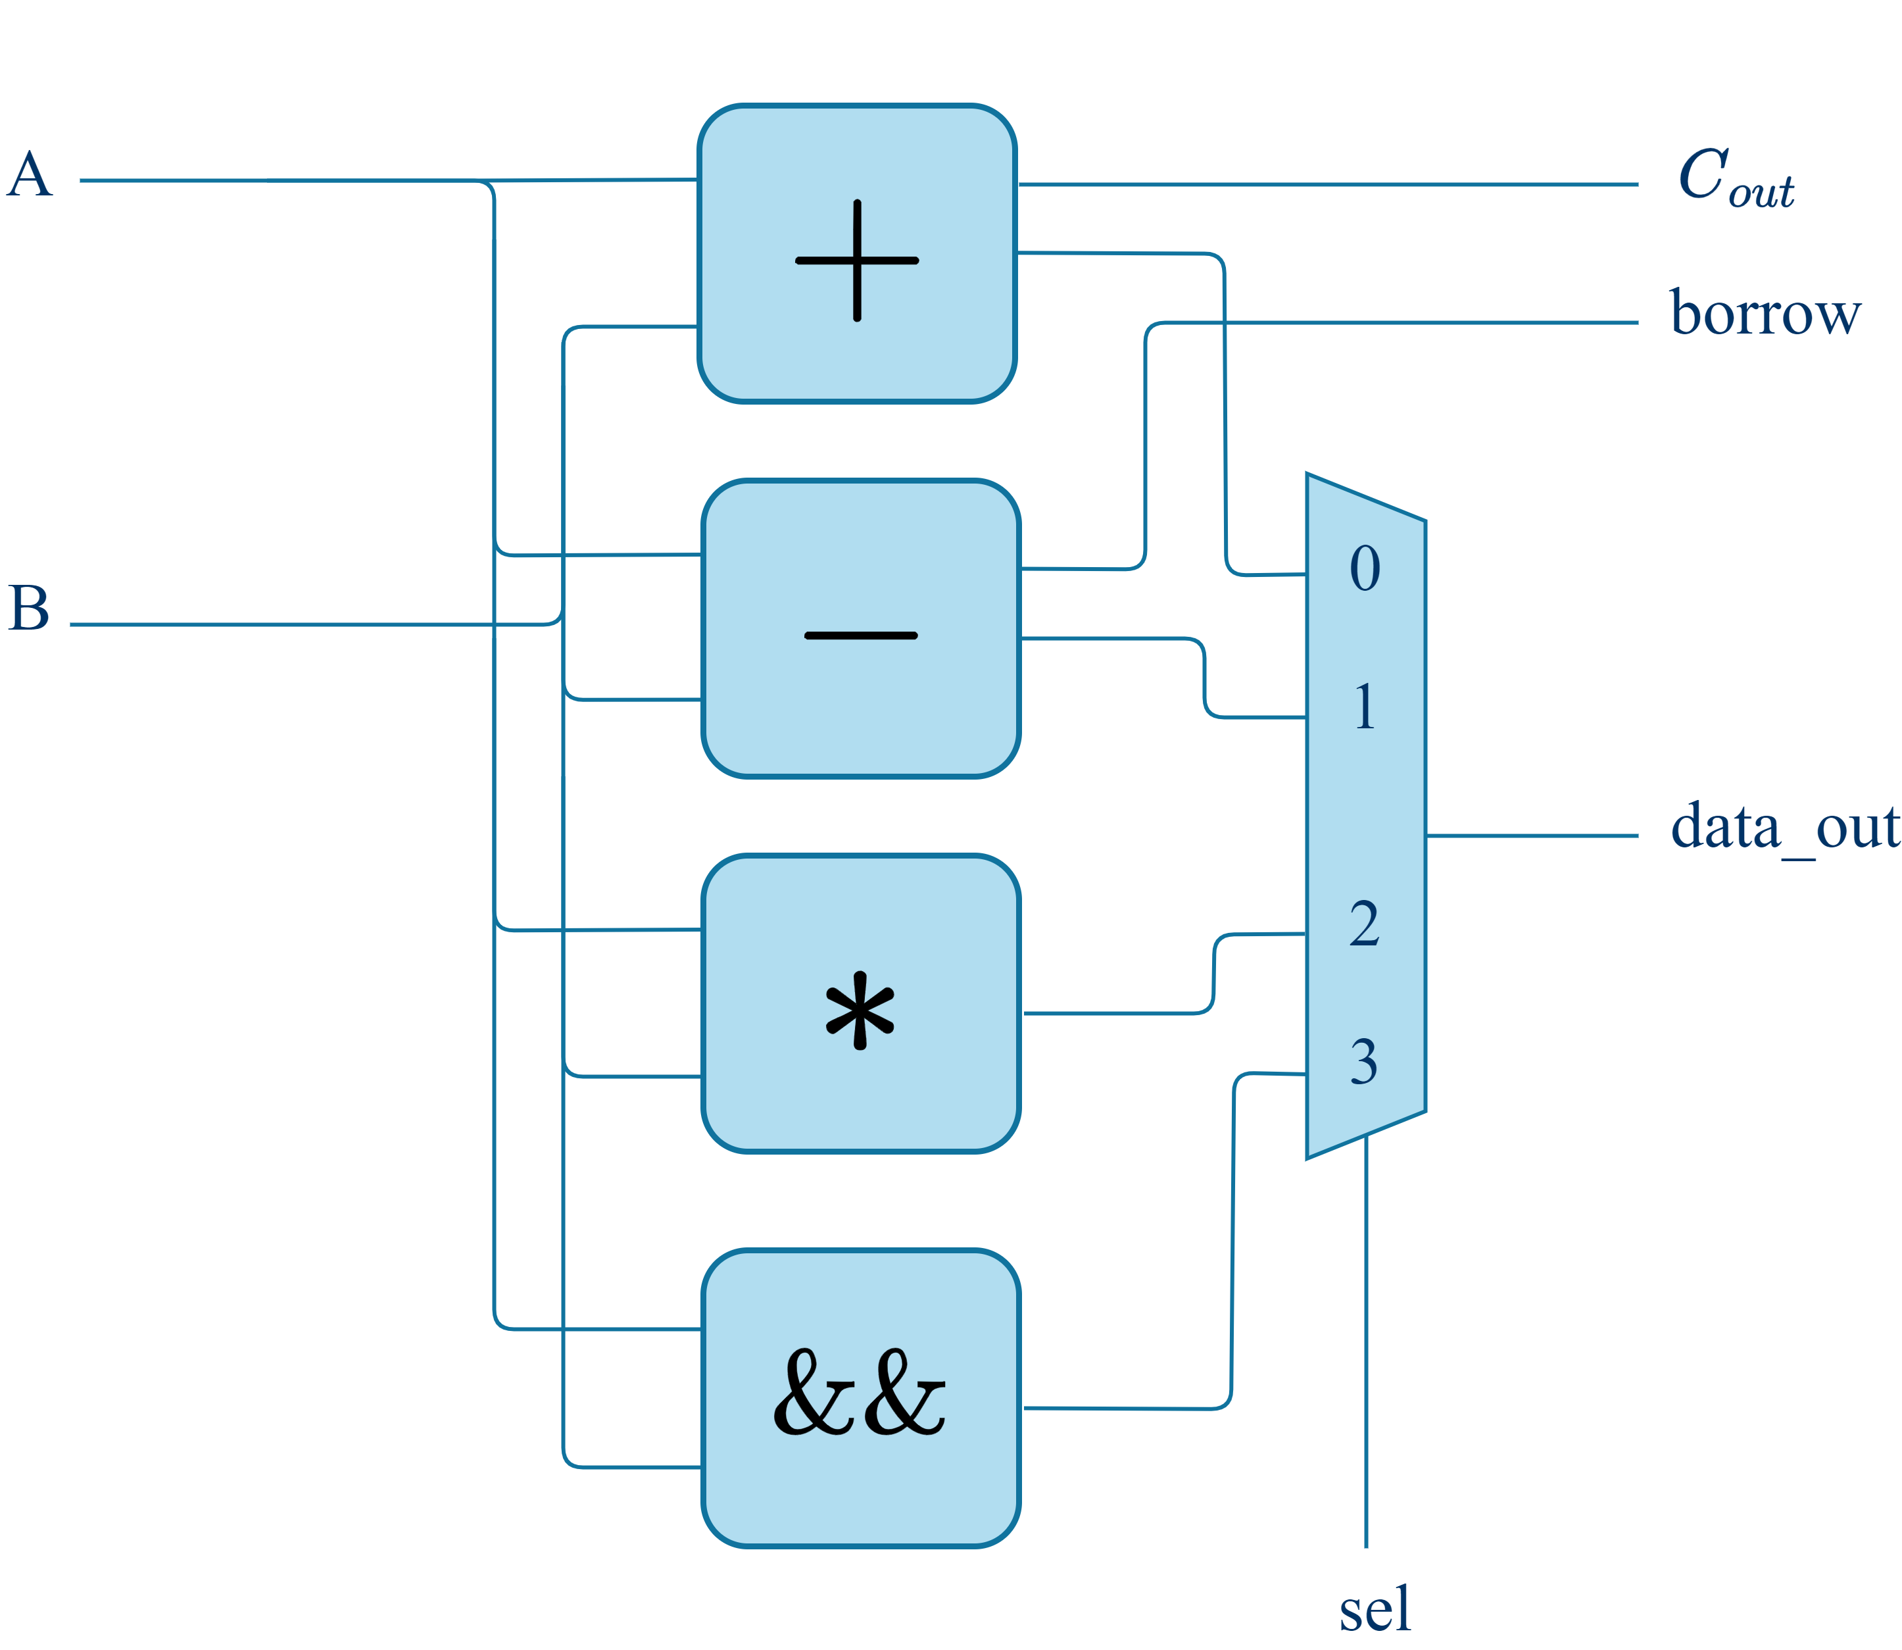
ALU
16-bit
1-bit
1-bit
Design your own ALU and test it with a testbench
16-bit
00
16-bit
01
10
11
2-bit

Slide 7
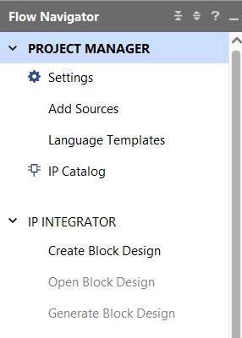
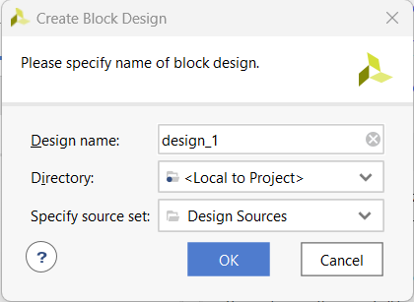
RTL Design of an Adder
Open the Vivado project for the Lab03b and create a new block design:
IP INTEGRATOR → Create Block Design, on the left Flow Navigator bar
The “Create Block Design” window will appear:
“Design name”: alu
“OK”
2.
1.
3.

Slide 8

RTL Design of an Adder
Our project has been created, and now we can implement the architecture of the adder:
Input ports:
A & B, two arrays of 16 bits [15:0]
sel, an array of 2 bits [1:0]
Output ports:
data_out, an array of 16 bits [15:0]
Cout and borrow, two single wires
Create the “ALU” block and test it
Look at the examples seen in the previous
LAB, and try to do the same steps…

Slide 9
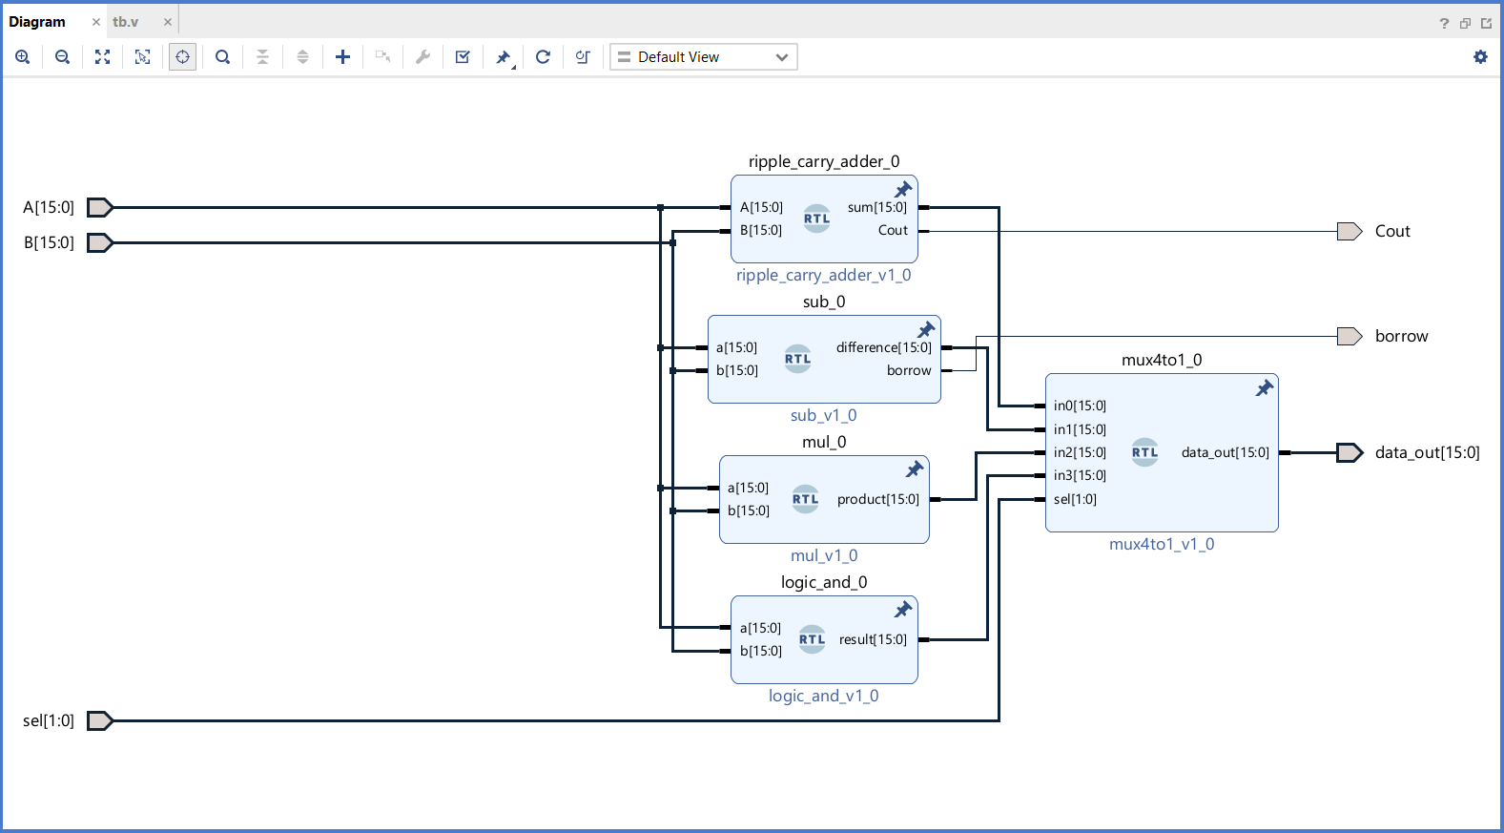
RTL Design of an Adder
Our project has been created, and now we can implement the architecture of the adder:
Input ports:
A & B, two arrays of 16 bits [15:0]
sel, an array of 2 bits [1:0]
Output ports:
data_out, an array of 16 bits [15:0]
Cout and borrow, two single wires
Create the “ALU” block and test it
Look at the examples seen in the previous
LAB, and try to do the same steps…

Slide 10
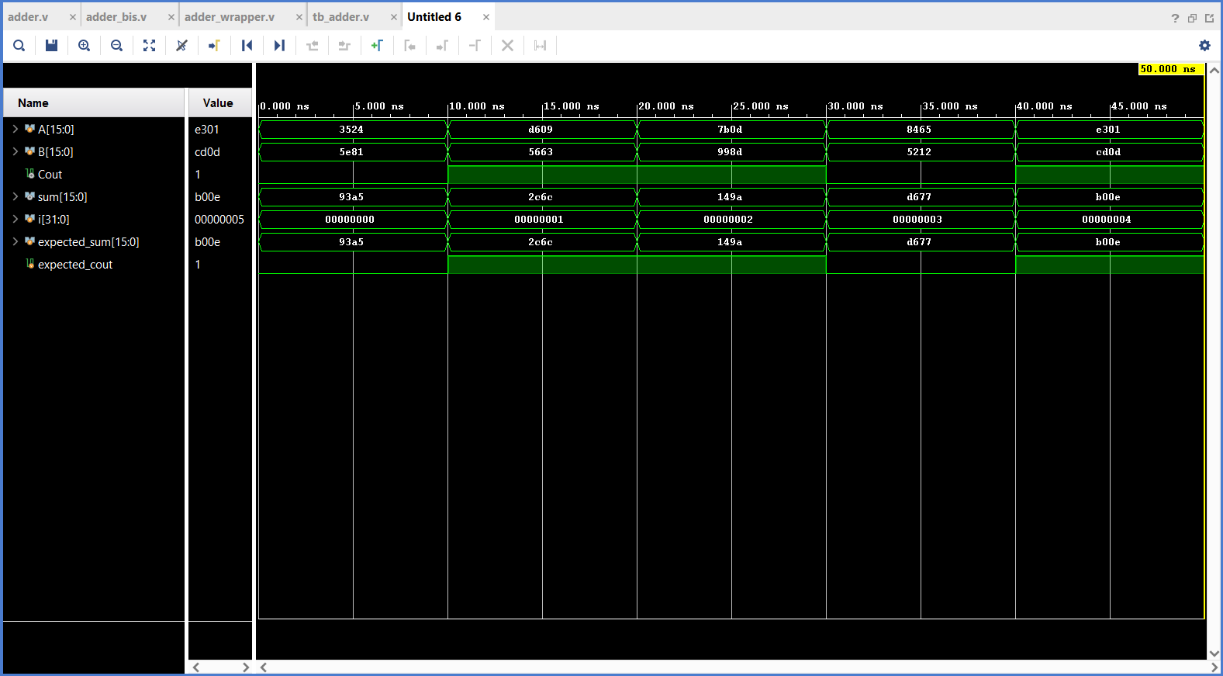
Verify the Design (Simulation)
Simulate the design and verify its correctness
Left-click on Run Simulation in the Flow Navigator
Run Behavioral Simulation
Check the waveforms…

Slide 11
Verify the Design (Simulation)
The provided testbench finds the value of the expression: (7+2)*3-5
It does it in the following way:
A=7, B=2, Sel=00 → data_out = 7 + 2
A=<previous_result>, B=3, Sel=10 → data_out = (7+2) * 3
A=<previous_result>, B=5, Sel=01 → data_out = (7+2)*3 - 5
Then, it also tests the Logic AND operation…
Note how the sequence of Sel values determines the sequence of operations performed → This is a (super-simplified) form of computer program!!!
In a “complete” computer, values of A, B, data_out and Sel would be stored in some type of memory

Slide 12
Lab 03 Part 2: Implementation Trade-offs (ALU Example)

Slide 13

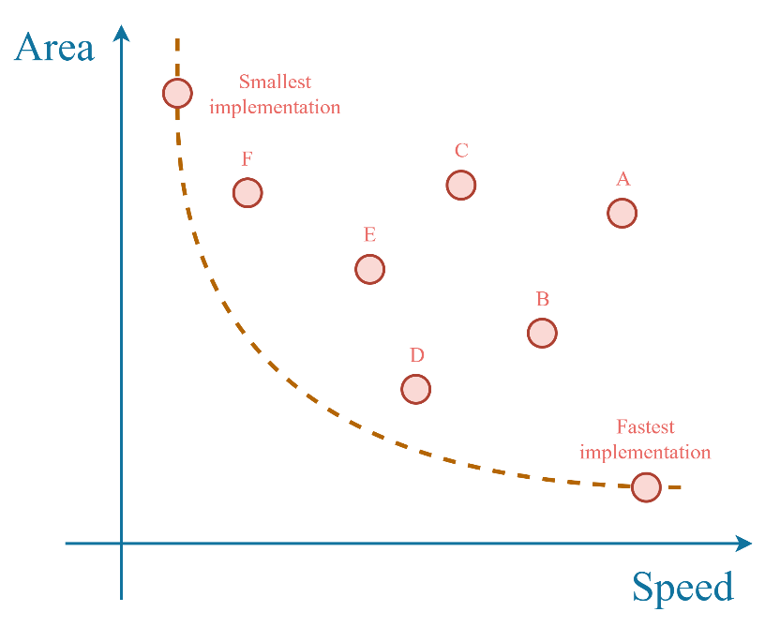
The Impact of Design Choices
Different implementations can lead to the same functionality but, with various performance, area, cost, and power consumption.
Design Space Exploration

Slide 14
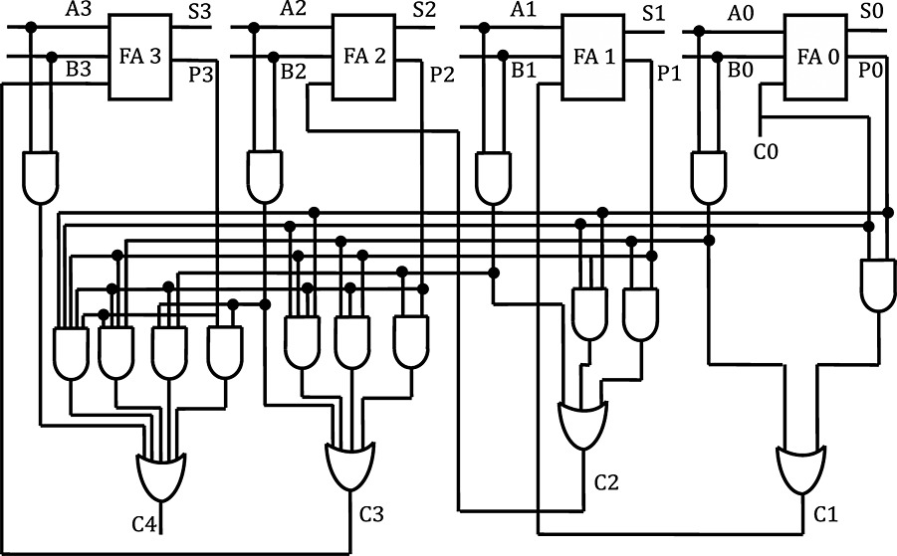
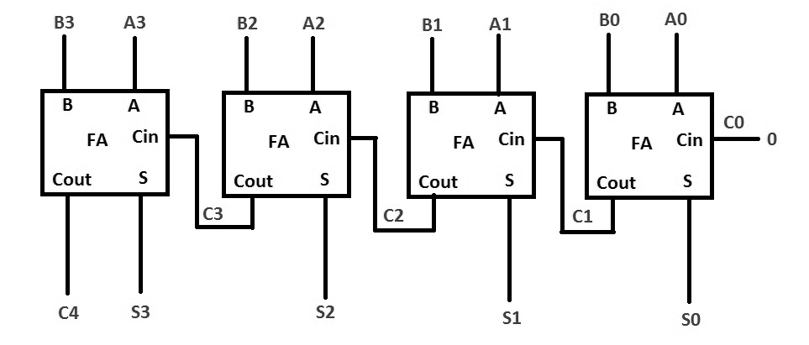
Example: Adder Architectures
The Ripple Carry Adder (seen in lab2) is simple, small but slow
Alternative: Carry Look-Ahead Adder: complex, big but fast

Slide 15
The Clock
For a block of combinational logic, like an adder, the EDA tool will try to make sure that all changes in the input bits propagate to the output before the end of the clock period.
A shorter clock period requires a faster circuit → Which means possibly larger and consuming more power.

Slide 16
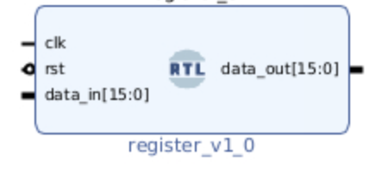
Adding Memory Elements to our ALU
Let’s explore implementation tradeoffs by adding some memories at the input and output of our ALU
Open your Block Design:
Add two modules of type “register” between the ports A and B, and the inputs of the adder/subtractor/multiplier/AND blocks.
Inputs to add/sub/mul/and
Port A or B

Slide 17
Adding Memory Elements to our ALU
Add another “register” between the output of the MUX and the data_out port.
Create two new single-bit Input Ports and call them clk and rst
clk will be our clock signal
rst is a reset signal (we will not use it…)
Connect clk and rst to the corresponding ports of all three registers.
data_out
Output of multiplexer

Slide 18
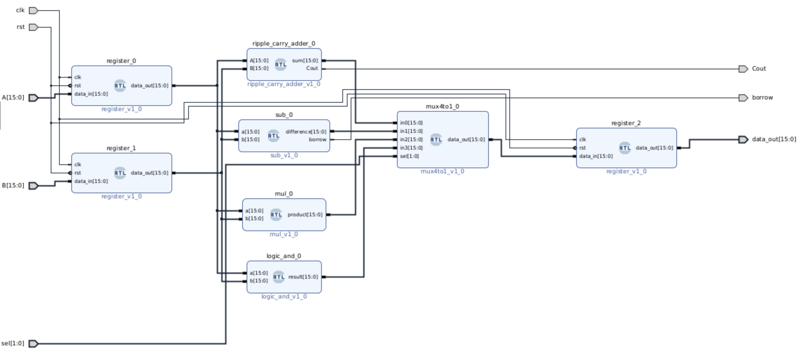
Adding Memory Elements to our ALU
Final block design:

Slide 19
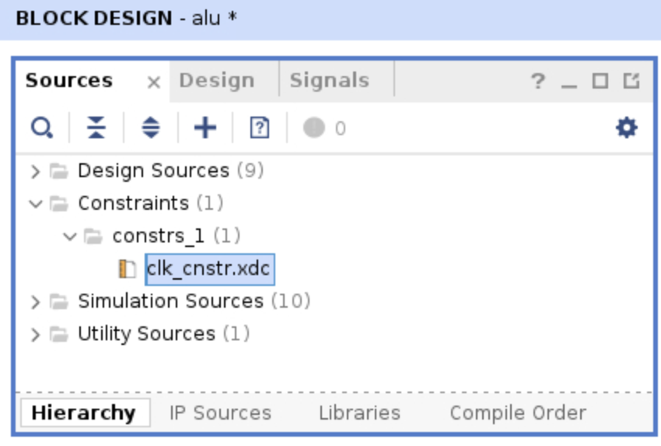
Setting Clock Constraints
Now, we need to tell the EDA tool how fast we want our clock period to be.
Under Sources/Constraints, open the clk_constr.xdc file.

Slide 20
Setting Clock Constraints
Modify the line of text contained in the file as follows:
create_clock –name clk –period 10 [get_ports clk]
This means we are asking the tool to make sure all logic changes propagate in less than 10 ns.

Slide 21
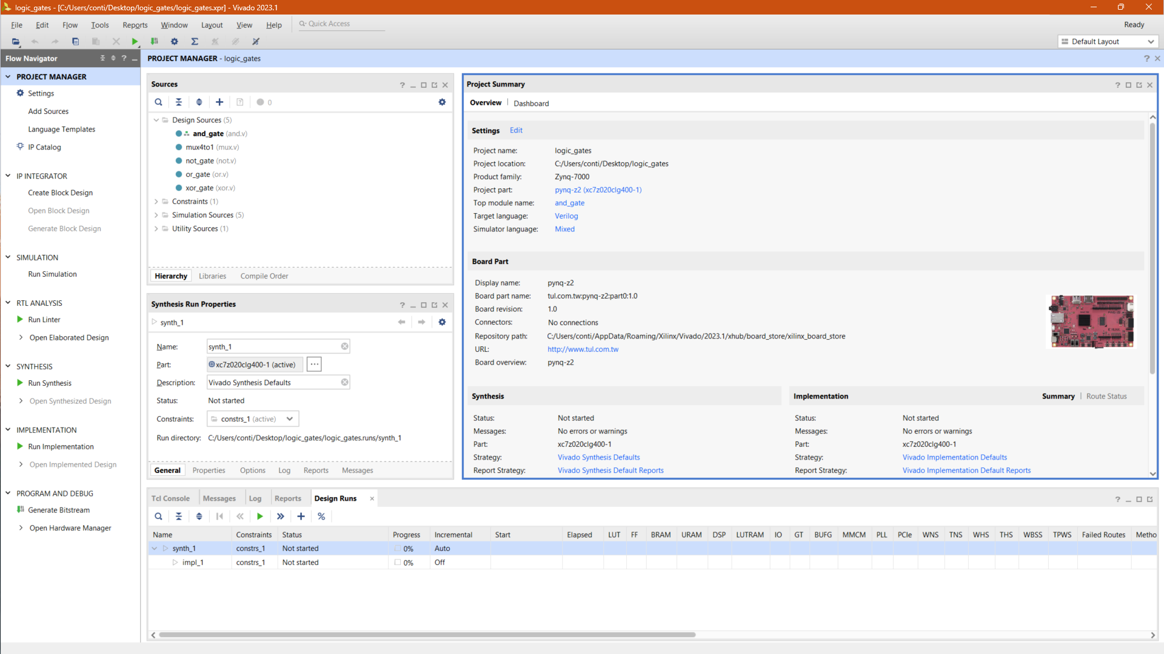
Implement the Circuit
Click on “Run Implementation” and the EDA Tool will generate the final circuit that can run on the board

Slide 22
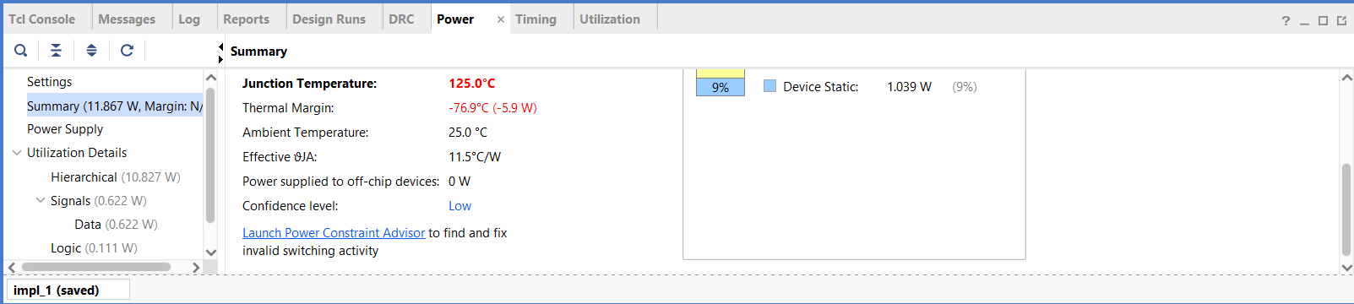
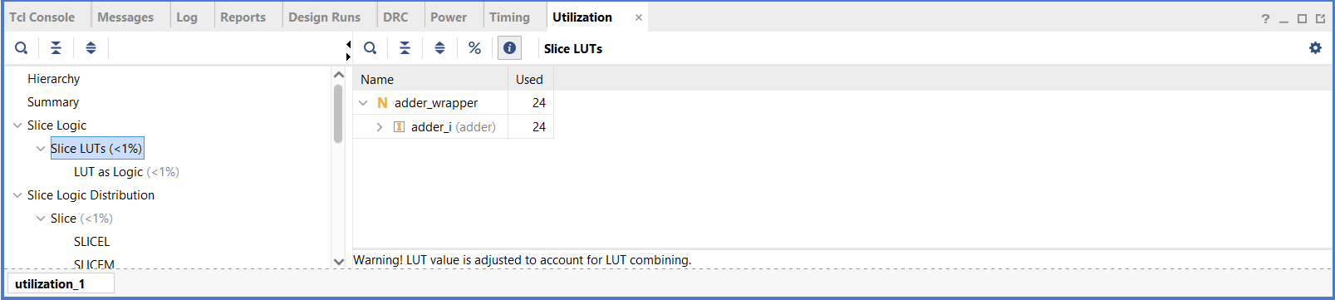
Timing & Area Reports
The EDA Tool produces the “reports” that contain useful information on the area (i.e. circuit size) and timing (i.e. circuit speed) of our design
Under implementation:
Report Timing Summary
Report Utilization

Slide 23
Timing & Area Reports
What should you look at?
Timing report:
The number reported as “WNS” (Worst Negative Slack) is related to the “remaining time available” in the clock period, when all transitions have finished propagating.
A positive number indicates that the tool successfully respected the imposed constraint.
Area Report:
The number reported under “LUTS” (Look-up Tables) is related to the number of logic gates included in the final version of your circuit implemented by the tool

Slide 24
Verify the Design (Simulation)
Now, change the constraint to:
create_clock –name clk –period 1 [get_ports clk]
This will try to make your circuit run 10 times faster!!!
Synthesize and Implement the design again!
How does the area (number of LUTs) change?
Do you see some negative value (in red) under WNS? What does it mean?

Slide 25
Lab 03 Part 3: A simple SoC

Slide 26
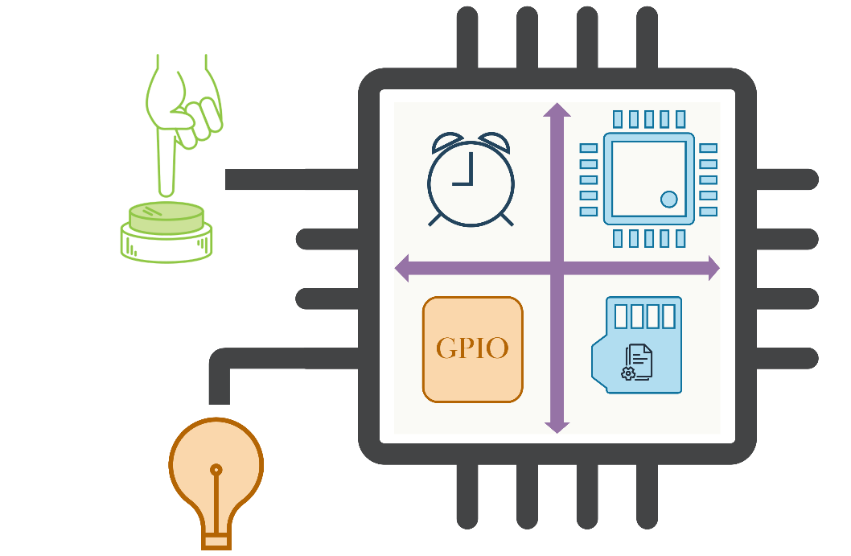
Laboratory: An SoC
We aim to design a small SoC capable of driving the LEDs on the board.
For this laboratory, our SoC will include:
One processing core.
A timer peripheral
A set of GPIO peripherals
A memory to store the data needed by the core, and the code of the program that it will execute

Slide 27
GPIO
General Purpose IOs (GPIOs) are simple peripherals that allow a SoC to read or write binary values (0 or 1) from/to external pins.
In our case, we use GPIOs only as inputs, to read the pressed/unpressed status of some push buttons.
Conceptual view:
GPIO Peripheral
SoC
read 0 (1st button pressed)
CPU
0
read 1 (2nd button unpressed)
1
0/1
Etc.
0/1
Memory “cells”
(one per pin)

Slide 28
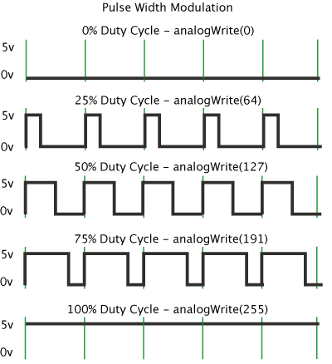
Timers
Timers are peripherals that, as the name says, allow a processor to keep track of the passing of time.
Example: do a certain operation 1 time every second, etc..
In our example, we use a timer to generate variable-width periodic pulses:
1
1
0
0
Yes but …why do we want to do that???

Slide 29
Timers
Turning on-and-off a LED with such a periodic pulse (with a very fast period)
The LED blinks so fast that our eyes cannot keep track…
What we perceive is that the LED is always on, but with a lower brightness (i.e. a “dimmed” light)
Increasing/decreasing the pulse width increases/decreases brightness
This technique is known as Pulse Width Modulation (PWM)
1
0

Slide 30
RTL Design of an SoC
Open the Vivado project for the Lab03c and create a new block design:
IP INTEGRATOR → Create Block Design, on the left Flow Navigator bar
“Create Block Design” window will appear:
“Design name”: soc
“OK”
2.
1.
3.

Slide 31
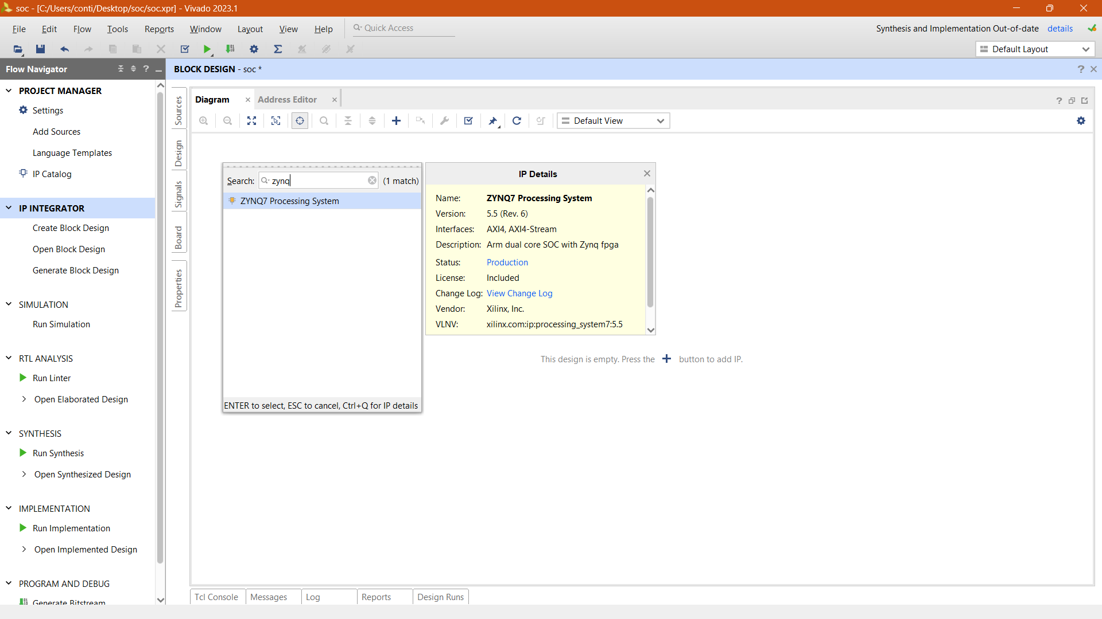
RTL Design: Main Core
Press the “+”, or “right-click”, in the block design window, then “Add IP”
Type “zynq” in the window menu
Select “ZYNQ UltraScale+ MPSoC Processing System”
These operations tell the EDA tool to consider in our design the core already present on the board.
2.
1.

Slide 32
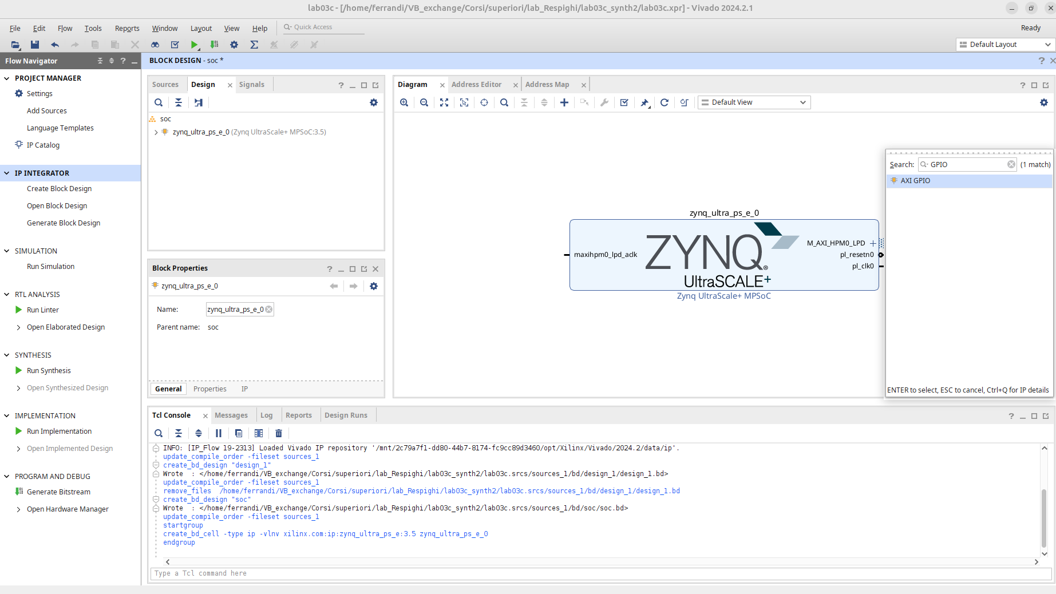
RTL Design: Add Peripherals
Right-click in the block design window, then “Add IP”
Type “GPIO” in the window menu
Select “AXI GPIO”

Slide 33
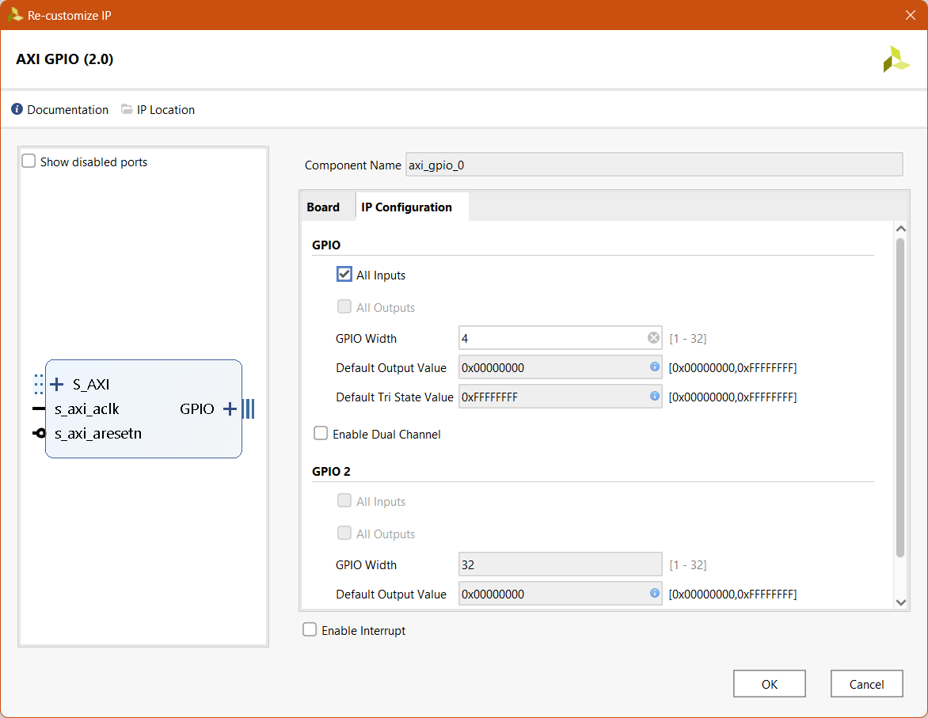
Customize GPIO Peripheral: INPUT
To receive user inputs from the push buttons, we need a GPIO configured as INPUT:
Double-click on the AXI-GPIO peripheral
Go to IP Configuration
Set “All Inputs”
Set “GPIO Width” to 4
OK
2.
3.
4.
5.

Slide 34
RTL Design: Add Peripherals
Add another GPIO for the output
Right-click in the block design window, then “Add IP”
Type “GPIO” in the window menu
Select “AXI GPIO”

Slide 35
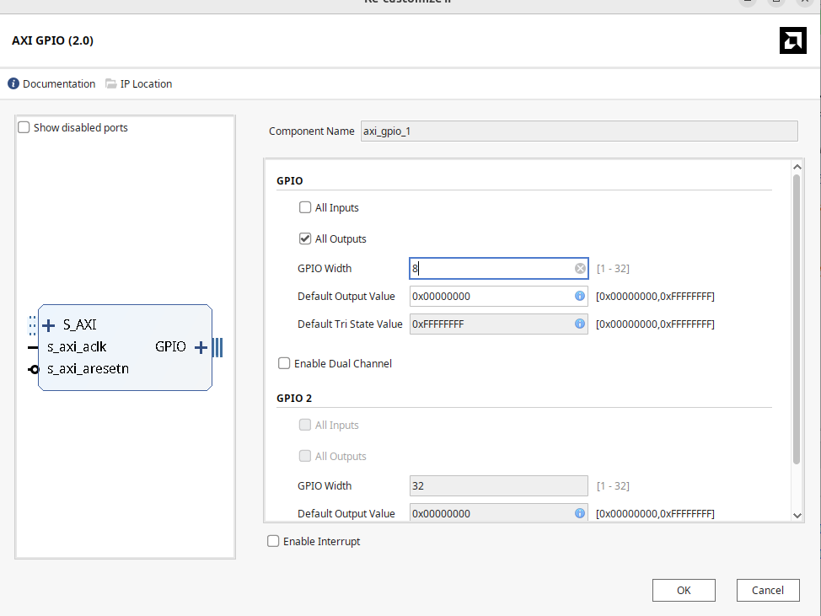
Customize GPIO Peripheral: INPUT
To propagate user outputs to the LED, we need another GPIO configured as OUTPUT:
Double-click on the AXI-GPIO peripheral
Go to IP Configuration
Set “All Outputs”
Set “GPIO Width” to 8
OK
2.
3.
4.
5.

Slide 36
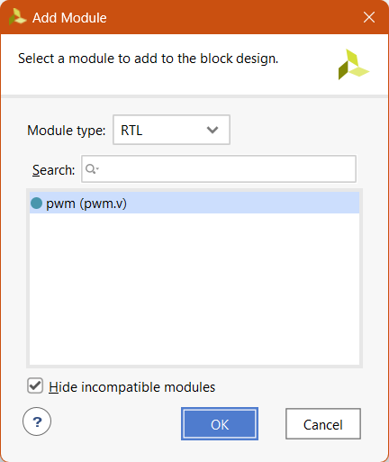
RTL Design: Add Custom Modules
The processing core and the GPIO peripheral are components in the standard library.
A set of pre-defined modules inside the EDA tool to speed up the design.
Sometimes, custom modules are required. These modules are complex combinations of logic gates.
Right-click inside the block design → Add Module…
Select “pwm’
2.

Slide 37
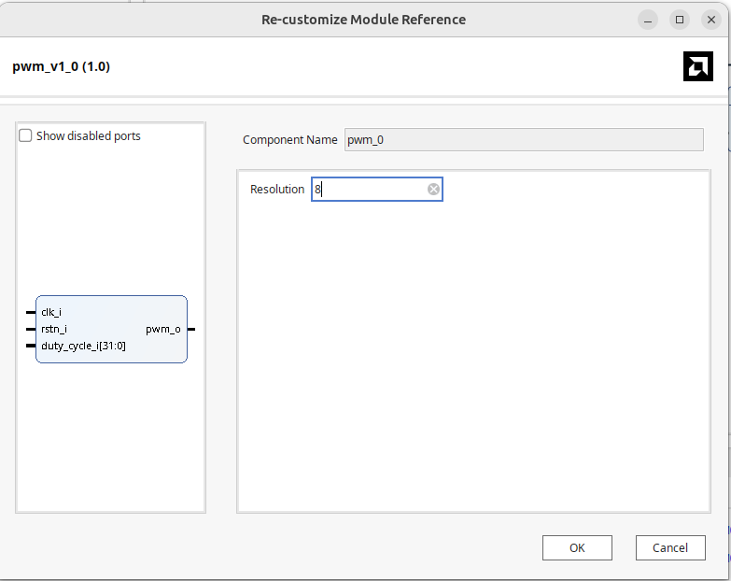
Customize pwm module
2.
Double-click on the PWM module
Change resolution to 8
OK
3.

Slide 38
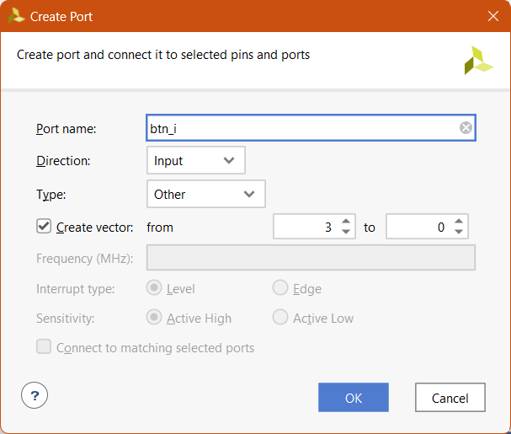
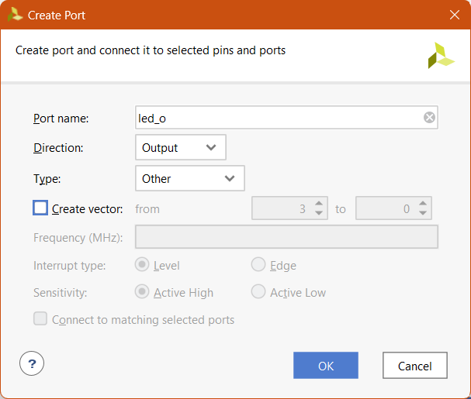
RTL Design: Input & Output
Add the input and output ports:
Right-Click → Create Port…
Input (Direction: Input):
Name: btn_i
Create vector from 3 to 0
Output (Direction: Output):
Name: led_o
Input
Output

Slide 39
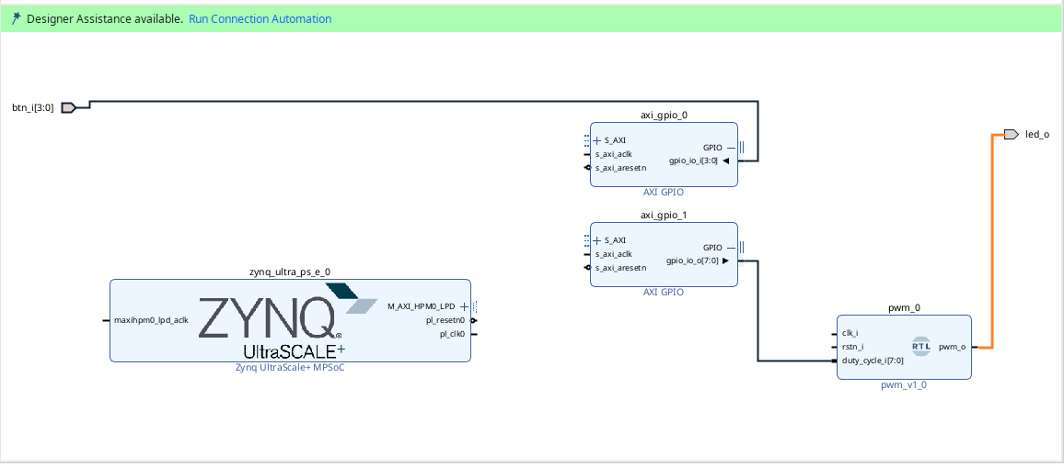
RTL Design: Interconnections
Connect the ports to peripherals:
btn_i → gpio_io_i
gpio_io_o → dute_cycle
pwm_o → led_o

Slide 40
RTL Design: Interconnections
EDA tools automate the connection of the various blocks of the design
Click on “Run Connection Automation"
Select “All Automation”
OK
1.

Slide 41
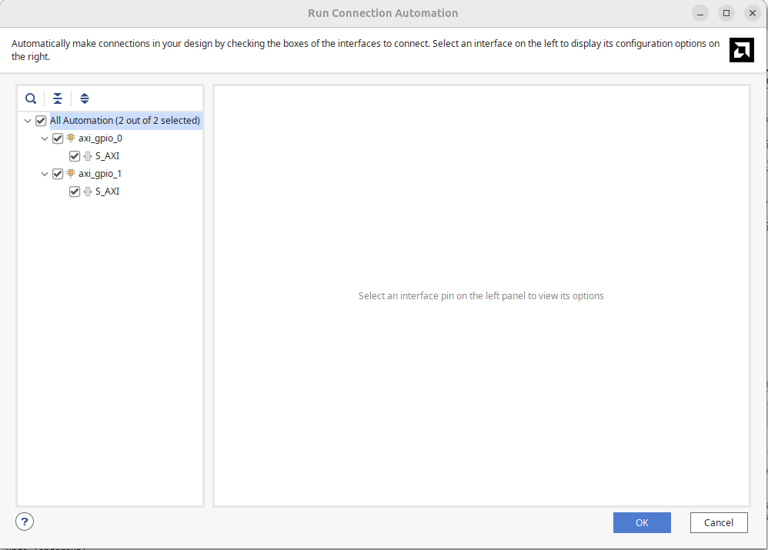
RTL Design: Interconnections
EDA tools automate the connection of the various blocks of the design
Click on “Run Connection Automation"
Select “All Automation”
OK
1.
2.
3.

Slide 42
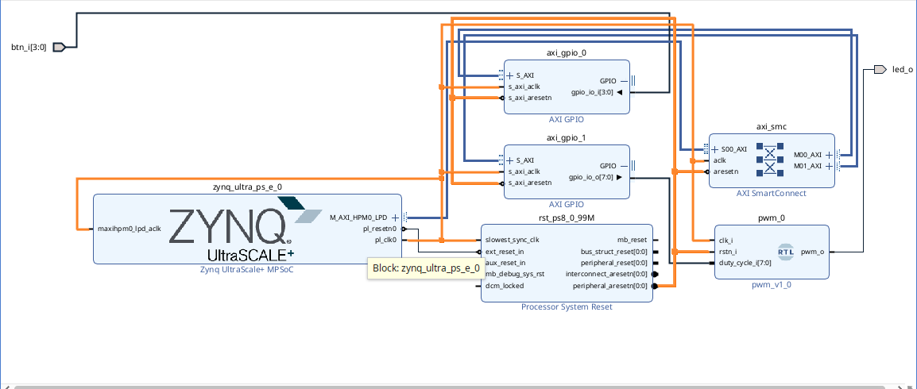
Connect reset and clock of pwm
Connect
pl_clk0 → clk_i of pwm
peripheral_aresetn → rstn_i of pwm

Slide 43
Generate the Design
The EDA tool generates the code of our design, taking into consideration the input and output ports of the chip:
Right-click on block design “soc” in Design Sources
Select Create HDL Wrapper…
A new window with the available modules will pop up
Ok

Slide 44
Implementing the Circuit on the Board
Click on “Generate Bitstream” and the EDA Tool will provide the files to upload the design on the board
In this case, we also have some program running on the core
We must upload the code to the memory of our SoC

Slide 45
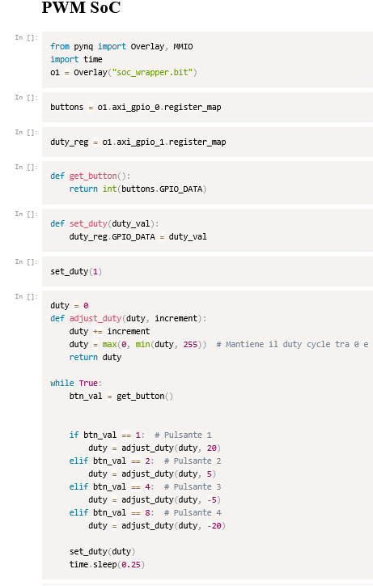
Python notebook with Pynq
Retrieve the soc_wrapper.bit and soc_wrapper.hwh after the bitstream has been generated
Load the two files on the Pynq system of the board

Slide 46
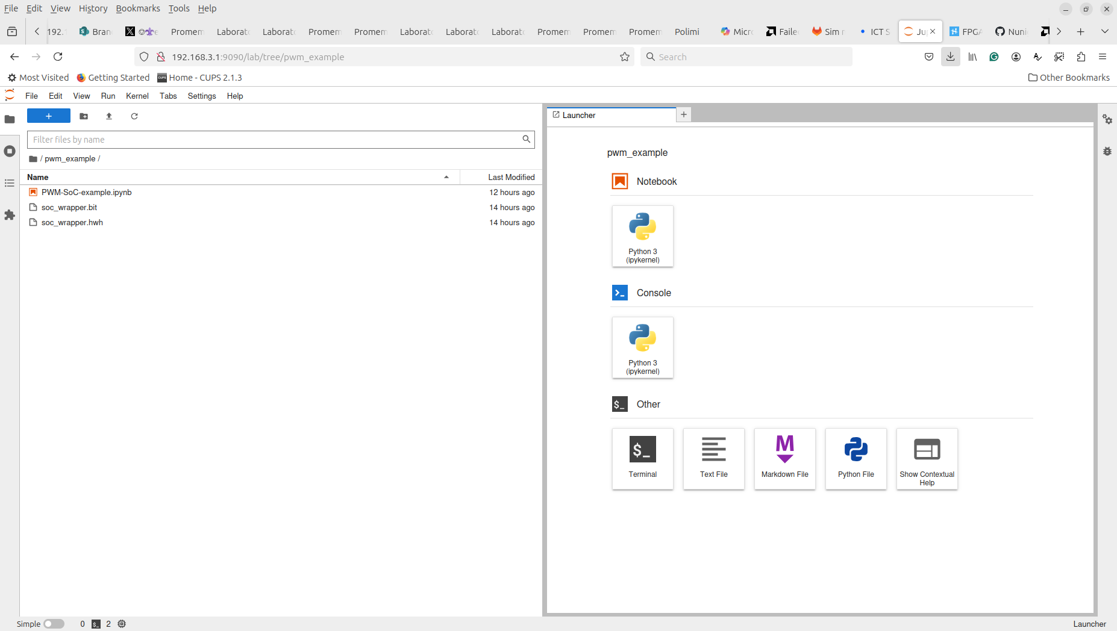
Exploiting Pynq programming approach
Connect to 192.168.3.1/lab and then run the python notebook

Slide 47







Authorship & License
Authors
License
Christian Conti christian.conti@polito.it
Gianvito Urgese gianvito.urgese@polito.it
Daniele Jahier Pagliari daniele.jahier@polito.it
Enrico Macii enrico.macii@polito.it
Cristiana Bolchini cristiana.bolchini@polimi.it
Fabrizio Ferrandi fabrizio.ferrandi@polimi.it
These slides are distributed under the Creative Commons license "Attribution – Non-commercial - Share alike 2.5 Italy (CC BY-NC-SA 2.5)"
You are free to:
to reproduce, distribute, communicate to the public, exhibit in public, represent, perform and recite this work
to modify this work
Under the following conditions:
Attribution - You must attribute authorship of the work to the original authors and in a way that does not suggest that they endorse you or the way you use the work.
Non-commercial - You may not use this work for commercial purposes.
Share Alike - If you alter or transform this work, or if you use it to create another, you may distribute the resulting work only under an identical or equivalent license to this one.
http://creativecommons.org/licenses/by-nc-sa/2.5/

