Slide 1
Lab 02: Design of an Adder
Presented By: (Name)

Slide 2
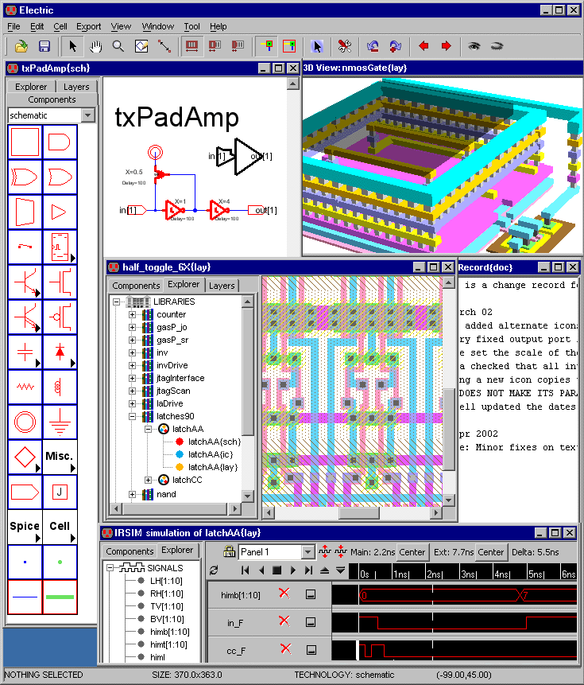
Electronic Design Automation Tools
Electronic Design Automation (EDA) are a suite of software, hardware, and services to assist in:
Design;
Implementation;
Verification;
Manufacturing;
EDA tools help engineers and designers automate complex tasks in the creation of electronic hardware.

Slide 3
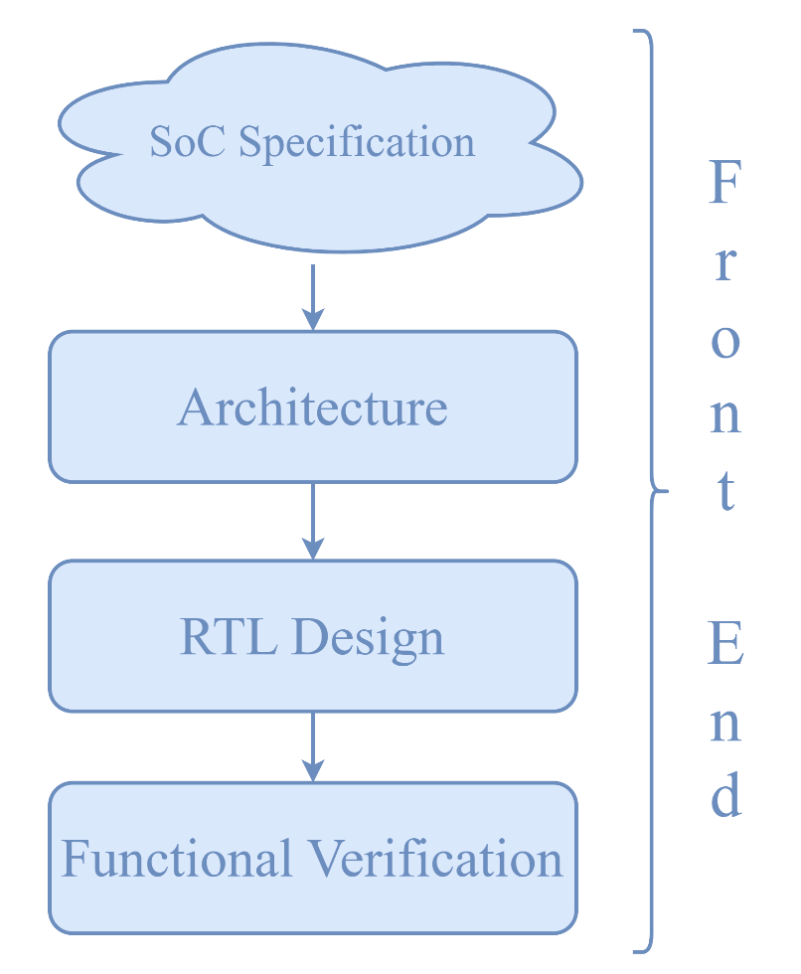

Hands-on: An Adder
We have seen how an EDA tool can help explore the design space of a project.
It is time to deploy a real circuit from its specifications to its implementation.
We will focus on a circuit that performs a simple mathematical operation: The addition (of bits)

Slide 4
Lab 02 Part 1: Half Adder
Presented By: (Name)

Slide 5
Summing Two Bits
How do we sum two bits?
Simple rules, similar to “standard” (decimal) arithmetic:
0 + 0 = 0
0 + 1 = 1
1 + 0 = 1
1 + 1 = ?

Slide 6
Summing Two Bits
What about 1+1?
With one bit, I can only represent 0 and 1… No “2” available.
Similar to 9 + 1 in decimal… How do you express the result?
→ Add one more “digit”. In our case, one more bit
1 + 1 = 10
10 in binary = 2 in decimal

Slide 7


Slide 8
A (first) Truth Table for Bit-Addition
Truth table with more than one output… this is new!
How do we proceed?
 |  | _{SUM (C) on two bits}
A | B | C₁ | C₀
0 | 0 | 0 | 0
0 | 1 | 0 | 1
1 | 0 | 0 | 1
1 | 1 | 1 | 0

Slide 9
A (first) Truth Table for Bit-Addition
Simply split it in two tables and treat them separately
A | B | C₁
0 | 0 | 0
0 | 1 | 0
1 | 0 | 0
1 | 1 | 1
A | B | C₀
0 | 0 | 0
0 | 1 | 1
1 | 0 | 1
1 | 1 | 0

Slide 10
A (first) Truth Table for Bit-Addition
A | B | C₁
0 | 0 | 0
0 | 1 | 0
1 | 0 | 0
1 | 1 | 1
A | B | C₀
0 | 0 | 0
0 | 1 | 1
1 | 0 | 1
1 | 1 | 0
Have we seen this function already??

Slide 11
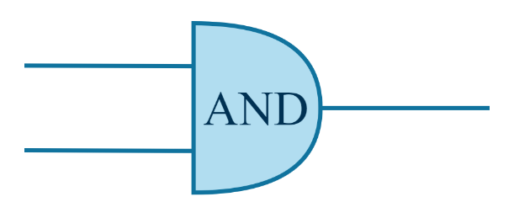
A (first) Truth Table for Bit-Addition
A | B | C₁
0 | 0 | 0
0 | 1 | 0
1 | 0 | 0
1 | 1 | 1
A | B | C₀
0 | 0 | 0
0 | 1 | 1
1 | 0 | 1
1 | 1 | 0

Slide 12
A (first) Truth Table for Bit-Addition
A | B | C₁
0 | 0 | 0
0 | 1 | 0
1 | 0 | 0
1 | 1 | 1
A | B | C₀
0 | 0 | 0
0 | 1 | 1
1 | 0 | 1
1 | 1 | 0
And this one??

Slide 13
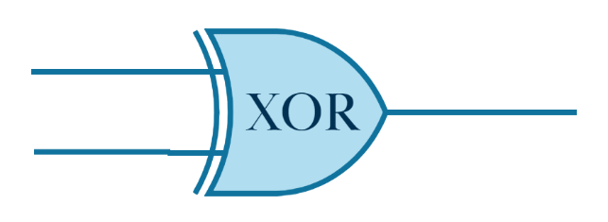
A (first) Truth Table for Bit-Addition
A | B | C₁
0 | 0 | 0
0 | 1 | 0
1 | 0 | 0
1 | 1 | 1
A | B | C₀
0 | 0 | 0
0 | 1 | 1
1 | 0 | 1
1 | 1 | 0

Slide 14
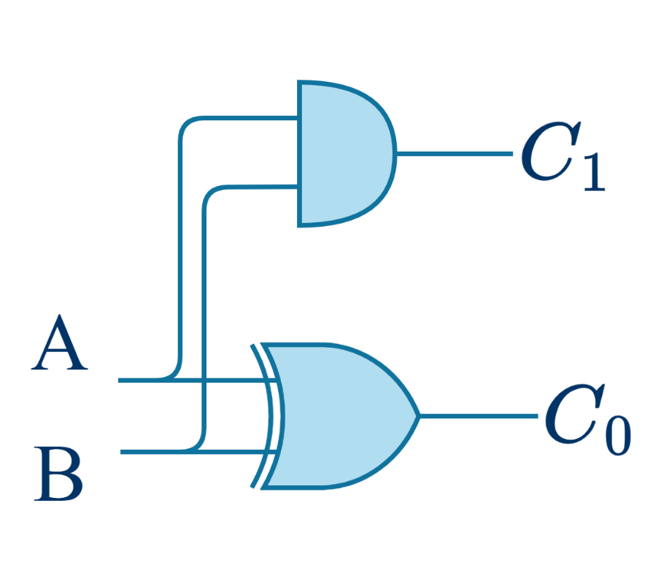
A (first) Circuit for Bit-Addition
First circuit to implement 1 bit + 1 bit addition.
Called a HALF ADDER

Slide 15


Let’s get our hands dirty….

Slide 16
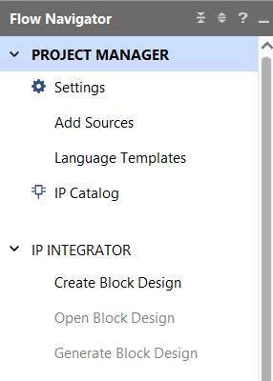
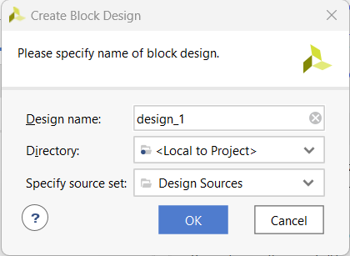
RTL Design of an Adder
Open the Vivado project for the Lab02 and create a new block design:
IP INTEGRATOR → Create Block Design, on the left Flow Navigator bar
The “Create Block Design” window will appear:
“Design name”: half_adder
“OK”
2.
1.
3.

Slide 17

RTL Design of an Adder
Our project has been created, now we can implement the architecture of the adder:
Add to the design the input ports
Add to the design the output ports
Add the logic gates of the half adder and connect the circuit to the input and output ports
Simulate the circuit to verify its correctness
Look at the example seen in LAB1, and try to do the same steps for the Half Adder circuit…

Slide 18
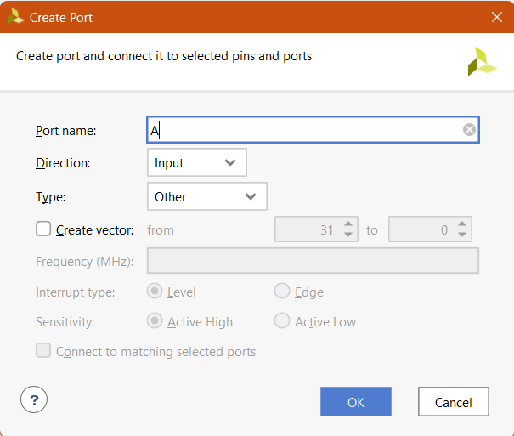
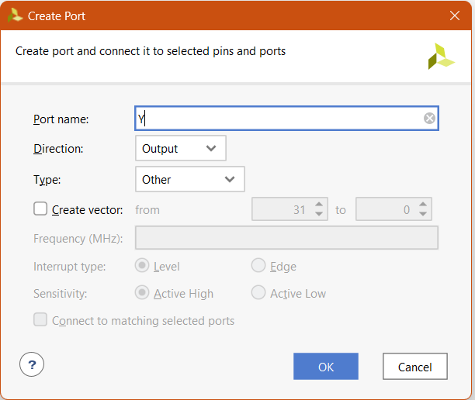
RTL Design: Input & Output Ports
Add the input and output ports:
Right-Click → Create Port…
Input (Direction: Input):
A, and B are the input ports
Output (Direction: Output):
C0 and C1 are the output ports
Input
Output

Slide 19
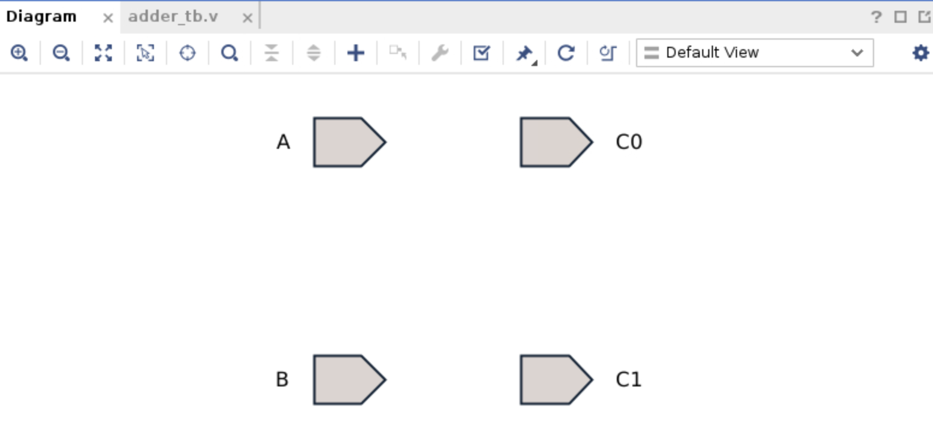
RTL Design: Input & Output Ports
Add the input and output ports:
Right-Click → Create Port…
Input (Direction: Input):
A, and B are the input ports
Output (Direction: Output):
C0 and C1 are the output ports
Input
Output

Slide 20
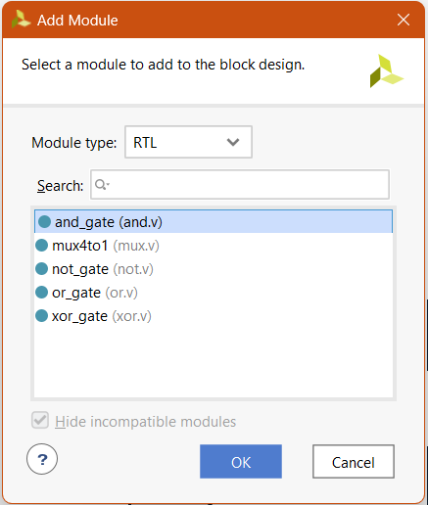
RTL Design: Logic Gates
Add the logic gates to build our full adder:
Right-click → Add Module…
From the list choose the correct gates
OK
A & B →

Slide 21

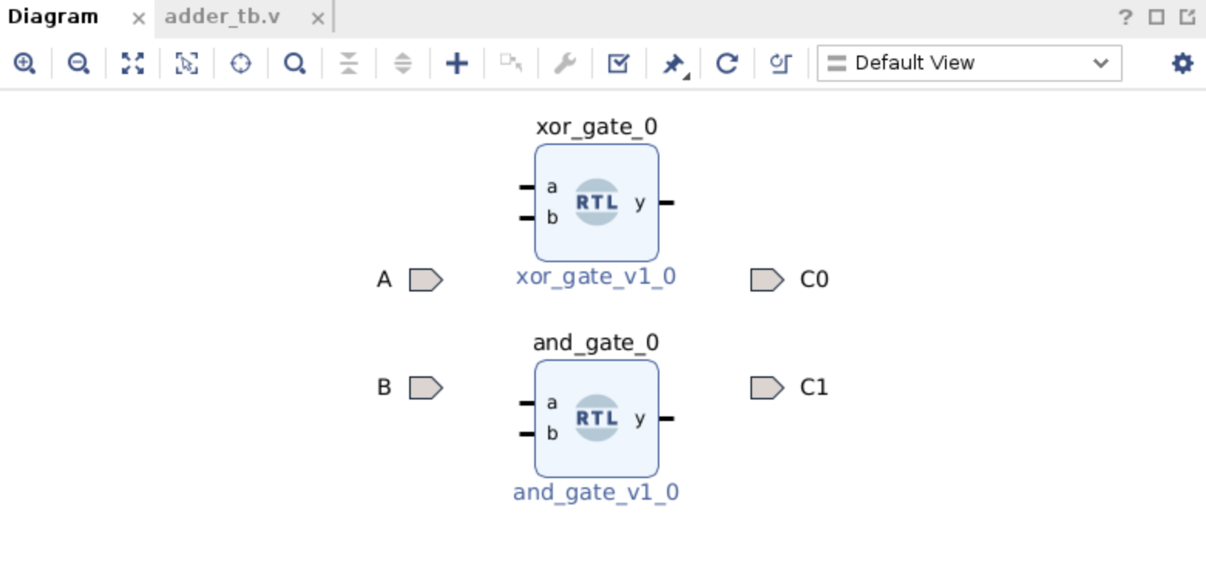
RTL Design: Logic Gates
Add the logic gates to build our full adder:

Slide 22
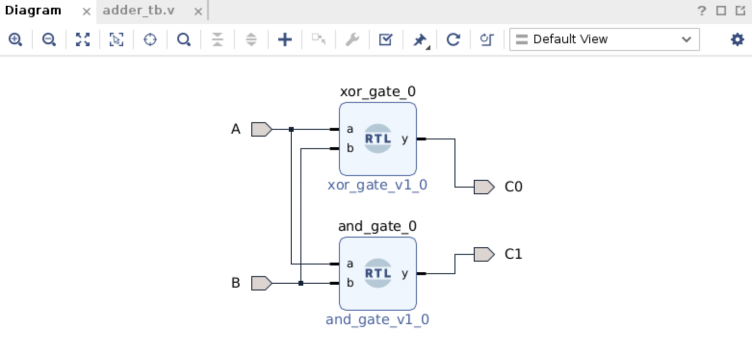
RTL Design: Interconnections
Connect the different logic gates to create the circuit:
With the mouse over on an input, click and drag to another connection point
Connect all the logic gates and the ports
Validate the design
2
↓
1
↓

Slide 23
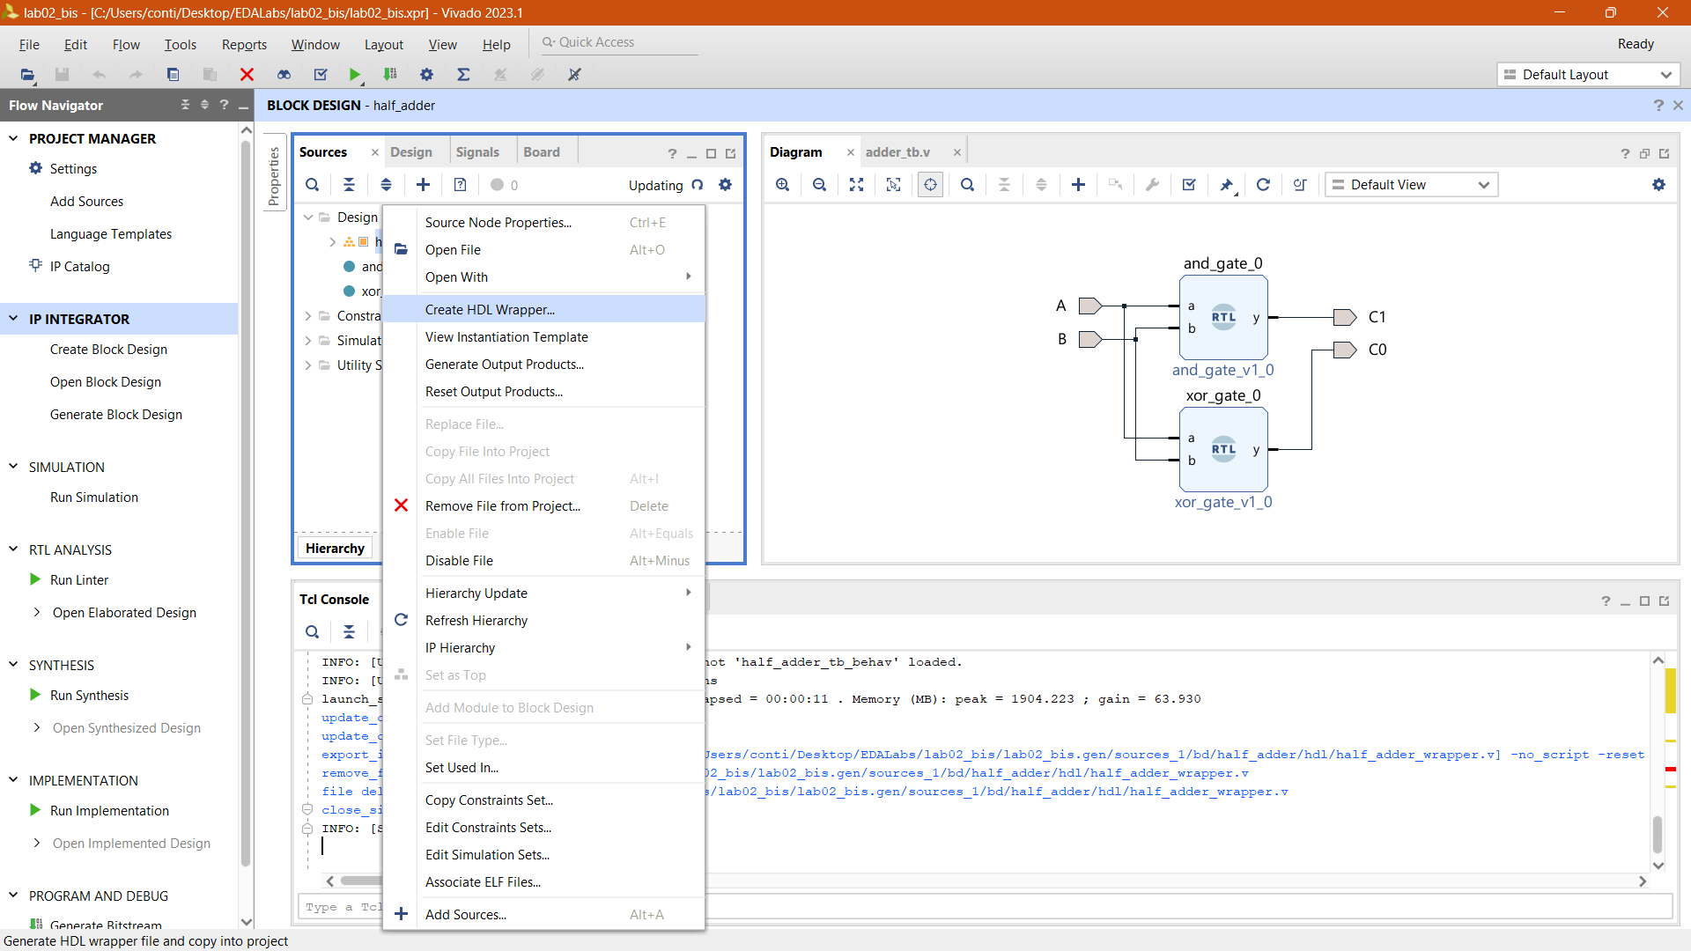


Generate the Design
The EDA tool generates the code of our design taking into consideration the input and output ports of the chip:
Right-click on block design “half_adder” in Design Sources
Select Create HDL Wrapper…
A new window with the available modules will pop up
Ok
1.
2.
L02.
Design of a Full-Adder

Slide 24
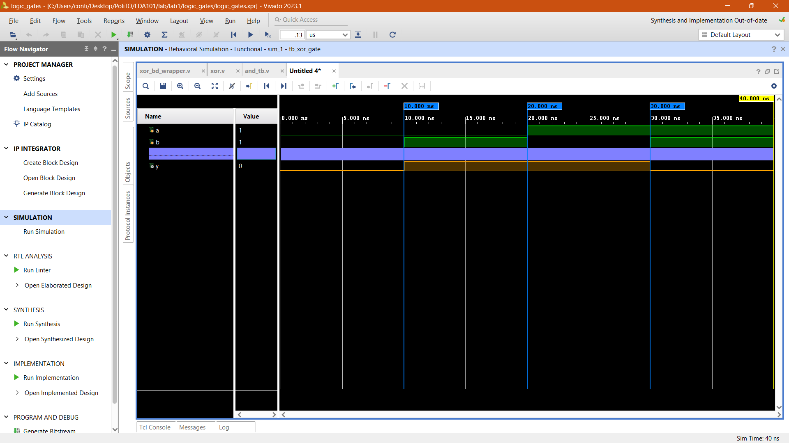
Verify the Design (Simulation)
Simulate the design and verify its correctness
Left-click on Run Simulation in the Flow Navigator window
Run Behavioral Simulation
Check the waveforms…
L01.
Introduction to Vivado & Logic Gates

Slide 25
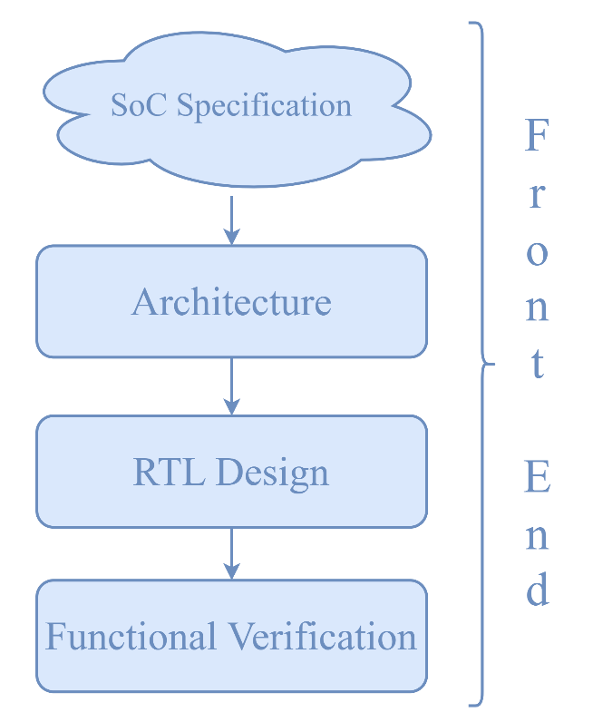
RTL Design Complete
`timescale 1 ps / 1 ps
module half_adder_wrapper
(A,
B,
C0,
C1);
input A;
input B;
output C0;
output C1;
wire A;
wire B;
wire C0;
wire C1;
half_adder half_adder_i
(.A(A),
.B(B),
.C0(C0),
.C1(C1));
endmodule

Slide 26
Lab 02 Part 2: Full Adder
Presented By: (Name)

Slide 27
Representing Numbers with More Bits…
With 2 bits, we can represent 4 natural numbers:
00 → 0
01 → 1
10 → 2
11 → 3
With 3 bits, 8 numbers, and so on…
000 → 0 100 → 4
001 → 1 101 → 5
010 → 2 110 → 6
011 → 3 111 → 7

Slide 28
Summing More Bits
To sum a multi-bit number, we use the same method you learned in elementary school for decimal numbers.
Example: 010 (2) + 011 (3) using 3 bits.
(2) 0 1 0 +
(3) 0 1 1 =

Slide 29
Summing More Bits
(2) 0 1 0 +
(3) 0 1 1 =
1

Slide 30
Summing More Bits
(2) 0 1 0 +
(3) 0 1 1 =
0 1
1

Slide 31
Summing More Bits
1
Carry
(2) 0 1 0 +
(3) 0 1 1 =
0 1
1

Slide 32
Summing More Bits
1
(2) 0 1 0 +
(3) 0 1 1 =
0 1

Slide 33
Summing More Bits
1
(2) 0 1 0 +
(3) 0 1 1 =
1 0 1
The result is 5 (see slide 14), as expected!

Slide 34
A Circuit for Addition
For every “column” of the sum:
We actually need to sum three bits (A, B and a possible carry)
The result can be:
00 (0)
01 (1)
10 (2), i.e., 0 with a carry
11 (3), i.e., 1 with a carry
→ It requires two bits!!
1
(2) 0 1 0 +
(3) 0 1 1 =
1 0 1

Slide 35
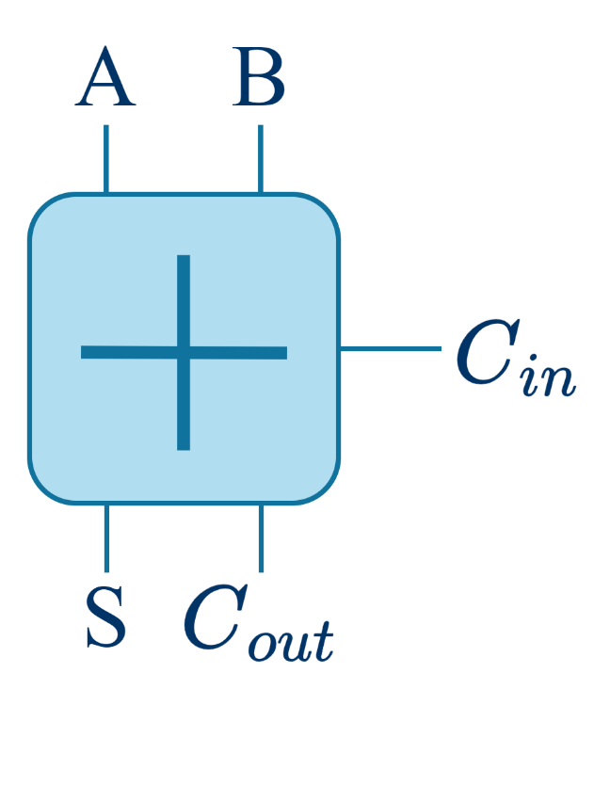
A 2nd Circuit for Addition
A circuit that implements “one column” of our sum is called a FULL ADDER
Let’s derive its truth table….
Input carry
(new input)
Earlier, we called them C₀ (S) and C₁ (C_{out})

Slide 36
Truth Table of a Full Adder
A | B | C_{in} | C_{out} | Sum
0 | 0 | 0 | 0 | 0
0 | 0 | 1 | 0 | 1
0 | 1 | 0 | 0 | 1
0 | 1 | 1 | 1 | 0
1 | 0 | 0 | 0 | 1
1 | 0 | 1 | 1 | 0
1 | 1 | 0 | 1 | 0
1 | 1 | 1 | 1 | 1

Slide 37
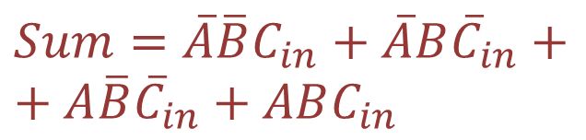
From the Truth Table to the Logic Gates
Consider one output at a time…
Cover the ones:
A | B | C_{in} | Sum
0 | 0 | 0 | 0
0 | 0 | 1 | 1
0 | 1 | 0 | 1
0 | 1 | 1 | 0
1 | 0 | 0 | 1
1 | 0 | 1 | 0
1 | 1 | 0 | 0
1 | 1 | 1 | 1
$$Sum=\overline{A}\overline{B}C_{in}+\overline{A}B{\overline{C}}_{in}+$$
$$+ A\overline{B}{\overline{C}}_{in}+ABC_{in}$$

Slide 38
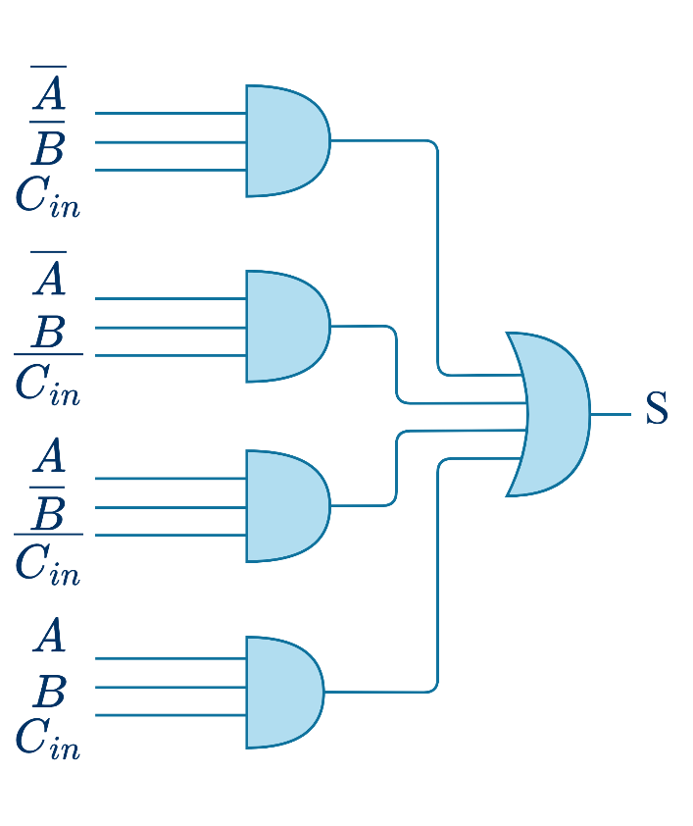
From the Truth Table to the Logic Gates
$$Sum=\overline{A}\overline{B}C_{in}+\overline{A}B{\overline{C}}_{in}+ A\overline{B}{\overline{C}}_{in}+ABC_{in}$$

Slide 39
From the Truth Table to the Logic Gates
Can we simplify it?
$$Sum=\overline{A}\overline{B}C_{in}+\overline{A}B{\overline{C}}_{in}+ A\overline{B}{\overline{C}}_{in}+ABC_{in}$$

Slide 40
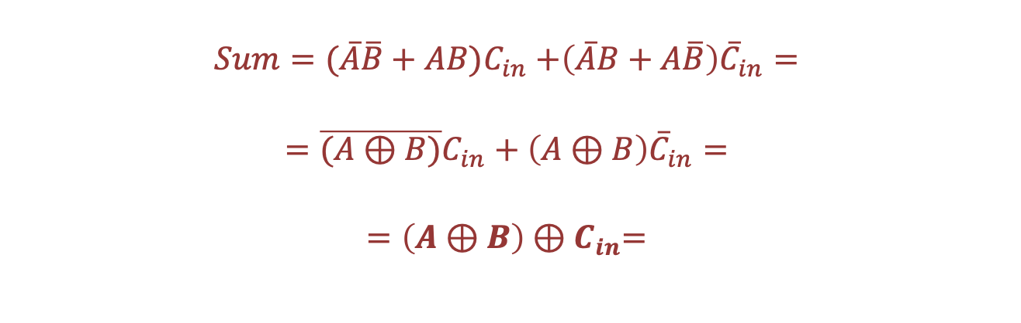
Can we simplify it?
$$Sum=\overline{A}\overline{B}C_{in}+\overline{A}B{\overline{C}}_{in}+ A\overline{B}{\overline{C}}_{in}+ABC_{in}$$
$$Sum=(\overline{A}\overline{B}{+ AB)C}_{in}+\left(\overline{A}B+A\overline{B}\right){\overline{C}}_{in}=$$
$$=\overline{(A⊕B)}C_{in}+\left(A⊕B\right){\overline{C}}_{in}=$$
$$=\left(A⊕B\right){⊕C}_{in}=$$

Slide 41

From the Truth Table to the Logic Gates
Can we simplify it?
$$Sum=\overline{A}\overline{B}C_{in}+\overline{A}B{\overline{C}}_{in}+ A\overline{B}{\overline{C}}_{in}+ABC_{in}$$
In practice, the EDA tool can do this for us
$$Sum= \left(A⊕B\right){⊕C}_{in}$$

Slide 42
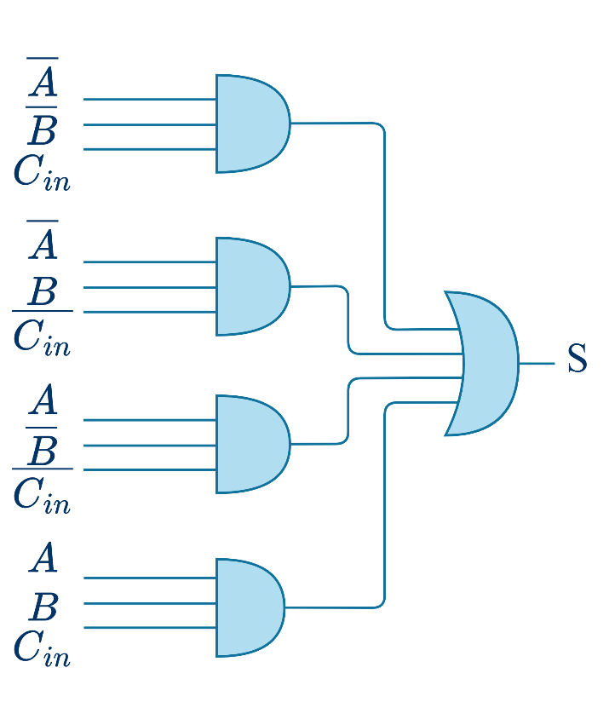
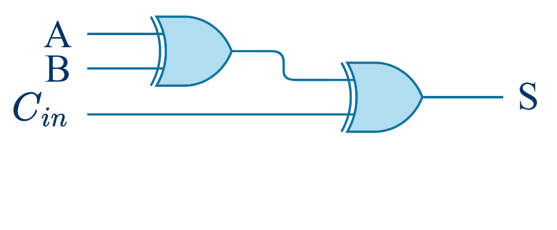

From the Truth Table to the Logic Gates
$$Sum=\overline{A}\overline{B}C_{in}+\overline{A}B{\overline{C}}_{in}+ A\overline{B}{\overline{C}}_{in}+ABC_{in}$$
$$Sum= \left(A⊕B\right){⊕C}_{in}$$
Smaller circuit, same result…

Slide 43
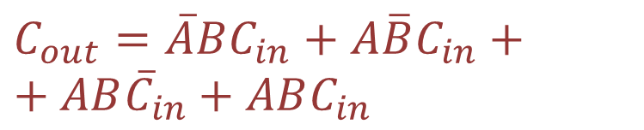
From the Truth Table to the Logic Gates
What about C_{out}
Cover the ones:
A | B | C_{in} | C_{out}
0 | 0 | 0 | 0
0 | 0 | 1 | 0
0 | 1 | 0 | 0
0 | 1 | 1 | 1
1 | 0 | 0 | 0
1 | 0 | 1 | 1
1 | 1 | 0 | 1
1 | 1 | 1 | 1
$$C_{out}=\overline{A}BC_{in}+A\overline{B}C_{in}+$$
$$+ AB{\overline{C}}_{in}+ABC_{in}$$

Slide 44

From the Truth Table to the Logic Gates
Simplify…:
$$C_{out}=\overline{A}BC_{in}+A\overline{B}C_{in}+ AB{\overline{C}}_{in}+ABC_{in}$$
$$C_{out}= \left(A⋅B\right)+(A ⊕B)⋅C_{in}$$

Slide 45
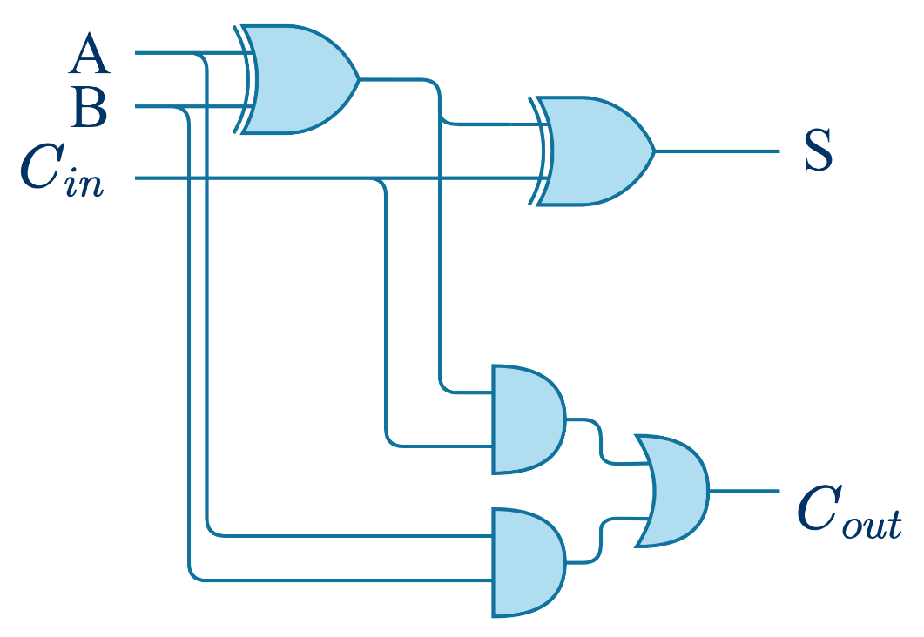


Final Full-adder Circuit
$$S=(A⊕B)⊕C_{in}$$
$C_{out}=\left(A⋅B\right)+(A$ $⊕B)⋅C_{in}$

Slide 46

Building an Adder
To create a circuit that sums multiple bits, we simply connect multiple full adders in a chain.
Example:
0
0
1
1
0
1
1
0
(2) 0 1 0 +
(3) 0 1 1 =
1 0 1
1
0
0
1
1
0

Slide 47

Practice Time
…again

Slide 48
RTL Design of an Adder
Open the Vivado project for the Lab02b and create a new block design:
IP INTEGRATOR → Create Block Design, on the left Flow Navigator bar
The “Create Block Design” window will appear:
“Design name”: adder
“OK”
2.
1.
3.

Slide 49
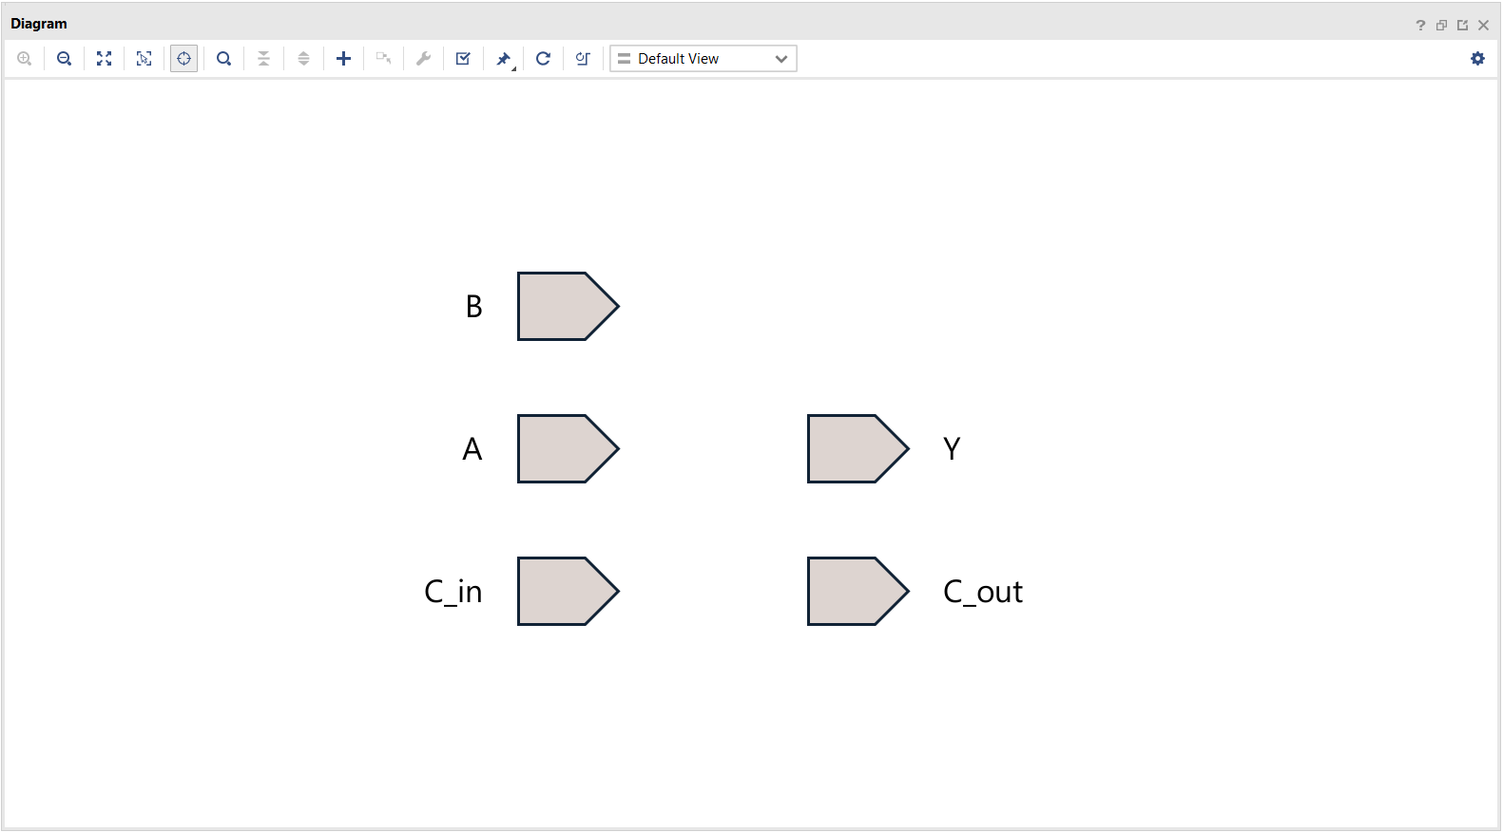
RTL Design: Input & Output Ports
Add the input and output ports:

Slide 50
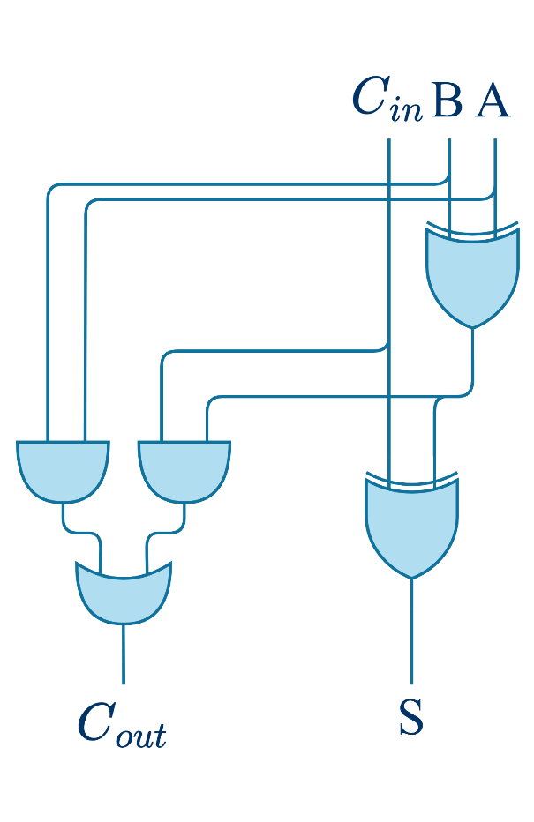
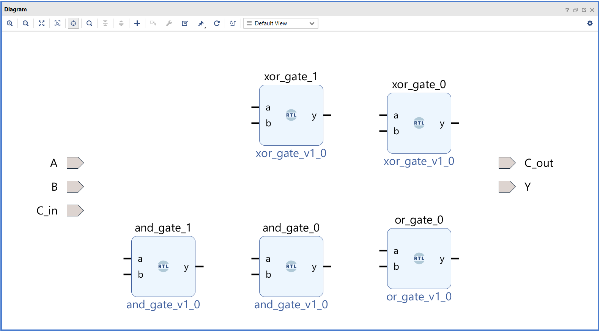
RTL Design: Logic Gates
Add the logic gates to build the full adder:

Slide 51
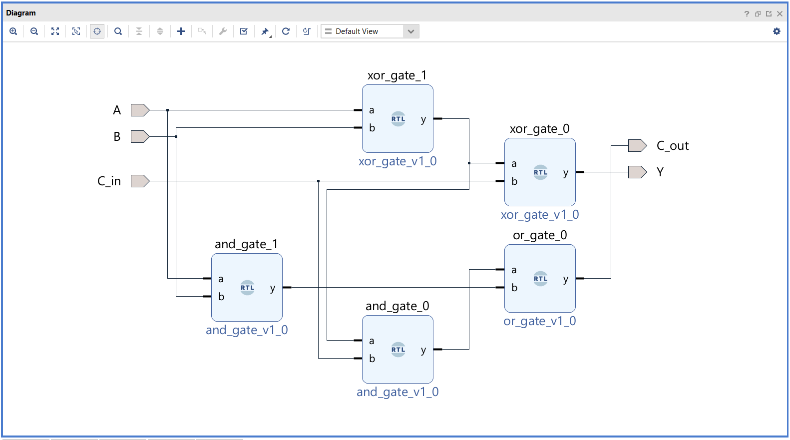
RTL Design: Interconnections
Connect the different logic gates to create the circuit:
Validate the design

Slide 52
Verify the Design (Simulation)
Simulate the design and verify its correctness
L01.
Introduction to Vivado & Logic Gates

Slide 53
RTL Design Complete
module full_adder ( input wire a, // Input a
input wire b, // Input b input wire cin, // Carry in
output wire sum, // Sum output output wire cout // Carry out
);
wire axb; // Intermediate XOR of a and b wire ab, a_xor_b_cin; // Intermediate AND gates
// XOR gate for sum
xor_gate xor1 ( .a(a), .b(b), .y(axb) );
xor_gate xor2 ( .a(axb), .b(cin), .y(sum) );
// AND gates for carry
and_gate and1 ( .a(a), .b(b), .y(ab) );
and_gate and2 ( .a(axb), .b(cin), .y(a_xor_b_cin) );
// OR gate for carry out
or_gate or1 ( .a(ab), .b(a_xor_b_cin), .y(cout));
endmodule

Slide 54
Lab 02 Part 3: Full Adder running on the Board
Presented By: (Name)

Slide 55
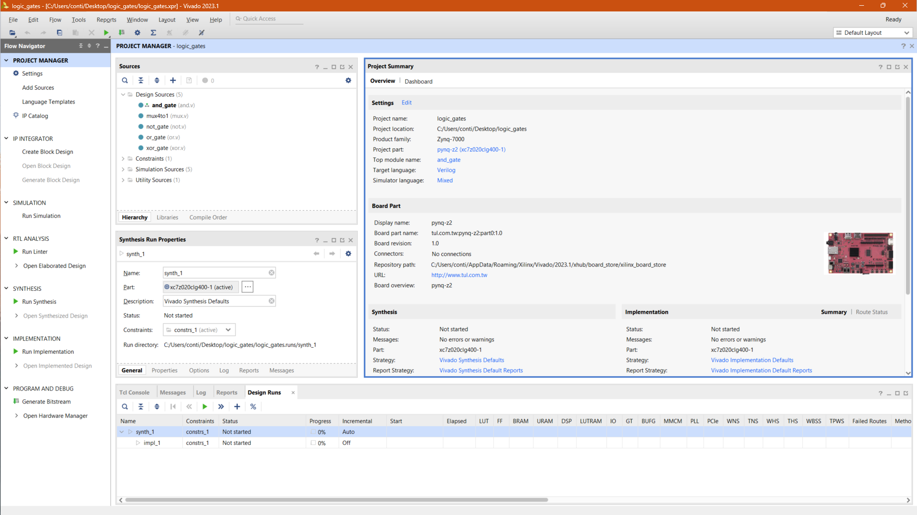
Implement the Circuit on the Board
Click on “Generate Bitstream” and the EDA Tool will provide the files to upload the design on the board
Open the “Hardware manager”

Slide 56
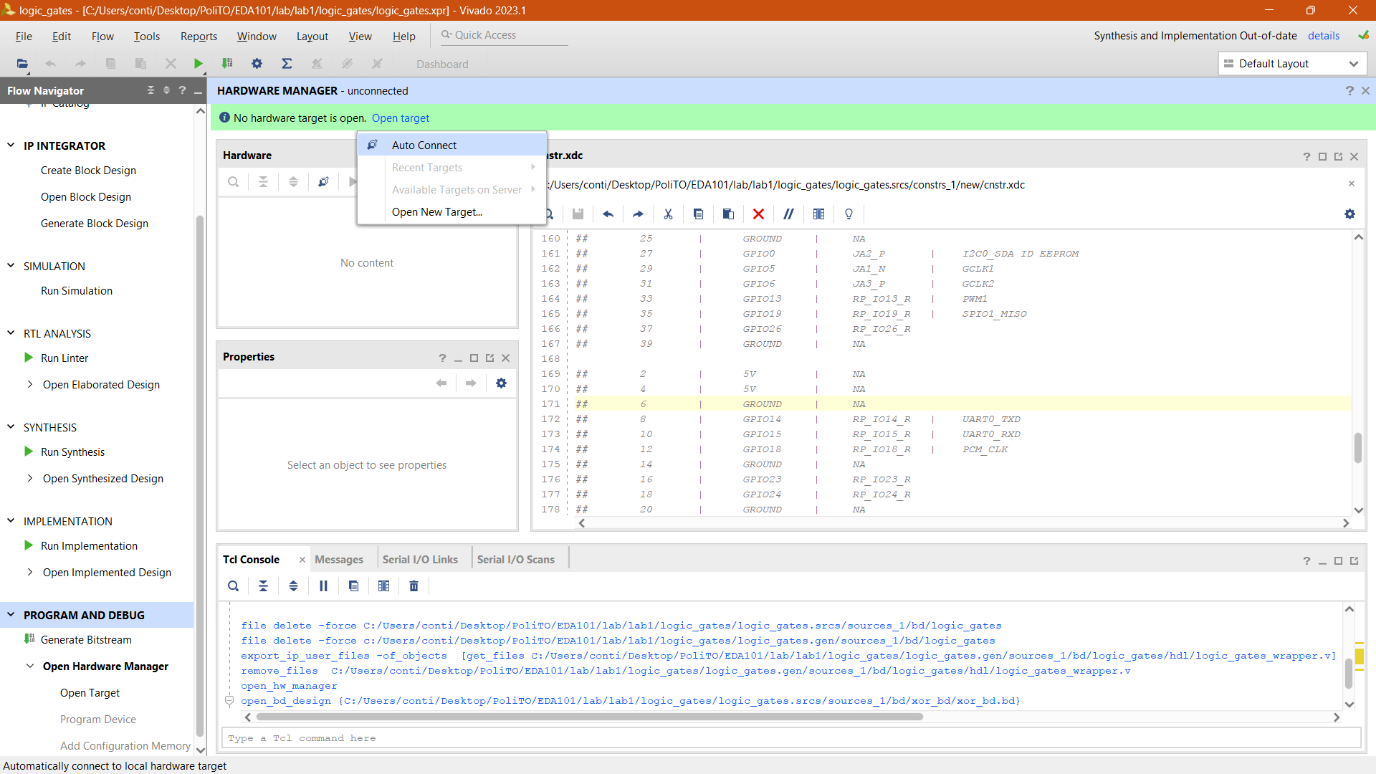
The Hardware manager
The Hardware Manager handles the connections with the board.
To connect:
Open target
Auto Connect

Slide 57
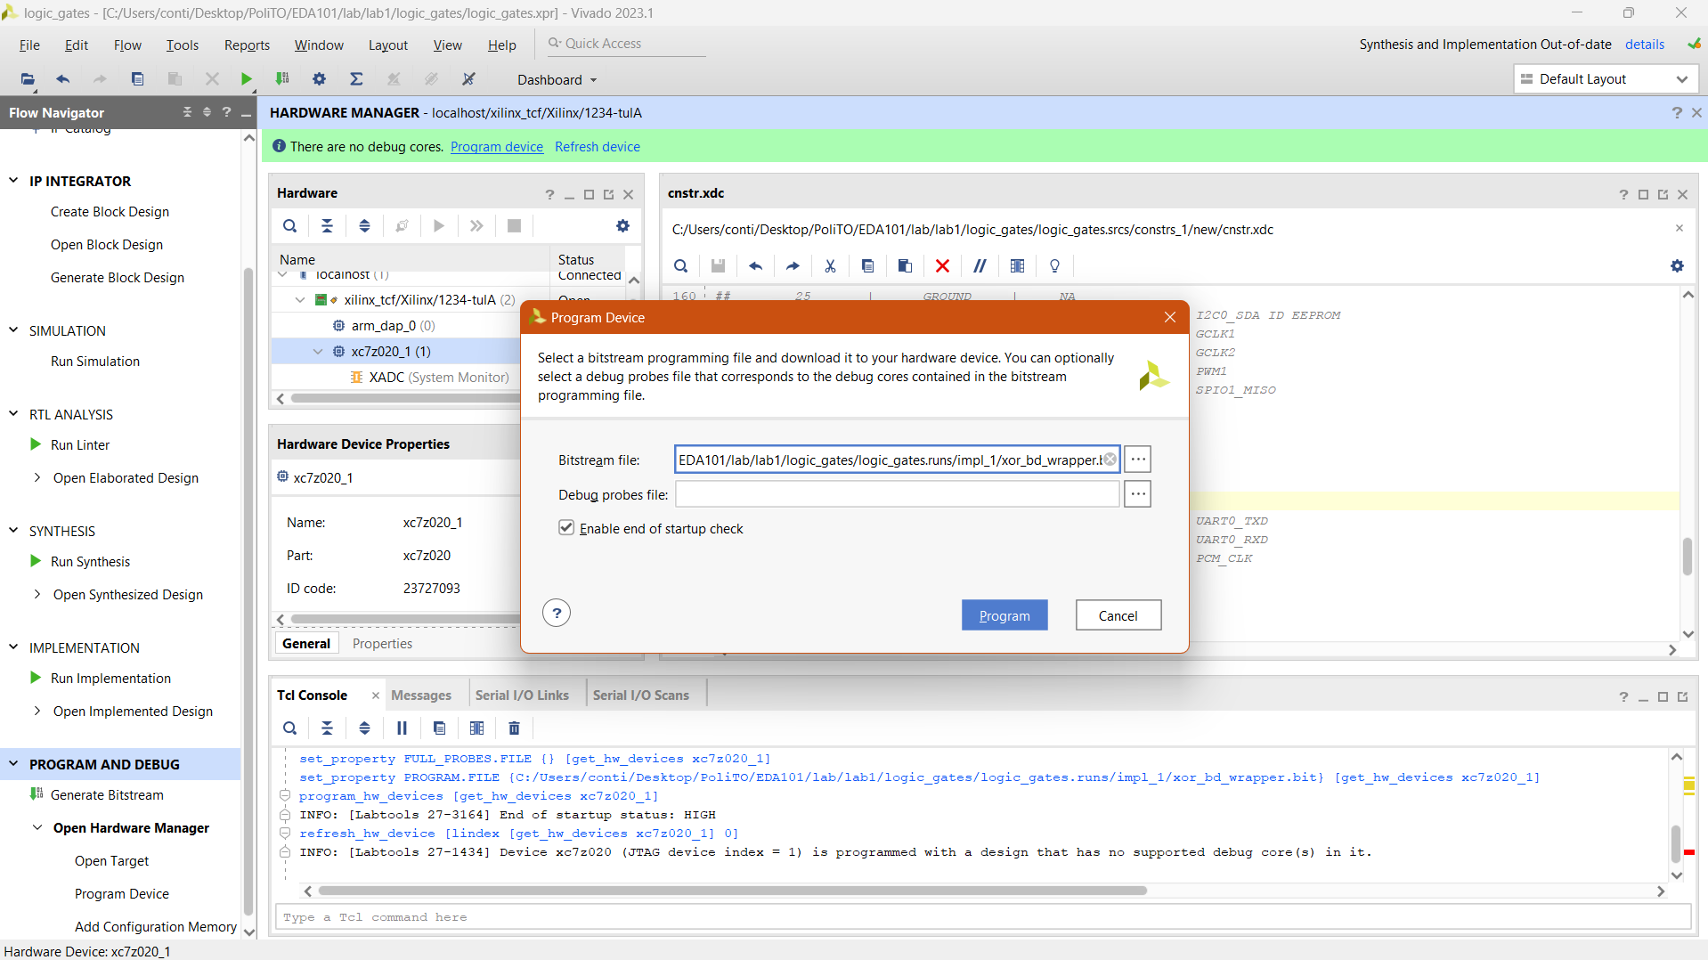
The Hardware manager
To program the device, click on Program device, then Program
Now your design is working on the board!

Slide 58
Lab 02 Part 4: Multi-bit Adder
Presented By: (Name)

Slide 59
RTL Design of a Multi-bit Adder
Open the Vivado project for the Lab02c and create a new block design:
IP INTEGRATOR → Create Block Design, on the left Flow Navigator bar
The “Create Block Design” window will appear:
“Design name”: adder
“OK”
2.
1.
3.

Slide 60
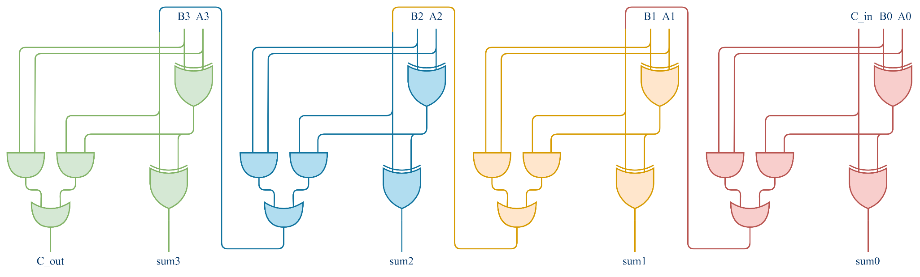
RTL Design of a Multi-bit Adder
Add the logic gates to build the full adder:
Connect the different logic gates to create the circuit:
Validate the design

Slide 61
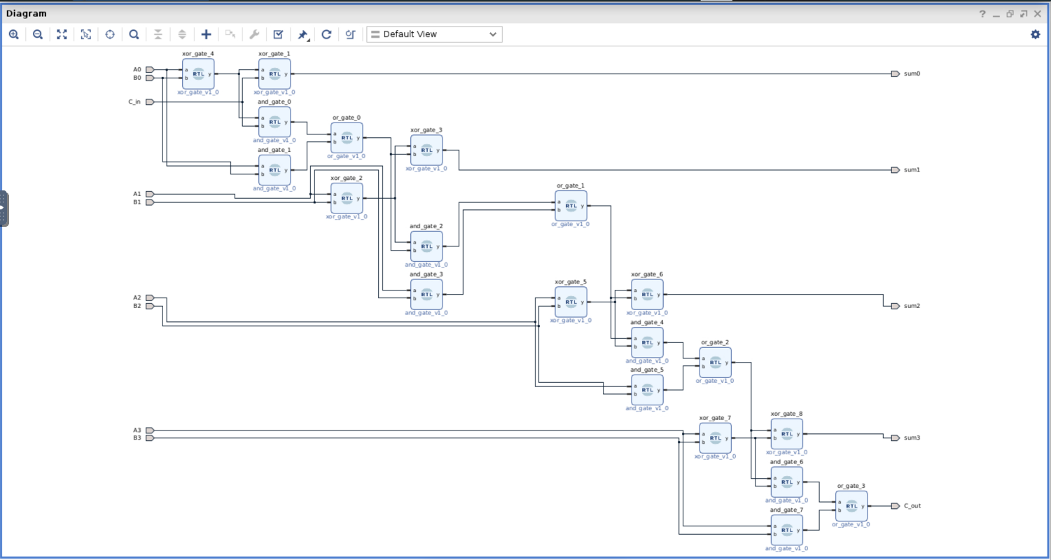
RTL Design of a Multi-bit Adder
Your design should look like something like this:

Slide 62
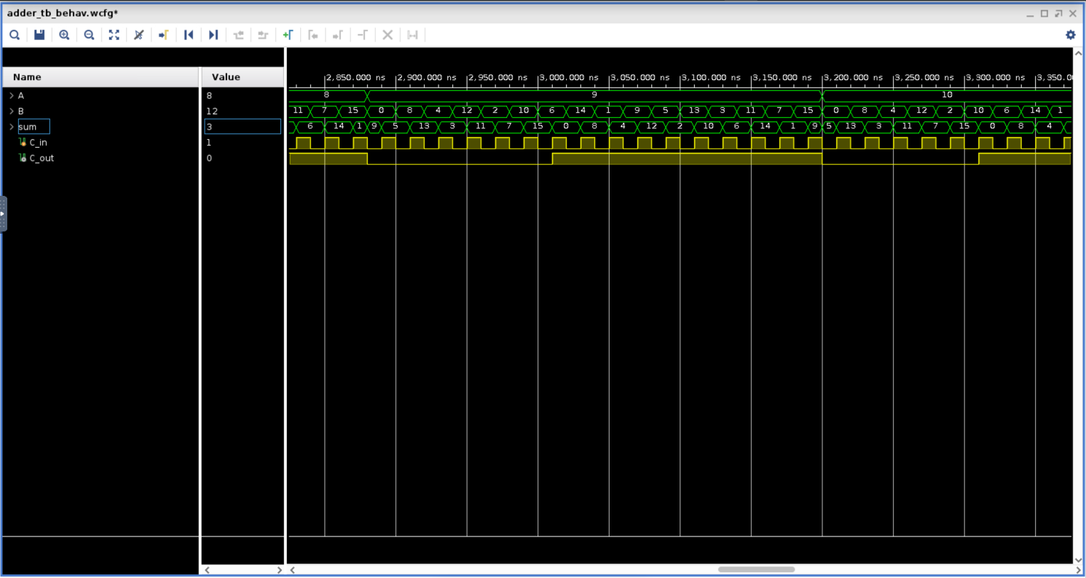
Verify the Design (Simulation)
Simulate the design and verify its correctness
L01.
Introduction to Vivado & Logic Gates

Slide 63







Authorship & License
Authors
License
Christian Conti christian.conti@polito.it
Gianvito Urgese gianvito.urgese@polito.it
Daniele Jahier Pagliari daniele.jahier@polito.it
Enrico Macii enrico.macii@polito.it
Cristiana Bolchini cristiana.bolchini@polimi.it
Fabrizio Ferrandi fabrizio.ferrandi@polimi.it
These slides are distributed under the Creative Commons license "Attribution – Non-commercial - Share alike 2.5 Italy (CC BY-NC-SA 2.5)"
You are free to:
to reproduce, distribute, communicate to the public, exhibit in public, represent, perform and recite this work
to modify this work
Under the following conditions:
Attribution - You must attribute authorship of the work to the original authors and in a way that does not suggest that they endorse you or the way you use the work.
Non-commercial - You may not use this work for commercial purposes.
Share Alike - If you alter or transform this work, or if you use it to create another, you may distribute the resulting work only under an identical or equivalent license to this one.
http://creativecommons.org/licenses/by-nc-sa/2.5/

