Slide 1
Lab 04 Part 1: A Real Use Case: Neural Networks
Presented By: (Name)

Slide 2
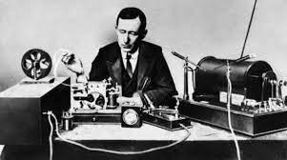

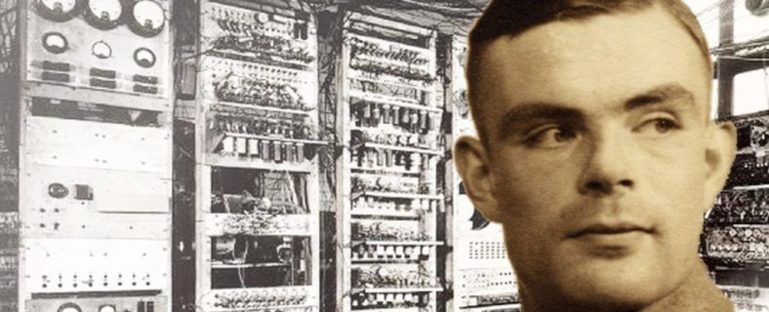
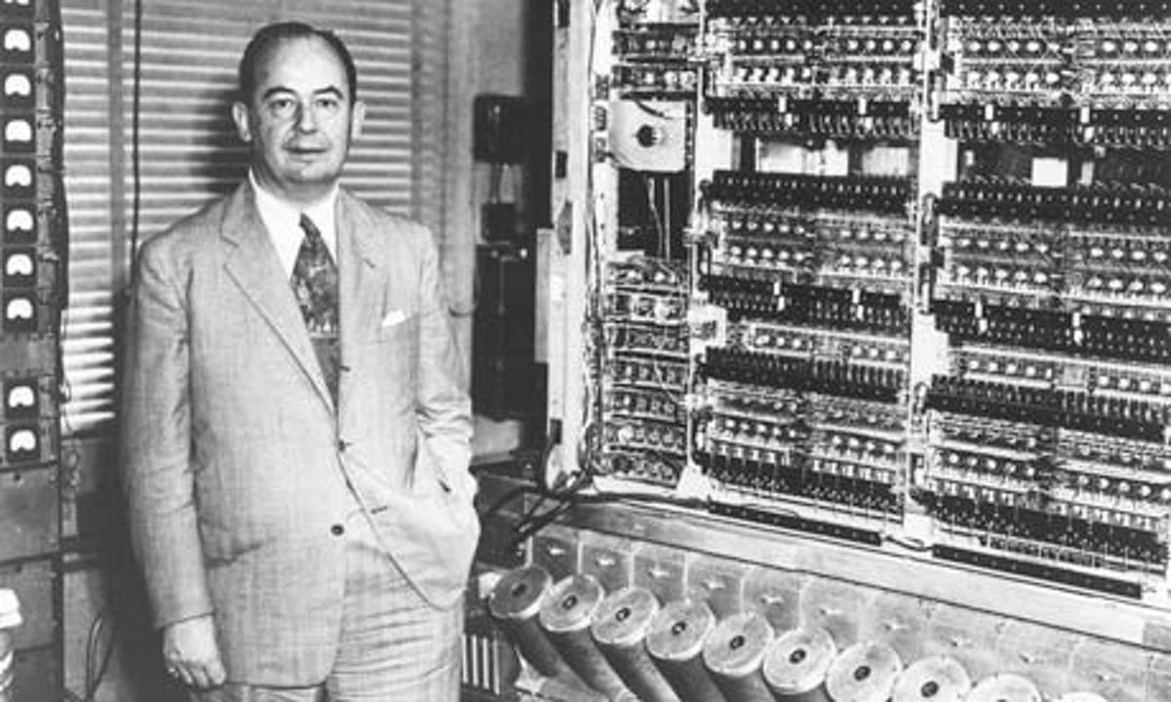
Where it all started…
The Radio – G. Marconi (1895)
The Phone – G. Bell vs. A. Meucci (1860-70)
The Computer – A. Turing and J. Von Neumann (1940-50)

Slide 3

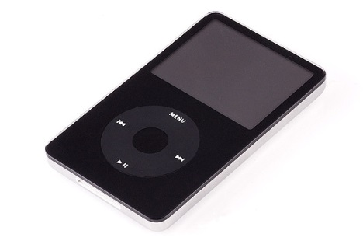
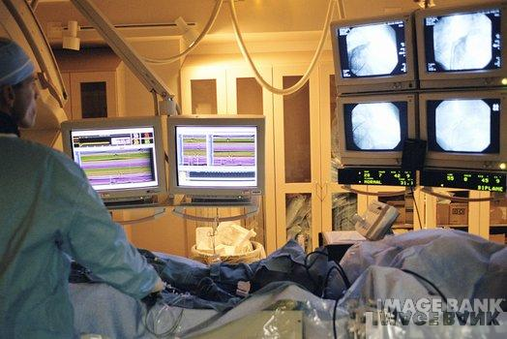
Digital data: Everything Becomes “bit”
Text
Data
Voice
01101100
Sound
Images
Notes:
Fondamenti di Informatica
cap. I

Slide 4










Breakthrough Technologies
2020
2015
2010
2005
2000
1990
1980
Web 4.0
Web 3.0
Low cost local storage
Multimedia
over the network
Web 2.0

Slide 5

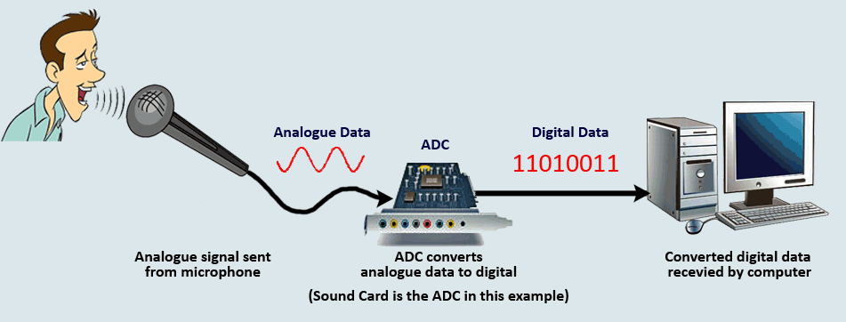
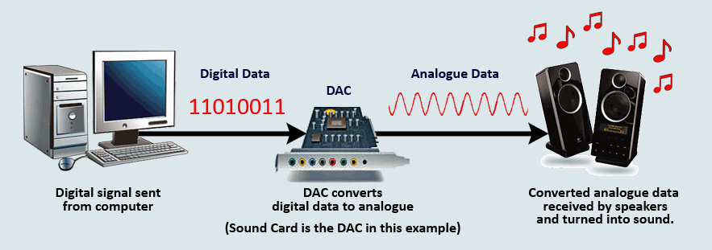
From Analog to Digital and Back
Any information (numbers, text, sounds, images, videos, …) to be processed by a computer is:
Acquired from the external environment;
Converted to the binary format;
Manipulated;
Converted back to the original format;
Returned to the external environment.

Slide 6
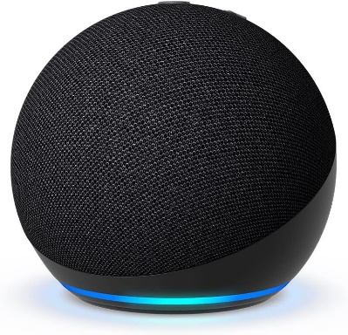

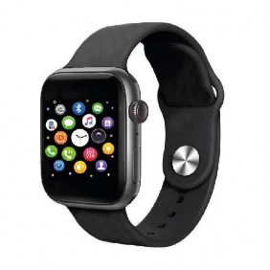
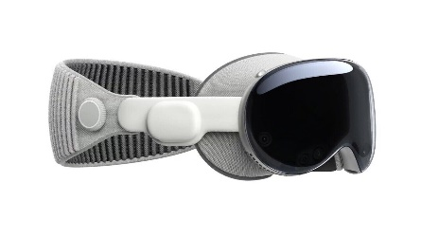
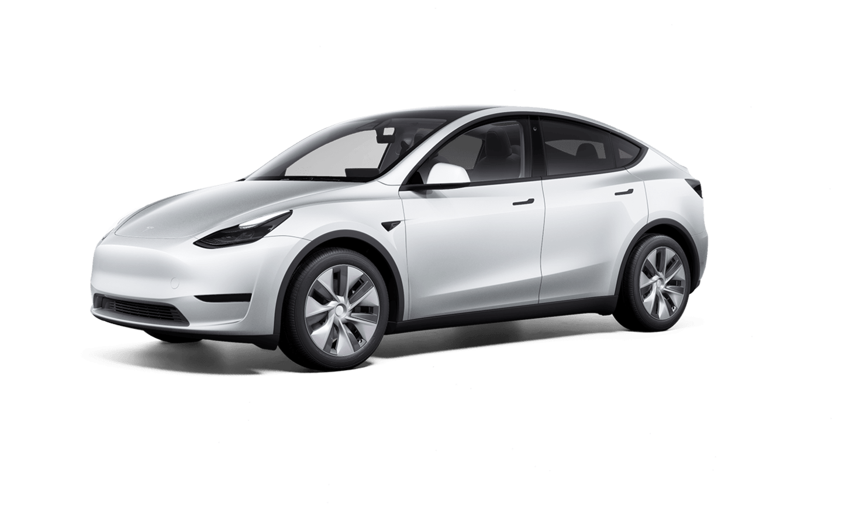
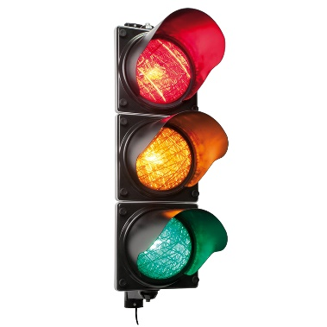
Understanding Electronic Systems
Electronic systems are a collection of electronic components and devices:
All the components have a specific function
The components are interconnected
Electronic systems can be found in everyday life objects from smartphones to traffic lights

Slide 7
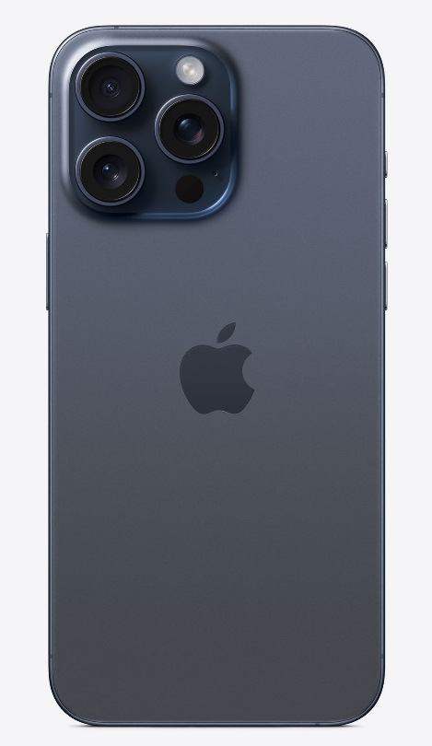
What is an Electronic System?
Electronic systems are a collection of electronic components and devices:
All the components have a specific function;
The components are interconnected;
They are designed to perform specific tasks.
They are utilized to solve specific tasks.

Slide 8
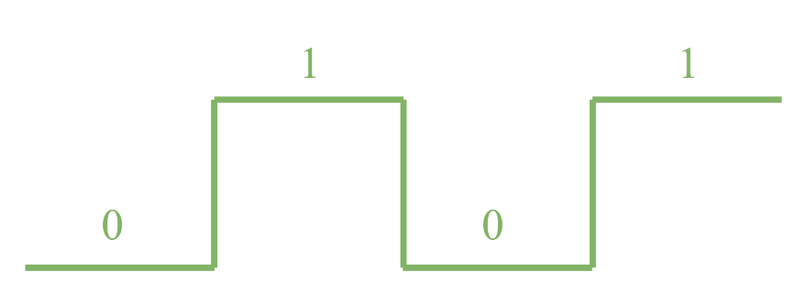
Boolean Algebra
DIGITAL SIGNAL
Digital devices elaborate the information in their binary form (represented with 0 & 1) .
Digital circuits or logic circuits work thanks to the information carried within the bits;
Boolean Algebra
Is used to describe the behaviour of a digital circuit.
LOGIC FUNCTION
Y = f (A, B, C, …, N)

Slide 9
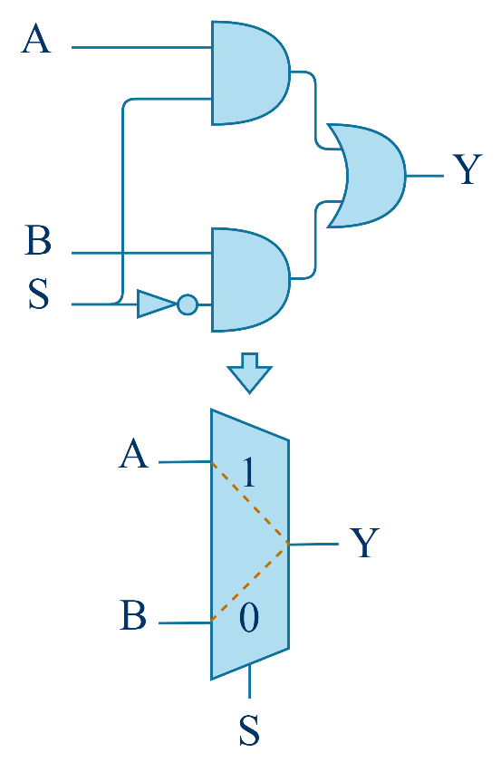
Logic Circuits
Logic circuits are used to represent an interconnected set of logic gates.
Combinational circuit:
Made of interconnected logic gates (AND, OR, NOT, XOR, NAND, NOR), the output Y depends only on the current input.
Sequential circuit:
Circuits made of interconnected logic gates plus an additional memory element.

Slide 10
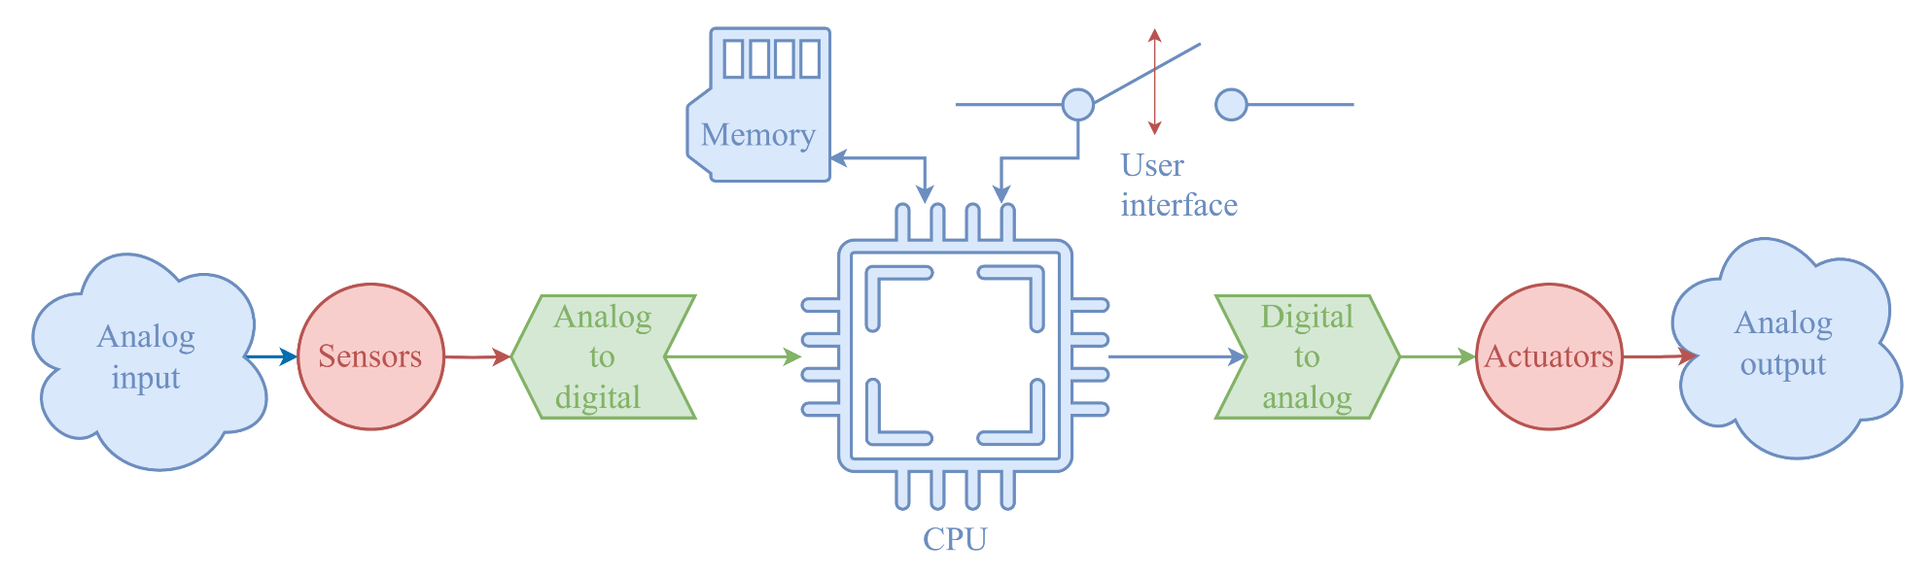
Components of an Electronic System

Slide 11
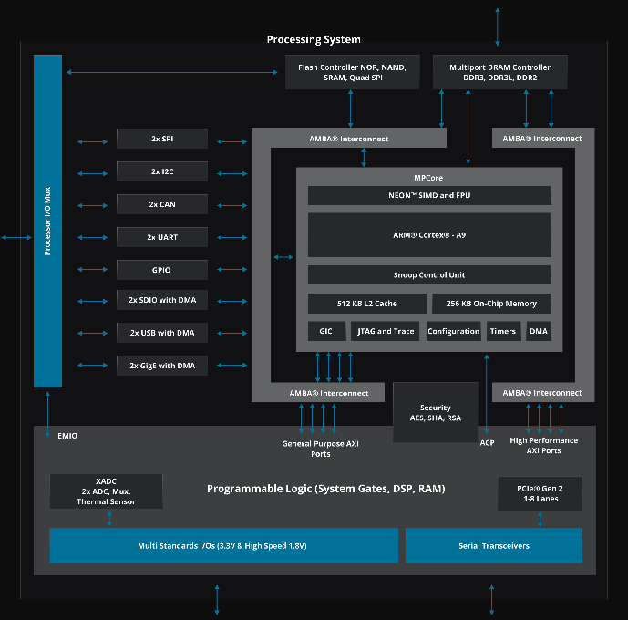
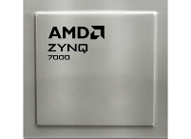
What is a SoC?
A System-on-Chip (SoC) is an electronic system that includes all of its components onto a single chip:
CPU;
Memory;
Peripherals;
Interconnections;

Slide 12
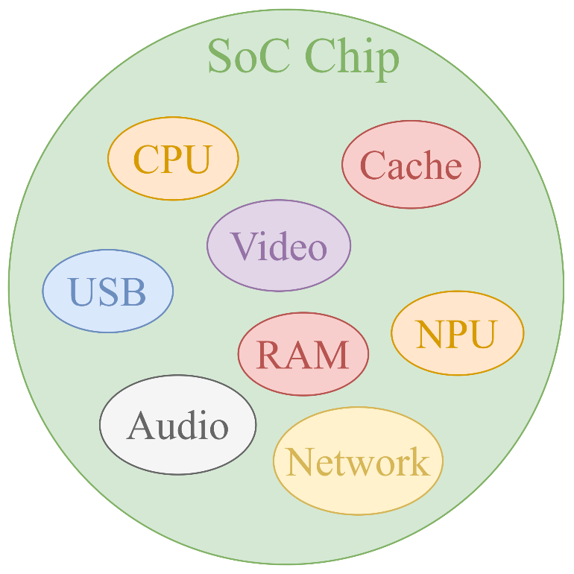
SoC Design
A System-on-Chip is composed of different units with specific tasks:
Elaborate information;
Store information;
Transport information;
Each unit is designed following different methodologies to obtain the best performances when combined.

Slide 13
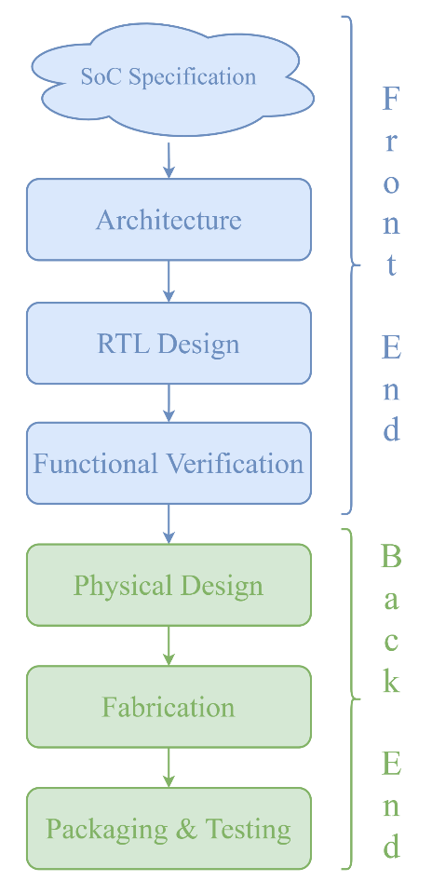
SoC Design Flow
To create an SoC, industries have developed a standard design flow to speed up the engineering process:
Front End:
The front end includes the transformation of the SoC specification into a deployable system design
Back End:
Once the system functionality has been verified, the back end is in charge of creating the physical chip

Slide 14
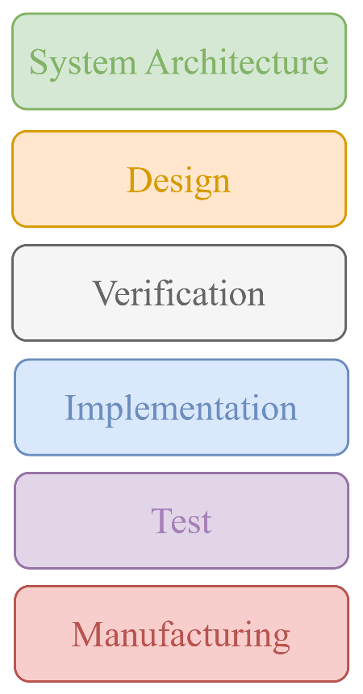
Electronic Design Automation Tools
EDA tools are used to design and validate the semiconductor manufacturing process;
EDA tools are used to verify that a design will meet all the project specifications;
EDA tools are used after manufacturing of the device to monitor its performance during time;

Slide 15
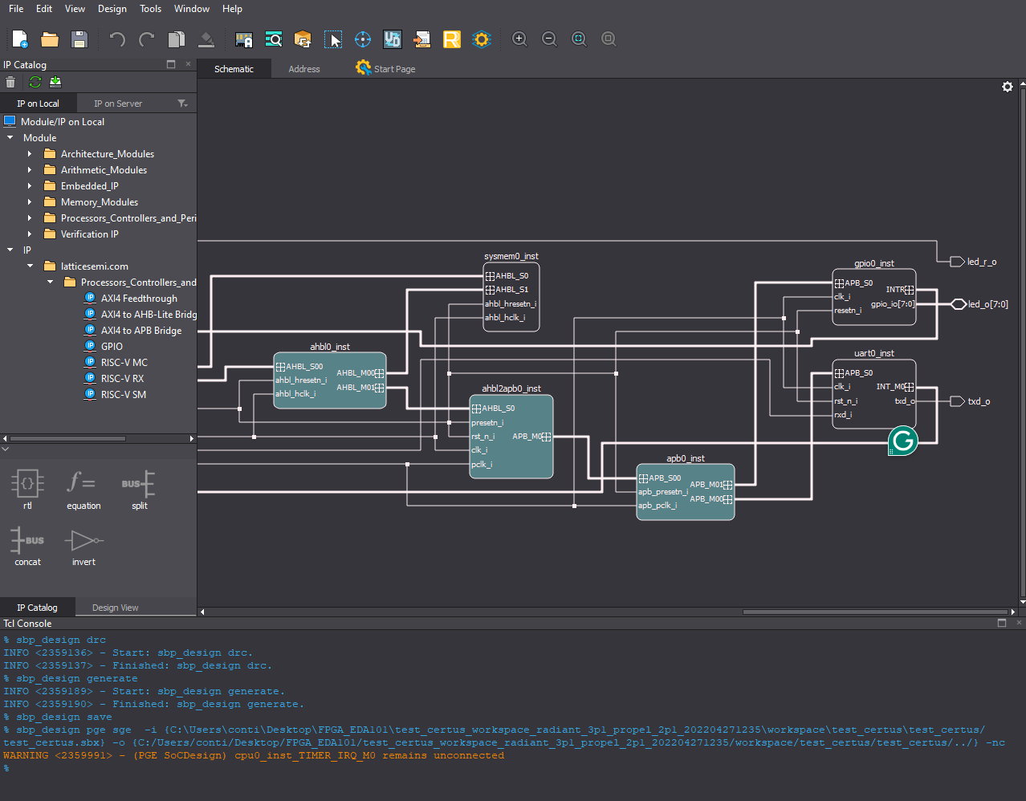
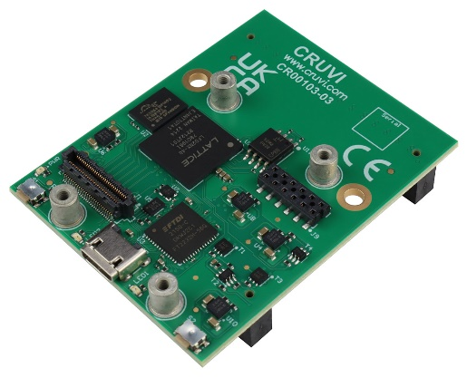
Types of EDA Tools
EDAs are mostly very sophisticated and complex software programs utilized to assist during the manufacturing of an electronic system.
Simulation tools;
Design tools;
Verification tools;
When high performances are required typically hardware solutions are utilized to process large amounts of data.

Slide 16
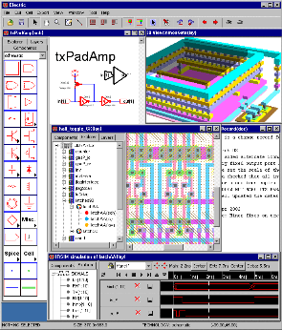
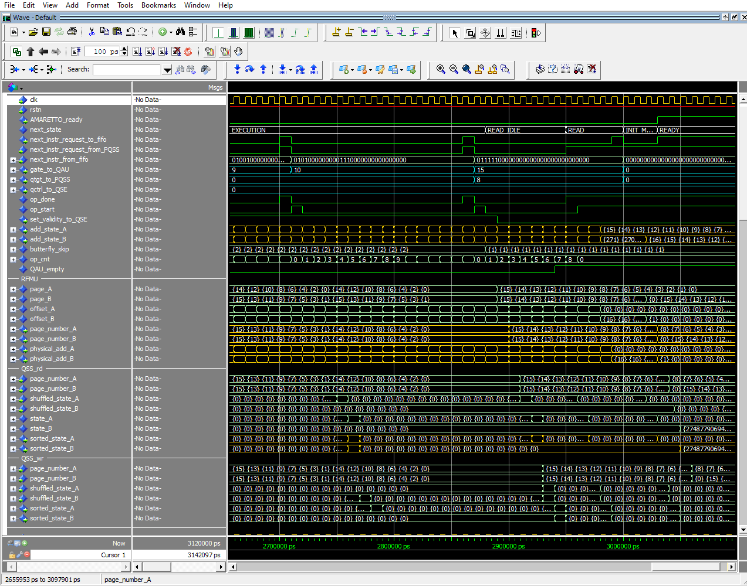
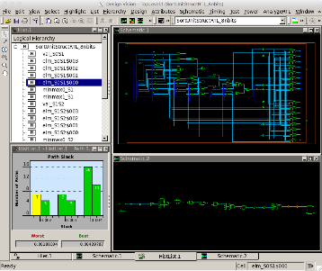
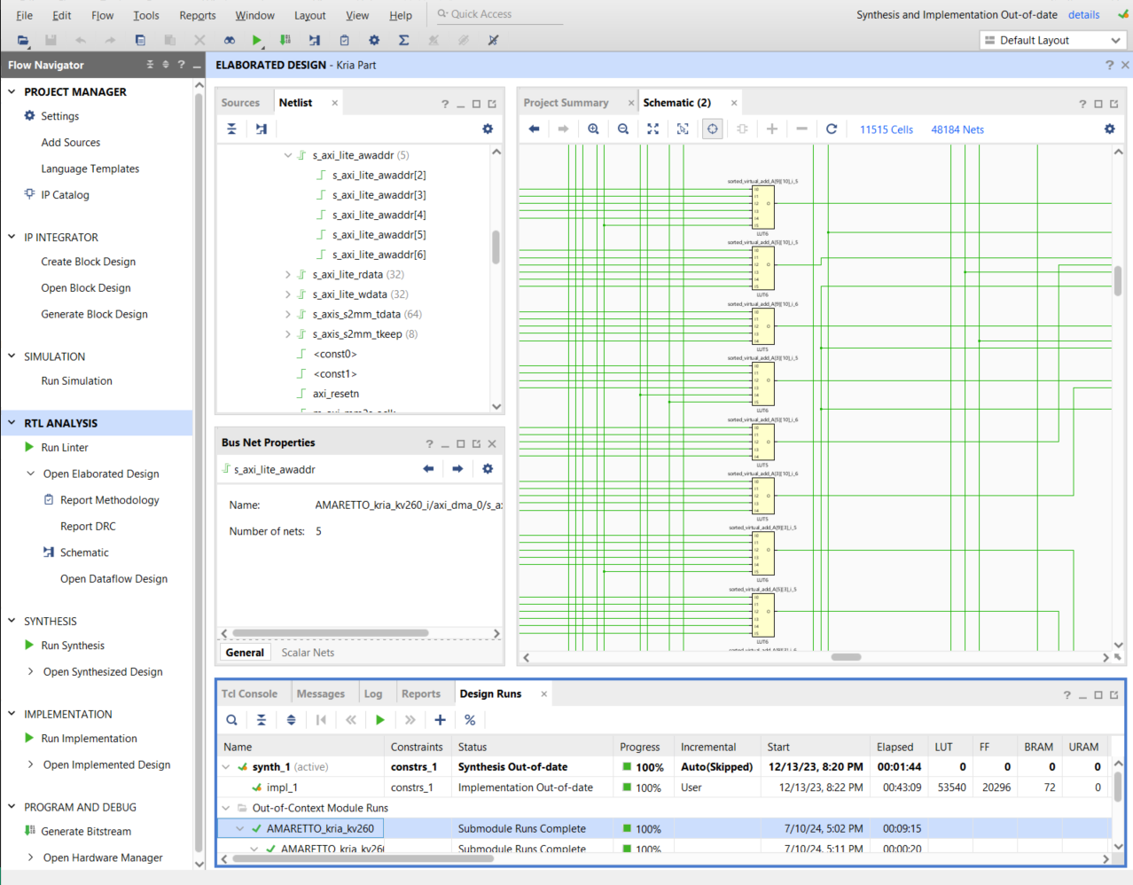
Why EDA Tools are important?
Chips are extremely complex, containing over a billion transistors;
Managing this complexity requires the assistance of Electronic Design Automation tools;
EDA helps limit human errors in chip manufacturing and speeds up the design process;

Slide 17
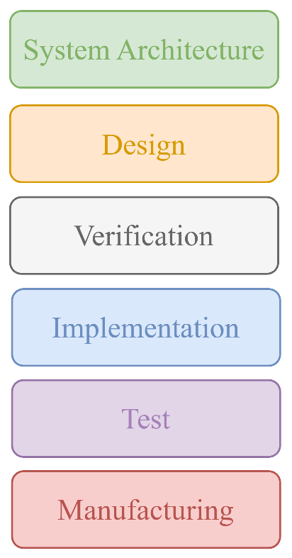
Functional Verification
Functional verification is the step related to the test in the EDA toolchain;
Ensures the correct behavior of the design and the correctness of the specifications;
Functional verification consists of stimulating the design with any possible input combination to verify the correctness of the output;

Slide 18
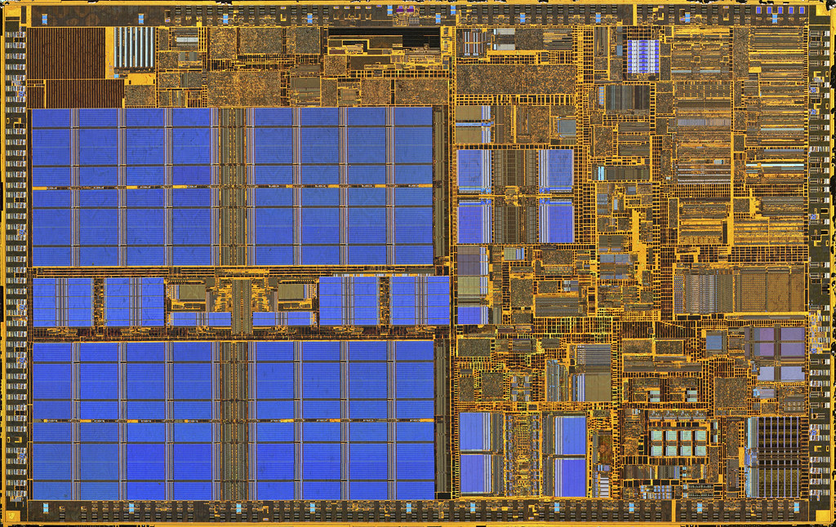
Functional Verification
Functional verification is performed on any electronic design;
The challenge is creating tools to test a design quickly and efficiently without leaving anything out;
The main challenge is identifying what to test, as testing everything is not possible:

Slide 19
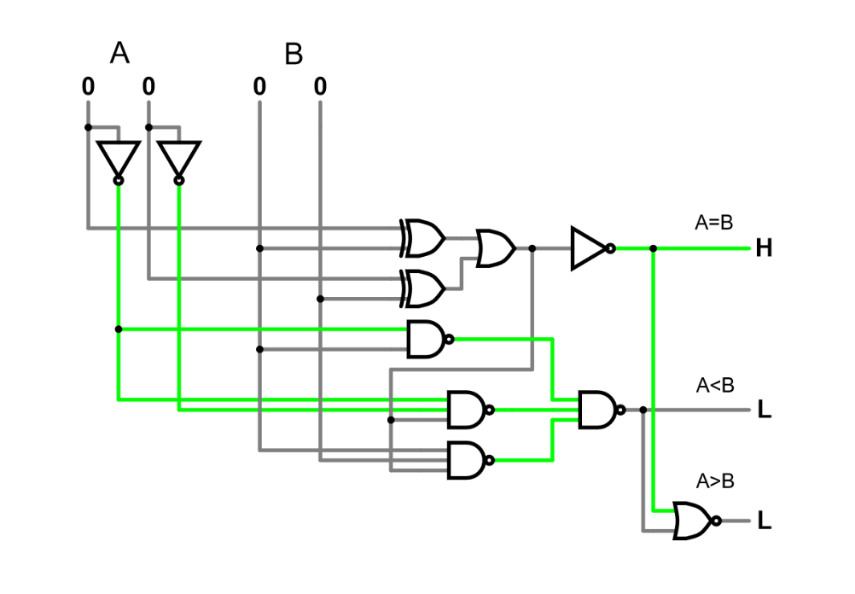
Test Benches, Key Tools for Verification
A test bench is a setup used to verify the functionality of a design by simulating its operation in a controlled environment.
A test bench is used for:
Verification, to detect and correct bugs;
Validation, to ensure the design meets the design specifications and requirements;
Efficiency, is always a preliminary step before hardware deployment;

Slide 20
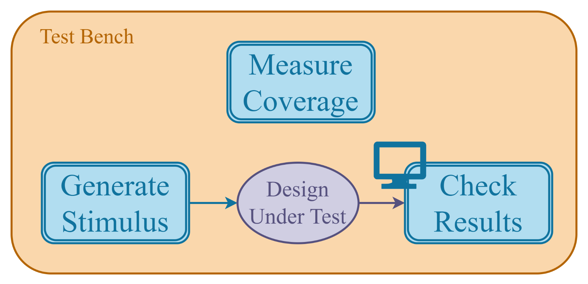
Test Benches, Key Tools for Verification

Slide 21
Lab 04 Part 2: Career paths
Presented By: (Name)

Slide 22
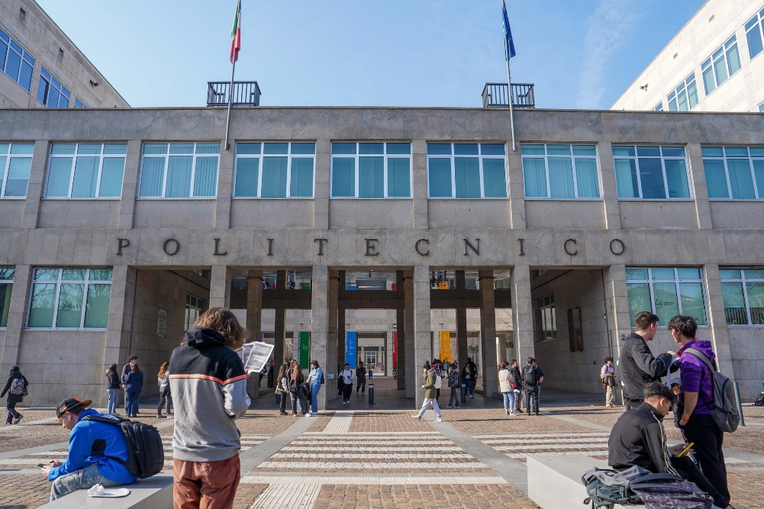
Electronic Engineering
Emerging trends in Information and Communications Technologies (ICT) increasingly demand a multidisciplinary background encompassing Communications, Electronics, and Computer Science.

Slide 23

Computer Engineering
A Computer Engineer is a professional skilled in designing, engineering, developing, operating, maintaining, and securing computer applications, information processing systems, and complex information systems.

Slide 24
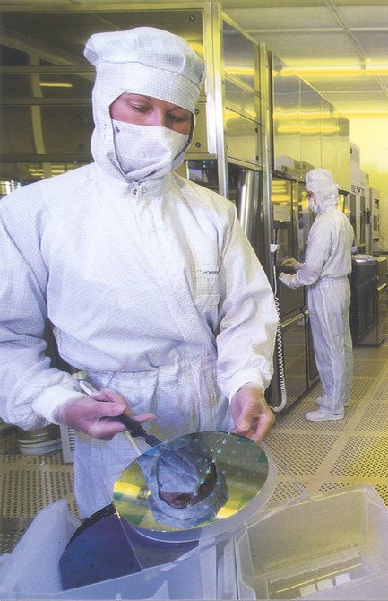



Career Opportunities
Semiconductor Engineer;
Analog Circuit Designer;
Test Engineer;
Process Integration Engineer;
Physical Design Engineer;

Slide 25


Career Opportunities
Verification Engineer;
Digital Design;
Validation Engineer;
CAD Engineer;
Many More Opportunities…

Slide 26
Lab 04 Part 3: Neural Networks: A Real Use Case
Presented By: (Name)

Slide 27
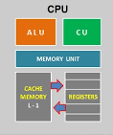
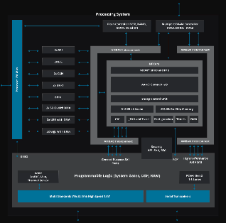
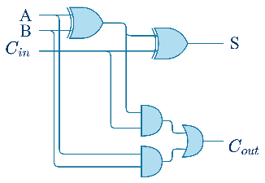
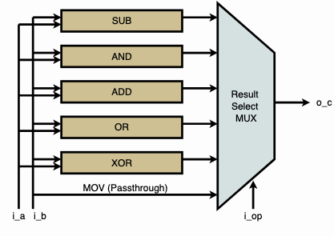
Hierarchical Design: From Gates to Architectures to SoCs
Gates
Multi-bit adder
ALU
CPU
SoC
Sum[15:0]
Cout
+
A[15:0]
B[15:0]
Seen in lab02
Seen in lab03 (at high-level)

Slide 28
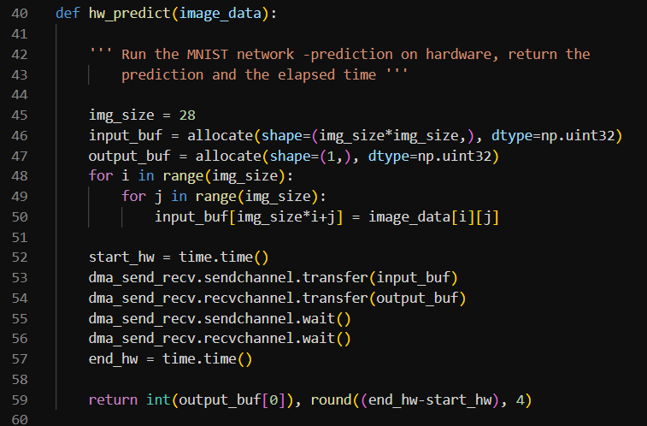
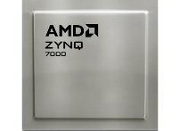
SoC Applications
A System-on-a-Chip (SoC) is a computing system within a single integrated circuit.
On an SoC is possible to run software to execute complex operations.
SoC are powerful tools to accelerate and improve the performances, of a sub-set of applications.

Slide 29

Artificial intelligence
Artificial intelligence is a field of science concerned with building computers and machines that can reason, learn, and act in such a way that would normally require human intelligence or that involves data whose scale exceeds what humans can analyse.

Slide 30

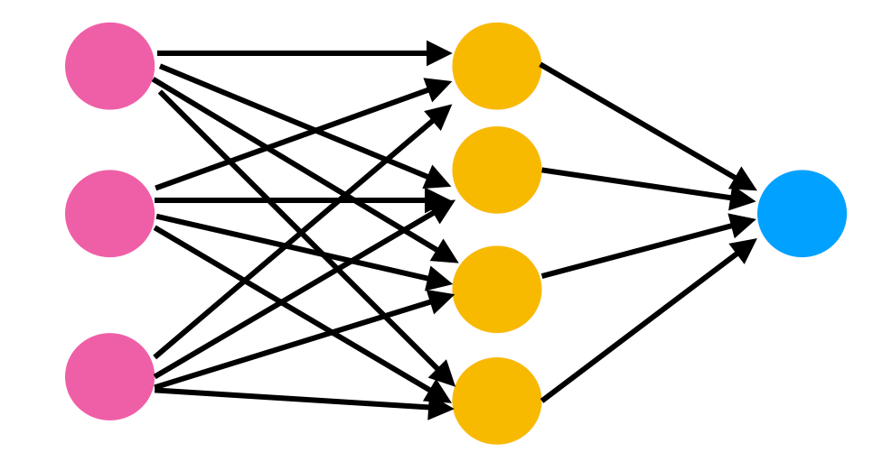
Neural Networks
A neural network is a method in artificial intelligence (AI) that teaches computers to process data in a way inspired by the human brain.
A neural network needs thousands of operations to produce a result.

Slide 31
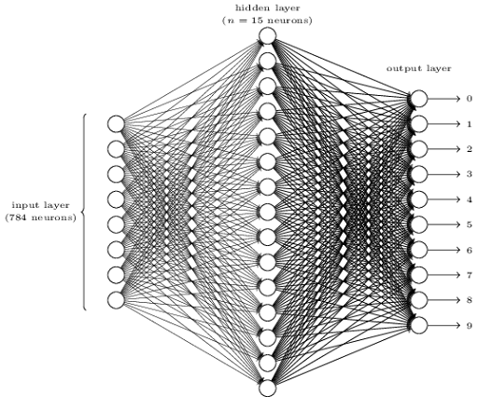
The Impact of Design Choices
Design a specific system to accelerate a neural network

Slide 32


Let’s get our hands dirty….

Slide 33
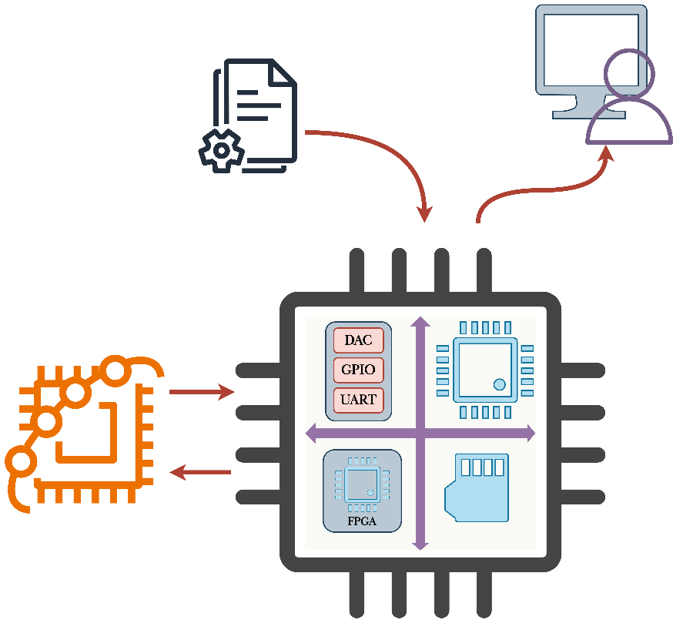
Laboratory: An Use Case
We aim to design a small SoC capable of accelerating a neural network.
For this laboratory, our SoC will include:
One processing core.
An accelerator peripheral
A memory to store the data needed by the core, and the code of the program that it will execute
All the components are inside the chip

Slide 34

MINIST
Our objective is to predict handwritten digits in the fastest way possible.
We utilize the MNIST Dataset:
The MNIST database (Modified National Institute of Standards and Technology database) is a large database of handwritten digits that is commonly used for training various image processing systems.

Slide 35
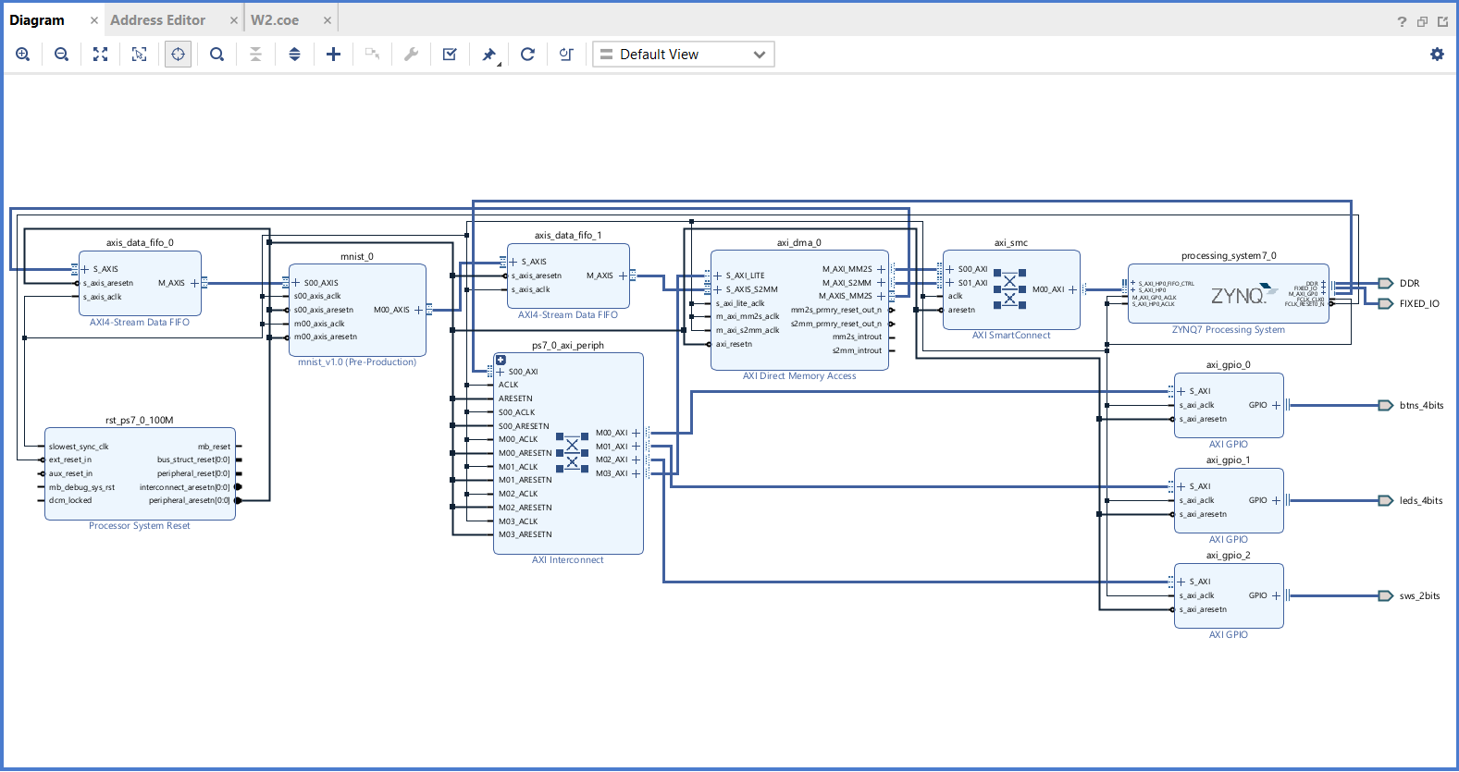
RTL Design of an SoC
Look at the project and the design, it is made of several hierarchal components, real word applications require a lot of components and testing:
EDA tools simplify the development of these applications

Slide 36
RTL Design of an SoC
A real application comprises different complex blocks interconnected with busses, memories, processors and peripherals.

Slide 37
RTL Design of an SoC
Our Custom Accelerator

Slide 38
RTL Design of an SoC
Input Memory
Output Memory

Slide 39
RTL Design of an SoC
GPIO

Slide 40
RTL Design of an SoC
Processor

Slide 41
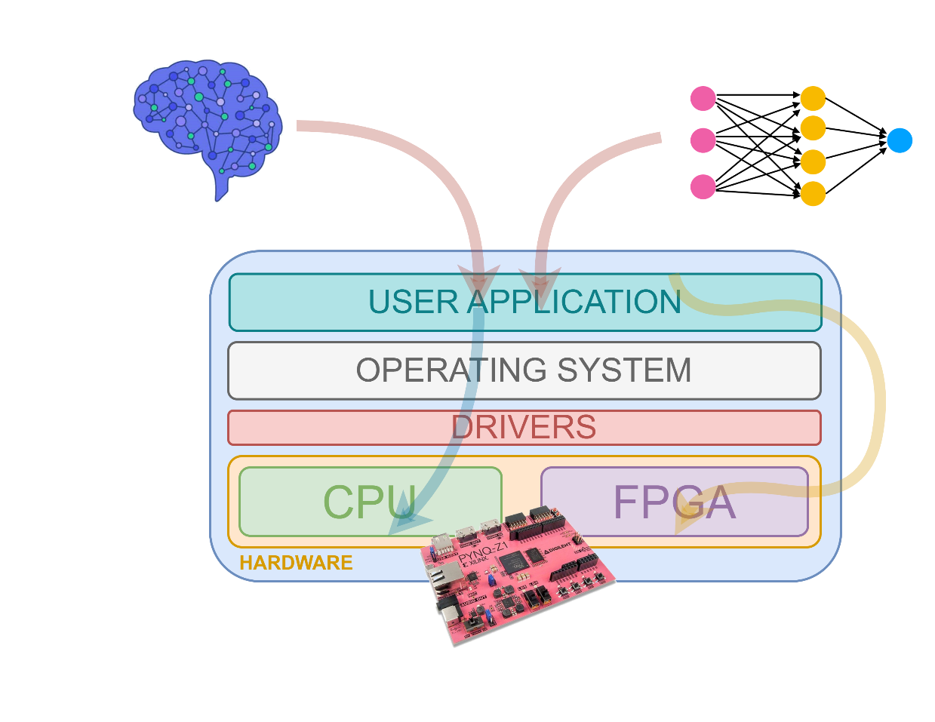
Software and Hardware Stack
Take a look at the code
There is more than one program running on the SoC:
The Operating System
The Server, to manage a graphical interface, and communications
The Drivers for the accelerator

Slide 42







Authorship & License
Authors
License
Christian Conti christian.conti@polito.it
Gianvito Urgese gianvito.urgese@polito.it
Daniele Jahier Pagliari daniele.jahier@polito.it
Enrico Macii enrico.macii@polito.it
Cristiana Bolchini cristiana.bolchini@polimi.it
Fabrizio Ferrandi fabrizio.ferrandi@polimi.it
These slides are distributed under the Creative Commons license "Attribution – Non-commercial - Share alike 2.5 Italy (CC BY-NC-SA 2.5)"
You are free to:
to reproduce, distribute, communicate to the public, exhibit in public, represent, perform and recite this work
to modify this work
Under the following conditions:
Attribution - You must attribute authorship of the work to the original authors and in a way that does not suggest that they endorse you or the way you use the work.
Non-commercial - You may not use this work for commercial purposes.
Share Alike - If you alter or transform this work, or if you use it to create another, you may distribute the resulting work only under an identical or equivalent license to this one.
http://creativecommons.org/licenses/by-nc-sa/2.5/

