Slide 1
Chips, what? An IEEE CEDA Education Initiative

Slide 2
Worldwide chips shortage
Matter of fact, impacting negatively most business sectors.
E.g., Automotive, computing, consumer.
Many causes:
COVID-19 pandemic
China-Taiwan tension
Ukraine war
China-EU-US tension
…
Most countries finally realized how important chips manufacturing is and how strategic it is to keep partial control on the overall chain.

Slide 3
CHIPS ACTs
US CHIPS Act: USD 52B
EU CHIPS Act: EUR 43B
KR CHIPS Act: 20% tax breaking for large companies
TW CHIPS Act: tax incentives if R&D exp. > USD 200M
…
Primarily, they provide support to industry for enhancing domestic semiconductor manufacturing capabilities.
They include funds for education, training, retraining, research.

Slide 4
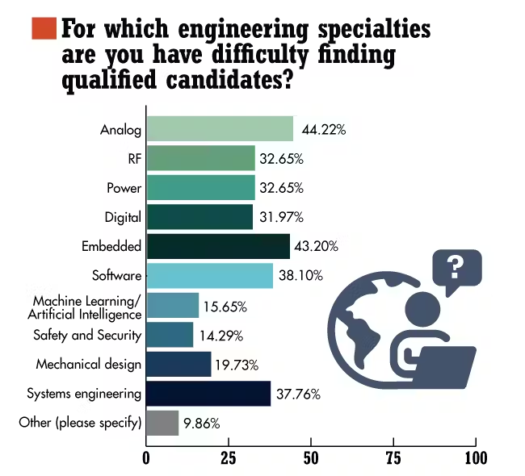
Design skills shortage
For which EE technical area are you having difficulties in finding qualified candidates for hiring?
Semiconductor industry needs hundred of thousands of new employees.
Circuits and systems designers are the most critical human resources to be found.

Slide 5
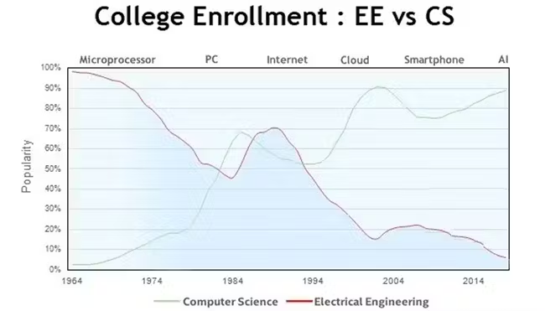
EE vocational crisis
The world is facing an electronics “vocational” crisis.
In the ICT domain, “electronics” is not as appealing as other subjects (e.g., AI, Data Science, Cloud, IoT).
Interest in EE curricula is steadily declining.

Slide 6
Several initiatives to face the issue
Specific programs to attract youngsters to the discipline of IC design are undertaken worldwide.
Within IEEE:
SSCS PICO program:
Democratizing circuit design.
CASS UNIC program:
Universalization of IC Design.
What about the IEEE Council on EDA (CEDA)?

Slide 7
Chips, what? Electronics Design for Youngsters
Goal: Introduce young students to microelectronics design.
Constraints:
Attendees have no EE and CS background.
Max duration: 25 hours, including lab sessions.
Design tools with simple GUI and simulation capabilities.
Teaching by example, very little theory, practical experience.
Free (or EDU) licenses.

Slide 8
Contents
Lecture 1: Introduction to Electronic Systems
Lecture 2: Fundamentals of Digital Design (Part I)
Lecture 3: Introduction to Design Flows and EDA Tools
Lab 1: Introduction to Vivado and the Design of Simple Logic Gates
Lecture 4: Fundamentals of Digital Design (Part II)
Lab 2: Design of an Adder (Design, Simulation, Implementation on Pynq FPGA)
Lecture 5: System-on-Chip (SoC) Design
Lab 3: From Architectures to SoCs
Lecture 6: Industry testimonial - A Designer from STMicroelectronics shares his experience
Lab 4: A Real Use Case: Neural Networks

Slide 9
Teaching team
Politecnico di Torino
Prof. Enrico Macii
Prof. Daniele Jahier Pagliari
Prof. Gianvito Urgese
Ing. Christian Conti
Politecnico di Milano
Prof. Cristiana Bolchini
Prof. Fabrizio Ferrandi
<name.lastname@polito.it>
<name.lastname@polimi.it>

Slide 10
Schedule
Martedì, 04/11/2025, 14:30-16:00, aula 4M Mercoledì, 05/11/2025, 14:30-17:30, aula 5B Martedì, 11/11/2025, 14:30-16:00, aula 4M Venerdì, 14/11/2025, 14:30-17:30, LAIB1T Martedì, 18/11/2025, 14:30-17:30, DAUIN, Aula Ciminiera Mercoledì, 19/11/2025, 14:30-17:30, LAIB5 Martedì, 25/11/2025, 14:30-16:00, aula 4M Mercoledì, 26/11/2025, 14:30-17:30, LAIB5 Martedì, 02/12/2025, 14:30-16:00, aula 4M Venerdì, 05/12/2025, 14:30-17:30, LAIB1T

Slide 11







Authorship & License
Authors
License
Christian Conti christian.conti@polito.it
Gianvito Urgese gianvito.urgese@polito.it
Daniele Jahier Pagliari daniele.jahier@polito.it
Enrico Macii enrico.macii@polito.it
Cristiana Bolchini cristiana.bolchini@polimi.it
Fabrizio Ferrandi fabrizio.ferrandi@polimi.it
These slides are distributed under the Creative Commons license "Attribution - Non commercial - Share alike 2.5 Italy (CC BY-NC-SA 2.5)"
You are free to:
to reproduce, distribute, communicate to the public, exhibit in public, represent, perform and recite this work
to modify this work
Under the following conditions:
Attribution - You must attribute authorship of the work to the original authors and in a way that does not suggest that they endorse you or the way you use the work.
Non-commercial - You may not use this work for commercial purposes.
Share Alike - If you alter or transform this work, or if you use it to create another, you may distribute the resulting work only under an identical or equivalent license to this one.
http://creativecommons.org/licenses/by-nc-sa/2.5/

