Slide 1
Lecture 2 Fundamentals of Digital Design (Part I)

Slide 2
Table of Contents
Inside the Computer's Brain: An Introduction to Boolean Algebra
01.
Fundamentals of Digital Logic: From Logic Operators to Logic Gates
02.
The Path from Logic Gates to Logic Circuits
03.

Slide 3
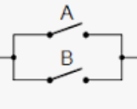

Digital computation
Devices are switches (open/closed).
Signals are high/low (represented as 1/0).
Calculations occur as if signals represent conditions (TRUE/FALSE).
This is called an AND operation (signal passes if and only if both A and B are closed, i.e., 1 or TRUE)
This is called an OR operation (signal passes if at least one between A and B is closed, i.e., 1 or TRUE)

Slide 4
Digital computation (cont.)
How can such an elementary circuit be more efficient than a “richer” circuit (i.e., analog)?
Two are the keys:
As they are simple (just switches…), they can be ultra-fast.
The can switch billions of times per second!!!
As they are simple, they can be built in ultra-small scale.
Typical size of one switch < 20 nm (10⁻⁹m).
Which means that you can fit billions of transistors in a single chip !!!
So, fast and small!
[and, as a consequence, they need little power to switch...]

Slide 5
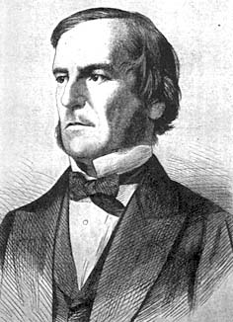
The Logic of the Computers (Boolean)
In 1847, George Boole introduced a new type of formal logic, based solely on statements whose truth or falsity could be unequivocally verified.
Boolean logic is the formal model at the basis of the calculations that computers do, as it provides the framework for manipulating information expressed in binary format.

Slide 6
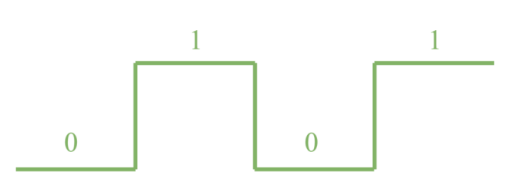
Boolean Algebra
DIGITAL SIGNAL
Digital devices elaborate the information expressed in binary format (i.e., represented with 0 & 1).
Digital circuits (or logic circuits) work thanks to the information carried by the bits.
Boolean Algebra
It is used to describe the behavior of a digital circuit.
LOGIC FUNCTION
Y = f (A, B, C, …)

Slide 7
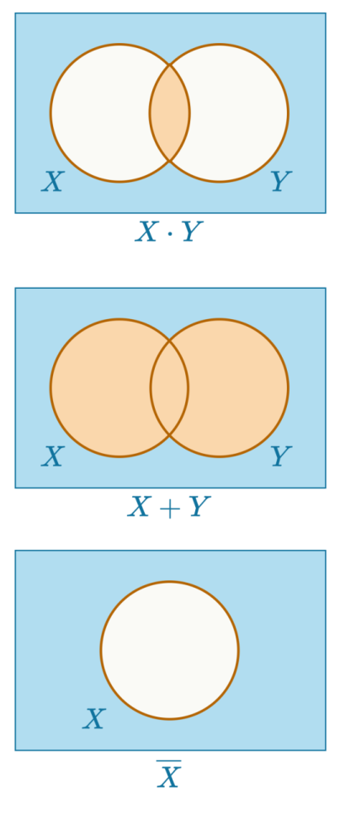
Logic Operators
Boolean algebra utilizes binary variables:
Binary variables can only assume 2 values 0 & 1.
Boolean algebra is based on three fundamental operators:
Logic product (AND operator).
Logic sum (OR operator).
Complementation (NOT operator).

Slide 8
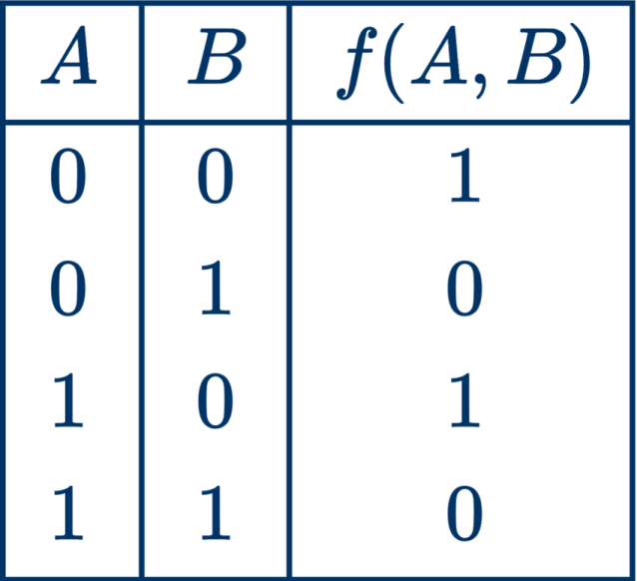
Logic Functions and Truth Tables
Logic (or Boolean) functions are obtained by combining Boolean operators and binary variables:
Such functions can be represented through
Truth Tables
A truth table specifies the value of function Y for any possible combination of N inputs (binary variables). Thus, the table has 2^{N} rows.
Y = f (A, B, C, …)

Slide 9

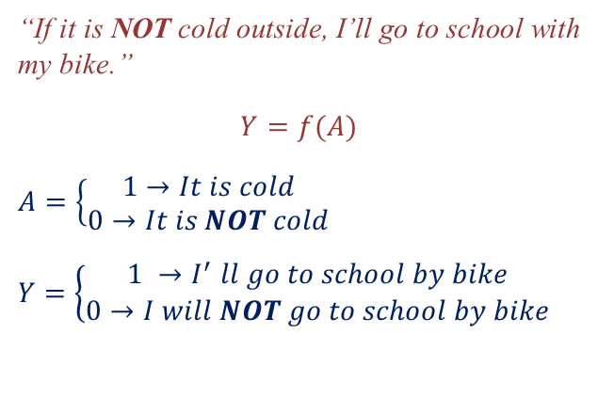

Logic Operators: NOT
“If it is NOT cold outside, I’ll go to school with my bike.”
$$Y=f(A)$$
$$A=\left\{\begin{aligned}1→It is cold \\ 0→It is NOT cold\end{aligned}\right.$$
$$Y=\left\{\begin{aligned}1 {→I}^{′}ll go to school by bike \\ 0→I will NOT go to school by bike\end{aligned}\right.$$
$$Y=\overline{A}$$

Slide 10
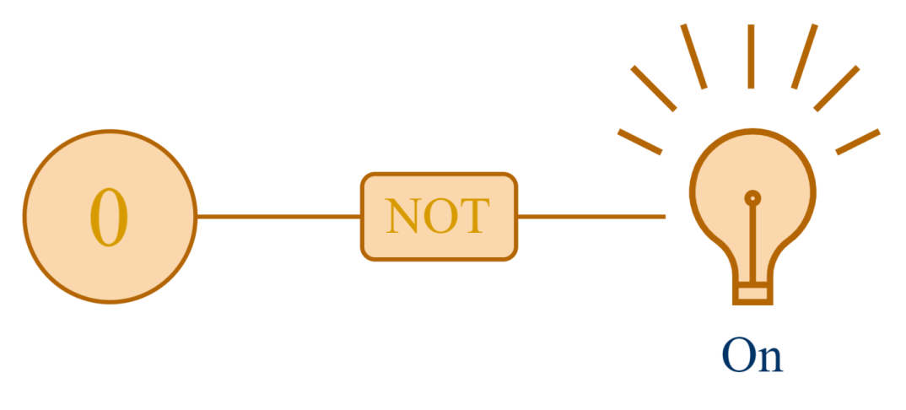
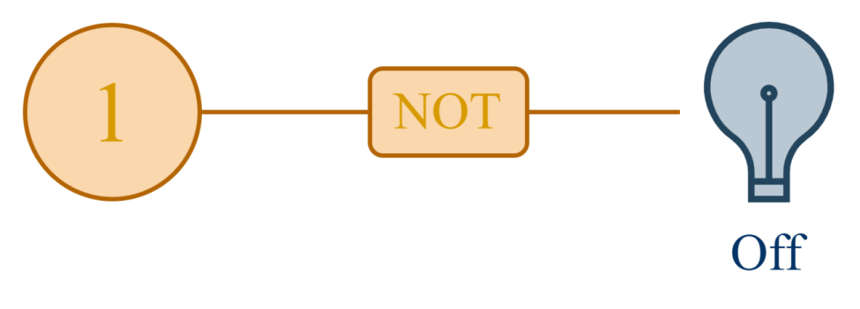
Logic Operators: NOT
$$Y=\overline{A}$$

Slide 11
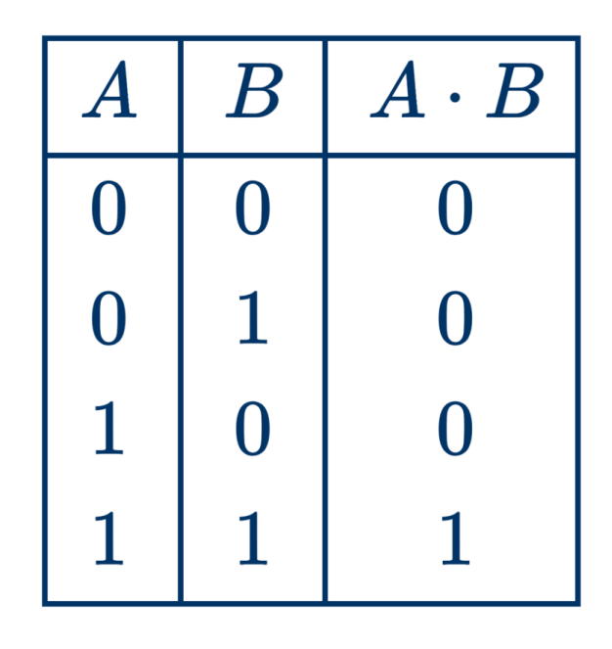
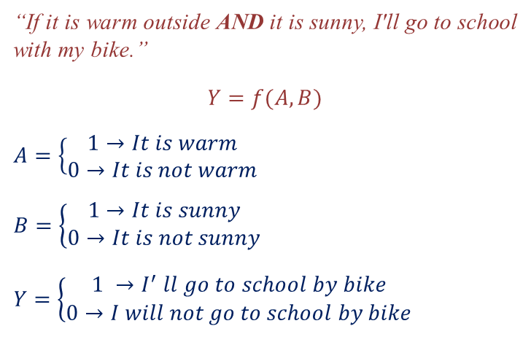

Logic Operators: AND
“If it is warm outside AND it is sunny, I'll go to school with my bike.”
$$Y=f(A, B)$$
$$A=\left\{\begin{aligned}1→It is warm \\ 0→It is not warm\end{aligned}\right.$$
$$B=\left\{\begin{aligned}1→It is sunny \\ 0→It is not sunny\end{aligned}\right.$$
$$Y=\left\{\begin{aligned}1 {→I}^{′}ll go to school by bike \\ 0→I will not go to school by bike\end{aligned}\right.$$
$$Y=A∙B$$

Slide 12
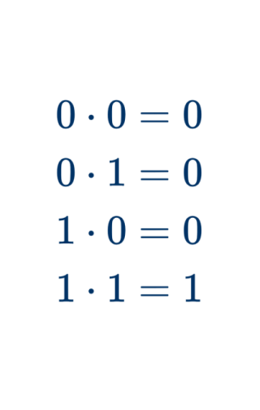
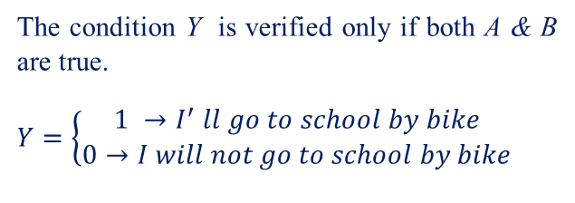


Logic Operators: AND
The condition Y is verified only if both A & B are true.
$$Y=\left\{\begin{aligned}1 {→I}^{′}ll go to school by bike \\ 0→I will not go to school by bike\end{aligned}\right.$$
$$Y=A∙B$$
$$Y=A∙B$$

Slide 13
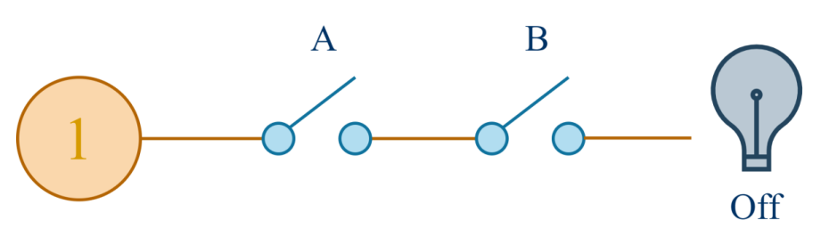
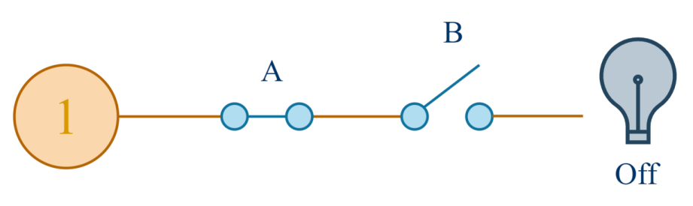
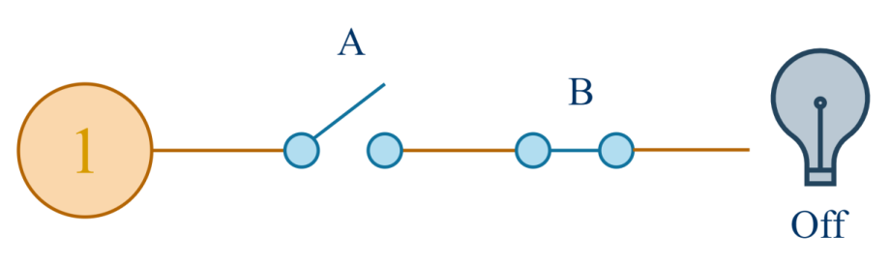
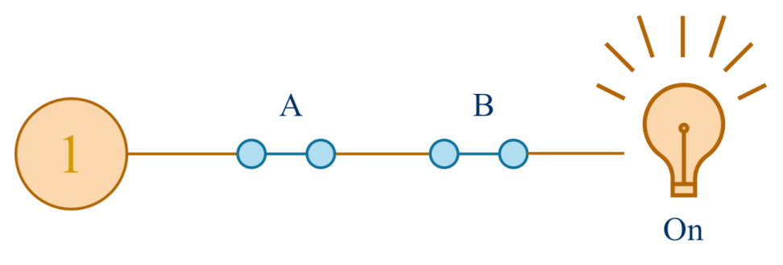
Logic Operators: AND
$$Y=A∙B$$

Slide 14
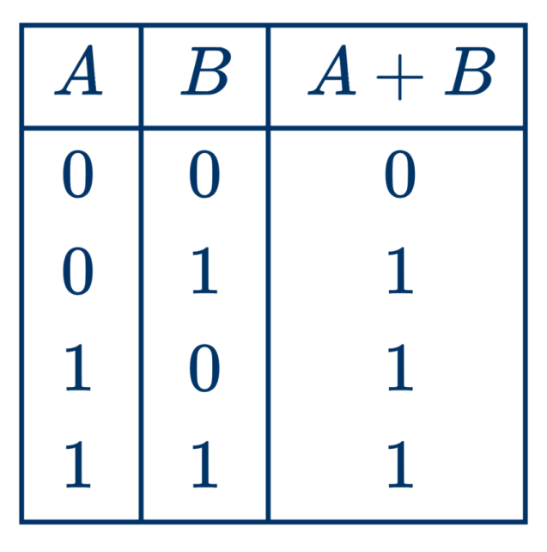
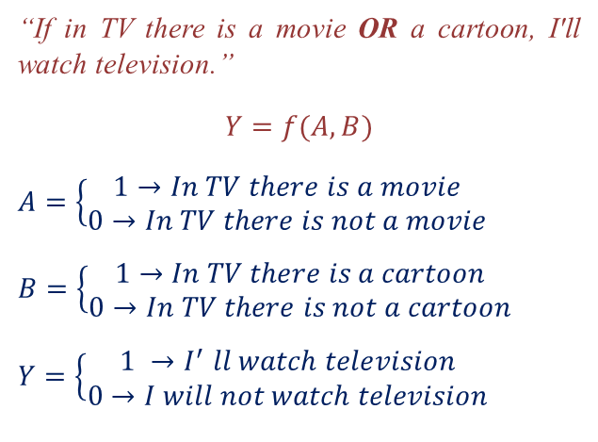

Logic Operators: OR
“If in TV there is a movie OR a cartoon, I'll watch television.”
$$Y=f(A, B)$$
$$A=\left\{\begin{aligned}1→In TV there is a movie \\ 0→In TV there is not a movie\end{aligned}\right.$$
$$B=\left\{\begin{aligned}1→In TV there is a cartoon \\ 0→In TV there is not a cartoon\end{aligned}\right.$$
$$Y=\left\{\begin{aligned}1 {→I}^{′}ll watch television \\ 0→I will not watch television\end{aligned}\right.$$
$$Y=A+B$$

Slide 15
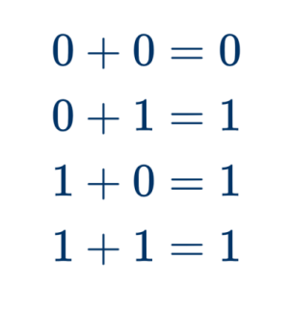
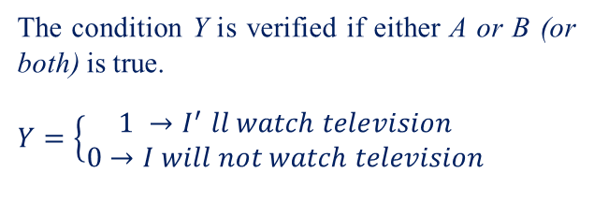

Logic Operators: OR
The condition Y is verified if either A or B (or both) is true.
$$Y=\left\{\begin{aligned}1 {→I}^{′}ll watch television \\ 0→I will not watch television\end{aligned}\right.$$
$$Y=A+B$$
$$Y=A+B$$

Slide 16
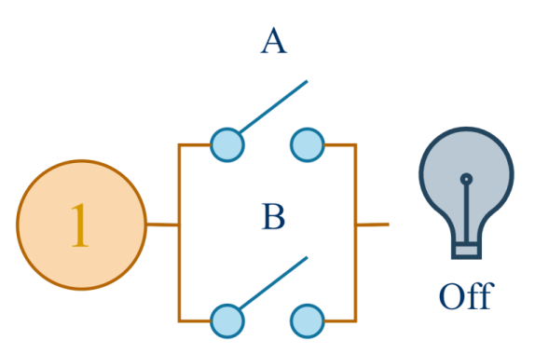
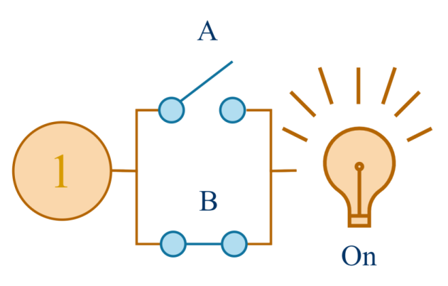
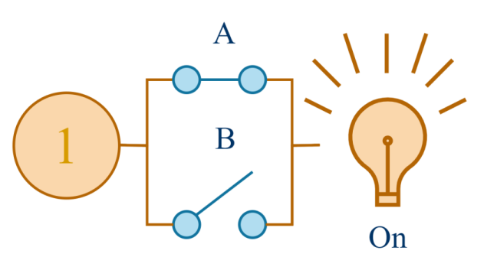

Logic Operators: OR
$$Y=A+B$$

Slide 17
Composed Logic Operators
The Boolean Algebra includes a few additional operators, different from the fundamental ones, which are used often:
NAND operator.
NOR operator.
XOR (exclusive-OR operator).

Slide 18
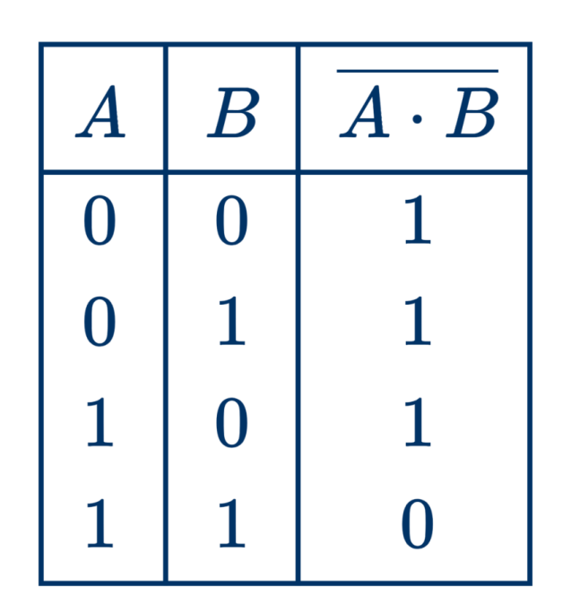

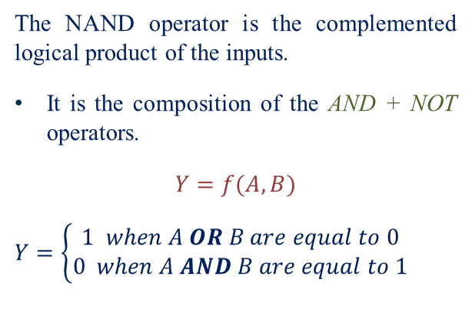
Composed Logic Operators: NAND
The NAND operator is the complemented logical product of the inputs.
It is the composition of the AND + NOT operators.
$$Y=f(A, B)$$
$$Y=\left\{\begin{aligned}1 when A OR B are equal to 0 \\ 0 when A AND B are equal to 1\end{aligned}\right.$$
$$Y=\overline{A∙B}$$

Slide 19
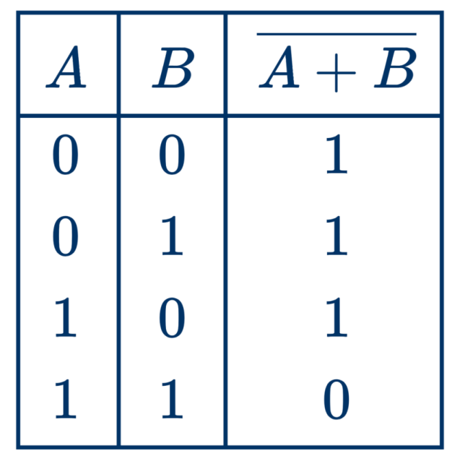

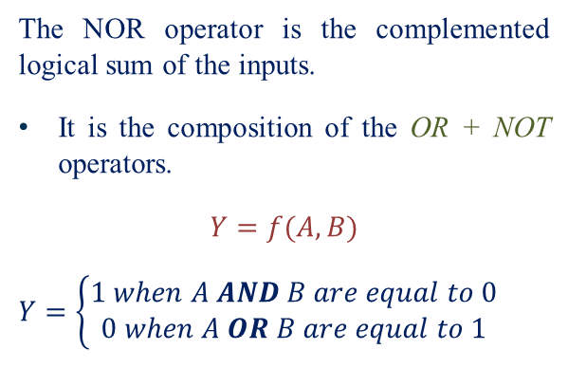
Composed Logic Operators: NOR
The NOR operator is the complemented logical sum of the inputs.
It is the composition of the OR + NOT operators.
$$Y=f(A, B)$$
$$Y=\left\{\begin{aligned}1 when A AND B are equal to 0 \\ 0 when A OR B are equal to 1\end{aligned}\right.$$
0
0
$$Y=\overline{A+B}$$

Slide 20
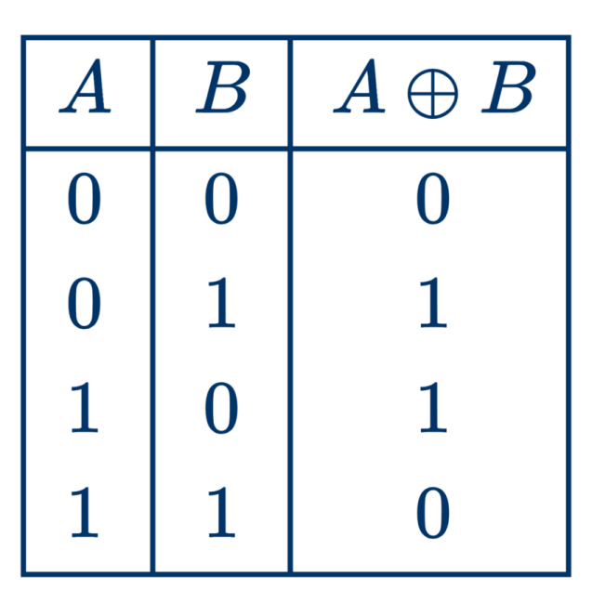

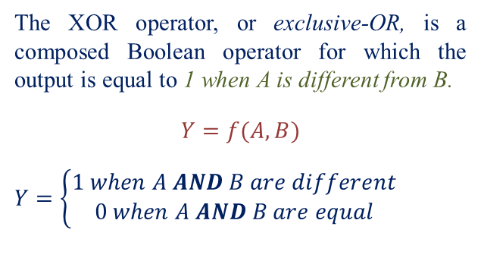
Composed Logic Operators: XOR
The XOR operator, or exclusive-OR, is a composed Boolean operator for which the output is equal to 1 when A is different from B.
$$Y=f(A, B)$$
$$Y=\left\{\begin{aligned}1 when A AND B are different \\ 0 when A AND B are equal\end{aligned}\right.$$
$$Y=\overline{A}B+A\overline{B}=A⊕B$$

Slide 21
Table of Contents
Inside the Computer's Brain: An Introduction to Boolean Algebra
01.
Fundamentals of Digital Logic: From Logic Operators to Logic Gates
02.
The Path from Logic Gates to Logic Circuits
03.

Slide 22
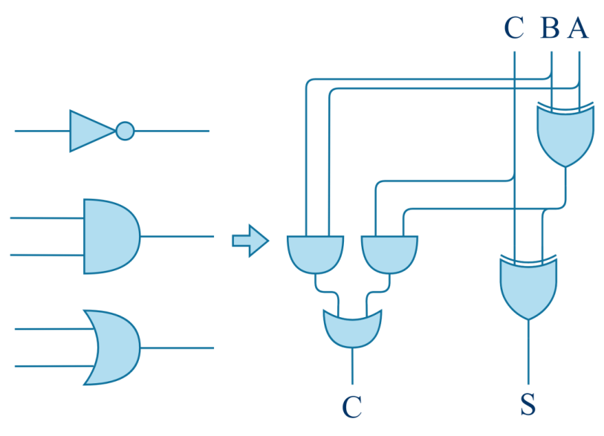
From Logic Operators to Logic Gates
A logic gate is the implementation, through electronic devices (i.e., transistors) of a logic operator.
Logic gates can be combined to create logic circuits that implement complex logic functions performing arithmetic calculations, memory storage, and other tasks in computers and other electronic systems.

Slide 23
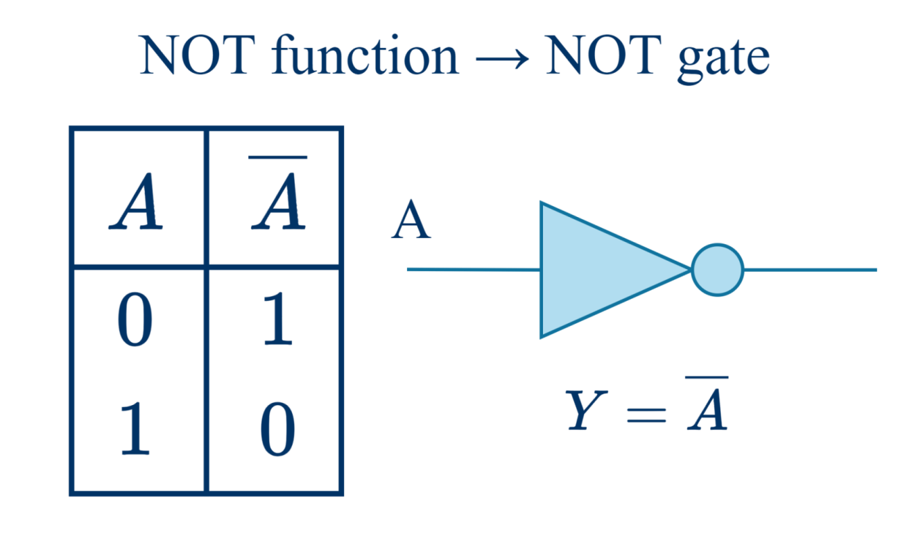
From Logic Operators to Logic Gates
NOT operator → INVERTER gate
Y

Slide 24
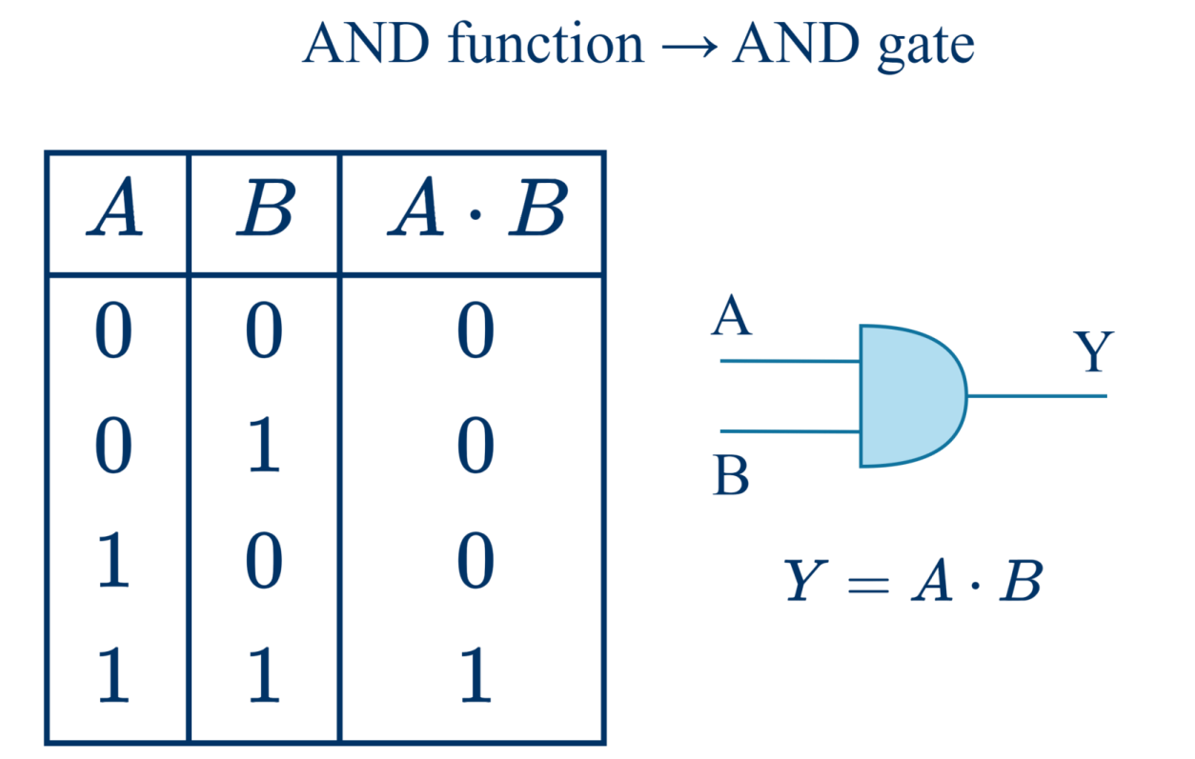
From Logic Operators to Logic Gates
AND operator → AND gate

Slide 25
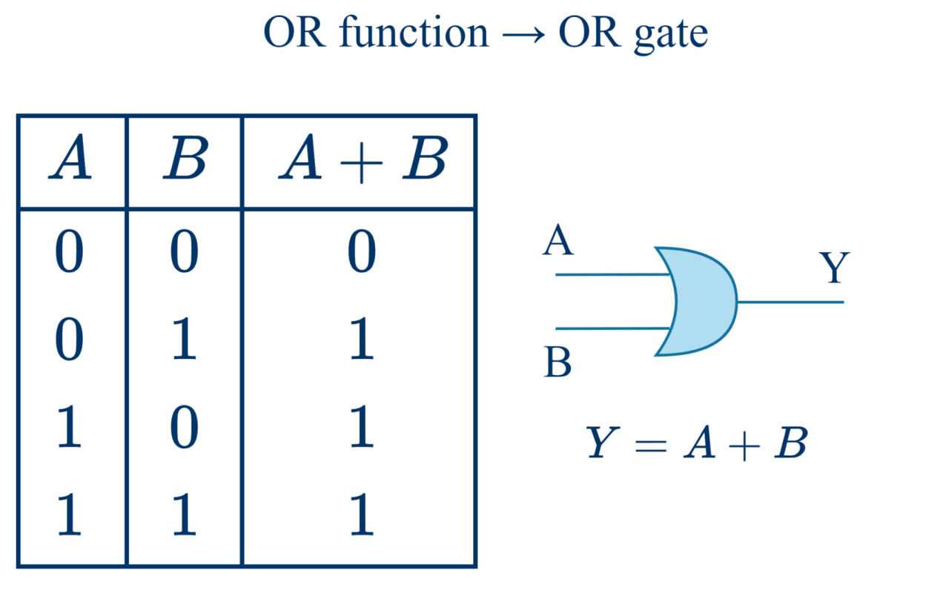
From Logic Operators to Logic Gates
OR operator → OR gate

Slide 26
Inside a Logic Gate
The basic electronic element used to build logic gates is a device, called transistor, which behaves like a switch.
In particular, logic gates use MOS (Metal Oxide Semiconductor) transistors as building blocks.
By connecting several transistors, one can implement any logic function.

Slide 27
MOS Transistors as Switches
MOS transistors are electrically controlled switches.
Voltage at “gate” controls the current path from “source” to “drain”.
There are two types of MOS transistors: nMOS and pMOS.
nMOS and pMOS transistors are always used in pairs to form CMOS devices.

Slide 28
CMOS Inverter
A | Y
0
1

Slide 29
CMOS Inverter
A | Y
0 | 1
1

Slide 30
CMOS Inverter
A | Y
0 | 1
1 | 0

Slide 31
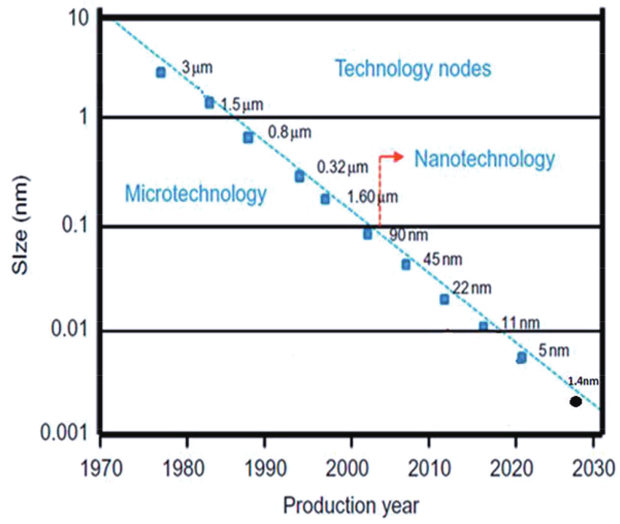
Transistor Size Scaling

Slide 32
Table of Contents
Inside the Computer's Brain: An Introduction to Boolean Algebra
01.
Fundamentals of Digital Logic: From Logic Operators to Logic Gates
02.
The Path from Logic Gates to Logic Circuits
03.

Slide 33
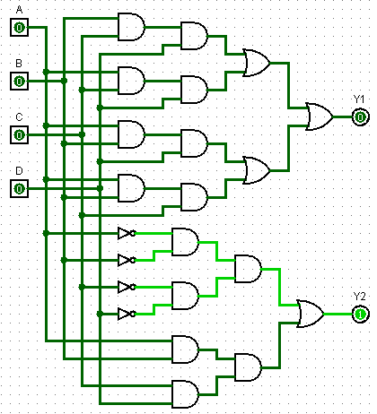
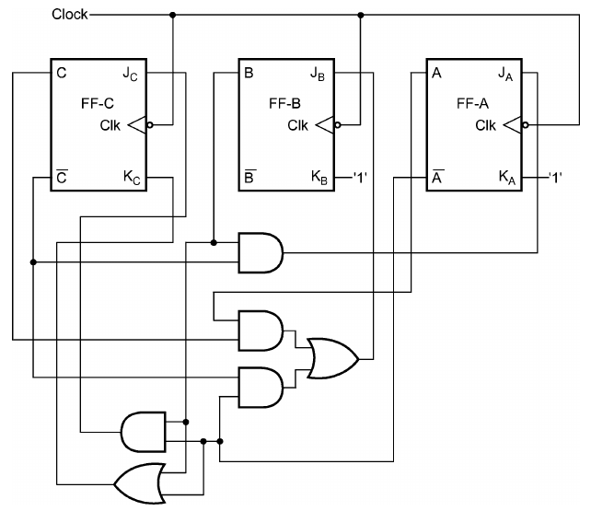
Logic Circuits
Logic circuits implement complex logic functions and are built by interconnecting several logic gates.
Combinational circuit:
Circuit whose future output depends only on the current input, that is, it always gives the same future output for a given input.
Sequential circuit:
Circuit whose future output depends on the current input and the current output, that is, it may give a different future output for a given input (and a different current output).
Sequential circuits have “memory” capabilities, therefore they can be used to implement more complex logic functions than combinational circuits, including storage functions.

Slide 34
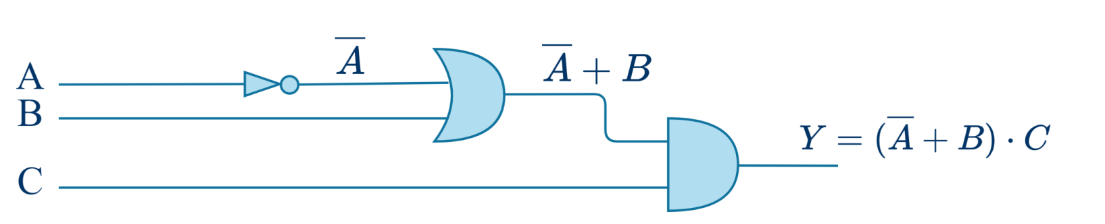
Combinational Circuits
A combinational circuit is a collection of logic gates.
Each combinational circuit can be described by its schematic or its truth table.
The gates in the circuit are traversed from left to right, and the logic function is derived.

Slide 35
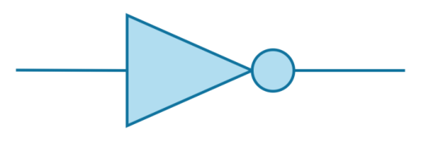
Combinational Circuits
A combinational circuit is a collection of logic gates;
Each combinational circuit can be described by its schematic or its truth table;
The gates in the circuit are traversed from left to right, and the logic function is derived.

Slide 36

Combinational Circuits
A combinational circuit is a collection of logic gates;
Each combinational circuit can be described by its schematic or its truth table;
The gates in the circuit are traversed from left to right, and the logic function is derived.

Slide 37
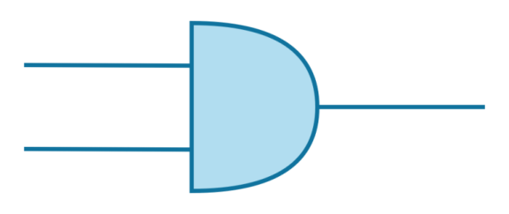
Combinational Circuits
A combinational circuit is a collection of logic gates;
Each combinational circuit can be described by its schematic or its truth table;
The gates in the circuit are traversed from left to right, and the logic function is derived.

Slide 38
From the specification to the circuit
Given the specification of a function, to obtain the corresponding circuit, the following steps are applied:
Define the binary variables (input and output).
Create the truth table.
Generate the expression of the function from the truth table.
Possibly minimize the expression of the function.
Design the circuit using logic gates consistently with the function.

Slide 39
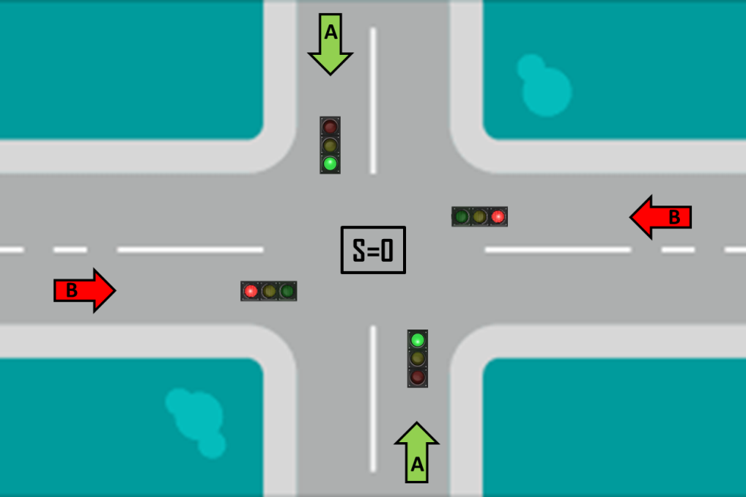
Example: The Multiplexer Circuit
The multiplexer is a combinational circuit that selects one way among two available inputs.
Functionality: Based on the value of control S, the output Y assumes the value of input A (if S = 0) or the value of input B (if S = 1).
Identification of the variables:
3 input signals (A, B, S) and 1 output signal (Y):
INPUT A – Way A
INPUT B – Way B
INPUT S – Control
A
Y=A (A cars can go)
A

Slide 40
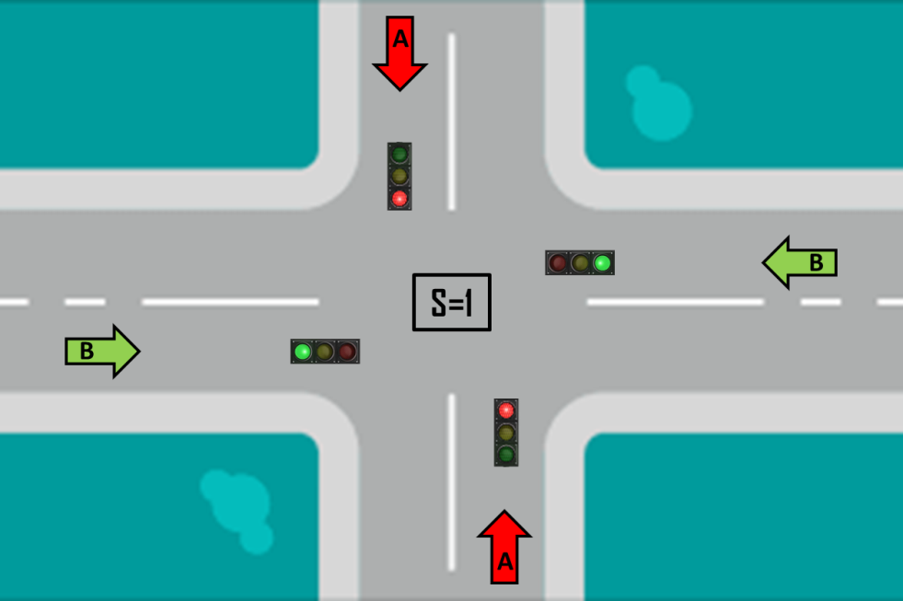
Example: The Multiplexer Circuit
The multiplexer is a combinational circuit that selects one way among two available inputs.
Functionality: Based on the value of control S, the output Y assumes the value of input A (if S = 0) or the value of input B (if S = 1).
Identification of the variables:
3 input signals (A, B, S) and 1 output signal (Y):
INPUT A – Way A
INPUT B – Way B
INPUT S – Control
A
Y=B (B cars can go)
A

Slide 41
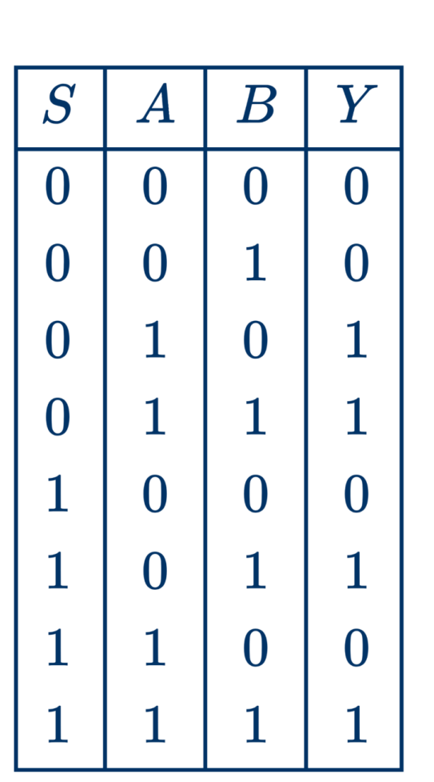
The Truth Table

Slide 42
From the Truth Table to the Function
Look for values "1" in the output column. They will represent generic terms SAB in the function.
SAB + SAB + SAB +SAB (four terms, because there are four "1“)
Let us consider the values ​​of S, A, B in the rows selected above. At their zero value, the variable must be complemented.
The function Y is:
$Y=\overline{S}A$ $\overline{B}+\overline{S}AB+S\overline{A}B+SAB$

Slide 43
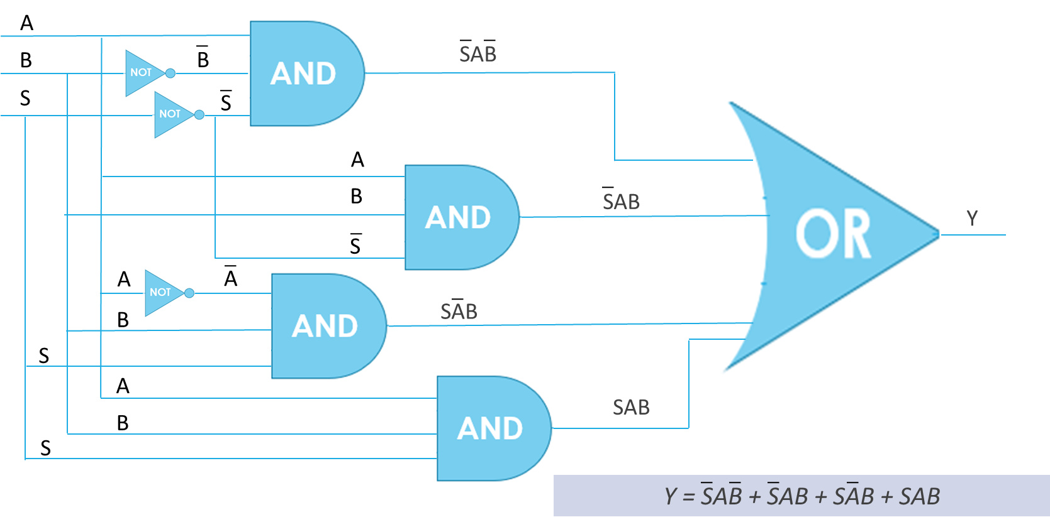
From the Function to the Circuit

Slide 44
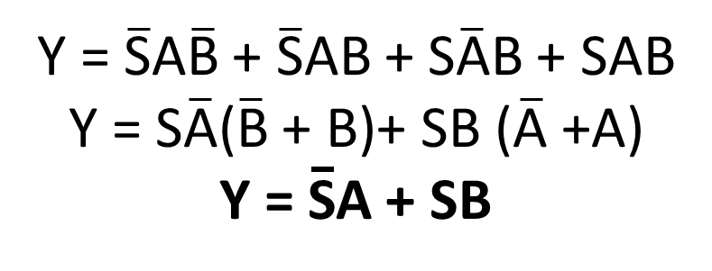
Function Minimization (if possible)
The expression of the function can be minimized using some properties of the Boolean Algebra.
This is helpful for making the circuit more efficient (smaller, i.e., fewer gates, faster, and lower power consuming)

Slide 45
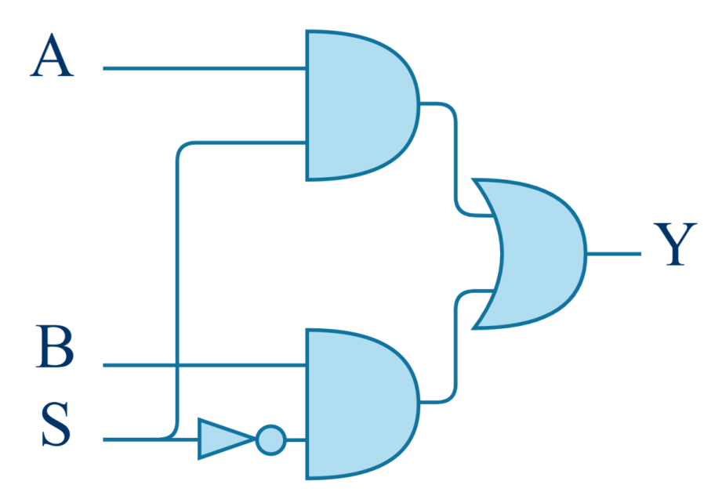

From the Function to the Circuit
$$Y=\overline{S }A+S B$$
B
A

Slide 46
The Impact of Design Choices
Different implementations can lead to circuits with the same functionality, but with different area, speed, cost, and power consumption.

Slide 47
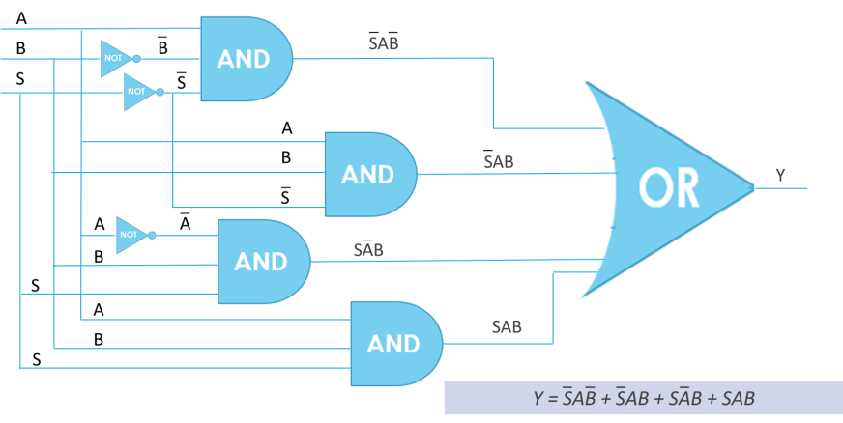
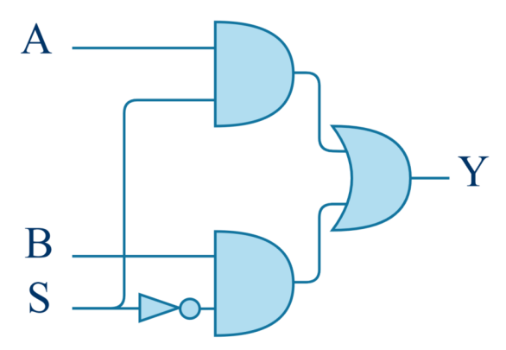
Area Minimization
The number of logic gates defines the area of the circuit. More gates means larger circuit.

Slide 48
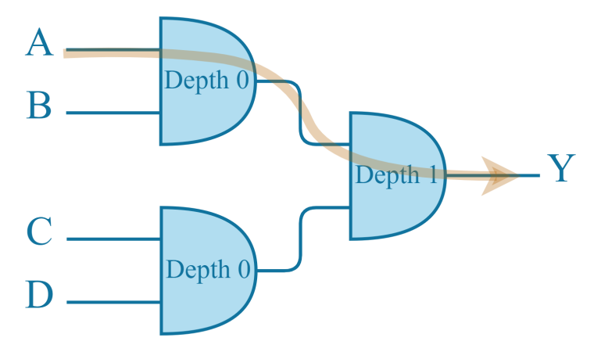
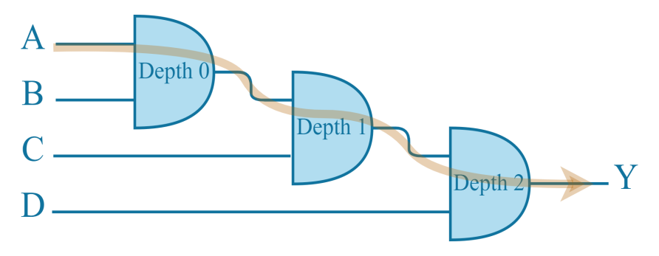
Delay Minimization
Circuits with fewer levels of logic are faster than deeper circuits.

Slide 49
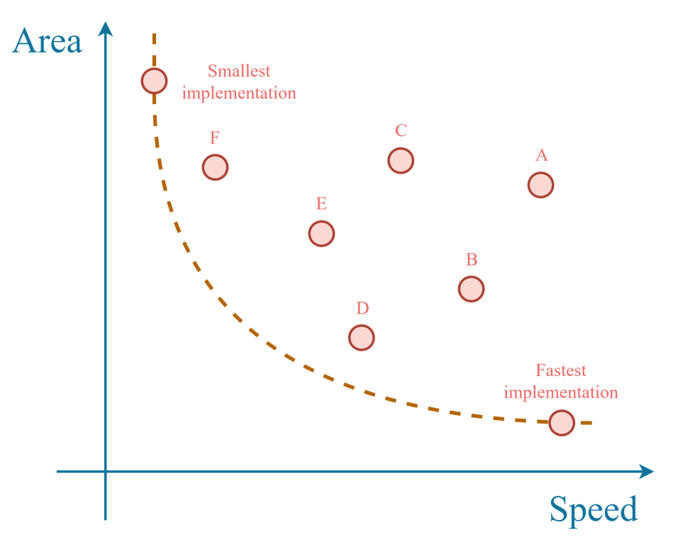
Design Trade-Offs
Often, optimizations do not move all in the same direction.
Example:
Area and delay require opposite optimizations.
A fast circuit is large, a small circuit is slow.
Area
Fastest implementation
Smallest implementation
Delay

Slide 50

Design Trade-Offs
Often, optimizations do not move all in the same direction.
Example:
Power and delay require opposite optimizations.
A fast circuit is power-eager, a power-efficient circuit is slow.

Slide 51
Need for Design Exploration Capabilities
Different implementations can lead to circuits with the same functionality, but, with different area, speed, cost, and power consumption.
Need for Design Space Exploration capabilities.
Designers need to explore different design options in order to obtain implementations which are compliant with the given constraints.

Slide 52


Example: The Comparator Circuit
The comparator is a combinational circuit that compares numbers expressed in binary format.
Functionality: The comparator checks if binary number A is less than, equal to, or greater than binary B.
Identification of the variables:
INPUTS:
A and B
OUTPUTS:
$$Y0 =1 \text{when} A>B, \text{0} \text{otherwise}$$
$$Y1 =1 \text{when} A=B\text{, }\text{0 }\text{otherwise}$$
$Y2 =1 \text{when} A<B,\text{0} \text{otherwise}$
Truth Table

Slide 53






Logic Functions and Circuits
Y0 = A·B
Y1 = A·B + AB
Y2 = A·B

Slide 54

Complete Circuit

Slide 55

Example: The De-multiplexer Circuit
The de-multiplexer is a combinational circuit that performs the inverse task w.r.t. a multiplexer.
Functionality: The de-multiplexer receives data on an input line, E, and it transmits them on one out of 4 lines: O0, O1, O2 and O3, based on control inputs S0 and S1.
Identification of the variables:
INPUTS:
S0, S1, E
OUTPUTS:
O0 = E when S0=0 and S1=0
O1 = E when S0=0 and S1=1
O2 = E when S0=1 and S1=0
O3 = E when S0=1 and S1=1
Truth Table

Slide 56



Logic Functions and Circuit

Slide 57

Example: Exam Passing Circuit
Combinational circuits that checks the existence of some input conditions.
Functionality: To pass an exam, a student should pass two written tests (S1 and S2), or a written test (S1 or S2) and an oral test (O).
Identification of the variables:
INPUTS:
S1, S2, O
OUTPUTS:
P = 1 when S1 = 1 and S2 = 1 or S1 = 1 and O = 1 or S2 = 1 and O = 1 or
S1 = 1 and S2 = 1 and O = 1
Truth Table

Slide 58



Logic Functions and Circuit

Slide 59

Example: Graduation Circuit
Truth Table
Combinational circuits that checks the existence of some input conditions.
Functionality: A student can graduate if he/she has passed all the exams (E) and he/she has done a thesis (T) or a stage (S).
Identification of the variables:
INPUTS:
E, T, S
OUTPUTS:
f = 1 when E = 1 and (T = 1 or S = 1)

Slide 60



Logic Functions and Circuit

Slide 61
Moore’s Law
Moore's Law
The number of transistors in an chip doubles every two years.

Slide 62

Moore’s Law

Slide 63

Moore’s Law

Slide 64

The Human Computer

Slide 65







Authorship & License
Authors
License
Christian Conti christian.conti@polito.it
Gianvito Urgese gianvito.urgese@polito.it
Daniele Jahier Pagliari daniele.jahier@polito.it
Enrico Macii enrico.macii@polito.it
Cristiana Bolchini cristiana.bolchini@polimi.it
Fabrizio Ferrandi fabrizio.ferrandi@polimi.it
These slides are distributed under the Creative Commons license "Attribution - Non commercial - Share alike 2.5 Italy (CC BY-NC-SA 2.5)"
You are free to:
to reproduce, distribute, communicate to the public, exhibit in public, represent, perform and recite this work
to modify this work
Under the following conditions:
Attribution - You must attribute authorship of the work to the original authors and in a way that does not suggest that they endorse you or the way you use the work.
Non-commercial - You may not use this work for commercial purposes.
Share Alike - If you alter or transform this work, or if you use it to create another, you may distribute the resulting work only under an identical or equivalent license to this one.
http://creativecommons.org/licenses/by-nc-sa/2.5/

