Slide 1
Lecture 3 Introduction to Design Flows and EDA Tools

Slide 2
Table of Contents
Introduction to Design Flows and Electronic Design Automation Tools
01.
Hands-on a real EDA tool, development of a basic logic function
02.

Slide 3
Design Flow
To design an electronic circuit, a well defined “design flow” needs to be followed, consisting of specific steps.
Normally, the flow is divided into three sections:
Front-end.
Back-end.
Manufacturing.
The front-end is in charge of generating a netlist of gates starting from the circuit’s functional specification.
The back-end takes care of generating the physical description of the circuit.
The manufacturing flow creates the chip from the physical description.

Slide 4
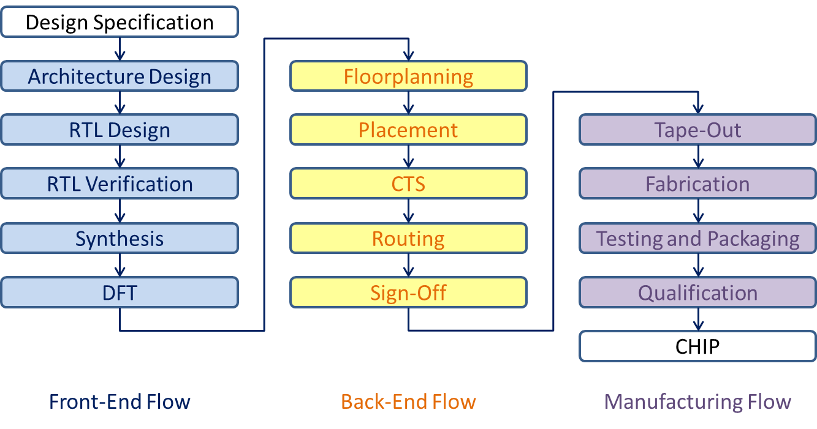
Design Flow

Slide 5
Design Specification
Goal:
Define the functionality, performance, power, area, and other requirements for the circuit.
Output:
A high-level specification document detailing the design requirements, constraints, I/O definitions, and interfaces.

Slide 6
Design Specification: Example
The circuit to be designed and manufactured requires:
Computational power to run imaging algorithms to support virtual reality.
Two ARM A53 processors with coherent interconnect and should run at 600 MHz.
USB 3.0, Bluetooth and PCIe 2nd gen interfaces.
In addition, it should support 1920x1080 pixel display with appropriate controller.

Slide 7
Architecture Design
Goal:
Develop a high-level architecture that meets the specification requirements.
Activities:
Define data paths, control paths, memory requirements, and other system components.
Perform feasibility studies and high-level simulations.
Output:
Block diagrams, high-level descriptions of modules, and a detailed architecture specification.

Slide 8
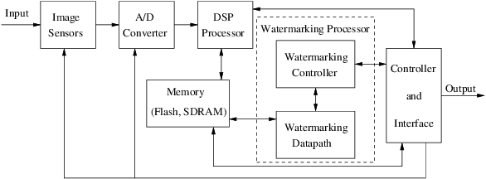
Architecture Design: Example

Slide 9
RTL Design
Goal:
Implement the design in an HDL (Hardware Description Language), such as Verilog or VHDL.
Activities:
Write RTL code for various modules based on the architectural specification.
Simulate the RTL code for functional verification using test-benches.
Output:
Synthesizable RTL code and test-benches.

Slide 10
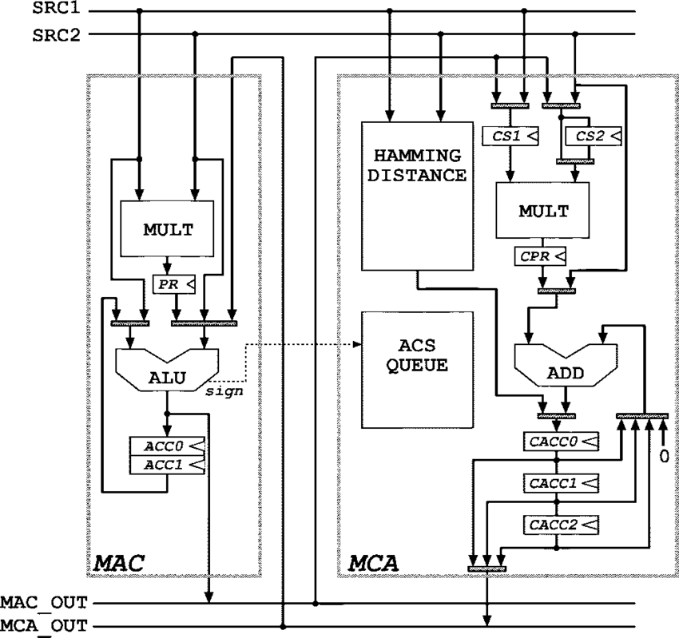
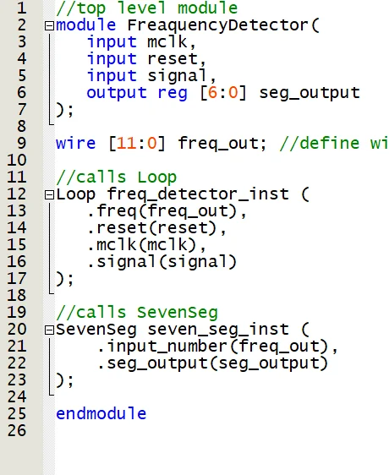
RTL Design: Example

Slide 11
RTL Verification
Goal:
Verify that the RTL code matches the design specification and that it works correctly.
Activities:
Use simulation tools to check the functionality with various test cases.
Perform code coverage analysis to ensure the code is fully tested.
Employ formal verification to prove certain design properties.
Output:
Verified RTL code and test results.

Slide 12
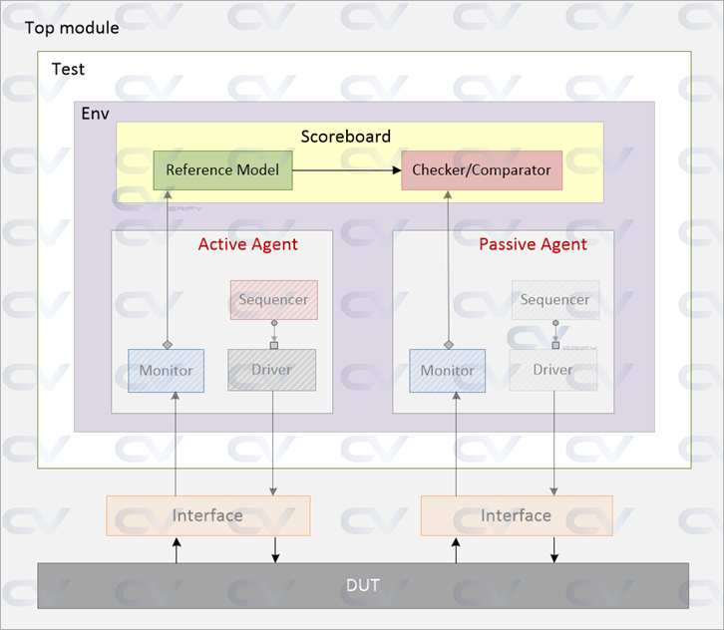
RTL Verification: Example

Slide 13
Synthesis
Goal:
Convert the RTL code into a gate-level netlist based on the target technology library.
Activities:
Use synthesis tools (e.g., Synopsys Design Compiler) to translate RTL to a netlist.
Optimize for performance, area, and power constraints.
Output:
Gate-level netlist and synthesis reports (timing, area, power).

Slide 14
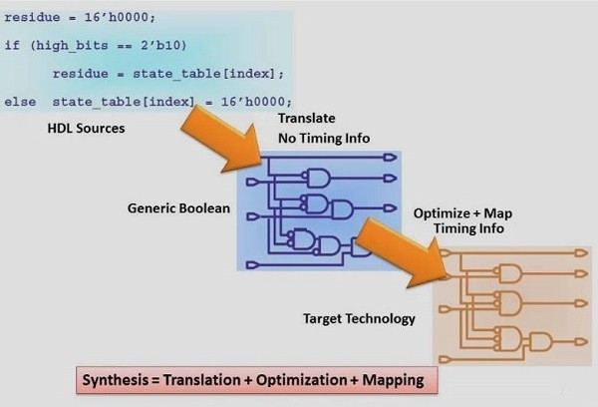
Synthesis: Example

Slide 15
Design for Testability (DfT)
Goal:
Integrate testability features into the design to facilitate manufacturing testing.
Activities:
Insert scan chains for scan testing.
Add Built-In Self-Test (BIST) structures for memories and logic blocks.
Output:
Updated gate-level netlist with DFT features.

Slide 16
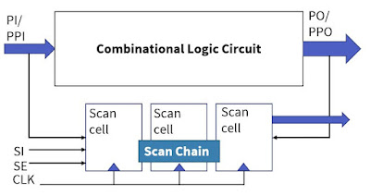
Design for Testability (DfT): Example

Slide 17
Floorplanning
Goal:
Define the physical layout and placement of the design components on the silicon die.
Activities:
Partition the design into logical blocks.
Plan the placement of macro blocks (e.g., memories, IP cores) and decide on routing paths.
Output:
Initial floorplan layout.

Slide 18
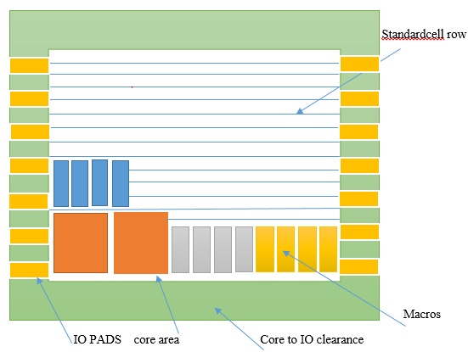
Floorplanning: Example

Slide 19
Placement
Goal:
Place standard cells on the chip according to the floorplan.
Activities:
Perform cell placement optimization to minimize wire length and meet timing constraints.
Output:
Preliminary placement layout.

Slide 20
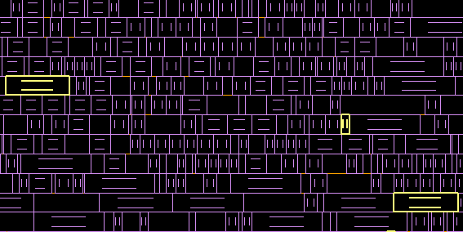
Placement: Example

Slide 21
Clock Tree Synthesis (CTS)
Goal:
Design and implement the clock distribution network to minimize skew and latency.
Activities:
Generate and optimize the clock tree, ensuring minimal skew across clock paths.
Output:
Clock tree layout with balanced clock paths.

Slide 22
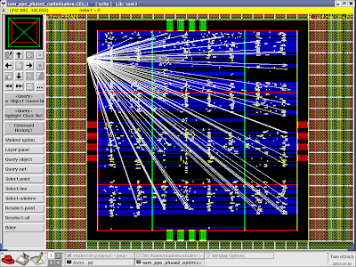
Clock Tree Synthesis (CTS): Example

Slide 23
Routing
Goal:
Establish the physical connections between placed cells using metal layers.
Activities:
Perform global routing followed by detailed routing.
Optimize routing to minimize congestion, crosstalk, and meet signal integrity constraints.
Output:
Routed design layout.

Slide 24
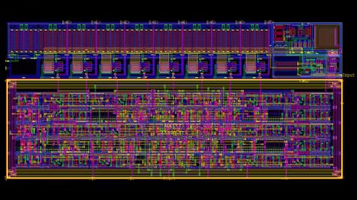
Routing: Example

Slide 25
Sign-Off
The sign-off process typically involves a comprehensive checklist to ensure no aspects are missed, including:
Timing closure (all timing paths meet requirements).
Power analysis (total power, IR drop, and thermal analysis).
Signal integrity (crosstalk, noise, and electromigration checks).
Physical verification (DRC, LVS, and antenna checks).
Test coverage (DFT and fault coverage).
Manufacturing readiness (DFM checks).

Slide 26
Tape-Out
Goal:
Finalize the design for manufacturing.
Activities:
Package all design files (GDSII, layout files, timing constraints) and send them to the foundry.
Output:
Tape-out package ready for fabrication.

Slide 27
Fabrication
Goal:
Manufacture the silicon wafers using photolithography and other semiconductor processes.
Output:
Silicon wafers with multiple die.

Slide 28
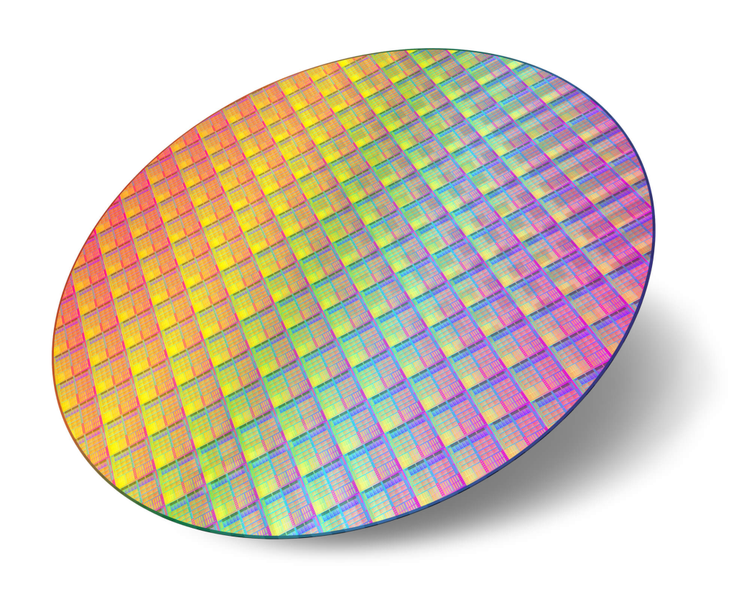
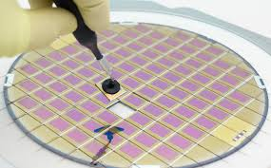
Fabrication: Example

Slide 29
Testing and Packaging
Goal:
Test individual die for functionality before packaging.
Activities:
Wafer Testing (Probe Test): Use automated test equipment (ATE) to check for defects.
Die Packaging: Encapsulate the functional die into a protective package.
Final Testing: Conduct additional tests (burn-in, functional, parametric) on the packaged chips.
Output:
Packaged and tested chips.

Slide 30
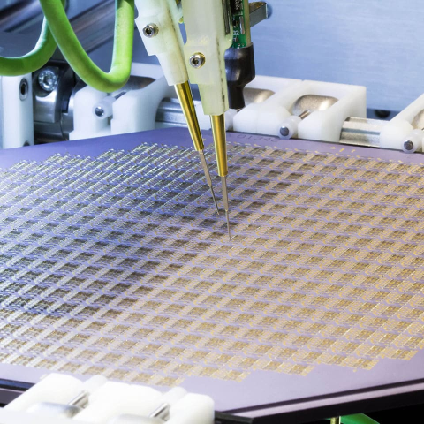
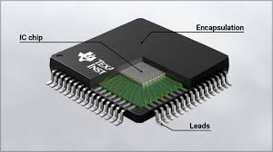
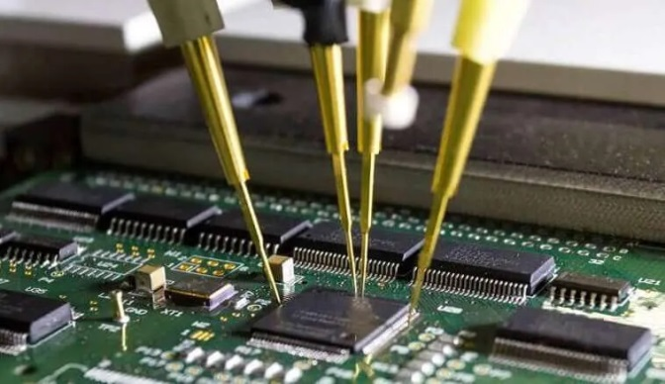
Testing and Packaging: Example

Slide 31
Qualification
Goal:
Validate the product under real-world conditions and ensure it meets all specifications.
Activities:
Perform stress testing, temperature, and voltage testing.
Conduct performance validation to ensure the chip meets the application requirements.
Output:
Qualified and validated chip ready for market.

Slide 32
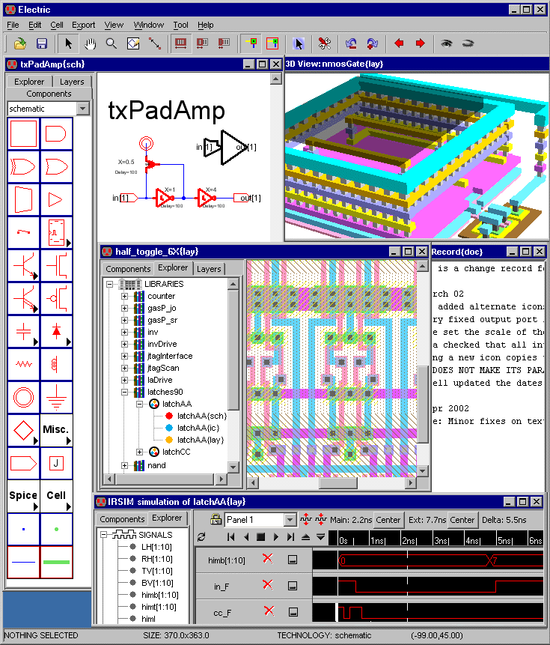
Electronic Design Automation Tools
Electronic Design Automation (EDA) tools are software programs that help designers in the different phases of the design flow.
In particular, EDA tools allow engineers and designers to automate some of the complex tasks of the flow.

Slide 33
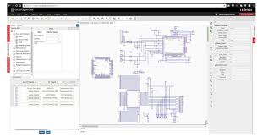
Types of EDA Tools
EDA tools are very sophisticated and complex software programs utilized to enable the automated design of electronic systems.
There are three types of tools:
Design tools.
Simulation tools.
Verification tools.

Slide 34
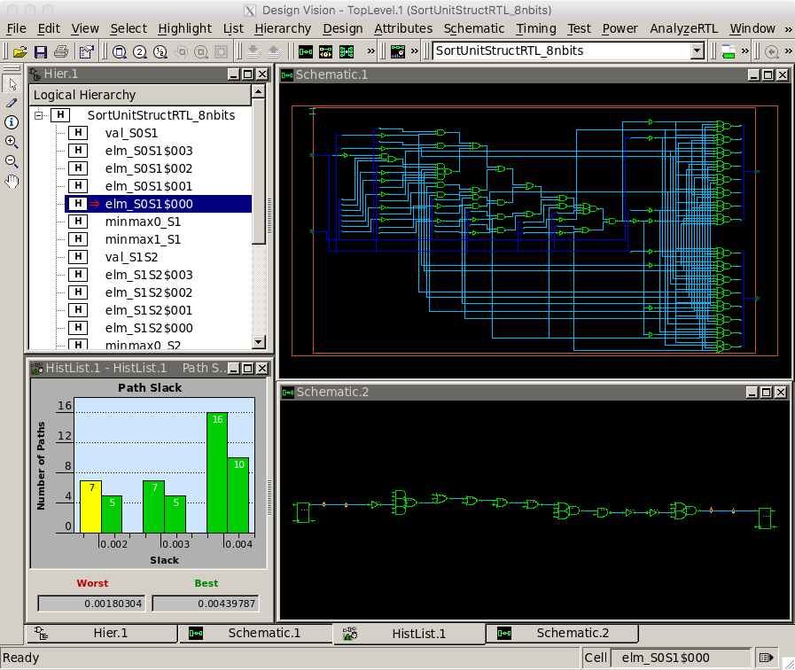
How Does an EDA Tool Work? Design
Design tools take a specification of the circuit function to be implemented and generate the interconnection of different basic elements, such as logic gates, to create the circuit that matches the initial function.
Logic: the correct elements to solve the circuits are chosen and connected.
Physical: shapes that implement the circuit on the silicon are assembled, placed, and routed together.

Slide 35
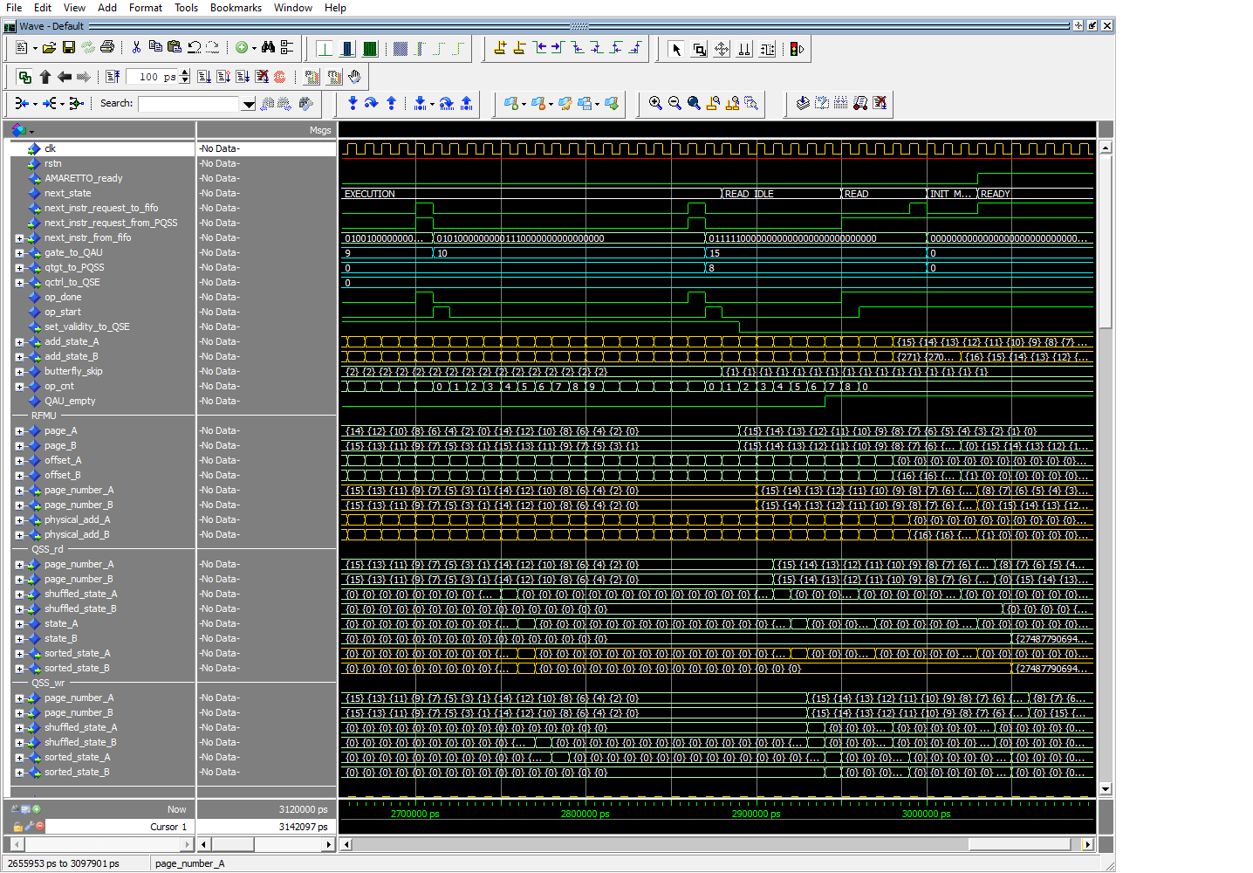
How Does an EDA Tool Work? Simulation
Simulation tools take a description of the proposed circuit and check its behaviour before physically implementing it.
Simulation tools take a description of the circuit and simulate it in cycles.
The level of detail required usually defines the time employed for the simulation.

Slide 36
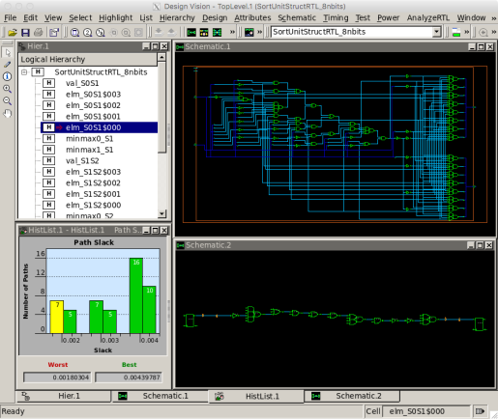
How Does an EDA Tool Work? Verification
Verification tools examine the logical or physical representations of the circuit to verify if the resultant design matches the specifications.
Logic: verify that the implemented function gives the same results as the expected behavior.
Physical: verify that the placement respects the foundry guidelines.

Slide 37

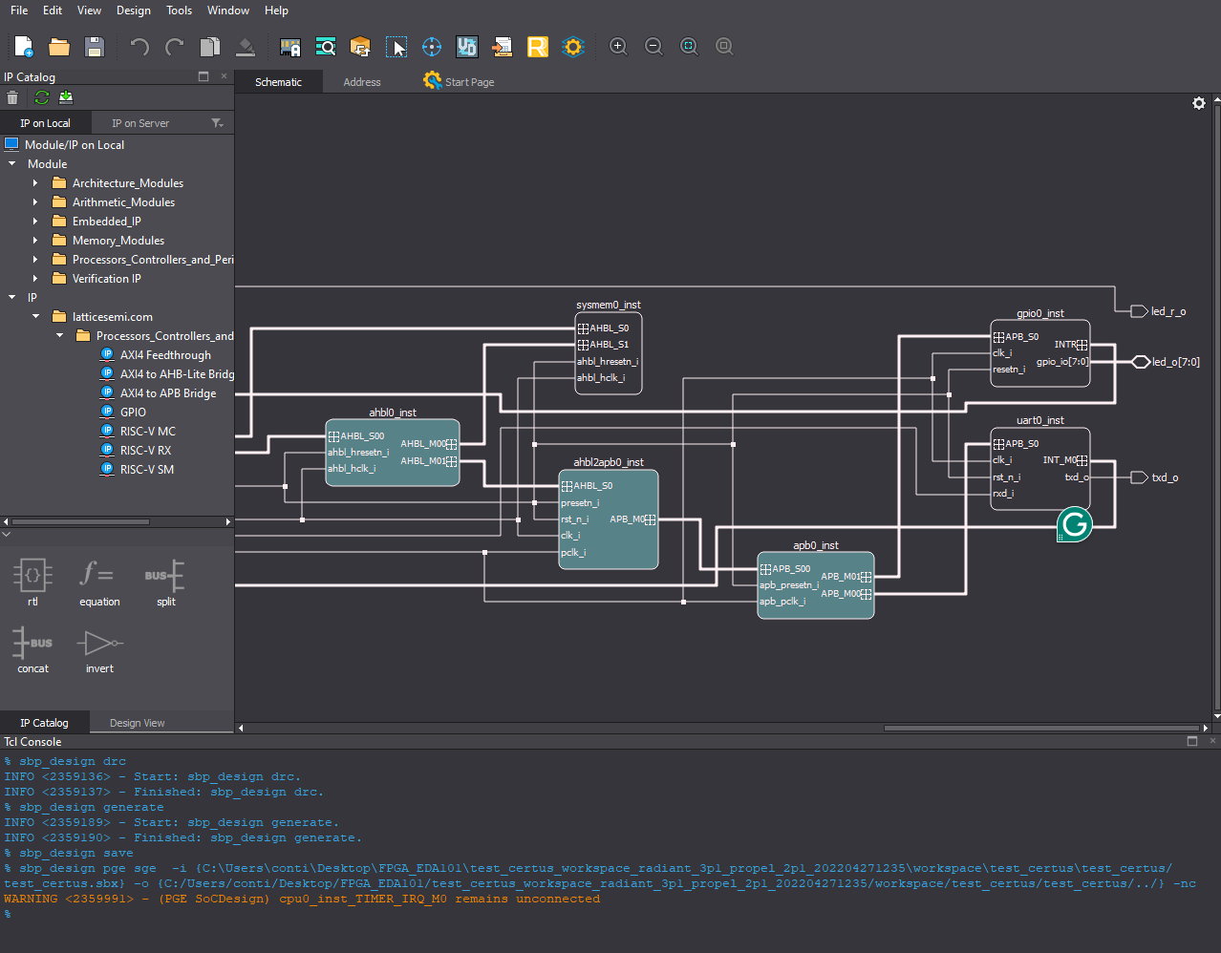

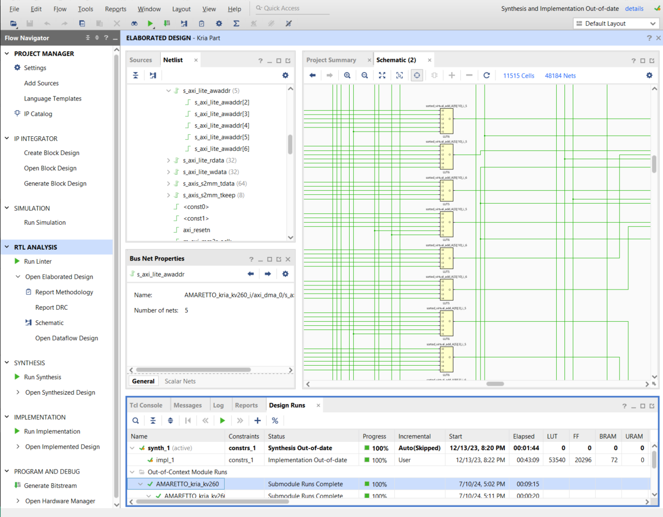
Why are EDA tools important?
Chips are extremely complex, as they may contain billions of transistors,
Managing such a complexity requires the assistance of Electronic Design Automation tools.
EDA tools speed-up the design process and help limiting human errors in chip manufacturing.

Slide 38




Popular EDA Tools
Different vendors produce various types of Electronic Design Automation software tailored to specific needs and applications:
FPGA vendors create EDA tools specifically designed to work with their products.
General EDA vendors specialized in chip design provide tools that cover the entire design flow of a chip.

Slide 39
Table of Contents
Introduction to Design Flows and Electronic Design Automation Tools
01.
Hands-on a real EDA tool, development of a basic logic function
02.

Slide 40
Front-End Design Flow
Design Specification
Architecture Design
RTL Design
RTL Verification
Front-End Flow
Synthesis
DFT
Back-End Flow

Slide 41
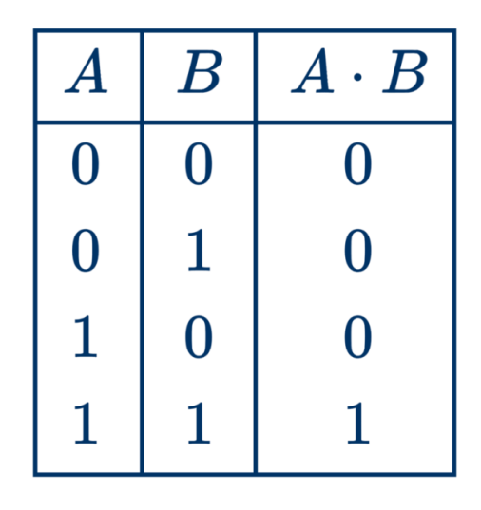

Design Specification
Design an electronic circuit implementing the AND operator.
The functionality of the AND operator is to output a logic value‘1’ when both inputs have a logic value‘1’ .
$$Y=A∙B$$

Slide 42
Architecture
The architecture of the circuit is very simple, since it must implement only one logic gate:
2 Input ports: A , B;
1 Output port: Y;
A
Y = A·B
B

Slide 43

RTL Design
During the RTL Design step, the architecture is translated into the hardware description of the electronic system through an HDL language.
In our project, we will use the EDA tools of AMD Xilinx: Vivado.
A
Y = A·B
B

Slide 44

RTL Design
Step 1: Create a new project

Slide 45
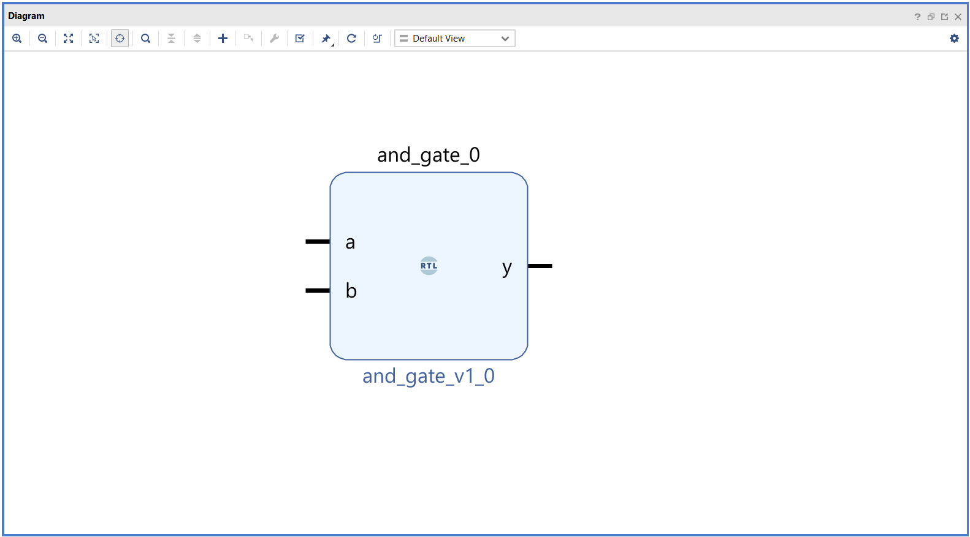
RTL Design
Step 1: Create a new project
Step 2: Instantiate the logic gate

Slide 46
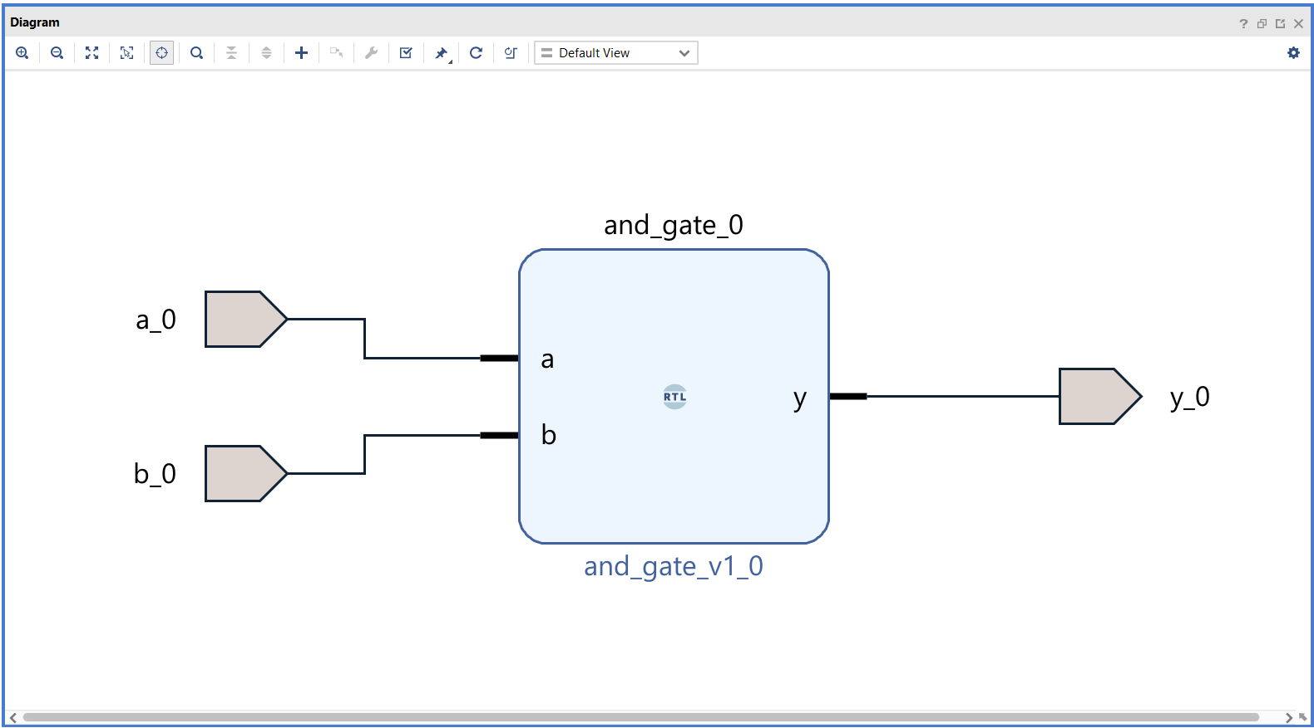
RTL Design
Step 1: Create a new project
Step 2: Instantiate the logic gate
Step 3: Instantiate the input and output ports

Slide 47
RTL Design
The output generated by the schematic entry tool is a hardware description of the behavior of the AND gate.
The AND gate is described in Verilog, a Hardware Description Language (HDL) utilized for the synthesis of digital circuits.
module and_gate (
input wire a, // Input a
input wire b, // Input b
output wire y // Output y
);
assign y = a & b; // AND
endmodule

Slide 48
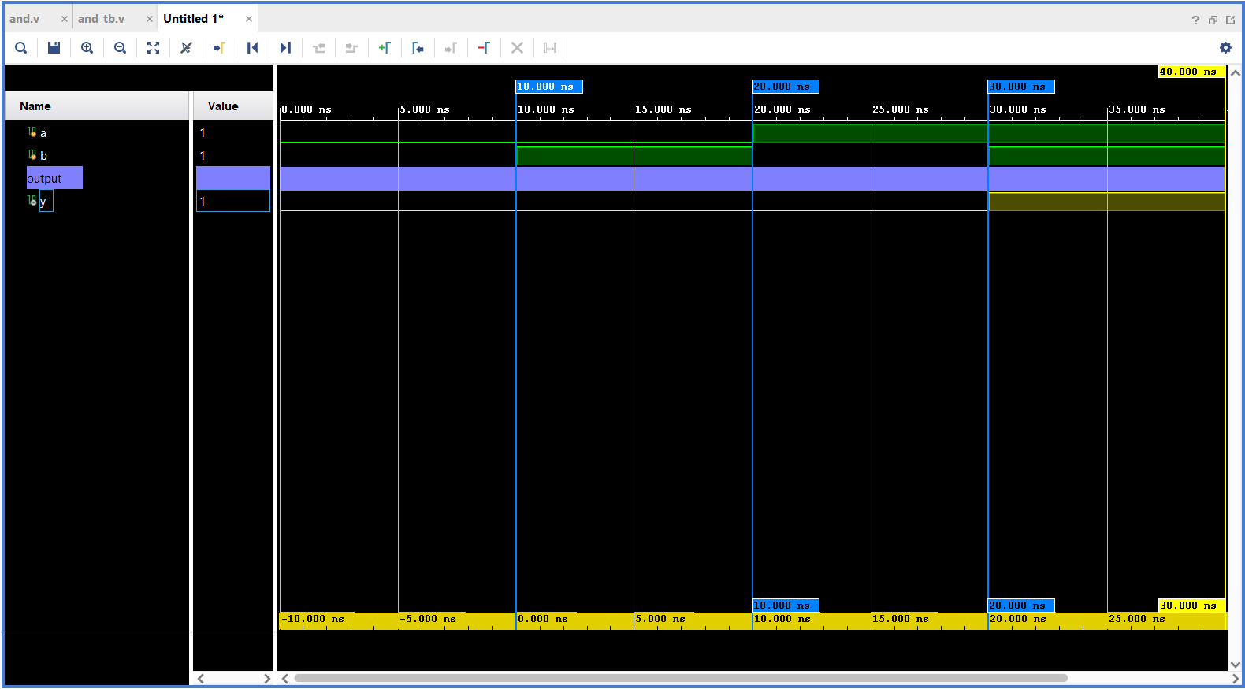
RTL Verification
To simulate the behavior of the circuit, a “testbench” is designed.
The testbench is a “wrapper” around the circuit that generates different input stimuli representing all the possible input combinations.
The output of the simulation is recorded and analyzed to verify the correctness of the design.

Slide 49
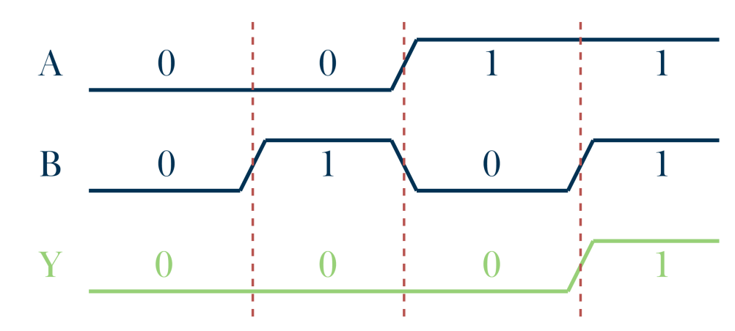
RTL Verification
To simulate the behavior of the circuit, a “testbench” is designed;
The testbench is a “wrapper” around the circuit that generates different input stimuli representing all the possible input combinations;
The output of the simulation is recorded and analyzed to verify the correctness of the design;

Slide 50







Authorship & License
Authors
License
Christian Conti christian.conti@polito.it
Gianvito Urgese gianvito.urgese@polito.it
Daniele Jahier Pagliari daniele.jahier@polito.it
Enrico Macii enrico.macii@polito.it
Cristiana Bolchini cristiana.bolchini@polimi.it
Fabrizio Ferrandi fabrizio.ferrandi@polimi.it
These slides are distributed under the Creative Commons license "Attribution - Non commercial - Share alike 2.5 Italy (CC BY-NC-SA 2.5)"
You are free to:
to reproduce, distribute, communicate to the public, exhibit in public, represent, perform and recite this work
to modify this work
Under the following conditions:
Attribution - You must attribute authorship of the work to the original authors and in a way that does not suggest that they endorse you or the way you use the work.
Non-commercial - You may not use this work for commercial purposes.
Share Alike - If you alter or transform this work, or if you use it to create another, you may distribute the resulting work only under an identical or equivalent license to this one.
http://creativecommons.org/licenses/by-nc-sa/2.5/

