Slide 1
Lecture 4 Fundamentals of Digital Design (Part II)

Slide 2
Table of Contents
01.
Introduction to Sequential Circuits
Circuits for Data Storage:
Latches, Flip-Flops, Registers, Memories
02.
03.
Synchronous Circuits

Slide 3
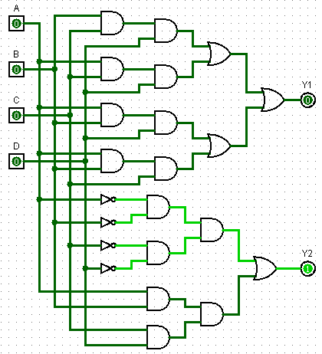
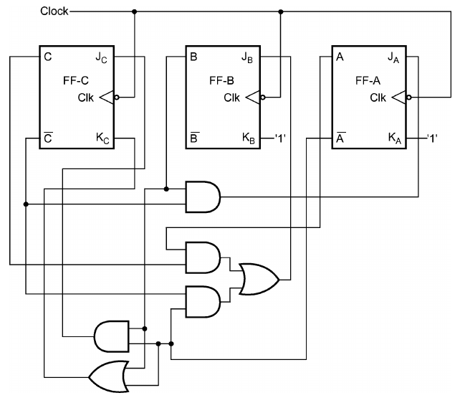
Sequential Circuits
Logic circuits implement complex logic functions and are built by interconnecting several logic gates.
Combinational circuit:
Circuit whose future output depends only on the current input, that is, it always gives the same future output for a given input.
Sequential circuit:
Circuit whose future output depends on the current input and the current output, that is, it may give a different future output for a given input (and a different current output).
Sequential circuits have “memory” capabilities, therefore they can be used to implement more complex logic functions than combinational circuits, including storage functions.

Slide 4
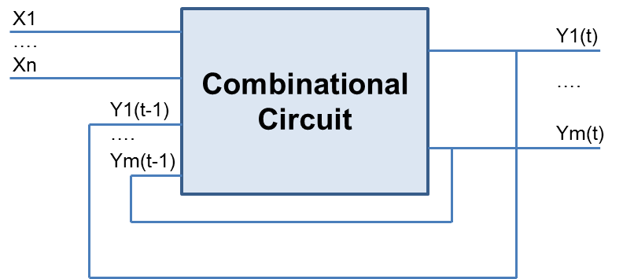
Architecture of a Sequential Circuit
In a sequential circuit, the outputs depend on the current, as well as the past inputs.
The outputs depend on the history, that is, the circuit has “memory” property, which can be used to store information.
Some/all the current outputs are fed back (with some delay) to the inputs of the combinational network, and contribute to the new outputs.

Slide 5
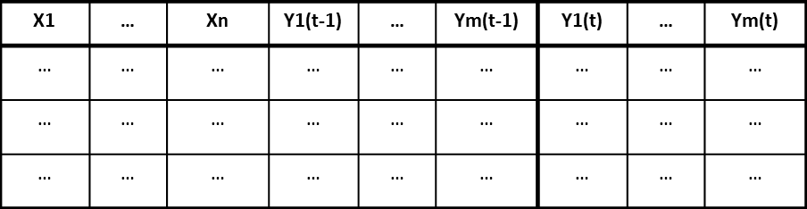
Truth Table of a Sequential Circuit

Slide 6
Table of Contents
01.
Introduction to Sequential Circuits
Circuits for Data Storage:
Latches, Flip-Flops, Registers, Memories
02.
03.
Synchronous Circuits

Slide 7
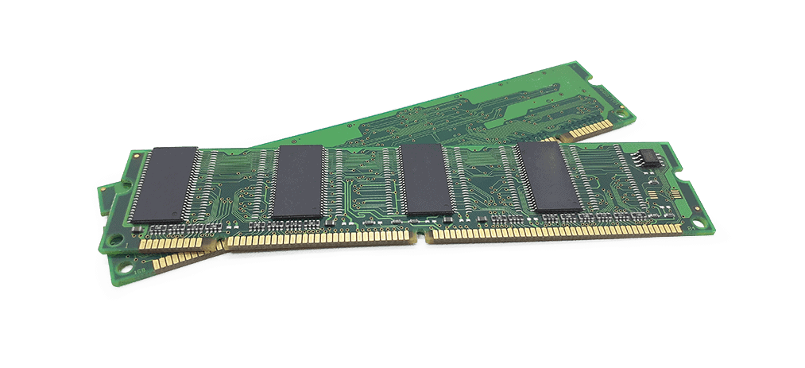
Circuits for Data Storage
Data storage circuits:
Latches.
Flip-Flops.
Registers.
Memories:
Static RAM.
Dynamic RAM.
FLASH.

Slide 8
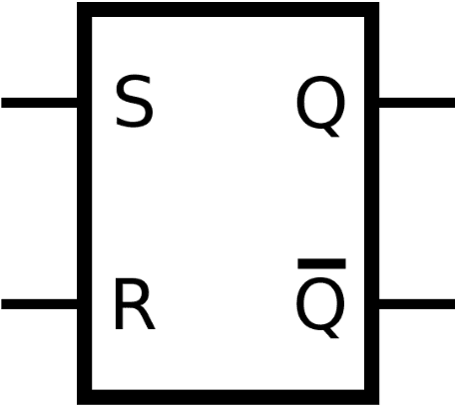
Memory Elements: The SR-Type Latch
Memory elements are needed to store logic values.
Example: The SR-Type Latch.
Input R is used to “reset” the element: R=1 → set output Q to zero.
Input S is used to “set” the element: S=1 → set output Q to one.
If both R and S are 0, the circuit is in a “quiescent” state – it holds its previous value.
If Q is 1, Q is 0, and vice versa.
_

Slide 9
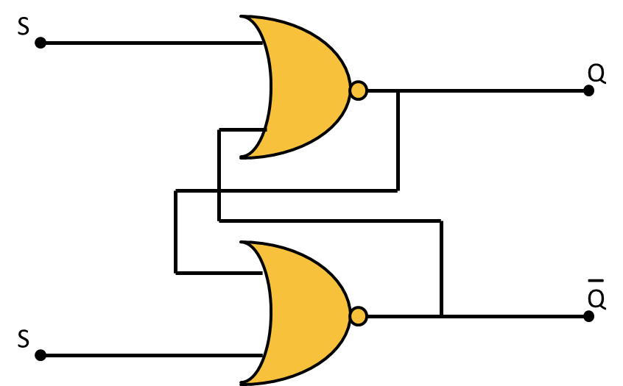
SR-Type Latch
R

Slide 10
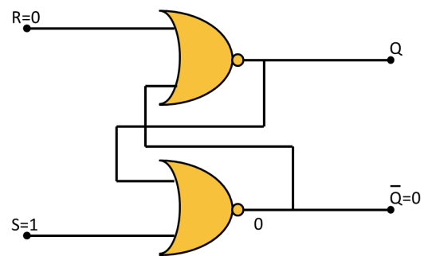


SR-Type Latch
R=0
S=1
Q goes to 1 (set)

Slide 11
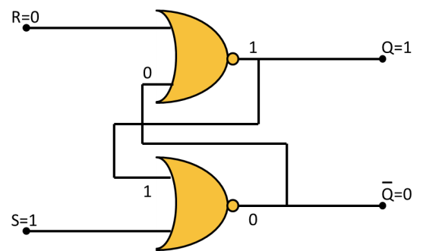

SR-Type Latch
R=0
S=1 → 0
Q keeps the previous value (1)
NOR outputs
depend on
Q and Q,
not on R and S

Slide 12




SR-Type Latch
R=0 → 1
S=0
Q goes to 0 (reset)

Slide 13


SR-Type Latch
R=1 → 0
S=0
Q keeps the previous value (0)

Slide 14
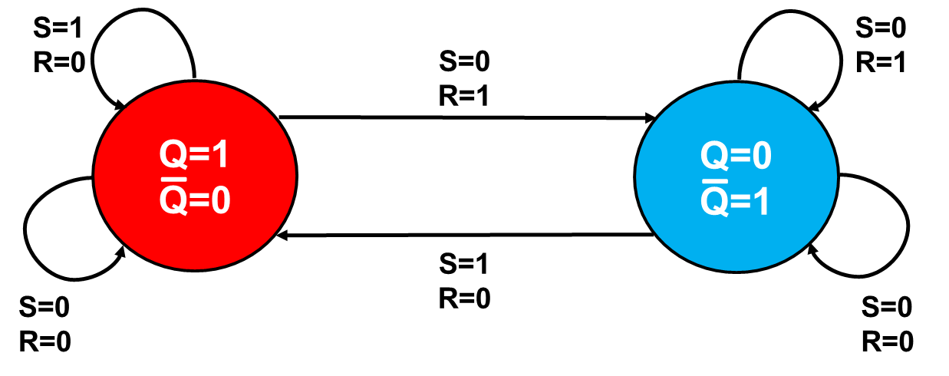
SR-Type Latch
The operation of the SR-Type Latch can be modeled through a State Diagram (Finite State Machine – FSM)

Slide 15
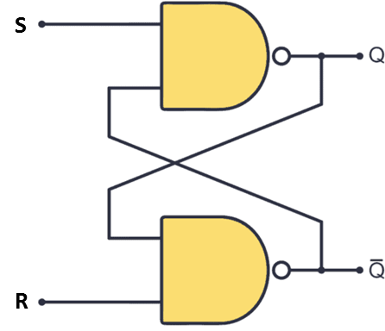
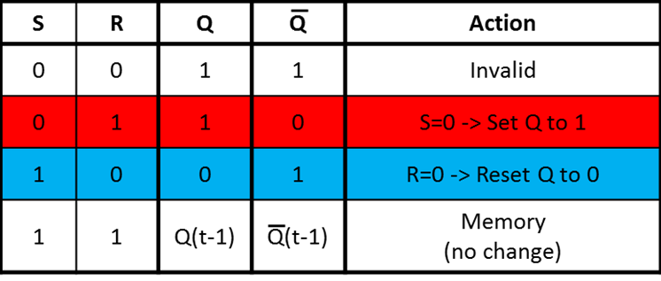
SR-Type Latch | NAND implementation
If we use NAND gates instead of NOR gates, we can implement a similar SR-type latch, but with complemented logic.

Slide 16

SR-Type Latch | NAND implementation
State Diagram (Finite State Machine – FSM) of the NAND SR-type latch

Slide 17
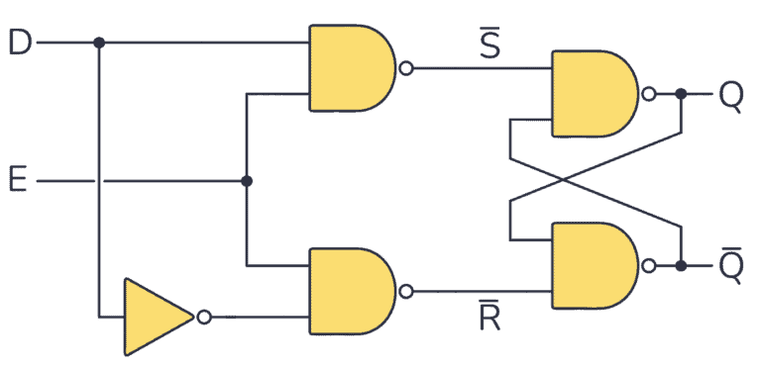
D-Type Latch
E | D | Q(t)
0 | 0 | Q(t-1)
0 | 1 | Q(t-1)
1 | 0 | 0
1 | 1 | 1

Slide 18
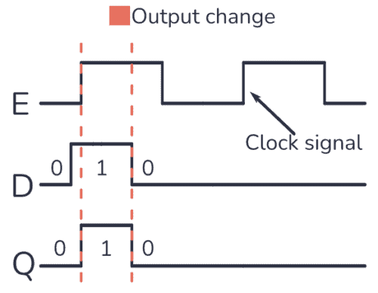
D-Type Latch
The output of a D-Latch can change at any time, while its Enable pin is 1. If a clock signal IS APPLIED to the D-Latch, the Q output could also change during the time the positive pulse lasts.

Slide 19
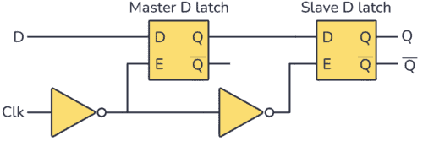
Master-Slave D-Type Flip-Flop
Flip-flops are synchronous circuits with a clock signal (Clk) connected to the enable (E) input.
The Master-Slave D-Type Flip-Flop is an edge-triggered circuit that combines two D-Type latches to store one bit of information.
The D-Type Flip-Flop only stores a new value from the D input when the clock goes from 0 to 1 (rising edge) or 1 to 0 (falling edge).

Slide 20
The clock
The clock signal is a periodic waveform, in which each pulse (named “tick”) occurs at a fixed period T.
T = Clock period
Unit = s
f = Clock frequency ( = 1/T )
Unit = s^{–1} = Hz (cycle/s)
t
T
Notes:
Fondamenti di Informatica
cap. VI

Slide 21
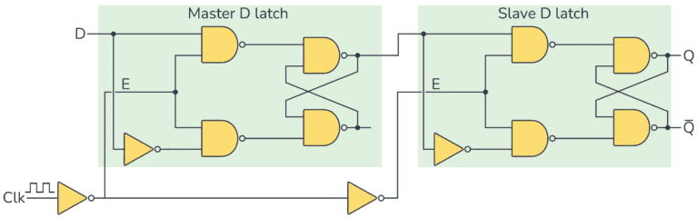
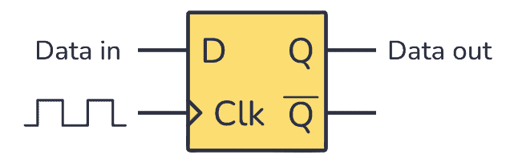
Master-Slave D-Type Flip-Flop

Slide 22
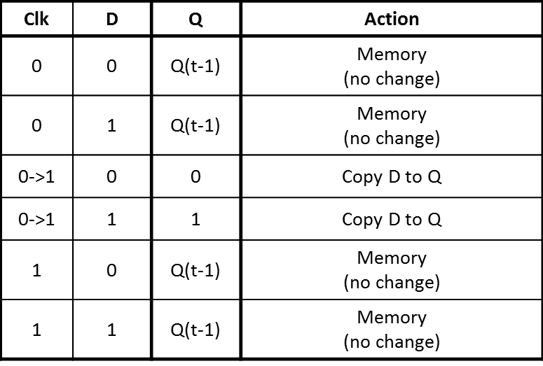
Master-Slave D-Type Flip-Flop

Slide 23
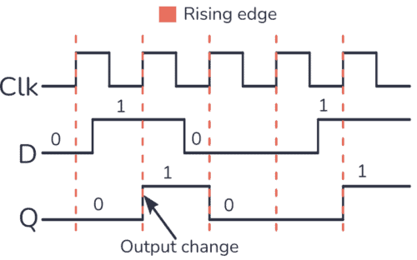
Master-Slave D-Type Flip-Flop
The output Q changes to the value taken by the D input only when the clock goes from 0 to 1.

Slide 24
Registers
A flip-flop can store just one bit of digital data, a 1 or 0.
In order to store multiple bits of data, multiple flip-flops need to be connected.
A multi-bit storage structure is called “register”.
Different kinds of registers can be implemented depending on the topology of the connected flip-flops:
Parallel in – parallel out register.
Serial in – serial out register.
Serial in – parallel out register.
Parallel in – serial out register.
Ring counter.
Up and down counter.

Slide 25
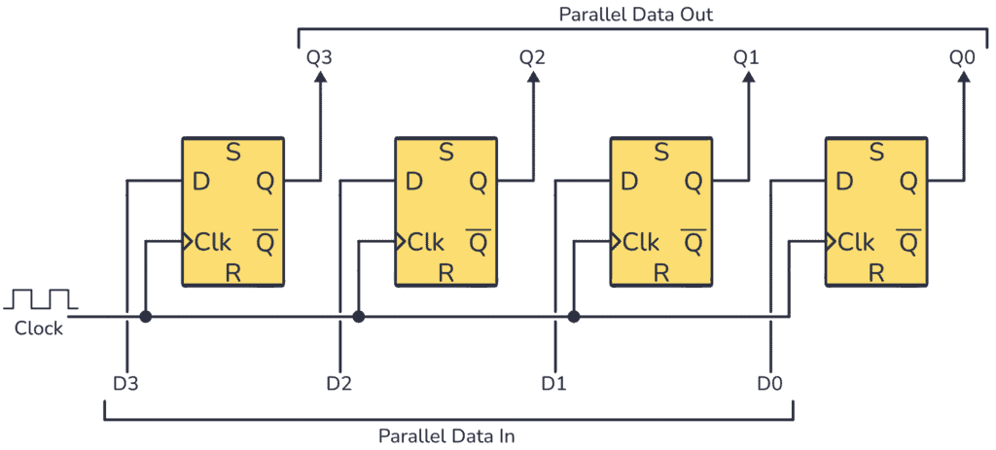
Parallel in – Parallel out Register

Slide 26
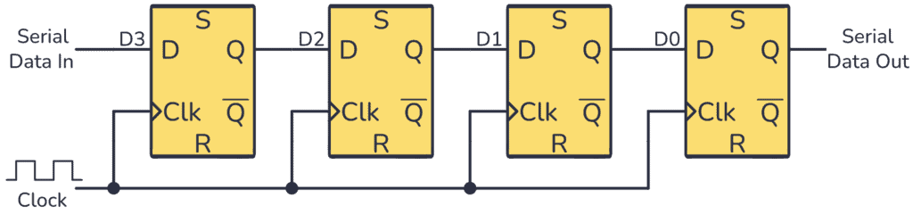
Serial in – Serial out Register

Slide 27
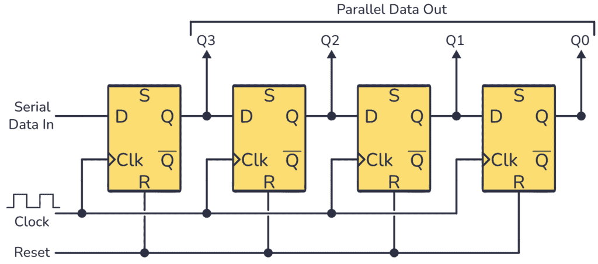
Serial in – Parallel out Register

Slide 28
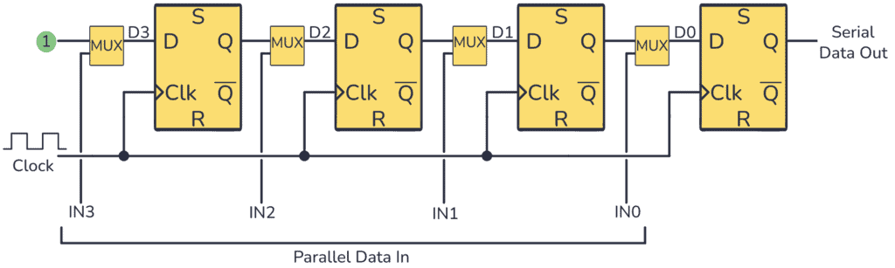
Parallel in – Serial out Register

Slide 29
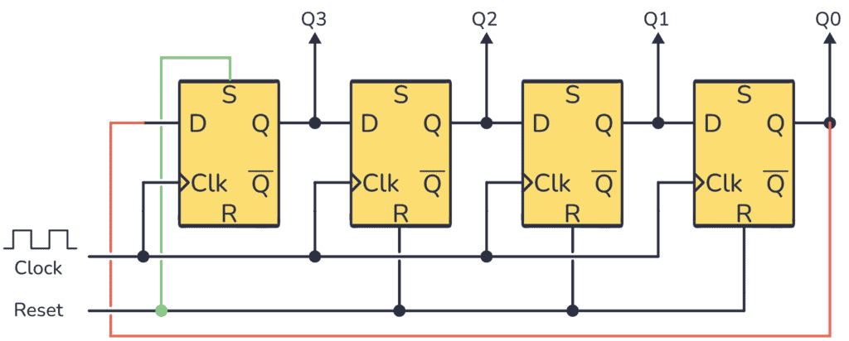
Ring Counter

Slide 30
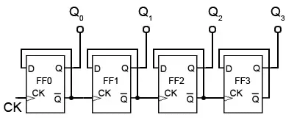
Up Counter

Slide 31
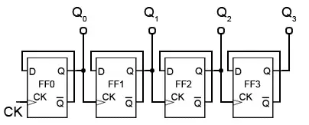
Down Counter

Slide 32
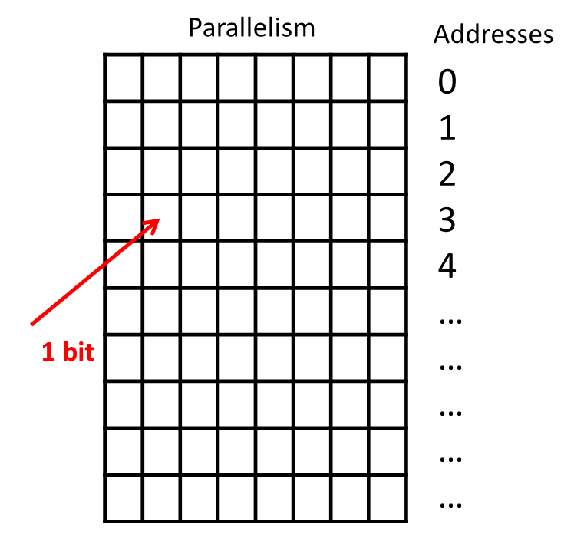
Memory
A memory is a circuit that can store several bits.
It is organized in rows and columns (array).
Each row can store m bits.
Each row is characterized by a unique “address”, i.e., a binary number that identifies it.
If a memory has addresses of n bits, it has a total of 2^{n} rows.
The total size of the memory is then:
M = m * 2^{n} bits
2^{n}
rows
m bits

Slide 33
Memory
In principle, a memory can be built by connecting several flip-flops with a rows and columns configuration.
Example: 2²x3 memory.
More efficient ways for building memories do exist.

Slide 34
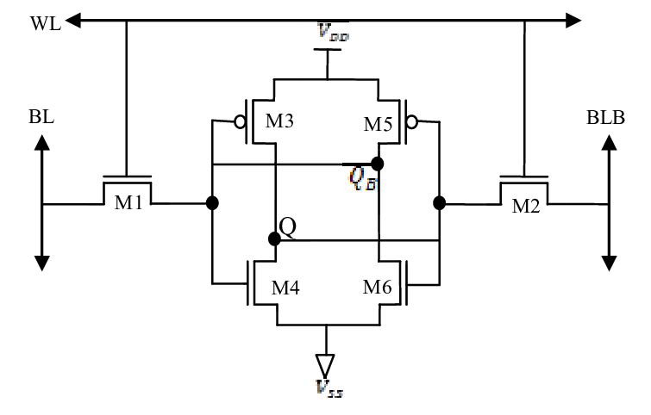
Static RAM
Static RAM
Volatile memory.
Complex schematic (6 transistors).
Fast access, but not very dense.
Keeps stored value until the circuit is powered up.
Example:
1-bit. 6T SRAM Cell.

Slide 35
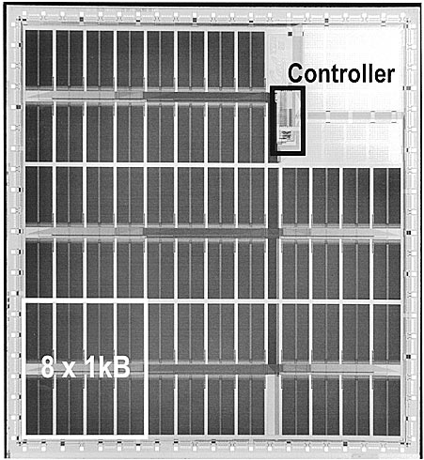
Static RAM
64 Kbit SRAM Chip.

Slide 36
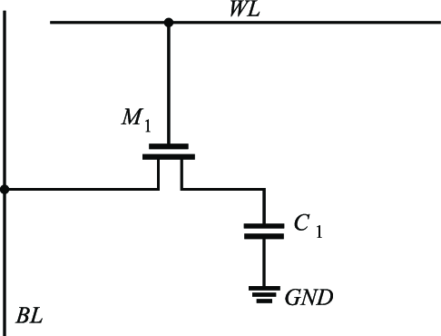
Dynamic RAM
Dynamic RAM
Volatile memory.
Simple schematic (2 transistors).
Slow access, but very dense.
Stored value requires periodic refresh.
Example:
1-bit. 2T DRAM Cell.

Slide 37
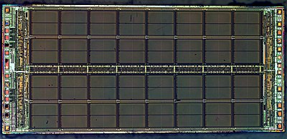
Dynamic RAM
1 Mbit DRAM Chip.

Slide 38
FLASH Memories
Each bit in a FLASH memory is made up of a single transistor, but these transistors have a special oxide layer called a floating gate.
FLASH memories are non-volatile, that is, stored data are retained when the circuit is turned off.
FLASH memories are fast and cheap (low cost per bit), but when a FLASH bit is erased, a large voltage (~ 20 V) is required to remove the electrons from the floating gate. This causes a small amount of breakdown in the oxide layer and over many write cycles, this will destroy the bit.
Transistors can be expected to survive as many as 100,000 erase cycles, which is not a problem for removable storage (such as a USB stick), but it is unacceptable for use in DRAM.

Slide 39
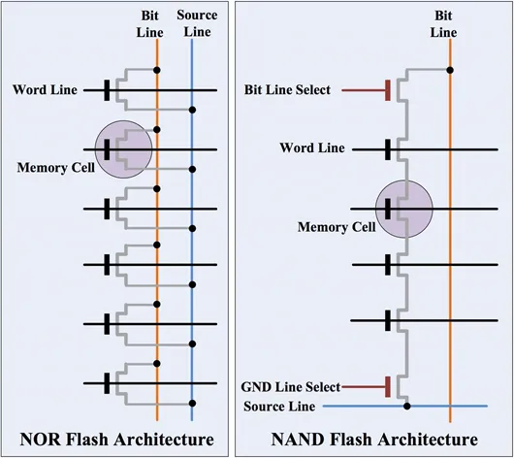
FLASH Memories
Two kinds of FLASH memories:
NAND-based.
More compact -> higher density.
NOR-based.
Faster access.

Slide 40
Table of Contents
01.
Introduction to Sequential Circuits
Circuits for Data Storage:
Latches, Flip-Flops, Registers, Memories
02.
03.
Synchronous Circuits

Slide 41
Synchronous Circuits
In digital electronics, a synchronous circuit is a digital circuit in which the changes in the state of the memory elements are synchronized by a clock signal.
Synchronous circuits can be sequential and combinational.

Slide 42
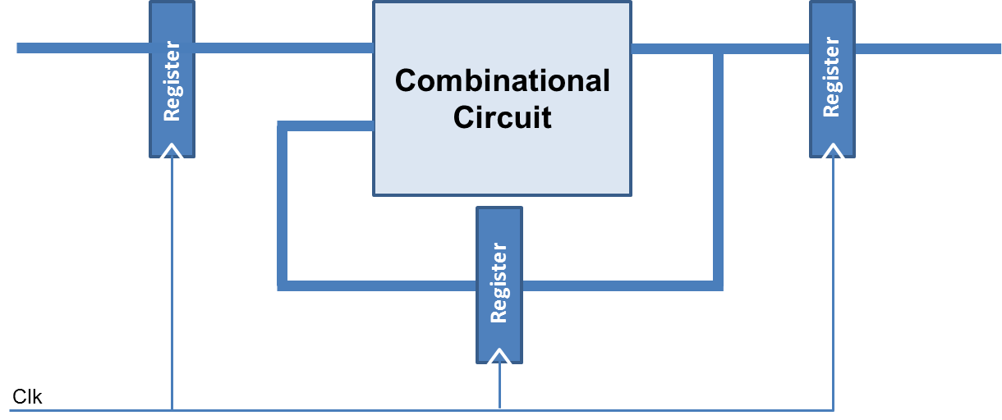
Synchronous Sequential Circuits

Slide 43
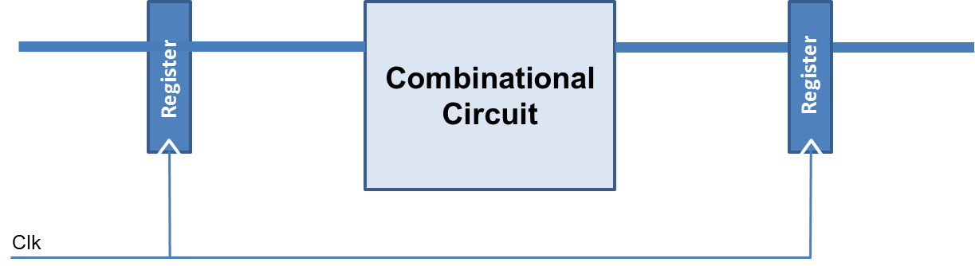
Synchronous Combinational Circuits

Slide 44
Synchronous Combinational Circuits
For sequential circuits, synchronous memory elements (e.g., flip-flops, registers) are necessary to implement the required functionality.
In combinational circuits the introduction of synchronous memory elements is normally done for optimization purposes.
Examples:
Timing optimization (pipelining).
Glitch power minimization (stop glitch propagation).

Slide 45
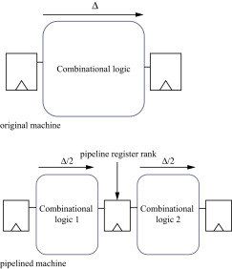
Timing Optimization by Pipelining
Insertion of pipeline registers helps in reducing the delay of the combinational logic, thus enabling performance improvement by clock cycle reduction.

Slide 46
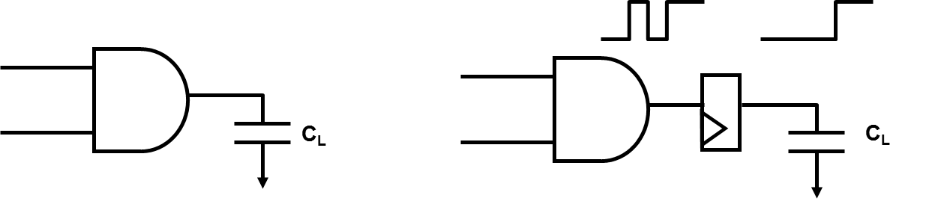
Glitch Power Minimization
Flip-flop outputs can make at most one transition per clock cycle.
This can be used to reduce the amount of glitching, and therefore, the amount of dynamic power consumption.

Slide 47







Authorship & License
Authors
License
Christian Conti christian.conti@polito.it
Gianvito Urgese gianvito.urgese@polito.it
Daniele Jahier Pagliari daniele.jahier@polito.it
Enrico Macii enrico.macii@polito.it
Cristiana Bolchini cristiana.bolchini@polimi.it
Fabrizio Ferrandi fabrizio.ferrandi@polimi.it
These slides are distributed under the Creative Commons license "Attribution - Non commercial - Share alike 2.5 Italy (CC BY-NC-SA 2.5)"
You are free to:
to reproduce, distribute, communicate to the public, exhibit in public, represent, perform and recite this work
to modify this work
Under the following conditions:
Attribution - You must attribute authorship of the work to the original authors and in a way that does not suggest that they endorse you or the way you use the work.
Non-commercial - You may not use this work for commercial purposes.
Share Alike - If you alter or transform this work, or if you use it to create another, you may distribute the resulting work only under an identical or equivalent license to this one.
http://creativecommons.org/licenses/by-nc-sa/2.5/

