Slide 1
Lecture 5 System-on-Chip (SoC) Design

Slide 2
Table of Contents
01.
System-on-Chip (SoC)
02.
SoC Building Blocks
03.
SoC Design

Slide 3
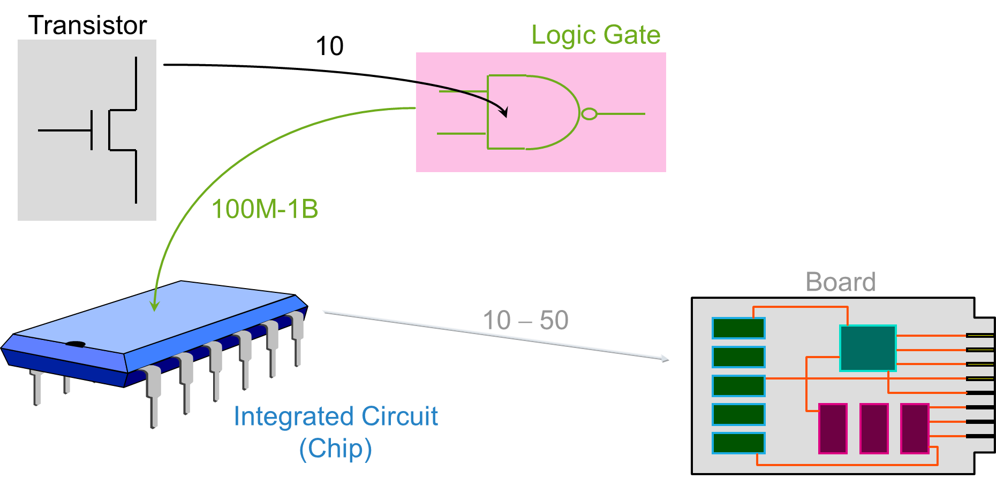
From Transistors to Boards

Slide 4
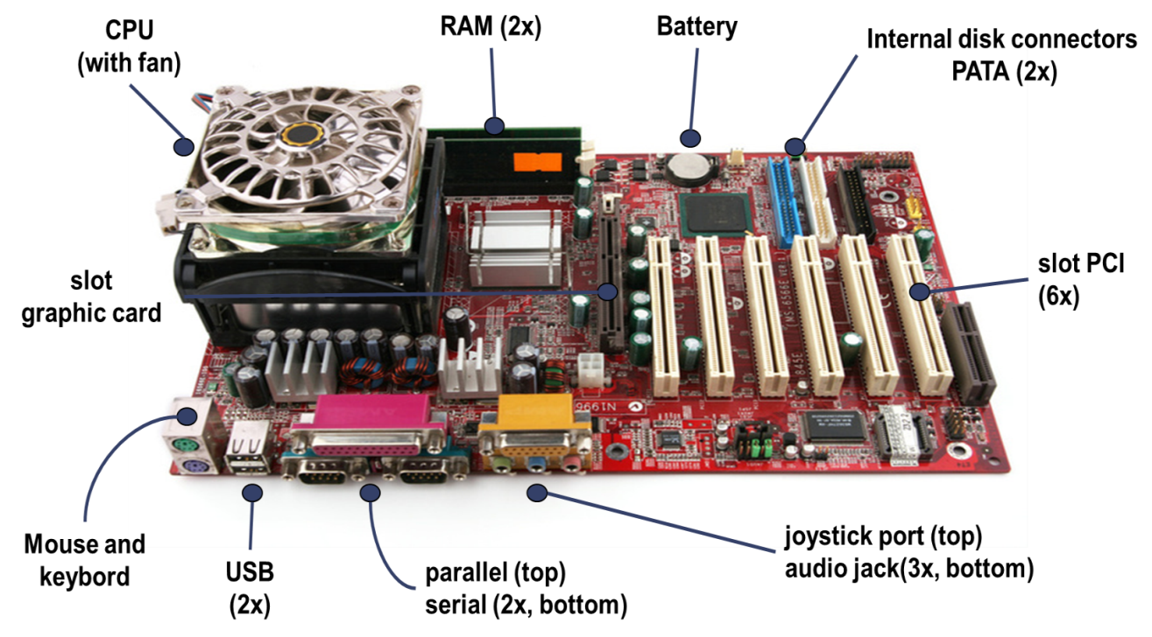
The “Motherboard” of a PC
Historically, computer components were mounted on the “motherboard” as separated chips.

Slide 5
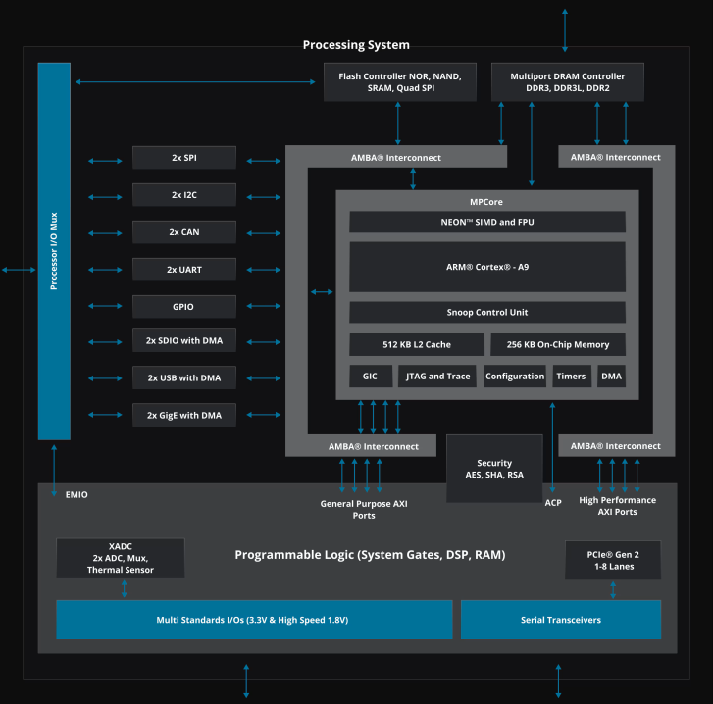
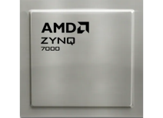
From Boards to SoCs
With the advent of advanced miniaturization capabilities, most of the functionalities of a computer can be implemented through a single chip: System-on-a-Chip (SoC).

Slide 6
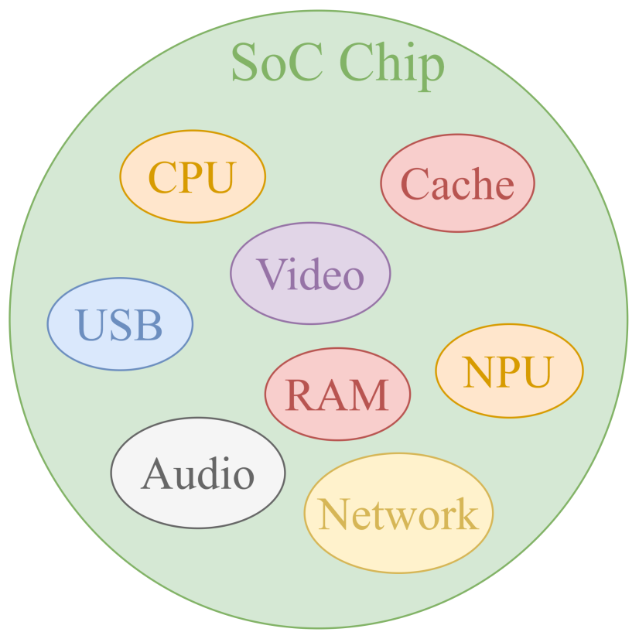
SoC Design For Optimal Results
A System-on-Chip includes different units with specific tasks:
Process information (CPU – Central Processing Unit).
Store information (Cache and RAM memory).
Transport information (Interconnects, i.e., Buses).
Each unit is designed following different methodologies to obtain the best performance when combined.

Slide 7
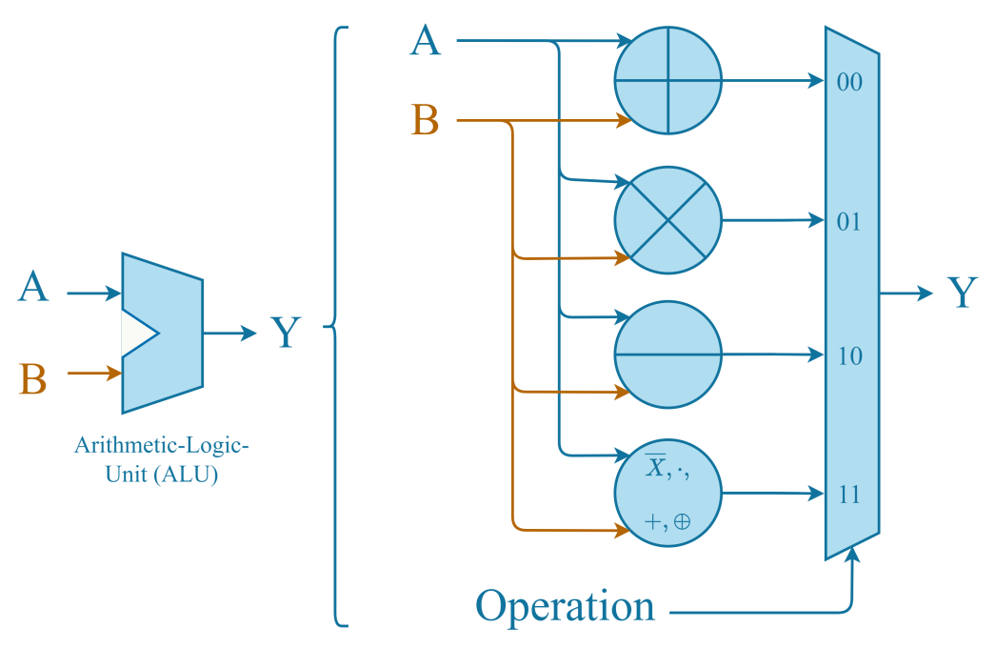
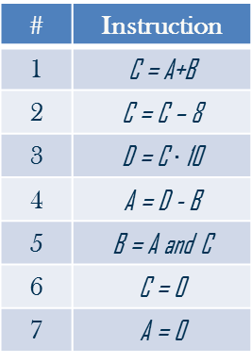
SoC Design: CPU
The processing unit of an SoC performs simple arithmetic and Boolean operations, sequentially, one after another.
# | Instruction
1 | C = A+B
2 | C = C – 8
3 | D = C $∙$ 10
4 | A = D - B
5 | B = A and C
6 | C = 0
7 | A = 0

Slide 8
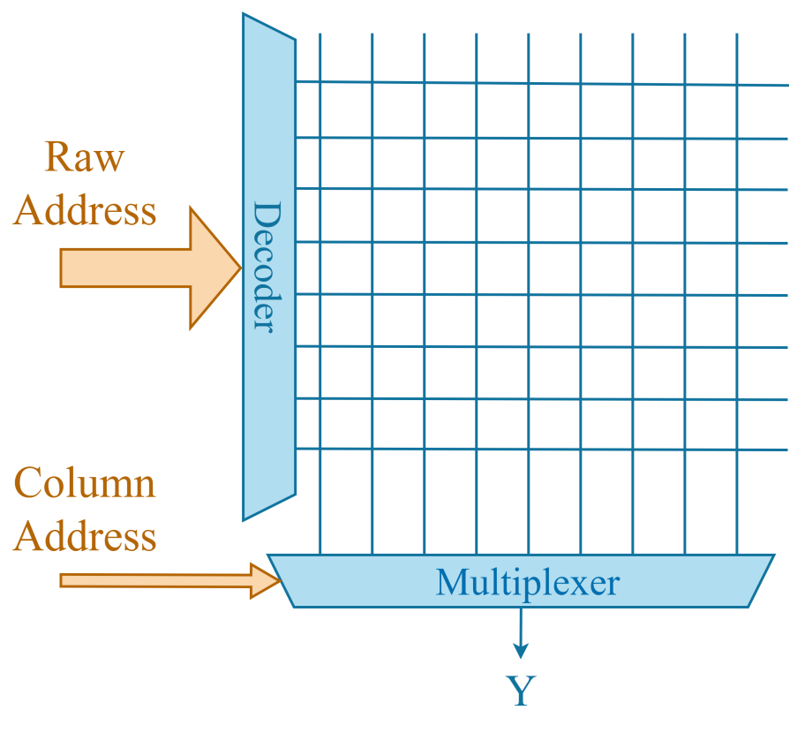
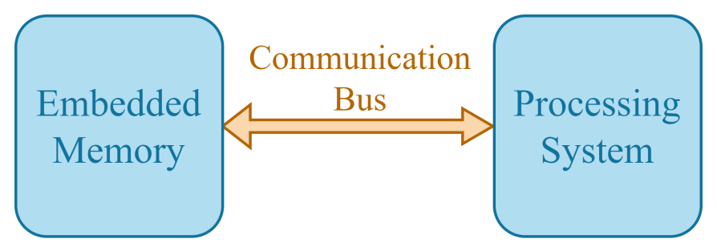
SoC Design: Memory
The information to be processed is stored in the internal memory system, which consists of different kinds of memories:
RAM.
Caches.
CPU
Memory System

Slide 9
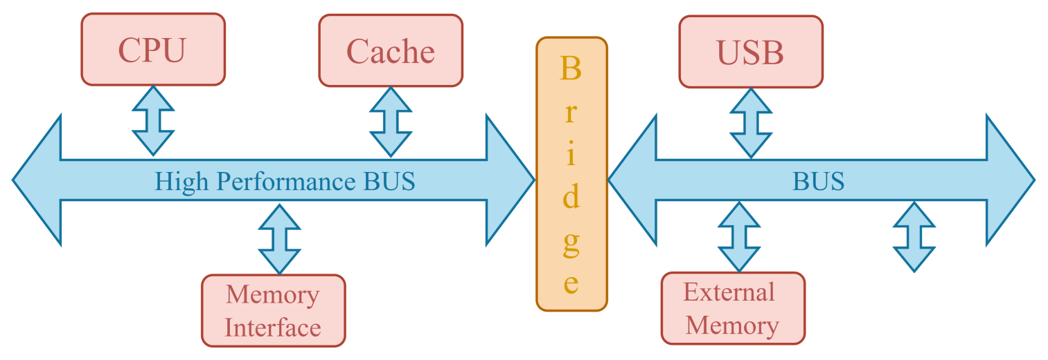
SoC Design: Interconnections
Since data are processed and stored in different places, information must be moved rapidly; hence, a specific architecture for interconnections (called BUS) is designed.
Cache
USB
RAM
External Memory

Slide 10
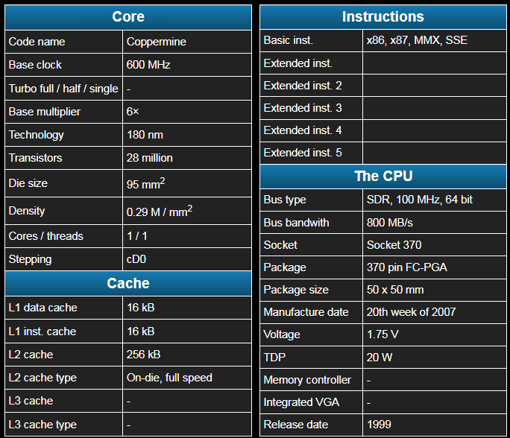
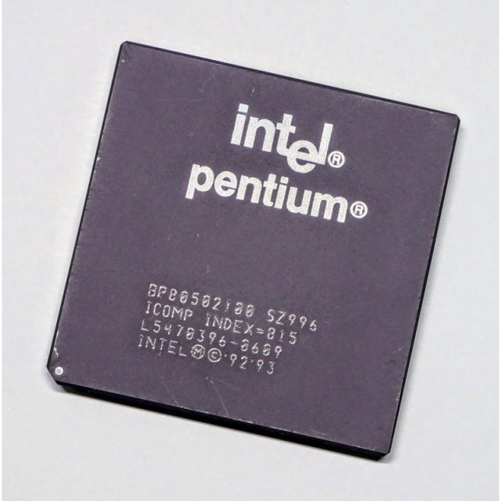
A Real SoC: Intel Pentium III

Slide 11
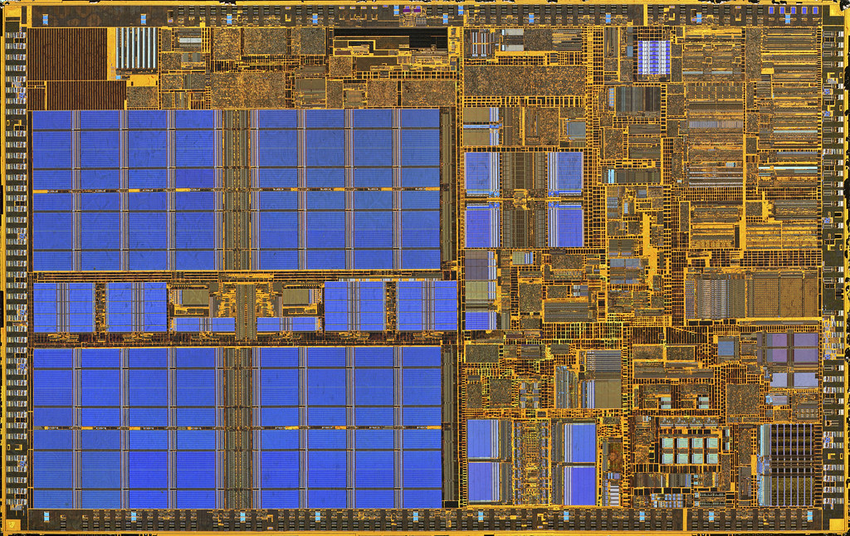
A Real SoC: Intel Pentium III

Slide 12
A Real SoC: Intel Pentium III
On-chip memory

Slide 13
A Real SoC: Intel Pentium III
On-chip memory
Data processing

Slide 14
The Largest SoCs Ever Built (as of 2025)
SoC Model | Manufacturer | Number of Transistors | Performance
Wafer Scale Engine 3 | Cerebras | 4.0 trillion | 125 PetaFLOPS
Wafer Scale Engine 2 | Cerebras | 2.6 trillion | 7.5 PetaFLOPS
Nvidia B100 | Nvidia | 208 billion | 20 PetaFLOPS
Apple M3 Ultra | Apple | 184 billion | 28 TeraFLOPS
Apple M2 Ultra | Apple | 134 billion | 18 TeraFLOPS
Apple M1 Ultra | Apple | 114 billion | 15 TeraFLOPS
Apple M3 Max | Apple | 92 billion | 14 TeraFLOPS
Nvidia GH100 | Nvidia | 80 billion | 3 PetaFLOPS
Apple M3 Pro | Apple | 37 billion | 7 TeraFLOPS
Apple M3 | Apple | 25 billion | 3.5 TeraFLOPS

Slide 15
The Wafer Scale Engine 3 SoC
The Wafer Scale Engine 3 (WSE-3) by Cerebras is a groundbreaking chip designed specifically for artificial intelligence (AI) and high-performance computing (HPC) workloads. Here are some key features:
Transistors: It contains an astonishing 4.0 trillion transistors.
Cores: The chip boasts 900,000 AI-optimized cores.
Memory: It includes 44 GB of on-chip SRAM memory.
Power Consumption: The chip consumes around 15 kW of power.
Performance: 125 petaflops.
The WSE-3 is unique because it uses an entire 5nm wafer to create a single, massive chip, bypassing the traditional reticle limits of chip manufacturing. This design allows for unprecedented computational power and efficiency, making it ideal for large-scale AI model training and other demanding computational tasks.

Slide 16
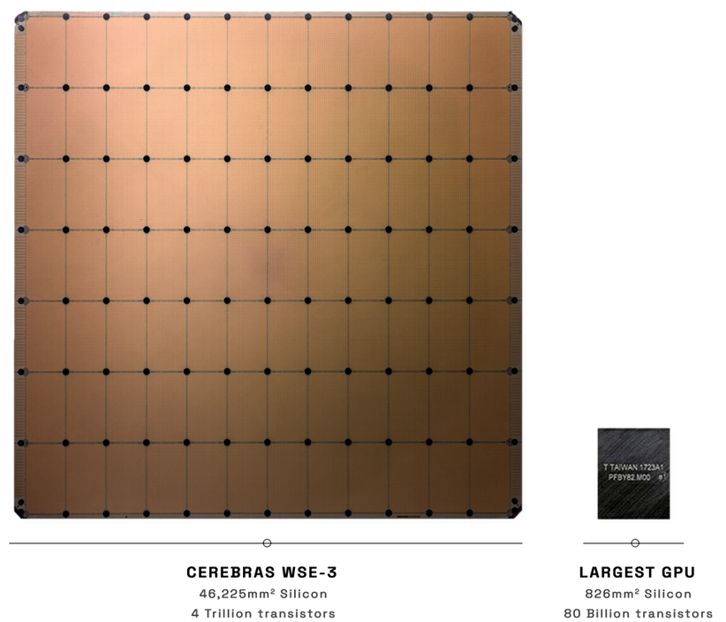
The Wafer Scale Engine 3 SoC

Slide 17
Table of Contents
01.
System-on-Chip (SoC)
02.
SoC Building Blocks
03.
SoC Design

Slide 18
SoC Components
SoC’s components can be divided into three main categories:

Slide 19
SoC Components
SoC’s components can be divided into three main categories:
CPU cores.

Slide 20
SoC Components
SoC’s components can be divided into three main categories:
CPU cores.
Memory devices.

Slide 21
SoC Components
SoC’s components can be divided into three main categories:
CPU cores.
Memory devices.
Peripherals.

Slide 22
SoC Components
SoC’s components can be divided into three main categories:
CPU cores.

Slide 23
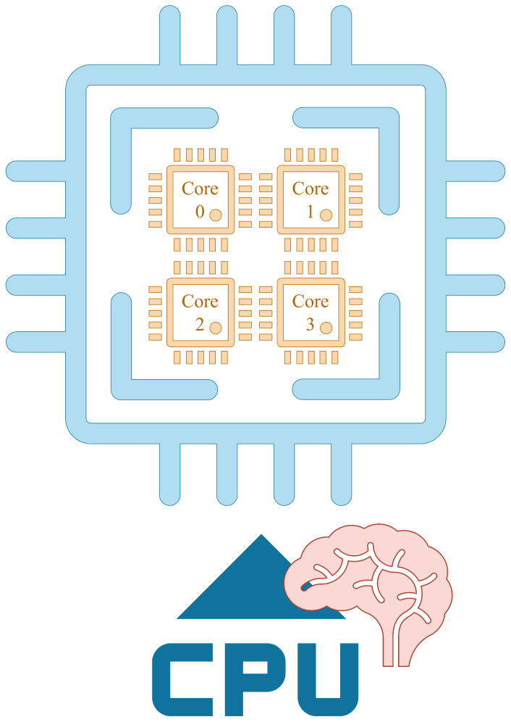
SoC Components: CPU & Cores
The Central Processing Unit (CPU) is the “brain” of the entire system.
The CPU is the control center of the SoC.
Modern SoCs have multi-core CPUs made of several single units able to split the execution of a task.
Each core contributes to the task by speeding up the computation.

Slide 24
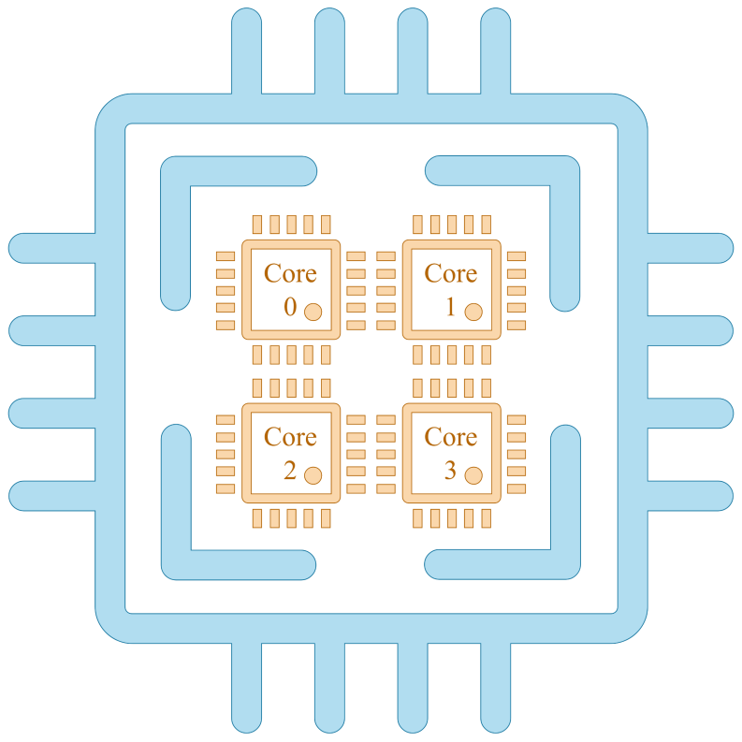
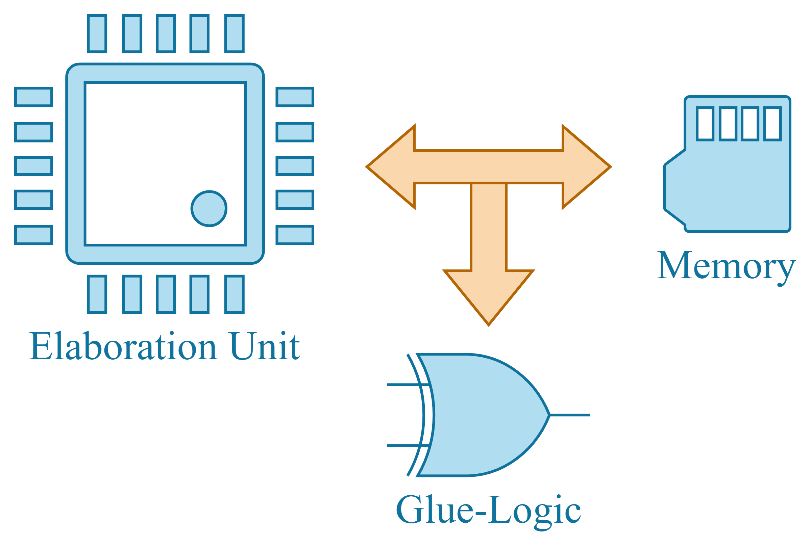
Inside a CPU Core
A CPU Core is composed of various logic circuits, optimized to perform fast operations:
Arithmetic-Logic-Unit (ALU) to perform computations.
Registers and fast-access memories to store temporary data.
Comparators.
Multiplexers.
Glue-Logic.
…

Slide 25
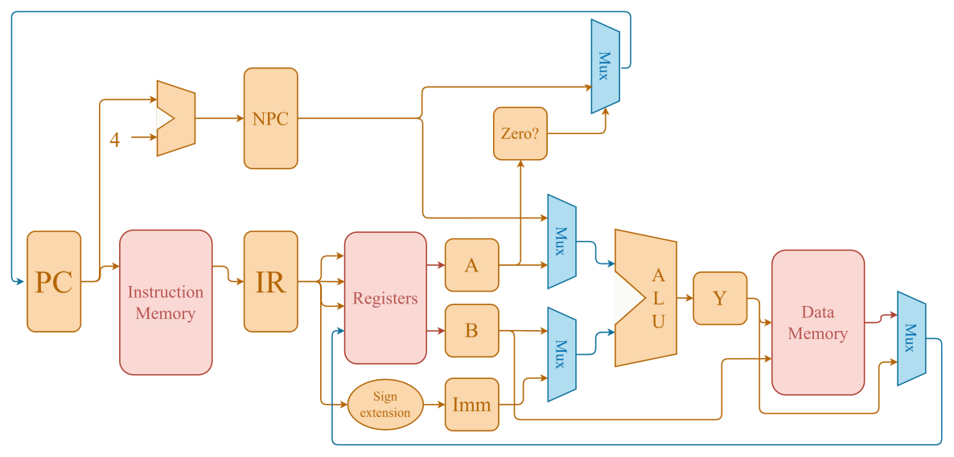
Inside a CPU Core
A CPU Core is composed of various logic circuits, optimized to perform fast operations:
Arithmetic-Logic-Unit (ALU) to perform computations.
Registers and fast-access memories to store temporary data.
Comparators.
Multiplexers.
Glue-Logic.
…

Slide 26
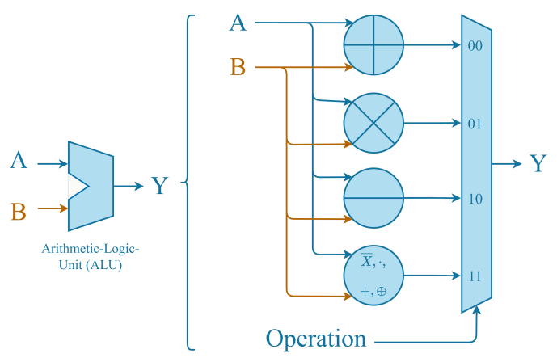
Inside a CPU Core
A CPU Core is composed of various logic circuits, optimized to perform fast operations:
Arithmetic-Logic-Unit (ALU) to perform computations.
Registers and fast-access memories to store temporary data.
Comparators.
Multiplexers.
Glue-Logic.
…

Slide 27
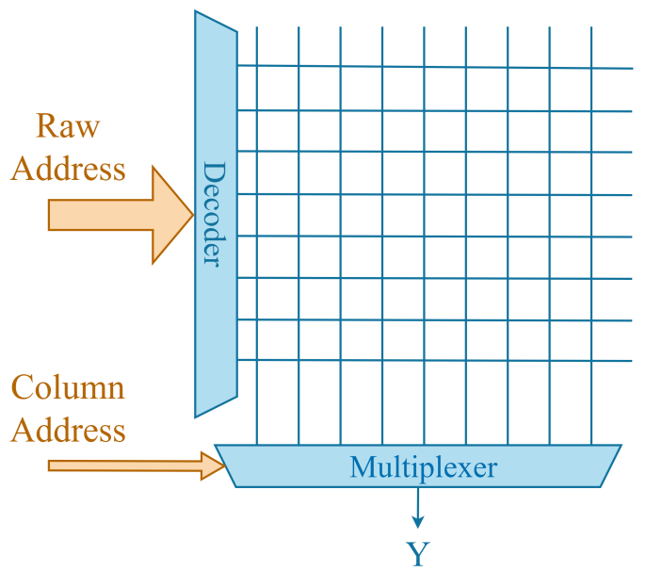
Inside a CPU Core
A CPU Core is composed of various logic circuits, optimized to perform fast operations:
Arithmetic-Logic-Unit (ALU) to perform computations.
Registers and fast-access memories to store temporary data.
Comparators.
Multiplexers.
Glue-Logic.
…

Slide 28
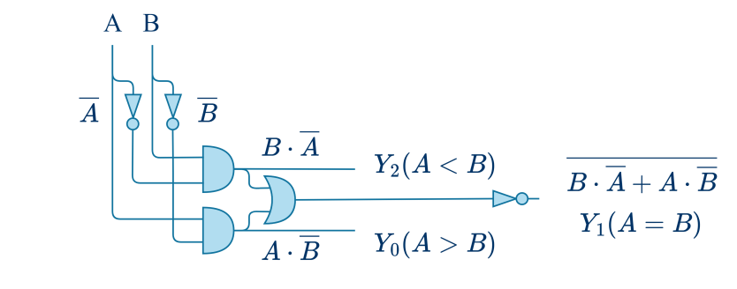
Inside a CPU Core
A CPU Core is composed of various logic circuits, optimized to perform fast operations:
Arithmetic-Logic-Unit (ALU) to perform computations.
Registers and fast-access memories to store temporary data.
Comparators.
Multiplexers.
Glue-Logic.
…

Slide 29
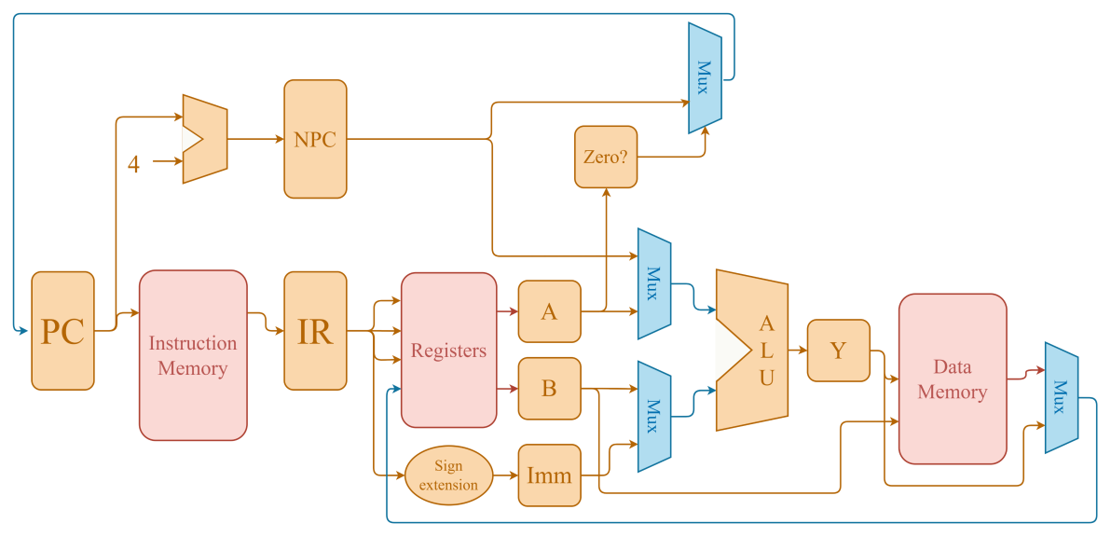
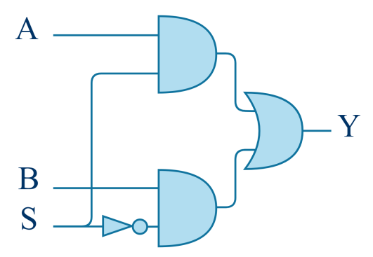
Inside a CPU Core
A CPU Core is composed of various logic circuits, optimized to perform fast operations:
Arithmetic-Logic-Unit (ALU) to perform computations.
Registers and fast-access memories to store temporary data.
Comparators.
Multiplexers.
Glue-Logic.
…

Slide 30
SoC Components
SoC’s components can be divided into three main categories:
Memory devices.

Slide 31
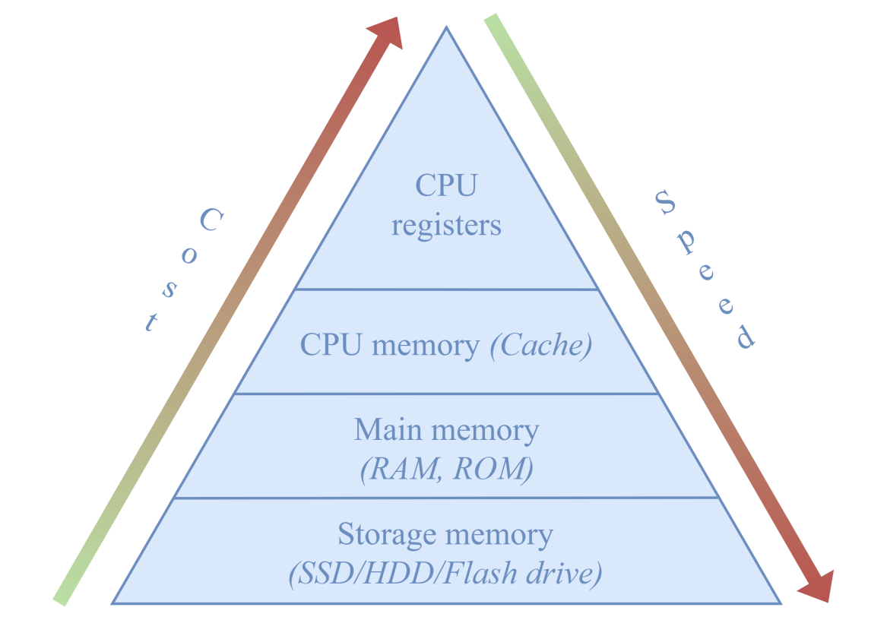
SoC Components: Memory Hierarchy
Different storage systems where data is kept so the CPU can access it when needed.
Different memories have different capacities, different speeds, and different cost.
Modern SoCs embed inside the CPU the cache and the main memory close to it.

Slide 32

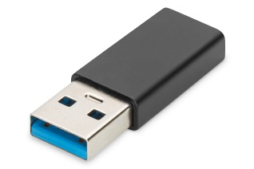
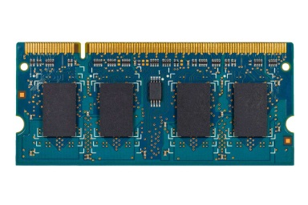

Memory: From Storage To Registers
Apps, images, videos, … are stored into the storage memory.
Then, they are loaded into the Random Access Memory (RAM) of the device.
From the RAM, the CPU can easily access the information to process.
Cloud
Storage Memory
Random Access Memory (RAM)

Slide 33
Memory: From Storage To Registers
When the CPU accesses information from the RAM, data are copied into the cache memory.
The cache memory is a small, high-speed memory inside the CPU.
Cloud
Storage Memory
Random Access Memory (RAM)
Cache Memory

Slide 34
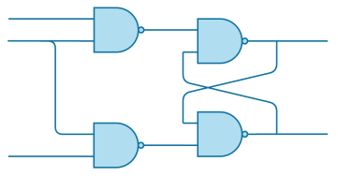
Memory: From Storage To Register
From the cache, data are moved to registers inside the CPU.
Registers are the smallest and fastest storage locations in an electronic system.
Registers
Cloud
Storage Memory
Random Access Memory (RAM)
Cache Memory

Slide 35
SoC Components
SoC’s components can be divided into three main categories:
Peripherals.

Slide 36
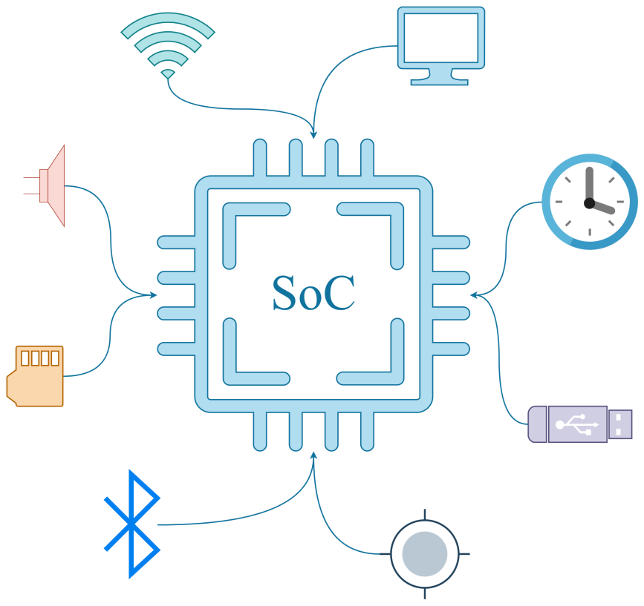
SoC Components: Peripherals
The CPU oversees the decision-making process and the data elaboration as the brain of the system.
Other units (called “peripherals”) manage complementary tasks, Bluetooth connection, audio encoding, image processing, position tracking, …
Such units are connected to the SoC through high performance buses.

Slide 37
SoC Components: Peripherals
Peripherals are components that provide specialized functions and capabilities.
They are essential for connection and interaction with external devices:
Input & Output Interfaces | Communication Interfaces
Memory Interfaces | Peripheral Controllers
Security Modules | Power Management

Slide 38
Table of Contents
01.
System-on-Chip (SoC)
02.
SoC Building Blocks
03.
SoC Design

Slide 39
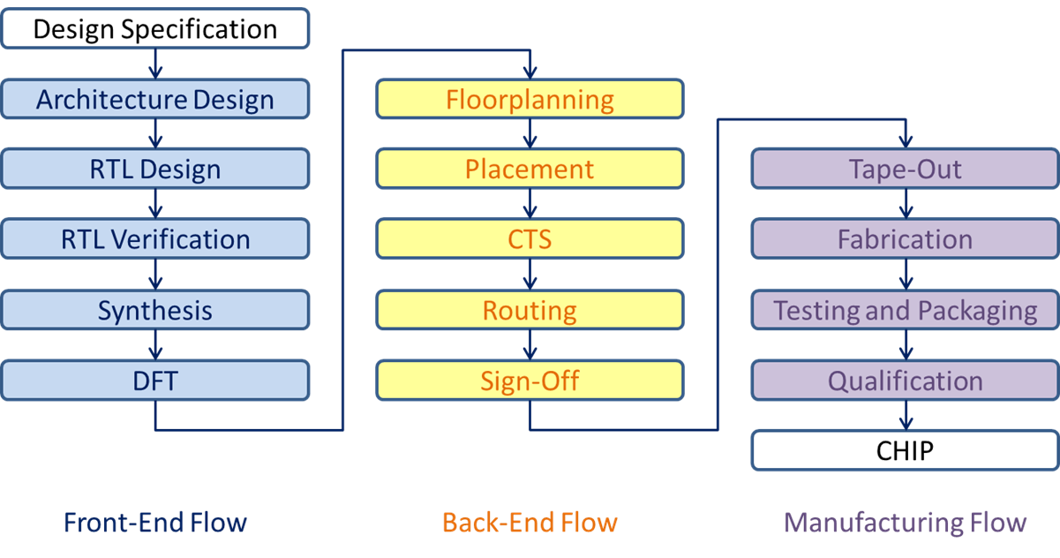
Design Flow
In this course, we focus our attention to the Front-End Flow (DfT excluded).

Slide 40
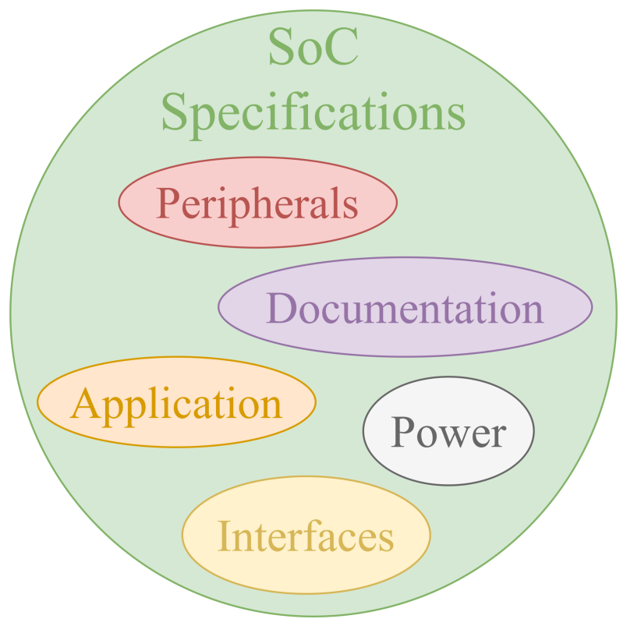
Design Flow: SoC Specification
Requirements and specifications of the SoC include:
Functionality.
Performance.
Power consumption.
Interface standards.
At this stage, only a general idea of the project and its tasks is defined…

Slide 41
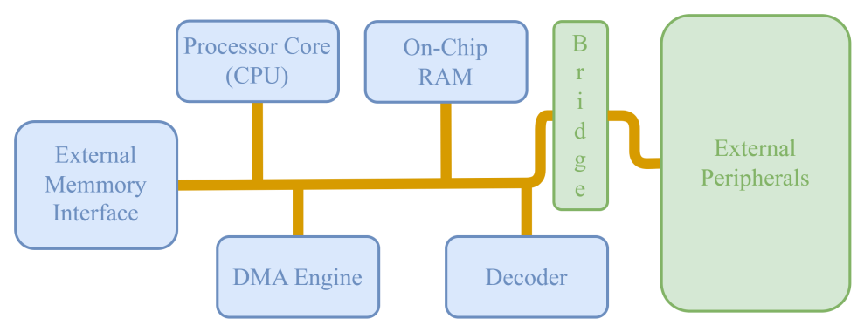
Design Flow: SoC Architecture
A high-level architecture of the components inside the SoC is defined and their characteristics are chosen:
CPU.
Memories.
Interconnections.
Peripherals.
At this stage, the characteristics of the system are well-defined, but the architecture is only an abstract project.

Slide 42
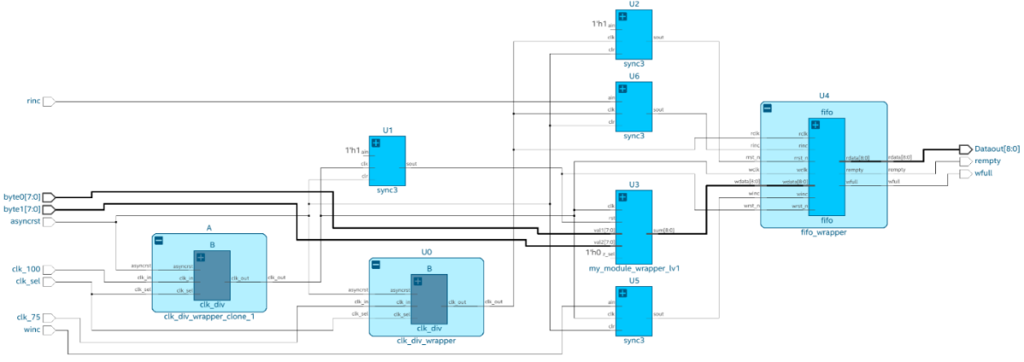
Design Flow: RTL Design
With Register-Transfer-Level (RTL) design, the architecture is translated into circuits featuring the interconnection of a mix of macro-blocks (e.g., adders, multipliers, multiplexers, comparators, registers, etc.) and logic gates.
Normally, an RTL design is described through a Hardware Description Languages (HDLs).
HDLs are like programming languages, but they are utilized to describe the hardware.

Slide 43

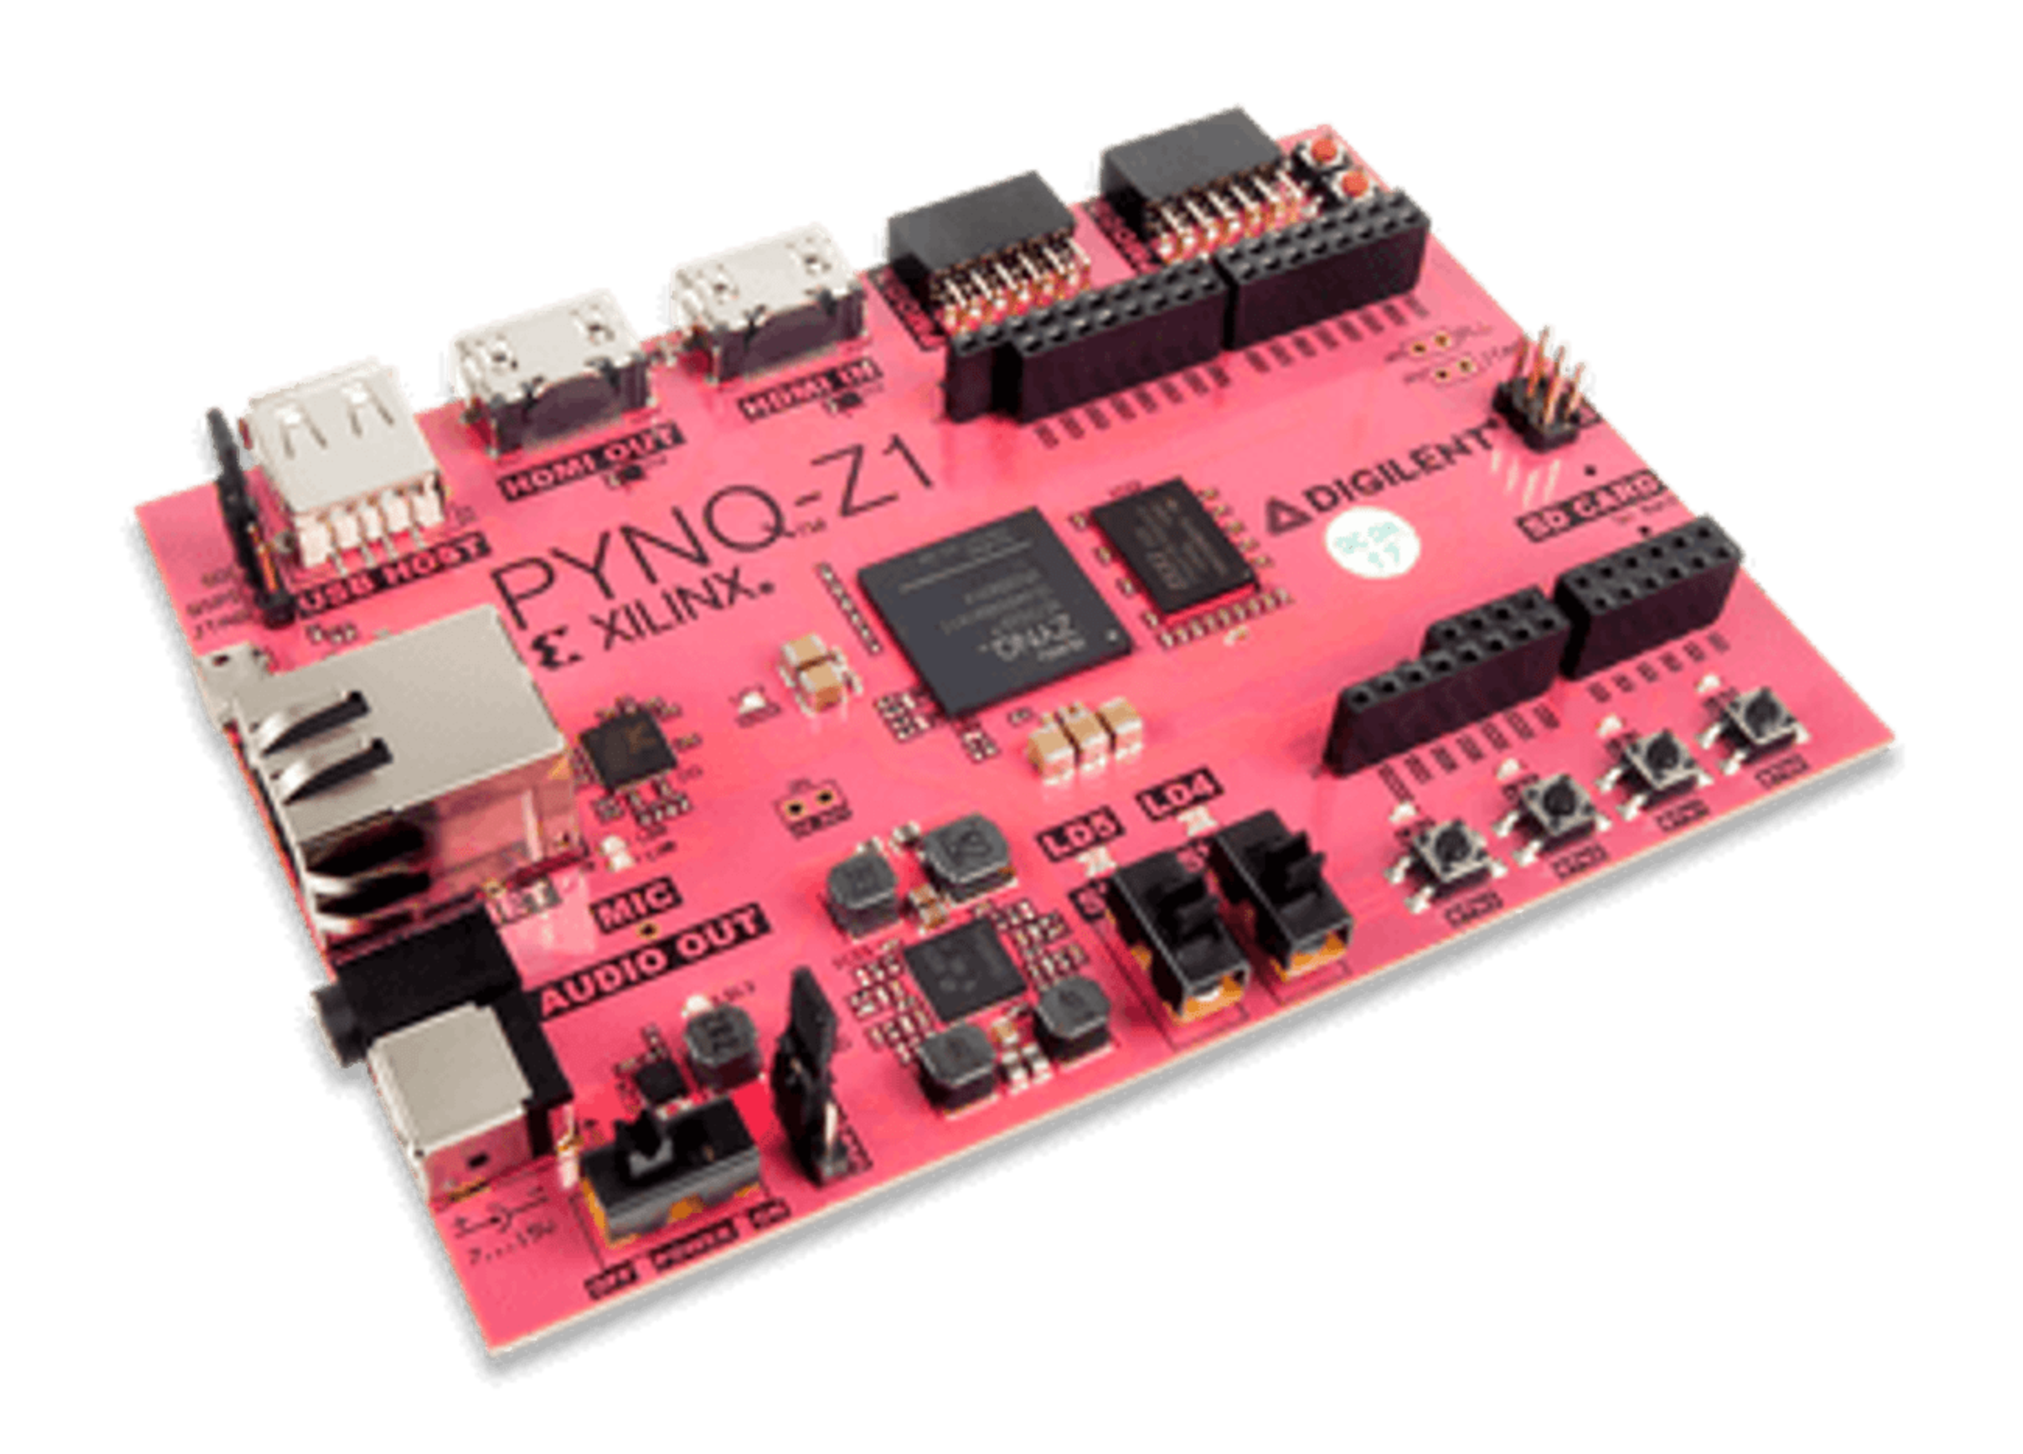
Design Flow: RTL Verification
Before going forward in the design process, the functionality of the RTL description is verified. To make sure that the behavior of the initial specification is met.
The verification is performed using EDA simulation tools to check the functionality with various test cases.
RTL verification can be also performed on a specific hardware called Field-Programmable-Gate-Array (FPGA).
FPGAs are components that can to be configured according to the design specification in order to perform more advanced tests.

Slide 44
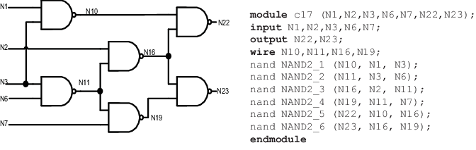
Design Flow: Synthesis
The verified RTL description is synthesized to obtain a gate-level netlist using automatic synthesis tools.
After setting the optimization constraints and objectives, the gate-level netlist of each RTL macro-block is obtained by a push-button process. As for RTL design, the description is represented by an HDL (e.g., Verilog, VHDL).

Slide 45







Authorship & License
Authors
License
Christian Conti christian.conti@polito.it
Gianvito Urgese gianvito.urgese@polito.it
Daniele Jahier Pagliari daniele.jahier@polito.it
Enrico Macii enrico.macii@polito.it
Cristiana Bolchini cristiana.bolchini@polimi.it
Fabrizio Ferrandi fabrizio.ferrandi@polimi.it
These slides are distributed under the Creative Commons license "Attribution - Non commercial - Share alike 2.5 Italy (CC BY-NC-SA 2.5)"
You are free to:
to reproduce, distribute, communicate to the public, exhibit in public, represent, perform and recite this work
to modify this work
Under the following conditions:
Attribution - You must attribute authorship of the work to the original authors and in a way that does not suggest that they endorse you or the way you use the work.
Non-commercial - You may not use this work for commercial purposes.
Share Alike - If you alter or transform this work, or if you use it to create another, you may distribute the resulting work only under an identical or equivalent license to this one.
http://creativecommons.org/licenses/by-nc-sa/2.5/

