Slide 1
Unit 20 – Client Side Customisation of Webpages
Task 2 - PRESENTATION

Slide 2
Part 1
The first part of this presentation will contain explanations of how JavaScript works as well as some examples of JavaScript

Slide 3
Characteristics of JavaScript
Object Oriented – JavaScript can be described as a object-oriented program. This is because JavaScript uses classes which is a feature of OOP. The class will act as a template which objects can be created from.
Event Driven – JavaScript can also be described as event driven. This is because different events can occur through the use of button clicks or key presses.

Slide 4
How it can be implemented in webpages
One way in which JavaScript can be implemented is externally. Like CSS, a separate file is created and then linked to the HTML page the JavaScript will be placed on. The advantage of this is that it keeps code separate. This will help with error checking because if there is a problem with a certain type of JavaScript then it is likely that the error will be in here.
Another way in which JavaScript can be implemented is through embedding it directly into the HTML code. This is commonly seen in small pieces of JavaScript. The advantage of this method is that other files are not needed which can save file size. Also, you know exactly where the JavaScript will be displayed.
Library file (jquery min cdn). Library files are publicly available scripts that can be found on the web. To implement libraries into the code the source of the JavaScript must be added. For example, to load jQuery the tag below must be used.
<script src="https://ajax.googleapis.com/ajax/libs/jquery/3.2.1/jquery.min.js"></script>

Slide 5
How does JavaScript work?
Variable – Variables are used as containers for storing values. For example, a variable named x could store the value of 10. The advantage of variables are that they can be used more than once which saves time and reduces the amount of code written.
Value – A value is what is stored inside of a variable. A value can range from a number to a string or Boolean (true or false).
Operator – Operators are mathematical signs like ‘+’, ‘-’ & ‘=‘. Operators are used to perform sums.

Slide 6
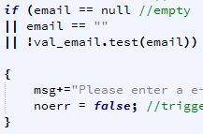
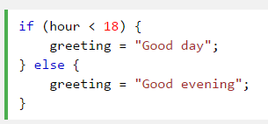
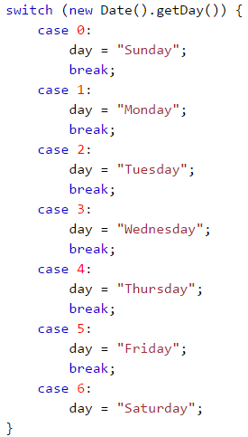
How are decisions made?
If Statements – If statements are used to one or more conditions. The condition which is true according to the data entered is the one that is ran and outputted. One way in which if statements are beneficial to a website is in regards to validation. For example for fields a test could be rain that if the field is left blank then display an error message saying so.
If/Else Statements – If/else statements are seen as an extension to if statements. The statement will test one condition and if that is false it will run what is contained inside of the else section.
Switch/Case Statements – These statements are used to select one of many blocks of code to be executed. The statements work by comparing the value of the expression with the values of each bloke of code. Then if there is a match with a block of code it will be executed.
if
If/else
Switch/case

Slide 7
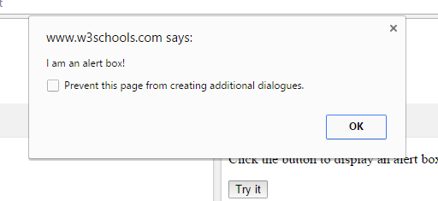
Alerts
Alerts are like popups in which a textbox appears on the screen containing some information. They are used to grab the users attention because something has gone wrong with something they have done. For example, if an incorrect password is entered then an alert could appear telling them this.
Notes:
Needs a screenshot

Slide 8
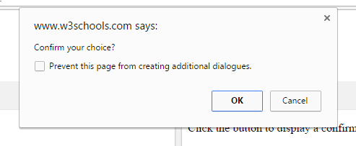
Confirming Choices
Confirming choices show in another textbox similar to that of alerts. It allows for users to double check that what they have entered before submitting. Again the textbox pops up in the users face to grab their attention. Confirming choices could be used when transferring money so that users don’t send the wrong amount of money.
Notes:
Needs a screenshot

Slide 9
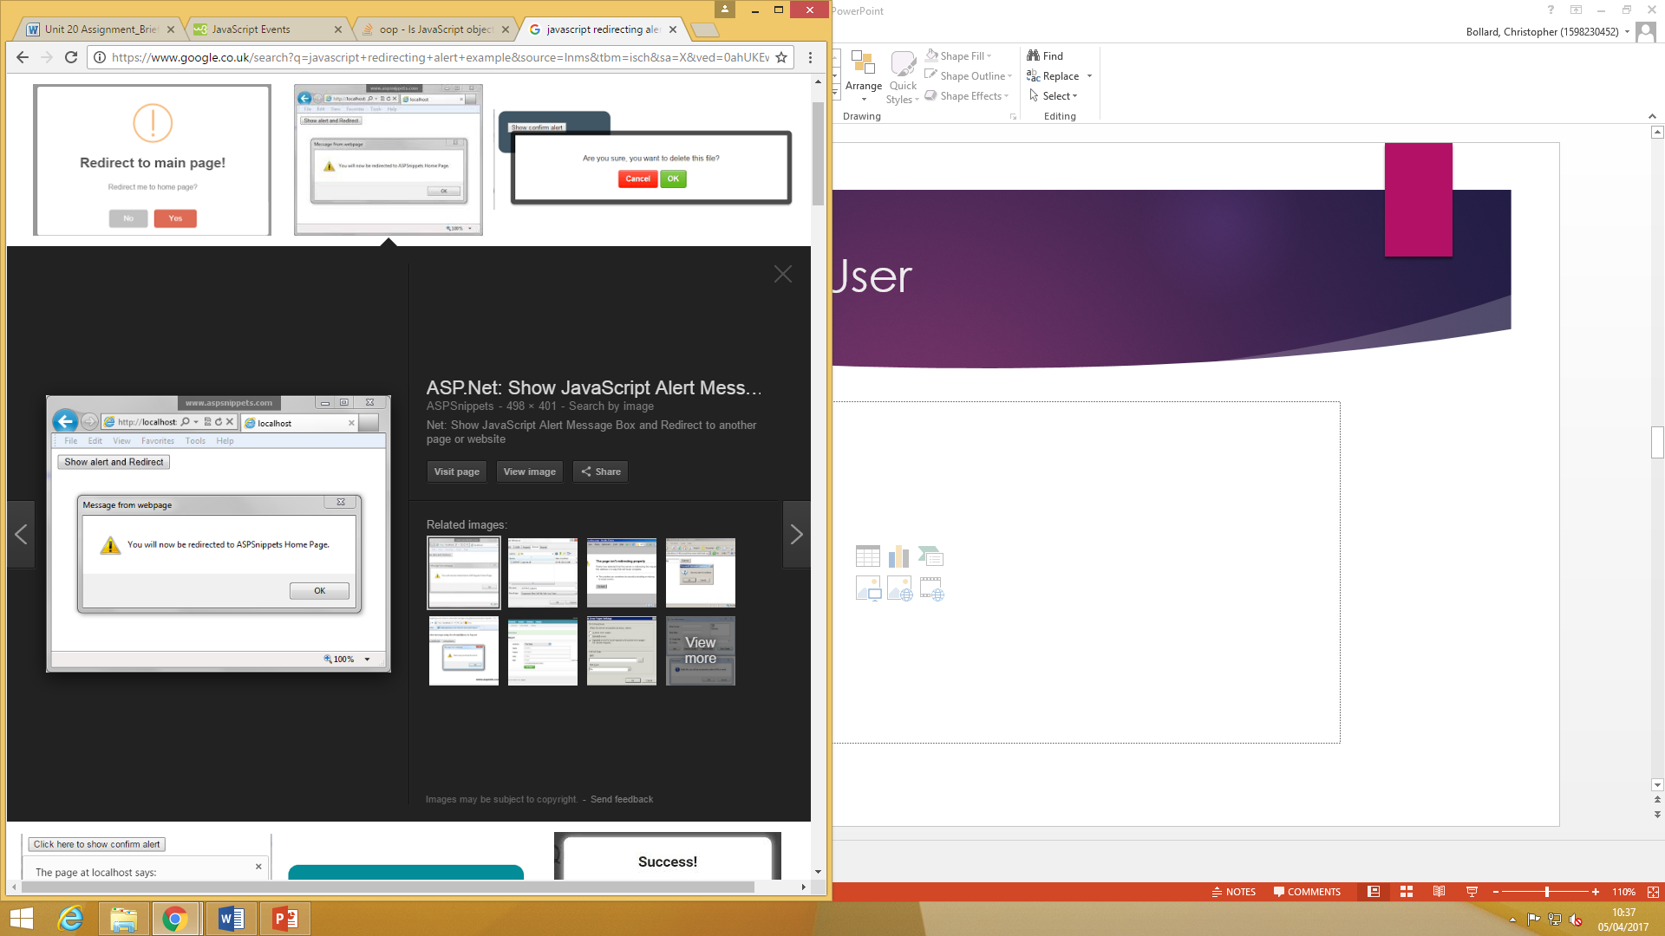
Redirecting the User
Redirecting the user is a common use of JavaScript. The most common place it is seen is within online banking. The purpose of this JavaScript is that it speeds up websites because the user does not have to manually click a hyperlink. Furthermore, it can help with security because it will take you to your own account and not someone elses.
Notes:
Needs a screenshot

Slide 10
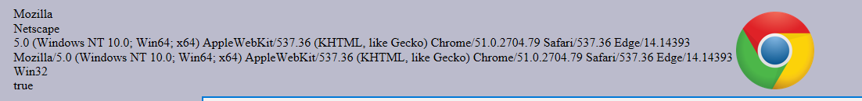
Browser Detection
Browser detection allows for websites to check what type of browser the user is using. This is used because some browsers do not support JavaScript or they have yet to be updated. This is very important for a website which uses a lot of JavaScript because it will lose a lot of its functionality. For example, if a browser was not up to date then users could enter invalid data into forms.
Notes:
Needs a screenshot

Slide 11
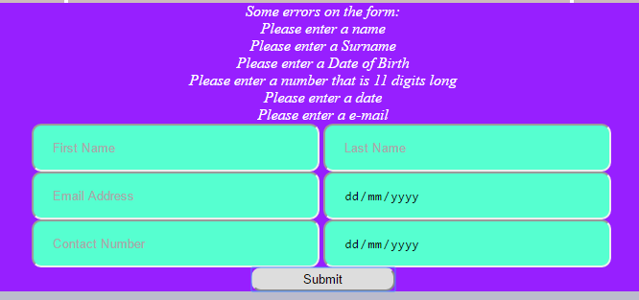
Handling Forms
Handling forms is a way of ensuring data integrity. Data can be entered incorrectly due to human error on many occasion so it is important to prevent this. Therefore, we set up validation methods in JavaScript so that the data is correct. For example, for an email address field we can set up a rule that it must contain an ‘@’ sign.
Furthermore, messages must be displayed to show the user which fields contain invalid data.
Notes:
Needs a screenshot

Slide 12
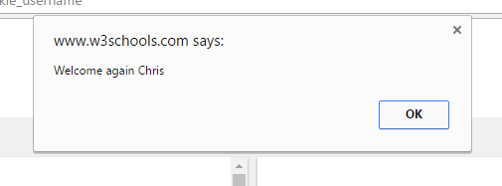
Cookies
Cookies are used to speed up and improve a users experience of a website. Cookies are used to store data which can be used later on. The advantage of this is that the data does not need to be re-entered which saves the user time. A common example in the use of cookies is remembering usernames and passwords.
Notes:
Needs a screenshot

Slide 13
Part 2
The second part of this presentation will include an explanation about how a scripting language can improve functionality of a website.
Example websites will be included as well as an explanation of how the user experience & data accuracy is improved.

Slide 14
How a scripting language can improve the functionality of a website…
One way in which JavaScript can improve the functionality of a website is through making it more accessible to different users. An example of this is font size being able to be increased or decreased according to the users preference. This will benefit people who have problems with their vision.
Another way in which JavaScript can improve functionality is through the speed of which users can use the website. This is particularly in relation to navigation. Often seen is a navigation bar which scrolls down the side with the user. This improves speed because the user does not have to keep scrolling to the top of the webpage.
A third way in which JavaScript can improve the functionality of a website is through data integrity. As mentioned before in the presentation, validation rules can be set so that data inputted into a form is in the correct format.

Slide 15
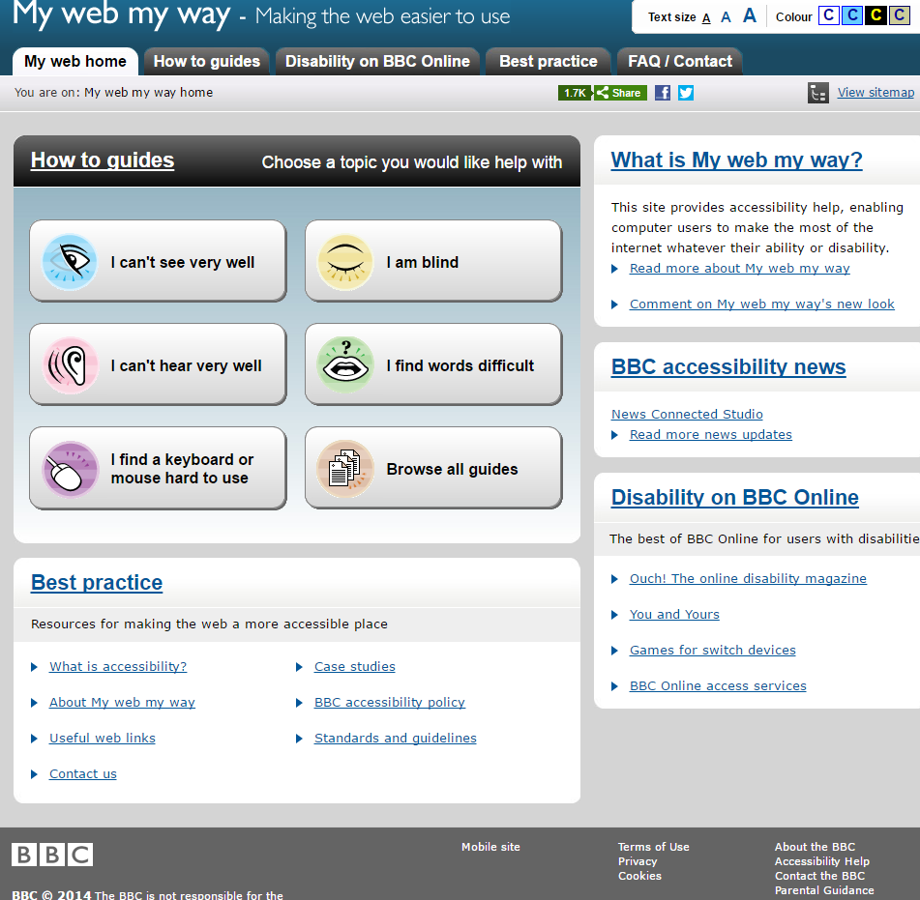
An example website…
A good example of a website that uses JavaScript to the benefit of the user is www.bbc.co.uk
Option to change font size and colour. Helps people who are visually impaired.
Share website to social media function. Lets others aware of the website
Other accessibility features. Makes other people able to use it.
Website uses cookies. Remembers data which can be used to speed up use when coming back to the website.

Slide 16
Part 3
This final section is about how web pages that are using scripts implement them in different browsers.
There is also information on browser & object detection combat the issues of browser capability

Slide 17
How do webpages combat browser compatibility?
Due to there being many different browsers which follow different rules and are updated differently it means that getting scripts to display can be hard. The way that web developers combat this is to make sure that they include the code for each browser. For example, to get the viewport size in firefox the command ‘window.innerWidth’ is used and in IE it is ‘document.documentElement.clientWidth’.
However, due to there being many browsers it is hard to cover each one as time, money and code keeps increasing. Therefore, some web developers simply ask the user that they use a certain browser which they know works.

Slide 18
Browser Detection
Browser detection is a JavaScript which grabs information about what browser the user is using. Going back to the point made on the previous slide some browsers are not able to support JavaScript meaning the website loses its functionality. Therefore, web developers will implement code which detects what browser the user is using and if it is out of date then they can warn them to update or change their browser. It can also select specific JS functions based upon the type of browser a client is using.

Slide 19
Object Detection
Another way of detecting the browser in use is through object detection. This is accomplished through the use of objects in the JavaScript code. The code will run as normal but if an object cannot be run then it is clear that there is something wrong with the browser. Therefore, through the use of an if statement an object can be tested and if it does not run then it can either display a message warning them to update their browser or run a different object which can be understood by the specific browser.
Example of this is modernzer. This is a website which has a whole host of downloadable files which checks what HTML, CSS & JavaScript can be used in each browser. The detection is done through the use of objects by checking if the object will be run or not.

