Slide 1


Slide 2

ManageIQ
Taming Hybrid Clouds
Christian Jung
October 2014

Slide 3
Who's Chris?
Joined Red Hat in 2006
EMEA Technical Specialist CloudForms
  CloudForms is “downstream” of ManageIQ
Provides Support to
  Pre-Sales
  Consulting
  Sales

Slide 4
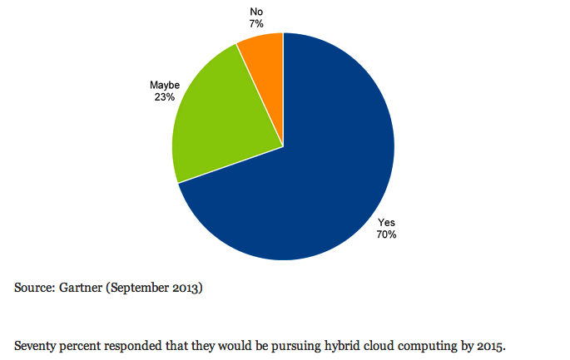
Interest in Hybrid Cloud Computing

Slide 5
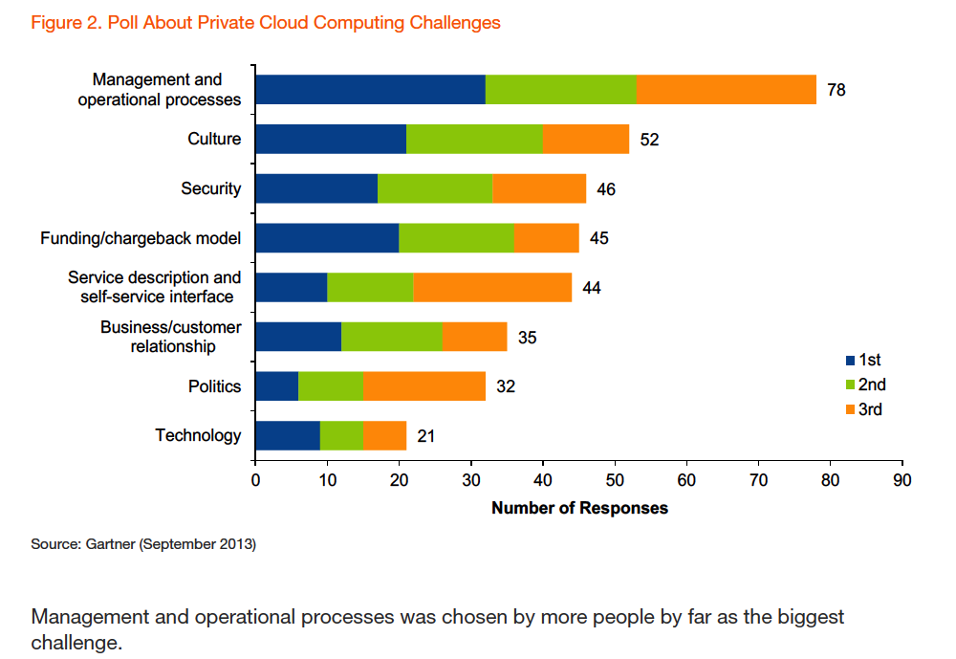
Private Cloud Computing Challenges

Slide 6
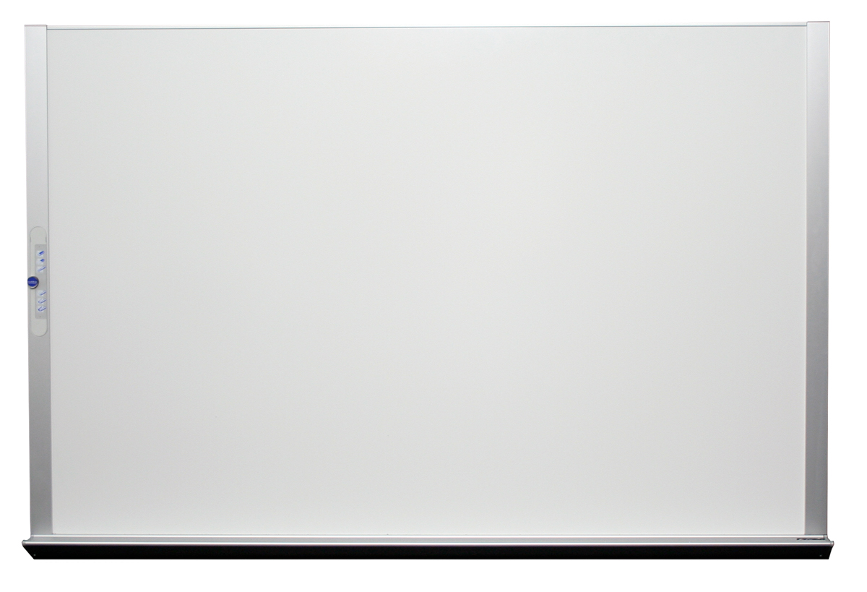

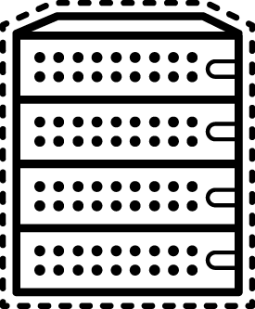
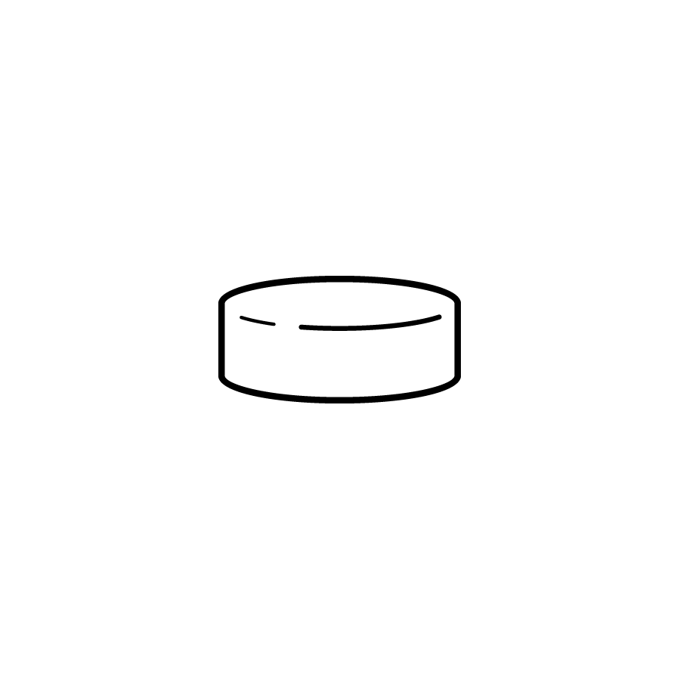

“I want to build a cloud....”
What KEY Capabilities are Important?
Self-Service Provisioning
Cloud Workload Management
Chargeback/Showback
Capacity Management & Planning
Cloud Brokering
Deploy N-Tier Applications
Public Cloud Flexing/Bursting
Leverage Existing Infrastructure
Notes:
Some prospects will know what they want from their cloud deployment and have thought through needs and wants, others will be less mature in their cloud approach.
Either way, its important for us to probe in key areas we've learned are important to our existing customers. This will help us target our capabilities and possibly help some realize needed capabilities they've not thought of (we become trusted advisor).
Self-Service Provision – prospect all want this! But need controls and analytics to operationally provide it. Intelligent workload placement is important as org look to automate this process.
Cloud Workload Mgmt – this is optimizing my environment, cloud doesn't really help save time and money if org simple throw resources (Compute, storage, networking) as consumption increases. Also being able to quickly identify and rectify problem is key to cloud operations
Chargeback – Most orgs want/need to be able to chargeback (or at least showback) to the business for infrastructure usage, especially in a self-service model. Detailed tracking and monitoring around CPU, Storage, memory, and network is key.
Capacity Management & Planning – These are actually two different disciplines – Capacity mgmt allows IT to know when resources are trending toward limits set by IT. Allows them to see resource availability across the environment, and make best-fit recommendations for new workloads based on availability, IT policies, and cost. Capacity Planning with CloudForms allows IT to model future scenarios to see impact prior to actually doing it. (If I add more CPU to cluster “x”, will it cause a problem with networking, storage, and memory resources?) Being able to model future additions and see projected impact, help orgs make informed and impactful and cost effective decision/additions to their cloud environment.
Cloud Brokering – Use intelligence around not only available resource pools, but policies that affect placement (production workloads cannot run in public cloud), and which options offer least cost (placing this workload on RHEV saves me licensing cost on VMware)
Deploy N-Tier Apps – Org have a need to offer/delivery “workloads” in addition to simple Virtual machines (VMs). By workloads I meant n-tier apps.....could be combination of web server, app server, and database server. This is a step in the direction of PaaS, but not as extensive and deep as OpenShift Enterprise.
Public Cloud Flexing and Bursting – Many orgs want to take advantage of readily available public cloud resources, but want to control usage and dictate conditions. Orgs may want to use Public Cloud for DR purposes, seasonal spikes in business demand, and/or more permanent use for dev and test reasons.
Use Existing Infrastructure – Orgs want to use existing platforms (ie VMware) and have option to add new, when and if they want to (OpenStack; RHEV). Integrate to config mgmt, service catlog, and other systems monitoring tools.
Manage Converged Infrastructure – Converged infrastructure is pre-configured hardware stacks like vBlock, FlexPod, and PureFlex. Typically these commercially available “stacks” come with cloud management capabilities, but some orgs want better capabilities than what's provided....hence an opportunity for CloudForms. Some orgs may also go to their local systems integrators and task them with building a “stack” for them.....this may be done without consideration for management. CloudForms also has an opportunity to win business here as well.

Slide 7

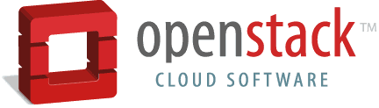





IT CLOUD MANAGEMENT
Siloed Self-Service
?
Role-based Delegation
Self-Service Portals
Service Catalogs
Automated Provisioning
Quotas & Chargeback
Notes:
Note: By OpenStack we mean Red Hat's distribution – Red Hat Enterprise Linux OpenStack Platform (CloudForms may be able to manage other distributions of OpenStack, but we've only tested our Red Hat version)
From a user perspective, getting to “self-service” poses some challenges.
There are often islands or silos of VM s for use in services
Multiple portals with inconsistent look and feel and different capabilities
Lack of any kind of quota or chargeback construct or display
CLOUDforms delivers capabilities to IT to have a policy controlled, role-delegated portal that is web accessible from any location. This service delivery can be effected across VMWare, Red Hat, Microsoft and Amazon environments with consistent look and feel and behavior.
Through CLOUDForms own Service Catalog or an integrated internal service catalog, you can provision and retire services to authorized users across the organization.
Users have access to dashboards that show them, what they have allocated, what is available and what is consumed, and offers them details on their quota levels and chargeback / showback amounts.

Slide 8


IT CLOUD MANAGEMENT
Seamless Self-Service
Role-based Delegation
Self-Service Portals
Service Catalogs
Automated Provisioning
Quotas & Chargeback
Notes:
Note: By OpenStack we mean Red Hat's distribution – Red Hat Enterprise Linux OpenStack Platform (CloudForms may be able to manage other distributions of OpenStack, but we've only tested our Red Hat version)
From a user perspective, getting to “self-service” poses some challenges.
There are often islands or silos of VM s for use in services
Multiple portals with inconsistent look and feel and different capabilities
Lack of any kind of quota or chargeback construct or display
CLOUDforms delivers capabilities to IT to have a policy controlled, role-delegated portal that is web accessible from any location. This service delivery can be effected across VMWare, Red Hat, Microsoft and Amazon environments with consistent look and feel and behavior.
Through CLOUDForms own Service Catalog or an integrated internal service catalog, you can provision and retire services to authorized users across the organization.
Users have access to dashboards that show them, what they have allocated, what is available and what is consumed, and offers them details on their quota levels and chargeback / showback amounts.

Slide 9








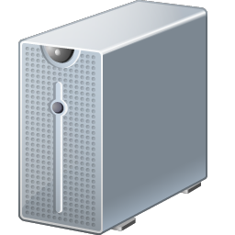





ManageIQ
Cloud Enablement Integrated with Infrastructure Management
Approval
Workflow
Self
Service
Quota
Enforcement
Compliance
Chargeback
Cloud Enablement
Automation
Cloud
Bursting
Policies
Tagging
Infrastructure
Management
Resource
Mgmt
Capacity
Planning
Config
Mgmt
Root Cause
Analysis
Optimize
Notes:
So let’s dig into the CloudForms solution by taking a look at it from a high level. As a cloud management platform CloudForms delivers the key capabilities required to enable private and hybrid clouds, and to manage your infrastructure as a service. First and foremost providing your users with “self-service” to fully automate the provisioning of new workloads and applications within your business rules as well as to manage and operate those workloads throughout their lifecycle. In addition to enabling self-service, and this is unique to CloudForms, are a fully integrated set of cloud optimized infrastructure management capabilities that alone are super valuable but in combination with self-service cloud enablement provide the highest levels of automation. The key differentiation here is tying the user supplied data from the self service request together with your business rules AND the real-time data from the infrastructure to fully automate the end to end lifecycle of that service. So what does that mean?
Let me give you an example…a user comes to the portal or your own enterprise service catalog for that matter, and requests an application environment made up of 3 tiers of servers. CF2 takes that request, validates it and then goes about the provisioning of the service. It determines that a business rule exists that says oracle database servers can only be provisioned to certain clusters to comply with licensing limitations so it identifies those clusters and then determines the one w/ the most capacity available based on real-time capacity and utilization information and provisions the db tier to that cluster. It then provisions the web tier onto the cloud area with not only the right capacity but with the correct network paths and then joins the web servers to a load balancer pool. Ultimately the entire service is provisioned, the user notified and the ongoing management of that service's lifecycle begins. We’ll dig into this in more detailed use cases shortly but the key takeaway here is the integration of the user data, the business rules and policies, with the real time infrastructure data and analytics to fully automate cloud service delivery and management. How is that different? on numerous occasions we’ve engaged with enterprise accounts that have put a service catalog on top of their virtualized infrastructure. The user requests a server or application which kicks off an email to the engineering team who take the request and determine the right location and configuration for the workload by looking at their vCenter UI, checking their capacity planning spreadsheets, requesting IP addresses from the network team and then manually creating and configuring the vm’s to fulfill the request. They then go update the ticket which kicks off an email to the requestor that their servers are ready to go. What they generally find is this not a scalable model and it really doesn't substantially decrease service request fulfillment times which leads to user dissatisfaction and in some cases lines of business going directly to Amazon for their workloads cutting out IT completely.

Slide 10




SELF-SERVICE AUTOMATED PROVISIONING
Deployment of Self-Service Resources
Quota
Enforcement
“Intelligent”
Workload Placement
Chargeback
Requests
Service Delivery
RBAC
Quota
ManageIQ
Role-Based
Access Controls
Approval Workflow
Converged
Infrastructure
Management
Notes:
Note: By OpenStack we mean Red Hat's distribution – Red Hat Enterprise Linux OpenStack Platform (CloudForms may be able to manage other distributions of OpenStack, but we've only tested our Red Hat version)
Service Delivery – could be VMs, Instances/Templates, n-tier applications/workloads; CF could be integrated into an existing Service Catalog
Role-Based Access Controls (RBAC) – Ensure only authorized workloads are accessible by authorized users and admins
Quota Enforcement – Ensure users/groups do not exceed their allocated infrastructure; Can Tag objects, users, groups to make quota enforcement as detailed or broad as org wants
Approval Workflow – Force an optional automated approval process on any IT request
Intelligent Workload Placement – Use logic and policies to determine best infrastructure for the job
Chargeback – Important for most orgs to be able to accurately track and charge for consumption. Even if they simply want to “showback” to the business consumption vs actualy charging them for it.
(This is actual saving told to us by Media Company... you could setup a peer-to-peer call with them and have them tell prospect same thing!)
Example: Media Company saved 25 person hours per VM provisioned
So far in 2013, they have provisioned little over 1000 VMs with CloudForms.
Assuming $100 cost per man hour
Comcast saves $2,500 per VM (25 x $100)
So far this year, they have saved $2.5M! ($2,500 x 1000 VMs)
Benefits
Business:
- Reduce time in meeting customer request/accelerate projects & innovation
- Elevate the value and perception of IT internally
Technical:
- Less people needed in the provision process (reallocate heads elsewhere)
- Control access, usage and request fulfillment – Lifecycle control (Request thru retirement)

Slide 11
ManageIQ
Cloud Operations Management
Complete Cloud Service Lifecycle
Automated Provisioning
  Simple/Multi-Tier, Full Stack
  Self-Service, Service Catalog
Delegated Operations
  Power Operations, Console
  Reconfiguration
Intelligent Optimization
  CPU, Memory & Storage
Demand-Driven Scaling
  Horizontal & Vertical
  Start/Stop or Provision/Destroy
Scheduled Retirement
  Fully Automated
  Multi-Phase
Automated
Provisioning
Scheduled
Retirement
Delegated
Operations
Demand-
Driven
Scaling
Intelligent
Optimization
Notes:
CLOUDForms covers service provisioning and deployment aspects shown earlier. CLOUDForms provides the ability to manage VMs across their lifecycle from provisioning or conversion (P2V/V2V) through operations and eventually to retirement. CLOUDForms automatically discovers, assesses, classifies, monitors and tracks VMs in any state, powered on, off or suspended, and provides a spectrum of lifecycle management and automation including:
VM Lifecycle Management- including automatic discovery, tracking, inventory, analysis, assessment, aging and retirement.
Self-Service Provisioning and Self-Management - through a rich, web-based portal with fine-grained access control and support for request management, tracking and approval.
Configuration Management - including automatic, agent-free deep VM discovery, analysis, assessment and tracking of software, accounts, users, groups, patches, services, packages, registry keys, MD5s and configuration files.
Comprehensive Baselining and Drift - including the virtual hardware, settings, guest configuration, network settings as well as relationships and classifications.
Real-Time Policy-Based Standards Enforcement – assessment, analysis and policy-based enforcement of VM configuration, operational, network, resource and security standards.
Resource Monitoring and Optimization – performance monitoring, identification of over-allocated resources, current and future bottlenecks, automatic VM aging and retirement.
Quota Enforcement, Usage, Chargeback and Cost Allocation – detailed usage tracking by configurable classifications with support for multiple rates tables, fixed cost, allocation and usage and reservation based chargeback.
Advanced Capacity Planning, Trending, and Best-Fit Placement – factors in resource availability, policies and business classifications across time periods optimizing planning and VM placement.

Slide 12
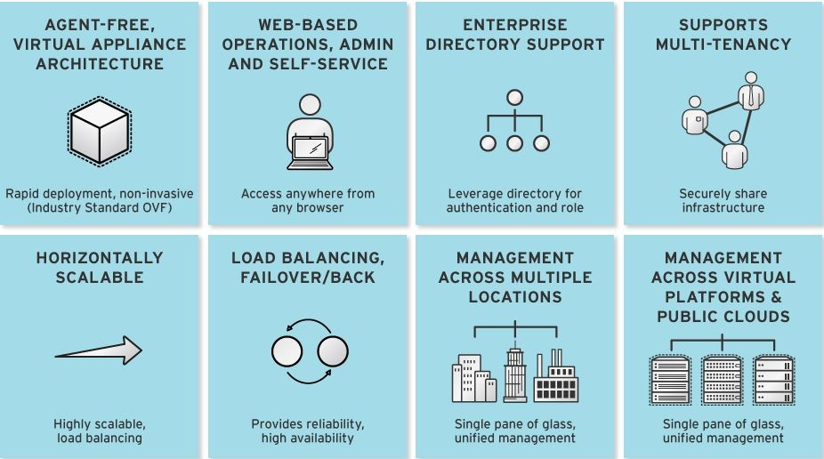
ManageIQ
Built for Enterprise Scale Cloud Operations Management
Notes:
CLOUDForms is designed from the ground up to run at enterprise scale. Many products in the market today lack fundamental capabilities to support large IT environments. The right kinds of product architectures are needed in key areas to mesh with IT production systems.
Rapid Deployment – Agent-free, virtual appliance architecture deploys rapidly providing immediate insight into and control over existing infrastructures and cloud environments.
Web-Based Operations and Self-Service – Web-based portals support standard web-browsers and require no clients or plugins to be installed.
Enterprise Directory - Integration includes support for any LDAP directory and requires no schema changes. Support multiple forests, domains and one-way trust models.
Scalable – CLOUDForms is vertically and horizontally scalable. As the managed environment grows, additional appliances can be added or additional virtual cpu and memory can be added to existing appliances.
High Availability – CLOUDForms supports load balancing and high availability and will automatically failover when an outage is detected and failback when the primary appliance(s) is restored.
Federation - supports single-system image across sites and locations using bidirectional, trigger-based database replication and intelligent wan connection monitoring.
Cross Platform Support - supports heterogeneous infrastructures, virtual platforms, brokers and clouds enabling unified management across environments.

Slide 13

ManageIQ Relationship to OpenStack

Slide 14
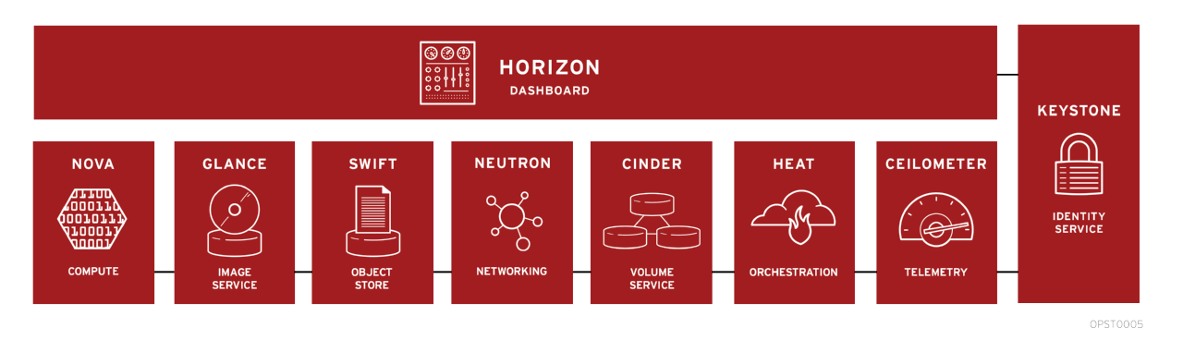
OpenStack
Notes:
I don’t get this revision.
PaaS and IaaS+ provide application containers, app lifecycle management, etc. IaaS+ is more than VM deployment – that’s IaaS. Under IaaS, what does “abstracted services” refer to?

Slide 15
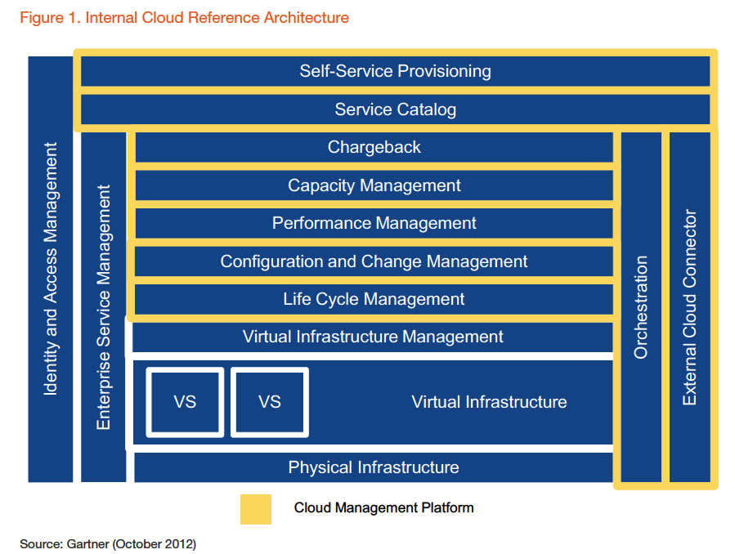
Relevant Taxonomies
Gartner - Cloud Management Platform (CMP)
Notes:
I don’t get this revision.
PaaS and IaaS+ provide application containers, app lifecycle management, etc. IaaS+ is more than VM deployment – that’s IaaS. Under IaaS, what does “abstracted services” refer to?

Slide 16

The Community Vision

Slide 17
Why Open Source CloudForms?
It's Red Hat DNA
First to open-source Cloud Management Platform
Provides an alternative to traditional proprietary management platforms
History proves an enterprise acceptance of open source and is pervasive throughout IT architectures (RHEL, JBoss, Satellite, RHEV)
Notes:
<Nummer>

Slide 18
ManageIQ to Date
Visitors to manageiq.org can download community builds and source code (as of June 19)
Community participants can ask and answer questions on web forums (talk.manageiq.org)
ManageIQ is now developed transparently and in the open
We're open for business – now with 9 partners: CiRBA, VMTurbo, BBVA, Gandi.net, AutoTrader Group, Booz Allen Hamilton, Cloudsoft, Chef, ICE Systems
Some partners are contributing open source projects to the ManageIQ Community

Slide 19
Open Source Community
Structure
Hosted under manageiq.org
Both Engineer and User Community
Users, ISVs/IHVs, System Integrators
Engineering
Community
User
Community
Innovation
Differentiation

Slide 20

ManageIQ Open Source Community
Resources
ManageIQ
Small Private
Company
Resource Constrained
Red Hat
Post Acquisition
Large Public
Company
Manageiq.org
Open Source
Global Community of Users, Integrators, Vendors
Notes:
<Nummer>

Slide 21
Open Source Community
Open Source Development Strategy
One Community
Many Projects
Cloud Governance
Financial
Management
Cloud Automation
Resource Management
Service
Management
Data
Management
Platform Instrumentation
Architecture/Taxonomy
Notes:
<Nummer>

Slide 22
Real World
Use Cases
Agile IT or DevOps

Slide 23
Agile IT and DevOps
Internal IT is usually not fast enough to meet developer requirements
Developers are under pressure to deliver results in short time frame
Cloud services put IT under specific pressure
  “Why does IT need a week to build a VM while AWS only needs minutes?”

Slide 24
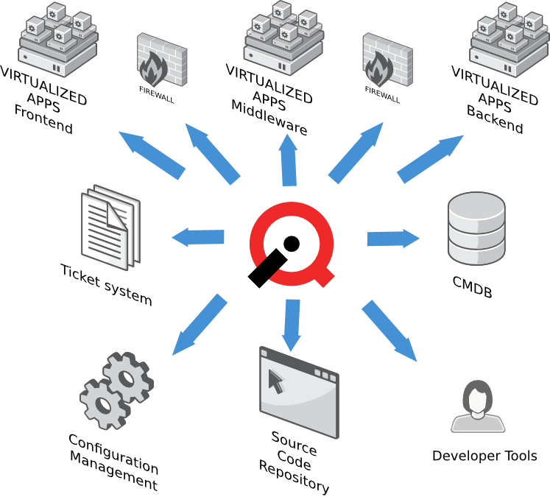
Deep integration
integration to build systems like Jason pre-configured
backup, monitoring, etc. pre-configured
developer tools like GCC, Java, IDE etc. are pre-installed
VM with additional application (like DB, Application Server etc) can be ordered from a self service catalog
IT will take care of security updates and bug fixes
App will work in production without modifications

Slide 25
Real World
Use Cases
Traditional IT

Slide 26
Operators and Admins
MIQ allows admins decide and influence how future software stacks will look like
e.g. a software stack is split into frontend/middleware/backend
  admins designs the stack and component is deployed into which zone
  admins have control about deployed application versions, configurations, make sure proper firewall and/or load balancer rules are in place
  a full stack can be deployed by just ordering a single service catalog item or bundle

Slide 27
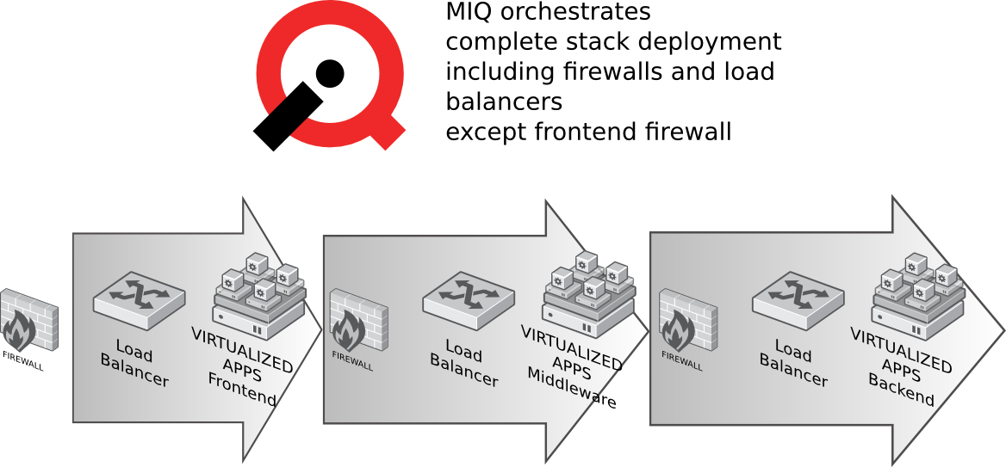
Stack Deployment

Slide 28
Operations and Admins
Predictable and reliable platform for application development
admin/ops still is in charge of what is deployed and where it is deployed
  software release and lifecycle management, firewalls/load balancers, monitoring etc.
Integration with e.g. ticket systems can be used to track all requests created
  will create automatic audit trail in external system about every service request, lifecycle changes and retirement

Slide 29
Placement
admins can define and enforce rules to meet their needs
  placement polices: "not near" to avoid cluster nodes are running on the same hypervisor
  placement to use "fast" storage only for I/O intensive workloads
  placement can also override manual migration of VMs

Slide 30
Placement “not near”
Based on existing code
  Never re-invent the wheel!
Fetch list of VMs for each hypervisor
Check tags of each VM
If match, skip hypervisor
Result is a list of hypervisors which are good to go

Slide 31
Code example - extract
provTags = prov.get_tag(:excludeworkload)
dropout = false
h.vms.each do | vm |
vm.tags.each do | key,value |
if key.split('/')[1] == provTags
$evm.log("info","---------Excluding Host : #{h.name}")
dropout = true
end
end

Slide 32
Real World
Use Cases
Automatic Scaling

Slide 33
Automatic Scaling
Application has Management component which keeps tracks of Requests/s and Queue Length
Management component calls MIQ to scale up based on actual load
MIQ has multiple ways for scaling:
  Dormant VM: Installed and configured, but powered off

Slide 34

Automatic Scale Up
On scale up request:
  Verify hard limit of maximum VMs has not been reached
  Check number of dormant VMs and bring up another one
  If number of dormant VMs is too low, create and install another VM and add it to the pool of dormant VMs
  Make sure minimum number of dormant VMs exists
Active VM in Monitoring
Keep track of license usage
Add VM to CMDB

Slide 35

Automatic Scale Down
On scale down request:
  Make sure minimum number of running VMs exist
  Shut down not needed VMs and add to dormant pool
  If dormant pool is to large, retire VM (delete)
Remove VM from monitoring
Reduce License usage counter
Deactivate in CMDB

Slide 36
Stop, demo time

Slide 37
Demo Basic UI

Slide 38
Demo Service Catalog

Slide 39


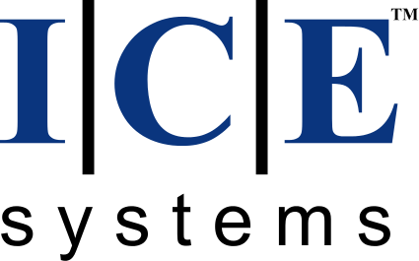
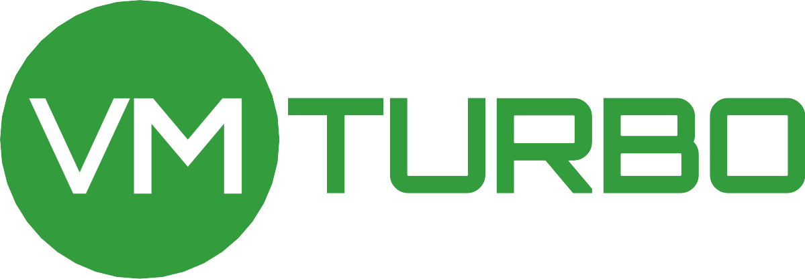






Founding Partners

Slide 40
Your Gateway to the Open Cloud
Web site: manageiq.org
Download: manageiq.org/download/
Discuss: talk.manageiq.org
Twitter: @manageiq
Git repo: github.com/ManageIQ/manageiq
ME:
jung@redhat.com

