Slide 1
Subject number | Normalization compensation % | Responses equal to random | KLDnh (mean) | KLDnh (median) | TVDnh (mean) | TVDnh (median) | WTA (mean) | WTA (median) | Trial Time (avg secs)
3 | 0.42 | 0.11 | 3.5377386 | 3.38485 | 0.58229615 | 0.590965 | 0.52272727 | 1 | 12.87
5 | 0.34 | 0.07 | 2.955415 | 2.23165 | 0.523444 | 0.501495 | 0.38636364 | 0 | 14.81
6 | 0.23 | 0.00 | 3.26093863 | 1.41345 | 0.45466778 | 0.394905 | 0.43181818 | 0 | 26.24
7 | 0.00 | 0.00 | 2.08021364 | 2.08135 | 0.44395914 | 0.48769 | 0.22727273 | 0 | 66.56
8 | 0.31 | 0.00 | 3.06785477 | 2.86775 | 0.57301773 | 0.57317 | 0.52272727 | 1 | 26.23
9 | 0.21 | 0.00 | 3.02453136 | 2.64705 | 0.56610139 | 0.590925 | 0.63636364 | 1 | 22.84
10 | 0.17 | 0.00 | 2.44631682 | 1.893 | 0.480875 | 0.43167 | 0.38636364 | 0 | 46.27
11 | 0.46 | 0.11 | 3.13423032 | 2.99475 | 0.55144278 | 0.60382 | 0.5 | 0.5 | 36.30
12 | 0.28 | 0.00 | 2.88229864 | 2.0011 | 0.5066648 | 0.395285 | 0.45454545 | 0 | 29.80
13 | 0.00 | 0.00 | 2.65895834 | 1.34525 | 0.37989582 | 0.29097 | 0.31818182 | 0 | 39.81
14 | 0.23 | 0.00 | 1.92226459 | 1.5572 | 0.39917652 | 0.381065 | 0.29545455 | 0 | 53.59
15 | 0.14 | 0.00 | 2.69013434 | 1.8947 | 0.46276211 | 0.466635 | 0.43181818 | 0 | 31.46
16 | 0.45 | 0.02 | 4.05090753 | 2.86845 | 0.56271209 | 0.57899 | 0.56818182 | 1 | 15.44
17 | 0.00 | 0.00 | 3.22010432 | 3.0069 | 0.58103366 | 0.61472 | 0.56818182 | 1 | 23.13
18 | 0.00 | 0.23 | 3.58043054 | 2.99825 | 0.58275115 | 0.64658 | 0.45454545 | 0 | 26.58
19 | 0.00 | 0.00 | 3.57751516 | 2.98395 | 0.57751659 | 0.6416 | 0.54545455 | 1 | 35.90
20 | 0.16 | 0.00 | 2.8439 | 2.62755 | 0.55373495 | 0.56328 | 0.56818182 | 1 | 25.89
21 | 0.20 | 0.00 | 2.93730146 | 2.82555 | 0.50593111 | 0.505785 | 0.34090909 | 0 | 36.16
22 | 0.01 | 0.00 | 2.92605023 | 2.59505 | 0.57022364 | 0.60795 | 0.5 | 0.5 | 90.74

Slide 2
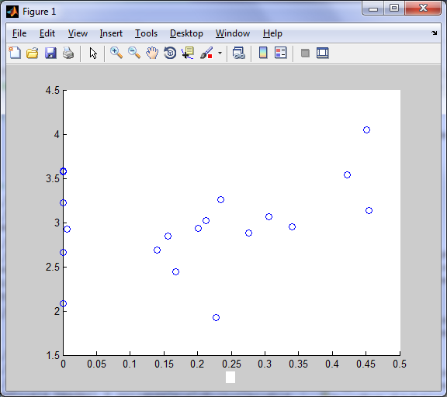
Compensation % by KLD

Slide 3
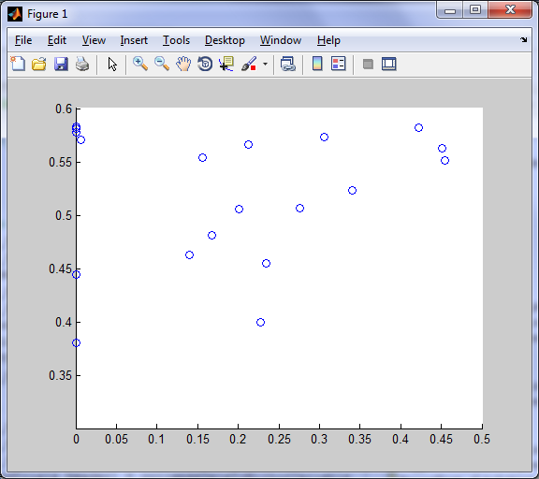
Compensation % by TVDnh

Slide 4
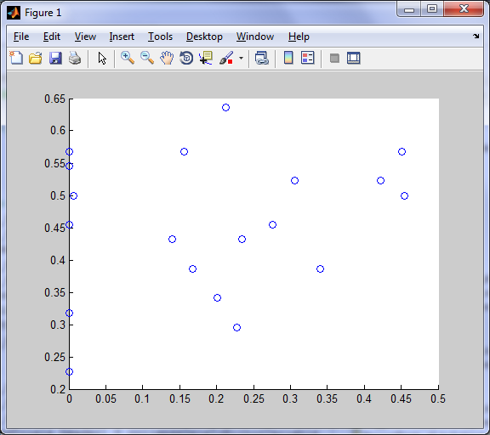
Compensation % by WTA (mean)

Slide 5
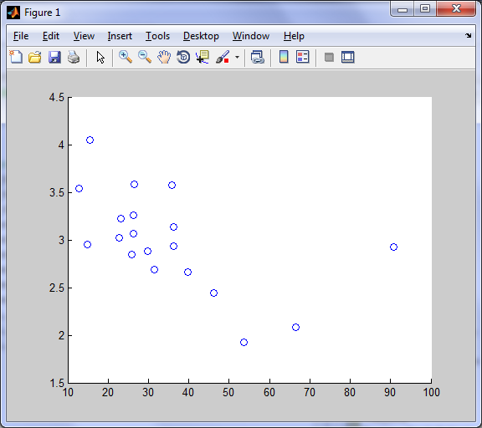
Time by KLD

Slide 6
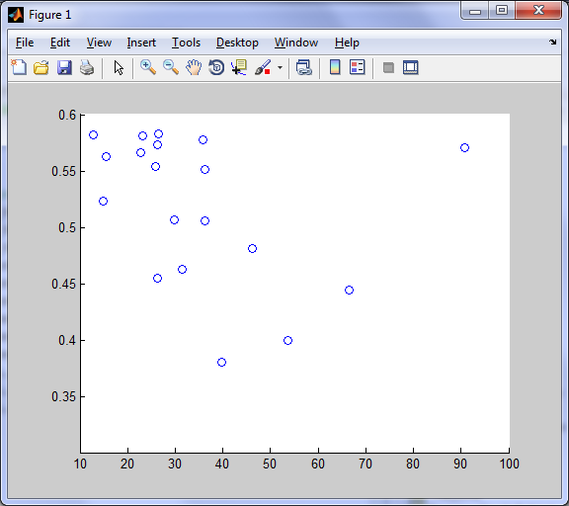
Time by TVD

Slide 7
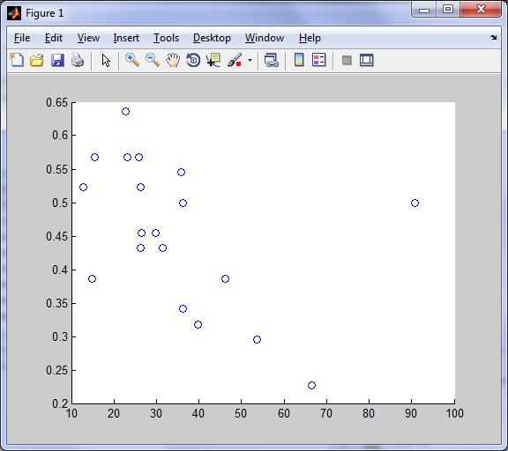
Time by WTA

Slide 8
Old data

Slide 9
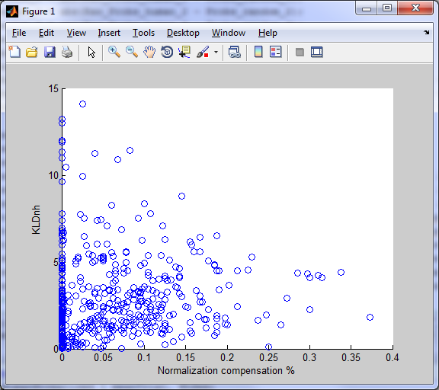
r = .09, p < .05

Slide 10
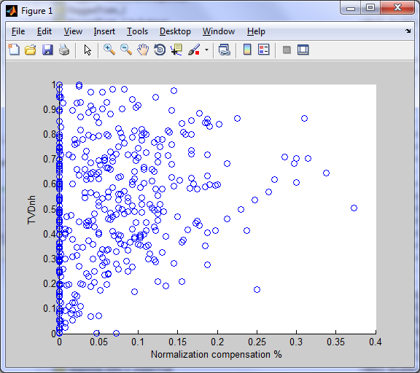
r = .26, p < .001

Slide 11
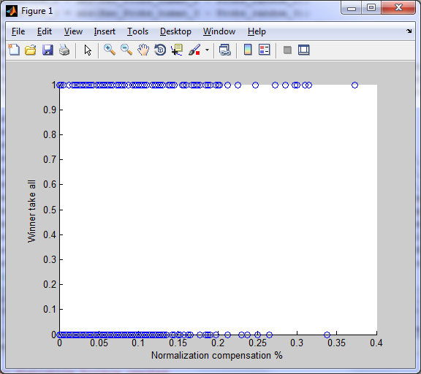
r = .28, p < .001

