Slide 1
CNN Transfer Learning Prediction of Tuberculosis (Surrogate for Black Lung)
Catherine Boomus
April 18, 2024

Slide 2
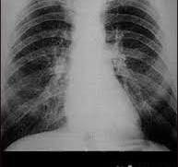
Project Long Term Goal:
Occupational lung disease is a major source of morbidity and mortality worldwide.
In the United States, people who qualify for asbestos, silica, and coal medical surveillance programs require chest x-rays with a specialized interpretation – one produced by a “B Reader”.
The long-term project is to produce a deep learning product that assists B Readers by providing a color map of areas suspicious for nodules or pleural plaques (indicators of particulate related lung disease).
This is the first step, which is to classify positive or negative.
Black Lung

Slide 3
Functions and Modules InceptionV3 trained on ImageNet
Import data – Kaggle; 700 positive, 700 negative PNG 512 x 512 pixel CXR’s
Import libraries – os, shutil, numpy, tensorflow, matplotlib
Preprocess data - resize, rescaling, augmentation (rotation, shift, shear, zoom, flip, fill) with ImageDataGenerator
Build model – InceptionV3 network trained on Imagenet, all frozen for feature extraction. Removed dense classification layer, added two dense layers (one with ReLU and one with sigmoid)
Train model – 978 images training, 280 images validation, 142 images test
Evaluate model – error and accuracy, runtime: 53 minutes after (data uploaded, three hours)
Potential improvements – more evaluation metrics, more hyperparameter tuning (learning rate, batch size, epochs)

Slide 4
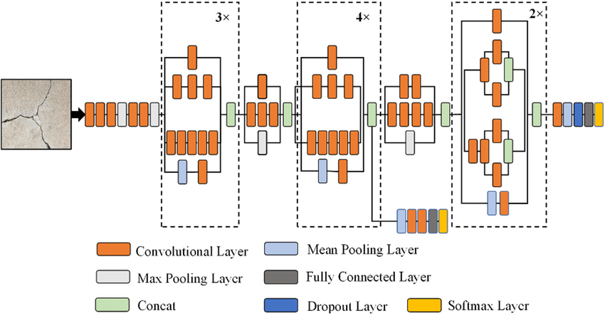
InceptionV3 trained on ImageNet

Slide 5
Results: 10 epochs of 32 / batch using training set 978, valid 280, test 142
Found 978 images belonging to 2 classes.
Found 280 images belonging to 2 classes.
Found 142 images belonging to 2 classes.
Epoch 1/10 30/30 [==============================] - 307s 10s/step - loss: 0.4856 - accuracy: 0.7537 - val_loss: 0.2568 - val_accuracy: 0.8945
Epoch 2/10 30/30 [==============================] - 327s 11s/step - loss: 0.3025 - accuracy: 0.8795 - val_loss: 0.2018 - val_accuracy: 0.9258
Epoch 3/10 30/30 [==============================] - 318s 11s/step - loss: 0.2348 - accuracy: 0.9165 - val_loss: 0.1889 - val_accuracy: 0.9102
Epoch 4/10 30/30 [==============================] - 303s 10s/step - loss: 0.1968 - accuracy: 0.9366 - val_loss: 0.1446 - val_accuracy: 0.9492
Epoch 5/10 30/30 [==============================] - 321s 11s/step - loss: 0.1753 - accuracy: 0.9366 - val_loss: 0.1514 - val_accuracy: 0.9414
Epoch 6/10 30/30 [==============================] - 320s 11s/step - loss: 0.1721 - accuracy: 0.9482 - val_loss: 0.1373 - val_accuracy: 0.9531
Epoch 7/10 30/30 [==============================] - 320s 11s/step - loss: 0.1731 - accuracy: 0.9535 - val_loss: 0.1332 - val_accuracy: 0.9531
Epoch 8/10 30/30 [==============================] - 319s 11s/step - loss: 0.1392 - accuracy: 0.9535 - val_loss: 0.1349 - val_accuracy: 0.9453
Epoch 9/10 30/30 [==============================] - 301s 10s/step - loss: 0.1475 - accuracy: 0.9482 - val_loss: 0.2006 - val_accuracy: 0.9102
Epoch 10/10 30/30[==============================] - 296s 10s/step - loss: 0.1389 - accuracy: 0.9545 - val_loss: 0.1430 - val_accuracy: 0.9492

Slide 6
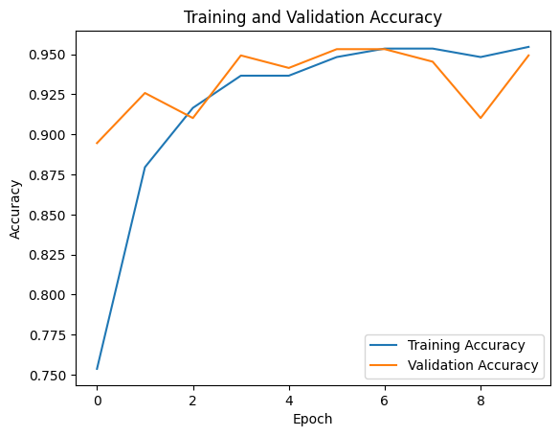
Results:
 | Loss | Accuracy
Training | 0.1389 | 0.9545
Validation | 0.1430 | 0.9492
Test | 0.1656 | 0.9141
Some overfitting, but better than expected

Slide 7
Thank you!
Reference:
Tawsifur Rahman, Amith Khandakar, Muhammad A. Kadir, Khandaker R. Islam, Khandaker F. Islam, Zaid B. Mahbub, Mohamed Arselene Ayari, Muhammad E. H. Chowdhury. (2020) "Reliable Tuberculosis Detection using Chest X-ray with Deep Learning, Segmentation and Visualization". IEEE Access, Vol. 8, pp 191586 - 191601. Link: https://ieeexplore.ieee.org/document/9224622

