Slide 1
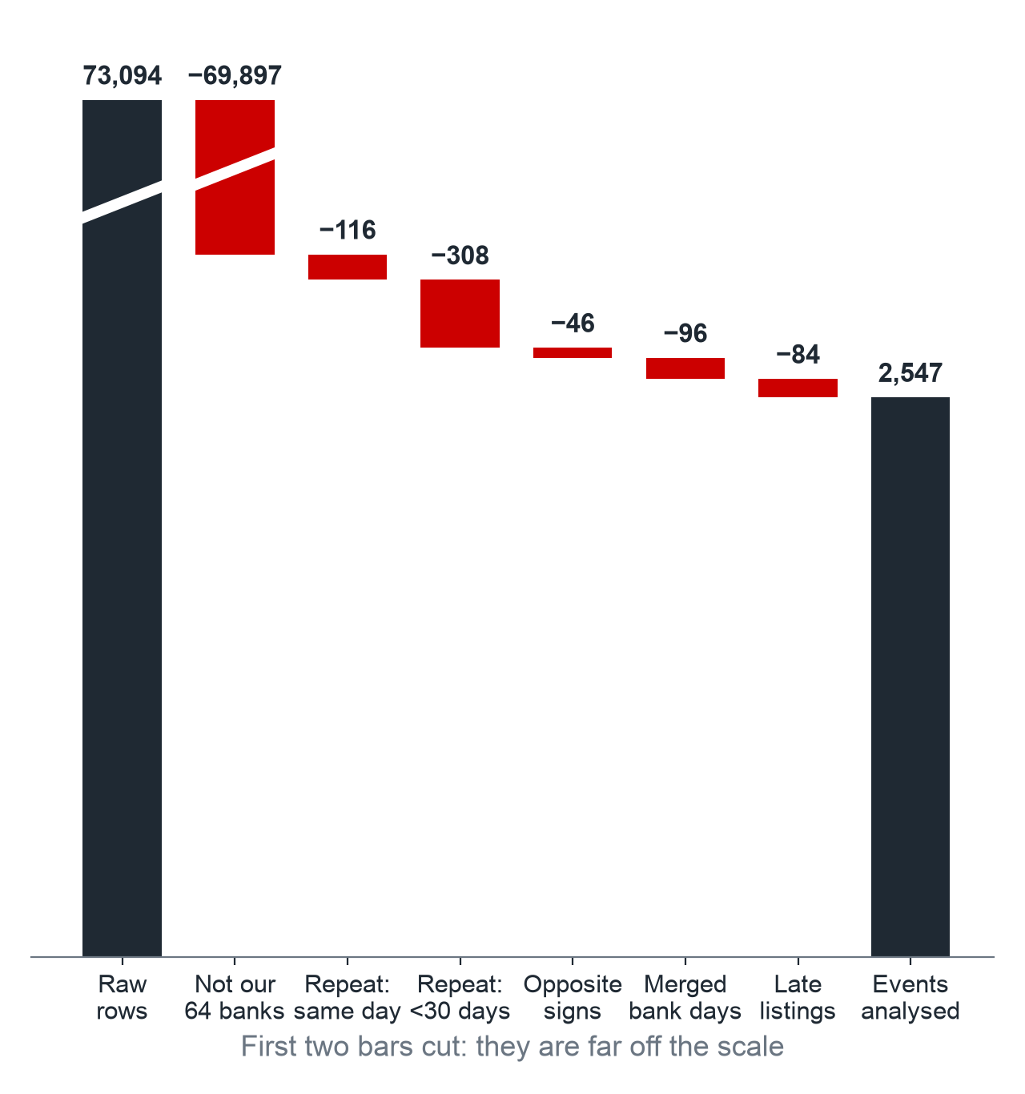
We tested whether NGO campaigns against banks move share prices, on 2,547 events from 2010 to 2018
Tasks chosen: Day 1, Day 2, Tasks #4, #5 and #6. Not done: Tasks #1, #2, #3 and #7.
From raw Sigwatch rows to the events we test
Sigwatch NGO reports
73,094 rows, 2010 to 2018
Datastream share prices
162 series, factors, FX rates
Clean the events
Name match to 64 banks, repeats and same-day conflicts out: 2,631 events
Clean the returns
Non-banks, illiquid series and holidays out, dividends in, in US dollars: 126 banks
Estimate the normal return
Rolling market model and Fama-French five factors + momentum,
on 250 days ending 50 days before the event
Event study (Krüger, 2015)
CARs over [−10, +10], winsorised:
2,547 events on 60 banks,
2,076 bad and 337 good news
Test the reaction
Clustered mean, median, BMP, sign test;
bad vs good news;
splits such as COP21, Trump
Stress-test the answer
8 alternative setups, random-day placebo,
Diff-in-Diff against never-targeted banks, power curve
Source: Sigwatch, Datastream, Ken French data library. Group 4, 20598 Finance with Big Data
Notes:
Answers the first question: which tasks we chose and what we did. The flow shows two data sources that are cleaned apart and then merged. The 84 late listings are 67 events before a bank was listed, 16 with too little history for betas, and one merged HSBC window. Four of the 64 targeted banks (Metro Bank, NIBC, Unicaja, Virgin Money) lose all their events to late listing, so 60 banks remain.

Slide 2
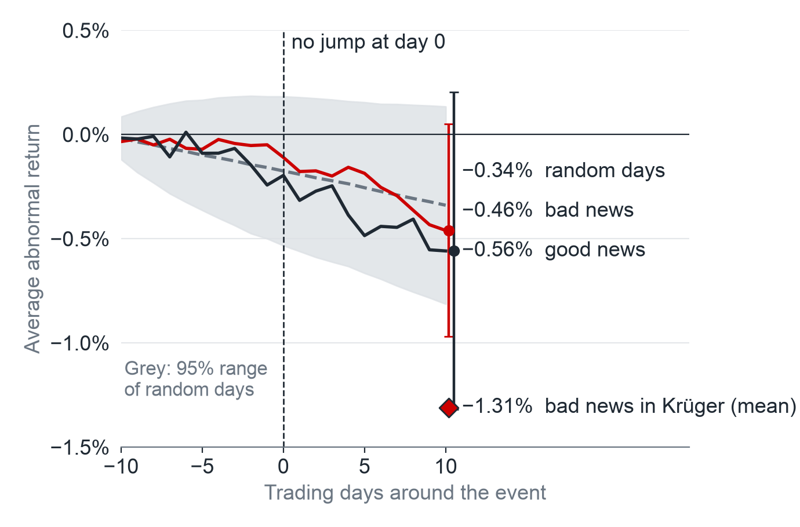
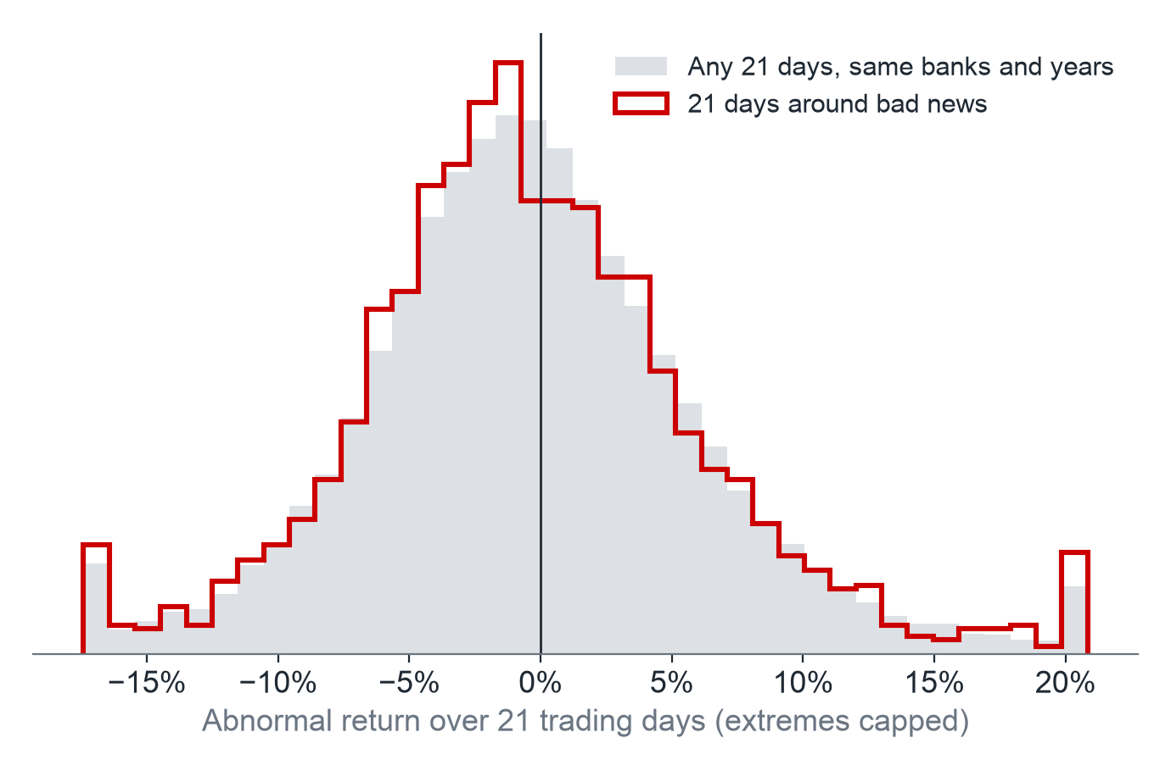
Over 21 days, a campaign is not a share price loss we can tell apart from noise, and good news falls too
No jump at day 0, and random days drift too
A campaign window looks like any other 21 days
What does not hold up
Against the market, the typical fall is near Krüger’s
With more risk factors it shrinks to −0.24% and is no longer significant
Against never-targeted banks: −0.37%, not significant
What we find
Bad news: mean −0.46%, median −0.88% (Krüger: −1.31% and −1.11%)
Good news: mean −0.56%, so the gap cannot be told from zero (p = 0.679)
Campaign windows fall 55.7% of the time, any 21 days 54.5%
Source: Sigwatch, Datastream, Ken French data library; Krüger (2015). 21 trading days around each event
Notes:
Answers the second question: findings. With more time: a Factiva news filter for earnings and crises, Tasks #1 and #2 for press and social media reach, and never-targeted banks matched on bank size. The left chart shows raw CARs on the market model with a 95% interval at day +10; the grey range is 1,000 draws of random days. The p = 0.679 is for the winsorised gap. On the market model the BMP and sign tests reject for bad news, but no test rejects with five factors and momentum or clustered by bank and month (notebook, section 6.2). The diff-in-diff is 0.00% without overlapping windows and −0.15% on US and euro area banks. It rests on parallel trends, comparable controls, random timing, no spillovers and one clean treatment per window, which may not all hold here, so we read it as exploratory.

Slide 3
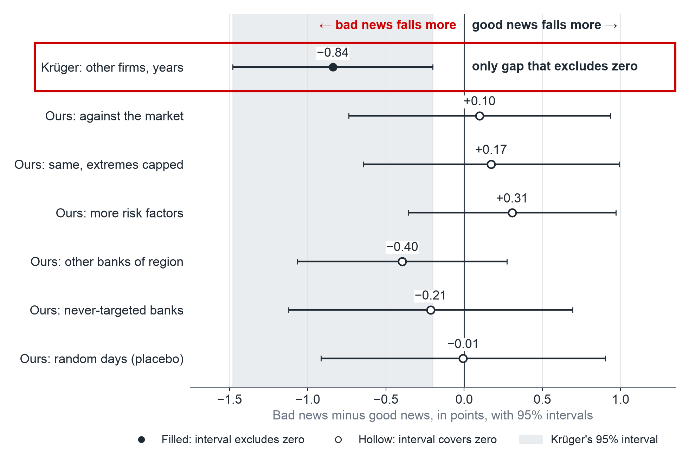
Only in Krüger does bad news clearly stand apart from good news; in our bank data it does not
Bad news minus good news over 21 trading days, by benchmark
So what: one campaign is no measurable share price risk here, but we cannot rule out an effect of Krüger’s size.
Why we may differ from Krüger (untested)
He: US firms of all sectors, 2001 to 2007. We: US, UK and EU banks, 2010 to 2018
His events are dated to press news; NGO dates may lag, and only 1 in 5 of our events names the bank in the headline
Banks are hit so often (median: 12 other events in the window) that one report may be no news
With more time
A Factiva news filter
Tasks #1 and #2 on press and social media
Never-targeted banks matched on size
Source: Sigwatch, Datastream, Ken French data library; Krüger (2015). Our rows from “extremes capped” down cap extremes
Notes:
Answers the third point: one plot that summarizes the work. Read each row as a different benchmark; a filled dot means the 95% interval excludes zero, and Krüger’s interval is shaded. The levels of the fall are on slide 2. Our test has 52% power against a gap of Krüger’s size. The reasons for differing from Krüger are hypotheses, not tested results.

