Slide 1
Teensy Touchscreen
  Clark Boylan
  Chris Noonan
  Nate Georgeson
  Abdelhalim Ragab
  CS572 Operating System Internals

Slide 2
Touchscreen device
Teensy microcontroller
Nintendo DS Touch Screen
Potentiometer (a knob!)
Some buttons

Slide 3
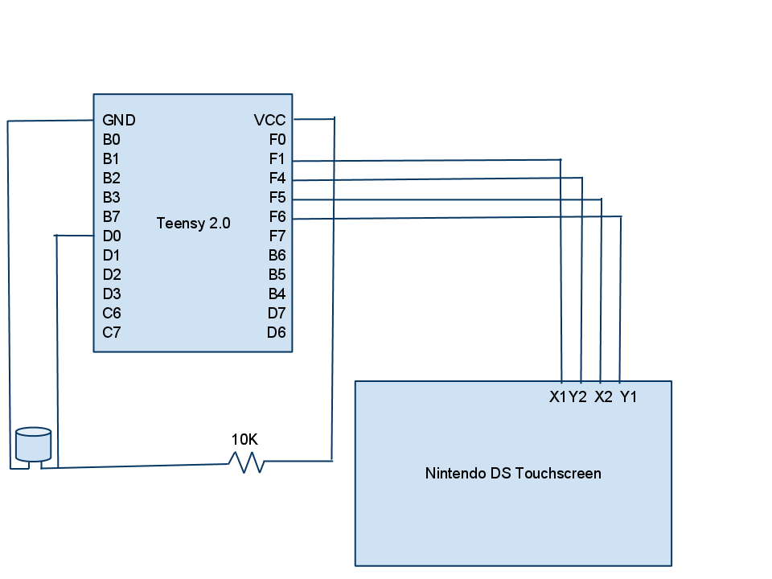
Schematic

Slide 4
Touch screen
Protocol and Pin assignment
Teensy Touchscreen X Pos. Y Pos.
------------------------------------------------------
F1 X1 5V ADC (Y)
F4 Y2 ADC(X) 5V
F5 X2 GND floating
F6 Y1 floating GND

Slide 5
Firmware
Ported from Teensy's USB mouse firmware
Updated to use Teensy Timer interrupt to collect touch screen data
Uses HID USB mouse data format
Identifies as vendor-specific device

Slide 6
Device Driver
Ported existing USB HID mouse driver
Interrupt-driven
Reports to Input_Device Layer API in kernel
Acts as a middle-man between USB and Input_Device

Slide 7
Future Improvements
Choice between Absolute/Relative Coordinates
Gesture support
Macro support

Slide 8
  Let's Look At The Code!

Slide 9
  Demonstration!

